Slide 1
PLAY NOW

Slide 2
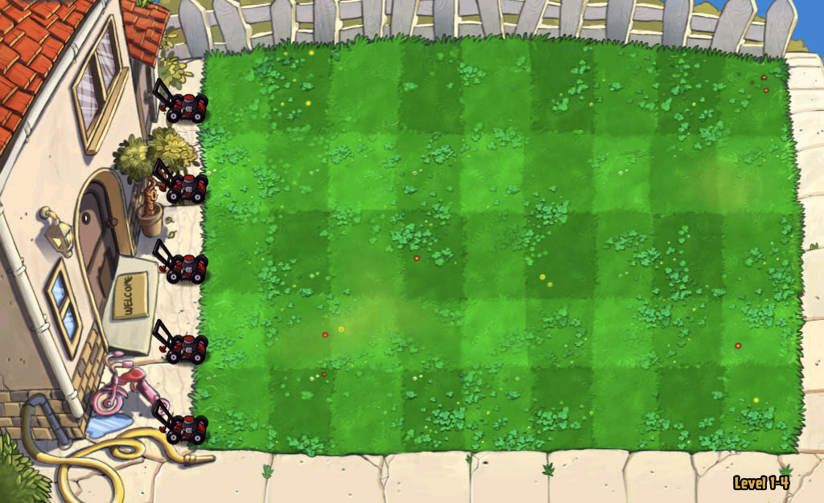
Made by – Himanshu and Udit

Slide 4
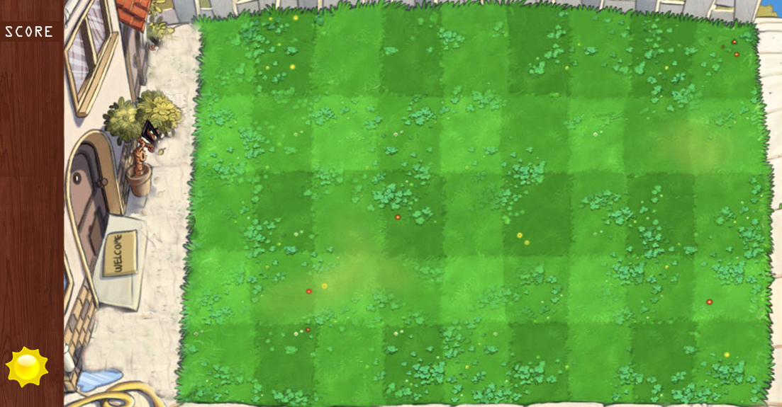

Slide 5
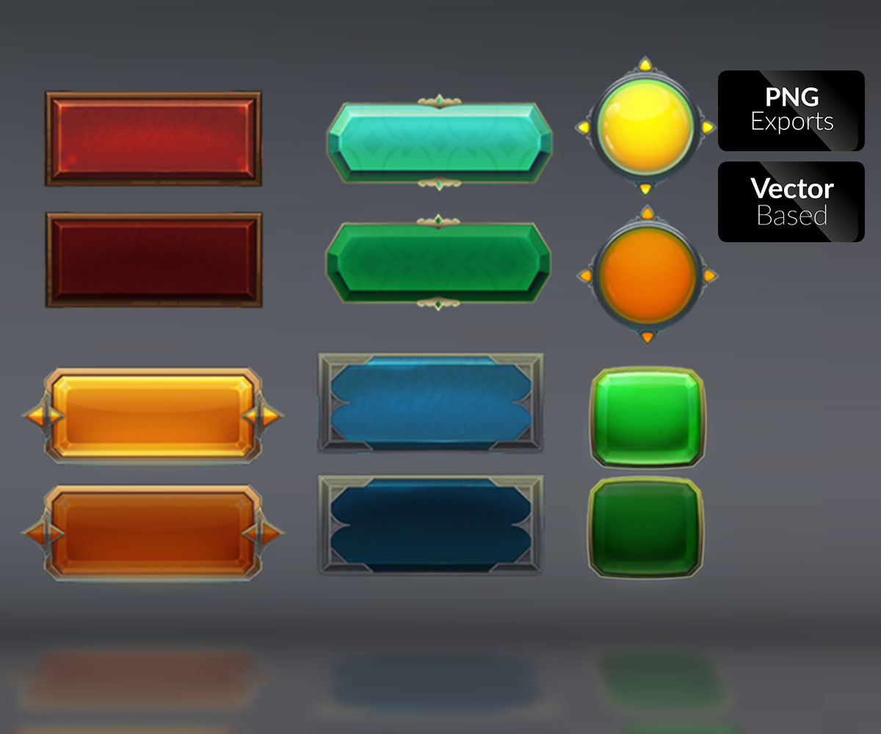
SAVE
RESTART
LOAD GAME
NEW GAME
EXIT

