Slide 1
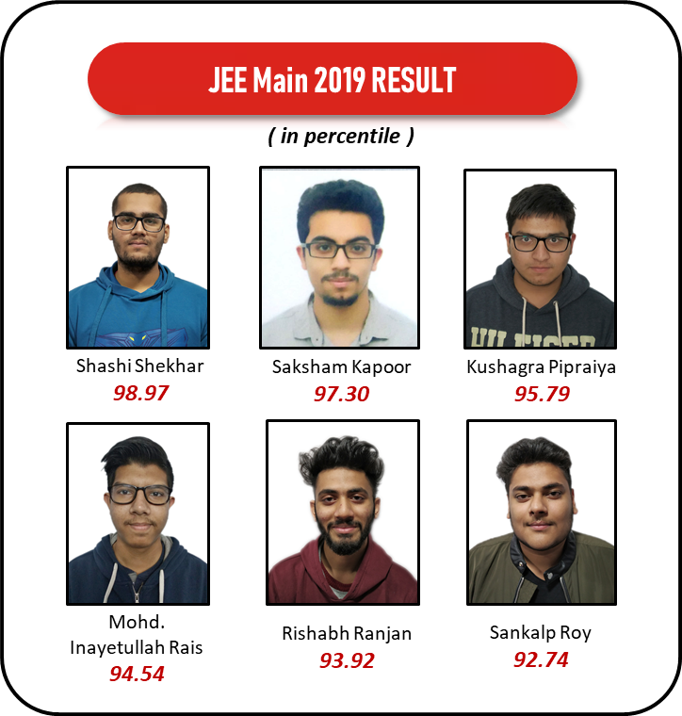
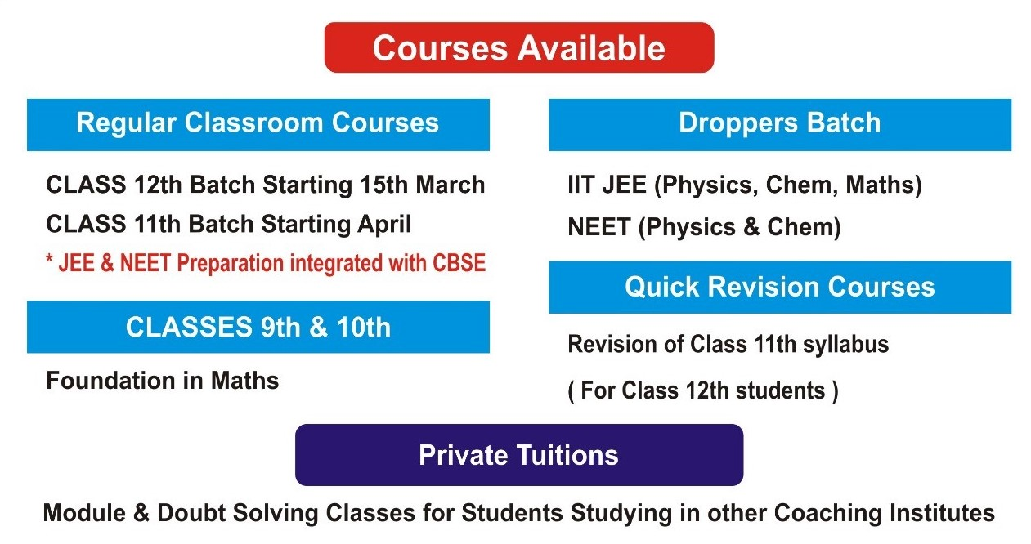

Slide 2
Courses Available (2019-2020)
Regular Classroom Course
Private Tuitions
Crash Course 2019
Class 12th Batch Starting 15th March
Class 11th Batch Starting April
*JEE and NEET Preparation integrated with CBSE
Module and Doubt Solving classes
for Students Studying in
other Coaching institutes
For JEE Main, BITSAT, IP,
NEET Physics & Chemistry.
Starting 19th March
Droppers Batch
Quick Revision Course
Classes 9th & 10th
IIT JEE (Phy, Chem & Maths)
NEET (Phy & Chem)
Revision of class 11th syllabus
(for 12th class students)
Foundation in Maths

Slide 3
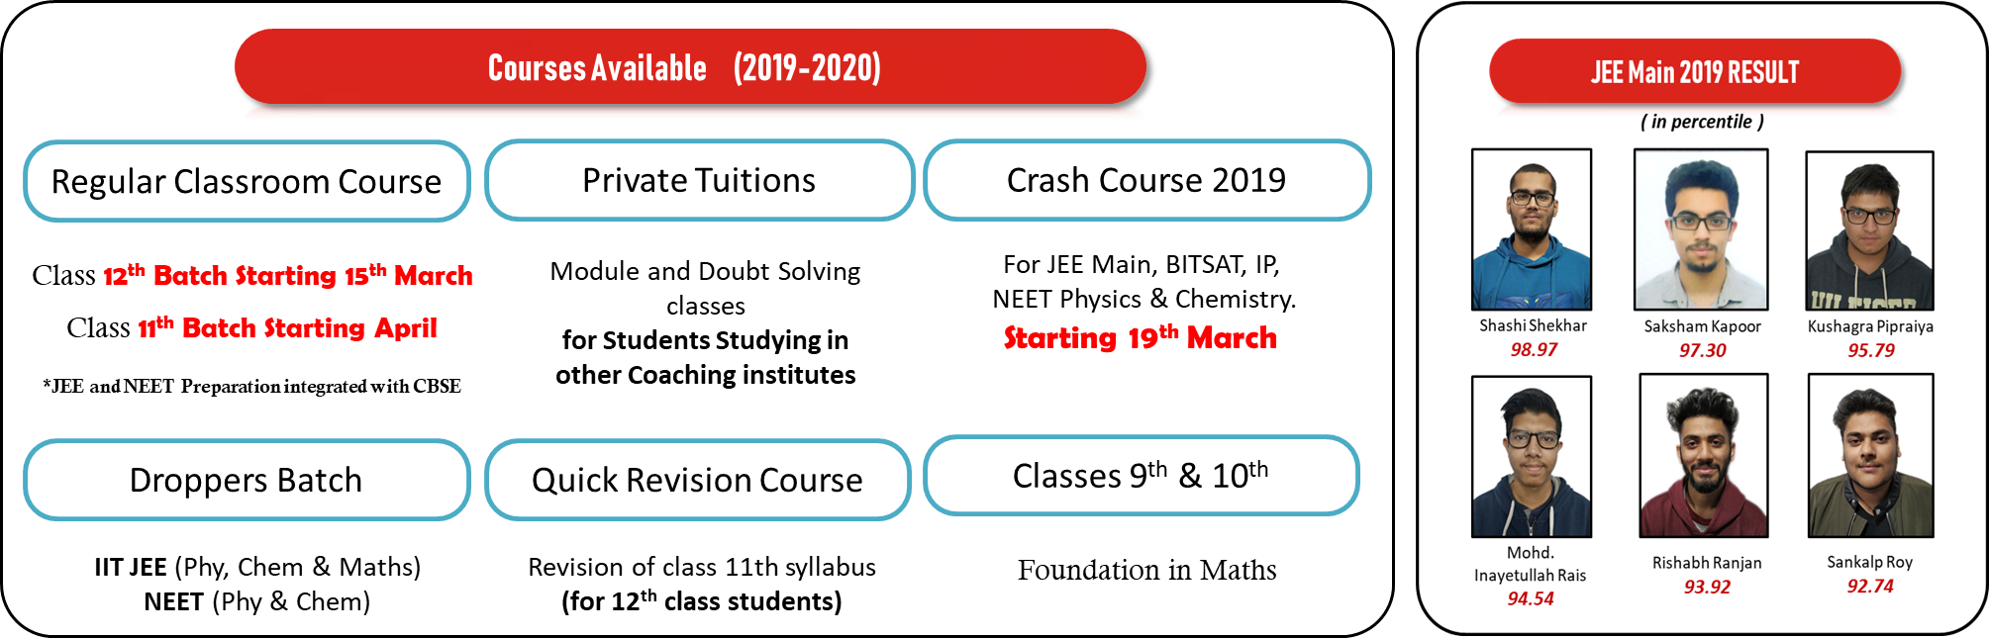

Slide 4
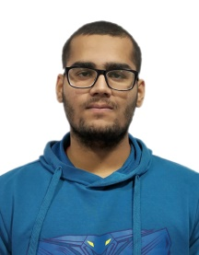
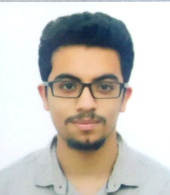
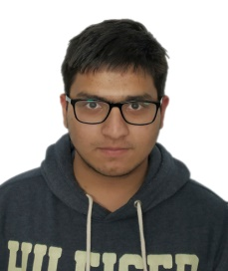
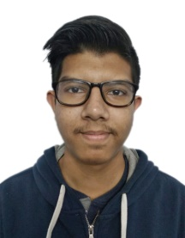
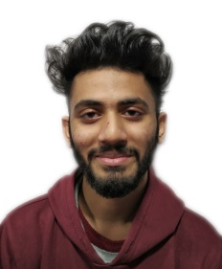

JEE Main 2019 RESULT
( in percentile )
Shashi Shekhar
98.97
Saksham Kapoor
97.30
Kushagra Pipraiya
95.79
Mohd. Inayetullah Rais
94.54
Rishabh Ranjan
93.92
Sankalp Roy
92.74

Slide 5


