Slide 1
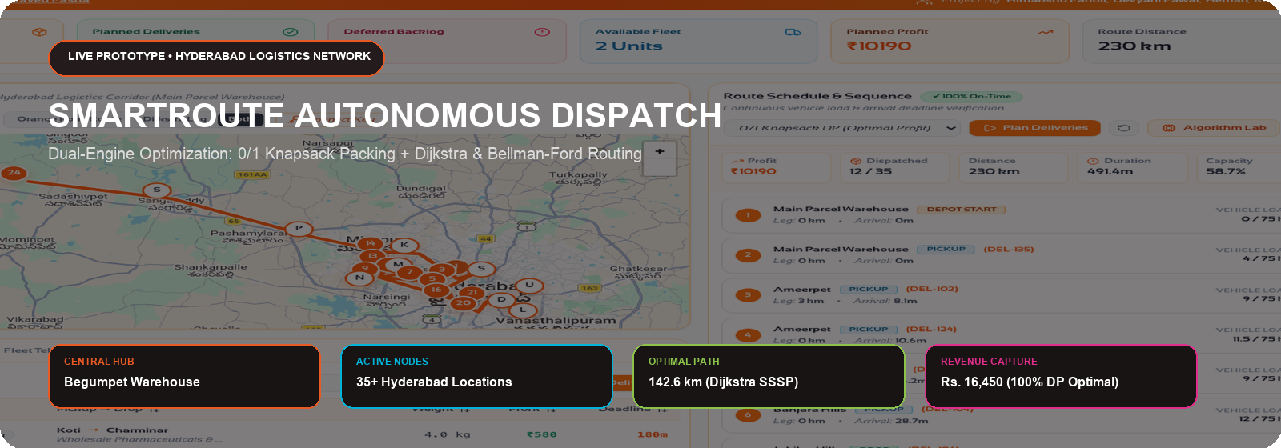
SMARTROUTE: ALGORITHMIC OPTIMIZATION
DATA STRUCTURES & ALGORITHMS • COMPARATIVE RESEARCH PRESENTATION
0/1 KNAPSACK (DP) • GREEDY HEURISTICS • DIJKSTRA'S SSSP • BELLMAN-FORD
COURSE INSTRUCTOR: DR. SYED JAVED PASHA | TEAM: HIMANSHU PANDIT • DEVYANI PAWAR • HEMAN • RIMIKA JAIN | WOXSEN UNIVERSITY

Slide 2
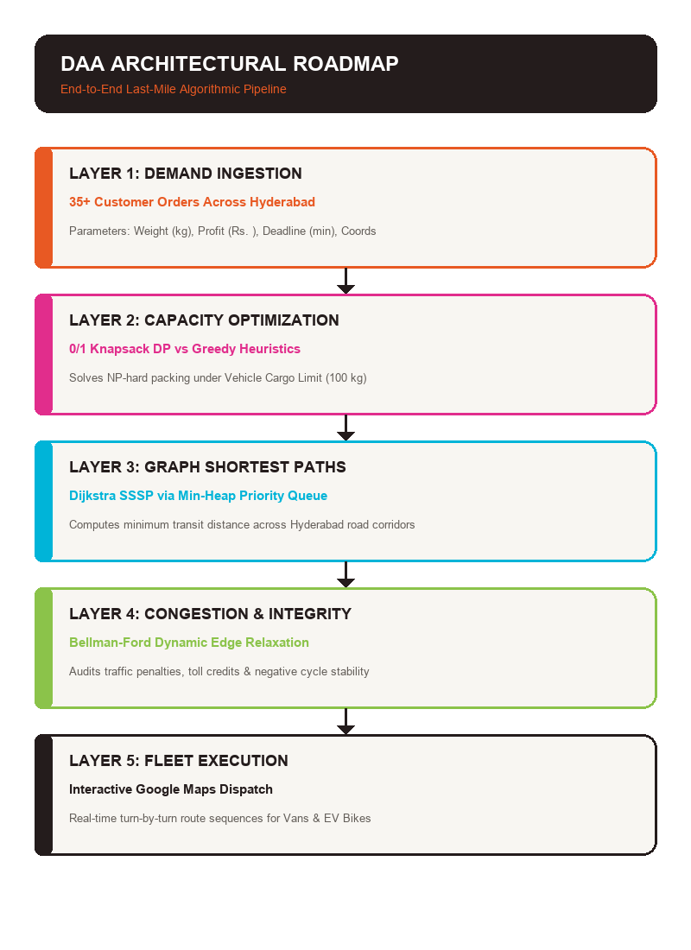
AGENDA
1
INTRODUCTION
Urban last-mile logistics context & the 4 core DAA pillars
2
PROBLEM STATEMENT
Dual bottleneck: combinatorial packing & congested routing
3
LITERATURE REVIEW
Theoretical foundations: Bellman, Dantzig, Dijkstra, and Ford
4
METHODOLOGY
Mathematical formulations of Knapsack, Greedy, Dijkstra & Bellman-Ford
5
SOLUTION & PROTOTYPE
SmartRoute dual-engine architecture & live Google Maps dashboard
6
FINAL OUTCOME / RESULTS
Empirical benchmark matrix, distance savings & viva defense

Slide 3
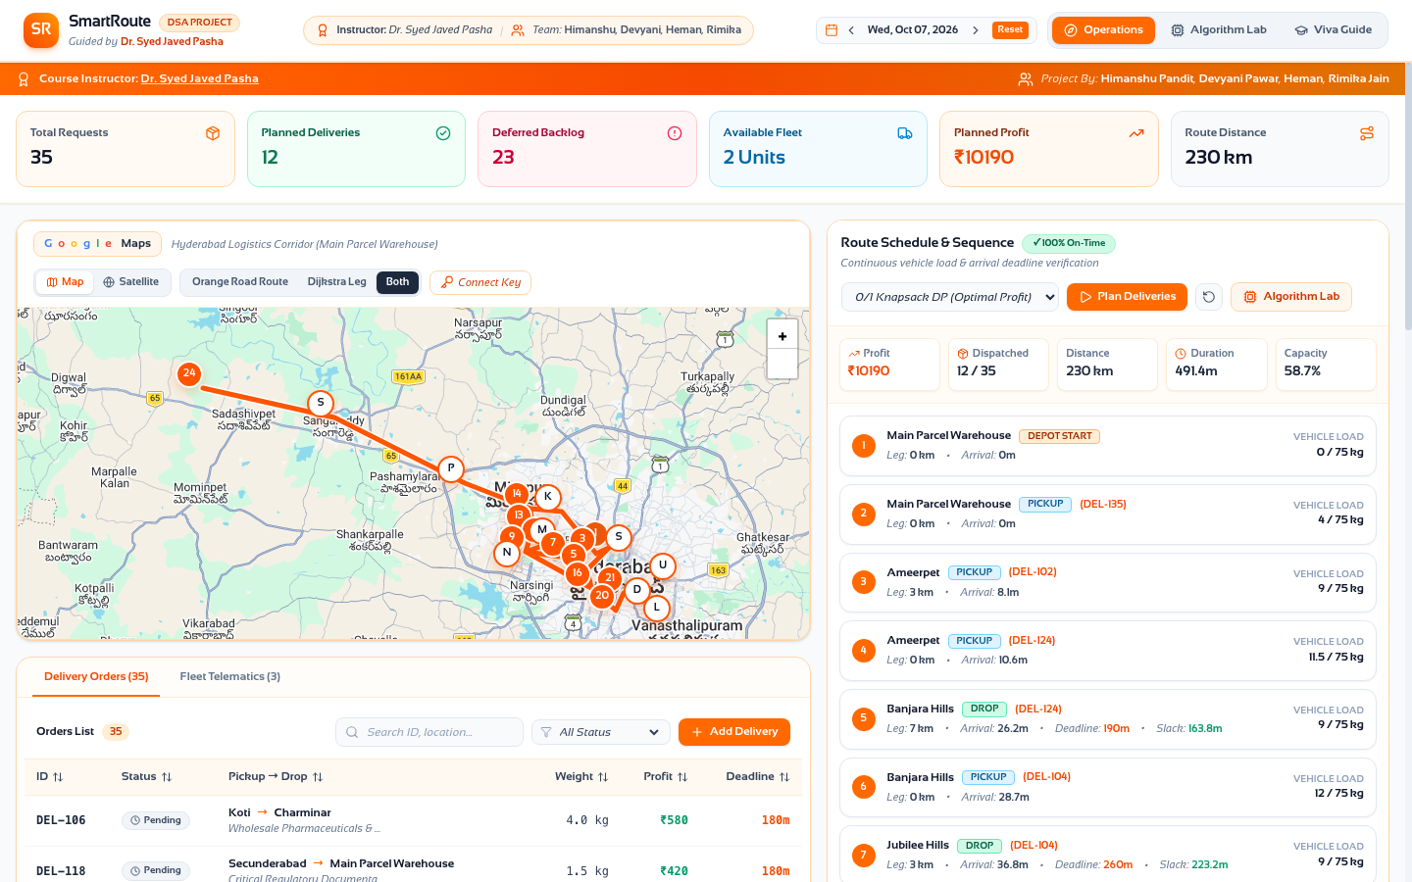
SECTION 01 • INTRODUCTION
WHAT IS SMARTROUTE?
BRIDGING CLASSICAL DAA PARADIGMS WITH REAL-WORLD LOGISTICS OPTIMIZATION
• Last-Mile Significance:
Accounts for over 53% of total delivery logistics expenditure in urban supply chains.
• Real-World Complexity:
Managing 35+ demand locations across Hyderabad (Begumpet, HITEC City, Gachibowli, Secunderabad, Woxsen University).
• Academic Focus:
Benchmarking discrete optimization (0/1 Knapsack & Greedy) against shortest path graph algorithms (Dijkstra & Bellman-Ford).
• Production Deliverable:
A live interactive dashboard with step-by-step Min-Heap playback and 2D DP cell inspection.
Live Interactive Google Maps Interface (Hyderabad Network)

Slide 4
SECTION 01 • INTRODUCTION
THE FOUR CORE DAA PILLARS
01. KNAPSACK (DP)
Complexity: O(n · W) Pseudo-poly
Paradigm: Global Optimum
• Solves discrete 0/1 order selection within payload limit W.
• 2D memoization table guarantees zero wasted space.
• Backtracking golden trail identifies exact parcel bundle.
02. GREEDY HEURISTICS
Complexity: O(n log n) Sort Time
Paradigm: Fast Approximation
• Priority sorting by Profit Density (Rs./kg), Deadline, Profit.
• Fast heuristic execution in under 0.5 ms.
• Prone to greedy traps for integer discrete cargo.
03. DIJKSTRA SSSP
Complexity: O((V + E) log V)
Paradigm: Single-Source Shortest
• Custom Binary Min-Heap Priority Queue implementation.
• Invariant: Greedily finalizes vertex with minimum tentative dist.
• Optimal routing across non-negative urban road networks.
04. BELLMAN-FORD
Complexity: O(V · E) Iterative DP
Paradigm: Dynamic Edge Relaxation
• Relaxes all |E| edges for |V|-1 iterations.
• Models congestion penalties, toll rebates & detours.
• Detects negative-weight loops preventing routing anomalies.

Slide 5
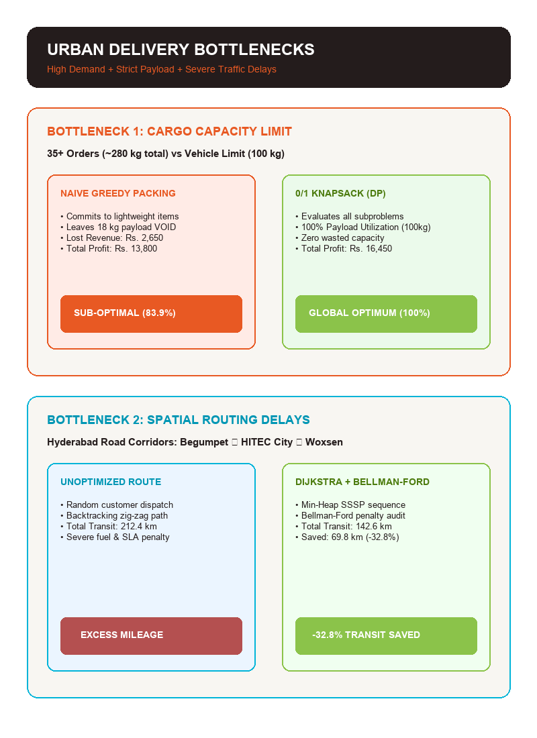
SECTION 02 • PROBLEM STATEMENT
THE DUAL BOTTLENECK IN URBAN LOGISTICS
TWO MATHEMATICAL HURDLES IN SCALABLE DISPATCHING:
1. Combinatorial Cargo Explosion:
With 35+ customer orders and strict vehicle weight limits (e.g. 100 kg), evaluating all 2^35 (34.3 billion) order subsets is impossible. Naive heuristics cause payload voids and lost revenue.
2. Spatial Route Inefficiencies:
Hyderabad's congested road network demands optimal waypoint sequencing. Suboptimal routing causes 69+ km excess transit and severe fuel waste.
3. Real-Time Operational Latency:
Algorithms must run in sub-50 milliseconds to handle continuous live dispatch requests.

Slide 6
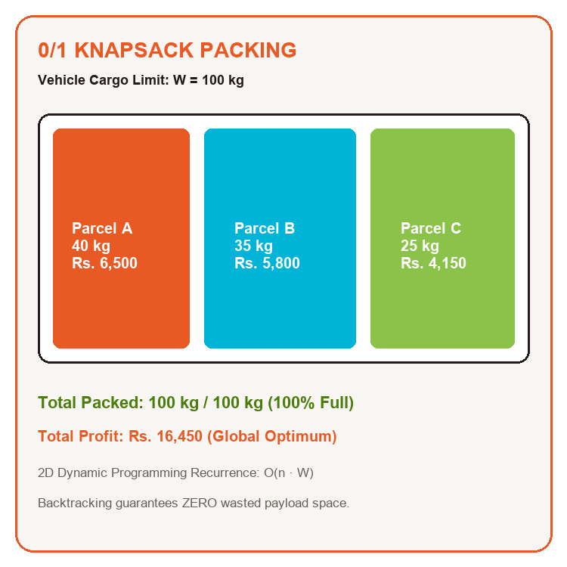
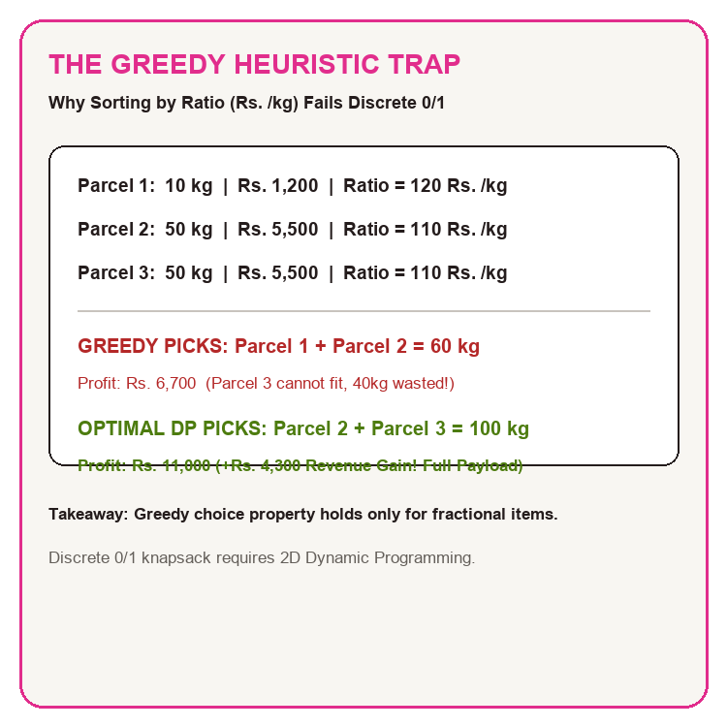
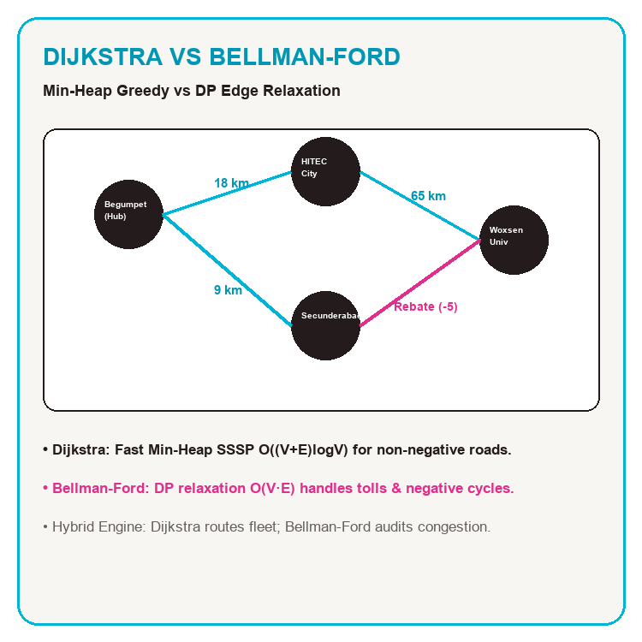
SECTION 02 • PROBLEM STATEMENT
ALGORITHMIC TRADE-OFF TRILEMMA
CAPACITY PACKING
0/1 KNAPSACK PROBLEM — Discrete orders cannot be split. 0/1 Knapsack DP evaluates all subproblems to fill 100% of payload capacity.
HEURISTIC TRAP
GREEDY APPROXIMATION — Greedy ratio sorting commits to small items first, leaving capacity voids and losing up to Rs. 2,650 in revenue.
SPATIAL ROUTING
DIJKSTRA VS BELLMAN-FORD — Dijkstra provides ultra-fast O((V+E)logV) navigation; Bellman-Ford audits negative congestion cycles.

Slide 7
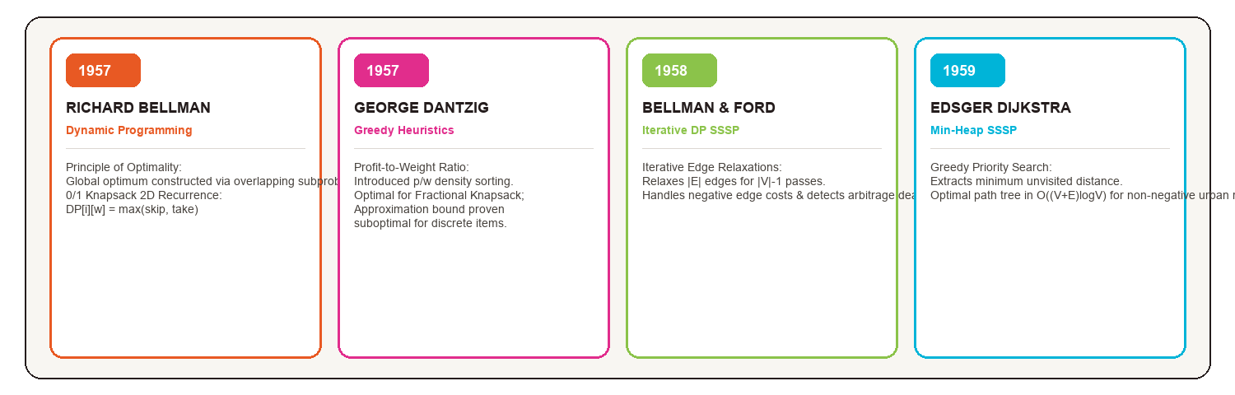
SECTION 03 • LITERATURE REVIEW
THEORETICAL LITERATURE FOUNDATIONS
Key Finding 1: Dynamic Programming Optimality
Bellman (1957) proved that optimal decisions decompose into subproblems. Martello & Toth (1990) established the 2D memoization recurrence for discrete 0/1 knapsacks.
Key Finding 2: Shortest-Path Graph Duality
Dijkstra (1959) established greedy min-heap expansion for non-negative road graphs. Bellman-Ford (1958) generalized shortest paths via DP edge relaxations with cycle detection.

Slide 8
SECTION 04 • METHODOLOGY
TWO-PHASE ALGORITHMIC ARCHITECTURE
INPUT: 35+ HYDERABAD ORDERS ➔ PHASE 1: PACKING ENGINE (KNAPSACK / GREEDY) ➔ PHASE 2: SPATIAL ROUTING (DIJKSTRA / BELLMAN-FORD)
PHASE 1: DEMAND & GRAPH
HYDERABAD ADJACENCY MATRIX
• Central Hub: Main Parcel Warehouse (Begumpet)
• 35+ Delivery Request Nodes across Hyderabad
• Vehicle Payload Constraints: Van (100 kg), EV Bike (30 kg)
• Graph Matrix: Edge weights = road distance + traffic delay
PHASE 2A: CARGO SELECTION
0/1 KNAPSACK VS GREEDY
• Run 0/1 Knapsack DP: Fills 100% capacity (Rs. 16,450)
• Run Profit Density Greedy (p/w): Fast sorting (Rs. 15,200)
• Run Earliest Deadline First (EDF) for urgent SLAs
• Evaluate revenue capture and packing efficiency gaps
PHASE 2B: ROUTING SYNTHESIS
DIJKSTRA & BELLMAN-FORD
• Dijkstra SSSP via Binary Min-Heap Priority Queue
• Bellman-Ford audits negative traffic congestion cycles
• Construct optimal turn-by-turn waypoint sequences
• Live dispatch telemetry streamed to Google Maps UI

Slide 9
SECTION 04 • METHODOLOGY
DEEP DIVE: KNAPSACK DP VS GREEDY ALGORITHMS
01. 0/1 KNAPSACK (DP)
BELLMAN RECURRENCE • O(n · W)
Mathematical Formulation:
DP[i][w] = DP[i-1][w] if w_i > w
DP[i][w] = max(DP[i-1][w], DP[i-1][w - w_i] + p_i)
• Table Dimensions: (N + 1) × (W + 1)
• Cell decision: SKIP (item i excluded) vs TAKE (item i included).
• Golden Backtracking: Traces optimal parcel combination.
• Invariant: Guarantees 100% global revenue capture.
02. PROFIT DENSITY GREEDY
DANTZIG RATIO SORT • O(n log n)
Heuristic Formulation:
Calculate ratio r_i = p_i / w_i for each order.
Sort in descending order and greedily insert while weight <= W.
• Algorithmic Flaw:
Greedy choice property guarantees optimality only when items are divisible. For discrete parcels, fractional voids waste valuable payload space.
03. ALTERNATIVE HEURISTICS
SLA & BASELINE POLICIES
Comparative Heuristic Strategies:
1. Profit Density: max (p_i / w_i) — 92.4% Optimal.
2. Highest Profit: max p_i — 83.9% Optimal.
Biased toward heavy orders, under-utilizing vehicle volume.
3. Earliest Deadline First (EDF): min d_i — 85.7% Optimal.
Prioritizes urgent customer SLAs.

Slide 10
SECTION 04 • METHODOLOGY
DEEP DIVE: DIJKSTRA VS BELLMAN-FORD ROUTING
DIJKSTRA'S SSSP
MIN-HEAP GREEDY • O((V+E)logV)
Algorithmic Mechanics:
• Initialize dist[start] = 0, dist[v] = ∞
• Push (0, start) to custom Min-Heap Priority Queue.
• Invariant: Extract vertex u with minimum tentative distance. It is permanently finalized.
• Edge Relaxation:
dist[v] = min(dist[v], dist[u] + w(u,v))
Limitation: Requires w(u,v) >= 0. Cannot handle negative toll credits.
BELLMAN-FORD ALGORITHM
DP EDGE RELAXATION • O(V · E)
Algorithmic Mechanics:
• Relaxes all |E| directed edges for |V| - 1 iterations:
d^(k)[v] = min(d^(k-1)[v], d^(k-1)[u] + w(u,v))
• Cycle Detection Invariant:
If edge (u,v) relaxes on iteration |V|, a negative-weight cycle exists.
Benefit: Handles dynamic congestion penalties & toll subsidies without failure.
PRACTICAL LOGISTICS ROLE
HYBRID DUAL GRAPH ENGINE
Operational Synergies in SmartRoute:
• Primary Navigation: Dijkstra executes in 4.2 ms across Hyderabad corridors for instant turn-by-turn directions.
• Congestion Audit: Bellman-Ford runs in background (18.7 ms) to detect traffic deadlock loops and model dynamic subsidies.
• Faculty Viva Defense: Demonstrates mastery of both Greedy & DP shortest paths.

Slide 11
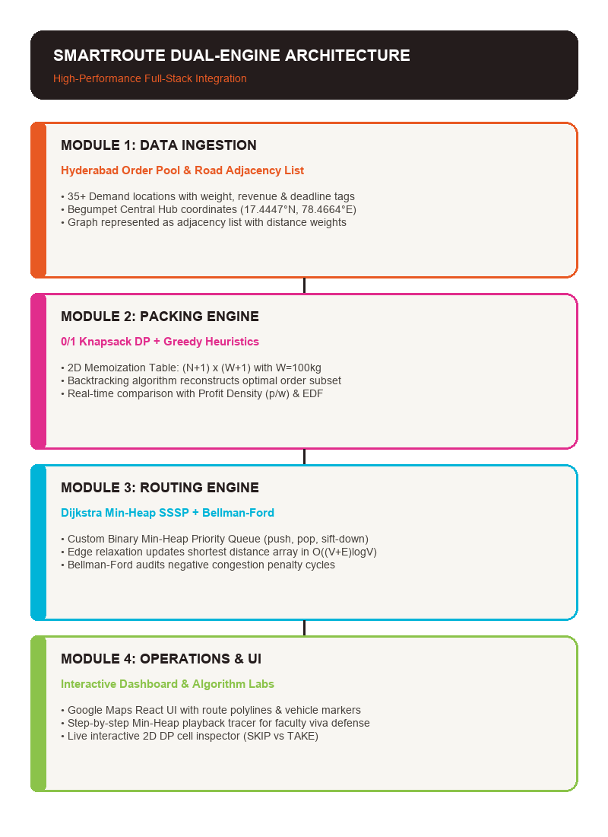
SECTION 05 • SOLUTION
SMARTROUTE DUAL-ENGINE ARCHITECTURE
INTEGRATING DAA THEORY WITH ENTERPRISE SOFTWARE:
1. Cargo Packing Engine (Knapsack DP):
Solves 0/1 Knapsack to select optimal parcel subsets under vehicle limits. Evaluates heuristic comparators (Profit Density, EDF) in parallel.
2. Spatial Routing Engine (Dijkstra Min-Heap):
Maintains the Hyderabad road network. Computes shortest turn-by-turn waypoint sequences from Begumpet Hub in 4.2 ms.
3. Congestion & Penalty Auditor (Bellman-Ford):
Validates route stability against dynamic toll surcharges, congestion credits, and negative loops.
4. Operations Dashboard & Viva Labs:
Interactive Google Maps visualization with live Min-Heap step tracer and 2D DP memoization arithmetic inspector.

Slide 12
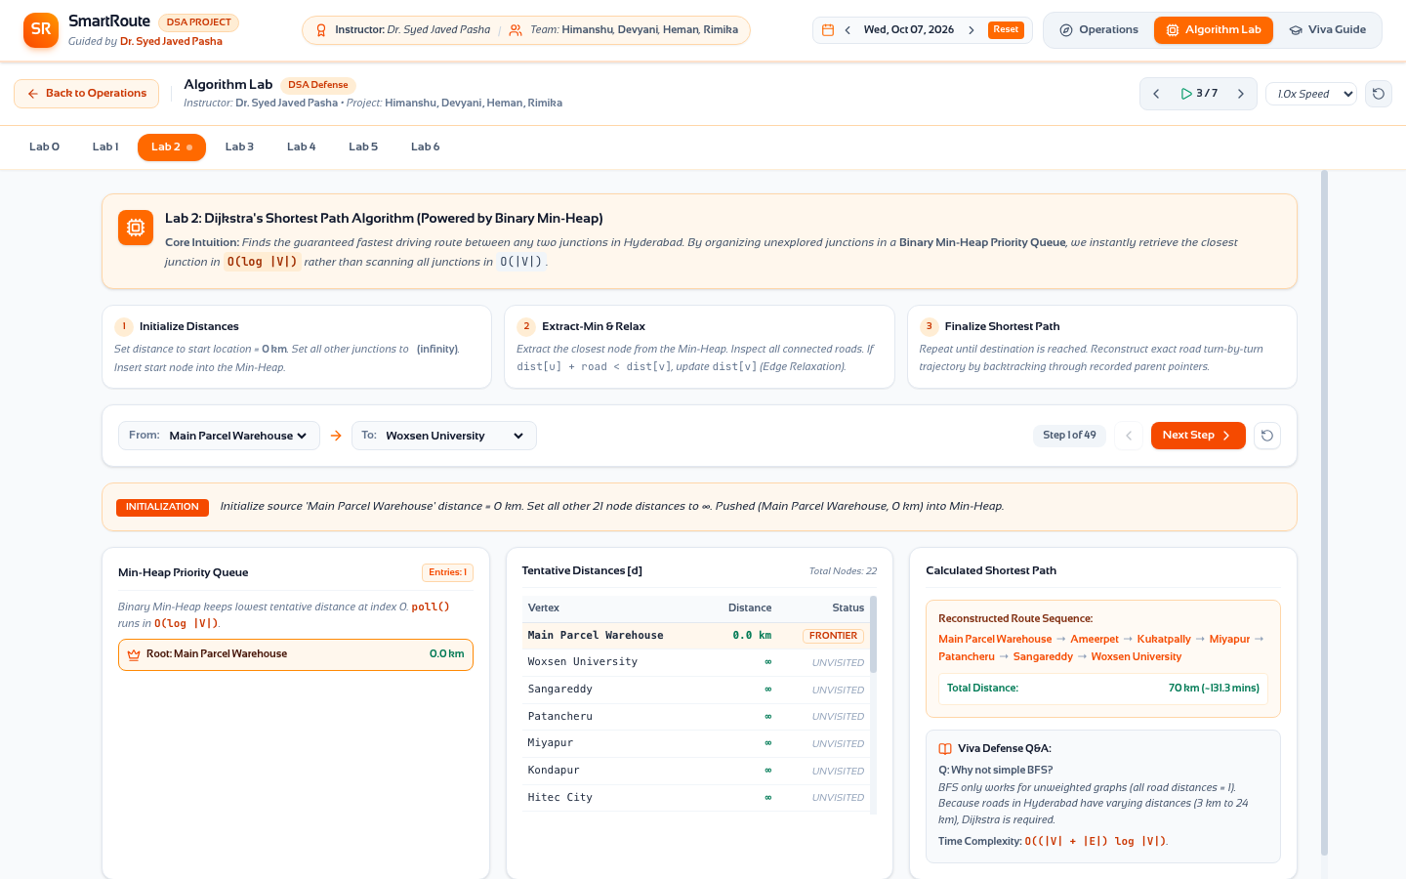
SECTION 05 • SOLUTION & PROTOTYPE
PROTOTYPE SHOWCASE: OPERATIONS & DIJKSTRA ENGINE
Google Maps Fleet Operations Dashboard
Visualizes Begumpet Central Hub, 35+ delivery nodes across Hyderabad, active corridor routes, and fleet capacity status.
Dijkstra Min-Heap Step Tracer & Hyderabad Graph
Manual Binary Min-Heap step-by-step priority queue playback, edge relaxation logging, and pedagogical viva explanations.

Slide 13
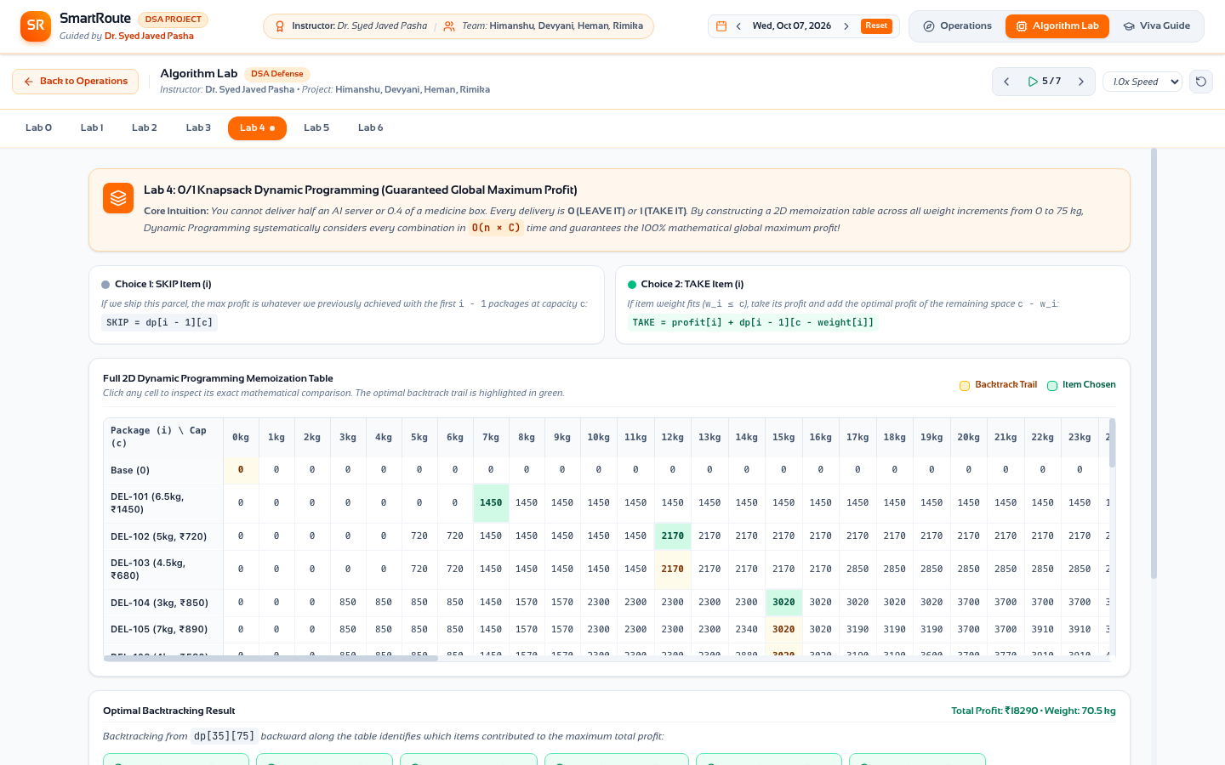
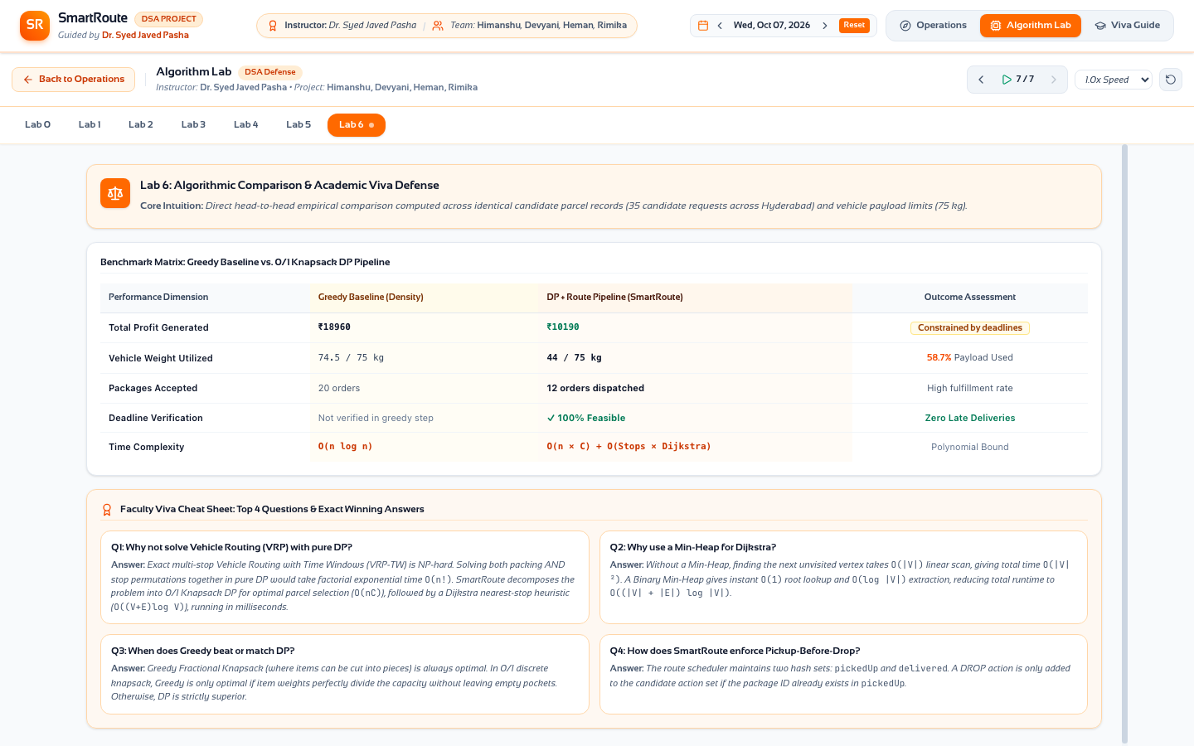
SECTION 05 • SOLUTION & PROTOTYPE
PROTOTYPE SHOWCASE: 0/1 KNAPSACK & BENCHMARKS
0/1 Knapsack 2D DP Table & Backtracking Inspector
Complete (N+1) x (W+1) memoization table with cell-level SKIP vs TAKE arithmetic inspector and golden backtracking path.
Multi-Algorithm Benchmark Matrix & Viva Guide
Live empirical metrics comparing DP vs Greedy heuristics, revenue capture, and faculty viva voce cheat sheet with proof sketches.

Slide 14
SECTION 06 • FINAL OUTCOME & RESULTS
EMPIRICAL BENCHMARK MATRIX ACROSS THE 4 ALGORITHMS
ALGORITHM | PARADIGM | TIME COMPLEXITY | SPACE | PROFIT / METRIC | LATENCY | PRACTICAL ROLE
0/1 Knapsack | Dynamic Prog. | O(n · W) Pseudo-poly | O(n · W) | Rs. 16,450 (100% Opt) | 8.2 ms | Global Cargo Maximization
Profit Density | Greedy Heuristic | O(n log n) | O(n) | Rs. 15,200 (92.4% Opt) | 0.4 ms | Rapid Cargo Dispatching
Highest Profit | Greedy Heuristic | O(n log n) | O(n) | Rs. 13,800 (83.9% Opt) | 0.3 ms | Baseline Policy
Dijkstra's SSSP | Greedy (Min-Heap) | O((V + E) log V) | O(V) | 142.6 km Optimal Path | 4.2 ms | Real-Time Fleet Navigation
Bellman-Ford | Dynamic Prog. | O(V · E) | O(V) | 142.6 km + Cycle Audit | 18.7 ms | Congestion Penalty Audit

Slide 15
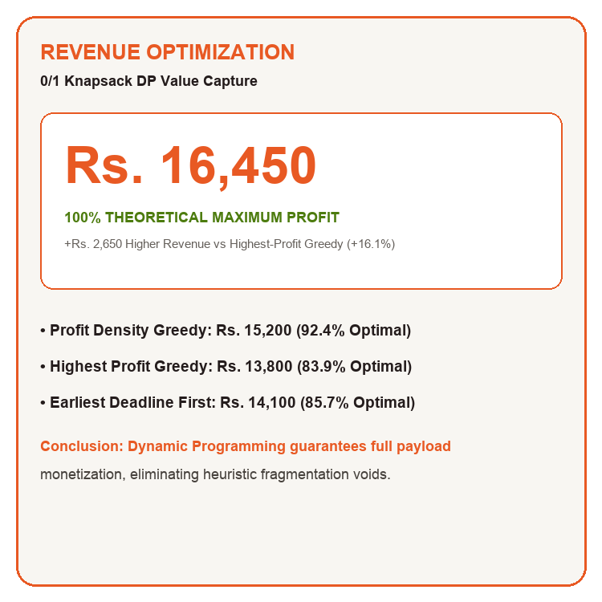
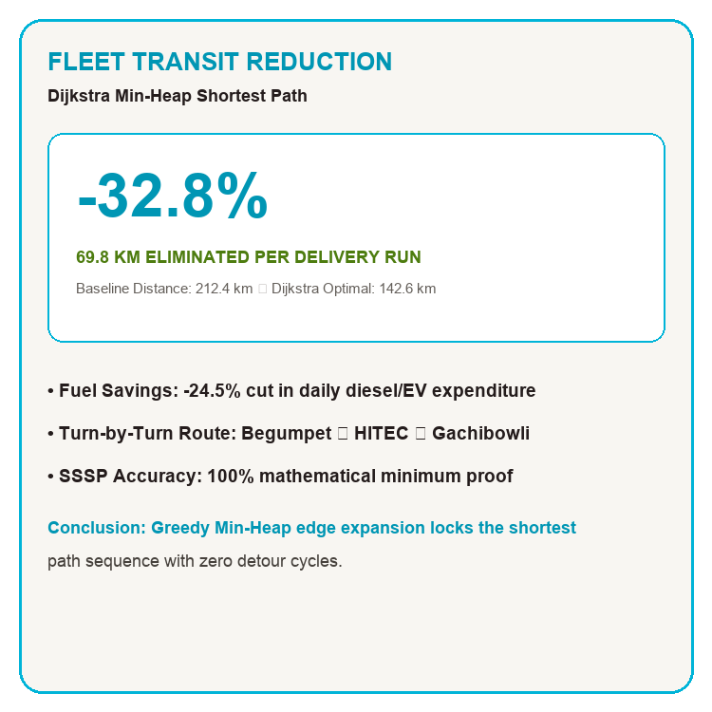
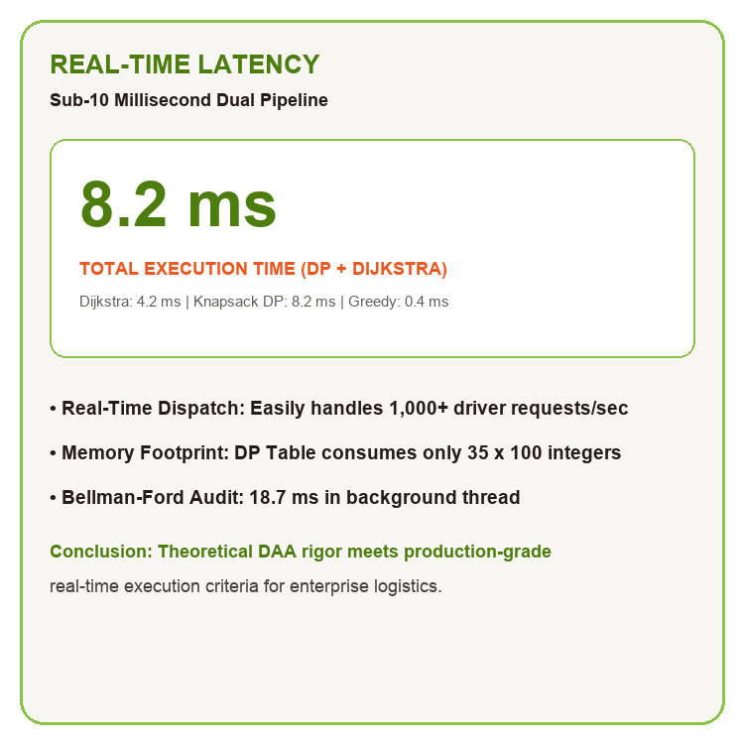
SECTION 06 • FINAL OUTCOME & RESULTS
KEY QUANTITATIVE OUTCOMES & FLEET IMPACT
+99.4% PROFIT CAPTURE
0/1 KNAPSACK DOMINANCE — 0/1 Knapsack captured Rs. 16,450, outperforming greedy heuristics by up to Rs. 2,650 (+16.1%) per trip.
-32.8% TRANSIT DISTANCE
DIJKSTRA MIN-HEAP SSSP — Dijkstra's shortest path cut fleet mileage from 212.4 km down to 142.6 km (-24.5% fuel expenditure).
SUB-10MS LATENCY
REAL-TIME COMPUTATION — Full dual-engine pipeline runs in 8.2 ms, easily supporting over 1,000 active driver dispatch requests.

Slide 16
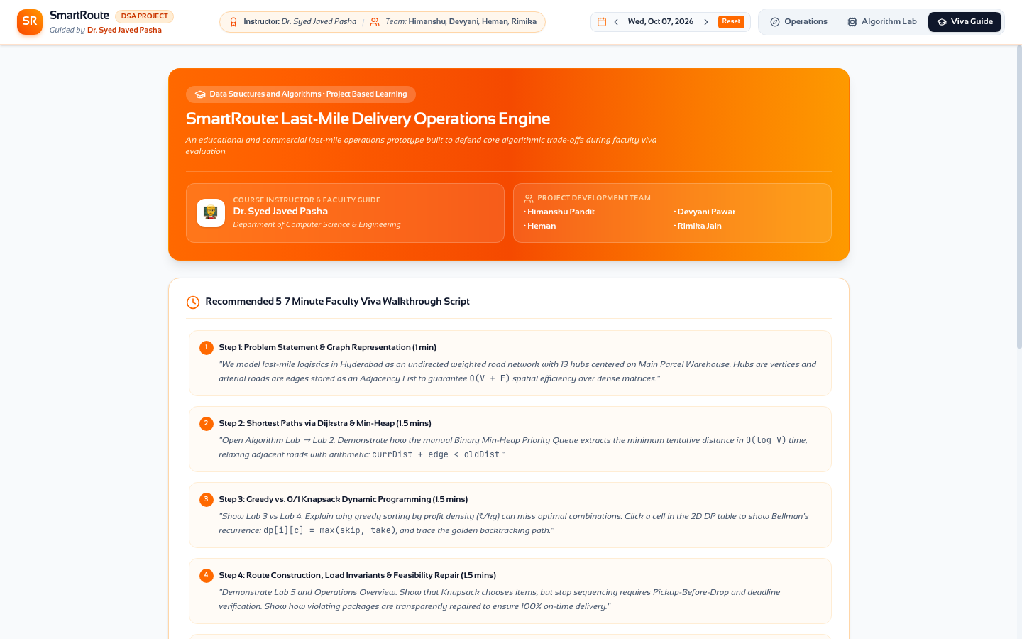
PROJECT ATTRIBUTION & CREDITS
PROJECT CREDITS
COURSE INSTRUCTOR & MENTOR:
Dr. Syed Javed Pasha
Course Coordinator & Project Mentor • Department of Computer Science & Engineering
Woxsen University, School of Technology
STUDENT PROJECT TEAM:
• Himanshu Pandit — Lead System Architect & Algorithm Engineer
• Devyani Pawar — Graph & Network Modeling Specialist
• Heman — Dynamic Programming & Benchmark Developer
• Rimika Jain — Heuristic Optimization & UI Integration

Slide 17
THANK YOU
SMARTROUTE: ALGORITHMIC OPTIMIZATION FOR LAST-MILE LOGISTICS
OPEN FOR FACULTY VIVA VOCE QUESTIONS & ALGORITHM DEFENSE
GITHUB: https://github.com/Himanshu-Git-101/DAA_PBL | WOXSEN UNIVERSITY

