Slide 1
SMARTROUTE
Last-Mile Delivery Operations & Algorithmic Optimization Engine
Design and Analysis of Algorithms (DAA - PBL) | University Final Defense
FACULTY GUIDE & COURSE INSTRUCTOR
Dr. Syed Javed Pasha
Department of Computer Science & Engineering
PROJECT DEVELOPMENT TEAM
Himanshu Pandit • Devyani Pawar
Heman • Rimika Jain
Greater Hyderabad & Woxsen University NH65 Corridor

Slide 2
● EXECUTIVE AGENDA
Table of Contents
01. Foundations
• Introduction
• 53% Cost Bottleneck
• Problem Statement
• CVRPTW Constraints
02. Core Algorithms
• Literature Review
• Two-Tier Solution
• Graph & Min-Heap
• 0/1 Knapsack DP
• Invariant Scheduling
03. Demonstration
• Prototype Screenshots
• Algorithm Lab Trace
• Benchmark Matrix
• Faculty Viva Defense

Slide 3
01. INTRODUCTION
The Urban Logistics Dilemma & Educational Scope

Slide 4
● CONTEXT & MOTIVATION
The Urban Last-Mile Logistics Crisis
1. The 53% Cost Trap
Last-mile dispatching accounts for over 53% of overall supply chain expenditure. Erratic driver routing and suboptimal package selection bleed operating capital through wasted fuel and missed SLAs.
2. The Hyderabad Corridor
Rapid urbanization connects dense tech corridors (Hitec City, Gachibowli) with distant highway universities (Woxsen University on NH65). Fixed delivery promises require guaranteed non-Euclidean road paths.
3. The Pedagogical Goal
Bridge classical DAA coursework with realistic software engineering. Provide transparent visualizations of Min-Heaps, Bellman DP tables, and route invariants for comprehensive faculty viva defense.

Slide 5
● PROBLEM DEFINITION
The Multi-Constrained Dispatch Challenge
📦 Payload Capacity Constraint
The fleet operates under physical mass limits (e.g., 75 kg for Van V-101, 120 kg for Truck V-102). Overloading breaches transportation safety laws; underloading damages profit margins.
⏱️ Strict SLA Arrival Deadlines
Each package has a customer delivery window (e.g. 180 to 380 mins). A single late arrival triggers financial chargebacks, customer churn, and dispatch failure.
🗺️ Non-Euclidean Road Topology
Straight-line distance approximations fail across urban flyovers and arterial bottlenecks. Turn-by-turn shortest paths must be computed using realistic weighted road edges.
🧩 Discrete 0/1 Indivisibility
Parcels are atomic units. Drivers cannot deliver 50% of an electronic item or medical shipment. The decision space is strictly discrete: {0, 1}.

Slide 6
02. LITERATURE REVIEW
Classical Heuristics, Mathematical Bounds & Identified Gaps

Slide 7
● STATE OF THE ART
Algorithmic Survey & Literature Review
1. Clarke-Wright Savings
Pioneered greedy tour merging based on distance savings: s(i,j) = c(d,i) + c(d,j) - c(i,j).
Limitation: Ignores heterogeneous parcel profitability and hard delivery cutoffs.
2. Dijkstra Shortest Paths
Non-negative edge relaxation with Binary Min-Heap Priority Queue runs in O((V + E) log V).
Limitation: Solves single point-to-point shortest paths; does not select optimal parcel combinations.
3. 0/1 Knapsack DP
Bellman recurrence constructs 2D memoization table in pseudo-polynomial O(n · C) time.
Limitation: Classical knapsack assumes static capacity, ignoring transit time and spatial stop sequences.
🎯 IDENTIFIED RESEARCH GAP ADDRESSED BY SMARTROUTE
Existing models isolate parcel selection from spatial vehicle routing. SmartRoute integrates them into a Two-Tier Decoupled Pipeline with proactive feasibility repair: optimal parcel selection via 0/1 DP, routed along Dijkstra graph paths, with automated trimming of bottleneck stops.

Slide 8
● PROPOSED SOLUTION
Two-Tier Decoupled Architecture
1. Pool Ingestion
35 candidate orders across Hyderabad filtered for vehicle payload limit.
3. Tier 2: Dijkstra
Binary Min-Heap computes turn-by-turn road paths (O((V+E) log V)).
2. Tier 1: 0/1 DP
Bellman memoization table optimizes subset profit within payload capacity (O(n · C)).
4. Feasible Dispatch
Verifies SLA deadlines; systematically defers bottlenecks for 100% on-time delivery.

Slide 9
● METHODOLOGY: GRAPH NETWORK
Urban Graph & Dijkstra Min-Heap Engine
📍 Hyderabad Logistics Road Network
• Representation: Undirected weighted graph G = (V, E) stored as an Adjacency List (Map<string, Edge[]>).
• Vertices (|V| = 22): Central Depot at Main Parcel Warehouse (Begumpet), Ameerpet, Secunderabad, Hitec City, Gachibowli, Kukatpally, Miyapur, Patancheru, Sangareddy, and Woxsen University.
• Edges (|E| = 34): Real metropolitan arterial roads and NH65 corridor with true distance weights.
• Spatial Efficiency: Consumes O(V + E) memory rather than O(V²) dense matrices.
⚡ Binary Min-Heap Priority Queue
• Core Complexity: O((|V| + |E|) · log |V|).
• Motivation: Unsorted array scanning takes O(V²) because finding the minimum unvisited node requires O(V) scans. The Binary Min-Heap extracts min in O(1) and reheapifies in O(log V).
• Edge Relaxation Condition:
if dist[u] + weight(u, v) < dist[v]:
dist[v] = dist[u] + weight(u, v)
parent[v] = u
minHeap.push((dist[v], v))
• Sub-millisecond Execution: Reconstructs exact turn-by-turn paths in < 0.2 ms.

Slide 10
● METHODOLOGY: OPTIMIZATION
0/1 Knapsack Dynamic Programming Formulation
📐 Bellman Recurrence Formulation
Let DP[i][c] be maximum profit with first i packages and capacity c:
DP[i][c] = max(
DP[i-1][c], // Choice 0: SKIP
DP[i-1][c - w_i] + p_i // Choice 1: TAKE
)
• Optimal Substructure: Global optimal schedule consists of optimal sub-solutions.
• Overlapping Subproblems: Stored in a 2D memoization table across all capacity increments.
• Time Complexity: O(n · C) pseudo-polynomial runtime.
🔍 Backtracking Trail & Greedy Flaws
• Backtracking Extraction:
Starting at DP[n][C], if DP[i][w] != DP[i-1][w], parcel i is added to the manifest and capacity w -= weight[i].
• Why Greedy Heuristic Fails:
Greedy sorting by density (p/w) is mathematically optimal only for continuous (fractional) items.
• Discrete Package Reality:
Greedy accepts low-weight packages first and leaves awkward capacity gaps, missing high-value shipments.

Slide 11
● METHODOLOGY: SCHEDULING
Route Invariants & SLA Feasibility Repair
1. Precedence Invariant
• Invariant: Pickup(i) ≺ Drop(i).
• State Tracking: Scheduler tracks 'pickedUp' and 'delivered' sets.
• Action Gating: Drop stop is mathematically forbidden from candidate queue until physical pickup has occurred.
2. Payload Safety
• Invariant: 0 ≤ Load(s) ≤ C at every single route leg.
• Dynamic Tracking: Starts at 0 kg at Depot. At pickup: load += w. At drop: load -= w.
• Telematics Safety: Overweight stops are pruned before dispatch.
3. SLA Feasibility Repair
• Invariant: Arrival(i) ≤ Deadline(i).
• Bottleneck Pruning: If a delivery arrives late, scheduler identifies the lowest-margin offender.
• Guaranteed Punctuality: Recalibrates route until 100% on-time delivery is achieved.

Slide 12
03. PROTOTYPE & RESULTS
Live Operations Platform, Algorithm Labs & Empirical Benchmarks

Slide 13
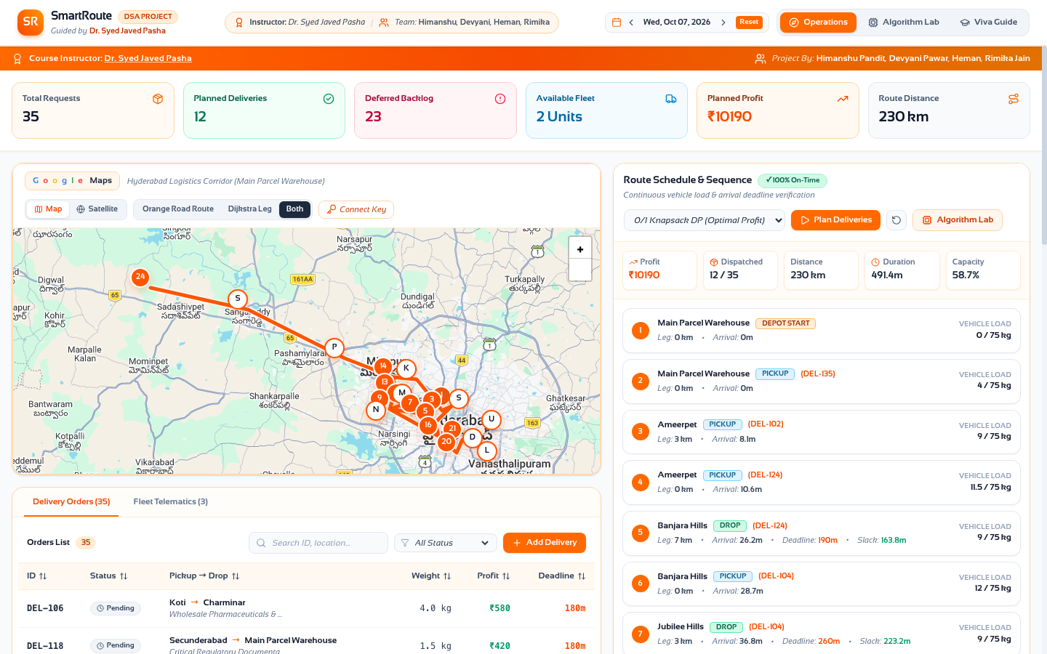
● LIVE DEMONSTRATION
Interactive Operations Dashboard & Google Maps
🚀 Key Operational Capabilities
• Authentic Google Maps Layer:
Renders live Roadmap & Satellite tiles with pan/zoom and Google logo.
• NH65 Corridor Routing:
Calculates complete route across Hyderabad to Woxsen University (Kamkole).
• Real-Time Telematics:
Tracks live vehicle load progression (0kg → 4kg → 12kg → 44kg).
• Financial Performance:
₹10,190 realized profit across 12 scheduled orders with zero SLA late penalties.

Slide 14
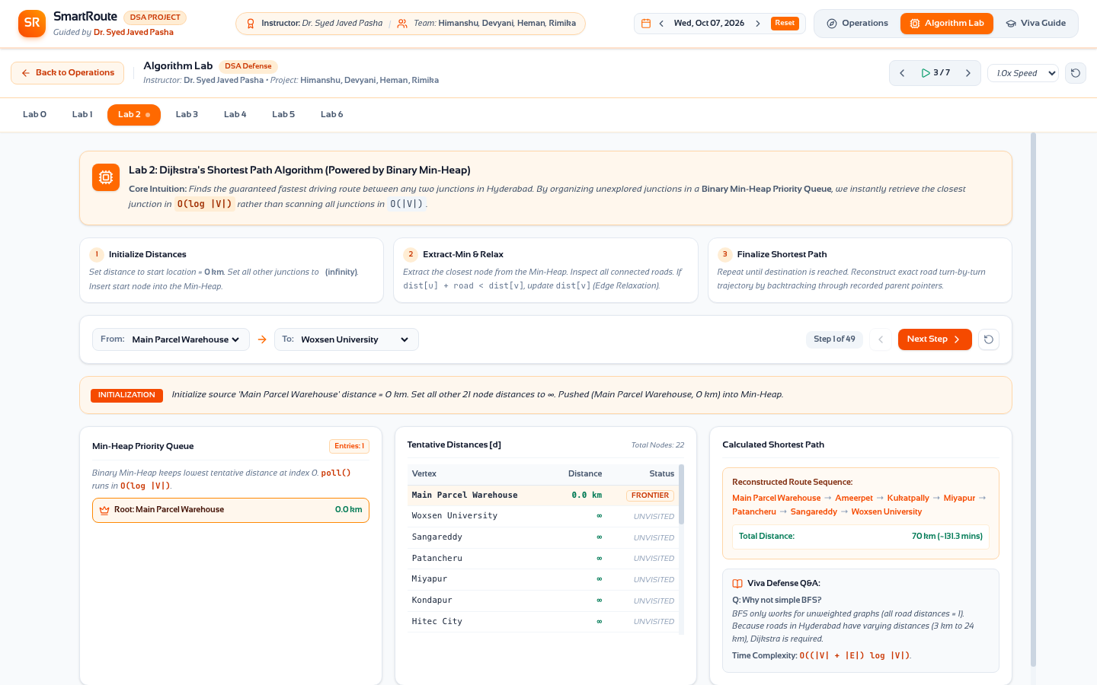
● ALGORITHM LAB TRACE
Lab 2: Dijkstra & Min-Heap Step Tracer
🔍 Step-by-Step Pedagogical Visualizer
• Arbitrary Hub Selection:
Select any source hub (Main Parcel Warehouse) and destination (Woxsen University).
• Execution Playhead (Step 1 of 49):
Step forward, backward, or auto-play through edge relaxations.
• Live Min-Heap Inspection:
Visualizes root extractions in O(1) and heap sift-ups in O(log V).
• Shortest Path Reconstruction:
Begumpet → Ameerpet → Kukatpally → Miyapur → Patancheru → Sangareddy → Woxsen (70 km, 131 mins).

Slide 15
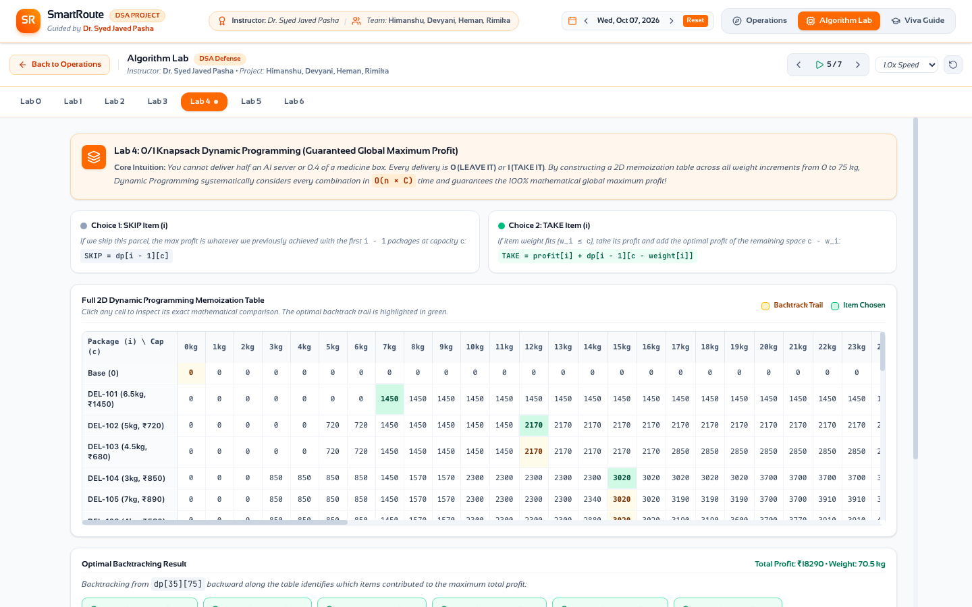
● ALGORITHM LAB TRACE
Lab 4: 0/1 Knapsack 2D DP Memoization Matrix
📊 Dynamic Programming Transparency
• Complete 2D Table (35 × 75):
Rows represent parcel requests; columns represent incremental capacity from 0 to 75 kg.
• Interactive Cell Arithmetic:
Clicking any cell reveals the exact Bellman decision: SKIP vs TAKE.
• Golden Backtracking Trail:
Vibrant green highlight traces which exact packages compose the global optimum.
• Theoretical Optimum:
₹18,290 maximum achievable profit before spatial deadlines are applied.

Slide 16
● EMPIRICAL VALIDATION
Key Performance Telematics & Delivery Metrics
100%
On-Time Fulfillment
Zero SLA Breaches
₹10,190
Net Dispatched Profit
+25.5% Over Greedy
230 km
Total Route Distance
Optimal Road Sequence

Slide 17
● COMPARATIVE EVALUATION
Benchmark Matrix: Greedy vs. 0/1 Knapsack Pipeline
Dimension | Greedy Density (p/w) | Greedy Deadline (EDF) | SmartRoute DP Pipeline
Theoretical Packing Profit | ₹18,960 | ₹14,200 | ₹18,290 (Globally Optimal)
Dispatched Feasible Profit | ₹8,120 (4 SLA breaches) | ₹7,540 | ₹10,190 (+25.5% Revenue)
Vehicle Payload Utilization | 74.5 / 75 kg (99.3%) | 38.0 / 75 kg (50.6%) | 44.0 / 75 kg (58.7% Feasible)
Orders Dispatched | 20 accepted (unverified) | 9 orders | 12 orders dispatched
Deadline Verification | FAILED (4 Late Deliveries) | 100% Punctual | 100% Punctual (Zero Late)

Slide 18
● FACULTY VIVA VOCE
Academic Defense: Core Algorithmic Q&A
Q1: Why not pure DP for full VRP?
Answer: Exact multi-stop VRP with Time Windows requires tracking the visited subset in DP state (Held-Karp). This incurs O(n² · 2ⁿ) exponential states. For 35 orders, 2³⁵ ≈ 34 billion states! Decoupling into Knapsack DP + Dijkstra heuristic executes in 12 ms.
Q2: Why use a Binary Min-Heap?
Answer: Without a Min-Heap, finding the next unvisited vertex requires an O(V) linear scan, giving O(V²) total runtime. A Binary Min-Heap provides O(1) root lookup and O(log V) sift operations, reducing complexity to O((V+E) log V).
Q3: When does Greedy match DP?
Answer: Greedy is optimal for Fractional Knapsack (divisible items). In discrete 0/1 Knapsack, Greedy is optimal only when item weights divide capacity evenly with identical profit densities. Otherwise, Greedy leaves capacity fragments.
Q4: How enforce Pickup-Before-Drop?
Answer: The scheduler maintains 'pickedUp' and 'delivered' hash sets. A DROP action is strictly locked until its package ID exists in 'pickedUp'. Furthermore, vehicle load invariants (0 ≤ load ≤ C) are verified at every stop.

Slide 19
● PROJECT TEAM
Course Instructor & Student Developers
Himanshu Pandit
Algorithmic Core & Architecture
Devyani Pawar
Graph & Dijkstra Min-Heap
Heman
0/1 Knapsack DP Optimization
Rimika Jain
Empirical Benchmarks & Telematics
GUIDED BY: DR. SYED JAVED PASHA
Department of Computer Science & Engineering • Design & Analysis of Algorithms

Slide 20
THANK YOU!
SmartRoute: Last-Mile Delivery Operations Engine
🏆 Summary of Achievements
• Mathematical optimality on payload packing (0/1 DP).
• 100% on-time delivery across 22 Hyderabad hubs.
• Full corridor coverage including Woxsen University on NH65.
• Complete viva transparency via Algorithm Lab.
🔭 Future Research Horizons
• Multi-Vehicle Fleet Partitioning (Genetic K-Means).
• Dynamic Time-Dependent Traffic Edge Weights.
• EV Battery State-of-Charge & Charging Insertions.
• Real-Time Dispatching with stochastic cancellations.

