Slide 1
API Credential Encryption Tool
GEE-61699
Developer: Himanshu Gupta

Slide 2
Overview
GEE-61699 - API Credential Encryption Tool
Description As the technical product manager, I want an API credential encryption tool developed, so that it can be used to generate encrypted Marketing Cloud API credentials and manage the creation and update of client secrets. Salesforce has recently enforced a 180-day expiration for client secrets.
Marketing Cloud Updates​
Data Extension: API_Details (Existing)
Data Extension: API_Credential_Audit_Log (New)
CloudPage: API Credential Encryption Tool (New)
Access is gated by requiring the user to sign in with a verified Marketing Cloud (OAuth) session before any Add/Update action is processed — and the authenticated email address is recorded against every change.

Slide 3
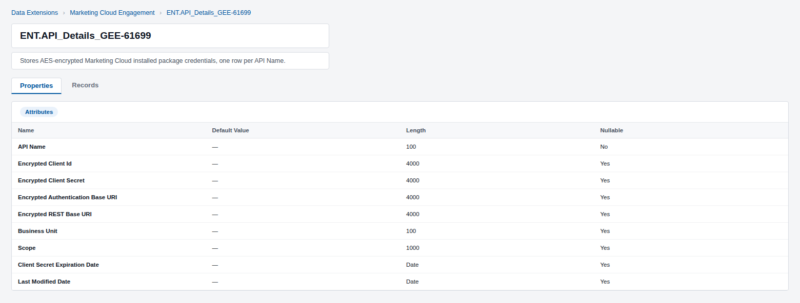
Data Extension: API_Details
This existing Data Extension already stores one encrypted row per Marketing Cloud installed package. It has been extended so this tool can look up, insert, and update rows for the packages it manages, in addition to the packages already using it.

Slide 4
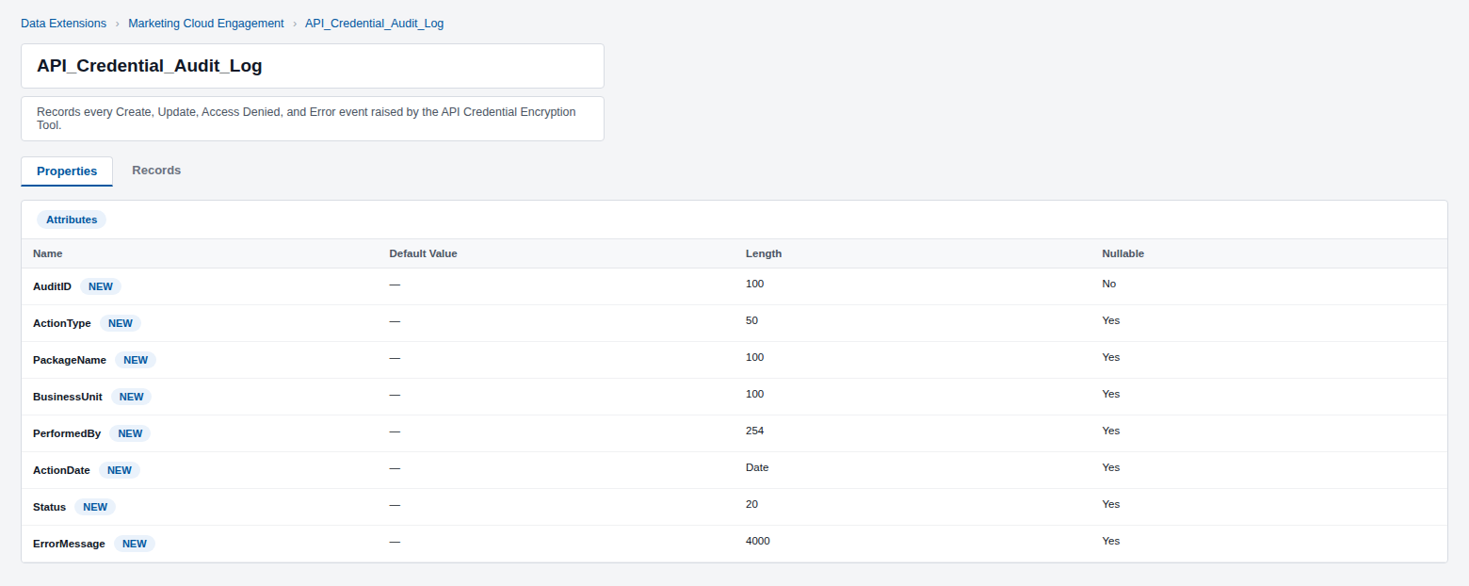
Data Extension: API_Credential_Audit_Log
This new Data Extension is used to capture a permanent record of every Create, Update, Access Denied, and Error event raised by the API Credential Encryption Tool CloudPage.

Slide 5
Cloud Page: API Credential Encryption Tool — Authentication & Access Control
Before any Add or Update action can be processed, the CloudPage enforces the following Marketing Cloud OAuth gate:
• Every request must present a valid, AES-encrypted session key minted for this page load and good for a fixed 60-minute window; anything else forces the OAuth flow.
• A one-time authorization code is exchanged with Marketing Cloud's /v2/token endpoint using this tool's own installed package, whose Client Id and Client Secret are themselves stored encrypted in API_Details.
• The authenticated user's email is read from /v2/userinfo and used to pre-fill the “Signed in as” identity shown on every screen and recorded against every change.
• If the visitor is signed into a different Business Unit, an interstitial notice tells them to switch before continuing, instead of Marketing Cloud's own unstyled access-denied page.
• Any Verify or Save request that reaches the page logic without a proven session is rejected and logged to API_Credential_Audit_Log as an “Access Denied” event.

Slide 6
Cloud Page: API Credential Encryption Tool — Add New Package
The Add New Package screen has been configured to perform the following functions:
• Capture API Name, Client ID, Client Secret, Authentication Base URI, REST Base URI, Client Secret Expiration Date, Business Unit, and Scope.
• Require every field to be completed; Client ID and Client Secret lengths are validated in AMPscript so the raw secret values are never handed to SSJS.
• Look up API_Details for an existing row with the same API Name and block the save with an inline error if a duplicate is found.
• AES-encrypt the Client ID, Client Secret, Authentication Base URI, and REST Base URI before they are ever written to the Data Extension.
• Insert the new row into API_Details and display a confirmation once the encrypted values are stored.
• Queue a “Create” audit entry with the outcome — Success or Failed — for every attempt, including duplicate-name failures.

Slide 7
Cloud Page: API Credential Encryption Tool — Update Existing Package
The Update Existing Package screen has been configured to perform the following functions:
• Capture the API Name of the package being rotated, its New Client Secret, and New Client Secret Expiration Date.
• Require all three fields; the new secret's length is validated in AMPscript before the SSJS update logic runs.
• Look up API_Details by API Name and return an inline error if no matching package is found.
• AES-encrypt the new Client Secret and update only the Encrypted Client Secret, Client Secret Expiration Date, and Last Modified Date columns only.
• Display a confirmation once the rotated secret has been stored.
• Queue an “Update” audit entry with the outcome for every attempt, including package-not-found failures.

Slide 8
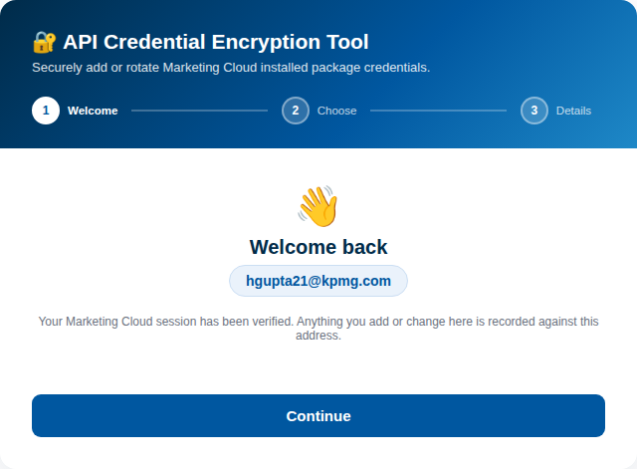
Test Results
Sign in with Marketing Cloud to verify identity before any action can be processed.

Slide 9
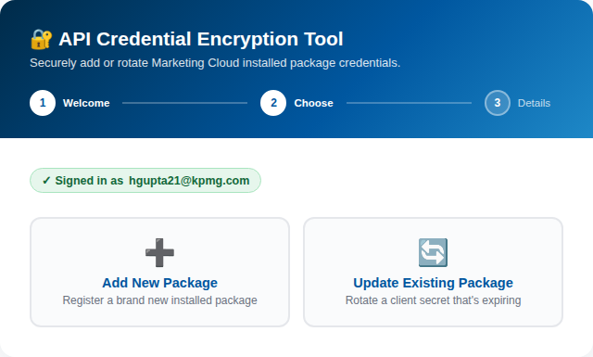
Test Results
Once verified, choose whether to add a new package or update an existing one.

Slide 10
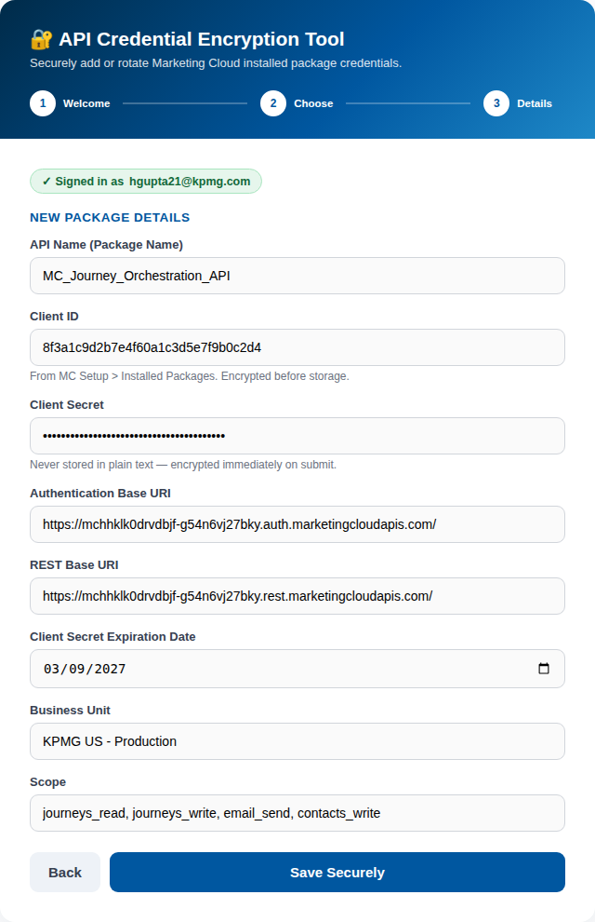
Test Results
Fill in the New Package Details for
MC_Journey_Orchestration_API
and select Save Securely.

Slide 11
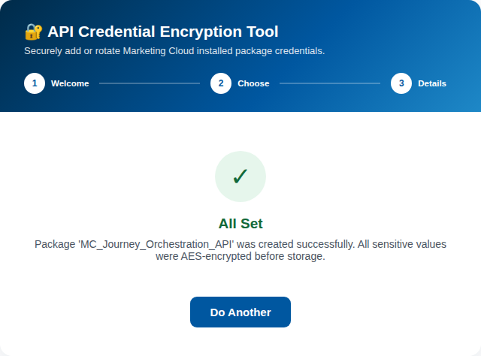
Test Results
The package is created successfully; all sensitive values were AES-encrypted before storage.

Slide 12
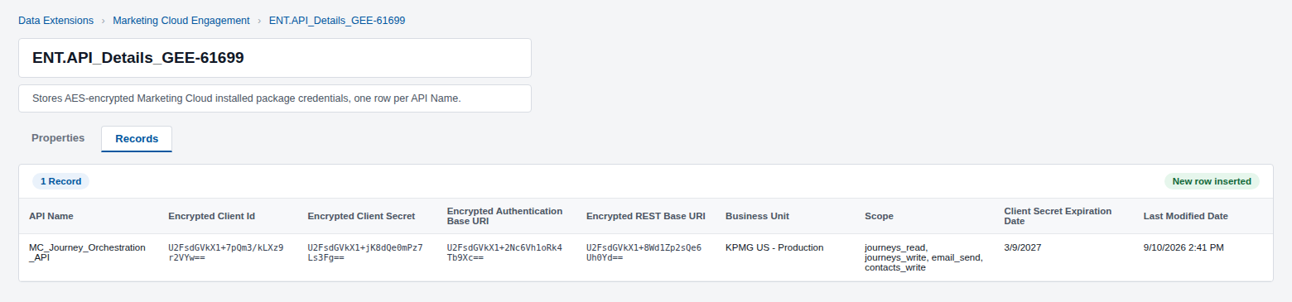
Test Results
The new record is inserted into API_Details DE with every credential value AES-encrypted.

Slide 13
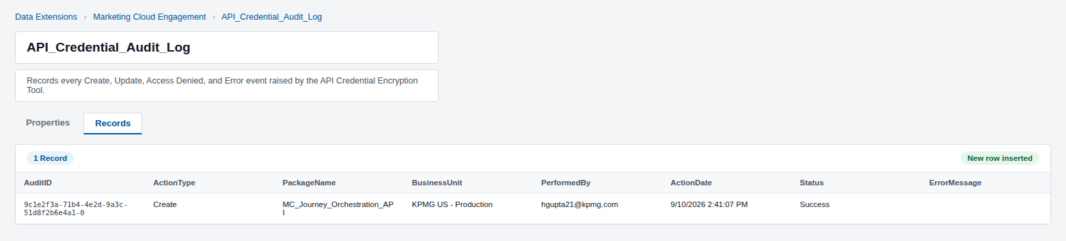
Test Results
A Create / Success entry is written to API_Credential_Audit_Log, recorded against hgupta21@kpmg.com.

Slide 14
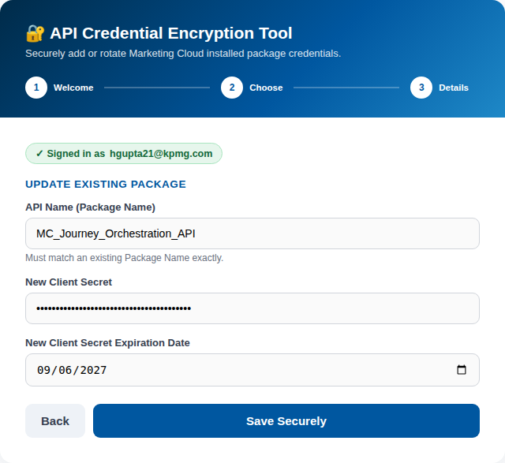
Test Results
To rotate a secret, choose Update Existing Package, enter the new secret and expiration date, and submit.

Slide 15
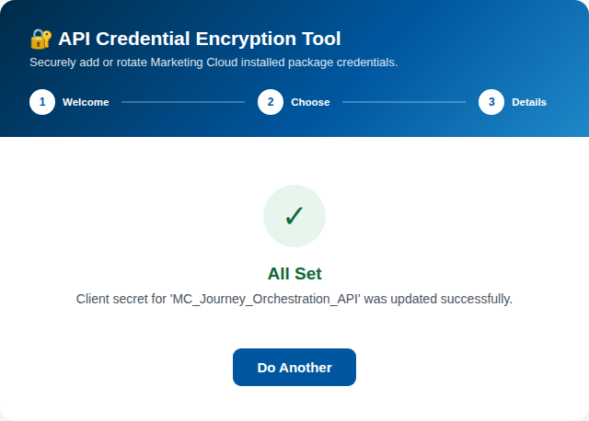
Test Results
The client secret for MC_Journey_Orchestration_API is updated successfully.

Slide 16
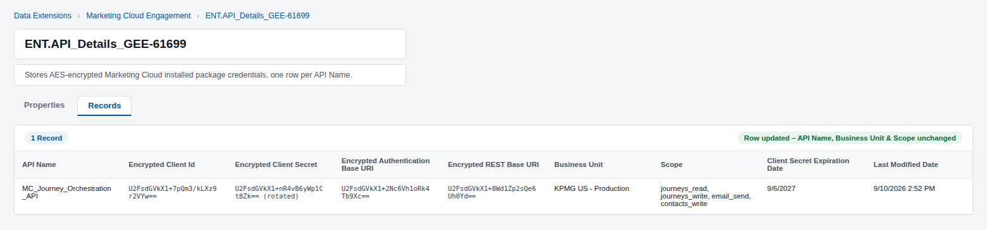
Test Results
The Encrypted Client Secret, Client Secret Expiration Date, and Last Modified Date are updated on the existing record.

Slide 17

Test Results
An Update / Success entry is written to API_Credential_Audit_Log DE, recorded against hgupta21@kpmg.com.

