Slide 1
Refactoring/cleanup for External Centralized Form Processor CloudPage
GEE-72810
Developer: Himanshu Gupta
Notes:
This demo is for GEE-72810, the refactoring and cleanup of the External Centralized Form Processor CloudPage, together with the fix for the Anteriad 404, INC4979312. The developer is Himanshu Gupta. We will go through what changed, how each acceptance criteria scenario was handled, and the test results.

Slide 2
Overview
GEE-72810 - Refactoring/cleanup for External Centralized Form Processor CloudPage
    Description
    As the lead for data management, I want the External Centralized Form Processor CloudPage code to be refactored and cleaned up per a previous Spike (GEE-35446), so that we can improve processing performance and development process.
    Additionally, the data management team reported 404 Error experienced by Anteriad while posting leads to the External Centralize Form Processor: INC4979312
    Contact Point Email record already existed in Salesforce for the submitted email address. During processing, the Centralized Form Processor (CFP) attempted to perform the standard Contact Point Email lookup to identify an existing Contact/Lead and retrieve associated consent information. However, at the time of processing, the required Salesforce data was not returned to CFP. As a result, no Salesforce ID was obtained, and CFP followed the new Lead creation path. Salesforce subsequently rejected the Lead creation request because the email address already existed in Contact Point Email.
    External CFP will be enhanced to handle scenarios where an existing Contact Point Email record is not returned during the lookup process. Additional checks will be put in place prior to attempting to create a new lead.
Marketing Cloud Updates​
Cloud Page: CentralizedFormProcessor-External (Existing)
Notes:
This enhancement focuses on refactoring and cleaning up the External Centralized Form Processor CloudPage to improve maintainability, reliability, and performance.
The change was initiated based on the recommendations from the earlier spike GEE-35446 and an issue reported by Anteriad where certain form submissions resulted in a 404 error due to Contact Point Email lookup inconsistencies in Salesforce.
In some scenarios, the Contact Point Email record existed in Salesforce, but the required Salesforce data was not returned during processing. This caused the application to incorrectly follow the new lead creation path, which was then rejected by Salesforce as a duplicate.
To address this, additional validation and lookup checks were introduced before attempting lead creation, making the solution more resilient and reducing the likelihood of processing failures.

Slide 3
Cloud Page: CentralizedFormProcessor-External
The CentralizedFormProcessor-External CloudPage has been enhanced to perform the following functions:
• Read and process all incoming parameters received from external form submissions, including contact details, company information, marketing attribution fields, preferences, campaign data, and form metadata.
• Generate and assign a unique tracking identifier (GUID-based Primary Key with EX- prefix) for each form submission to support audit, tracking, and traceability requirements.
• Perform comprehensive field length validation across all submitted parameters to ensure data complies with defined Data Extension field limits and prevent truncation, malformed submissions, or potential injection attempts.
• Execute special character validation and script pattern detection across submitted fields and URL parameters, rejecting submissions containing unauthorized characters or suspicious script content.
• Create a staging record in the NoSFID_CentralizedFormProcessor Data Extension to ensure submissions are captured before Salesforce processing begins.
• Perform Salesforce Lead and Contact resolution by searching ContactPointEmail records, synchronized ContactPointEmail data, and Individual relationships to identify existing person records associated with the submitted email address.
• Promote successfully processed records into the Centralized_Form_Processor_DE Data Extension, including the associated Salesforce ID, and remove the corresponding staging record after successful promotion.
Notes:
This slide highlights the key capabilities of the enhanced External Centralized Form Processor CloudPage.
The CloudPage now processes all incoming form parameters, generates a unique tracking identifier for every submission, and performs comprehensive validation checks to ensure data quality and security.
Additional validations include field length checks, special character validation, and script detection to prevent malformed submissions and potentially malicious input.
The solution also stages records for processing, performs Salesforce Lead and Contact resolution using Contact Point Email data, and promotes successfully processed submissions into the Centralized Form Processor Data Extension with the associated Salesforce ID.

Slide 4
Cloud Page: CentralizedFormProcessor-External (Contd.)
• Update Salesforce consent status by setting eligible Lead and Contact records to Opt In status and remove related unsubscribe records where required.
• Synchronize suppression management by removing qualifying email addresses from Global Suppression and Unsubscribe Data Extensions when consent is restored.
• Process associated email addresses linked to the same Salesforce person record and reactivate their subscription status where applicable.
• Securely retrieve and decrypt API credentials required for authenticated Marketing Cloud API integrations and Journey Builder event processing.
• Dynamically trigger Journey Builder entries based on form configurations, business unit mappings, and journey event key configurations without using hard-coded event identifiers.
• Return a success response upon successful processing, either as a JSON response or by redirecting the user to a configured confirmation page.
• For any validation, Salesforce integration, consent management, preference processing, journey execution, data insertion, or system error, capture submission details and insert an error record into the Centralized_Form_Processor_DE_Error_Log Data Extension to support troubleshooting, monitoring, and audit requirements.
Notes:
Beyond validation and Salesforce resolution, the CloudPage also manages consent and subscription synchronization.
When appropriate, Salesforce Lead or Contact records are updated to Opt In status, and associated suppression or unsubscribe records are removed to ensure marketing preferences remain aligned across systems.
The solution securely retrieves API credentials, supports dynamic Journey Builder triggering without hard-coded event identifiers, and returns a success response once processing is completed.
In addition, robust error handling has been implemented. Any validation, integration, consent, or journey processing failure is logged in the Centralized_Form_Processor_DE_Error_Log Data Extension to support troubleshooting, monitoring, and auditing.

Slide 5
Acceptance Criteria Coverage
All six acceptance criteria scenarios are covered in this enhancement.
Scenario | Acceptance criteria
1 Remove Inquiry Type logic | Inquiry Type checks and branches removed; no Inquiry Type-dependent code remains
2 Remove Contact Us journey logic | Contact Us journey conditions and execution removed from the External page
3 Consolidate lead create / update | One flow: create a Lead when nothing matches, update the existing record when it does
4 Existing Contact Point Email not returned | Additional check before a submission is classified as a new Lead; no duplicate-email error
5 Remove redundant ContactPointEmail lookups | Required lookup result stored and reused by later processing steps
6 Expand error-log details | Error log populated with the submitted values available at the point of failure
Notes:
This slide is our map for the demo. The unit testing document has six acceptance criteria scenarios and every one of them is covered here. Scenarios 1 to 3 are the code cleanup. Scenarios 4 and 5 are about how the page finds an existing Contact Point Email record, which is the root cause of the Anteriad 404, INC4979312. Scenario 6 is error handling and the expanded error log. The right-hand column tells you which slides show each scenario, and the last slide of the deck maps each scenario to its test evidence.

Slide 6
Scenario 1: Inquiry Type Removed
Inquiry Type is not populated for External submissions, so all code that depended on it was removed.
GIVEN / WHEN
WHAT CHANGED
Acceptance criteria
In the External CloudPage
Given: Inquiry Type is not populated for External CFP submissions
When: the External CFP page code is cleaned up
Then: Inquiry Type checks and conditional branches are removed, and no Inquiry Type-dependent code remains
Inquiry Type checks and the conditional branches that hung off them are gone
The lead create and update logic no longer forks on Inquiry Type null / not null (Scenario 3)
Inquiry Type is no longer part of the data sent to journeys
Notes:
Scenario 1. The spike, GEE-35446, found that Inquiry Type is never populated for submissions that arrive on the External page. Even so, the page carried checks and branches that depended on it. We removed those checks and the branches behind them, so there is no Inquiry Type-dependent code left on the External page. A side effect is that the lead logic no longer needs two versions, which is Scenario 3, and the journey data no longer includes Inquiry Type. The Internal page is a separate page and is not part of this change.

Slide 7
Scenario 2: Journey Logic Removed
The journey stage now triggers only the journeys that apply to External submissions.
1
Access token
2
Dynamic journeys
3
CFP journey
Contact Us journey
Removed
API credentials are decrypted and a token is requested for the business unit
Event ids for the submitted formName come from FormName_Event_ID_Mapping_DE
Event key read from the journey configuration DE for the MID, never hard-coded
dynamic
Centralized Form Processor
ACCEPTANCE CRITERIA
Given the Contact Us journey logic is not applicable to External submissions, when the journey-processing code is cleaned up, then the Contact Us journey conditions and execution logic are removed.
A failing journey is logged as non-fatal and does not stop the others.
Notes:
Scenario 2. The Contact Us journey does not apply to External submissions, so its conditions and execution were removed from the journey stage. What remains is the access token, the form-mapped dynamic journeys looked up by form name, and the Centralized Form Processor journey. Event keys come from configuration Data Extensions, not from hard-coded values. If any journey call fails, the failure is written to the error log as non-fatal and the remaining journeys still run. The last test result slide of the flow shows the contact entering the Centralized Form Journey.

Slide 8
Scenario 3: Single Lead Flow
The duplicated Inquiry Type null / not null logic is now one create-or-update flow.
1
Eligibility
2
Resolve record
3
Create or update
Same rule as before: Function is empty, Other/Not Sure, Advisory, Tax or Audit
Lookup chain finds an existing Lead or Contact Id, or finds nothing
One decision on the lookup result replaces the two duplicated branches
unchanged
single flow
NO MATCH FOUND
MATCH FOUND
A new Lead is created from the submitted values
A short wait lets Salesforce finish building the Lead and its related records
Consent is then set to Opt In
An existing Lead is updated with the same 10 attributes as before
A Contact is not updated, unchanged from today (GEE-5976)
Name, title, phone, country and function are not overwritten
Notes:
Scenario 3. Before the cleanup, lead creation and update logic existed twice, once for Inquiry Type null and once for not null, and the two copies were identical. Now there is a single flow. First the same eligibility rule as before decides whether a lead is processed. Then the lookup chain, which we will see in Scenario 4, resolves an existing record. If nothing is found, a new Lead is created. If a record is found, an existing Lead is updated with the same ten attributes as before. A Contact is not updated, and name, title, phone, country and function are not overwritten. The acceptance criteria say those exclusions must stay the same as today, and they do.

Slide 9
Scenario 4: The Problem and Fix
INC4979312: Anteriad received a 404 when the existing Contact Point Email was not returned.
BEFORE
AFTER
What went wrong
What happens now
A Contact Point Email record already existed for the submitted email
The lookup did not return the Salesforce data, so no Salesforce ID was obtained
The page took the new Lead path
Salesforce rejected the Lead because the email already existed, and Anteriad saw a 404
The page performs additional checks for a matching Contact Point Email before treating the submission as new
The Lead or Contact linked to the match is used for continued processing
No Lead creation is attempted for an email that already exists, so no duplicate-email error is generated
Notes:
Scenario 4 is the production incident. Anteriad posts leads to the External Centralized Form Processor. For some submissions the Contact Point Email record already existed in Salesforce, but the lookup did not return it. With no Salesforce ID the page assumed the person was new and tried to create a Lead. Salesforce rejected that because the email address was already there, and Anteriad received a 404. The fix is to add checks before a Lead is ever created. If an existing Contact Point Email is found by any of the checks, the associated Lead or Contact is used and processing continues. The next slide shows the checks.

Slide 10
Scenario 4: Lookup Fallback Chain
A new Lead is created only after every lookup has come back empty.
1
Primary lookup
2
Fallback 1
3
Fallback 2
4
Create Lead
Live Salesforce query on ContactPointEmail by the submitted email address
Synchronized ContactPointEmail Data Extension, searched only if step 1 returned no Id
A row exists but has no Id: follow its Individual to the Contact, or else the Lead
Only if steps 1 to 3 found nothing; a match goes on to the update step
PRIMARY
FALLBACK_SYNC_DE
FALLBACK_INDIVIDUAL_*
CREATED
TRACEABILITY
Each step records where the record was found in the LOOKUP value shown in the error log
A failing fallback is logged as non-fatal and processing moves on to the next step
Notes:
This is the heart of the fix. Step one is the normal live Salesforce query on Contact Point Email by email address. If it returns a Lead or Contact Id, we use it and stop. If it does not, fallback one searches the synchronized Contact Point Email Data Extension. If that also finds no Id but a Contact Point Email row exists, fallback two follows the row to its Individual and picks the associated Contact, or the Lead if there is no Contact. Only if all three come back empty is a new Lead created. Each outcome is labelled, PRIMARY, FALLBACK_SYNC_DE, FALLBACK_INDIVIDUAL or CREATED, and that label appears as LOOKUP in the error log, so support can see how a record was found. If a fallback itself fails, it is logged as non-fatal and we carry on.

Slide 11
Scenario 5: One Lookup, Reused
The Salesforce ID is resolved once and every later stage reuses it.
BEFORE
Resolved once
REUSED BY
ContactPointEmail looked up repeatedly to retrieve the Salesforce ID
Each repeat is an extra Salesforce call on the submission path
Consent update
Associated email addresses
Preference processing
Journey data and consent safety net
Stored in Salesforce_ID after the lookup chain
Result: end-to-end processing time dropped from about 16 seconds to about 8 seconds in the test run.
Notes:
Scenario 5. The page used to repeat the Contact Point Email lookup in several places just to get the Salesforce ID. Now the lookup chain runs once, the result is stored in Salesforce_ID, and the consent update, the associated email handling, preference processing, the journey data and the consent safety net all reuse it. Only the fallbacks add extra lookups, and only when the primary lookup comes back empty. Together with the other cleanup, this took the end-to-end time of a submission from roughly 16 seconds to roughly 8 seconds in our test, which you can see on the 200 OK slide.

Slide 12
Error Handling: Fatal Errors
A fatal error is logged first, then the visitor gets an error response.
HTTP | Stages | What it means
400 | INPUT_VALIDATION, EMAIL_VALIDATION | Submission rejected: value too long, disallowed characters, script pattern in a URL value, or missing / invalid email
500 | STAGING_INSERT, DATA_PROMOTION, SUBSCRIBER_ACTIVATION_OR_API_CREDENTIALS, JOURNEY_PROCESSING | An internal processing step could not complete
502 | SF_INTEGRATION, CONSENT_UPDATE, ASSOCIATED_EMAILS, PREFERENCE_PROCESSING, CONSENT_SAFETY_NET | A Salesforce or consent step failed
Every stage is wrapped in its own handler, so the log shows exactly where a submission failed.
Notes:
Now error handling, which is part of Scenario 6. Each stage of the page has its own handler that writes to the error log and then ends the request with an error response. Validation failures are logged as 400: a value that is too long, characters that are not allowed, a script pattern in a URL value, or a missing or invalid email. Failures of internal steps, such as the staging insert, promotion into Centralized_Form_Processor_DE, credential retrieval or journey processing, are logged as 500. Failures of Salesforce or consent steps are logged as 502. Because every stage is named, support can see exactly where a submission failed.

Slide 13
Error Handling: Non-Fatal Errors
Housekeeping failures are logged but do not fail the submission.
LOGGED WITH A NON-FATAL FLAG; PROCESSING CONTINUES
ERROR RESPONSE MODE
Lookups fallback lookups on the sync DE and the Individual
Clean-up staging record delete, unsubscribe and suppression updates, associated-email and preference clean-up
Journeys token request, dynamic and CFP journey entries, and any response other than 201; one failing journey does not stop the others
THROW (default) script error response
REDIRECT visitor sent to an error page
RAISE_ERROR returns the stage's status code
Notes:
The other side of error handling is the non-fatal errors. The submission has already been captured and the person has been processed, so things like deleting the staging record, unsubscribe and suppression clean-up, the fallback lookups and the journey calls should not turn a successful submission into a failure. These are logged with a NON-FATAL flag and processing continues. A failing journey does not stop the others. On the right, how a fatal error is returned is one configuration value: throw a script error, which is the default, redirect to an error page, or raise an error with the status code.

Slide 14
Error Log: Submitted Values
Centralized_Form_Processor_DE_Error_Log now captures all 52 posted fields available at the point of failure.
Contact
Company data
Campaign and attribution
FirstName, LastName, EmailAddress, Phone, Company, JobTitle, Country
db_* fields: industry, sub industry, city, state, zip, street, employee count, annual sales, website
CID, medium, term, Campaign, Source, content, Tactic_ID, marketingTheme, marketingCampaign, marketingSubCampaign
Preferences
Form metadata
Routing and identity
Preference1 to Preference10
formName, pageURL, Full_Page_URL, confirmationPage, conditionalProcessing, MID
Function, Level, Department, Lead_Source, Lead_Source_Detail, Message, PrimaryKey, RFP_Attachments, Page_Type = External
Each value is trimmed to the length of its Data Extension field.
Notes:
Scenario 6. Before, the error log did not hold all the values that were submitted, which made failed submissions hard to troubleshoot. Now every error writes the 52 posted form fields that are available at the point of failure. They are grouped on this slide: contact details, company data, campaign and attribution fields, the ten preference fields, form metadata, and routing and identity values including the primary key, the attachment flag and the page type, External. Each value is trimmed to the length of its Data Extension field so the insert cannot fail on length.

Slide 15
Error Log: Message Context
Format of the ErrorMessage column (illustrative, values shown as placeholders).
[STAGE] <error text> | HTTP=<status> | SFID=<id> | LOOKUP=<step> | t=+<ms>ms
STAGE
HTTP
SFID
LOOKUP
t=+ms
Which stage failed, for example SF_INTEGRATION
Status for the stage: 400, 500 or 502
Salesforce Id resolved so far
PRIMARY, FALLBACK or CREATED
Time since the request started
SAFEGUARDS
A NON-FATAL marker is added when the submission continued; the message is capped at 3,999 characters
If the full insert fails, a minimal record (FirstName, LastName, EmailAddress, ErrorMessage) is written; logging never blocks the response
Notes:
The ErrorMessage column carries the context that was missing before. It starts with the stage that failed and the error text. After that come the HTTP status for the stage, the Salesforce Id resolved so far, which lookup step found the record, and the time in milliseconds since the request started. When the submission continued after the error, a NON-FATAL marker is added. There are two safeguards: the message is capped at 3,999 characters, and if the full insert ever fails, a minimal record is written so the failure is still traceable. Logging never blocks the response.

Slide 16
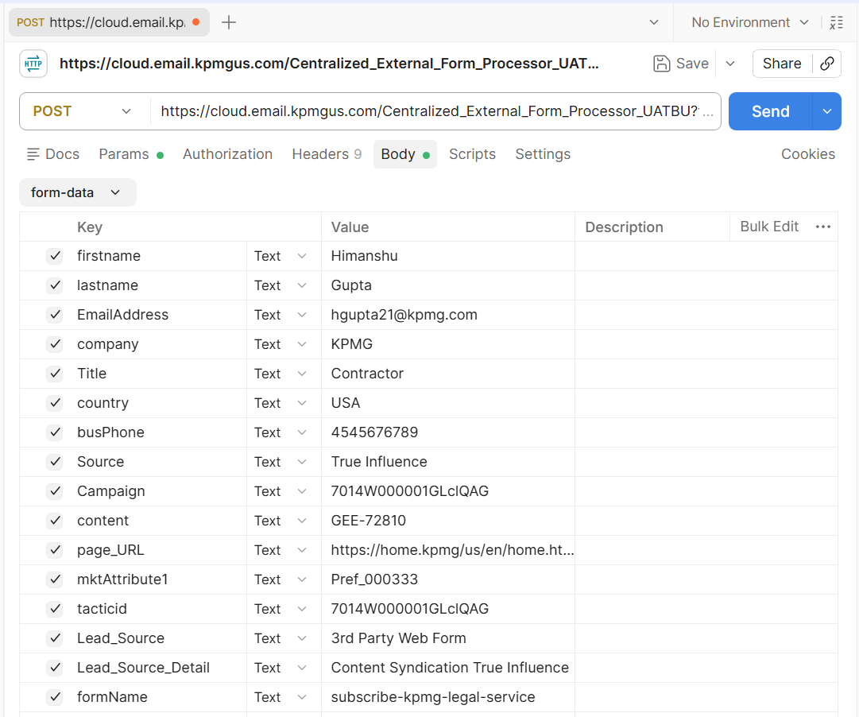
Test Results
Set the required field values
in the payload and send the
request using a POST request
in Postman.
Notes:
For testing, all required form parameters were configured in Postman and submitted to the External Centralized Form Processor endpoint using a POST request.
The test payload included contact information, campaign details, form metadata, and preference-related values to simulate a real-world external form submission.
This test validates the end-to-end processing path from initial submission through Salesforce resolution, preference processing, and journey injection.

Slide 17
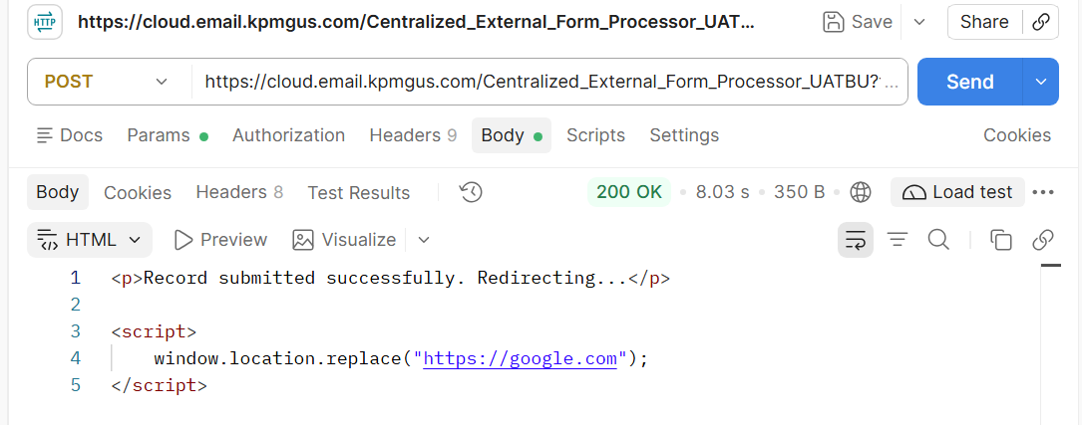
Test Results
The request was submitted successfully, and a 200 OK response was received from the API.
Notes:
This slide shows the successful API response received after submitting the request. A 200 OK status confirms that the request was processed successfully without any errors.
As part of the refactoring effort, we also observed a significant performance improvement. The end-to-end processing time was reduced from approximately 16 seconds to around 8 seconds. This represents roughly a 50 percent reduction in processing time and provides a faster experience for external form submissions.
The improved performance was achieved through code optimization, cleanup activities, and more efficient processing logic introduced during the enhancement.

Slide 18
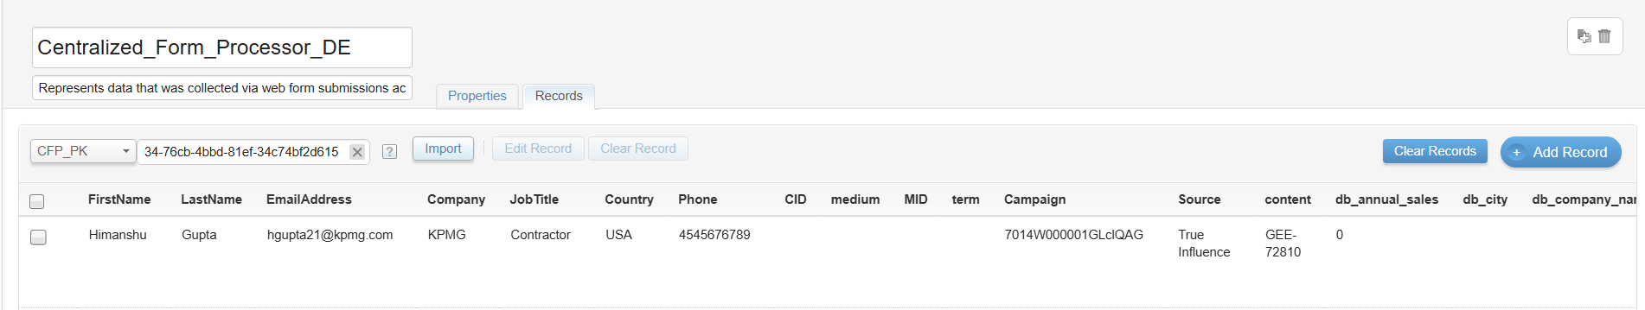
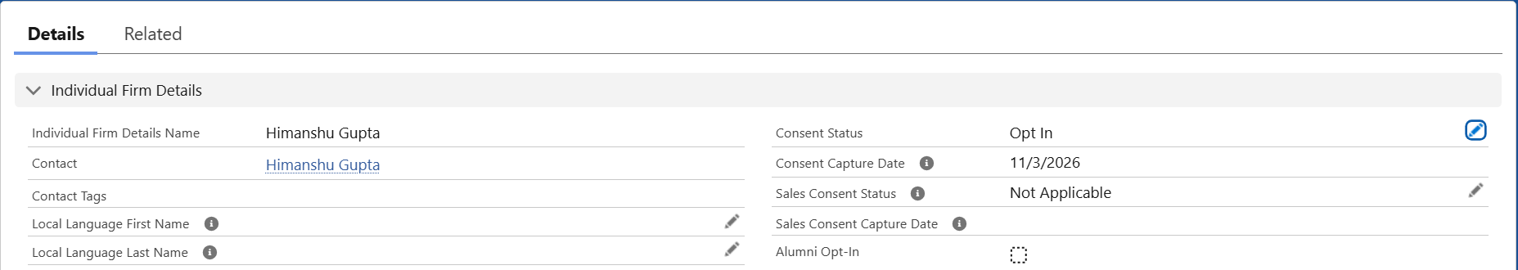
Test Results
After an external form submission, the record is inserted into the Centralized_Form_Processor_DE, and the Sales Cloud consent status is also updated to Opt In.
Notes:
After submission, the record was successfully processed and inserted into the Centralized_Form_Processor_DE.
The screenshots demonstrate that the Salesforce consent status was also updated to Opt In as part of the processing workflow.
This confirms that the solution successfully completed both data capture and consent management activities within Sales Cloud and Marketing Cloud.

Slide 19
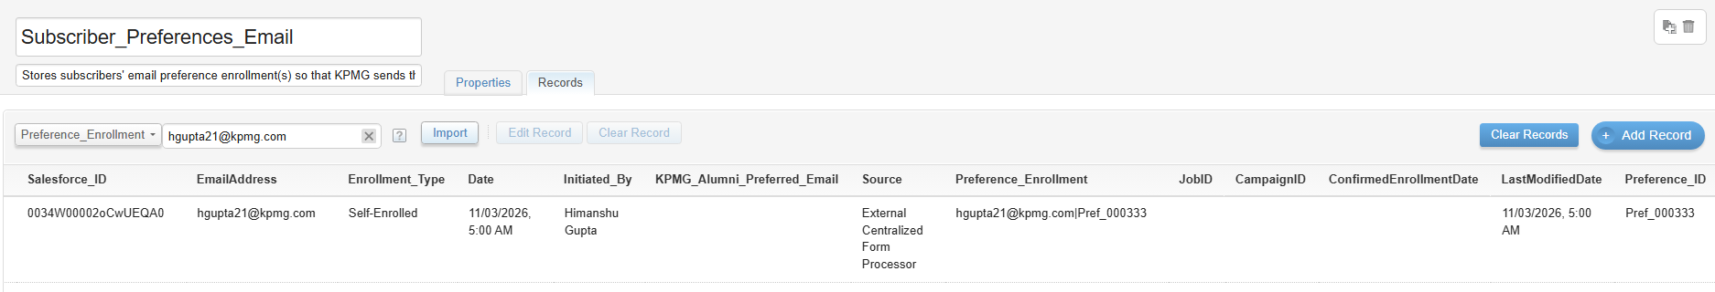
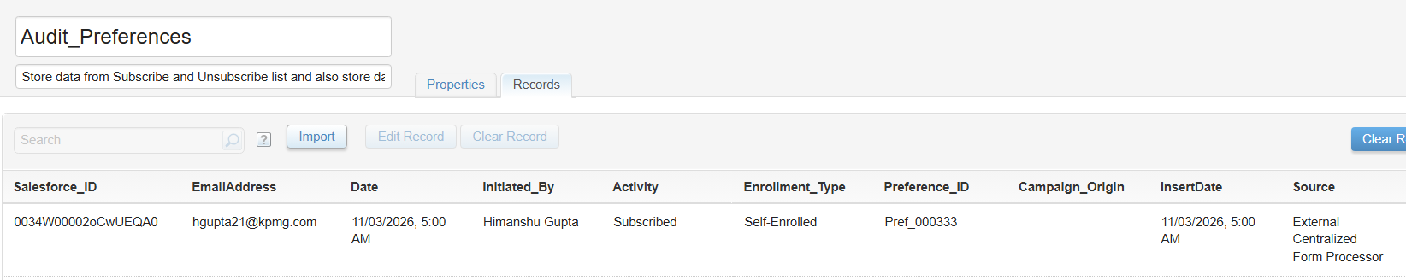
Test Results
The record is processed successfully and inserted into the corresponding preference-related Data Extensions based on the submitted preferences.
Notes:
This slide demonstrates that the submitted preferences were processed successfully and routed to the Subscriber_Preferences_Email Data Extension and Audit_Preferences Data Extension.
This validates that preference management functionality continues to operate correctly following the refactoring effort.

Slide 20
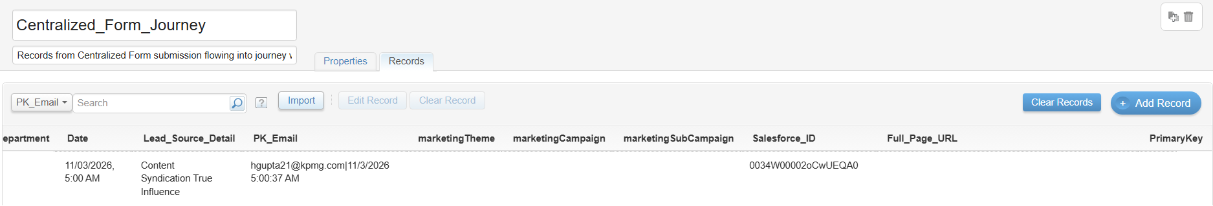
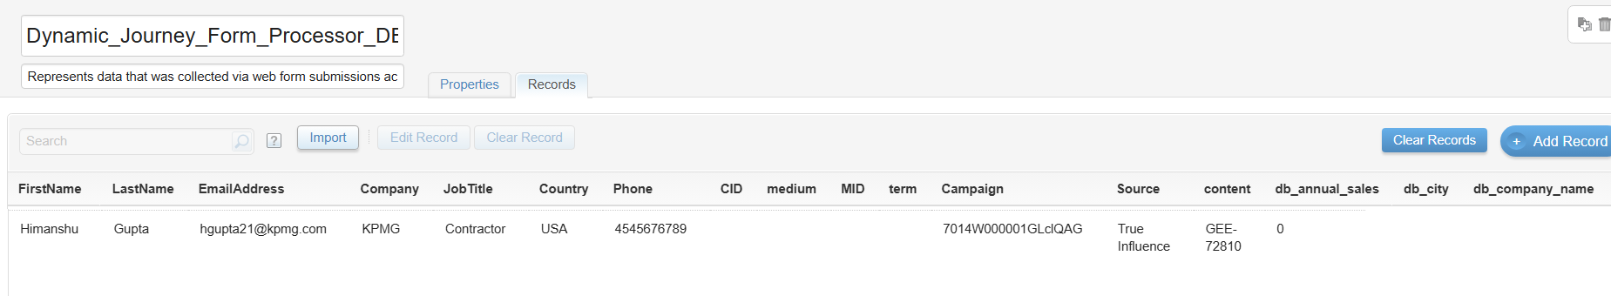
Test Results
In addition to the preferences Data extension, the record is processed successfully and inserted into the corresponding CFP journey entry data extension and Dynamic_Journey_Form_Processor_DE.
Notes:
In addition to the preference Data Extensions, the submission was also inserted into the CFP journey entry Data Extension and the Dynamic_Journey_Form_Processor_DE.
These records are used to support downstream journey orchestration and dynamic journey processing requirements.
The successful insertion confirms that journey qualification logic executed correctly and that all required data was prepared for journey entry.

Slide 21
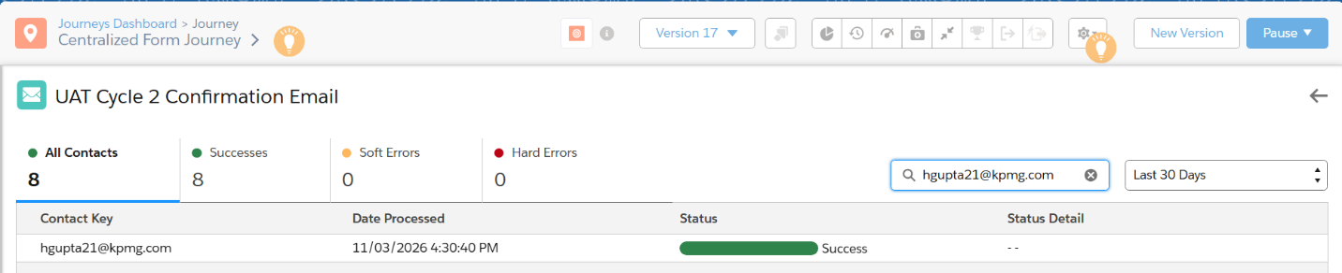
Test Results
The record has been successfully injected into the Centralized Form Journey.
Notes:
The final validation step confirms that the record was successfully injected into the Centralized Form Journey.
The journey accepted the submission and the contact entered the configured journey path without any processing errors.
This demonstrates successful end-to-end execution, starting from the external form submission, through validation and Salesforce processing, all the way to Journey Builder entry.

