Slide 1
<DEV> Implement Journey Builder Cleanup: monthly Cleanup Review and Recycle Bin automations
GEE-26092
Developer: Himanshu Gupta

Slide 2
Overview
    As the email marketing lead, I would like recommendations for automating Journey Builder cleanup with an approval process, so that we can delete items that are no longer needed by the team. This build automates the monthly deletion of the Recycle Bin folder (replacing the manual monthly RITM) and moves journeys not sent in 180 days into a Journey Cleanup Review folder for approval.
Marketing Cloud Updates​
Automations (New): JourneyBuilder-Move_Cleanup_Review_Journeys_To_RecycleBin (Automation 1 · last day of every month)
JourneyBuilder-Monthly_RecycleBin_Cleanup_Review_And_Notification (Automation 2 · 1st of every month)
Data Extensions (New): Journey_Master (all journeys and metadata)
Journey_Activity (activities of each journey)
Journey_Triggers (trigger of each journey)
Journey_Deletion_Exclusion (business-editable exclusion list; never cleared)
Journey_Activity_Stale_180 (journeys with no email send in 180 days)
Journeys_Eligible_For_Cleanup (journeys to move to Cleanup Review)
Journey_Recycle_Bin_Folder (live snapshot of the Recycle Bin folder)
Journey_Cleanup_Review_Folder (live snapshot of the Cleanup Review folder)
Journey_Error_Log (audit log of runtime and API errors)
Email (New): Journey Cleanup Review notification (sent to Cedric Bastian with the folder contents)

Slide 3
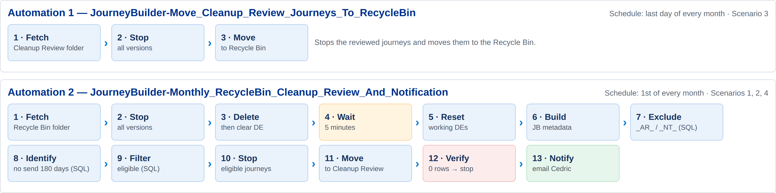
Automation changes or additions
Automation overview: Two scheduled automations cover the full monthly lifecycle. Automation 1 (last day of the month) moves reviewed journeys to the Recycle Bin; Automation 2 (1st of the month) deletes the Recycle Bin, then stages new candidates for review and notifies Cedric Bastian.

Slide 4
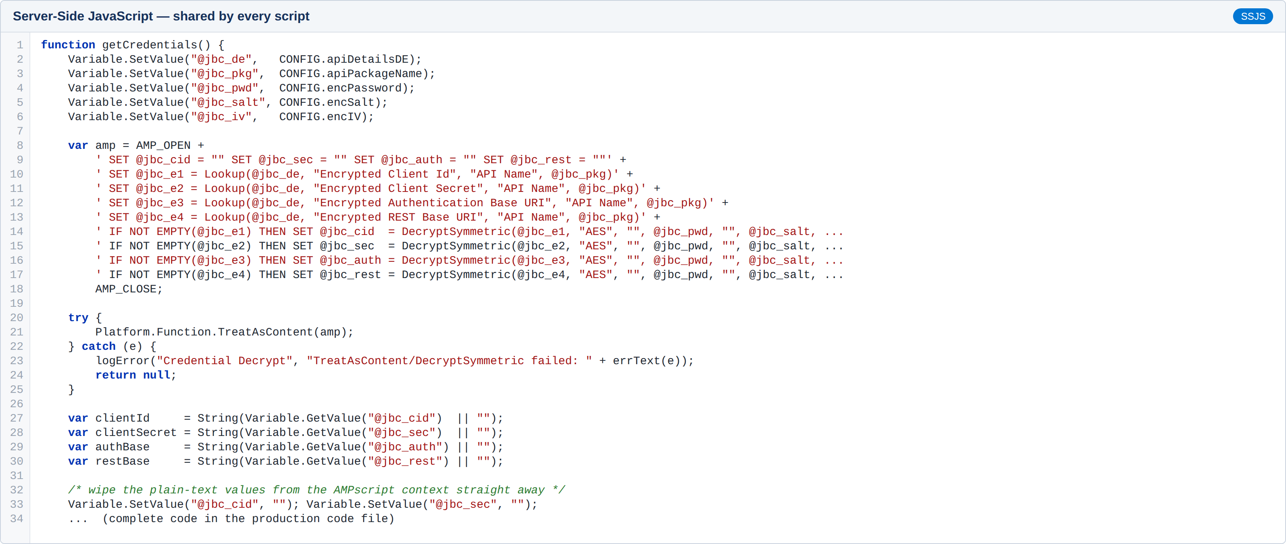
Automation changes or additions
Shared logic (every Script Activity): Credentials for the KPMGUS_Privilege_API package are read from API_Details and decrypted with the same AES DecryptSymmetric call as the API Credential Encryption Tool, run through TreatAsContent(). No credential is hard-coded or logged.

Slide 5
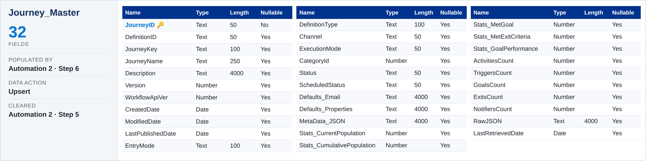
Data Extension Changes or Additions
Journey_Master: Master list of every journey and its metadata, retrieved from the Journey Builder REST API.

Slide 6
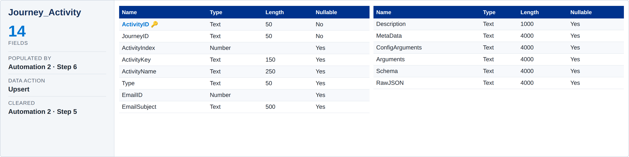
Data Extension Changes or Additions
Journey_Activity: Details of every activity inside each journey (including Type, e.g. EMAILV2).

Slide 7
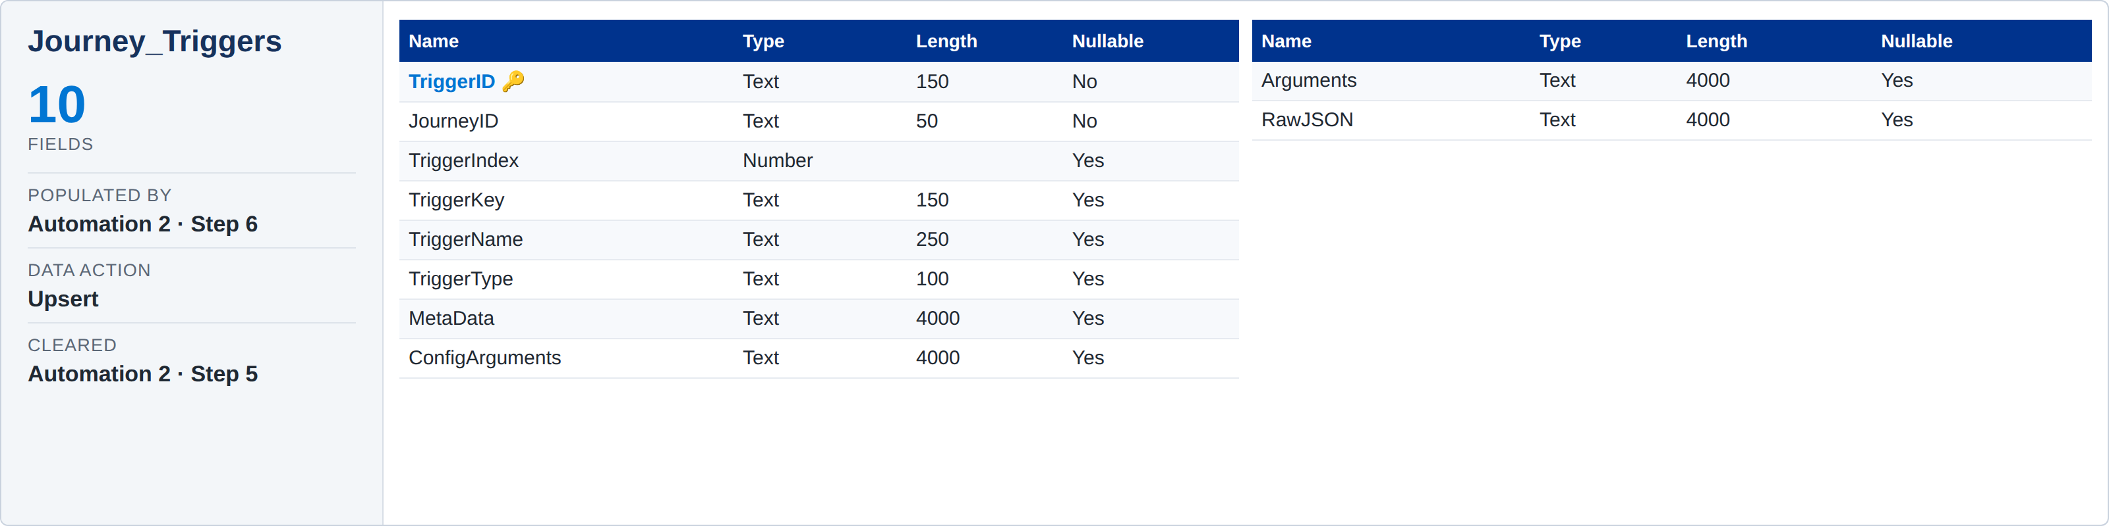
Data Extension Changes or Additions
Journey_Triggers: Trigger configuration for each journey (first trigger, e.g. EmailAudience, APIEvent).

Slide 8
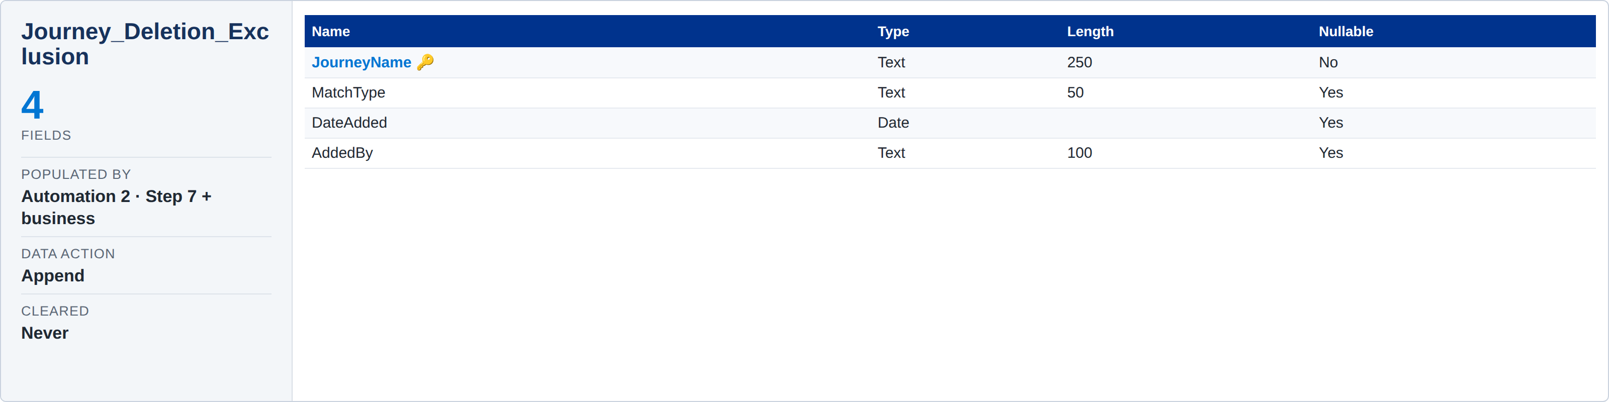
Data Extension Changes or Additions
Journey_Deletion_Exclusion: Business-editable exclusion list. Seeded with "_AR_" / "_NT_" matches; manual rows (MatchType = Manual) are never changed.

Slide 9
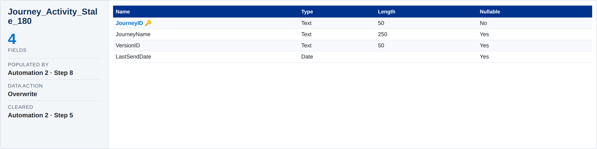
Data Extension Changes or Additions
Journey_Activity_Stale_180: Journeys whose email activities have not sent in the last 180 days — one row per journey.

Slide 10
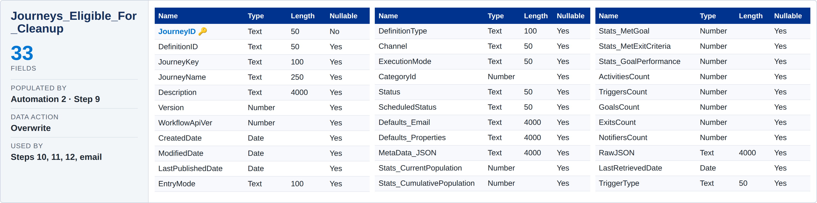
Data Extension Changes or Additions
Journeys_Eligible_For_Cleanup: Journeys eligible to move to Cleanup Review: Journey_Master structure plus TriggerType, after exclusions.

Slide 11
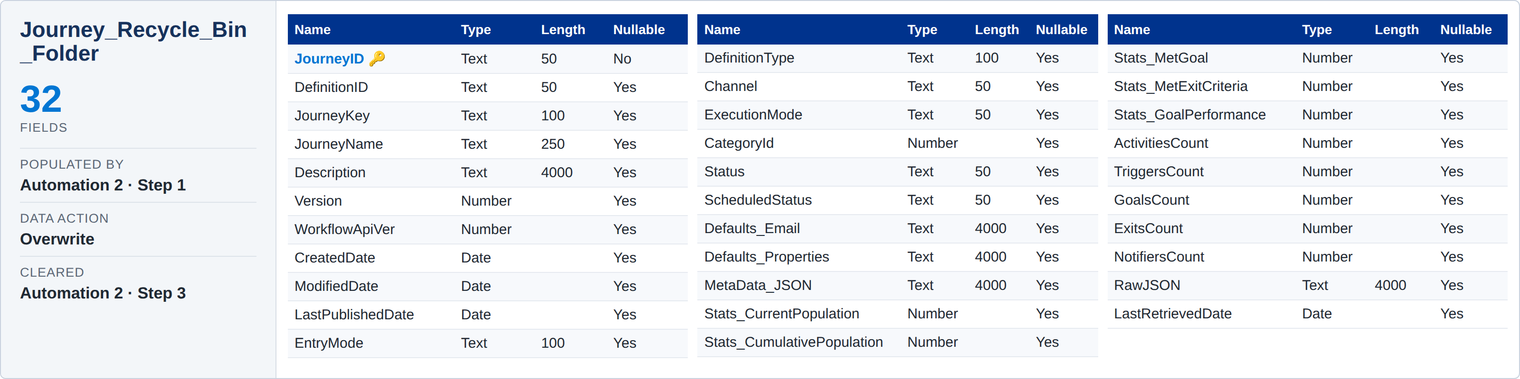
Data Extension Changes or Additions
Journey_Recycle_Bin_Folder: Live snapshot of the Recycle Bin folder, fetched at the start of Automation 2 (same structure as Journey_Master).

Slide 12
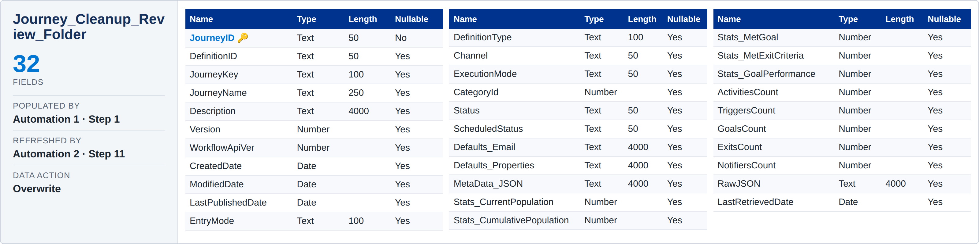
Data Extension Changes or Additions
Journey_Cleanup_Review_Folder: Live snapshot of the Journey Cleanup Review folder (same structure as Journey_Master). Also read by the notification email.

Slide 13
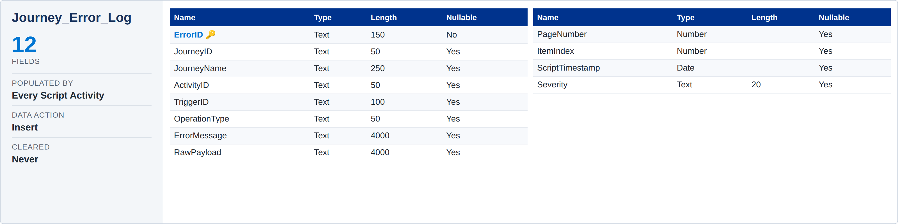
Data Extension Changes or Additions
Journey_Error_Log: Audit log of runtime and API failures across both automations (same 12 fields as the POC).

Slide 14
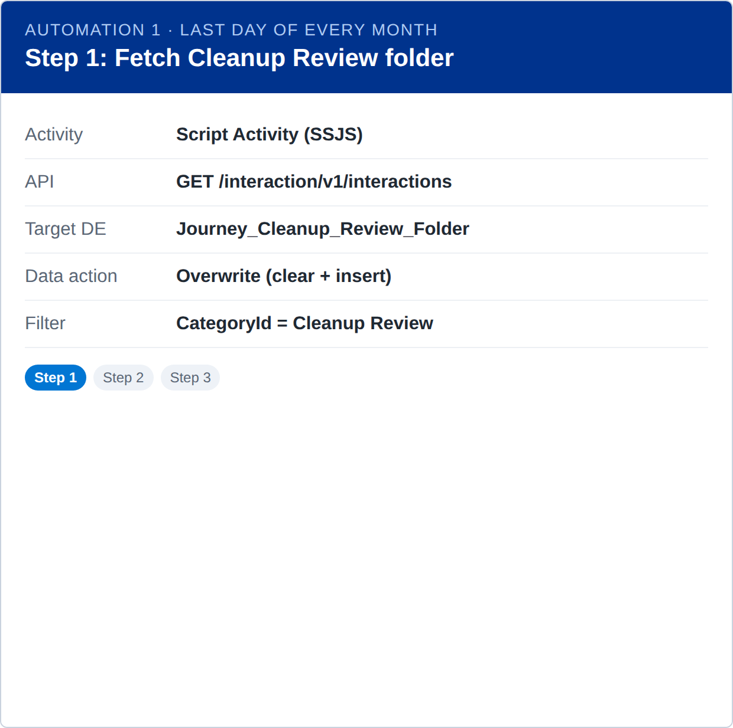
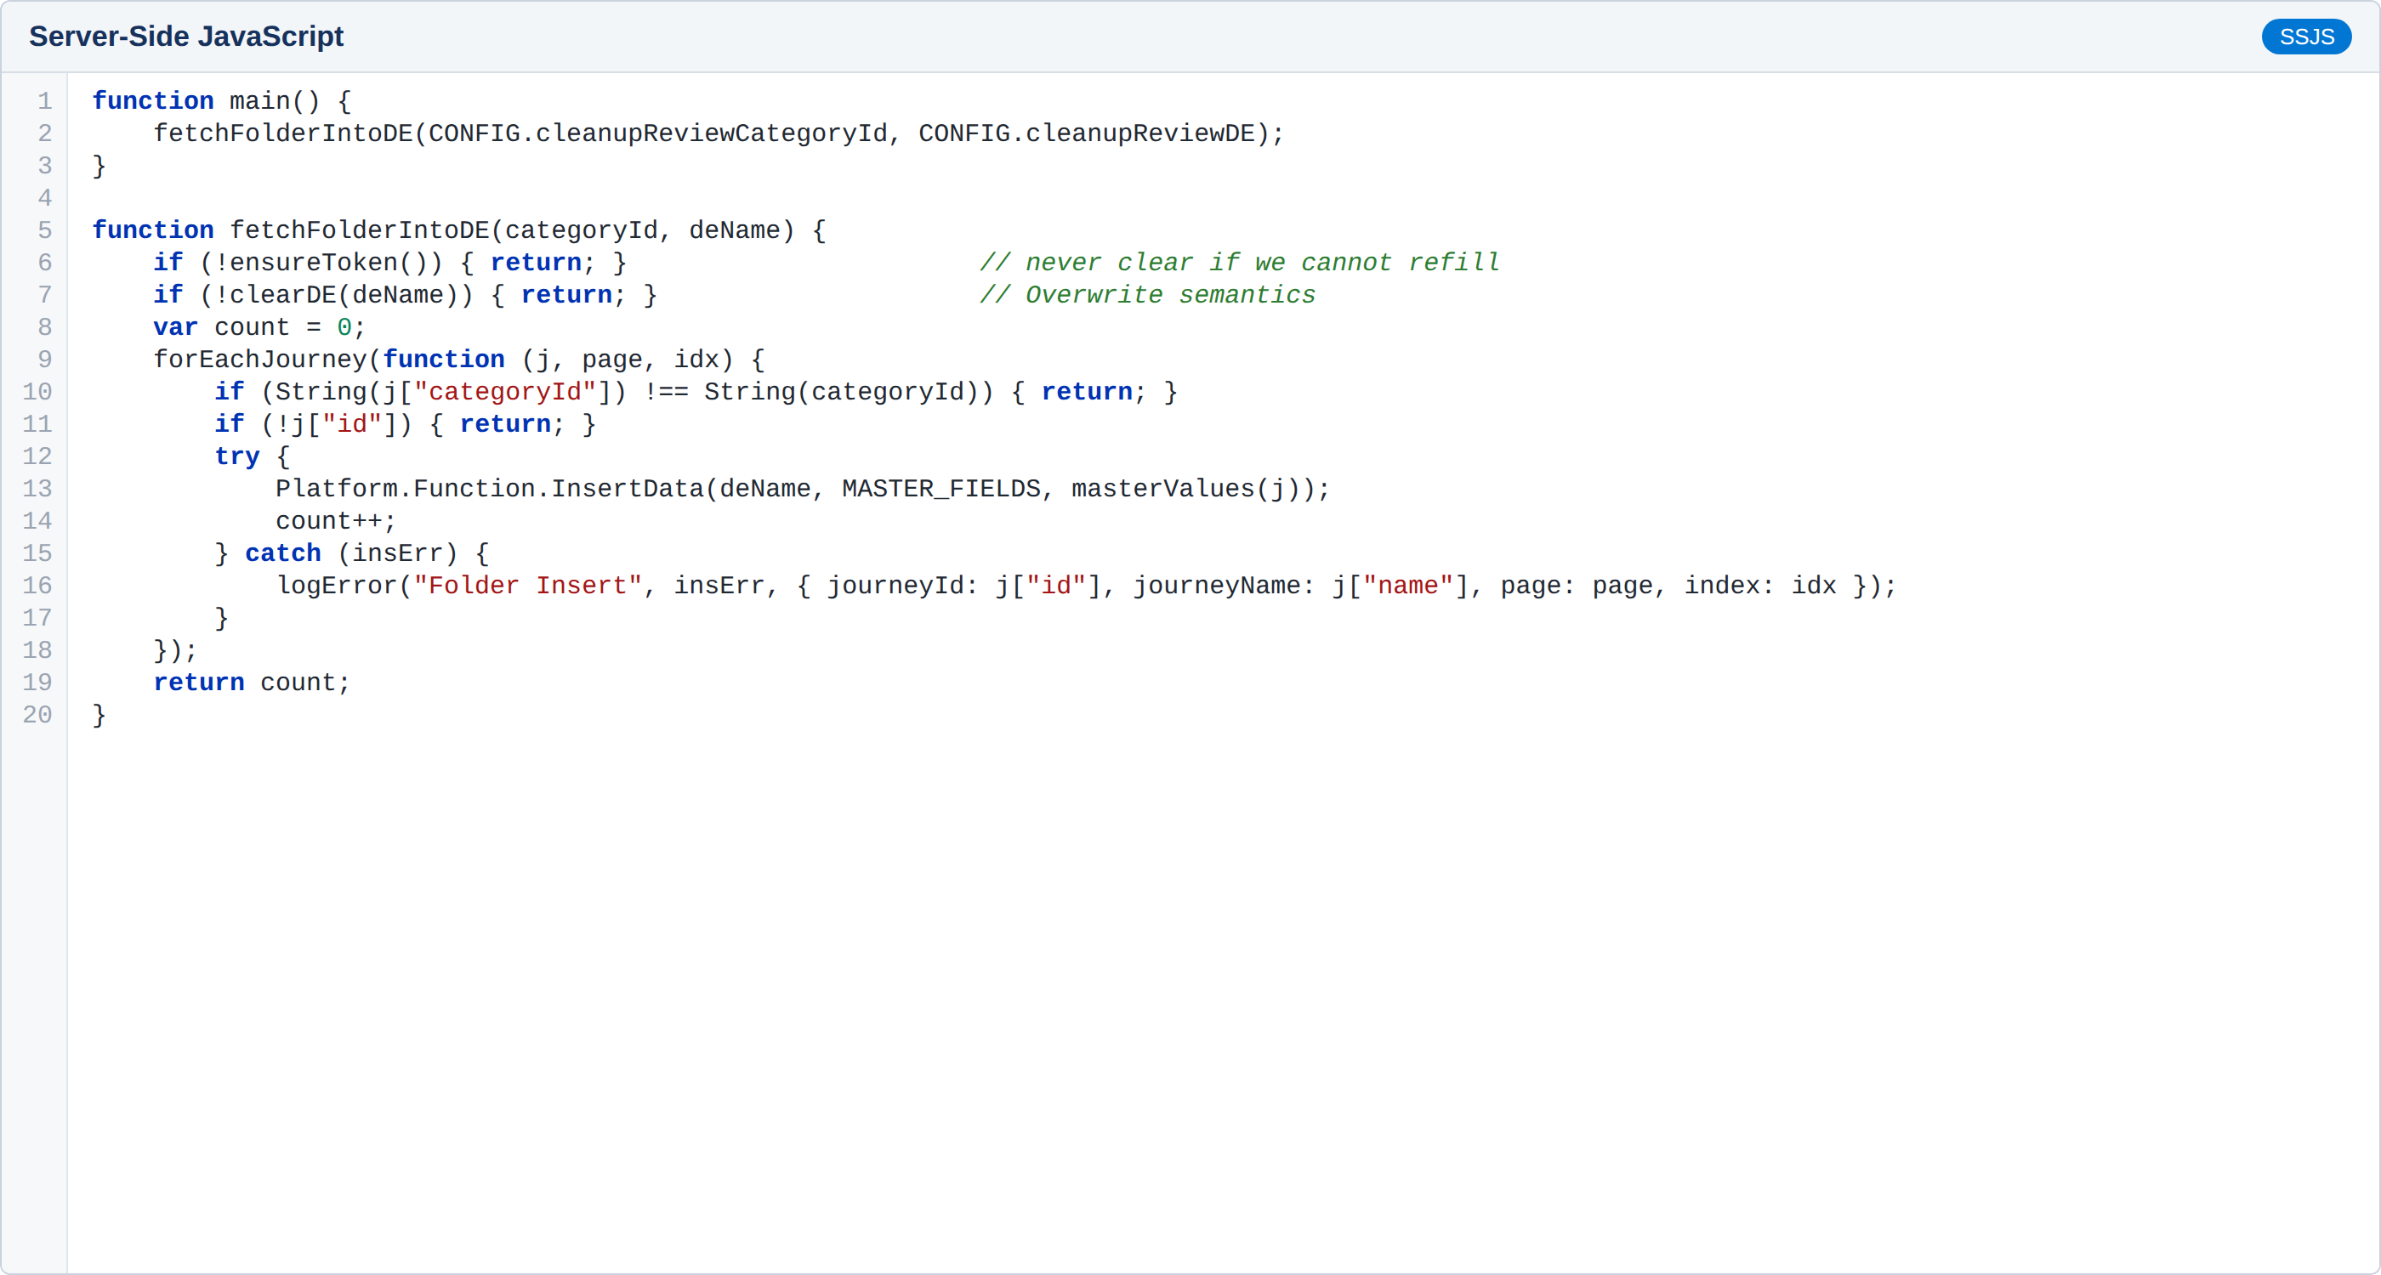
Automation changes or additions
Automation 1 – Step 1: Live REST fetch of every journey in the Journey Cleanup Review folder (paginated, filtered by folder ID) into Journey_Cleanup_Review_Folder, so Steps 2–3 act on what is in the folder right now.

Slide 15
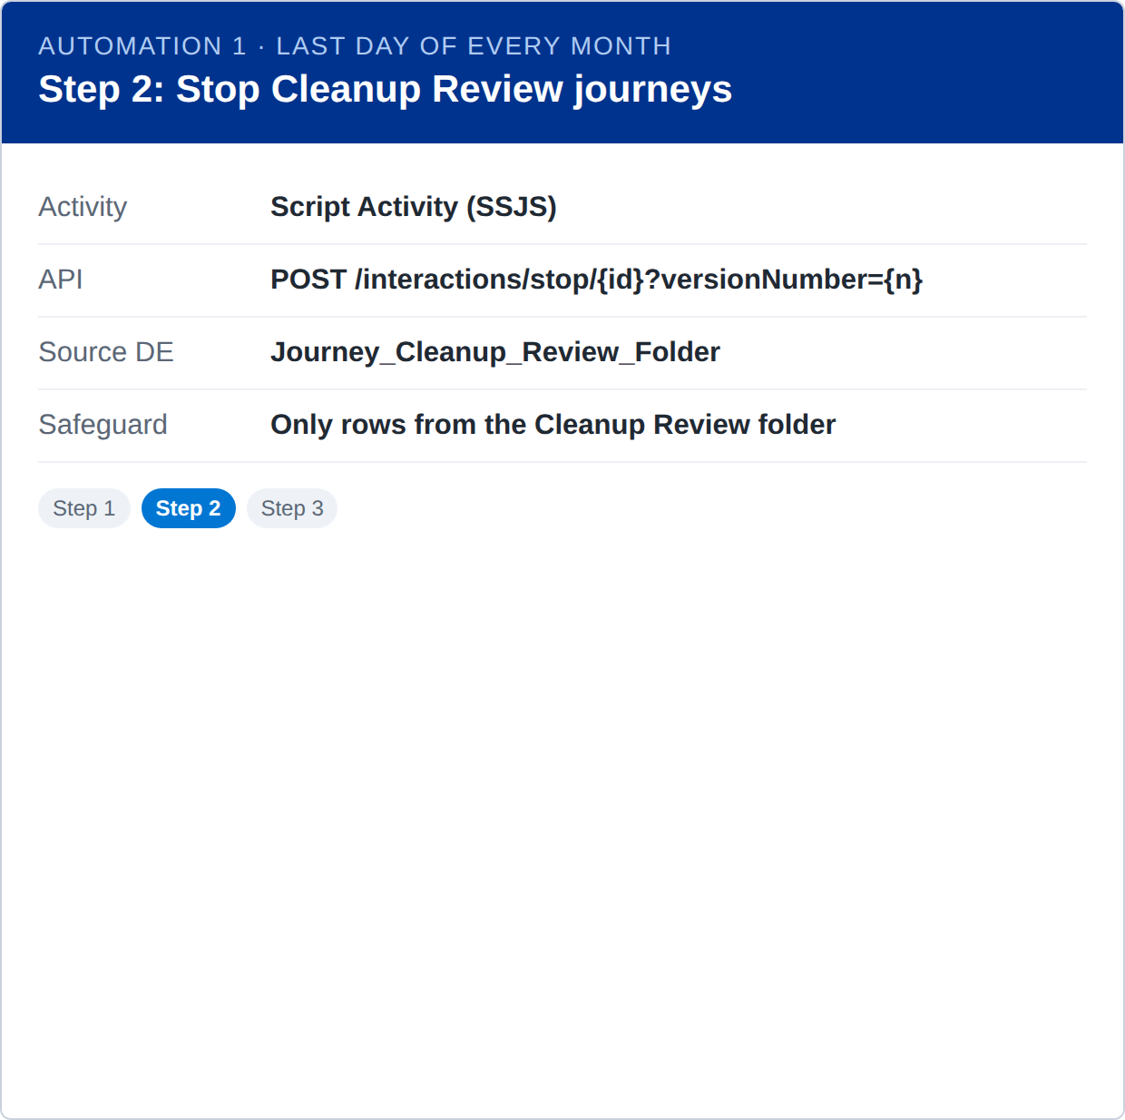
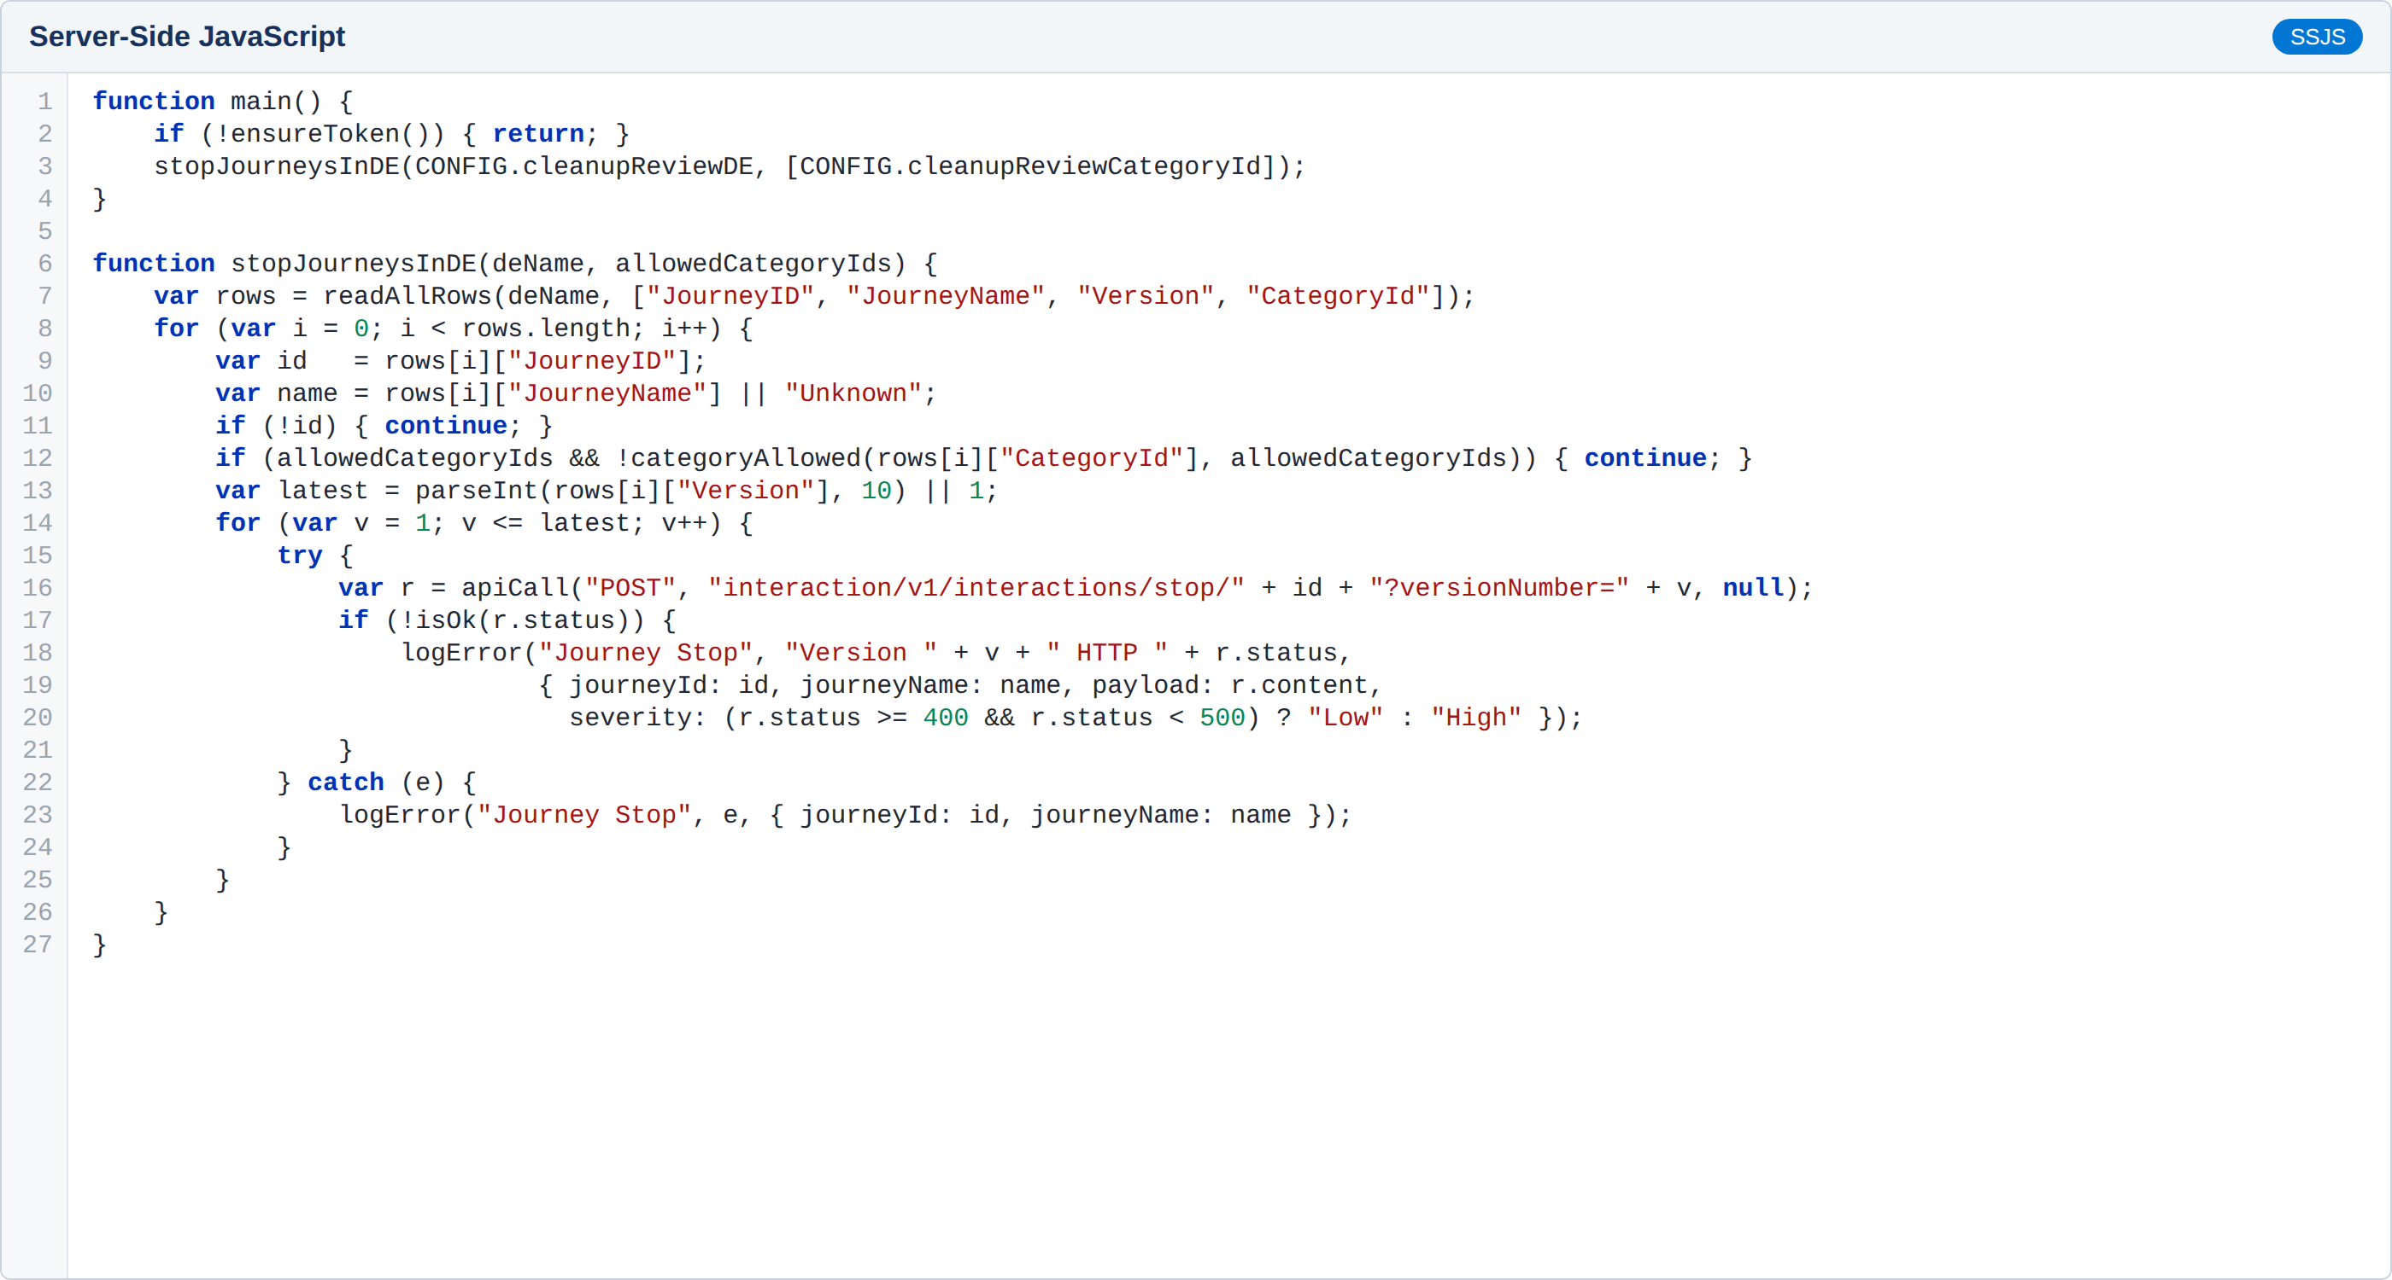
Automation changes or additions
Automation 1 – Step 2: Stop every version of every journey listed in Journey_Cleanup_Review_Folder (Scenario 3). 4xx responses for versions that are not running are logged as Low severity.

Slide 16
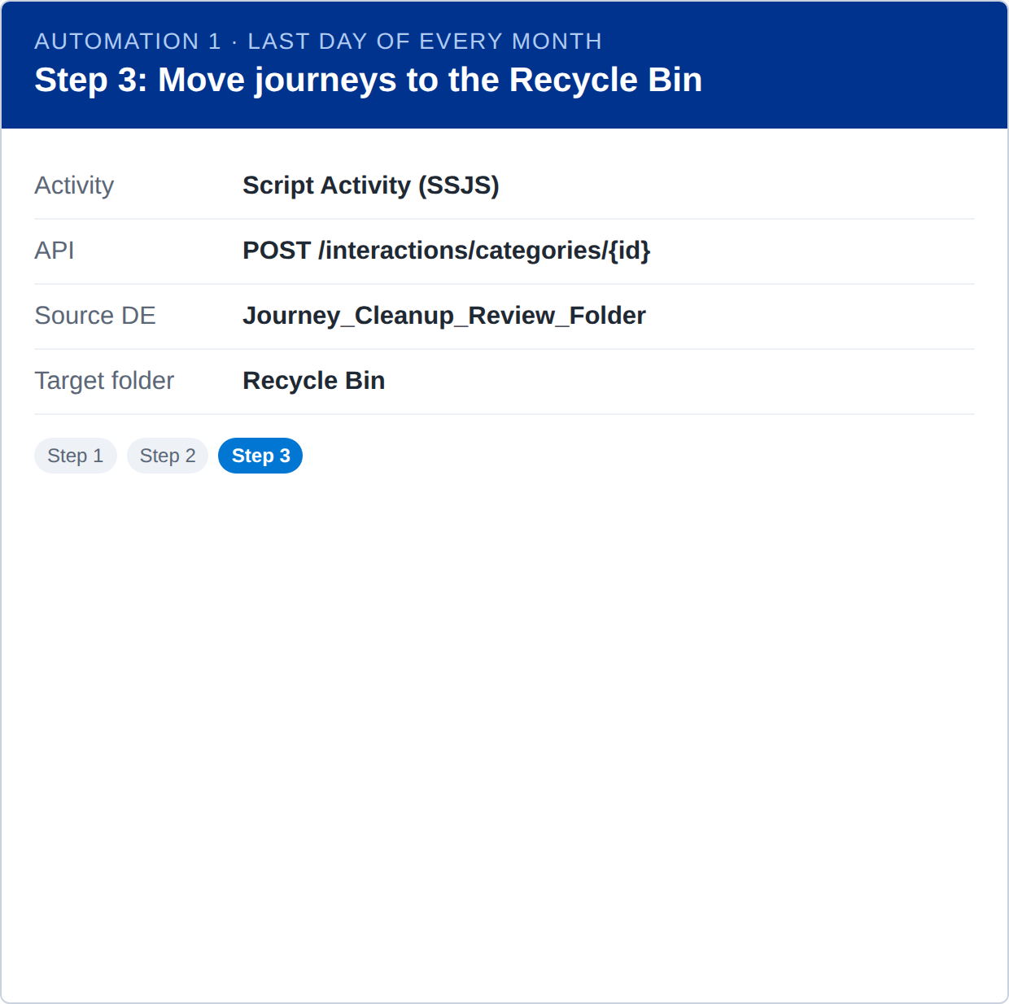
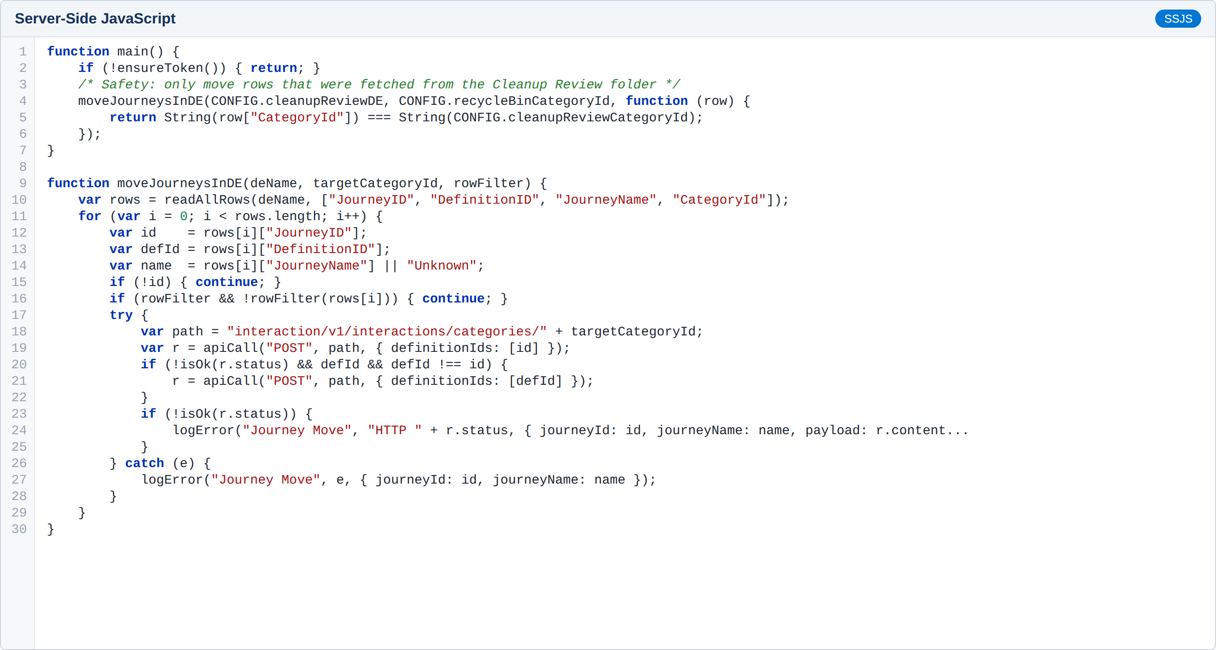
Automation changes or additions
Automation 1 – Step 3: Move the same journeys from the Journey Cleanup Review folder to the Recycle Bin folder using the Journey Builder categories API (Scenario 3). No notification is required for this scenario.

Slide 17
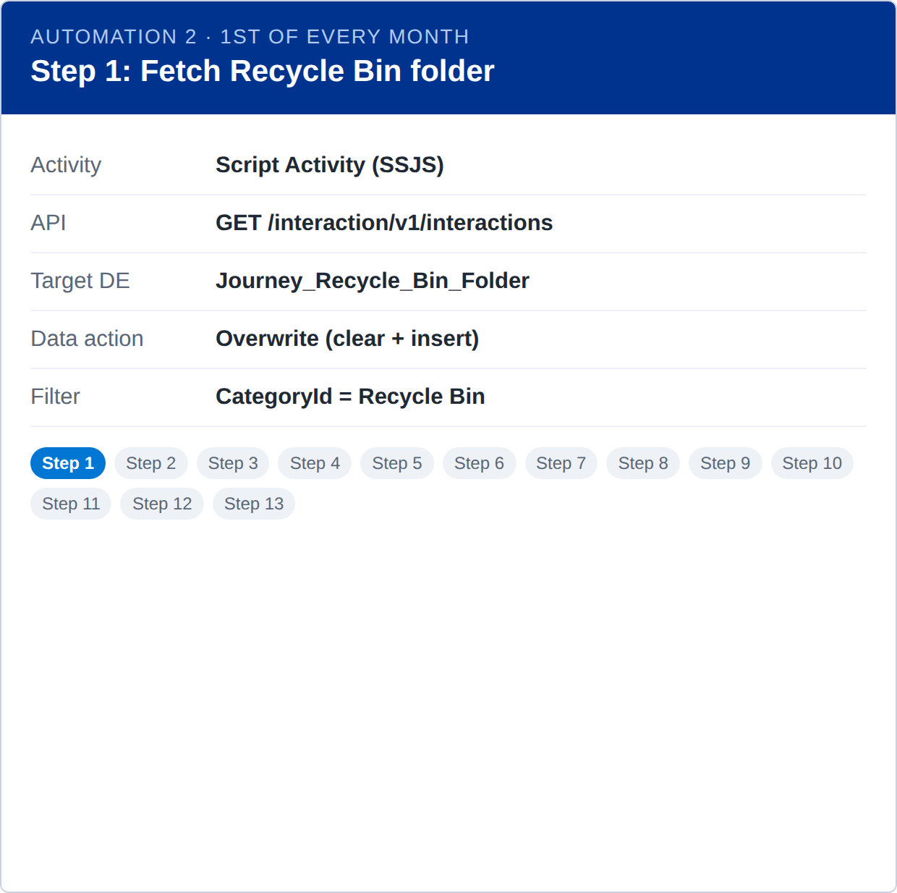
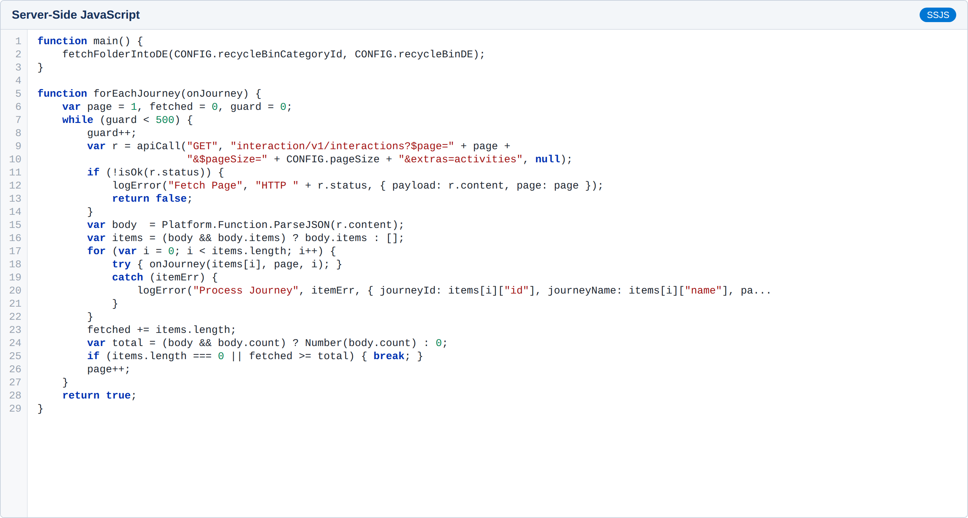
Automation changes or additions
Automation 2 – Step 1: Live REST fetch of every journey currently in the Recycle Bin folder into Journey_Recycle_Bin_Folder — the first action of the month.

Slide 18
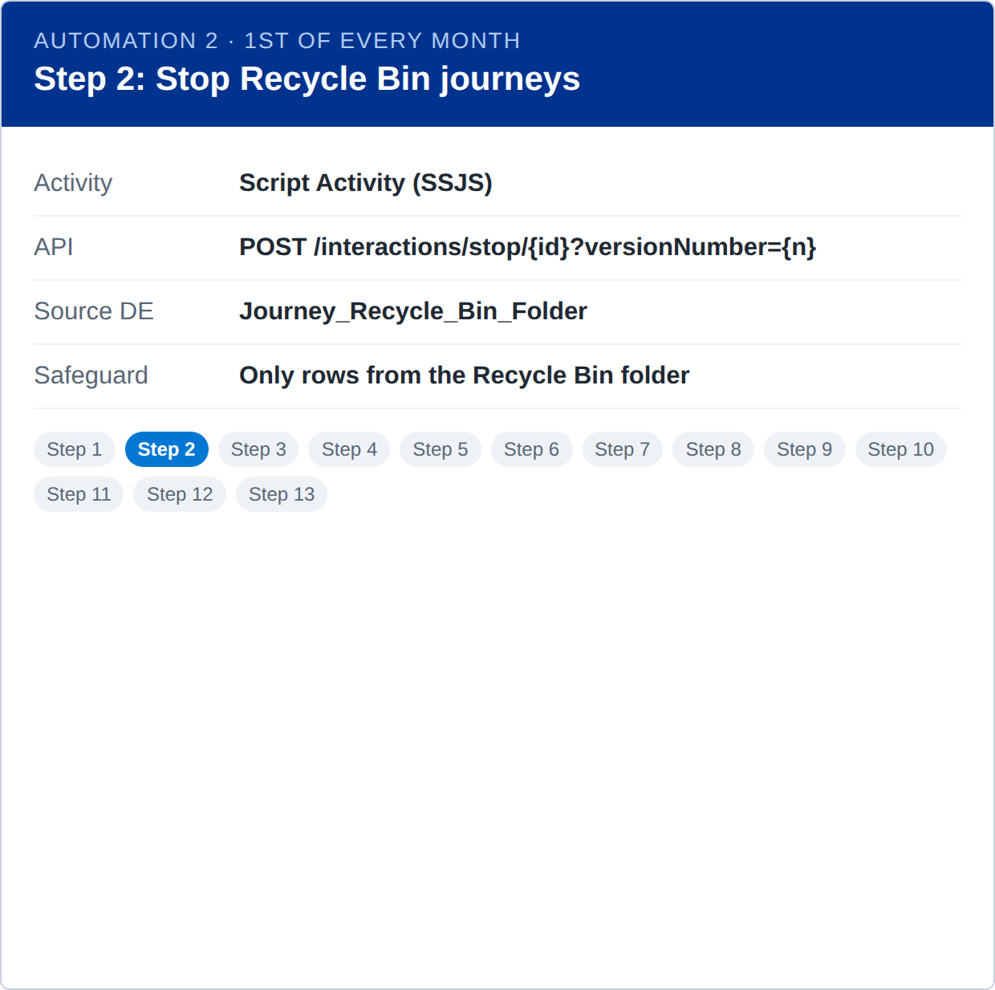

Automation changes or additions
Automation 2 – Step 2: Stop every version of every journey listed in Journey_Recycle_Bin_Folder, ahead of deletion (Scenario 4).

Slide 19
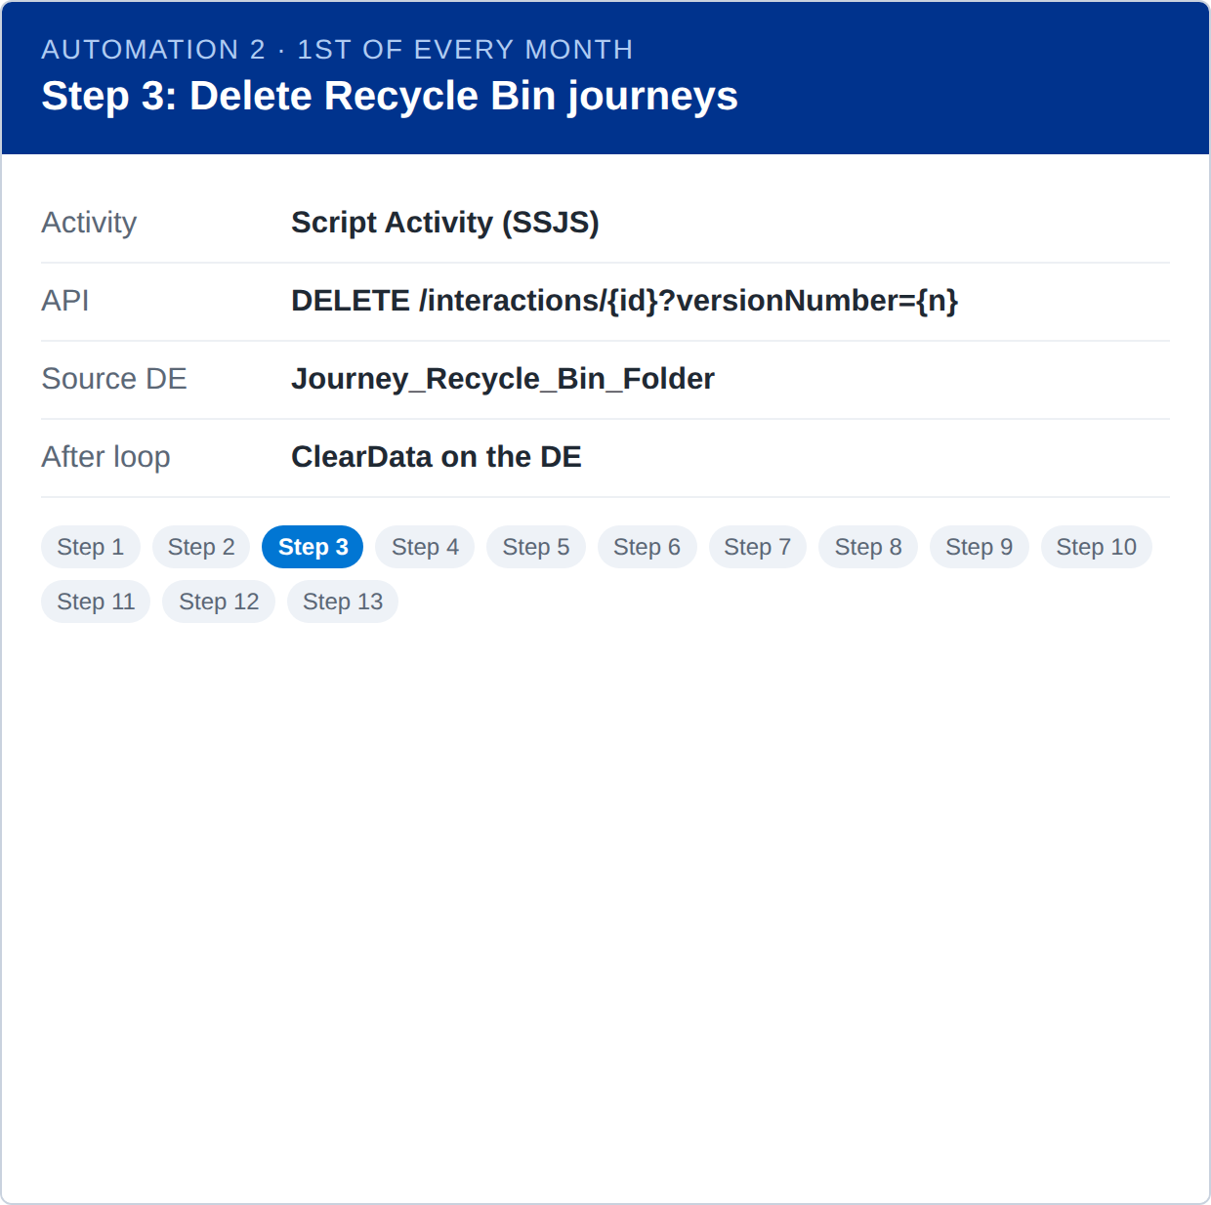
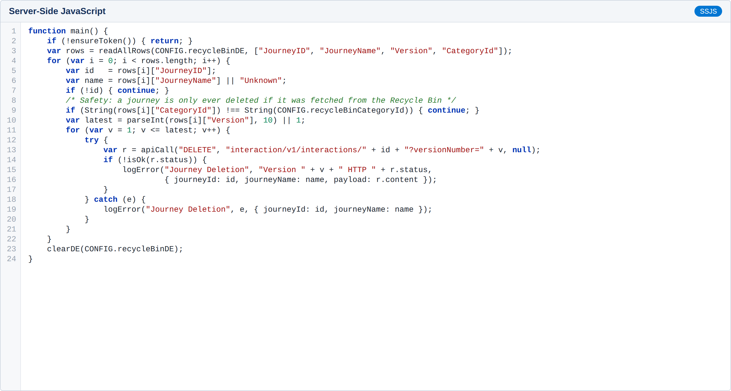
Automation changes or additions
Automation 2 – Step 3: Delete every version of every journey in Journey_Recycle_Bin_Folder, then clear the DE (Scenario 4). A journey is only deleted if its CategoryId is the Recycle Bin folder.

Slide 20
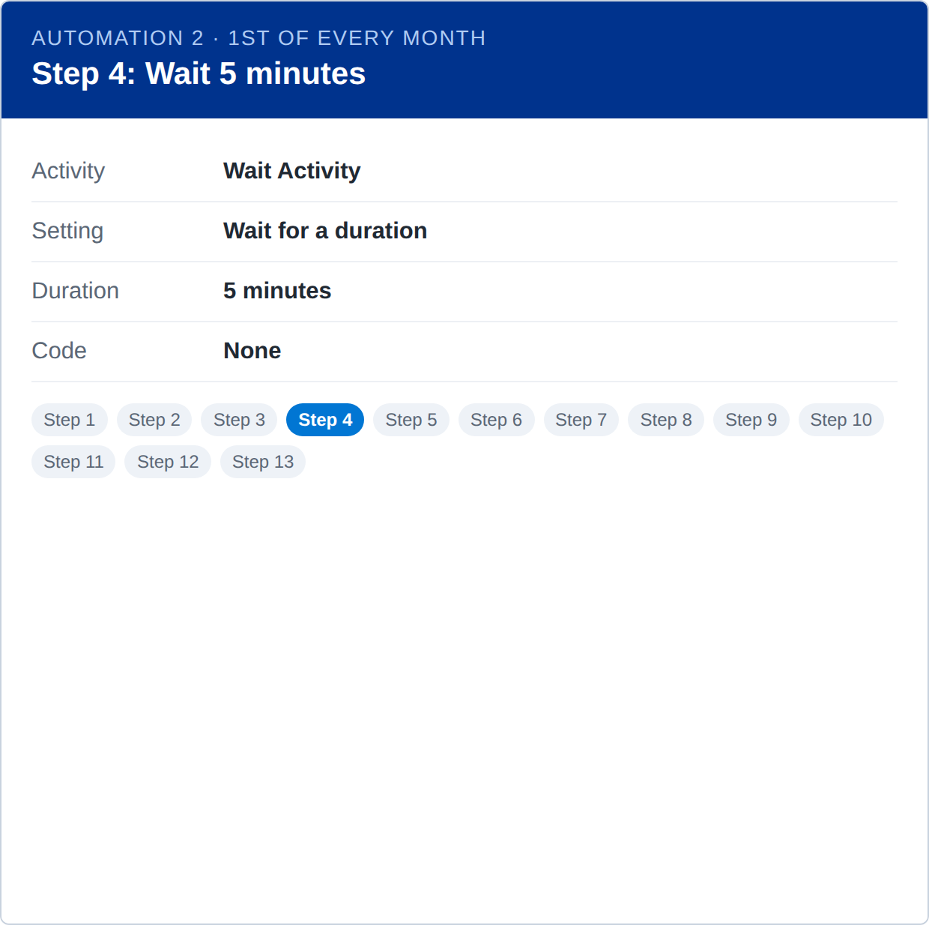
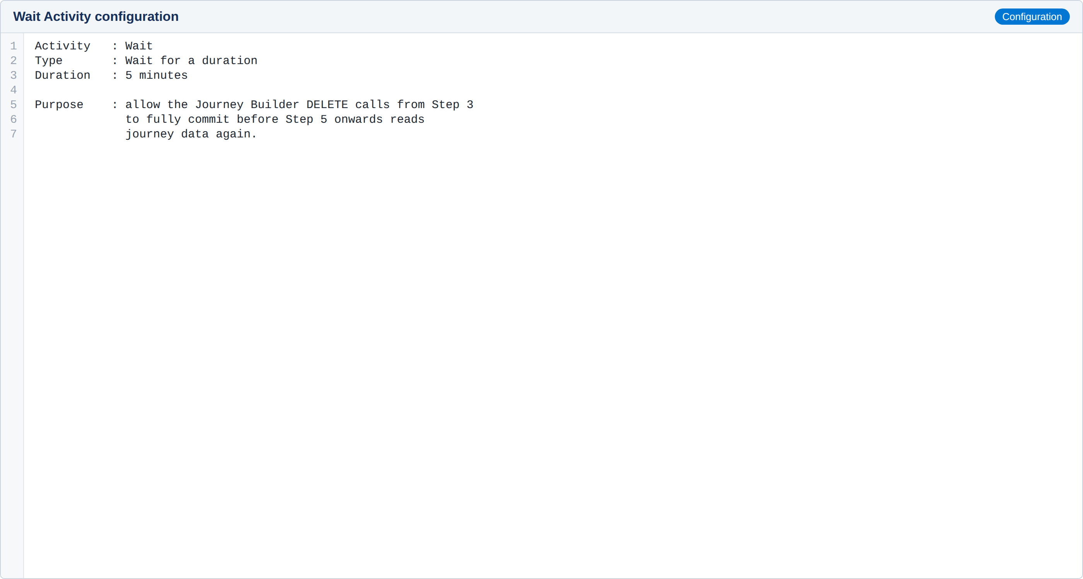
Automation changes or additions
Automation 2 – Step 4: Native Wait Activity that gives the DELETE calls from Step 3 time to commit before journey data is read again.

Slide 21
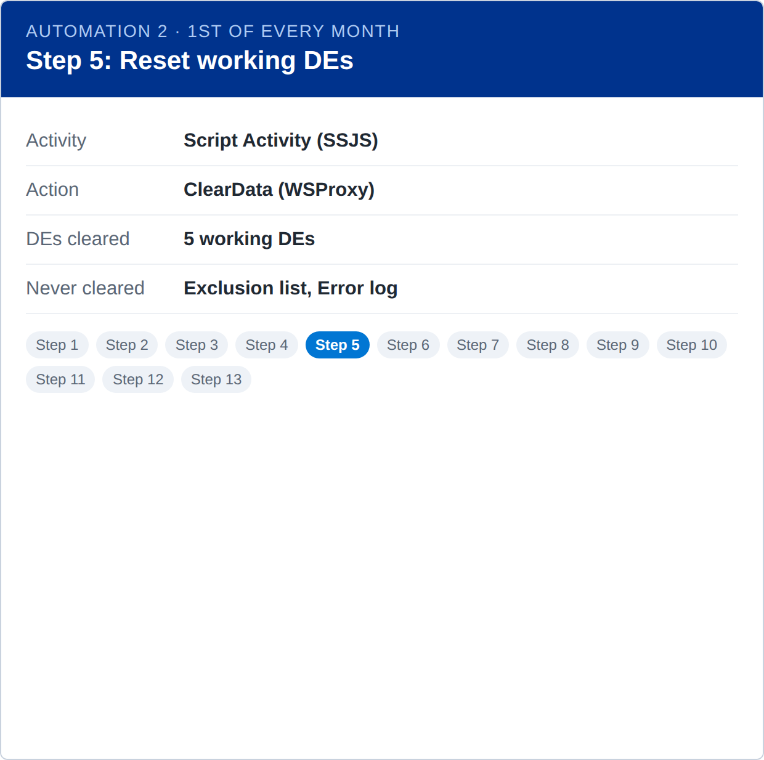
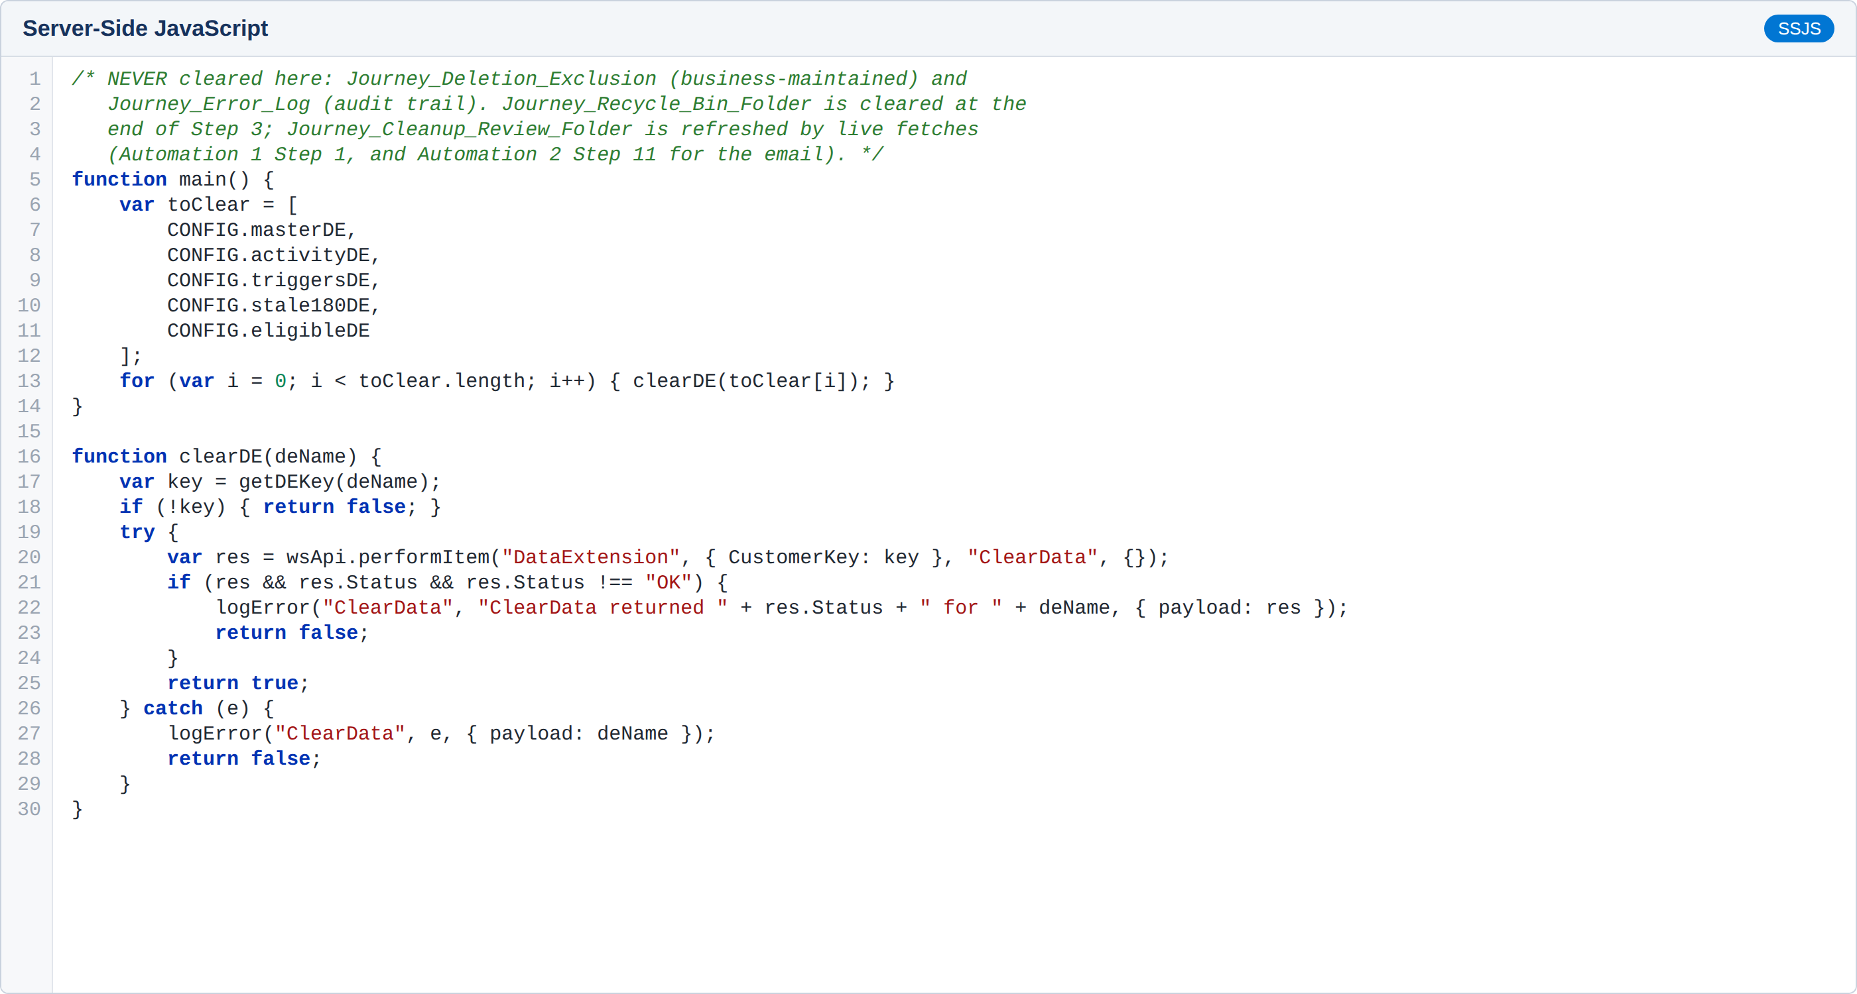
Automation changes or additions
Automation 2 – Step 5: Clear the working Data Extensions so last month's rows never leak into this month's results. Journey_Deletion_Exclusion and Journey_Error_Log are never cleared.

Slide 22
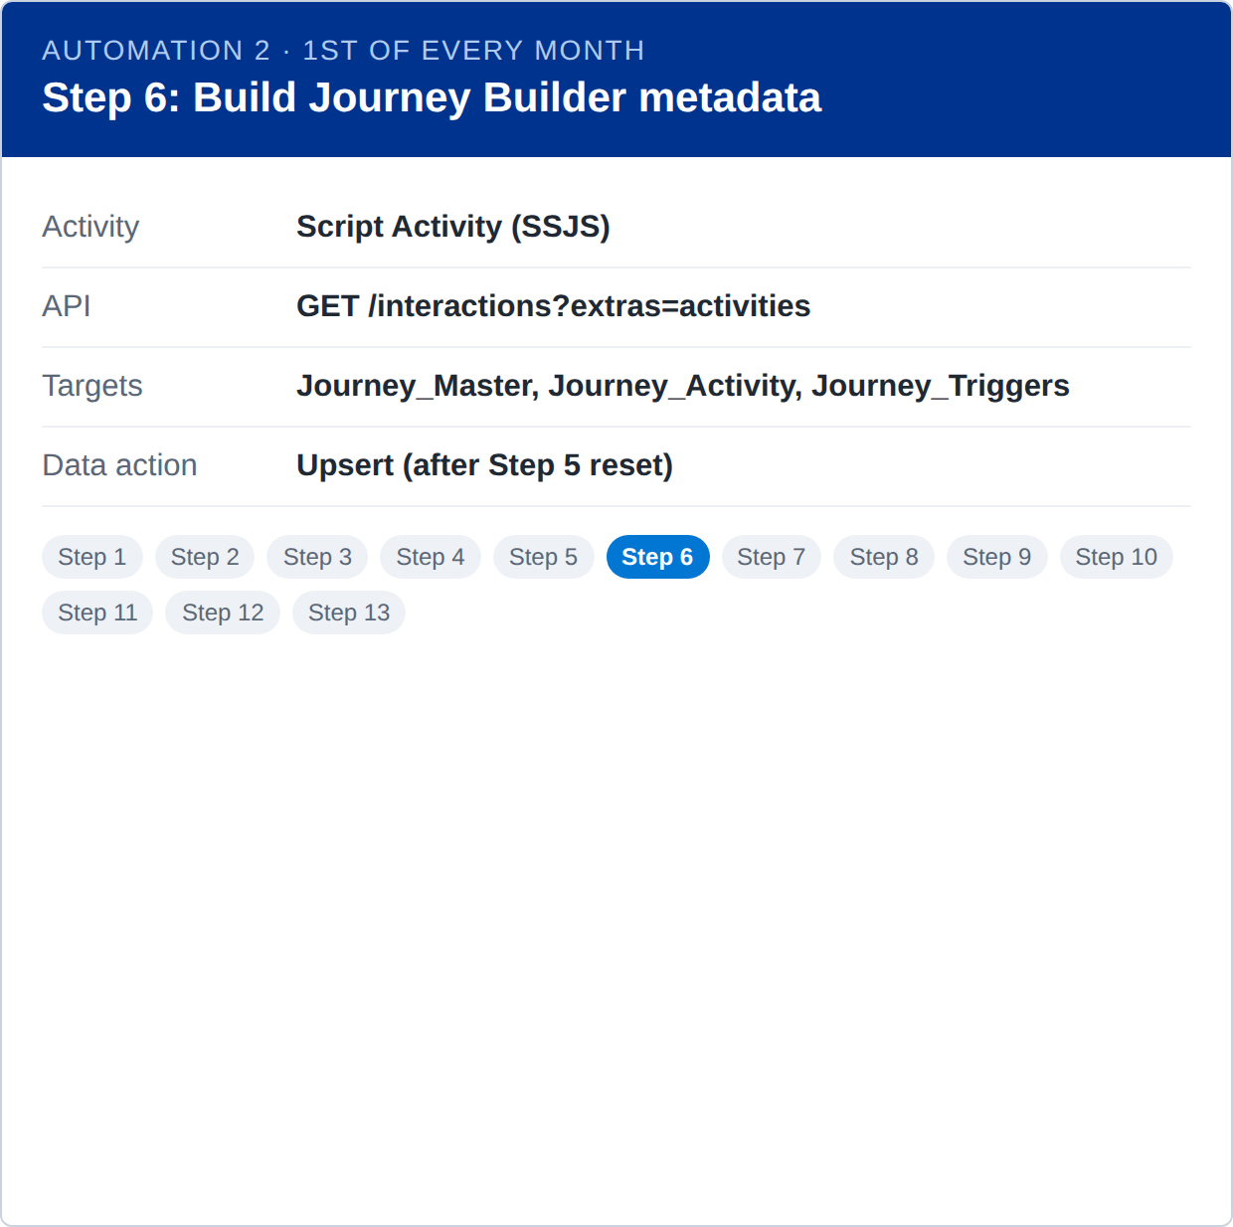
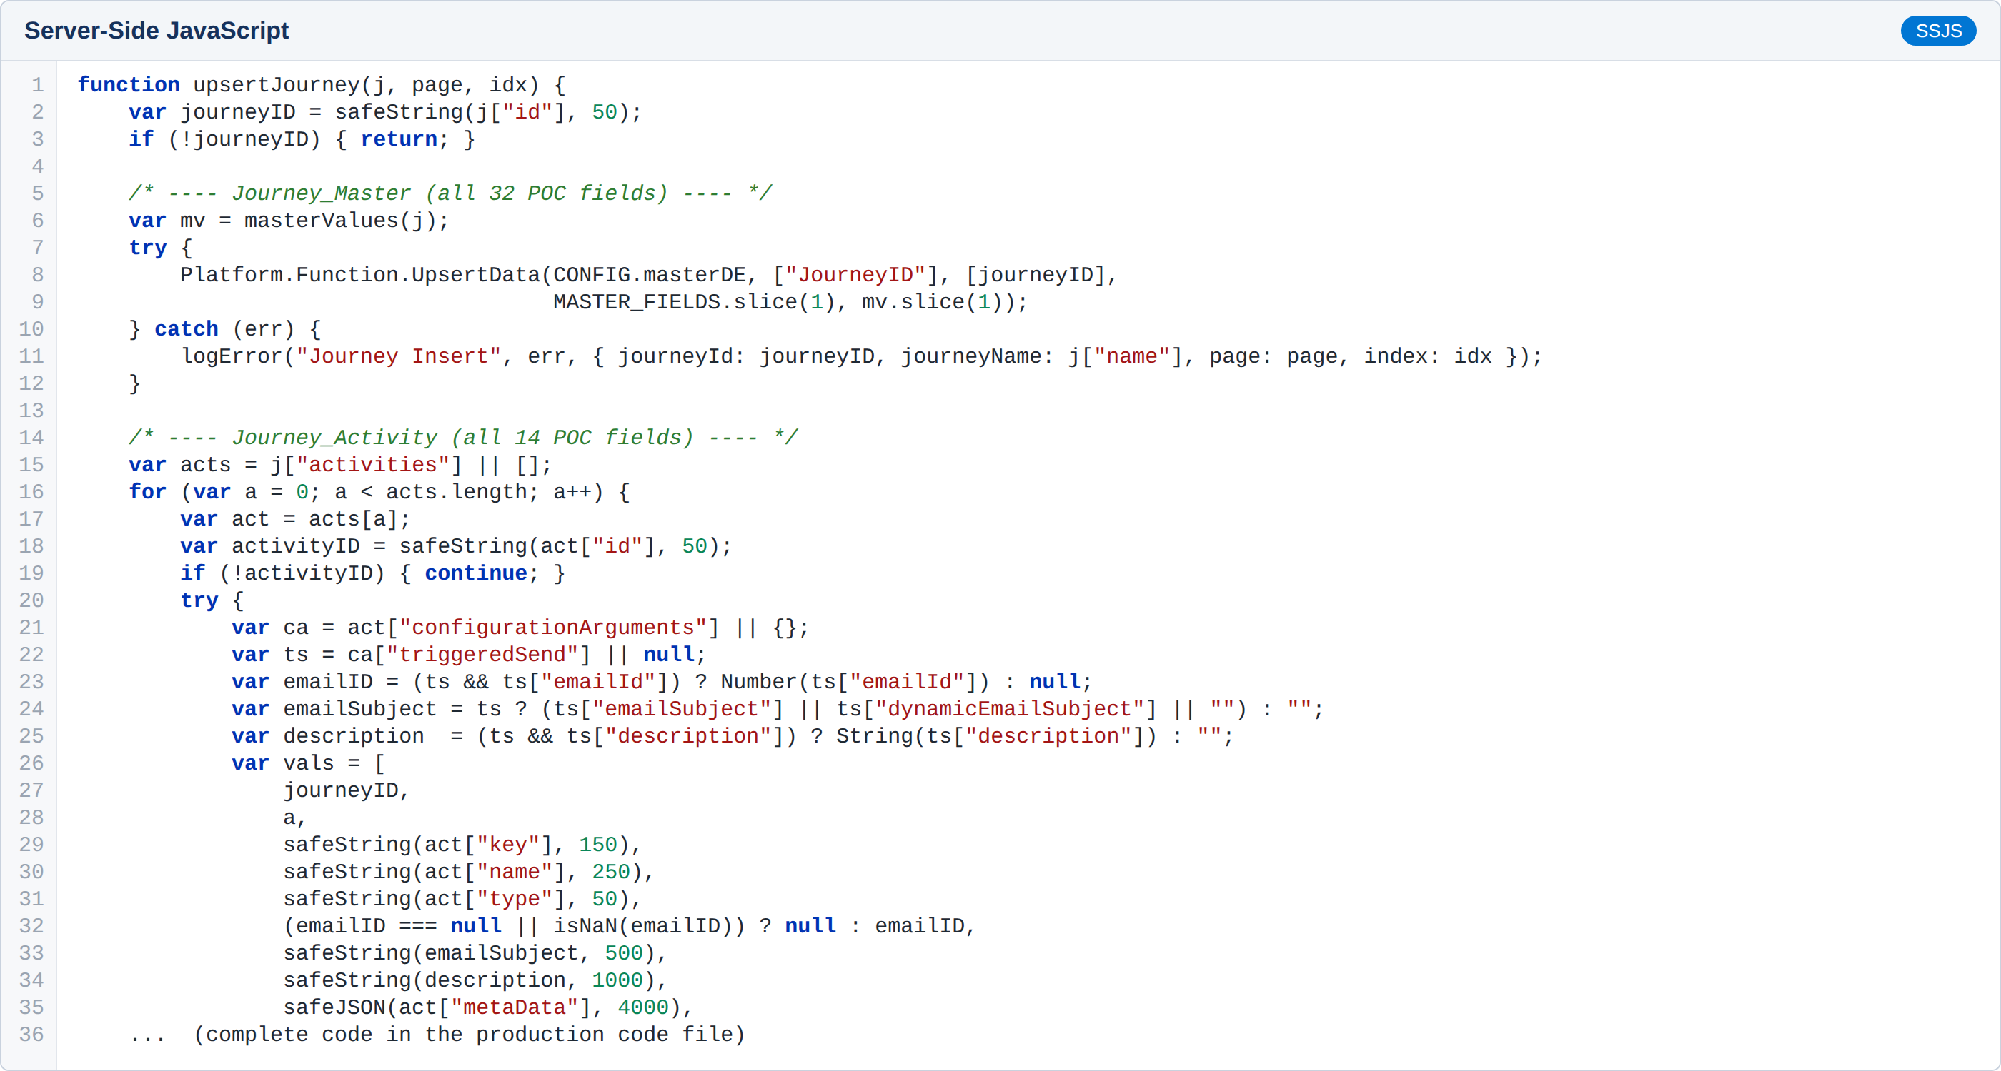
Automation changes or additions
Automation 2 – Step 6: Page through every journey via the REST API and upsert Journey_Master, Journey_Activity and Journey_Triggers with the full POC field sets.

Slide 23
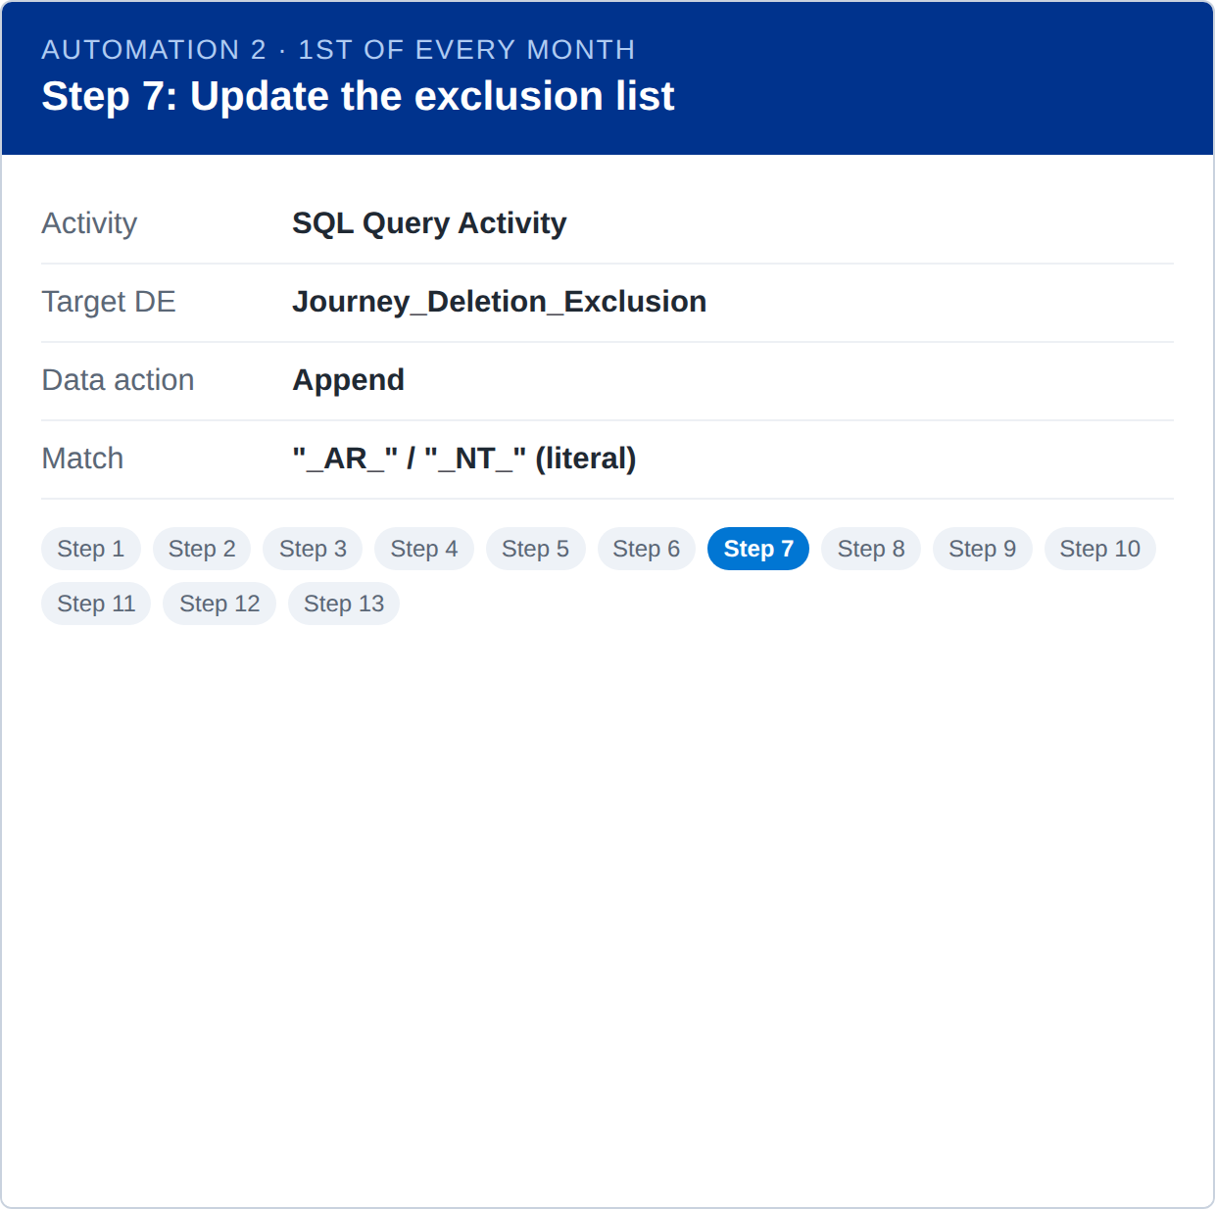
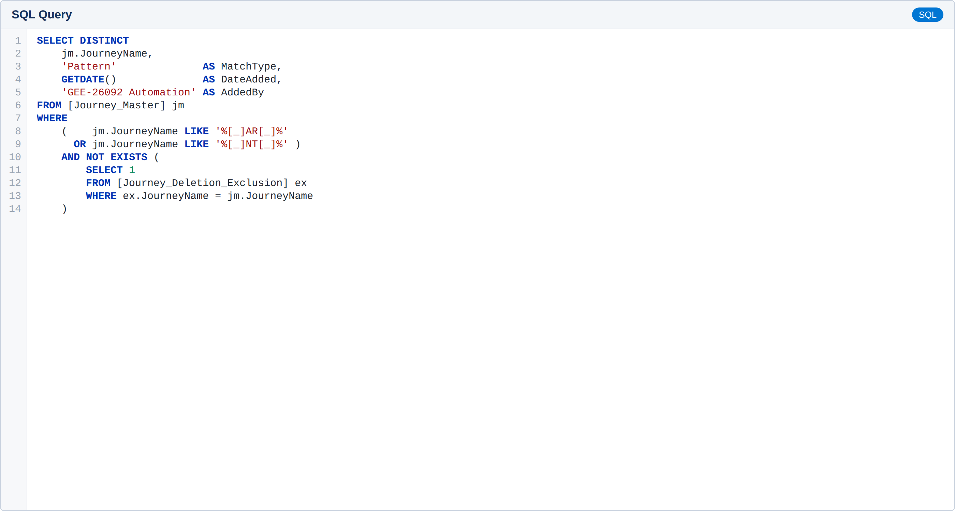
Automation changes or additions
Automation 2 – Step 7: Append every journey whose name contains "_AR_" or "_NT_" to Journey_Deletion_Exclusion (Scenario 1). Rows added manually by the business are never changed.

Slide 24
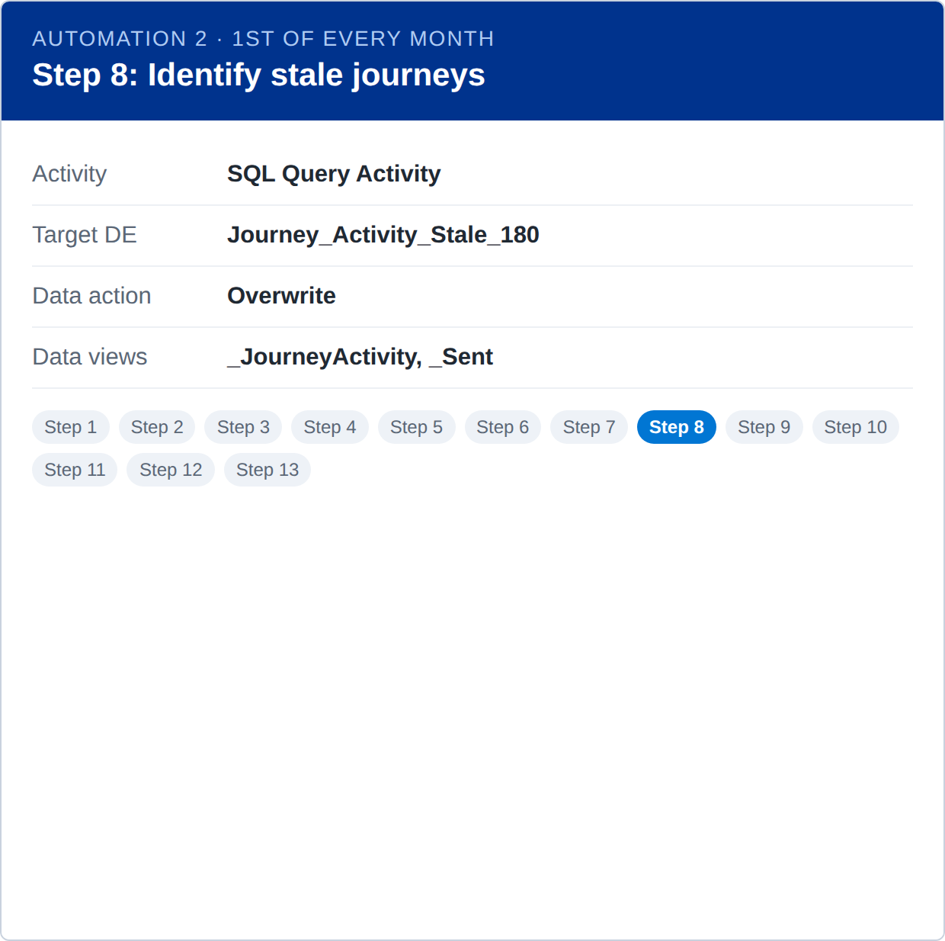
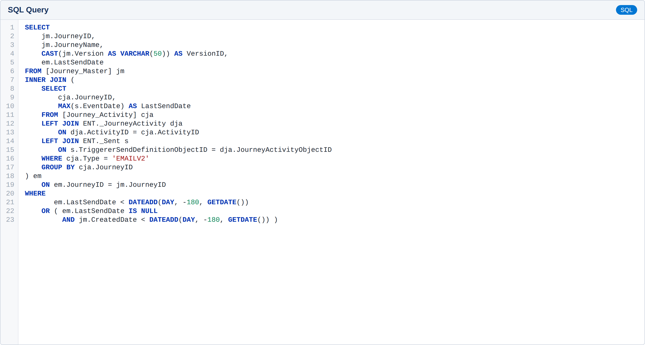
Automation changes or additions
Automation 2 – Step 8: Find journeys with at least one email activity whose latest send is older than 180 days (or that never sent and were created over 180 days ago). Every trigger type is in scope.

Slide 25
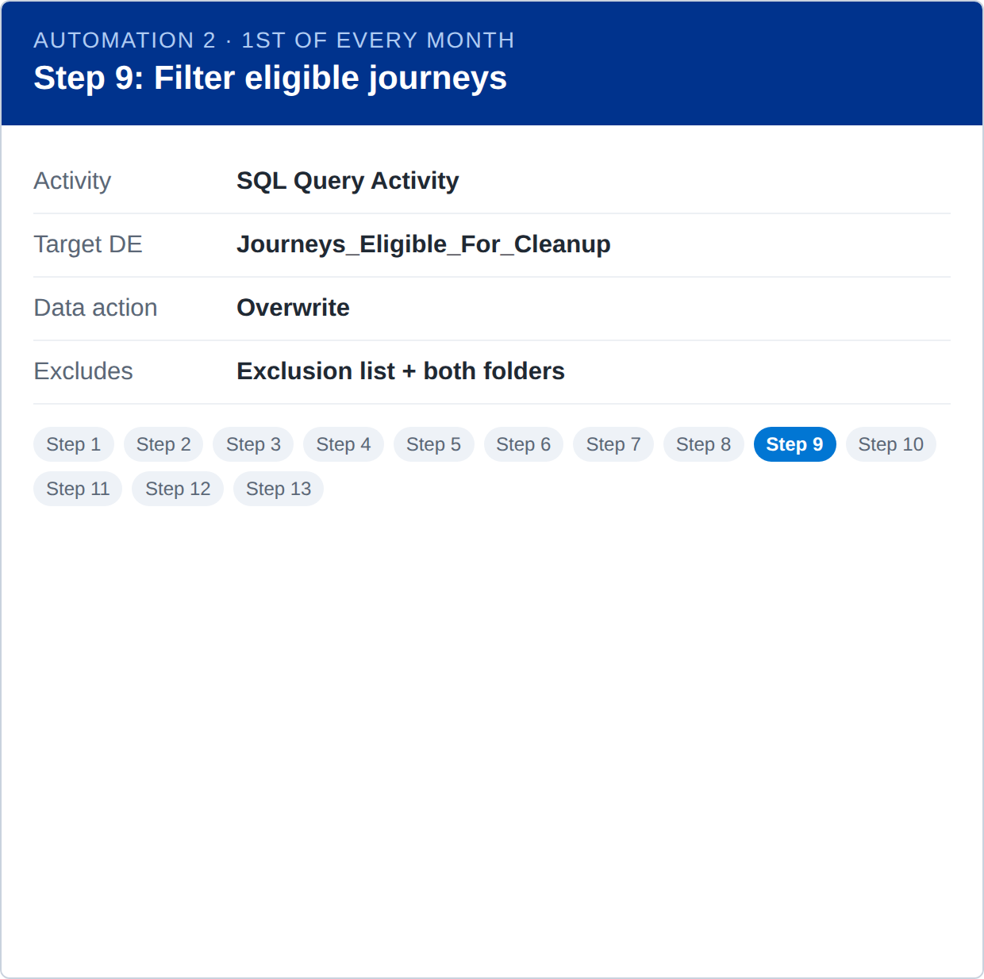
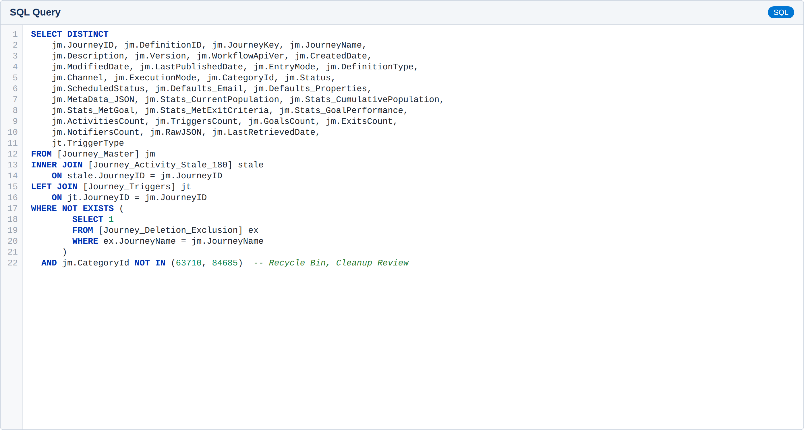
Automation changes or additions
Automation 2 – Step 9: Remove every journey in Journey_Deletion_Exclusion and any journey already in the Recycle Bin or Cleanup Review folder. Output has the POC structure plus TriggerType.

Slide 26
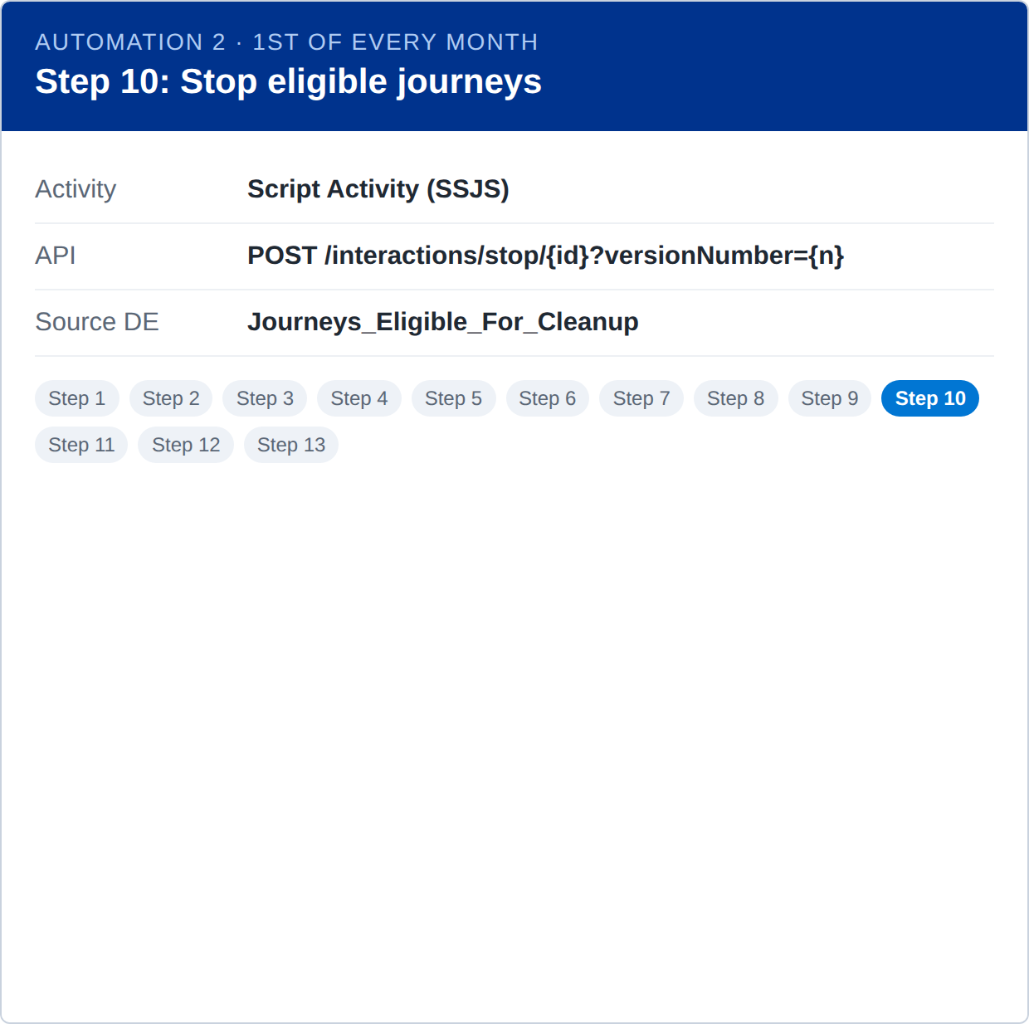
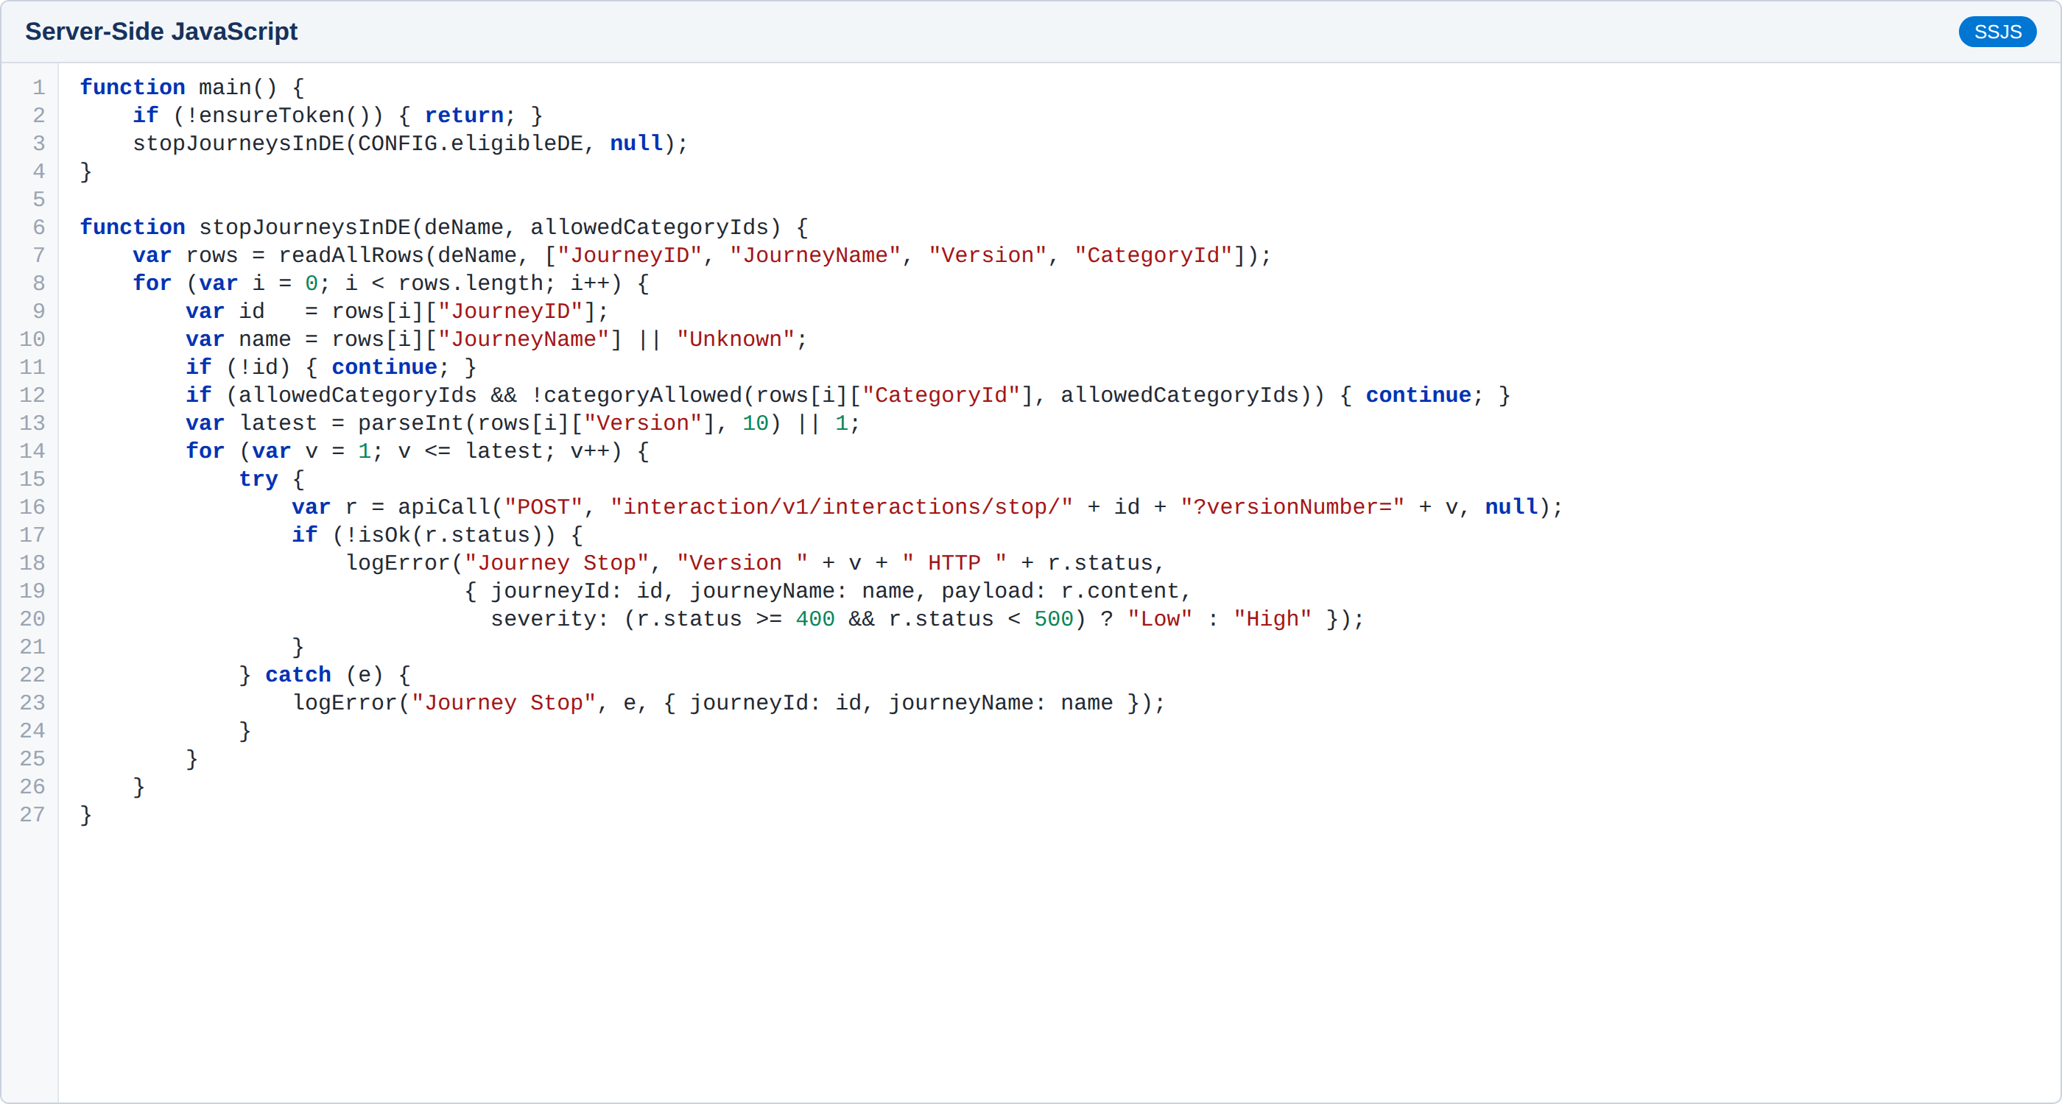
Automation changes or additions
Automation 2 – Step 10: Stop every version of every journey in Journeys_Eligible_For_Cleanup before it is moved (Scenario 2).

Slide 27
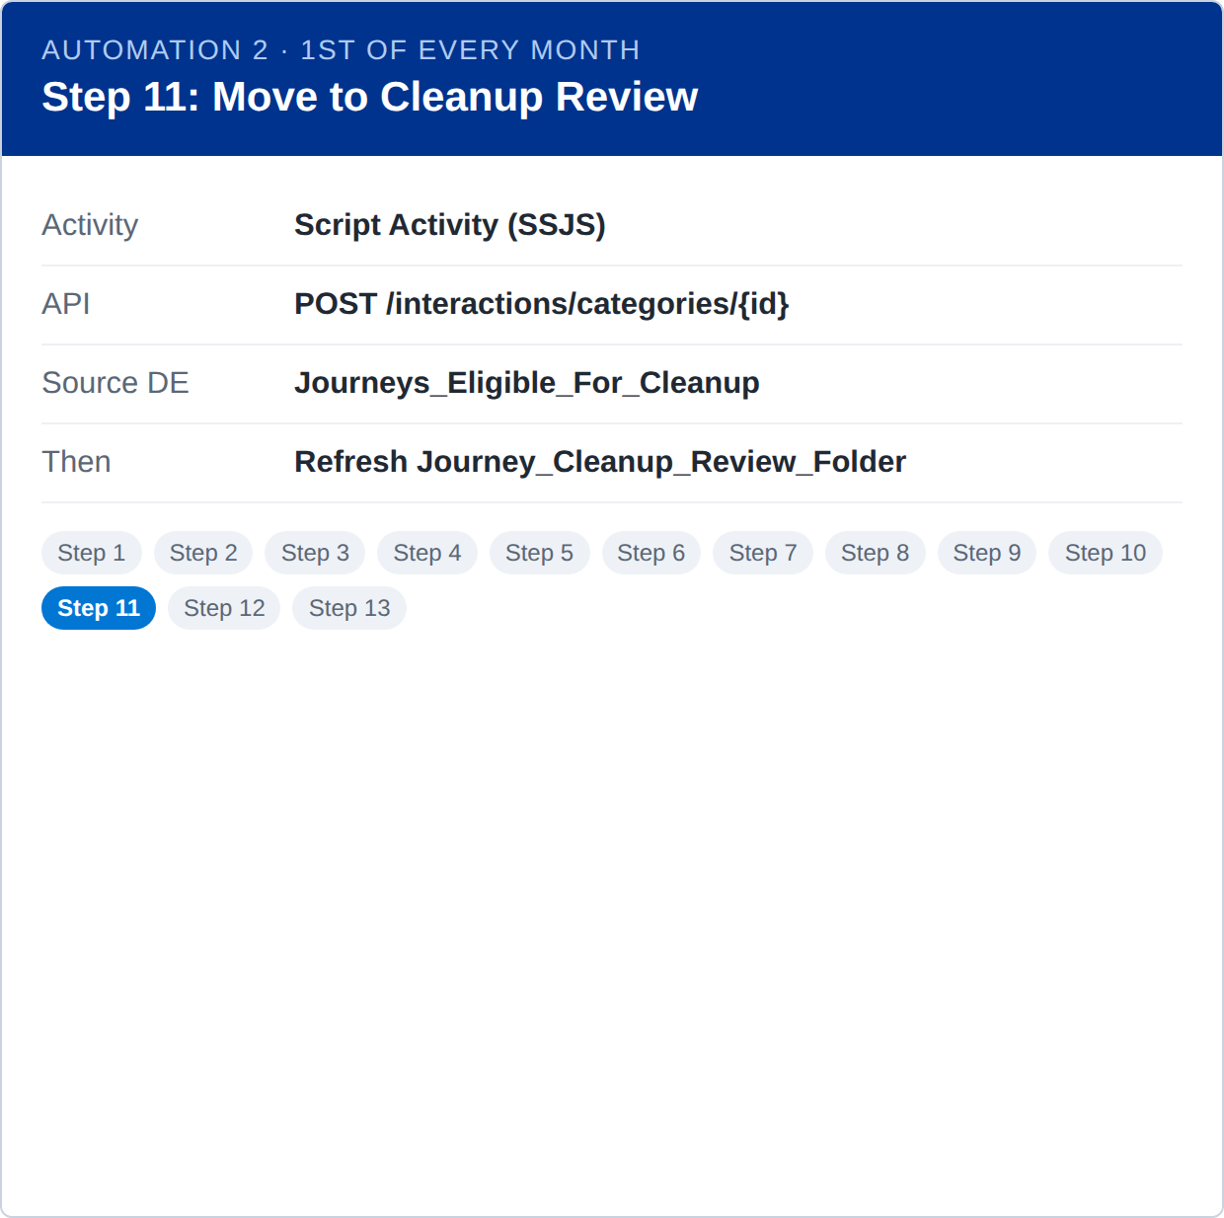
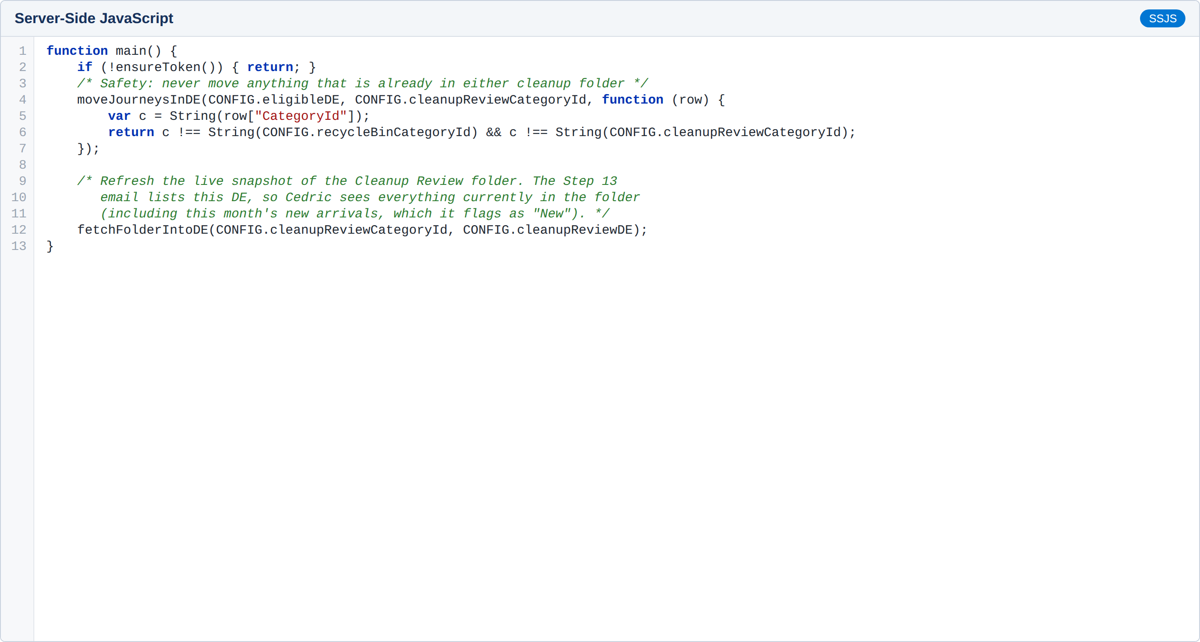
Automation changes or additions
Automation 2 – Step 11: Move the eligible journeys to the Journey Cleanup Review folder (Scenario 2), then refresh Journey_Cleanup_Review_Folder, which the Step 13 email reads.

Slide 28
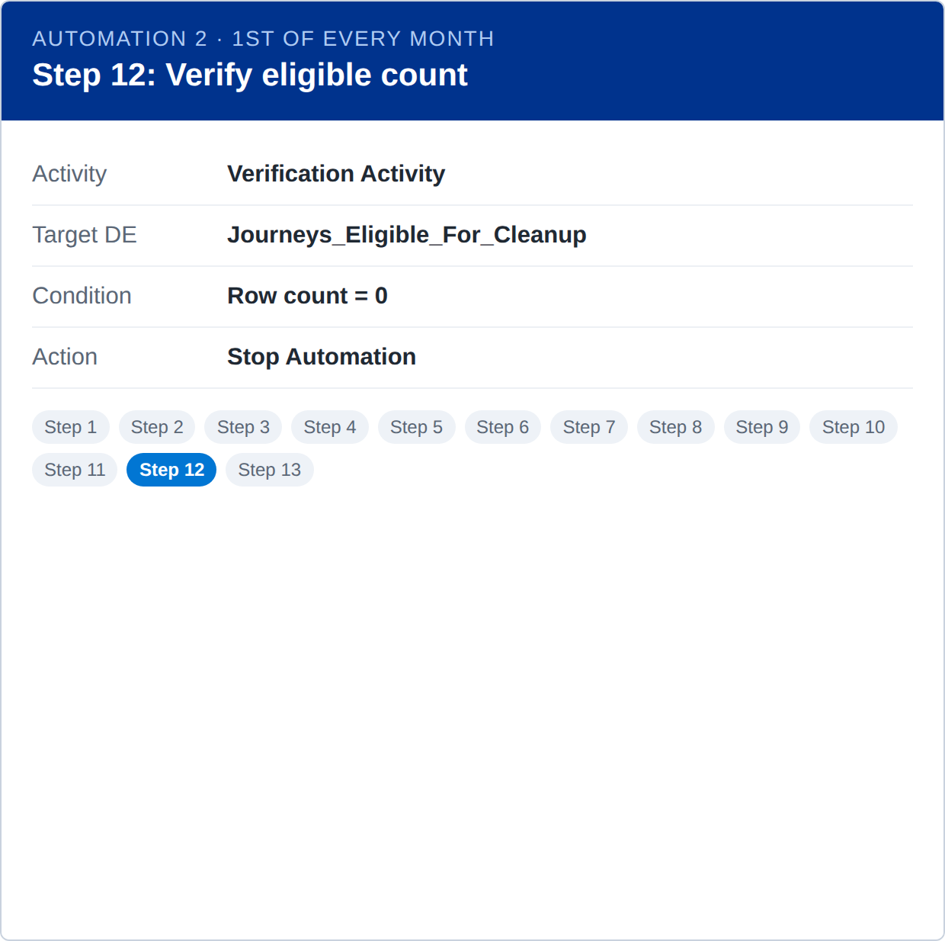

Automation changes or additions
Automation 2 – Step 12: Verification Activity: if Journeys_Eligible_For_Cleanup has 0 rows the automation stops, so no empty email is sent (same pattern as the POC).

Slide 29
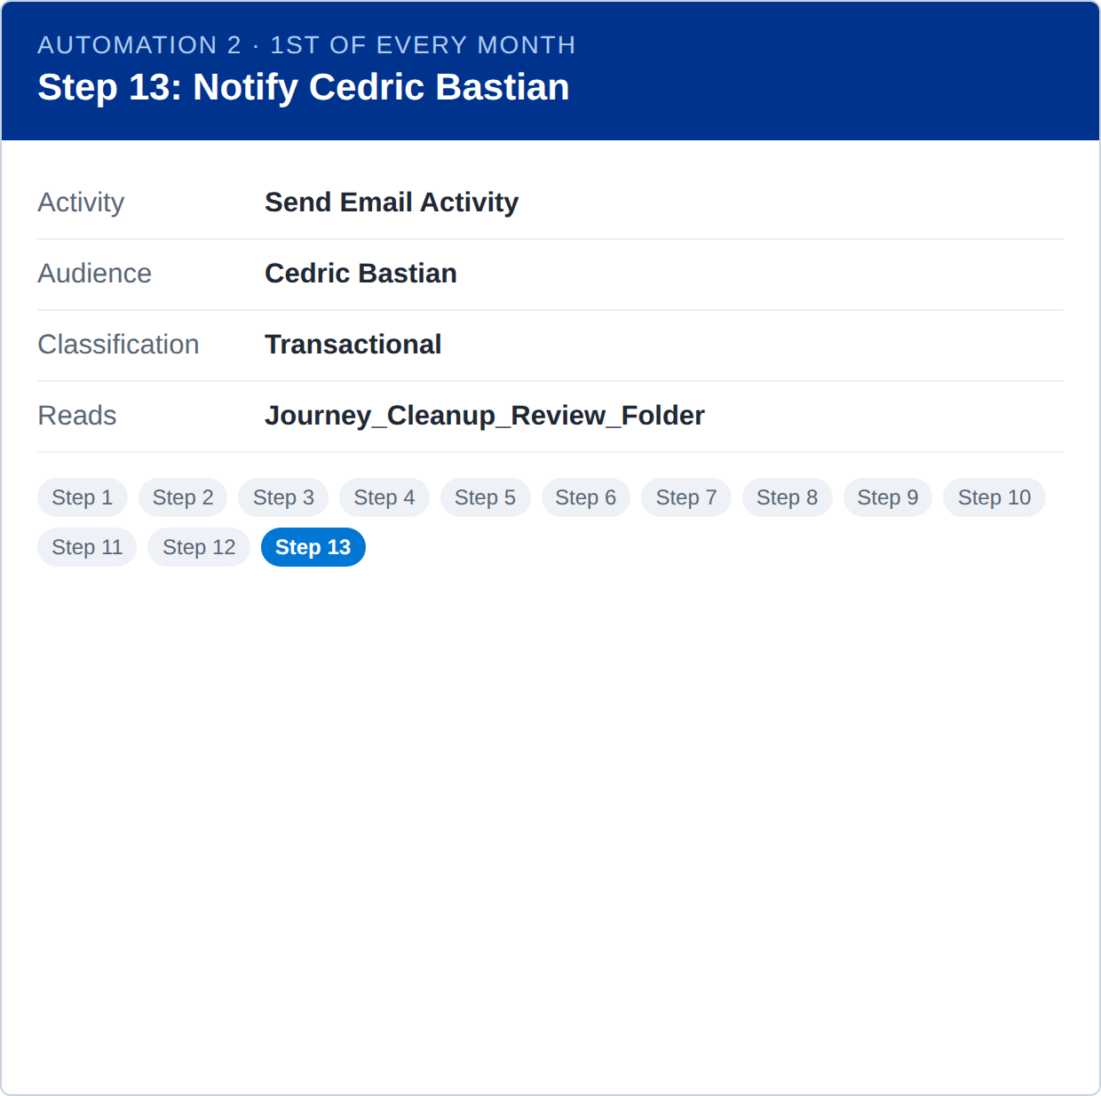
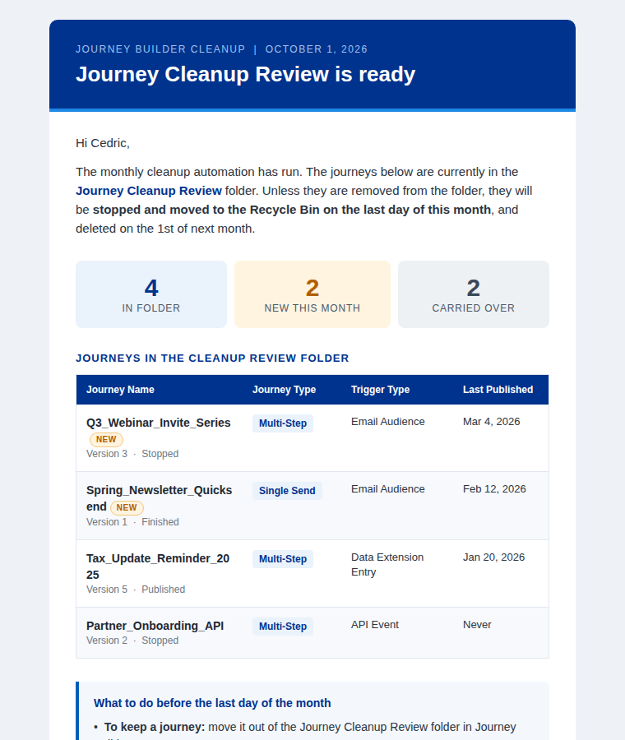
Automation changes or additions
Automation 2 – Step 13: Send Email Activity to Cedric Bastian listing the Cleanup Review folder (Journey Name, Journey Type, Trigger Type, Last Published) with new journeys flagged.

Slide 30
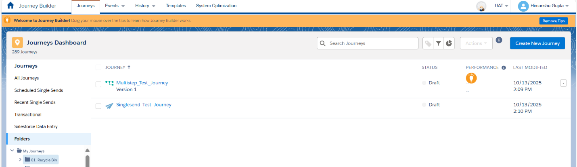
Test Data
POC run (UAT): The Journey Builder Recycle Bin folder contains 2 journeys before execution (Multistep_Test_Journey and Singlesend_Test_Journey).

Slide 31
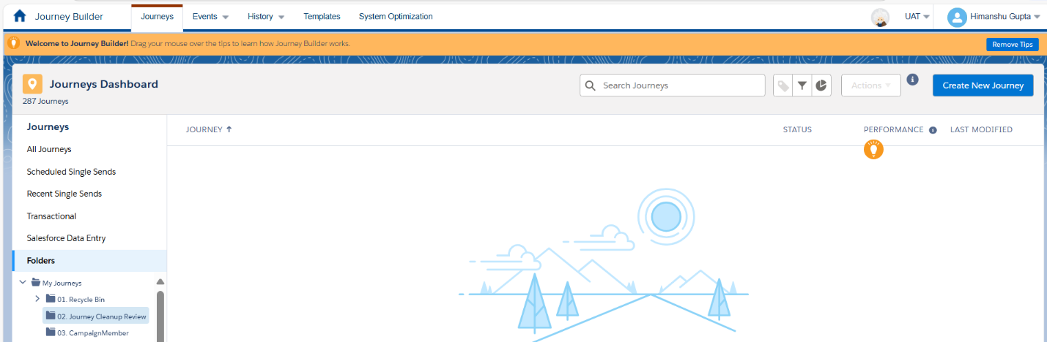
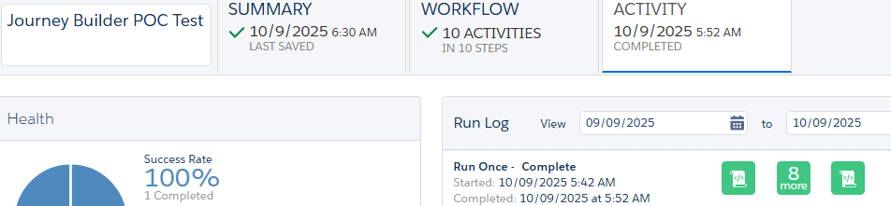
Test Data
POC run (UAT): The Journey Cleanup Review folder contains no journeys before execution, and the automation completed successfully (10 activities, 100% success).

Slide 32
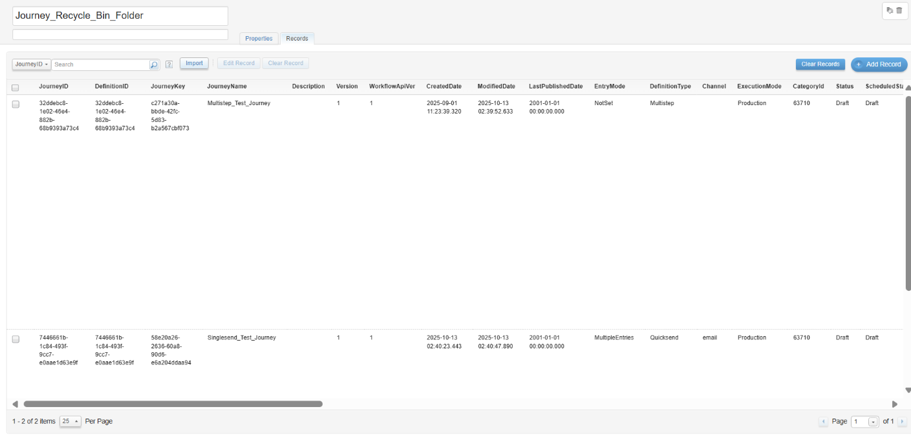
Test Results
Journey_Recycle_Bin_Folder: The Data Extension shows the 2 journeys fetched from the Recycle Bin folder before deletion.

Slide 33
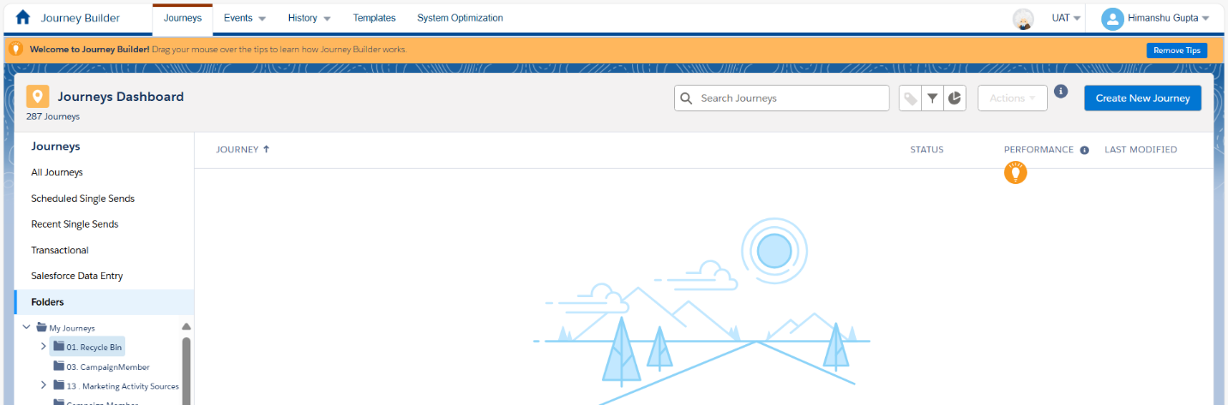
Test Results
Recycle Bin folder after execution: Both journeys were stopped and deleted; the Recycle Bin folder is now empty (Scenario 4).

Slide 34
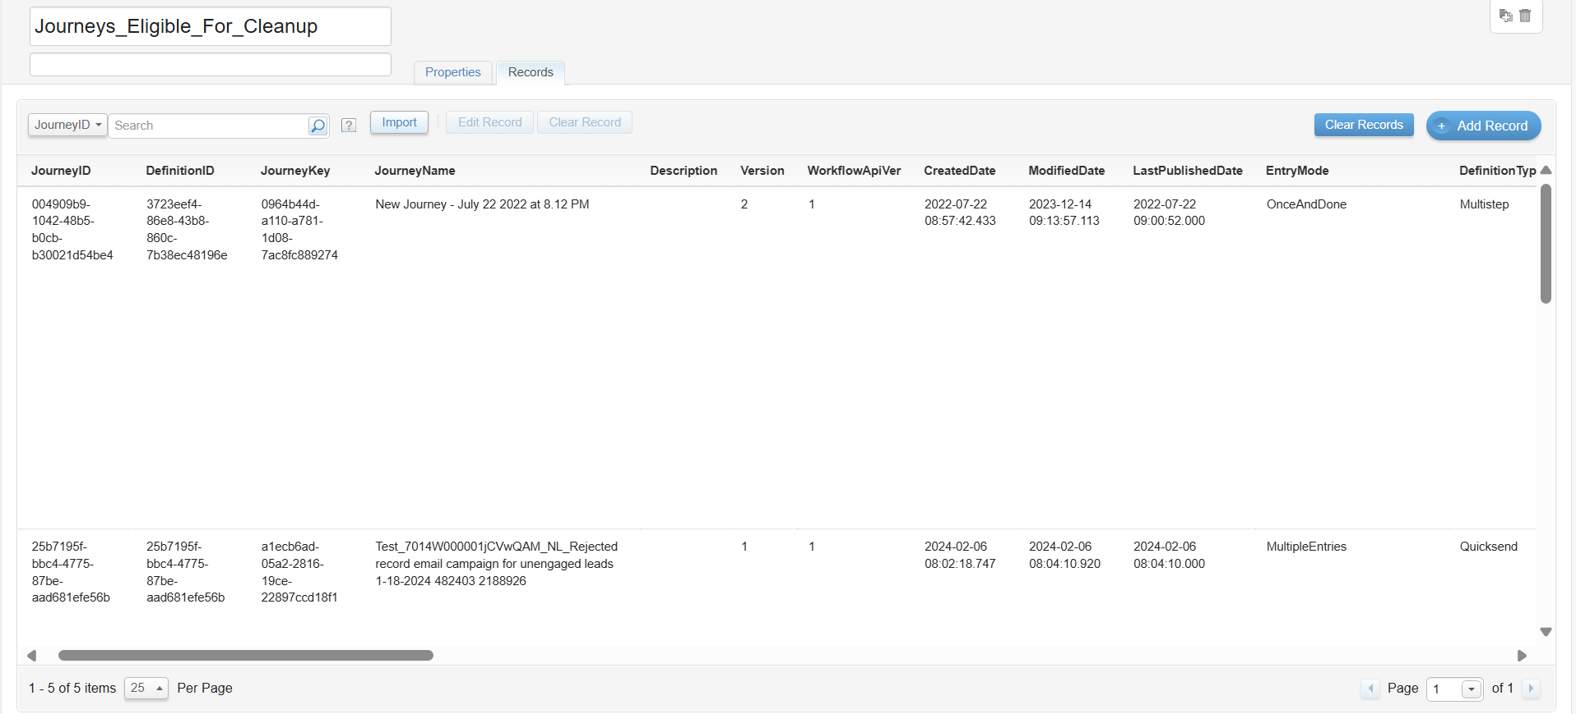
Test Results
Journeys_Eligible_For_Cleanup: The Data Extension shows 5 journeys identified as eligible for cleanup (no email send in the last 180 days, not excluded).

Slide 35
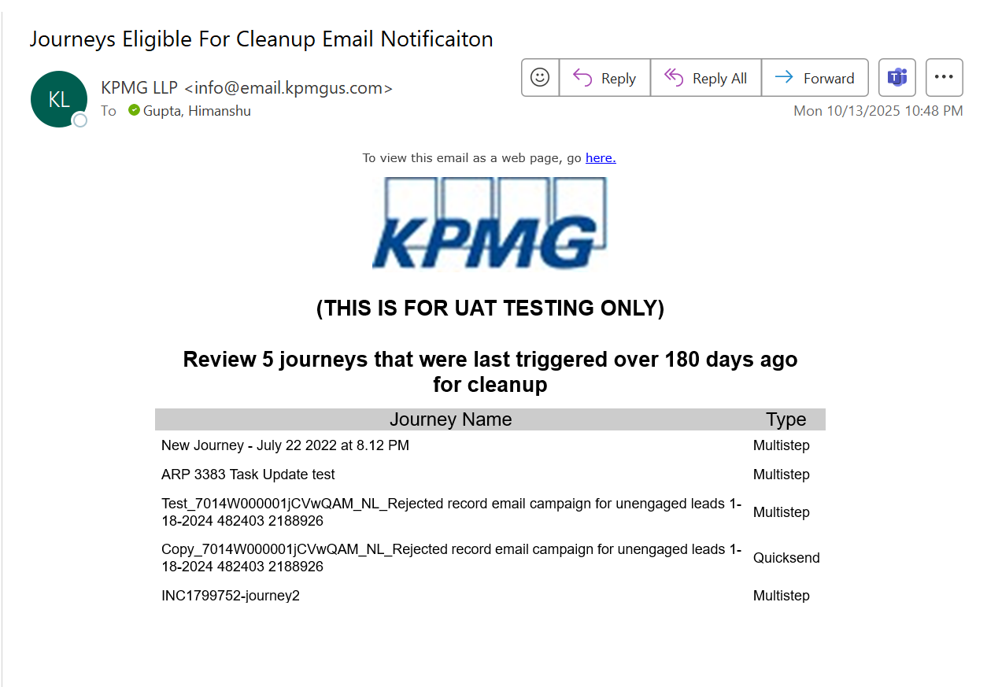
Test Results
Notification email: The email lists the journey names and journey types in the Journey Cleanup Review folder for review (Scenario 2).

Slide 36
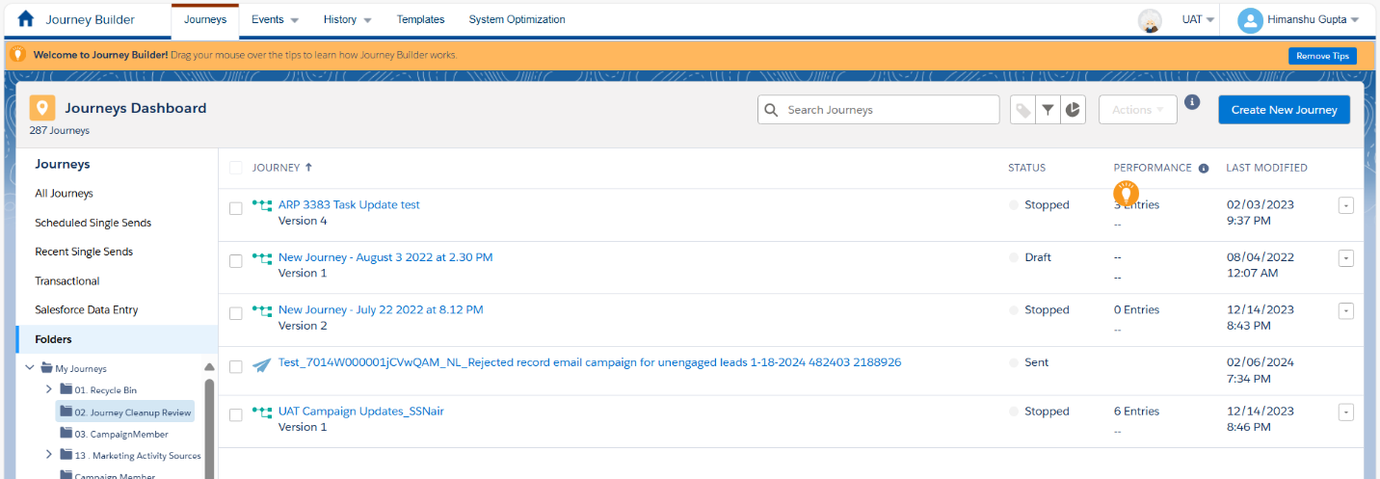
Test Results
Journey Cleanup Review folder after execution: The folder now displays the 5 eligible journeys, confirming the move worked as expected (Scenario 2).

Slide 37
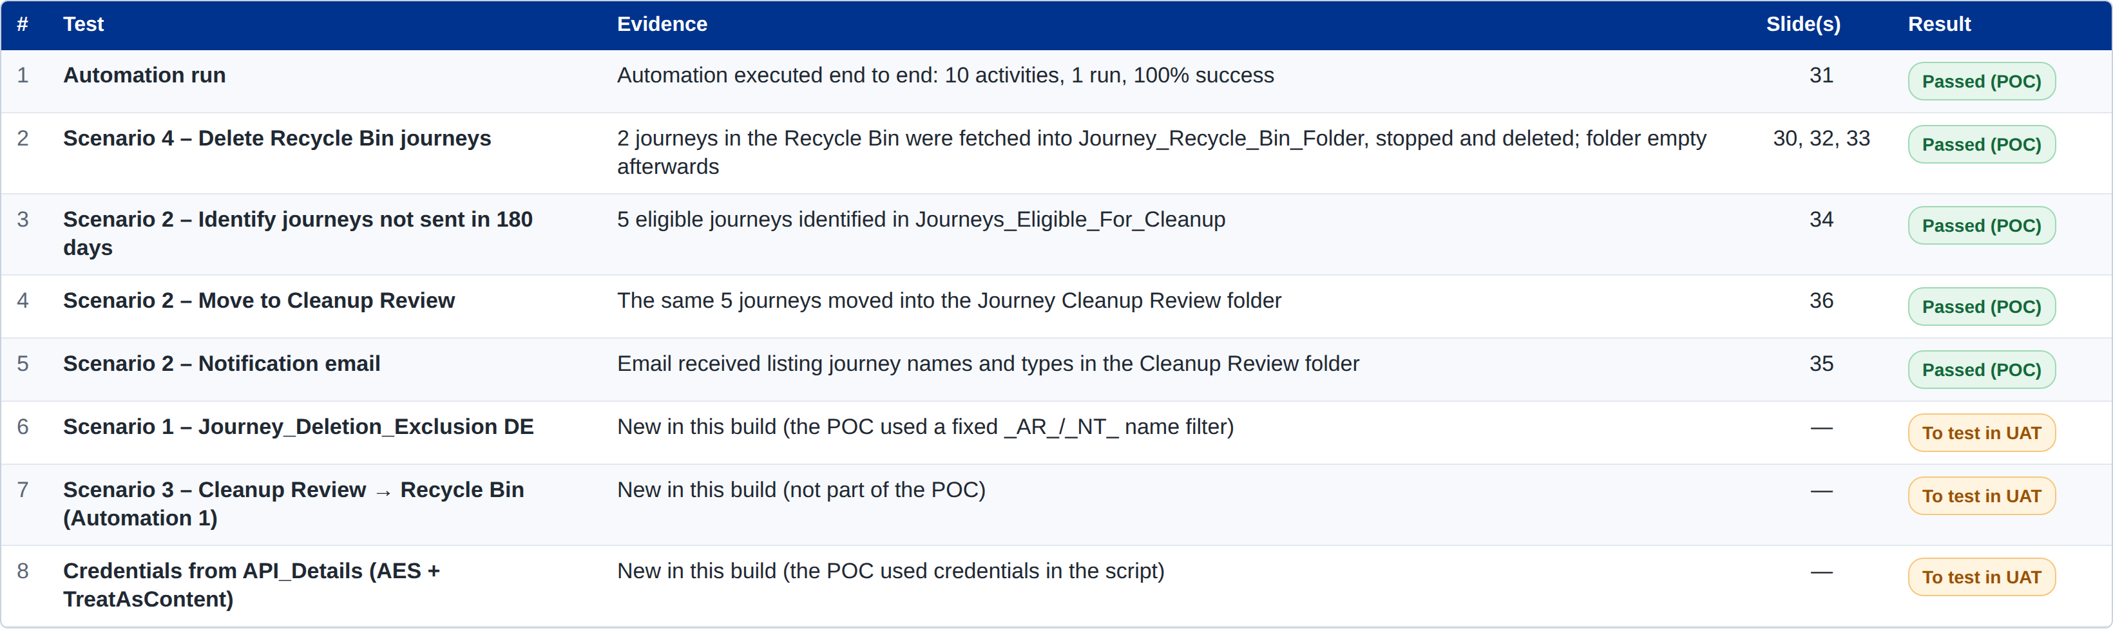
Test Results
Summary: POC results for each acceptance criterion. Items new in this production build are marked for UAT testing.

