Slide 1
API Credential Encryption Tool — CloudPage
GEE-19032 (Related) | New Story
Developer: Himanshu Gupta

Slide 2
API Credential Encryption Tool — Overview
Description
As the technical product manager, I want an API credential encryption tool developed, so that it can be used to generate encrypted Marketing Cloud API credentials and manage the creation and update of client secrets. Salesforce has recently enforced a 180-day expiration for client secrets.
Marketing Cloud Updates
• Data Extension: ENT.API_Details (Existing)
• Data Extension: API_Credential_Audit_Log (New)
• CloudPage: API Credential Encryption Tool (New)
Access is gated by verifying the entered email against an active Salesforce User record before any Add/Update action is processed.

Slide 3
CloudPage: API Credential Encryption Tool
The API Credential Encryption Tool CloudPage has been configured to perform the following functions:
• Capture an email address and verify it against Salesforce as an active User (RetrieveSalesforceObjects) before allowing any further action.
• Present a guided flow: Verify Email → Choose Add or Update → Enter Details → Confirmation.
• On Add: validate all required fields, confirm the Package Name doesn't already exist, encrypt the Client ID, Client Secret, Authentication Base URI and REST Base URI (AES, via the same EncryptSymmetric method already used across other CloudPages), and insert a new record into ENT.API_Details.
• On Update: confirm the Package Name exists, encrypt only the new Client Secret, and update just the Encrypted Client Secret, Client Secret Expiration Date and Last Modified Date fields — nothing else on the record is touched.
• Write an entry to the new API_Credential_Audit_Log Data Extension for every attempt — successful, failed, or denied — capturing who, what action, which package, when, and the outcome.
• Redirect to a fresh page after a successful save (POST/Redirect/GET) so refreshing the browser can never resubmit or duplicate an action.
• Send Cache-Control / Pragma / Expires headers so no browser, proxy, or CDN ever caches a response containing another user's result.

Slide 4
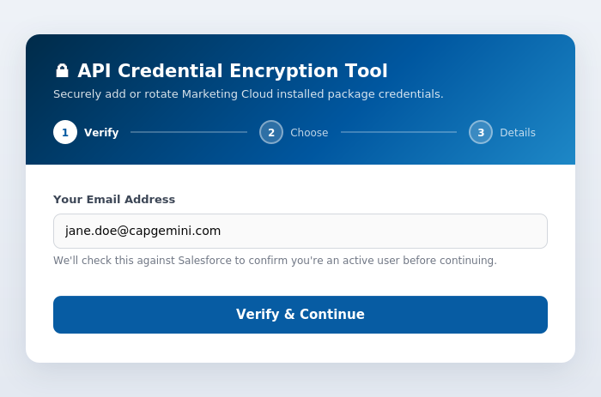
Test Results — Step 1: Verify Email
The user enters their email address. On submit, the page checks it against Salesforce (RetrieveSalesforceObjects) for an active User match before anything else can happen.
Preview note: these screens are rendered directly from the approved CloudPage code — there is no deployed Marketing Cloud environment yet to capture live screenshots from, so this shows exactly what the code produces rather than a staged mock-up.

Slide 5
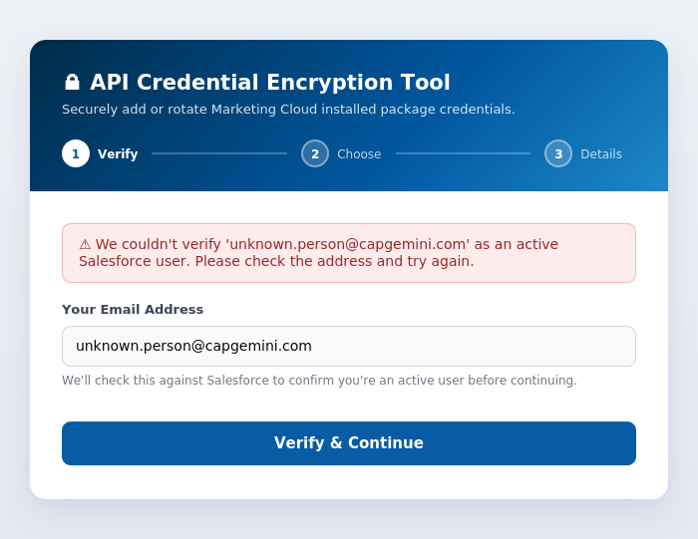
Test Results — Unverified Email
If the email doesn't match an active Salesforce user, an inline error is shown, the user stays on this screen, and an "Access Denied" entry is logged to the audit trail.

Slide 6
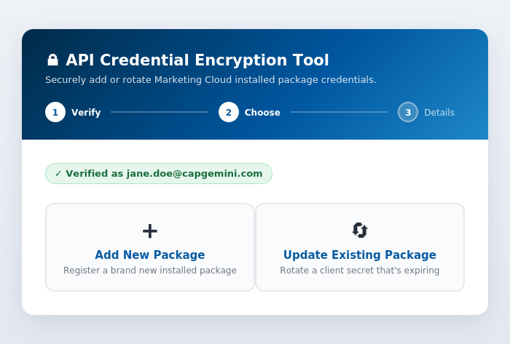
Test Results — Step 2: Choose an Action
Once verified, a green confirmation pill stays visible while the user chooses to either add a brand-new package or update an existing one.

Slide 7
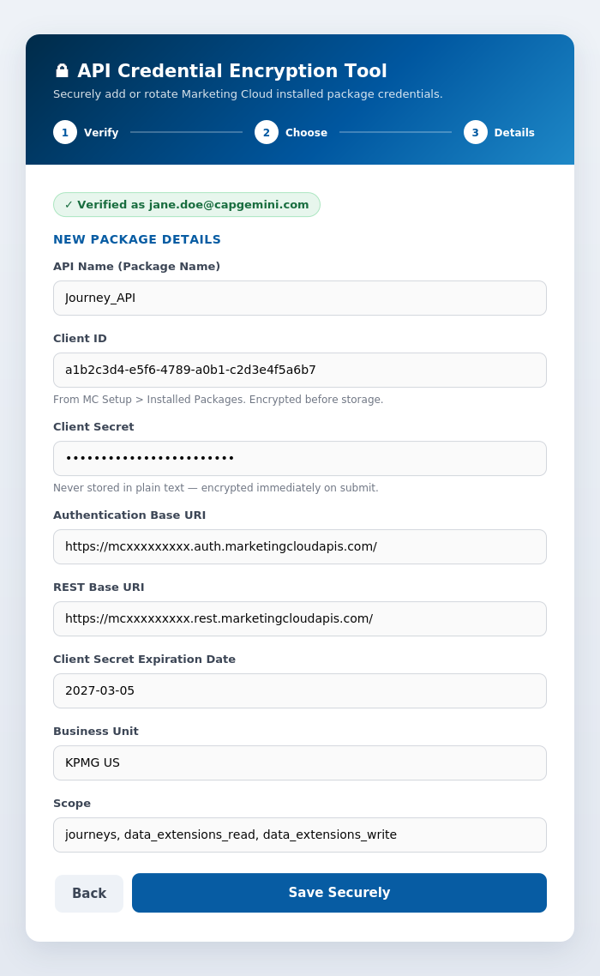
Test Results — Step 3a: Add New Package
All fields are required. Client ID, Client Secret, Authentication Base URI and REST Base URI are AES-encrypted immediately before the record is saved to ENT.API_Details.

Slide 8
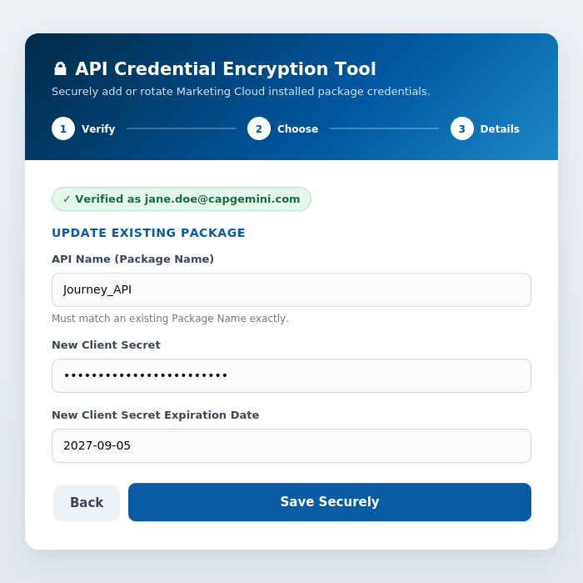
Test Results — Step 3b: Update Existing Package
Only the Package Name, new Client Secret and new Expiration Date are captured — every other field already on that record is left untouched.

Slide 9
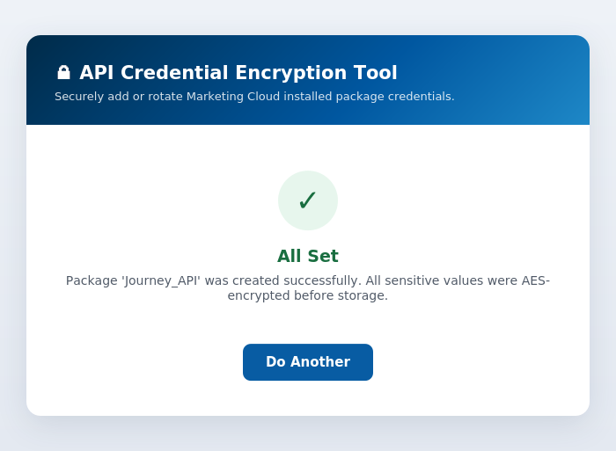
Test Results — Confirmation
On success, the browser is redirected to this confirmation screen. Refreshing the browser here cannot resubmit or duplicate the action (POST/Redirect/GET).

