Slide 1
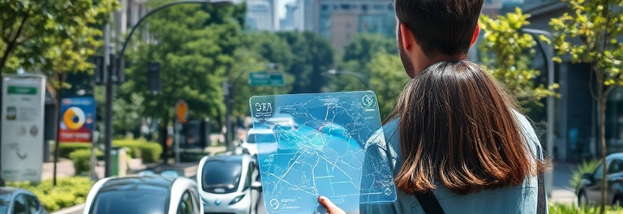
EcoPool : “Cut Carbon, not Convenience”
CREATED BY: GROUP 9 (Ruhi, Eshan, Parth, Harshil, Himanshu)
SMART URBAN MOBILITY STRATEGY
Cut Carbon, not Convenience

Slide 2
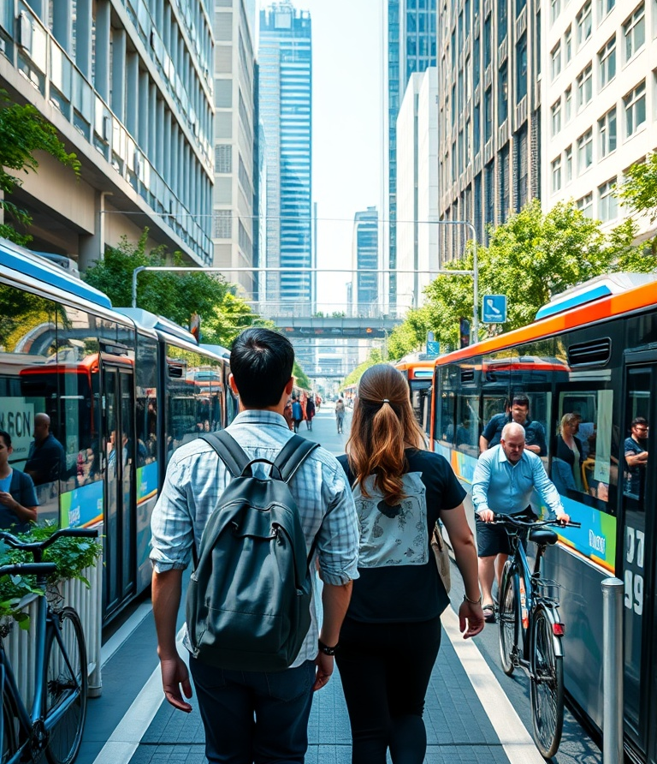
Problem Statement
Smart Urban Mobility Strategy
CHALLENGES IN URBAN COMMUTING
Urban commuters encounter significant trade-offs between travel time, costs, and environmental impacts. Bus services provide cost-effective solutions but tend to be slower. Conversely, private rides are quicker but come at a higher price and generate more CO₂ emissions. Understanding these dynamics is crucial for enhancing transportation strategies.

Slide 3
Dataset Overview
Smart Urban Mobility Strategy
TRIP DATA
KEY VARIABLES
The dataset comprises trips covering Uber, Carpool, and Bus modes, enabling a thorough analysis of urban commuting patterns and their impact on mobility efficiency.
Key variables in the dataset include Distance (in miles), Time (in minutes), Cost (in USD), and CO₂ emissions (in kg), which facilitate in-depth evaluations of transportation choices.

Slide 4
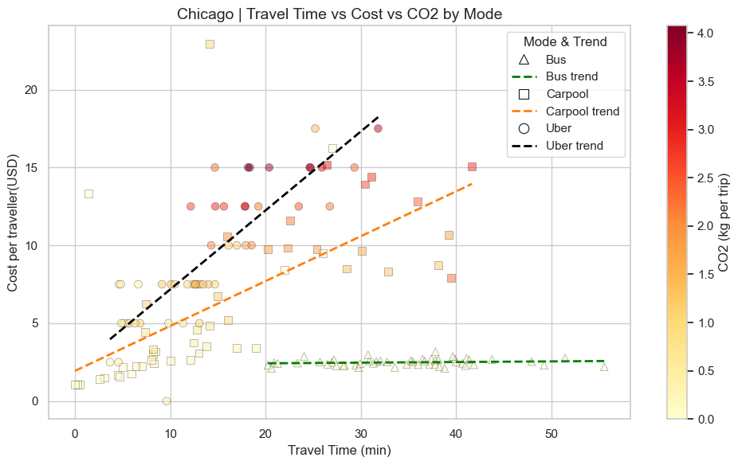
How do Different Modes Compare?
Smart Urban Mobility Strategy
Cost vs Time vs CO2

Slide 5
Key Insights
Smart Urban Mobility Strategy
COST AND EMISSIONS
CARPOOL BENEFITS
UBER ANALYSIS
Buses are the cheapest and emit the least CO₂ but compromise on speed, making them the slowest option for commuters.
Carpools strike a balance between cost and speed, offering moderate pricing with faster travel times compared to buses.
Uber is the quickest transportation mode but comes with high costs and the greatest CO₂ emissions of all options listed.

Slide 6
Recommendations & Business Case
Smart Urban Mobility Strategy
SMART BUS SCHEDULING
ECO-DRIVING TRAINING
Implement smart bus scheduling with advanced real-time data analytics for better efficiency.
Introduce eco-driving training and optimize routes to enhance sustainability.
ECOPOOL PROGRAM
PROJECTED IMPACT
Launch a EcoPool program that seamlessly integrates with existing bus routes.
Aim for a 35–40% reduction in CO₂ emissions and save $1M in annual operational inefficiencies.

