Slide 1

Hospital Labs
⬇
Team members:-
1. Shweta Waghulde
2. Vaishnavi chaudhari
3. Aashana kanwar
4. Sandhya tapare
5. Tushar harinkhede
6. Himanshu pathak
Here is where your presentation begins
MEDEASE

Slide 2
HMS
⬇
⬇
A software system designed to manage various hospital’s operations and workflow.

Slide 3
Systems Blocks
⬇
⬇
Patient registration and appointment system.
Scheduling and diagnosis system.
Medication store.
Regular visits and diagnosis.
Bed availability system.

Slide 4
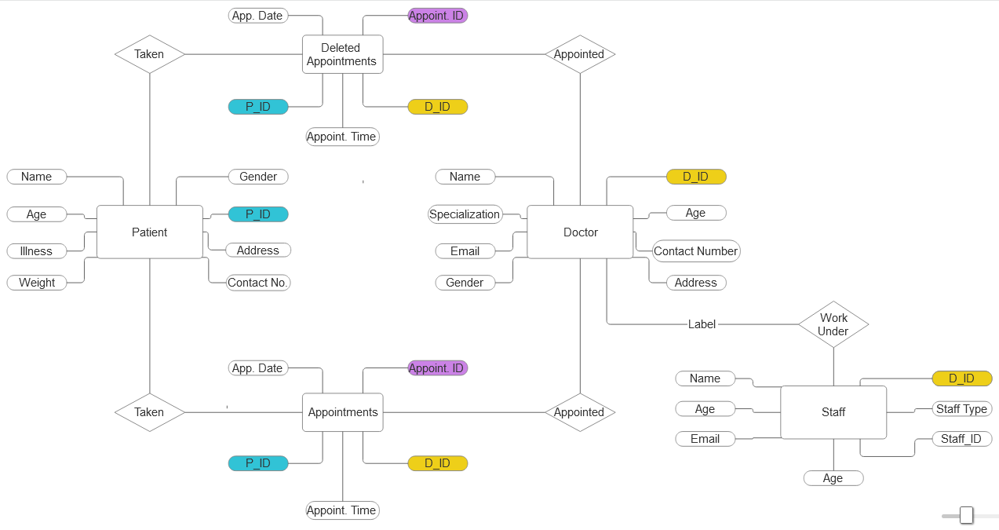

Slide 5
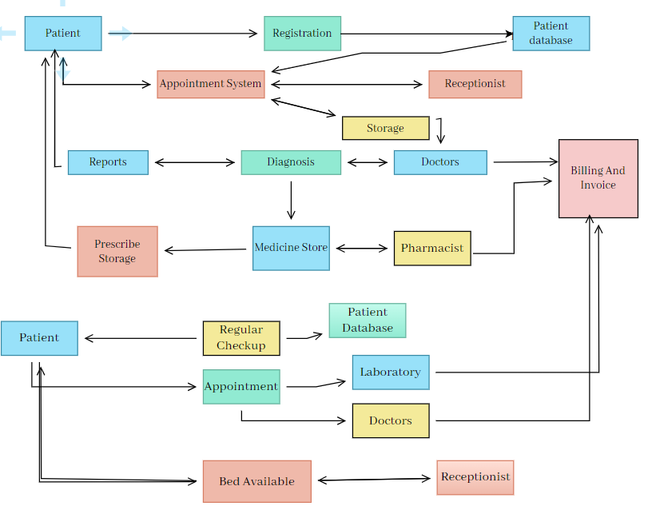

Slide 6

Technologies used
⬇
⬇
Frontend technology: HTML, CSS, JS
Front-end framework: React.js
Back-end server side : Spring boot Java
Database Management: MySQL
Authentication and Authorization: JSON
Web server: Apache Tomcat
Deployment: Jenkins

Slide 7
THANK YOU!

