Slide 1
हृदय
HEART

Slide 2
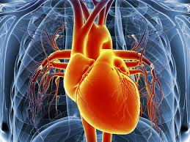
Cardiovascular disease generally refers to conditions that involve narrowed or blocked blood vessels that can lead to a heart attack, chest pain or stroke. Other heart conditions, such as those that affect your heart's muscle, valves or rhythm, also are considered forms of heart disease.

Slide 3
OUR PROGRAM IS BASED ON TO RECOGNIZE WHETHER THE PERSON IS HAVING HEART DISEASE PROBLEM OR NOT

Slide 4
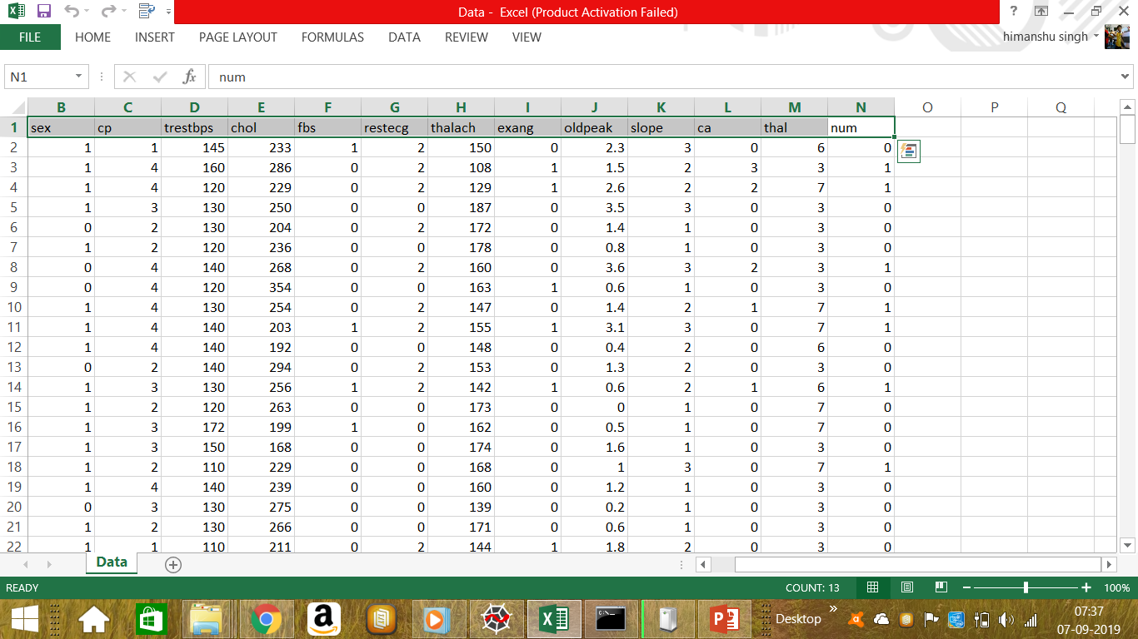
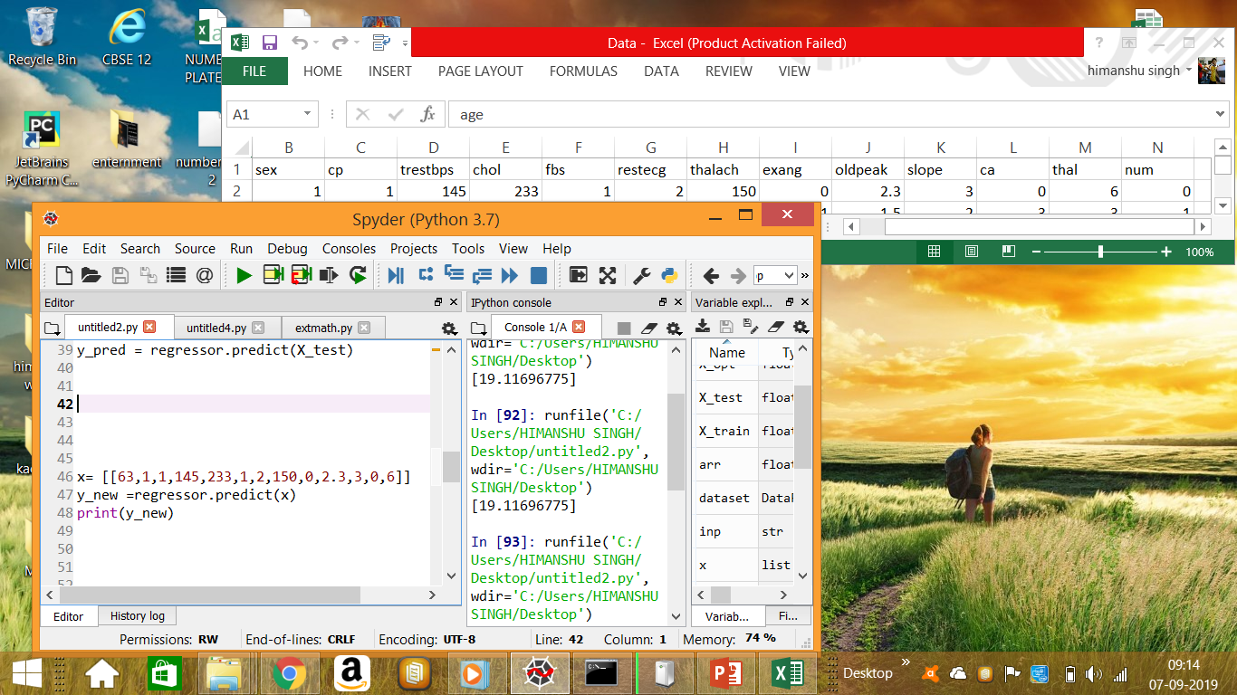
DATASET

Slide 5
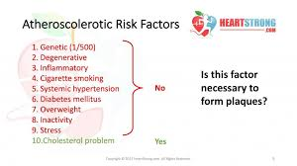
Heart disease - Symptoms and causes :
High levels of cholesterol in your blood can increase the risk of formation of plaques and atherosclerosis. Diabetes. Diabetes increases your risk of heart disease. Both conditions share similar risk factors, such as obesity and high blood pressure

Slide 6
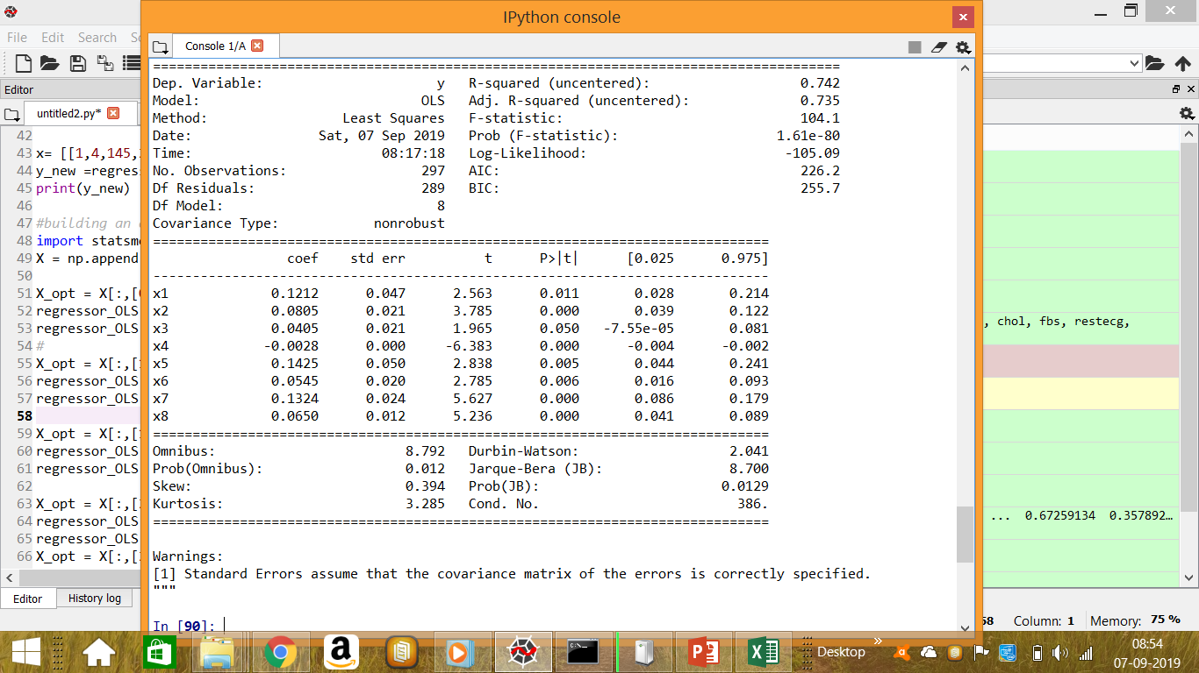
#building an optimal model using backward elimination

Slide 7
Thank you
Himanshu R Singh
& Aman sharma

