Slide 1

Data Mining & Machine Learning I
10. Support Vector Machines

Slide 2
10. Support Vector Machines

Slide 3
Support Vector Machines 101
A supervised learning method, typically used for classification or regression purposes.
For classification: a binary classifier or a collection of binary classifiers for multi-class classification
Central notion of a SVM is the learning of a d-1 dimensional hyperplane
They are a black box method – very hard to understand why a SVM does what it does! Typically due to high dimensionality – they also suffer from the curse of dimensionality.
They are well known for being good at handling nonlinear, complex systems and processes

Slide 4

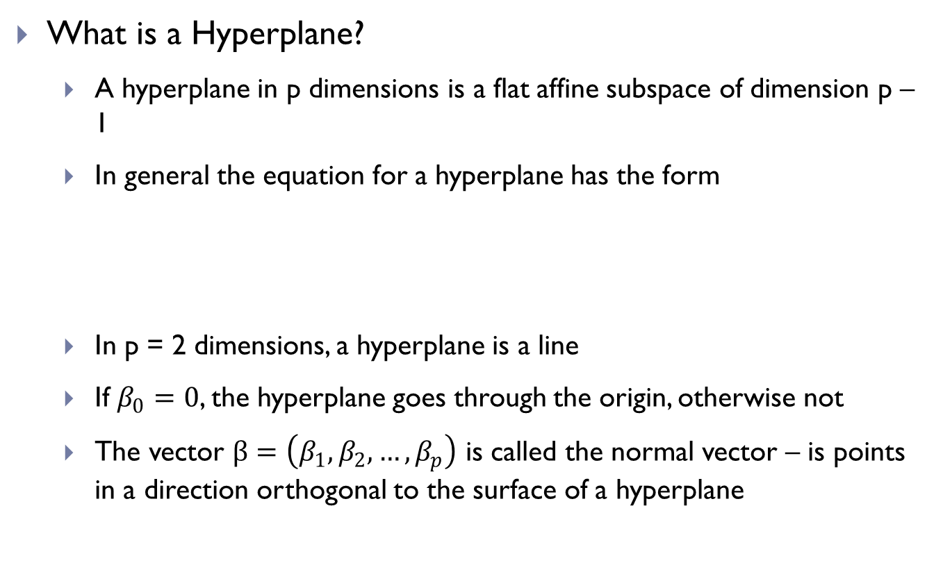
Support Vector Machines 101
What is a Hyperplane?
A hyperplane in p dimensions is a flat affine subspace of dimension p – 1
In general the equation for a hyperplane has the form
In p = 2 dimensions, a hyperplane is a line
If $β_{0}=0$, the hyperplane goes through the origin, otherwise not
The vector $β=\left(β_{1},β_{2},…,β_{p}\right)$ is called the normal vector – is points in a direction orthogonal to the surface of a hyperplane
$$β_{0}+β_{1}X_{1}+β_{2}X_{2}+…+β_{p}X_{p}=0$$

Slide 5
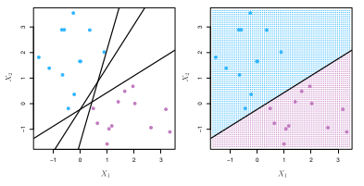

Support Vector Machines 101
If $f\left(X\right)=β_{0}+β_{1}X_{1}+β_{2}X_{2}+…+β_{p}X_{p}$ then $f\left(X\right)>0$ for points on one side of the hyperplane, and $f\left(X\right)<0$ for points on the other.
If we code the colored points as $Y_{i}=+1$ for blue, say, and $Y_{i}=−1$ for mauve, the if $Y_{i} . f\left(X_{i}\right)>0$ for all i, $f\left(X\right)=0$ defines a separating hyperplane.

Slide 6
Support Vector Machines 101
Given an arbitrary data set there are many hyperplanes that we can learn for classification purposes
A SVM attempts to achieve maximum separation (margin) between classes.
i.e. we maximise the distance from the hyperplane to a set of nearest points
The hyperplane that achieves this goal is called the maximum margin hyperplane.
The problem is that there may be an infinite number of hyperplanes that could achieve separation, and at the same time, many will over fit the data
The other issue is that we need to assume that a class is linearly separable, or do we?

Slide 7
Generalization – VC Dimension
To calculate the upper-bound of a model’s error (called the generalization bound) we need to take account of the model’s complexity
Vapnik introduced a measure of complexity called the
The VC dimension is used in computing the capacity of learning algorithms – this capacity determines the generalization reachable during learning
i.e. The model’s complexity, expressive power, flexibility, or richness
The VC dimension is useful because it can be used to predict the upper bound of a model’s error.
Vapnik-Chervonenkis Dimension
or
VC Dimension

Slide 8
Generalization – Understanding VC Dimension
The idea behind supervised Machine Learning is to learn some functions from a set of training examples.
Let’s say that
t = the set of training instances = {x₁, x₂, ..., x_{n}}
We can view these instances as data points that are associated with some discrete values from a set C = {c₁, c₂, ..., c_{m}}
We are attempting to find a function f: X → C where t is a subset of X.
The function f can be learned by using an algorithm which can generate only a small subset of all possible functions.

Slide 9
Generalization – Understanding VC Dimension
f is the target function
The algorithm derives a function h ∈ H (the set of all possible hypotheses (functions) derivable by the algorithm)
It is unlikely that f = h
A measure of the degree of dissimilarity is provided for by the error rate
Let’s keep this simple. Introducing: shattering
Consider that we want to learn a straight line to split a number of points in a 2 dimensional space.
How many points can we have before a straight line cannot always split these points into 2 classes?
The ability to do this is called shattering

Slide 10
Generalization – Shattering
Consider a set of N points in the 2D x-y plane
Then there are 2^{N} ways to assign binary class labels to these points
P1 = (x1, y1)
P2 = (x2, y2)
P3 = (x3, y3)
 | P1 | P2 | P3
1 | 0 | 0 | 0
2 | 0 | 0 | 1
3 | 0 | 1 | 0
4 | 0 | 1 | 1
5 | 1 | 0 | 0
6 | 1 | 0 | 1
7 | 1 | 1 | 0
8 | 1 | 1 | 1
P1
P3
P2

Slide 11

Generalization – Shattering
Consider a class of functions H (a particular Hypothesis Space)
A set of N points is said to be shattered by H if and only if for all the 2^{N} label permutations there exists a function h ∈ H such that when we use h as a classification rule then there are no training errors
The largest number of points that a function class can shatter is the VC Dimension

Slide 12
Generalization – Shattering
Let’s consider as a class of functions H = {h | h is a straight line}
What is the VC Dimension of H in this case?
What is the maximum number of points in the plane that a straight line could successfully classify?
P1 = (x1, y1)
P2 = (x2, y2)
P3 = (x3, y3)
P1
P3
P2

Slide 13
Generalization – Understanding VC Dimension
Would the class of straight lines be able to shatter 4 points in the 2D plane?
What about the class of rectangles?
P4
P1
P1 = (x1, y1)
P2 = (x2, y2)
P3 = (x3, y3)
P4 = (x4, y4)
P3
P2

Slide 14

Generalization – Understanding VC Dimension
Different classes of functions have different capacity measures in separating data instances
Some can separate more data instances → greater generalization
A function from a high capacity class of functions will separate with greater ease any particular training set
If a function from a low capacity class of functions successfully separates any particular training set then it will probably also separate a set of test data
May lead to overfitting though!
May lead to underfitting though!

Slide 15
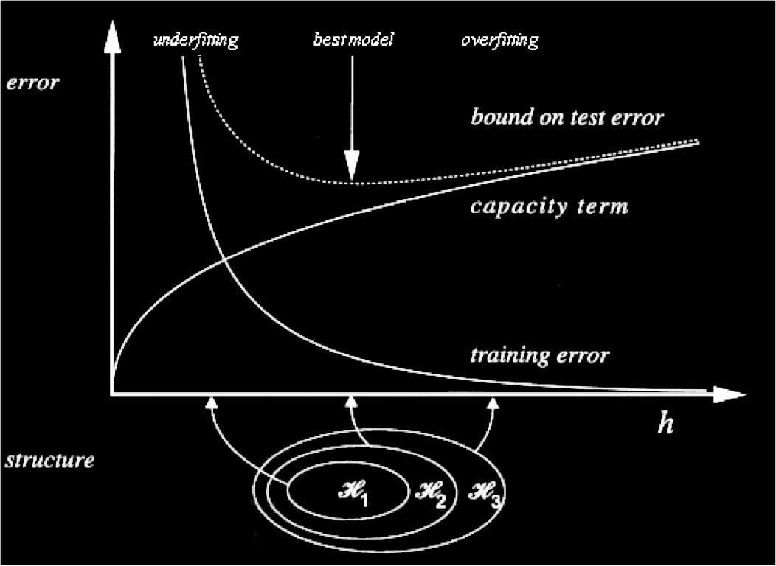
Generalization – Understanding VC Dimension

Slide 16
Generalization
We have seen that a 1D line can shatter 3 points on the 2D plane
Similarly, it can be shown that a 2D plane can shatter 4 points in a 3D cube
...
A (n-1)-D plane (i.e. a hyperplane) can shatter (n+1) points in a n-D hypercube
Support Vector Machines rely on such classes of linear functions

Slide 17
Perceptrons
A linear binary classifier: read is class A or is not class A
Learns linear functions (i.e. hyperplanes) as a means to separate and differentiate between a large number of data instances
Given an input vector x = [x₁, x₂, ..., x_{n}]
Associated with a vector of weights w = [w₁, w₂, ..., w_{n}]
A peceptron uses a threshold value θ and assigns
+1 if w.x > θ
-1 if w.x < θ
Where w.x = θ is considered “wrong” – such cases sit on the decision boundary

Slide 18
Perceptrons
The weight vector w defines a hyperplane of dimension d – 1
Where d is the set of points x such that w.x = θ
Points on the positive side of the hyperplane are classified +1; -1 on the negative side
If there are multiple hyperplanes possible a perception will converge to one that separates the given training data
Danger of over fitting!
A perceptron can ONLY classify linearly separable data
If data is not linearly separable: infinite loop that doesn’t converge

Slide 19
Perceptrons
Perceptron Learning Rule Algorithm
Set all weights to zero
Until all instances in the training data are classified correctly
For each instance I in the training data
If I is classified incorrectly by the perceptron
If I belongs to the first class add it to the weight vector
Else subtract it from the weight vector
The algorithm will only work properly if a separating hyperplane exists i.e., the data is linearly separable. Corrections are incremental and can interfere with earlier updates. The algorithm converges however in a finite number of iterations if the data is linearly separable – if the data is not linearly separable then the algorithm will not converge, so an upper bound needs to be imposed on the number of iterations when this method is applied in practice.

Slide 20
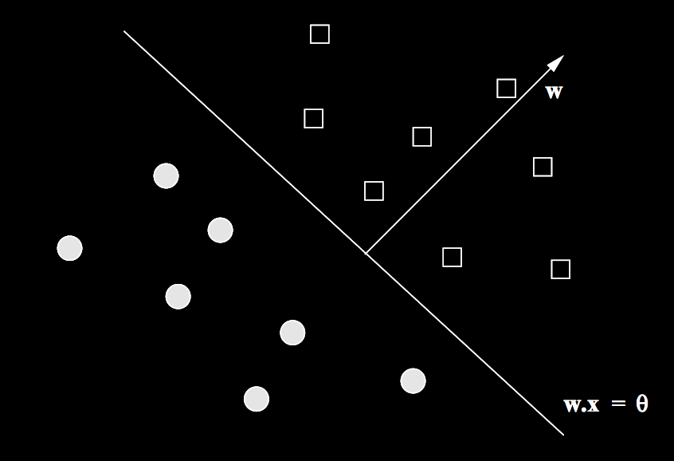
Perceptrons

Slide 21
Training a perceptron
Let us first consider the simplest case: θ = 0
Simple assumption if we don’t know what the threshold should be
Essentially, we try to find a weight vector such that:
All feature vectors with y = +1 are on the positive side of the hyperplane
All feature vectors with y = -1 are on the negative side of the hyperplane
Set up:
Initialise all weights to 0
Pick a learning rate η – a small positive real number; it controls the speed of convergence. Too small and convergence is slow, too big and convergence is too volatile (and again slow – if it converges at all)

Slide 22
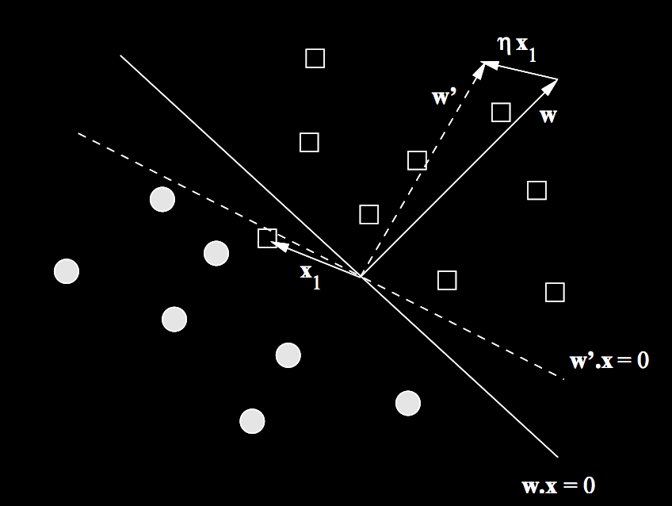
Training a perceptron
Consider each training example t = (x, y) individually, and
Let y’ = w.x
If y’ = y: Do nothing if t is properly classified
If y’ != y: Replace w with w + ηyx,
i.e. adjust w in the direction of x
Moving w towards x shifts
the hyperplane

Slide 23
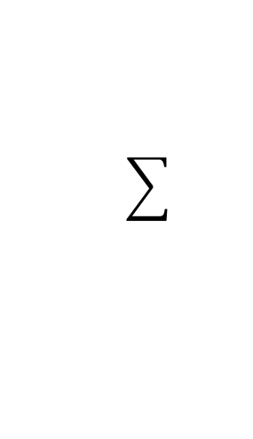
Perceptrons
Output can be modelled by a hyperplane:
y = x₁w₁ + x₂w₂ + ... + x_{n}w_{n} + b = 0
y = x . w + b = 0
The perceptron classification function is
f(x) = sgn(y) = sgn(x . w + b)
Perceptron
x₁
w₁
x₂
w₂
w₃
Learning algorithm will find suitable values for the vector
and the scalar b
and will determine a hyperplane
x₃
y
.
.
.
w_{n}
b
x_{n}
Threshold
+1

Slide 24
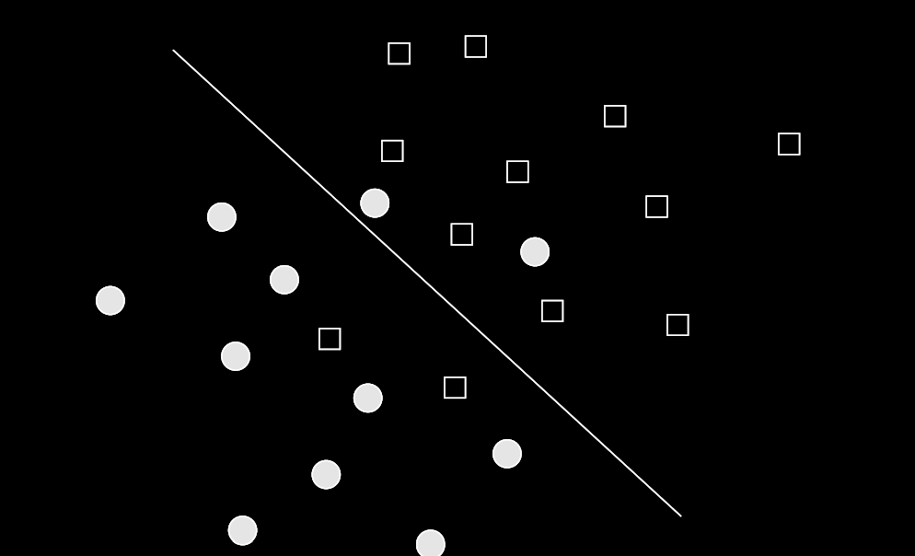
Perceptrons – limitations
Lack of linear separability

Slide 25
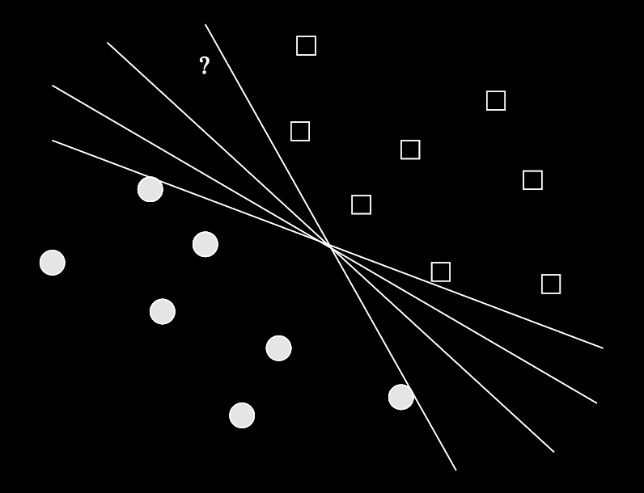
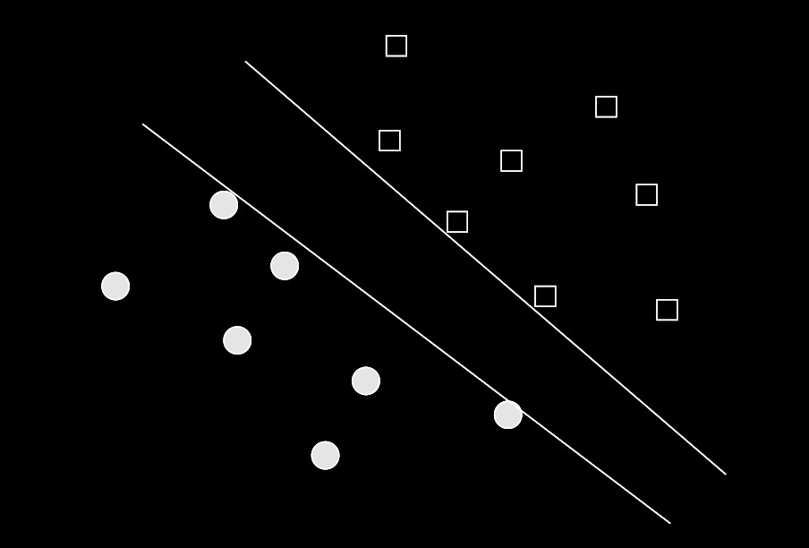
Perceptrons – limitations
Multiple solutions for a hyperplane

Slide 26
Perceptron – example: spam detection
The training (x, y) set consists of 0’s and 1’s indicating the presence (x_{i} = 1) or absence (x_{i} = 0) of a word in an email
y = +1 if the email is known to be spam and -1 otherwise
We’re going to use a learning rate η = ½
We use only 5 keywords: “and”, “viagra”, “the”, “of”, “nigeria” to keep things simple
Initially, w is all 0’s
 | and | viagra | the | of | nigeria | y
a | 1 | 1 | 0 | 0 | 1 | +1
b | 0 | 0 | 1 | 1 | 0 | -1
c | 0 | 1 | 1 | 0 | 0 | +1
d | 1 | 0 | 0 | 1 | 0 | -1
e | 1 | 0 | 1 | 0 | 1 | +1
f | 1 | 0 | 1 | 1 | 0 | -1

Slide 27
Perceptron – example: spam detection
Start with a: [1,1,0,1,1]; y=+1
w.a = 0 – this is wrong, so we move w in the direction of a
w = w + ηya
w = w + ½ * 1 * a
w = [0,0,0,0,0] + [½, ½, 0, ½, ½]
w = [½, ½, 0, ½, ½]
Now consider b: [0,0,1,1,0]; y=-1
w.b = [½, ½, 0, ½, ½] . [0,0,1,1,0] = ½
b is misclassified so we move w again
w = w + ½ * -1 * b
w = [½, ½, 0, ½, ½] – [0, 0, ½, ½, 0] = [½, ½, -½, 0, ½]

Slide 28
Perceptron – example: spam detection
Now consider c: [0,1,1,0,0]; y=+1
w.c = [½, ½, -½, 0, ½] . [0, 1, 1, 0, 0] = 0; move again
w = w + ½ * 1 * c = [½, ½, -½, 0, ½] + [0, ½, ½, 0, 0] = [½, 1, 0, 0, ½]
Now consider d: [1,0,0,1,0]; y=-1
w.d = [½, 1, 0, 0, ½] . [1, 0, 0, 1, 0] = 1; move again
w = [½, 1, 0, 0, ½] – [½, 0, 0, ½, 0] = [0, 1, 0, -½, ½]
Now consider e: [1,0,1,0,1]; y=+1
w.e = [0, 1, 0, -½, ½] . [1, 0, 1, 0, 1] = ½; that’s fine, do nothing
Now consider f: [1,0,1,1,0]; y=-1
w.f = [0, 1, 0, -½, ½] . [1, 0, 1, 1, 0] = -½; that’s fine too
Let’s check: w.a = 1; w.b = -½; w.c = 1; w.d = -½
This looks good, but what does it mean?

Slide 29
Perceptron – example: spam detection
w = [0, 1, 0, -½, ½]
The words “and” and “the” are considered neutral
The words “viagra” and “nigeria” are considered indicative of spam
The word “of” is considered indicative of not spam
In this case, we terminated at a viable solution using training data only.
Whilst the training data is linearly separable, test data may not be.
Therefore, we can use stopping criteria like:
Terminate after k rounds
Terminate when the number of misclassified instances stops changing
…

Slide 30
Perceptrons – Winnow algorithm
There are many ways to adjust the weights vector.
The Winnow algorithm (one way) basically tries to control the rate of convergence
If w.x > θ and y=+1 or w.x < θ and y=-1 then do nothing
If w.x < θ, but y=+1 then the weights for components where x has 1 are too low. So double them, i.e.: if x_{i} = 1 then set w_{i} := 2w_{i}
If w.x > θ, but y=-1 then the weights for components where x has 0 are too high. So halve them, i.e.: if x_{i} = 0 then set w_{i} := w_{i}/2
Example: a = [1, 1, 0, 1, 1]; y=+1
Let w = [1, 1, 1, 1, 1] and θ=5
w.a = 4, which is less than θ; so we double all components where x_{i}=1
So the new w = [2, 2, 1, 2, 2]

Slide 31
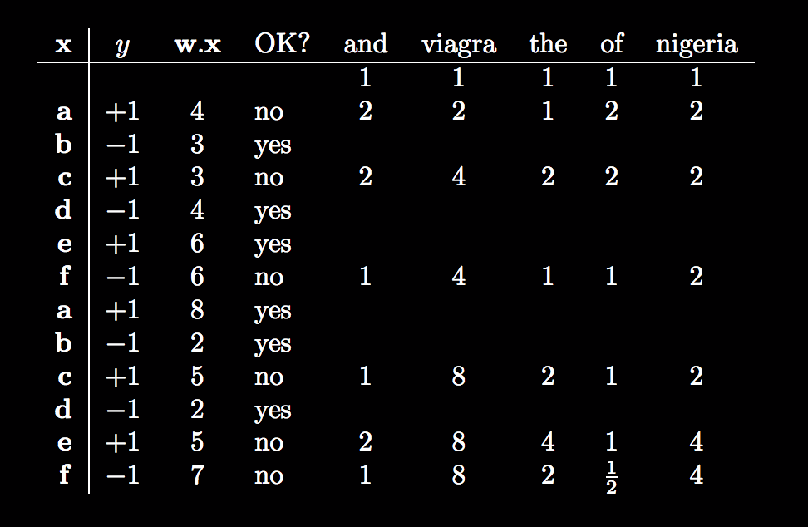
Perceptrons – Winnow algorithm

Slide 32
Perceptrons – setting θ
We can just increase the dimensionality of the problem, and treat θ like a weight
In other words:
Replace w = [w₁, w₂, …, w_{d}] with w’ = [w₁, w₂, …, w_{d}, θ]
Replace ever feature vector x = [x₁, x₂, …, x_{d}] with x’ = [x₁, x₂, …, x_{d}, θ]
For each instance, we treat θ as 0 and execute as before
Why can we do this?
If w’.x’ > 0, then this is equivalent to Σ^{d}_{i=1}w_{i}x_{i}+θ*-1 > 0
which is equivalent to w.x – θ > 0
which is equivalent to w.x > θ
which is the positive response from a perceptron with threshold θ

Slide 33
Support Vector Machines
Support Vector Machines extend the idea associated with a Perceptron to find a certain hyperplane, but
There is only 1 solution to a SVM:
A hyperplane that maximises the distance (margin) between the points of the training set
SVMs can also handle data instances that are not immediately lineraly seperable
Consider the graph
How many ways are there to separate the class instances using lines (i.e. hyperplanes)?

Slide 34
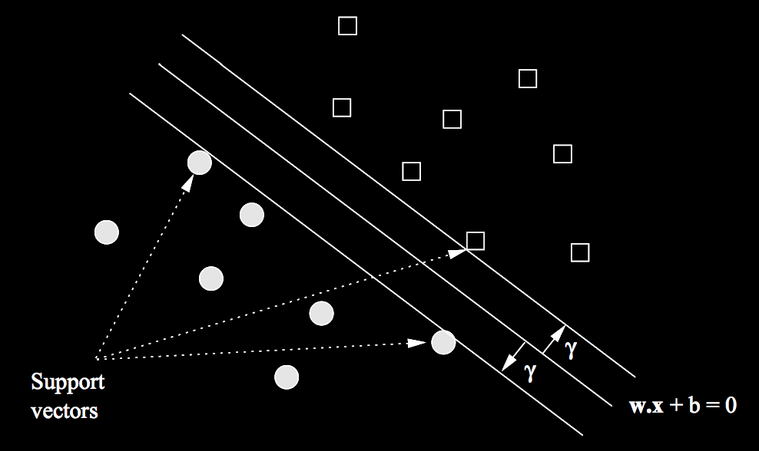
Support Vector Machines
Given (x, y), find a linear function on the form:
f(x) = w.x + b = 0
that maximises γ
An input vector xi is assigned to the positive class if f(x) > 0 and to the negative class otherwise.
Typically d + 1 support vectors
Maximising the margin means
that points close(r) to the
hyperplane in the test dataset
have a better chance of being
correctly classified

Slide 35
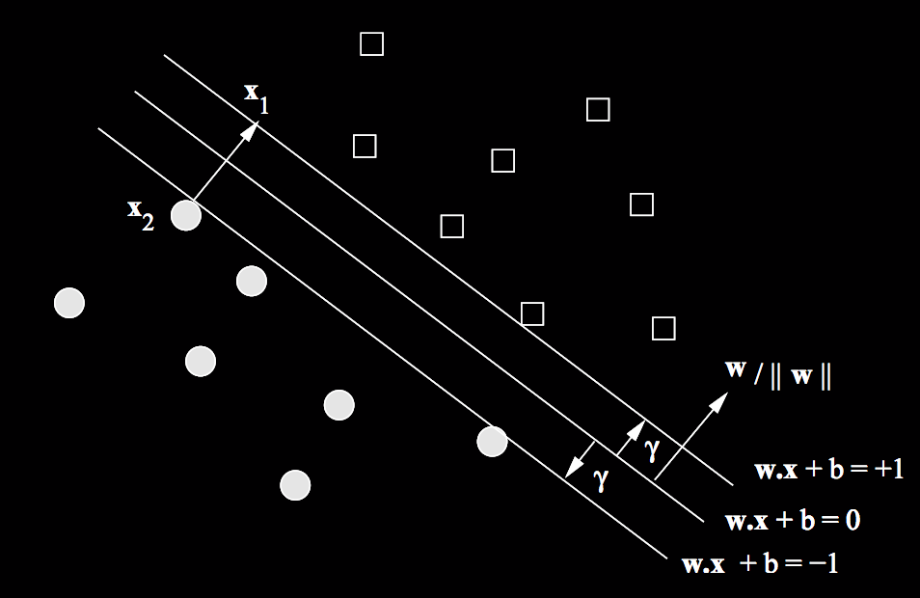
Objective of a Support Vector Machine
Maximise γ as the multiple of the unit vector w / ||w||
||w|| is the Frobenius norm (the square root of the sum of squares of the components in w)
Given a training set (x1,y1), … (xn,yn) minimise ||w|| by varying w and b such that:
y_{i}(w.x_{i} + b) > 1

Slide 36
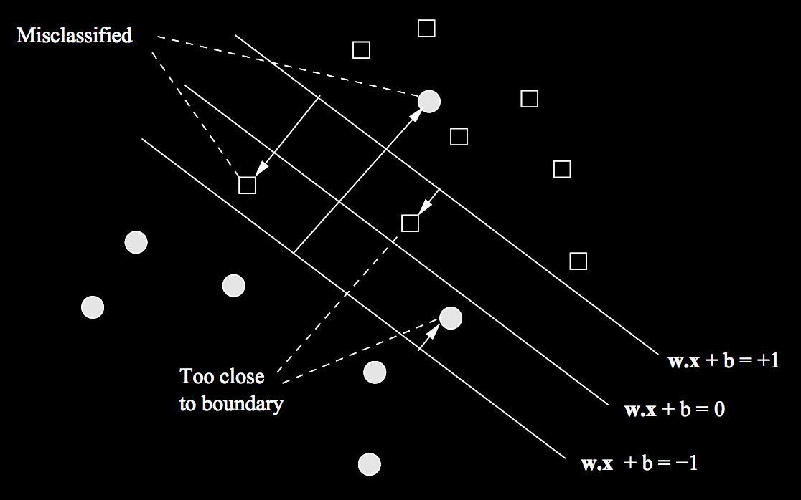
Support Vector Machines – non seperable?
Liu, Web Data Mining

Slide 37
Handling Non-separable data
We have a few options to handle our not separable issue:
1. We make new features, for example if our feature vector X has 2 components X₁ and X₂ we could add X₁² and X₂² with more features, we can use higher order linear functions to try to find a linear hyperplane.
Typically if our feature space is larger than the number of instances (or essentially big enough) we can usually find a linear hyperplane that will separate the data.
2. We relax our notion of a maximal margin hyperplane slightly and allow a number of points to be inside the margin, but we constrain this!

Slide 38
Epsilon and Cost Parameters
Epsilon permits training instances to stray inside the margin and be “too close” to the maximal margin.
Cost provides a budget of summed epsilons corresponding to a convex optimization problem within the training of the SVM.
Together they essentially regularize the margin, and allow more points to be considered as support vectors.

Slide 39
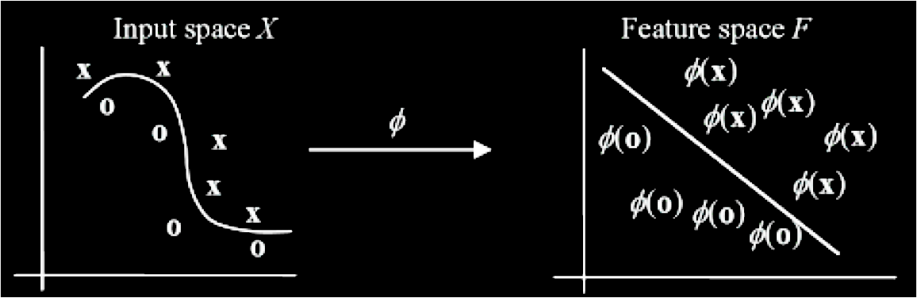
Support Vector Machines
SVM – Kernel Methods
In the Input Space the decision boundary is non-linear.
To create a classifier in this case we can use the same techniques as with the linear case – however, we must transform the input data from the original space into another space called a Feature Space F by using a non-linear mapping ϕ.
ϕ:X → F with x ⟼ ϕ(x)
The Feature Space will typically have many more dimensions. The same linear SVM method can then be applied.

Slide 40
Support Vector Machines
SVM – Kernel Methods
Suppose the input space is 2-dimensional and we choose the following mapping
(x₁,x₂) ⟼ (x₁²,x₂², √2x₁x₂)
Then the training example ((2, 3), -1) would map to ((4, 9, 8.5), -1)
Problem is that we may encounter the curse of dimensionality.
Explicit calculations can be avoided though by using the kernal trick.

Slide 41
Kernel Trick
The kernel basically transforms our linear classifier into a non-linear classifier
It applies a non-linear function to our data
This increases its dimensionality to make it linearly separable, and thus separable with a linear function
It does this using Mercer’s theorem, so:
if the kernel arguments are in a finite measurable space
and the kernel is positive, semi-definite (returns a positive number; and uses real numbers)
Then: there exists some function φ(x) whose range is in an inner product space of potentially high dimension
In short, the kernel trick transforms any algorithm that relies on the dot product of 2 vectors. So instead of computing a dot product, we apply the kernel function.

Slide 42
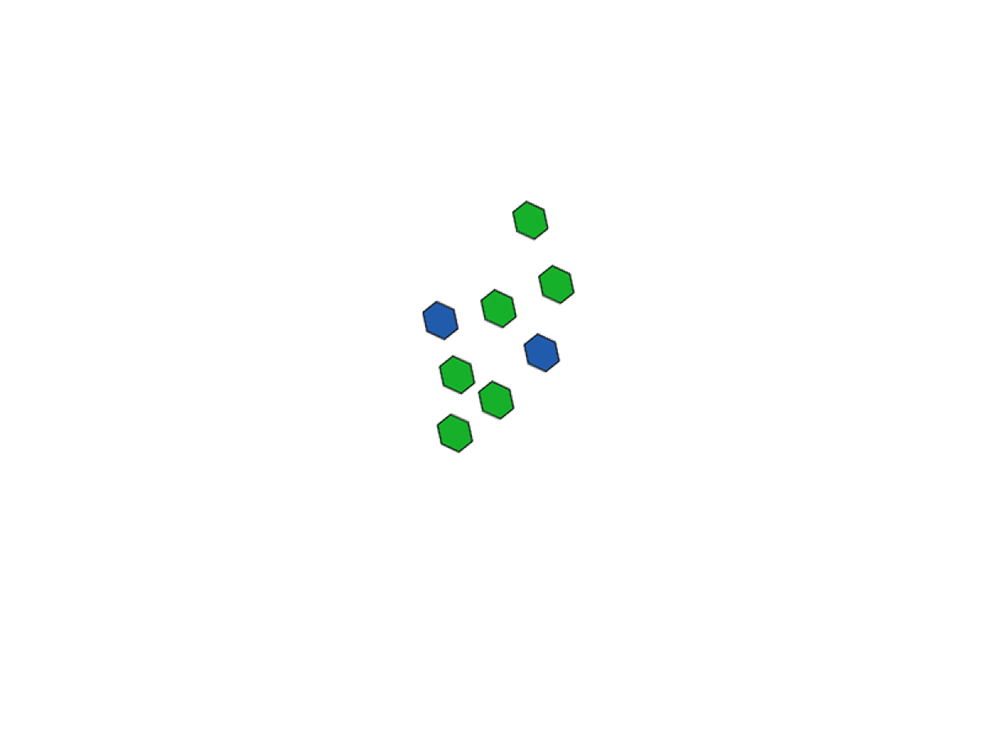
Visual Example of a kernel

Slide 43
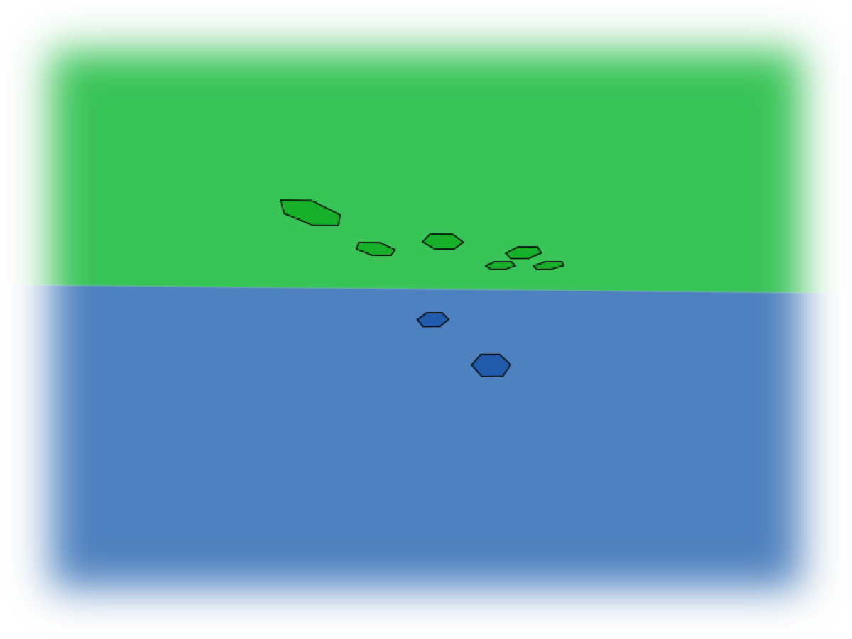
Visual Example of a kernel

Slide 44
Kernel Trick
The new non-linear algorithm is equivalent to the original linear algorithm, but it operates in a different, higher dimensional space.
Because we use a kernel function, we never actually have to compute the φ function.
This is very important, as our mapping function may increase the dimensionality of our problem to a space of infinite dimensions.
Out of interest, the Gaussian kernel does this.

Slide 45
Support Vector Machines – Kernel Methods
So if we had a way of computing φ(x) . φ(z) in the Feature Space F using the input vectors x and z directly then we would not explicitly need to calculate φ (x) and φ (z).
In SVM, this is done with kernel functions.
K(x,z) = φ (x) . φ(z)
E.g., the polynomial kernel
K(x, z) = (x . z)^{d}
Let’s compute this kernel in a 2-dimensional space with the polynomial degree d = 2.

Slide 46
Support Vector Machines – Kernel Method
Let us consider a vector x (with two attributes) in the input space that is mapped into a vector φx (with three attributes) in the feature space given by:
φx=φ((x₁, x₂)) = (x₁² ,x₂², √2 x₁x₂)
Consider a function K that takes two input vectors as parameters and computes the squa𝑟e of the dot product of the two vectors, i.e., K(x,y)= <x.y>²
Then for
x=(x₁, x₂)
y=(y₁, y₂)
K = <x.y>²
=(x₁y₁+ x₂y₂)²
= (x₁y₁)²+2(x₁y₁x₂y₂)+(x₂y₂)²
= x₁²y₁²+2(x₁y₁x₂y₂)+x₂²y₂²
Let us also compute: φx . φy
φx . φy = (x₁²,x₂², √2 x₁x₂) . (y₁²,y₂², √2 y₁y₂)
= x₁²y₁²+2(x₁y₁x₂y₂)+x₂²y₂²
So <x.y>² = φx . φy

Slide 47
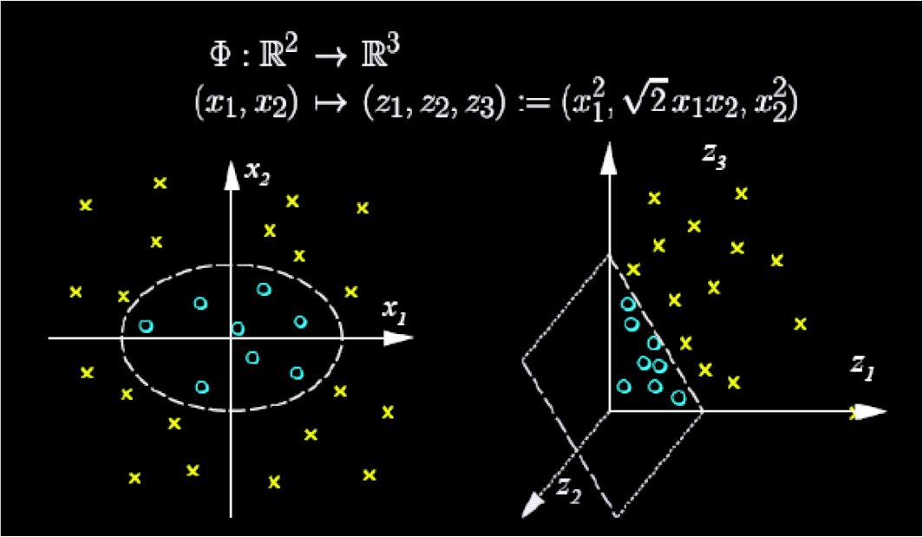
Support Vector Machines
(Scholkopf, 2001)

Slide 48
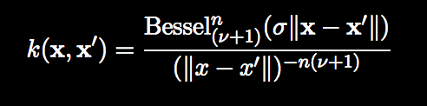
Some kernel methods
Linear kernel (the simplest one):
k(x, x′) = ⟨x, x′⟩
Gaussian radial function kernel:
k(x, x′) = exp(−σ||x − x′||²)
Polynomial kernel:
k(x, x′) = (scale · ⟨x, x′⟩ + offset)^{degree}
Hyperbolic tangent kernel:
k(x, x′) = tanh (scale · ⟨x, x′⟩ + offset)
Laplace radial basis kernel:
k(x, x′) = exp(−σ||x − x′||)
Bessel kernel:
General purpose (we go in blind):
Gaussian, Laplace and Bessel
Sparse data (e.g. text analytics)
Linear
Polynomial
Image processing
ANOVA
Regression problems

Slide 49
Summary so far
SVMs: supervised linear learning method to 2-class problems with numeric data
Objective: maximise margin between 2 classes
Non-separable problems are handled by mapping the vector into a higher dimensional non-linear feature space
Kernel functions are used to simplify calculations in the feature space
Data must be normalised for a SVM!
Limitations:
Only work in real-valued spaces. We need to convert values to numeric values if this is not the case
Only 2 classes are permissible
Hyperplanes are hard for users to understand – hence we tend to use SVMs in cases where human understanding is not required

Slide 50
Binary problems are great, but…
How often do we only have a binary classification problem!?!
In reality, each training point belongs to one of N different classes.
The goal is to construct a function which, given a new data point, will correctly predict the class to which the new point belongs.
At a high level, we:
Decompose the multiclass classification problem into multiple binary classification problems.
Use a majority voting principle (a combined decision from the committee of SVMs) to predict the label
Common approaches: simple but effective
One-vs-rest (one-vs-all) approaches
Pairwise (one-vs-one, all-vs-all) approaches

Slide 51
One-vs-rest / One-vs-all (OVA)
Solve K different binary problems: classify “class k” versus “the rest classes” for k = 1,··· ,K.
Assign a test sample to the class giving the largest fk(x) (most positive) value, where fk(x) is the solution from the kth problem
Very simple to implement and also performs well in practice
Not optimal if there is no dominating class!
Essentially, we have k binary SVMs.
We train the ith SVM with all examples in the ith class with +ve labels, all other instances are assigned a –ve label.
More info: Rifkin and Klautau (2004) “In Defense of One-vs-all Classification”

Slide 52
Pairwise approach: all-vs-all (AVA)
Solve all combinations of “class k” versus “class j” for all j != k.
For prediction at a point, each classifier is queried once and issues a vote. The class with the maximum number of (weighted) votes is the winner.
Training process is efficient, by dealing with small binary problems.
If K is big, there are too many problems to solve. If K = 10, we need to train 45 binary classifiers.
Simple to implement; performs competitively in practice.
More info: Park and Furnkranz (2007) “Efficient Pairwise Classification”
Also One-vs-One

Slide 53
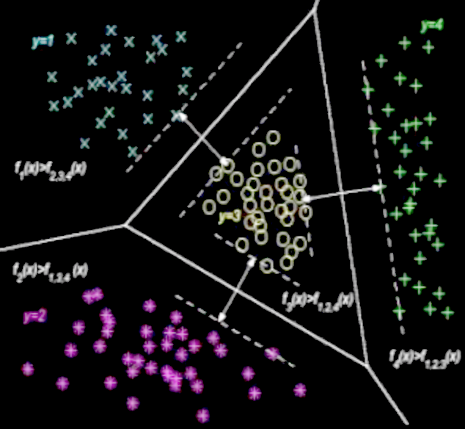
Multi-class SVMs
We are essentially forming inter locking hyperplanes

Slide 54

Summary
References / Bibliography
Burges, C. (1998). A tutorial on support vector machines for pattern recognition. Data Mining and Knowledge Discovery, 2:121-167.
Cristianini, N. & Shawe-Taylor, J. (2000). An introduction to support vector machines. Cambridge University Press, Cambridge, UK.
James, G., Witten, D., Hastie, T., & Tibshirani, R. (2013). An Introduction to Statistical Learning. Springer.
Leskovec, J., Rajaraman, A., & Ullman, J. D. (2014). Mining of massive datasets. Cambridge University Press.
Liu, B. (2007). Web data mining: exploring hyperlinks, contents, and usage data. (Section 3.8) Springer Science & Business Media.
Hsu, C. W. & Lin, C. J. (2002). A comparison of methods for multiclass support vector machines. Neural Networks, IEEE Transactions on, 13(2), 415-425.
Olson, D. L. & Delen, D. (2008). Advanced data mining techniques. (Chap. 7) Springer Science & Business Media.
Schölkopf, B. (2001). SVM and Kernel Methods, Neural Information Processing Systems conference.
Online Sources:
http://www.jstatsoft.org/v15/i09/
http://math.arizona.edu/~hzhang/math574m/2014Lect16_msvm.pdf
http://www.csie.ntu.edu.tw/~cjlin/papers/multisvm.pdf

