Slide 1

Data Mining & Machine Learning I
3. Prediction Models Evaluation

Slide 2
3. Prediction Models Evaluation
3.1 Model Evaluation
3.2 Data Splitting & Sampling Methods
3.3 Summary

Slide 3
3.1 Model Evaluation
Introduction
Inherently Application specific
if you are trying to identify/predict a nasty disease you potentially have a different notion of performance than for spam detection
Uses of model evaluation:
Comparing and juxtaposing model performance
Determining the quality of a classifier
Types of data used in evaluating a model:
Actual class values
Predicted class values
Estimated probabilities of predictions
Main evaluation methods:
Hold-out, k-fold cross validation, bootstrapping etc.
This can be useful if two models appear the same, but one is more confident than the other, i.e. it is more accurate at estimating uncertainty.

Slide 4
3.1 Model Evaluation
Isn’t Accuracy Enough?
Accuracy: no. of correctly labelled instances (for a classifier)
Example: predicting a nasty, but treatable, illness
1 in every 10000 people have some disposition to the illness
if we detect this, it is treatable, if not it’s fatal
Assume our classifier always predicts no (it’s lazy and doesn’t consider the data) – it will be correct 99.99% of the time
But it’s clearly not doing what it was designed to do, and is therefore useless
This is a problem of class imbalance: when one class is (massively) more prevalent
For reasons such as this, we need other notions of performance and quality for DM and ML methods!

Slide 5
3.1 Model Evaluation
Classification / Co-incidence Matrix
 |  | True Class
 |  | Positive | Negative
Predicted Class | Positive | True Positive Count (TP) | False Positive Count (FP)
 | Negative | False Negative Count (FN) | True Negative Count (TN)
Using the values in this table we can compute most useful measures of performance
Note this is currently a two-class classification problem

Slide 6

3.1 Model Evaluation
Classification / Co-incidence Matrix
 |  | Actual Classification of Classes in the dataset
 |  | Class 1 | Class 2
Model Classification | Class 1 | 674 | 91
 | Class 2 | 89 | 146
 | Probability | 0.76 | 0.24
 | Accuracy | 0.88 | 0.62 | 0.82
True Positive Rate: 88%; True Negative Rate: 62%
So we are better at identifying positives than negatives
Overall accuracy: 82%
Notice a disparity in the number of TPs and TNs – we will capture this later

Slide 7
3.1 Model Evaluation
Classification / Co-incidence Matrix
Simply put:
Numbers on the diagonal from top left to bottom right are correct decisions
Everything else is an error
Using these numbers we can compute the:
True Positive Rate (also called Hit Rate, or Recall): TP / (TP + FN)
False Positive Rate (also called False Alarm Rate): TN / (TN + FP)
Accuracy: (TP + TN) / (TP + TN + FP + FN)
Error Rate: 1 – Accuracy or (FP + FN) / (TP + TN + FP + FN)
Precision: TP / (TP + FP)
Recall: TP / (TP + FN)
F-Measure: 2 / ( (1 / Precision) + (1 / Recall) )

Slide 8

3.1 Model Evaluation
Classification / Co-incidence Matrix [Multi-Class]
 |  | True Class
 |  | A | B | C
Predicted Class | A
 | B
 | C

Slide 9
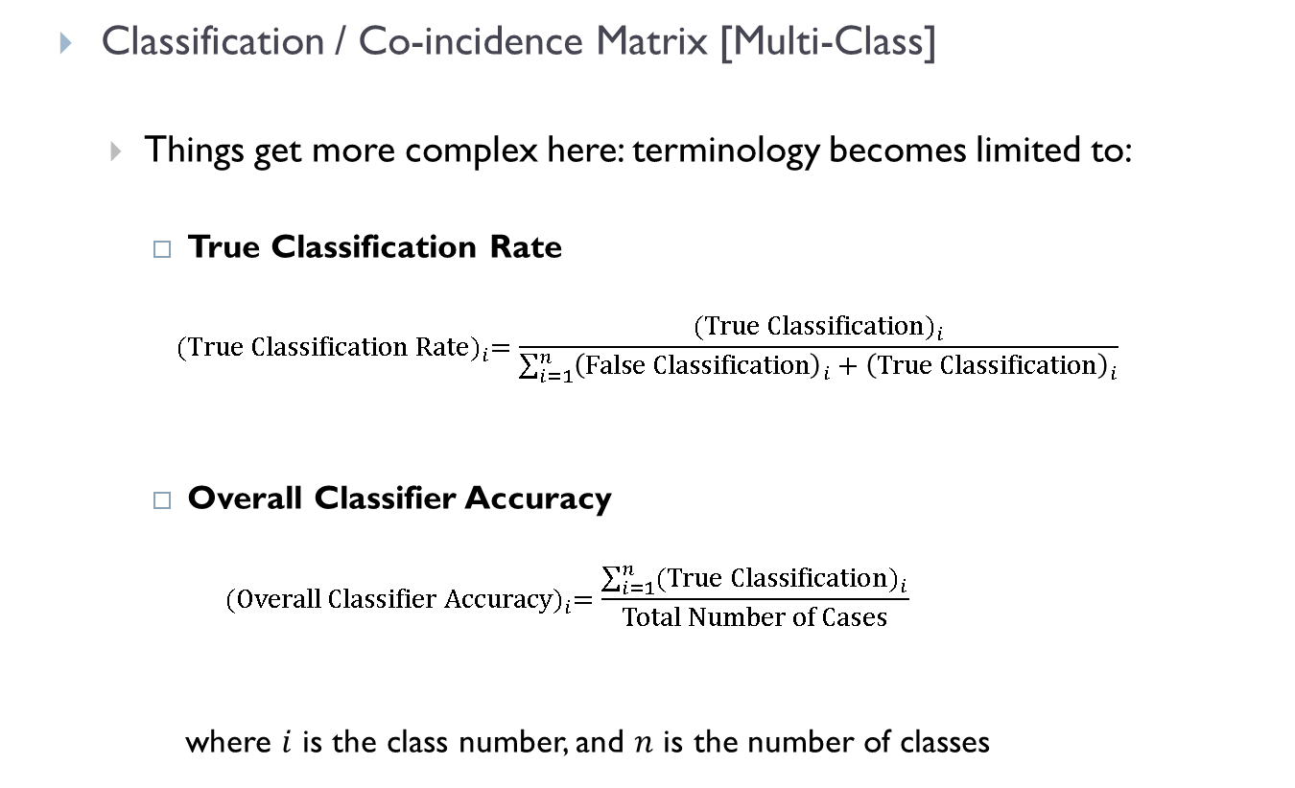
3.1 Model Evaluation
Classification / Co-incidence Matrix [Multi-Class]
Things get more complex here: terminology becomes limited to:
True Classification Rate
$${(\text{True} \text{Classification} \text{Rate})}_{i}=\frac{{(\text{True} \text{Classification})}_{i}}{\sum_{i=1}^{n}{{\left(\text{False} \text{Classification}\right)}_{i}+{\left(\text{True} \text{Classification}\right)}_{i}}}$$
Overall Classifier Accuracy
$${(\text{Overall} \text{Classifier} \text{Accuracy})}_{i}=\frac{\sum_{i=1}^{n}{{(\text{True} \text{Classification})}_{i}}}{\text{Total} \text{Number} \text{of} \text{Cases}}$$
where $i$ is the class number, and $n$ is the number of classes

Slide 10
3.1 Model Evaluation
Classification / Co-incidence Matrix [Multi-Class]
 |  | Actual Classification of Classes in the dataset
 |  | Class 1 | Class 2 | Class 3
Model Classification | Class 1 | 22 | 7 | 2
 | Class 2 | 5 | 18 | 7
 | Class 3 | 3 | 5 | 21
 | Probability | 0.33 | 0.33 | 0.33
 | Accuracy | 0.73 | 0.60 | 0.70 | 0.68

Slide 11
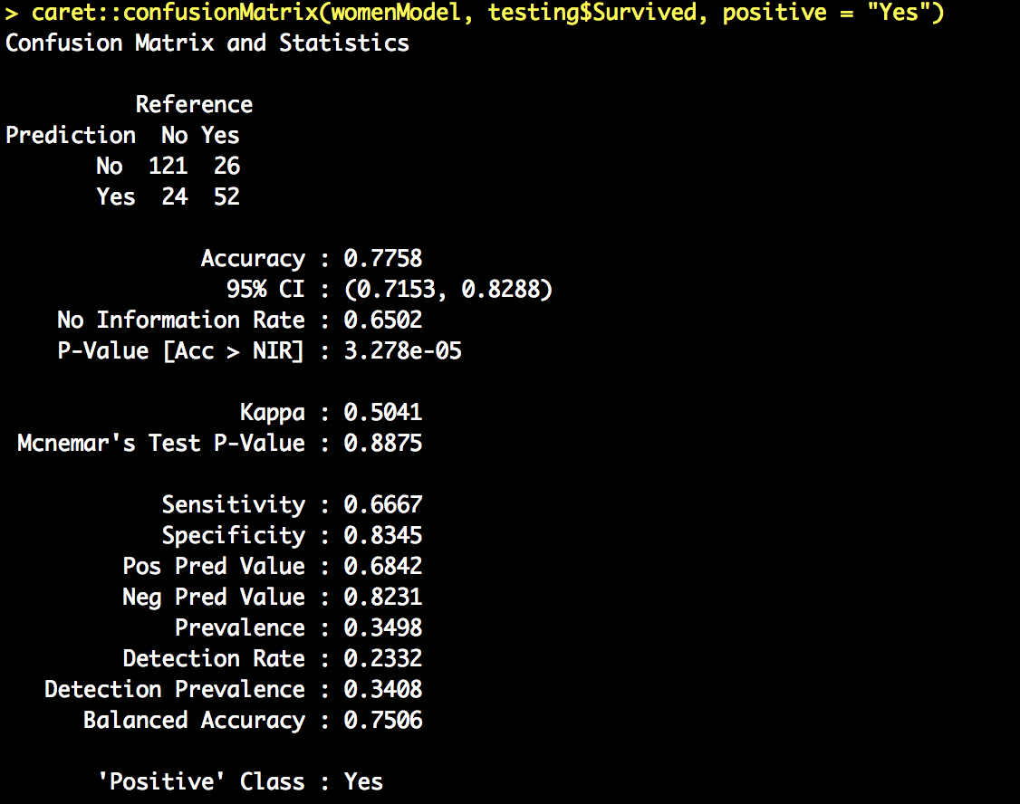
3.1 Model Evaluation
Beyond the Co-incidence Matrix
Adjusts accuracy by accounting for the possibility of correct prediction by chance alone
95% confidence interval
largest proportion of the observed classes
Sensitivity: the proportion of positive examples correctly classified
1-sided hypothesis test if accuracy is greater than the rate of the largest class – helpful when there are large class imbalances in the dataset
Specificity: the proportion of negative examples correctly classified
% of predicted +ves that are actually +ve (precision)
The rate of true positives also predicted to be positive
% of predicted –ves that are actually -ve
The rate of the positive class

Slide 12
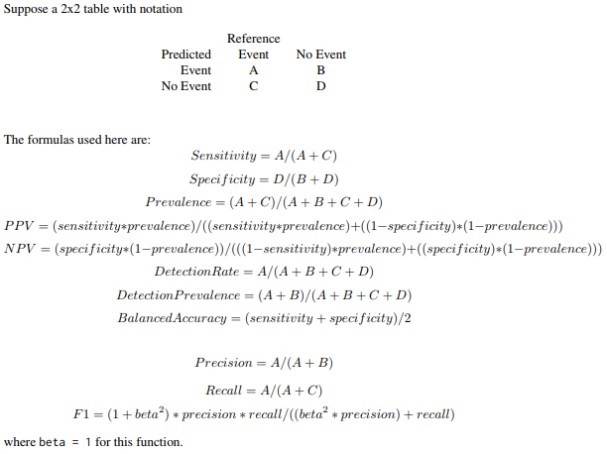
3.1 Model Evaluation
Beyond the Co-incidence Matrix
https://cran.r-project.org/web/packages/caret/caret.pdf

Slide 13

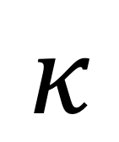
3.1 Model Evaluation
$$κ$$
Kappa
The kappa statistic adjusts the notion of accuracy by also accounting for the possibility that a correction prediction is chance
Kappa values are in the range [0,1]
where 1 is a “perfect” agreement between predictions and true values
1 is very rare!
A somewhat arbitrary, but common basis for evaluating Kappa values is:
Poor agreement: < 0.20
Fair agreement: 0.20 – 0.40
Moderate agreement: 0.40 – 0.60
Good agreement: 0.60 – 0.80
Very good agreement: 0.80 – 1.00
The notion of “good” agreement is also very context specific!
E.g. predicting a sports result vs. landing a shuttle safely

Slide 14
3.1 Model Evaluation
Sensitivity & Specificity
Classification is often a balance between conservative and aggressive decision making
E.g. we could eliminate all spam by also eliminating all ham
Or we could allow all ham through by not filtering spam
Sensitivity and specificity capture this trade off
Sensitivity: proportion of +ve examples correctly classified: TP / (TP + FN)
Specificity: proportion of –ve examples correctly classified: TN / (TN + FP)
Both are in the range [0,1] with 1 being desirable.
Sensitivity : 0.6667 ← 66.7% of survivors correctly classified
Specificity : 0.8345 ← 83.5% of those who did not survive correctly classified
The question is always going to be, do you prefer to be better at identifying those who survived or those that didn’t?
Finding a balance of the 2 though is very application dependent!!
True Positive Rate
True Negative Rate

Slide 15
3.1 Model Evaluation
Sensitivity & Specificity
Suppose we have a dataset of 100 emails that are labeled as spam or ham (not spam) and we build two classifiers that distinguishes future spam emails from ham emails
True Positive : the model correctly labels it with the positive class (spam).
False Negative: the model mislabels it with the negative class (ham), but it truly belongs in the positive class (spam).
False Positive: the model mislabels it with the positive class (spam), but it truly belongs in the negative class (ham).
True Negative (bottom right entry): the model correctly labels it with the negative class (ham).
Compute sensitivity and specificity
for each classifier?
 |  | True Class
 |  | Spam | Ham
Predicted Class | Spam | TP (40) | FP (20)
 | Ham | FN (10) | TN (30)

Slide 16
3.1 Model Evaluation
Sensitivity & Specificity
Suppose we have a dataset of 100 patients that are labeled as cancer or not cancer and we build two classifiers that distinguishes future patients as having or not having cancer.
Compute sensitivity and specificity
for each classifier?
 |  | True Class
 |  | Cancer | Not Cancer
Predicted Class | Cancer | TP (40) | FP (20)
 | Not Cancer | FN (10) | TN (30)

Slide 17
3.1 Model Evaluation
Precision & Recall
These are very closely related to sensitivity and specificity; but come from the domain of information retrieval
Precision: (the positive predicted value): proportion of positive examples that are truly positive.
I.e., when you predict positive, how often you are right.
High precision means that only very likely positives are predicted as positive
Precise models are trustworthy
TP / (TP + FP)
For titanic: high precision means identifying survivors, but simultaneously ignoring the rest
Recall: how complete the results are
Basically the same as sensitivity, but with a subtle difference in interpretation
High recall means capturing a large portion of the positive examples
TP / (TP + FN)
For titanic: high recall means the majority of survivors are identified
Similar to sensitivity and specificity, most real-world problems struggle to be highly precise and have a high recall

Slide 18
3.1 Model Evaluation
R
library(caret)
Precision:
> posPredValue(womenModel, testing$Survived, positive="Yes")
[1] 0.6842105
Recall / Sensitivity:
> sensitivity(womenModel, testing$Survived, positive="Yes")
[1] 0.6666667
Specificity:
> specificity(womenModel, testing$Survived, negative = "No")
[1] 0.8344828

Slide 19
3.1 Model Evaluation
F-Measure / F-Score
One way to combine both precision and recall into a single measure ☺
Thus making it easier to compare models
but not necessarily address the trade off of precision vs. recall – here they are assumed to be equally important…!
We can assign weights to the F-Measure, but it is hard for these to be non-arbitrary
Leverages the harmonic mean instead of the arithmetic mean in order to place higher emphasis on the positive count
F-measure = (2 * Precision * Recall) / (Recall + Precision)
= (2 * TP) / (2 * TP + FP + FN)
Instead of weighting the F-Measure can use it in combination with other more globally encapsulating measures of a model’s strengths and weaknesses

Slide 20

3.1 Model Evaluation
ROC Curve
ROC: Receiver Operating Characteristics
From the days of radio transmission
A method to visually evaluate the performance of a classifier:
A 2D graph with the true positive rate on the x-axis and the false positive rate on the y-axis
4 keys points on a ROC curve:
(0, 0): classifier doesn’t do anything
(1, 1): classifier always predicts true
(0, 1): perfect classifier that never issues a false positive
Line y = x: random classification (coin toss); the standard base line
A classifier is:
better the closer it is to the point (0,1)
conservative if it is on the left hand side of the graph
liberal if they are on the upper right of the graph
The classifier needs to rank the test cases according to their likelihoods of belonging to the positive class with the most likely positive class ranked at the top.

Slide 21
3.1 Model Evaluation
ROC Curve
Conservative: they make positive classifications in the presence of strong evidence, so they make fewer false positive errors;
typically at the cost of low true positive rates
Liberal: they make positive classifications with weak evidence so they classify nearly all positives correctly
typically at the cost of high false positive rates
Many real world data sets are dominated by negative instances.
Left hand side of the ROC curve is therefore more interesting
To reduce the curve to a meaningful number or scalar, we compute the area under the curve.
It is always between 0 and 1
1 is perfect, 0.5 random, and 0 should never happen

Slide 22
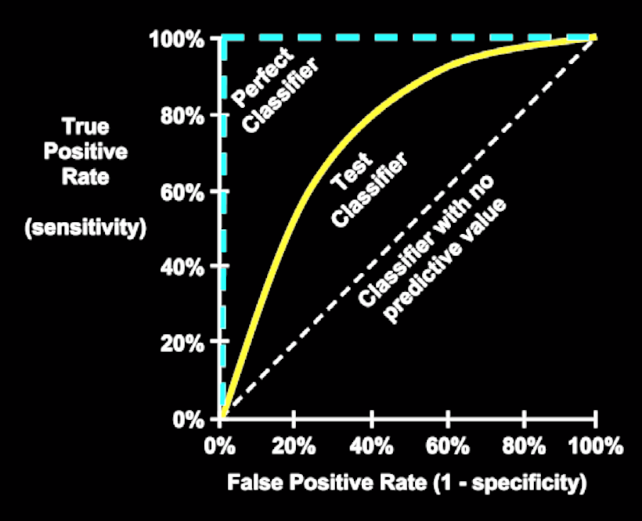
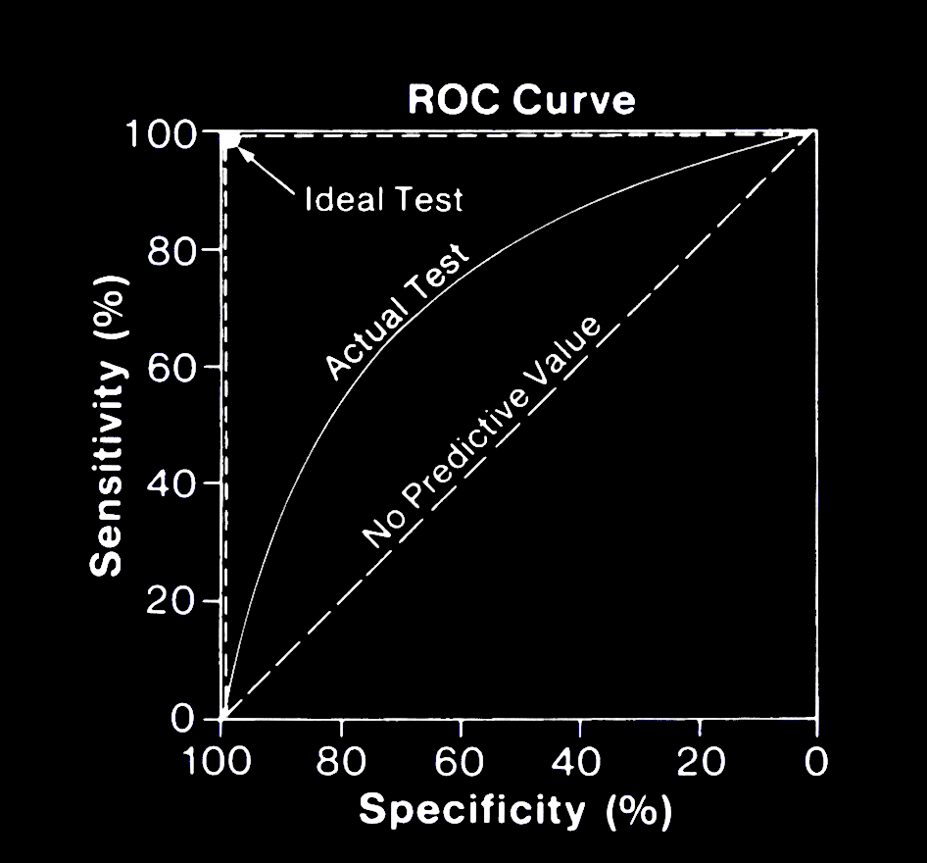
3.1 Model Evaluation
ROC Curve

Slide 23
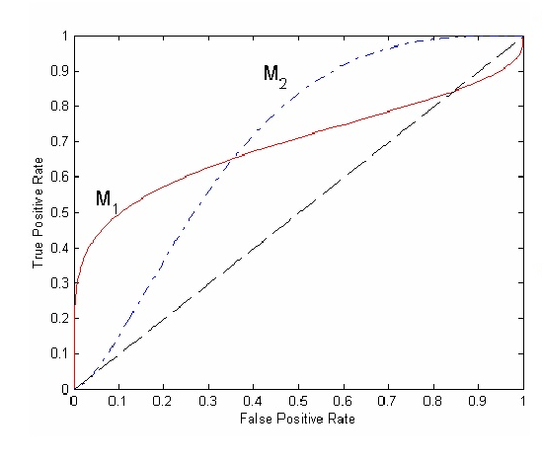
3.1 Model Evaluation
ROC Curve
Compare these two ROC curves?
The ROC curves suggest that
M11 is better than M12 when the FPR < 0.35
M12 is better than M11 when the FPR >= 0.35
However, this may not be satisfactory as we cannot say any one of the classifiers is strictly better than the other.

Slide 24
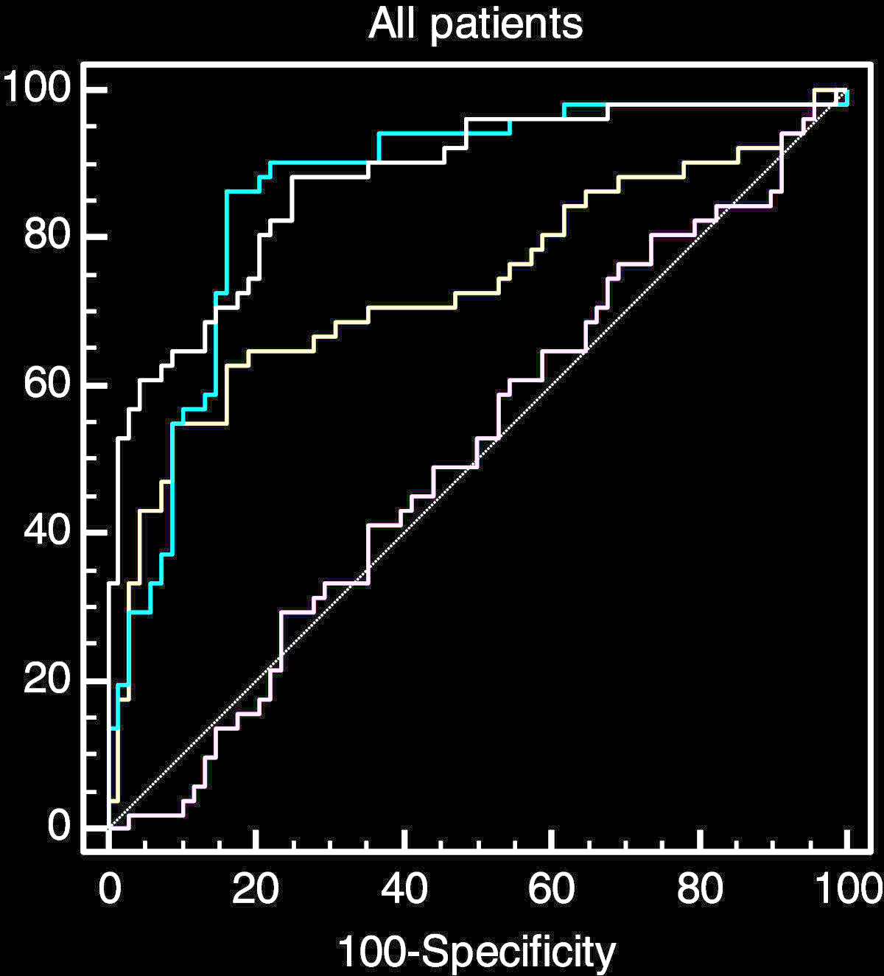
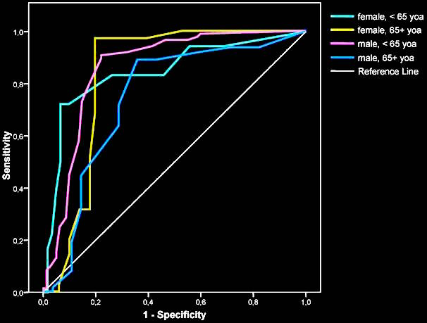
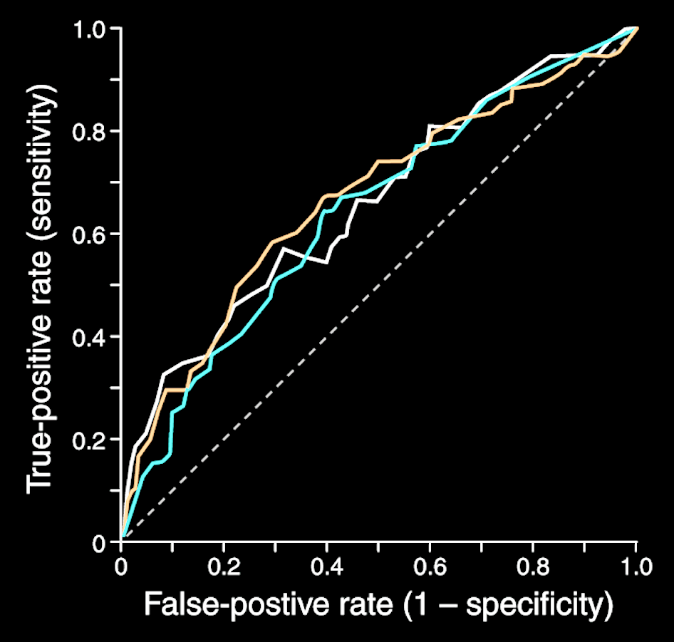
3.1 Model Evaluation
ROC Curve
To create a ROC curve we do the following:
Rank the predictions of a classifier by confidence (or probability) in (of) correct classification
Order them (highest first)
Plot each prediction’s impact on the true positive rate and false positive rate
Curves are nice, but not always easy to interpret e.g.:
So we tend to compute the area under the ROC curve instead (AUC)

Slide 25
3.1 Model Evaluation
AUC
A convention for AUC:
0.9 – 1.0 = A (outstanding)
0.8 – 0.9 = B (excellent / good)
0.7 – 0.8 = C (acceptable / fair)
0.6 – 0.7 = D (poor)
0.5 – 0.6 = F (no discrimination)
Note that ROC curves with similar AUCs may be shaped very differently so AUC can still be misleading and shouldn’t be computed without some qualitative examination of the ROC curve itself.

Slide 26
3.2 Data Splitting & Sampling Methods
Performance Estimation
Why estimate?
We can look to predict the learner’s future performance on unseen data – thus building a confidence measure
We can determine which of potentially many options we have is best
What do we want?
Low bias
Bias is an error from erroneous assumptions in the learning algorithm
Low variance
Variance is an error from sensitivity to small fluctuations in the training set
Popular/standard approaches:
Simple Split: Hold-out
k-Fold Cross Validation
Bootstrapping
Jack-Knifing

Slide 27
3.2 Data Splitting & Sampling Methods
Simple Split / Hold-out
Portion the data set into 2 slices
Training
Testing
Build the model with the training data (commonly 75% or 80% of the data)
Test model predictions with the test data (commonly 25% or 20% of the data)
An 80/20 holdout means 80% training, 20% testing.
Although this method is nice (and simple) it assumes that the split is fair and equally representative!
Training Data
Classification Model
Preprocessed Data
Testing Data
Classification Accuracy

Slide 28
3.1 Model Evaluation
R
Random sample:
index <- sample(1:dim(mydata)[1], dim(mydata)[1] * .75, replace=FALSE)
Stratified sample: (stratified retains the distribution of the dependent variable)
library(caret)
index <- createDataPartition(mydata$classLabel, p = 0.75, list = FALSE)
Then:
mydata_train <- mydata[index]
mydata_test <- mydata[-index]

Slide 29
3.2 Data Splitting & Sampling Methods
K-Fold Cross Validation
a.k.a.: rotation estimation – the classifier is trained k times
Minimises the bias associated with one-shot random sampling by breaking the data into k mutually exclusive subsets of appropriately equal size
The model is evaluated according to the average accuracy across the k individual folds
It is important to ensure that the folds are stratified (i.e. representative of the data set as a whole) to ensure more reliable results
See: Kohavi, R. (1995). A study of cross-validation and bootstrap for accuracy estimation and model selection. In Ijcai (Vol. 14, No. 2, pp. 1137-1145).
Cross Validation Accuracy

Slide 30
3.2 Data Splitting & Sampling Methods
K-Fold Cross Validation
It has become common practice to set k to 10 – it tends to produce optimised results without significant compute effort
See: Breiman, L., Friedman, J., Stone, C. J., & Olshen, R. A. (1984). Classification and regression trees. CRC press.
Process:
Divide data set into k disjoint datasets of roughly equal size and ensure it is stratified
For each fold construct a classifier using all data except that of the fold data.
Test the classifier using the fold data.
Repeat 2 and 3 for all folds and compute the CVA
Interestingly, cross validation requires less data than the standard holdout approach, and tends to work well for small datasets.

Slide 31
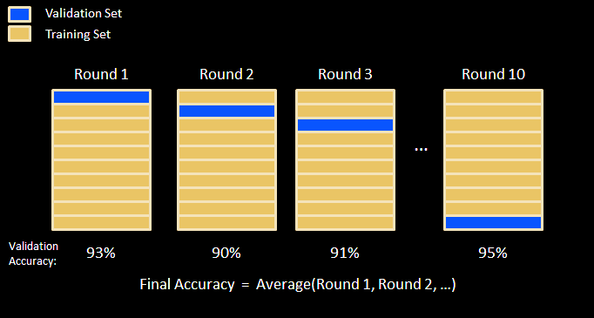
3.2 Data Splitting & Sampling Methods
K-Fold Cross Validation

Slide 32
3.1 Model Evaluation
R
folds <- createFolds(mydata$classLabel, k = 10)
mydata_train_01 <- mydata[folds$Fold01, ]
mydata_test_01 <- mydata[-folds$Fold01, ]
…
mydata_train_10 <- mydata[folds$Fold10, ]
mydata_test_10 <- mydata[-folds$Fold10, ]

Slide 33

3.3 Summary
Model Evaluation
Data Splitting & Sampling Methods
Bibliography/References
Lantz, B. (2013). Machine learning with R. Chaps. 10 and 11 Packt Publishing Ltd.
Liu, B. (2007). Web data mining: exploring hyperlinks, contents, and usage data. Chap 3. Springer Science & Business Media.
Kuhn, M. (2008). Building predictive models in R using the caret package. Journal of Statistical Software, 28(5), 1-26.
Olson, D. L., & Delen, D. (2008). Advanced data mining techniques. Chap 9. Springer Science & Business Media.

