Slide 1

Data Mining & Machine Learning I
4. Regression Models I

Slide 2
4. Regression Models I
4.1 Overview
4.2 Measuring the Quality of Fit
4.3 Bias/ Variance Trade-off
4.4 Linear Regression
4.5 Summary

Slide 3
4.1 Overview
Overview
X2
X1
X3
Y
Xp
Input Variables
Predictors
Independent Variables
Features
Output Variables
Dependent Variables
Response

Slide 4
4.1 Overview
Suppose we observe and for
We believe that there is a relationship between Y and at least one of the X’s.
We can model the relationship as
Where f is an unknown function and ε is a random error with mean zero.

Slide 5
4.1 Overview

Slide 6
4.1 Overview
ε_{i}
f

Slide 7
4.1 Overview
The difficulty of estimating f will depend on the standard deviation of the ε’s.

Slide 8
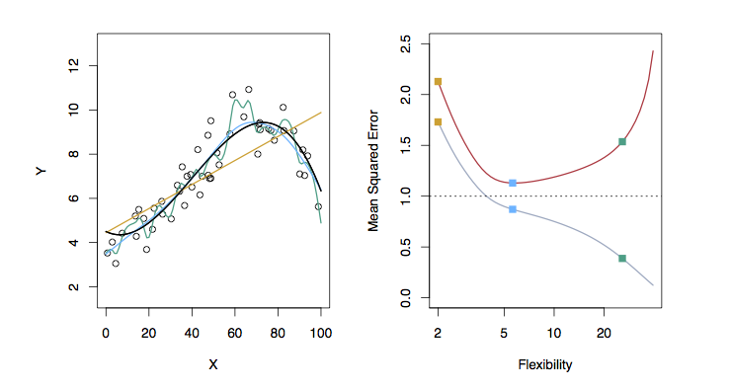
4.2 Measuring the Quality of Fit
Examples with Different Levels of Flexibility: Example 1
LEFT
Black: Truth
Orange: Linear Estimate
Blue: smoothing spline
Green: smoothing spline (more flexible)
RIGHT
RED: Test MSE
Grey: Training MSE
Dashed: Minimum possible test MSE (irreducible error)

Slide 9
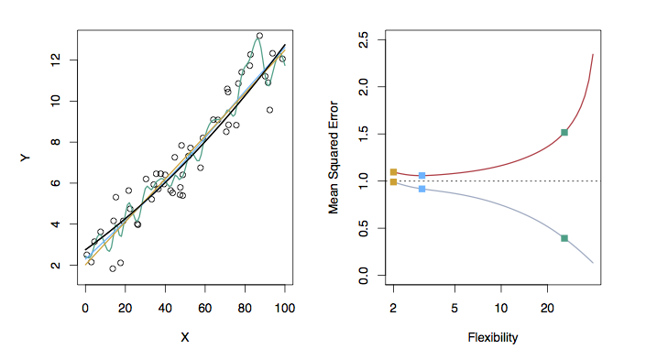
4.2 Measuring the Quality of Fit
Examples with Different Levels of Flexibility: Example 2
LEFT
Black: Truth
Orange: Linear Estimate
Blue: smoothing spline
Green: smoothing spline (more flexible)
RIGHT
RED: Test MSE
Grey: Training MSE
Dashed: Minimum possible test MSE (irreducible error)

Slide 10
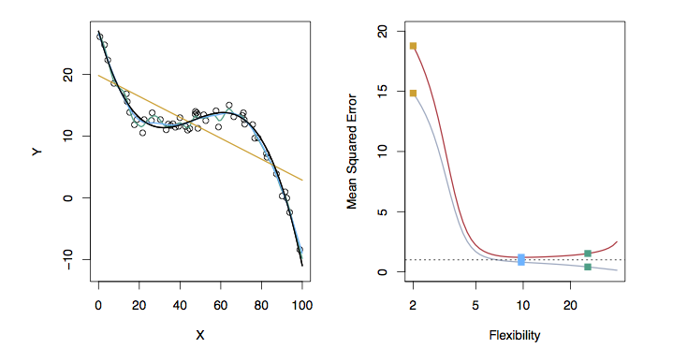
4.2 Measuring the Quality of Fit
Examples with Different Levels of Flexibility: Example 3
LEFT
Black: Truth
Orange: Linear Estimate
Blue: smoothing spline
Green: smoothing spline (more flexible)
RIGHT
RED: Test MSE
Grey: Training MSE
Dashed: Minimum possible test MSE (irreducible error)

Slide 11
4.3 Bias/ Variance Trade-off
The previous graphs of test versus training MSE’s illustrates a very important tradeoff that governs the choice of statistical learning methods.
There are always two competing forces that govern the choice of learning method i.e. bias and variance.

Slide 12
4.3 Bias/ Variance Trade-off
Bias of Learning Methods
Bias refers to the error that is introduced by modeling a real life problem (that is usually extremely complicated) by a much simpler problem.
For example, linear regression assumes that there is a linear relationship between Y and X. It is unlikely that, in real life, the relationship is exactly linear so some bias will be present.
The more flexible/complex a method is the less bias it will generally have.

Slide 13
4.3 Bias/ Variance Trade-off
Variance of Learning Methods
Variance refers to how much your estimate for f would change by if you had a different training data set.
Generally, the more flexible a method is the more variance it has.

Slide 14
4.3 Bias/ Variance Trade-off
The Trade-off
It can be shown that for any given, X=x₀, the expected test MSE for a new Y at x₀ will be equal to
What this means is that as a method gets more complex the bias will decrease and the variance will increase but expected test MSE may go up or down!

Slide 15
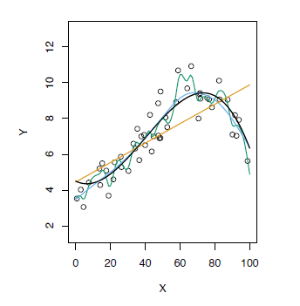
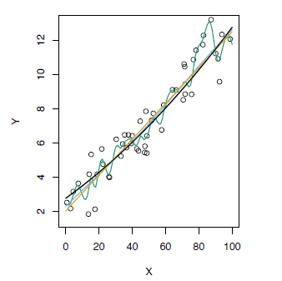
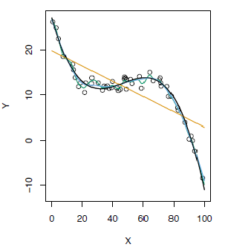
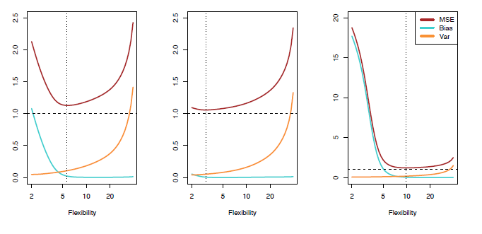
4.3 Bias/ Variance Trade-off
Test MSE, Bias and Variance

Slide 16
4.3 Bias/ Variance Trade-off
The Classification Setting
For a regression problem, we used the MSE to assess the accuracy of the statistical learning method
For a classification problem we can use the error rate i.e.
is an indicator function, which will give 1 if the condition is correct, otherwise it gives a 0.
Thus the error rate represents the fraction of incorrect classifications, or misclassifications

Slide 17
4.3 Bias/ Variance Trade-off
Bayes Error Rate
The Bayes error rate refers to the lowest possible error rate that could be achieved if somehow we knew exactly what the “true” probability distribution of the data looked like.
On test data, no classifier (or stat. learning method) can get lower error rates than the Bayes error rate.
Of course in real life problems the Bayes error rate can’t be calculated exactly.

Slide 18
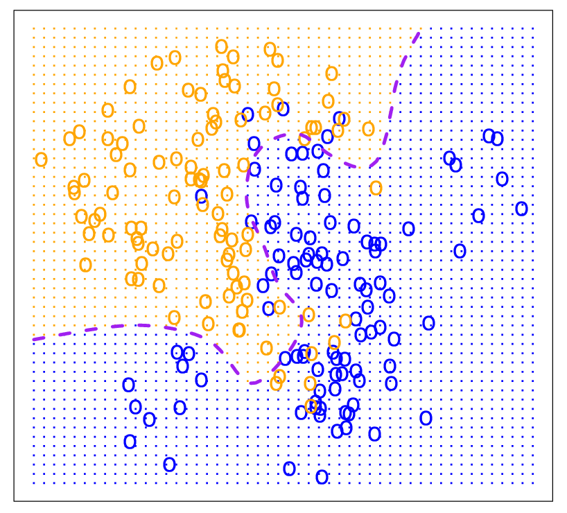
4.3 Bias/ Variance Trade-off
Bayes Optimal Classifier

Slide 19
4.3 Bias/ Variance Trade-off
K-Nearest Neighbors (KNN)
k Nearest Neighbors is a flexible approach to estimate the Bayes Classifier.
For any given X we find the k closest neighbors to X in the training data, and examine their corresponding Y.
If the majority of the Y’s are orange we predict orange otherwise guess blue.
The smaller that k is the more flexible the method will be.

Slide 20
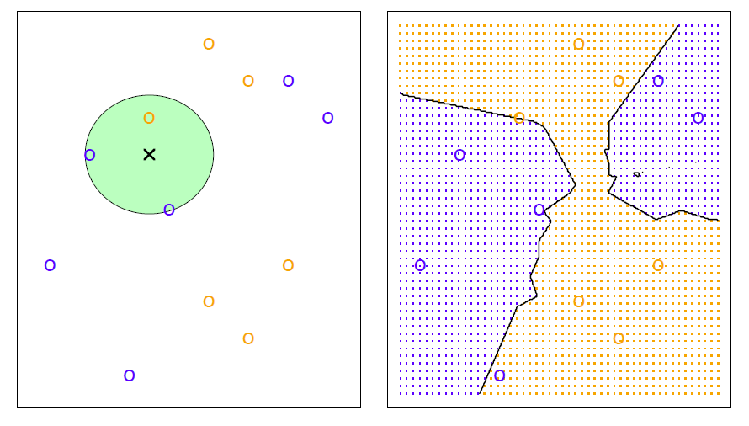
4.3 Bias/ Variance Trade-off
KNN Example with k = 3

Slide 21
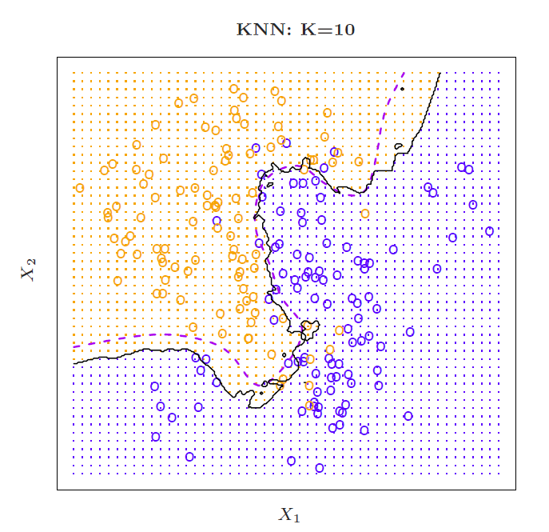
4.3 Bias/ Variance Trade-off
Simulated Data: K = 10

Slide 22
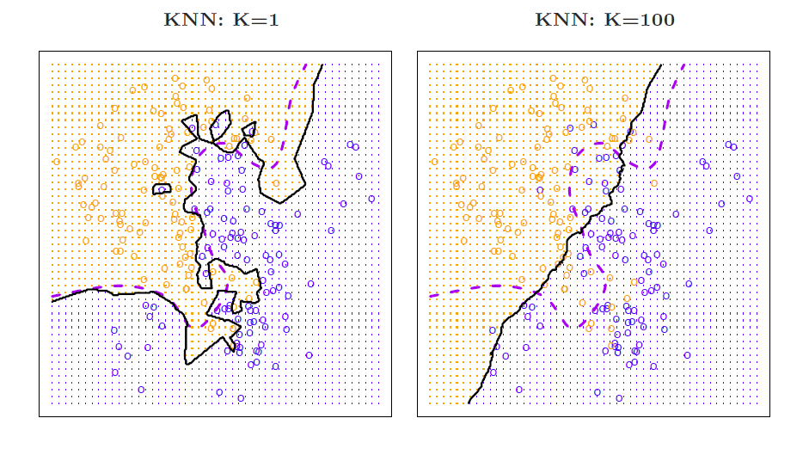
4.3 Bias/ Variance Trade-off
K = 1 and
K = 100

Slide 23
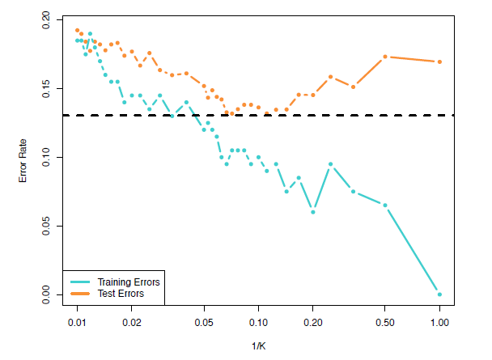
4.3 Bias/ Variance Trade-off
Training vs. Test Error Rates on the Simulated Data
Notice that training error rates keep going down as k decreases or equivalently as the flexibility increases.
However, the test error rate at first decreases but then starts to increase again.

Slide 24
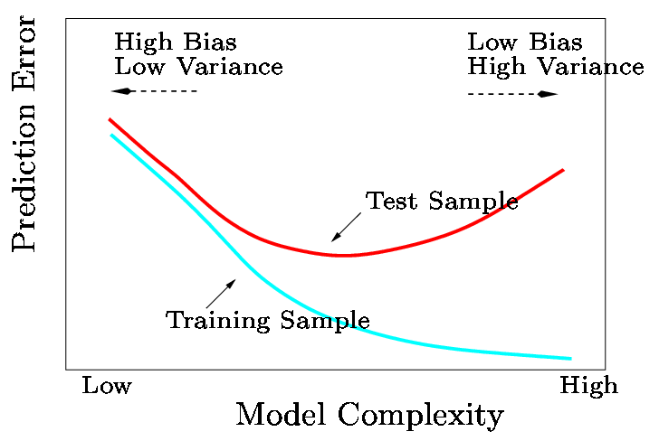
4.3 Bias/ Variance Trade-off
In general training errors will always decline.
However, test errors will decline at first (as reductions in bias dominate) but will then start to increase again (as increases in variance dominate).
We must always keep this picture in mind when choosing a learning method. More flexible/complicated is not always better!

Slide 25
4.4 Linear Regression
The Linear Regression Model
The parameters in the linear regression model are very easy to interpret.
β₀ is the intercept (i.e. the average value for Y if all the X’s are zero), β_{j} is the slope for the jth variable X_{j}
β_{j} is the average increase in Y when X_{j} is increased by one and all other X’s are held constant.

Slide 26
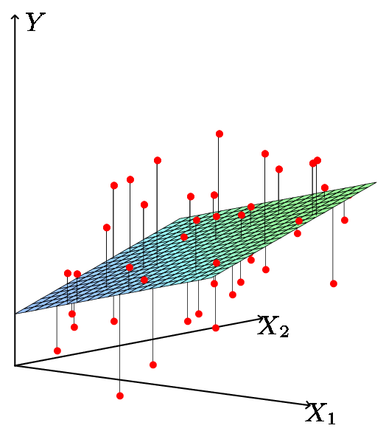
4.4 Linear Regression
Least Squares Fit
We estimate the parameters using least squares i.e. minimize

Slide 27
4.4 Linear Regression
Relationship between population and least squares lines
Population line
Least Squares line
We would like to know β₀ through β_{p} i.e. the population line. Instead we know through i.e. the least squares line.
Hence we use through as guesses for β₀ through β_{p} and as a guess for Y_{i}. The guesses will not be perfect just as is not a perfect guess for μ.

Slide 28
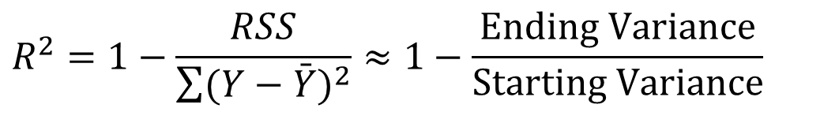
4.4 Linear Regression
Measures of Fit: R²
Some of the variation in Y can be explained by variation in the X’s and some cannot.
R² tells you the fraction of variance that can be explained by X.
$$R^{2}=1−\frac{RSS}{\sum{(Y−\bar{Y})^{2}}}≈1−\frac{\text{Ending} \text{Variance}}{\text{Starting} \text{Variance}}$$
R² is always between 0 and 1. Zero means no variance has been explained. One means it has all been explained (perfect fit to the data).

Slide 29
4.4 Linear Regression
Estimated (least squares) line.
Inference in Regression
The regression line from the sample is not the regression line from the population.
What we want to do:
Assess how well the line describes the plot.
Guess the slope of the population line.
Guess what value Y would take for a given X value
14
12
10
8
6
4
2
0
-10
-5
0
5
10
X
True (population) line. Unobserved

Slide 30
4.4 Linear Regression
Some Relevant Questions
Is β_{j}=0 or not? We can use a hypothesis test to answer this question. If we can’t be sure that β_{j}≠0 then there is no point in using X_{j} as one of our predictors.
Can we be sure that at least one of our X variables is a useful predictor i.e. is it the case that β₁= β₂=⋅⋅⋅= β _{p}=0?

Slide 31
4.4 Linear Regression
Is β_{j}=0 i.e. is X_{j} an important variable?
We use a hypothesis test to answer this question
H₀: β_{j}=0 vs H_{a}: β_{j}≠0
Calculate
If t is large (equivalently p-value is small) we can be sure that β_{j}≠0 and that there is a relationship
Number of standard deviations away from zero.
is 17.67 SE’s from 0
P-value

Slide 32
4.4 Linear Regression
Testing Individual Variables
Is there a (statistically detectable) linear relationship between Newspapers and Sales after all the other variables have been accounted for?
No: big p-value
Small p-value in simple regression
Almost all the explaining that Newspapers could do in simple regression has already been done by TV and Radio in multiple regression!

Slide 33
4.4 Linear Regression
Is the whole regression explaining anything at all?
Test for:
Answer comes from the F test in the ANOVA (ANalysis Of VAriance) table.
The ANOVA table has many pieces of information. What we care about is the F Ratio and the corresponding p-value.
H₀: all slopes = 0 (β₁=β₂=⋅⋅⋅=β_{p}=0),
H_{a}: at least one slope ≠ 0

Slide 34

4.5 Summary
Overview
Measuring the Quality of Fit
Bias/ Variance Trade-off
Linear Regression
Slides by Abbass Al Sharif, PhD
https://www.alsharif.info/iom530
Bibliography/References
James G., Witten D., Hastie T., Tibshirani R. (2013). An Introduction to Statistical Learning. Springer.

