Slide 1

Data Mining & Machine Learning I
5. Regression Models II

Slide 2
5. Regression Models II
5.1 Overview
5.2 Regression Model Considerations
5.3 kNN Regression
5.4 Partial Least Squares Regression
5.5 Summary

Slide 3
5.1 Overview
Overview
Linear Model Considerations
Qualitative Predictors
Predictor Interactions
Collinearity
Non-linearity considerations
Dimensionality
KNN Regression
Non-parametric
Partial Least Squares Regression (PLS)
May contribute to potential issues with fitting the model to the data.

Slide 4
5.2 Regression Model Considerations
Recall …
Suppose we observe and for
We believe that there is a relationship between Y and at least one of the X’s.
We can model the relationship as
Where f is an unknown function and ε is a random error with mean zero.
Thus far, we have assumed that the values associated with the
values are numeric/quantitative.
What about categorical/qualitative features? Can we use such features/factors in a regression model?

Slide 5
5.2 Regression Model Considerations
Qualitative Predictors
Say we had a feature for specifying whether or not a subject of study was either Male or Female – how might we consider building such a predictor into a regression model?
We could encode such a feature as an
indicator (or dummy) variable
Male → 0
Female → 1

Slide 6
5.2 Regression Model Considerations
Suppose we want to include Income and Gender.
Two genders (male and female). Let
Then the regression equation is
β2 is the average extra balance each month that females have for given income level. Males are the “baseline”.

Slide 7
5.2 Regression Model Considerations
There are different ways to code categorical variables.
Two genders (male and female). Let
Then the regression equation is
β2 is the average amount that females are above the average, for any given income level.
β2 is also the average amount that males are below the average, for any given income level.
NOTE: Regardless of the encoding scheme employed the final predictions will be the same; however, our interpretation of the coefficients will changes.

Slide 8
5.2 Regression Model Considerations
What about qualitative predictors with more than two levels?
Create more dummy variables.

Slide 9
5.2 Regression Model Considerations
Predictor Interactions
When the effect on Y of increasing X1 depends on another X2.
Example:
Maybe the effect on Salary (Y) when increasing Position (X1) depends on gender (X2)?
For example maybe Male salaries go up faster (or slower) than Females as they get promoted.
Advertising example:
TV and radio advertising both increase sales.
Perhaps spending money on both of them may increase sales more than spending the same amount on one alone?

Slide 10
5.2 Regression Model Considerations
Predictor Interactions - Example
Spending $1 extra on TV increases average sales by
(0.0191 + 0.0011) Radio
Spending $1 extra on Radio increases average sales by
(0.0289 + 0.0011) TV
Interaction Term

Slide 11
5.2 Regression Model Considerations
Parallel Regression Lines
Line for women
Regression equation
female: salary = (112.77 + 1.86) + 6.05 × position
males: salary = (112.77 - 1.86) + 6.05 × position
Line for men
Parallel lines have the same slope. Dummy variables give lines different intercepts, but their slopes are still the same.
Different intercepts
Same slopes
A Potential Limitation!!
Introduce an interaction variable (Gender x Position)

Slide 12
5.2 Regression Model Considerations
Parallel Regression Lines
Our model has forced the line for men and the line for women to be parallel.
Parallel lines say that promotions have the same salary benefit for men as for women.
If lines aren’t parallel then promotions affect men’s and women’s salaries differently.

Slide 13
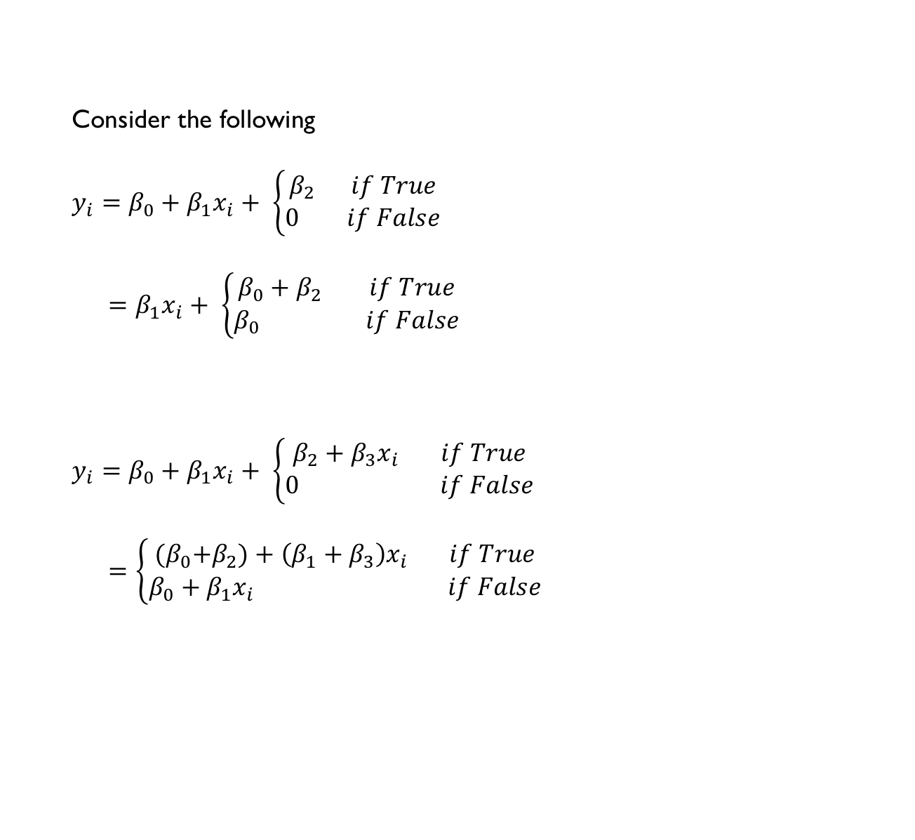
5.2 Regression Model Considerations
Parallel Regression Lines
Consider the following
$$y_{i}=β_{0}+β_{1}x_{i}+ \left\{\begin{aligned}β_{2} if True \\ 0 if False\end{aligned}\right.$$
$=β_{1}x_{i}+ \left\{\begin{aligned}{β_{0}+β}_{2} if True \\ β_{0} if False\end{aligned}\right.$
$$y_{i}=β_{0}+β_{1}x_{i}+ \left\{\begin{aligned}β_{2}+β_{3}x_{i} if True \\ 0 if False\end{aligned}\right.$$
$=\left\{\begin{aligned}{{(β}_{0}+β}_{2})+\left(β_{1}+β_{3}\right)x_{i} if True \\ β_{0}+β_{1}x_{i} if False\end{aligned}\right.$
No Interaction
With Interaction

Slide 14
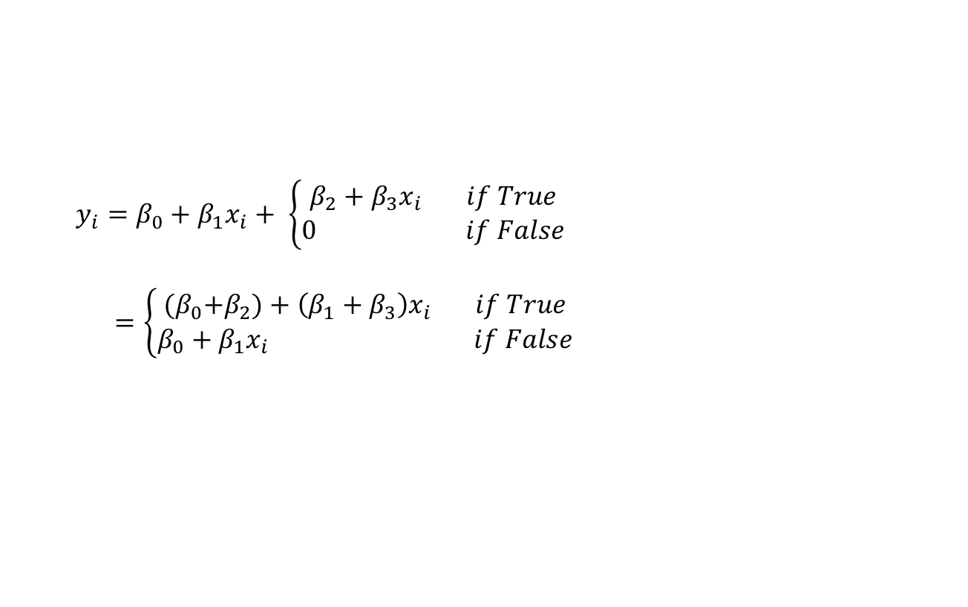
5.2 Regression Model Considerations
Parallel Regression Lines
Now we have two regression lines with different intercepts and different slopes
Allows for a change in predictor variable to (possibly) affect the response output depending on different categorical predictor variables
$$y_{i}=β_{0}+β_{1}x_{i}+ \left\{\begin{aligned}β_{2}+β_{3}x_{i} if True \\ 0 if False\end{aligned}\right.$$
$=\left\{\begin{aligned}{{(β}_{0}+β}_{2})+\left(β_{1}+β_{3}\right)x_{i} if True \\ β_{0}+β_{1}x_{i} if False\end{aligned}\right.$
With Interaction

Slide 15
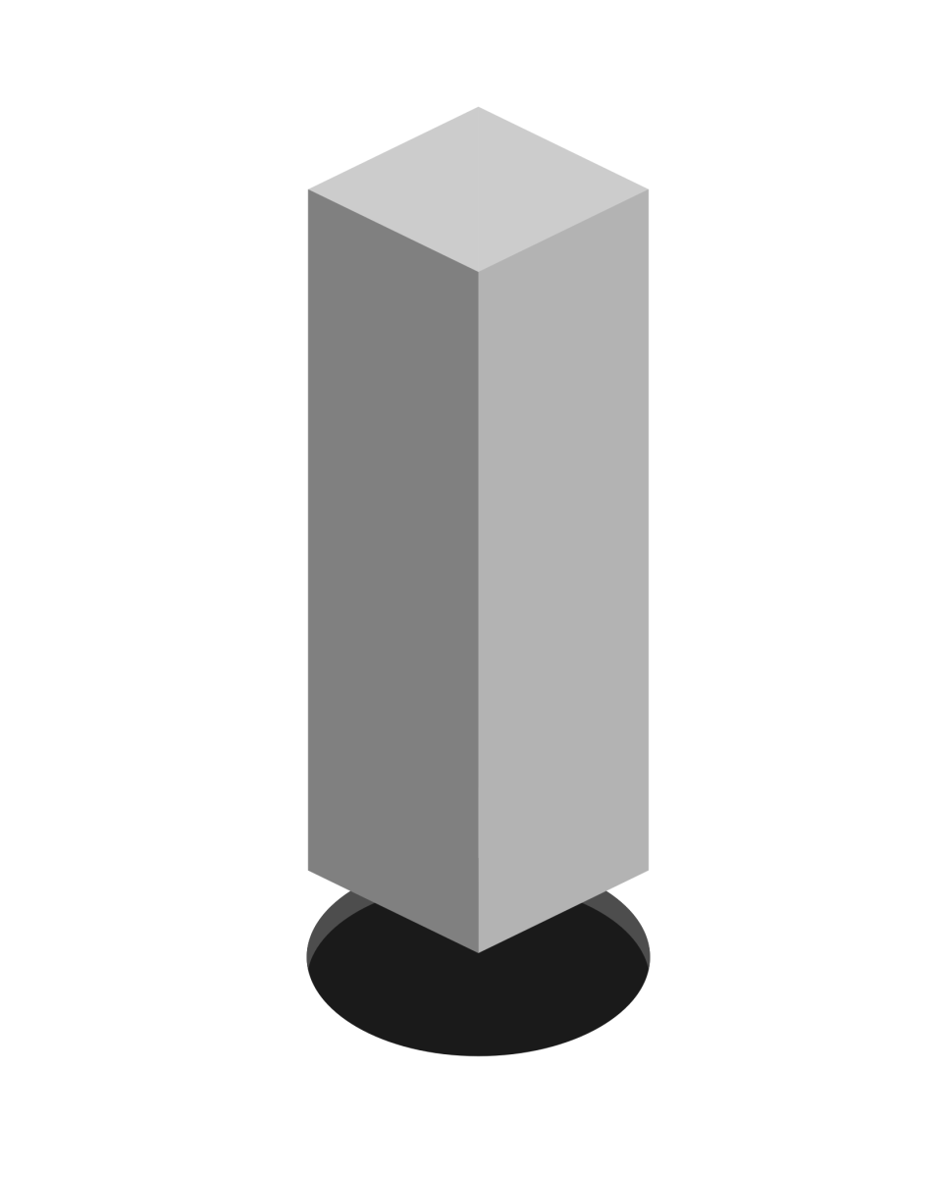
5.2 Regression Model Considerations
Potential Fit Problems
There are a number of possible problems that one may encounter when fitting the linear regression model.
Non-linearity of the data
Dependence of the error terms
Non-constant variance of error terms
Outliers
High leverage points
Collinearity

Slide 16
5.3 kNN Regression
kNN Regression
kNN Regression is similar to the kNN classifier.
To predict Y for a given value of X, consider k closest points to X in training data and take the average of the responses. i.e.
If k is small kNN is much more flexible than linear regression.
Is that better?
We will cover classification with kNN later!

Slide 17
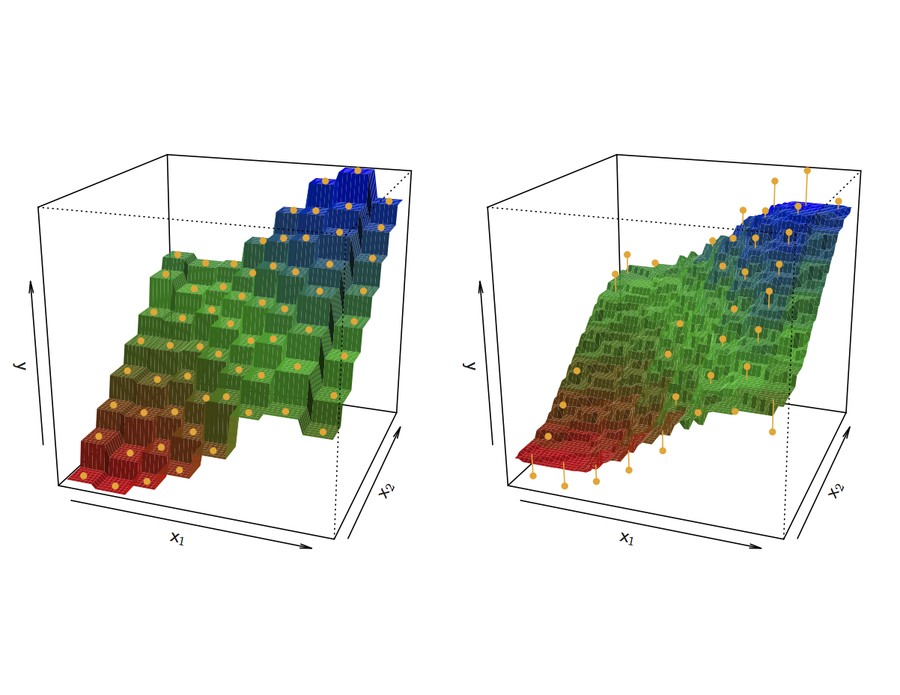
5.3 kNN Regression
kNN Regression
Here we have 2 predictors. For k = 1, the fit perfectly interpolates the training observations and takes the form of a step function. For k = 9, we still have a step function but due to the averaging the constant regions are smaller and the fit is smoother.
kNN Fits for k =1 and k = 9

Slide 18
5.3 kNN Regression
kNN Regression
The optimal value of k will depend on the bias-variance trade-off. A smaller value of k provides the most flexible fit with low bias and high variance. Larger values for k will result in a smoother and less variable fit.
kNN Fits for k =1 and k = 9

Slide 19
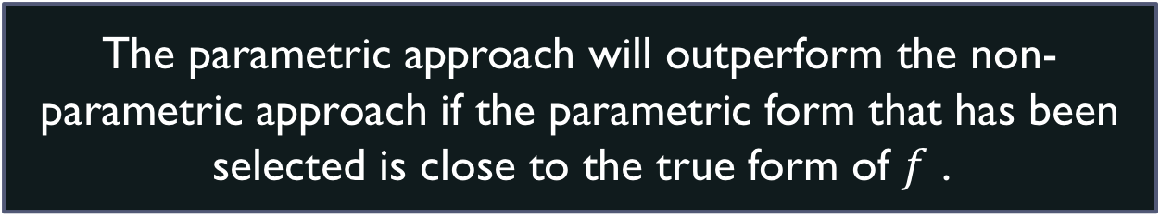
5.3 kNN Regression
kNN Regression
When will a parametric approach (e.g., least squares linear regression) outperform a non-parametric approach (e.g., kNN regression)?
The parametric approach will outperform the non- parametric approach if the parametric form that has been selected is close to the true form of $f$ .

Slide 20
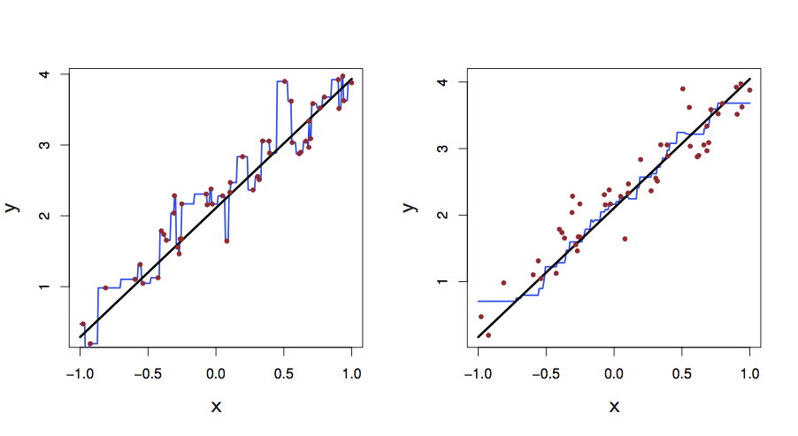

5.3 kNN Regression
kNN Regression
The black line represents $f(X)$.
The blue curves are kNN fits with k = 1 and k = 9.
The k = 1 predictions are too variable.
The k = 9 fit is much closer to $f(X)$.
However, since the true relationship is linear, it is hard for a non-parametric approach to compete with linear regression.
kNN Fits (in One Dimension) for k =1 and k = 9

Slide 21
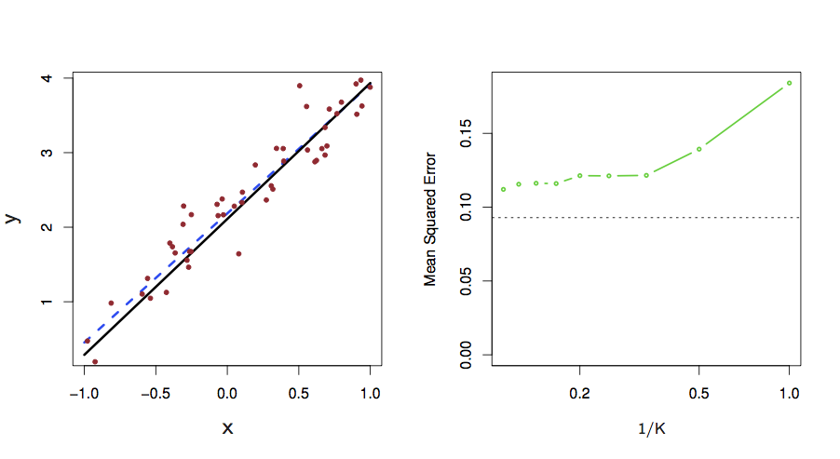
5.3 kNN Regression
kNN Regression
The blue dashed line represents the linear regression fit.
We can see that linear regression outperforms kNN regression for this example.
kNN performs far worse when the value of k is small.
Linear Regression Fit

Slide 22
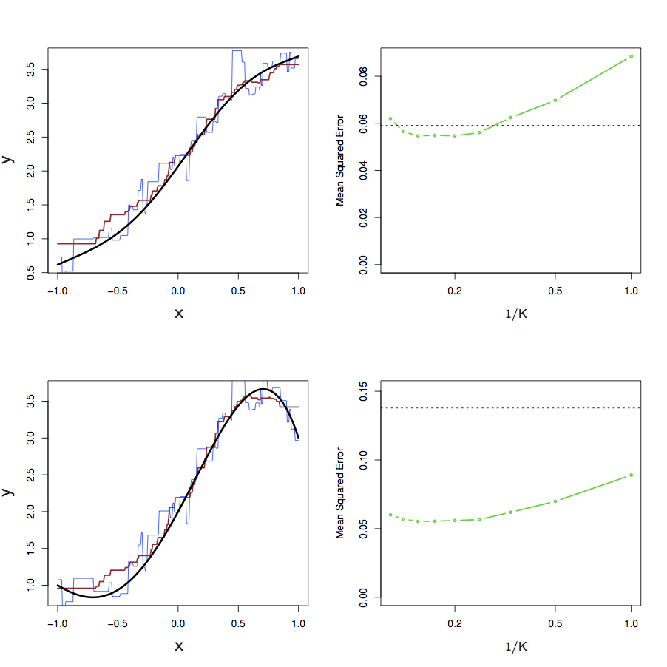
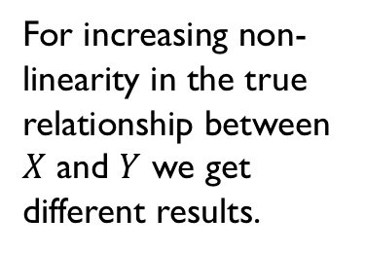
5.3 kNN Regression
kNN Regression
For increasing non-linearity in the true relationship between $X$ and $Y$ we get different results.
Note the movements in MSE as the extent of non-linearity increases.
kNN vs. Linear Regression

Slide 23
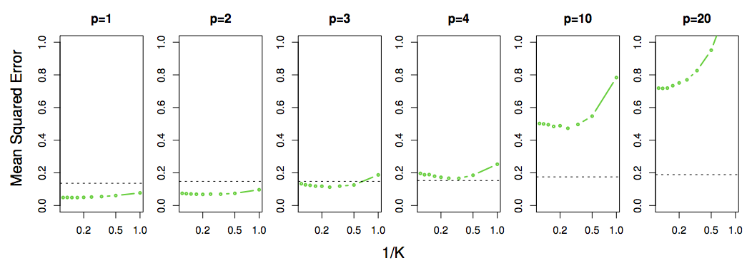
5.3 kNN Regression
kNN Regression
kNN vs. Linear Regression as number of (noisy) predictors increases
Not so good in high dimensional situations!
This is an example of the curse of dimensionality – when we spread observations over larger number of dimensions we find it more difficult to find nearby nieghbours.

Slide 24
5.4 Partial Least Squares Regression
Dimensionality Reduction
Is it possible to transform the predictors and then fit a least squares model using the transformed variables?
These techniques are known as dimension reduction methods
Principal Components Regression (PCR)
Apply Principal Components Analysis (PCA) to define the linear combinations of the predictors
Partial Least Squares (PLS) Regression
Identify a new set of features that are linear combinations of the original features and then fit a linear model (OLS) using these new features

Slide 25
5.4 Partial Least Squares Regression
PCR vs. PLS Regression
Principal Components Regression identifies linear combinations (directions) that represent a set of predictors
This happens in an unsupervised manner
The response value is not used to help determine the component directions
The response does not supervise the identification of the principal components
Potential drawback
There is no guarantee that the directions that best explain the predictors will also be the best directions for predicting the response

Slide 26
5.4 Partial Least Squares Regression
PCR vs. PLS Regression
PLS Regression identifies a new set of features that are linear combinations of the original features
This happens in a supervised manner
The response value is used to identify new features that both approximate the original features and are related to the response
In essence, PLS attempts to find directions that help explain both the response and the predictors

Slide 27


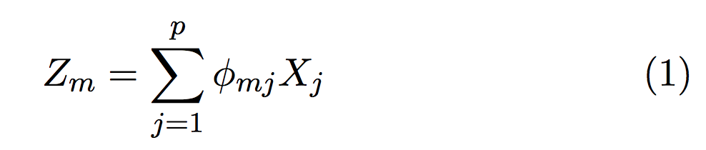

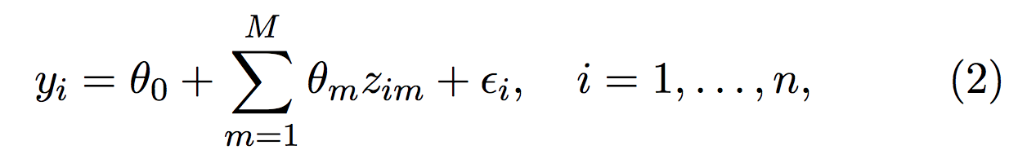

5.4 Partial Least Squares Regression
Dimension Reduction
Let represent linear combinations of an original set of $p$ predictors. That is
for some constants .
Using OLS, we can then fit the linear regression model

Slide 28

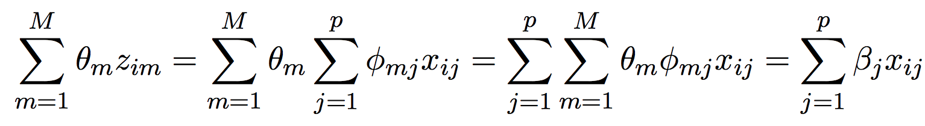
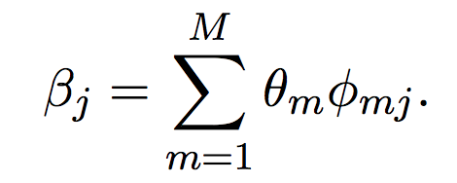
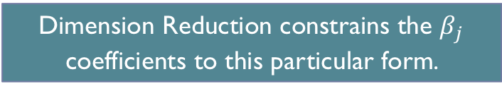
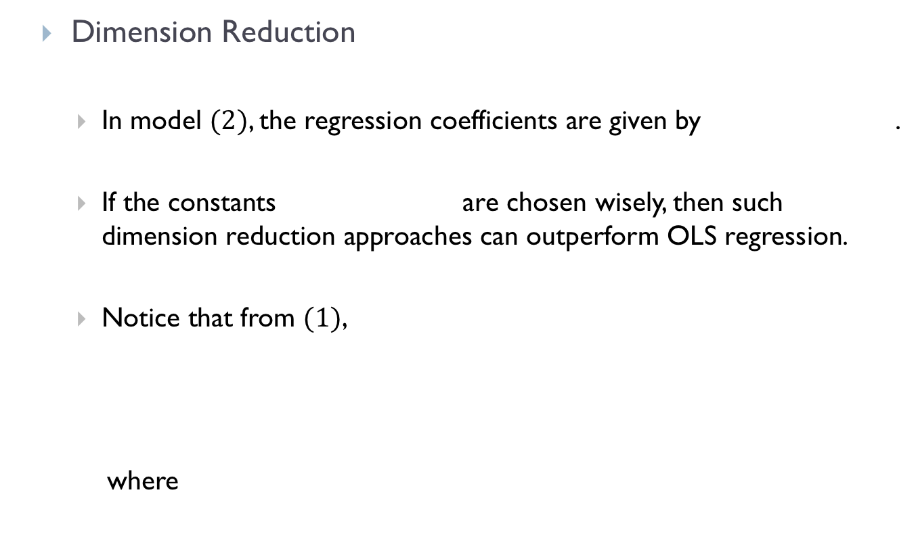
5.4 Partial Least Squares Regression
Dimension Reduction
In model $(2)$, the regression coefficients are given by .
If the constants are chosen wisely, then such dimension reduction approaches can outperform OLS regression.
Notice that from $(1)$,
where
Can win in the bias-variance trade-off.
Dimension Reduction constrains the $β_{j}$ coefficients to this particular form.

Slide 29
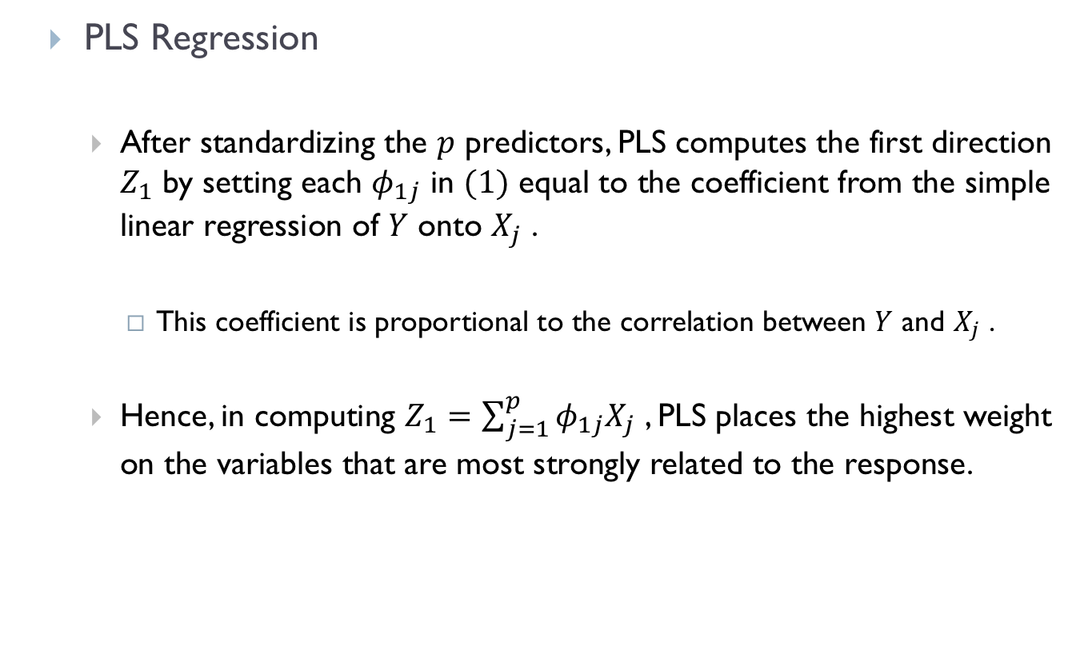
5.4 Partial Least Squares Regression
PLS Regression
After standardizing the $p$ predictors, PLS computes the first direction $Z_{1}$ by setting each $φ_{1j}$ in $(1)$ equal to the coefficient from the simple linear regression of $Y$ onto $X_{j}$ .
This coefficient is proportional to the correlation between $Y$ and $X_{j}$ .
Hence, in computing $Z_{1}=\sum_{j=1}^{p}{φ_{1j}X_{j}}$ , PLS places the highest weight on the variables that are most strongly related to the response.

Slide 30
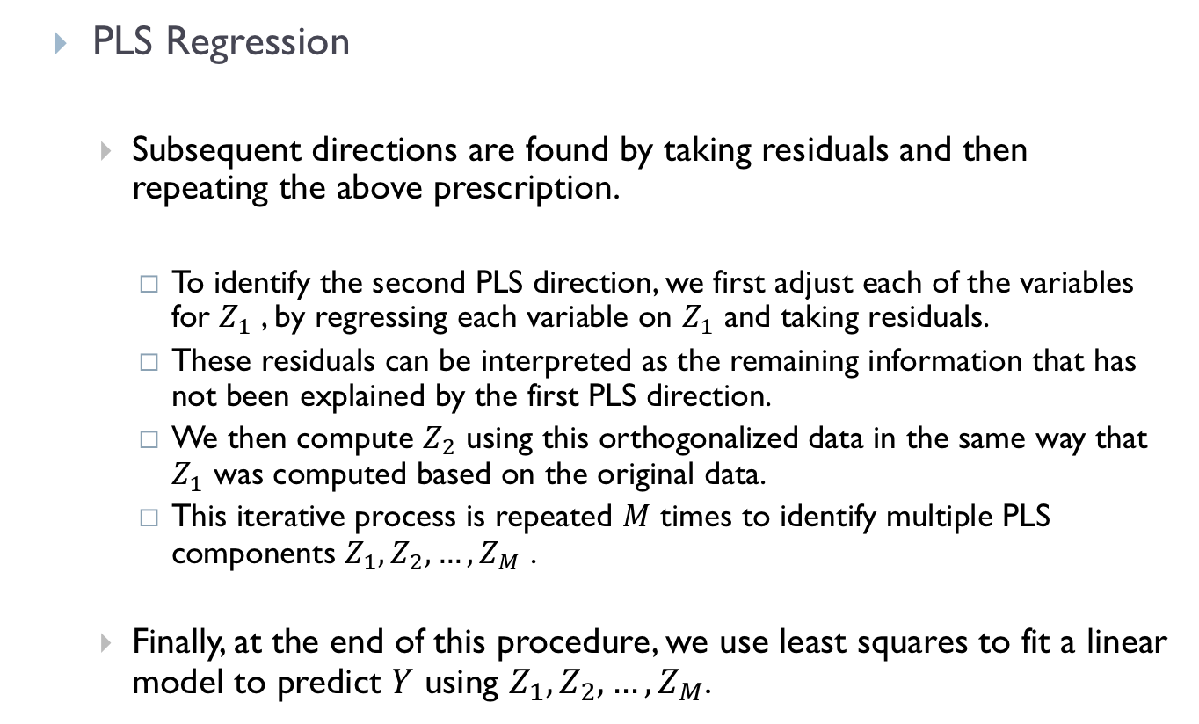
5.4 Partial Least Squares Regression
PLS Regression
Subsequent directions are found by taking residuals and then repeating the above prescription.
To identify the second PLS direction, we first adjust each of the variables for $Z_{1}$ , by regressing each variable on $Z_{1}$ and taking residuals.
These residuals can be interpreted as the remaining information that has not been explained by the first PLS direction.
We then compute $Z_{2}$ using this orthogonalized data in the same way that $Z_{1}$ was computed based on the original data.
This iterative process is repeated $M$ times to identify multiple PLS components $Z_{1},Z_{2},…,Z_{M}$ .
Finally, at the end of this procedure, we use least squares to fit a linear model to predict $Y$ using $Z_{1},Z_{2},…,Z_{M}$.

Slide 31
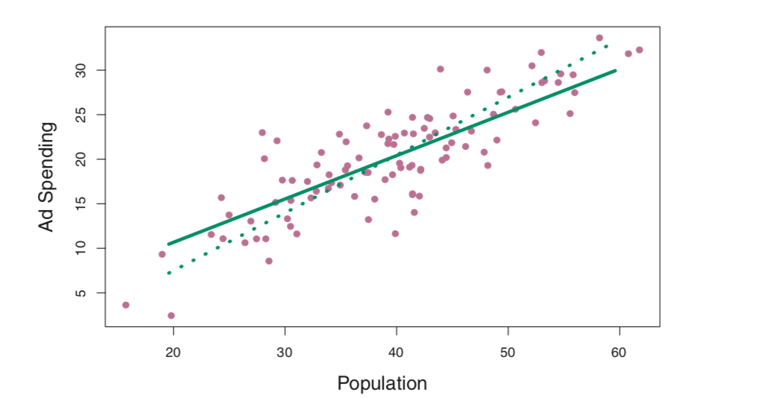
5.4 Partial Least Squares Regression
PLS Regression Example
From James G., Witten D., Hastie T., Tibshirani R. (2013). An Introduction to Statistical Learning. Springer
The first PLS direction is represented by the solid line.
The first PCR direction is represented by the dotted line.

Slide 32
5.4 Partial Least Squares Regression
PLS Regression Example
PLS has chosen a direction that has less change in Ad Spending per unit change in Population, relative to PCA. This suggests that Population is more highly correlated with the response than is Ad Spending. The PLS direction does not fit the predictors as closely as does PCA, but it does a better job explaining the response.

Slide 33

5.6 Summary
Overview
Regression Model Considerations
kNN Regression
Partial Least Squares Regression
Slides by Abbass Al Sharif, PhD
https://www.alsharif.info/iom530
Slides by Hastie T., Tibshirani R
https://www.r-bloggers.com/in-depth-introduction-to-machine-learning-in-15-hours-of-expert-videos/
Bibliography/References
James G., Witten D., Hastie T., Tibshirani R. (2013). An Introduction to Statistical Learning. Springer.

