Slide 1
Data Mining and Machine Learning in Bank Marketing and Real Estate
Submitted by:
Sobil Dalal
x19148496

Slide 2
Research Questions
What are the most critical factors for forecasting house prices?
What is the impact of a marketing campaign on a customer’s decision to open a term deposit account with the bank?

Slide 3
Data I: House Pricing: Sales of houses in King County, USA
This dataset has 21,613 records with 21 parameters, containing both continuous and categorical parameters about the price of house sale in King County (including Seattle), USA.
Environment Setup: In R script, setwd() to data source’s location before running.
Sampling: K-Fold cross validation (CV) technique has been used in multi-linear model to perform evaluation of the model where k is equal to 10 and thus, no training and testing samples were generated.
Stratified random sampling with 80-20 ratio has been used to create groups with equal representation of all the classes in the data for regression decision tree model.
Models:
Multi-linear regression: AIC of 11587, CV delta value of 0.1001,adjusted R-squared value of 0.6394 and RMSE of 0.3163
Decision Tree regression: Regression tree performed better with RMSE of 1.794102 .

Slide 4
DATA II: House Pricing: Computer generated house pricing
This dataset is computer generated and contains 16 continuous parameters of the house including price. It has about half a million records.
Environment Setup : In R script, setwd() to data source’s location before running.
Sampling: K-Fold cross validation (CV) technique has been used to evaluate the model where k is equal to 10 and thus, no training and testing samples were generated.
Models:
Multi-linear regression: The adjusted R-squared value of the model is 0.9793 and RMSE is 1743.

Slide 5
DATA III: Bank Marketing: Portugal bank marketing campaign
This dataset is about the decision (yes/no) of clients to open a term-deposit account in Portugal bank. It has 17 parameters and 45 211rows.
Environment Setup : In R script, setwd() to data source’s location before running.
Sampling: Using the "caret::createDataPartition" function, stratified random sampling has been used to create two samples: training and testing sample in 80-20% ratio, such that both the samples have equal categorical values of "yes" and "no" classes.

Slide 6
DATA III: Bank Marketing: Portugal bank marketing campaign
Models | Accuracy | Kappa | Sensitivity | Specificity
K-NN | 88.99% | 0.3282 | 0.30496 | 0.96415
Naïve Bayes | 88.17% | 0.4335 | 0.58513 | 0.91344
Jrip Decision Tree | 91.68% | 0.5667 | 0.58513 | 0.95895
SVM | 90.14% | 0.4857 | 0.51509 | 0.95047
Jrip DT for under-sampled data | 84.19% | 0.4953 | 0.9472 | 0.8286
Models:

Slide 7
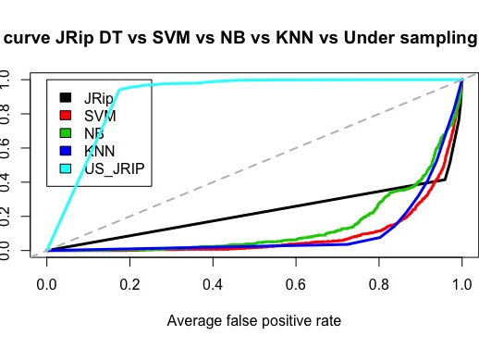
DATA III: Bank Marketing: Portugal bank marketing campaign
Models:

Slide 8
FAILED MODEL
K-NN:
Dummy variables created for nominal attributes
Custom method for normalization
Even though accuracy was high : 0.9004
Sensitivity was very poor : 0.15409
Kappa : 0.2307

Slide 9
CONCLUSION
The most important factors influencing house price prediction have been identified as living space (sqftliving), grade of the house (grade), built year (yrbuilt), view, number of bathrooms(bathrooms) and number of floors in the house(floors) for King County, USA by training a multi-linear regression model with RMSE value 0.3163.
For computer-generated dataset, novel factors such as type of floor (white marbel or Indian marbel), city, fiber and glass doors were also recognised by the multi-linear model with RMSE value 1743.
A customer's decision to open a term deposit account with the Portugal bank after a marketing campaign, is highly influenced by last contact duration (duration), number of employees (nr.employed) and employment variation rate (emp.var.rate) as suggested by JRip decision tree's results with an accuracy of 90.013% and AUC of 0.90.

Slide 10
Thank You

