Slide 1
Algorithm Analysis (Time complexity): Big O Notation
What is Algorithm?
Algorithm Characteristics
What is Algorithm Analysis?
Why Algorithm Analysis?
Types of complexities
Big O Notation
Examples

Slide 2
What is Algorithm?
An Algorithm is a step-by-step instructions to solve a given problem.

Slide 3
Algorithm Characteristics:
Each and every step should be precise and clear.
Each step should be performed in a finite time.
Steps should not be repeated infinitely.
The desired result should be obtained after the algorithms terminates.

Slide 4
Algorithm Example
To swap two numbers
Step 1: Input first number as A
Step 2: Input second number as B
Step 3: Set Temp =A
Step 4: Set A = B
Step 5: Set B = Temp
Step 6: Print A,B
Step 7: End

Slide 5
Algorithm Example
How-To : Get Good Grades
Step 1: Accept the fact that you are going to fail if you do not study.
Step 2: Go to your faculty and get a list of prescribed books for the course.
Step 3: Go to the library and get a copy of those books for yourself.
Step 4: Start reading those books.
Step 5: Attend the course regularly.
Step 6: Practice the course skills religiously.
Step 7: Take the end-term exam

Slide 6
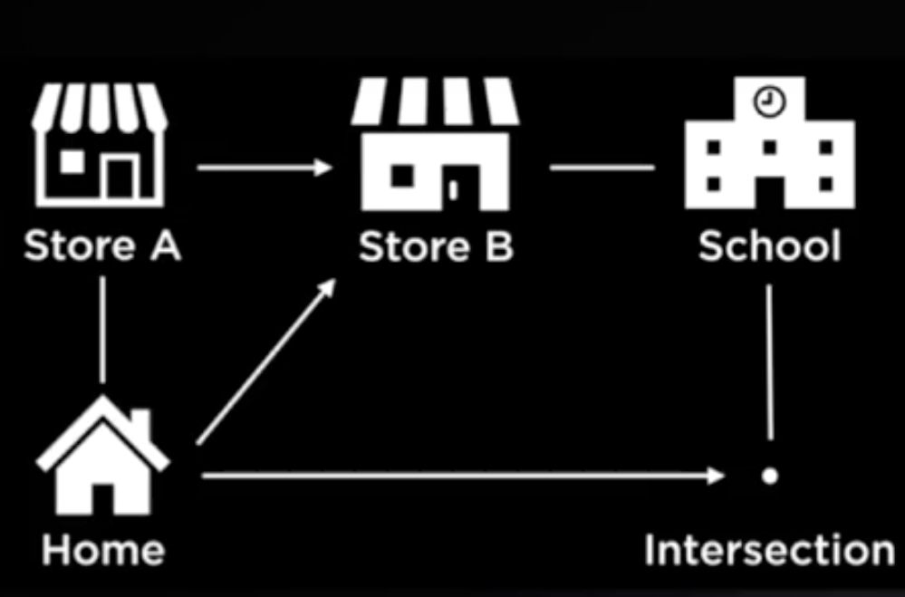
Why Analysis of Algorithms?
Similarly, In Computer Science multiple algorithms are available to solve the same problem.
Algorithm analysis helps us to determine which of them is efficient in terms of time and space consumed.

Slide 7
Goal of Analysis of Algorithms
To compare algorithms (Solutions) mainly in terms of running time but also in terms of other factors (e.g memory etc).

Slide 8
What is Asymptotic Algorithm Analysis?
Definition: In mathematical analysis, asymptotic analysis of algorithm is a method of defining the mathematical boundaries of its run-time performance.
Using the asymptotic analysis, we can easily estimate about the average case, best case and worst case scenario of an algorithm.
In Simple words it is used to mathematically calculate the running time of any operation inside an algorithm.
Asymptotic Algorithm analysis is to estimate the time complexity function for arbitrarily large inputs.

Slide 9
Types of Asymptotic Notations / Measurement
Big Oh(O) : Upper bound
Big Omega (Ω) : Lower bound
Big Theta (Θ) : Average bound
………..

Slide 10
Big O Notation
Simplified analysis of an algorithm’s efficiency

Slide 11
Big O Notation
Big O notation is a way to measure how well a computer algorithm scales as the amount of data involved increases.
Big O notation is the most widely used method which describes algorithm complexity- the execution time required or space used in memory or disk by an algorithm.

Slide 12
Big O for time complexity
When analysing the time complexity for an algorithm, Big O notation is used to describe the rough estimate of the no of steps to complete an algorithm.

Slide 13
Example
int fun(int n)
{
// part 1
do();
// part 2
for(int i = 1;i<n;i++)
{ do(); }
// Part 3
for(int i =1;i<n;i++)
{ for(int j =1; j<=n;j++)
{ do(); }
}
//Part 4
return 0;
}
Let’s assume that do() takes C steps to complete
Part 1: When the time complexity is independent to the input parameter, we use O(1) to make it.
Part 2: It does do() n times. Each time it takes C steps. So in total, it takes C*n steps to complete. For C*n the complexity becomes n*O(1). So the time complexity becomes O(n).

Slide 14
Example
int fun(int n)
{
// part 1
do();
// part 2
for(int i = 1;i<n;i++)
{ do(); }
// Part 3
for(int i =1;i<n;i++)
{ for(int j =1; j<=n;j++)
{ do(); }
}
//Part 4
return 0;
}
Part 3: It has 2 loops. The inner loop is exactly like part 2. The outer loop does part 2 n times, so the time complexity is n*O(n) = O(n^2)
Part 4: It takes exactly 1 step to return. So the time complexity is O(1).
Total time complexity: Add the time complexity of all the 4 parts :
O(1) + O(n)+ O(n^2) + O(1)

Slide 15
Algorithm Example
Add sugar to Tea Algorithm
Step 1: Fetch the bowl containing the sugar
Step 2: Get a spoon
Step 3: Scoop out sugar using the spoon
Step 4: pour the sugar from the spoon into the tea
Step 5: Repeat step 3 and 4 until you have added the desired amount of sugar.

Slide 16
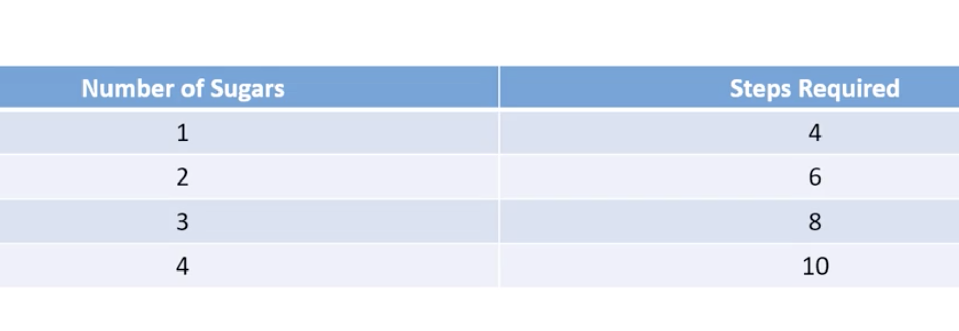
Add Sugar to Tea Algorithm

Slide 17
Big- O value for Sugar Algorithm
Number of desired sugars= n
Total number of steps = 2n+2
As n grows, the number of steps grows
The “2” in 2n and the “+2” remain constant, so they don’t factor into the time complexity. The value of n determines the growth rate.
Time complexity is O(n) which is linear time complexity

Slide 18
Rules for Big O Notation
When add up big O notations, the notation with slower increase speed could be ignored by notation with faster increase speed
O(1) * O(n) = O(n)
O(n) * O(n) = O(n^2)
O(1) + O(n) = O(n)
O(n) + O(n^2) = O(n^2)
O(1) + O(n) + O(n^2) = O(n^2)

Slide 19
General Rules
When add up big O notations, the notation with slower increase speed could be ignored by notation with faster increase speed
Ignore constants
5n → O(n)
Certain terms “dominate“ others
O(1) < O(logn) < O(n) <O(nlogn) < O(n^2) < O(2n) < O(n!)

Slide 20
Constant time
O(1) “big O of one”
A = 5 +(10*20)
Independent of input size N

Slide 21
Example
A = 5 +(10*20)
B = 15-9
Print A + B
Total time = O(1) + O(1) + O(1)
3 * O(1) = O(1)

Slide 22
Logarithmic time
O(log n)
for (int i = 1; i < n; i = i * 2){
System.out.println("Hey - I'm busy looking at: " + i);
}

Slide 23
Linear time
N * O(1) = O(N)
for y in range (o,n)
Print y
// O(1)

Slide 24
N Log N Time
O(n log n)
for (int i = 1; i <= n; i++){
for(int j = 1; j < 8; j = j * 2) {
System.out.println("Hey - I'm busy looking at: " + i + " and " + j);
}
}

Slide 25
Polynomial Time Algorithms – O(n^p)
It is a general term which contains Quadratic (n2) ,Qubic(n3) Quartic(n4) etc. What’s important to know is that O(n2) is faster than O(n3) which is faster than O(n4), etc.

Slide 26
Quadratic time
O(N^2)
for y in range (0,n)
for x in range (0,n)
Print y * x
// O(1)

Slide 27
