Slide 1
LG
Sales Performance Dashboard
End-to-End Business Intelligence Project
Python · SQL · Power BI
Prepared by: [Your Name]
Data period: 2015 – 2018 | Superstore Sales Dataset

Slide 2
Project Overview
Diagnosing where a $2.3M retail business is losing profit — and exactly what to fix
Business Problem: A national retail chain wants to understand where profit is being left on the table — which products, regions, states, and discount practices are helping vs. hurting the bottom line, and what specific actions would improve profitability without sacrificing revenue.
Objectives
Tools & Skills
Identify revenue, profit, and sales trends over a 4-year period
Evaluate product & category performance, including loss-making items
Compare regional and state-level performance on margin, not just volume
Segment customers by value, frequency, and profitability (RFM, ABC, CLV)
Surface concrete, quantified, actionable business recommendations
Python
Pandas, NumPy, Matplotlib, Seaborn
SQL
SQLite — star schema, 40 business queries
Power BI
3-page dashboard, DAX time intelligence
Sales Performance Dashboard — End-to-End BI Project
Page 1 of 14

Slide 3
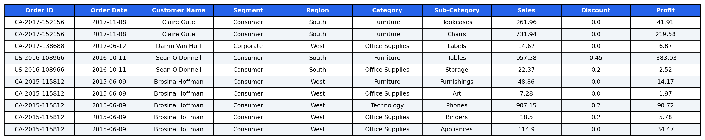
Dataset & Sample Records
Superstore Sales Dataset — 9,994 order lines across 5,009 orders, 2015–2018
9,994
5,009
793
1,850
34
Order Lines
Unique Orders
Customers
Products
Columns (post-cleaning)
Sample records (cleaned dataset)
Sales Performance Dashboard — End-to-End BI Project
Page 2 of 14

Slide 4
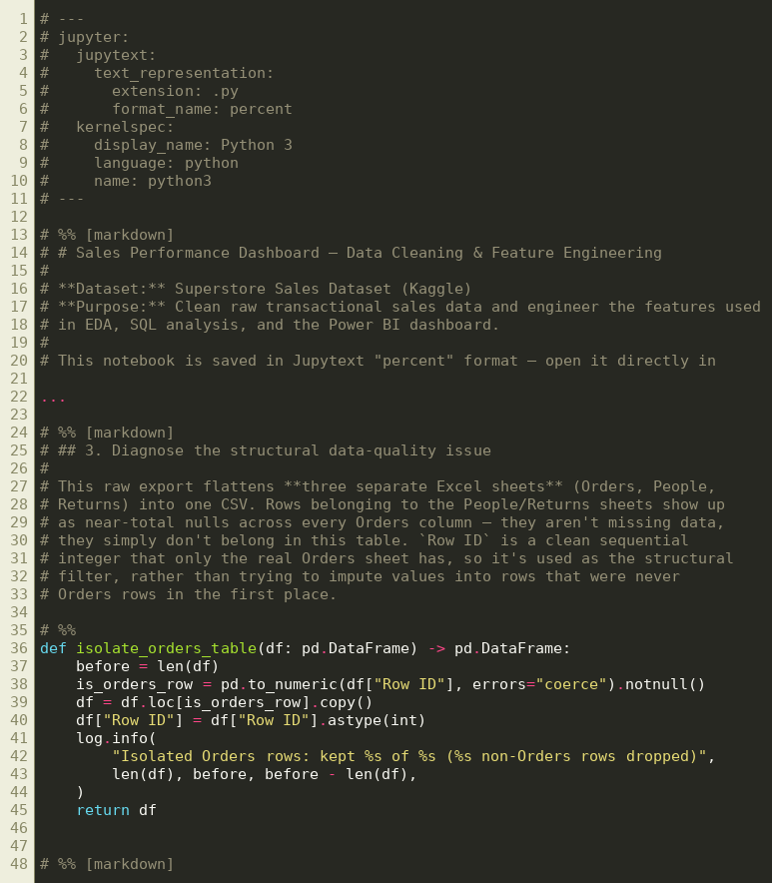
Data Cleaning — Python Notebook
01_data_cleaning.py · modular, typed, logged, validated pipeline
Key steps
Diagnosed a structural issue: 3 Excel sheets (Orders/People/Returns) merged into one export
Isolated 9,994 genuine Orders rows from 806 unrelated rows using Row ID
Removed 504 full-row duplicates; validated business rules (Sales>0, Discount 0–1, Ship≥Order date)
Flagged IQR-based outliers without deleting them
Engineered 12 features: Profit Margin, Order Year/Month/Quarter/Weekday, Sales/Discount Tiers, Customer Type
4 assertions guard the pipeline's invariants before export
Sales Performance Dashboard — End-to-End BI Project
Page 3 of 14

Slide 5
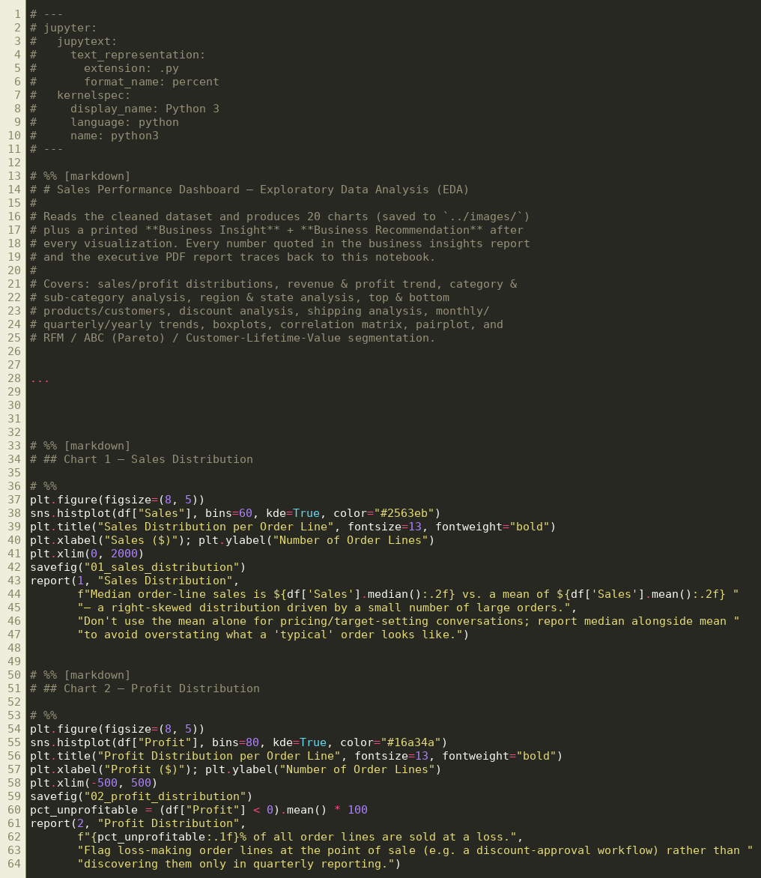
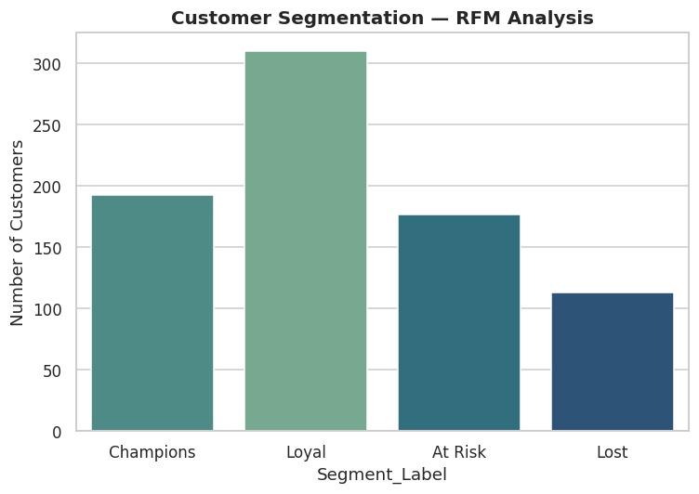
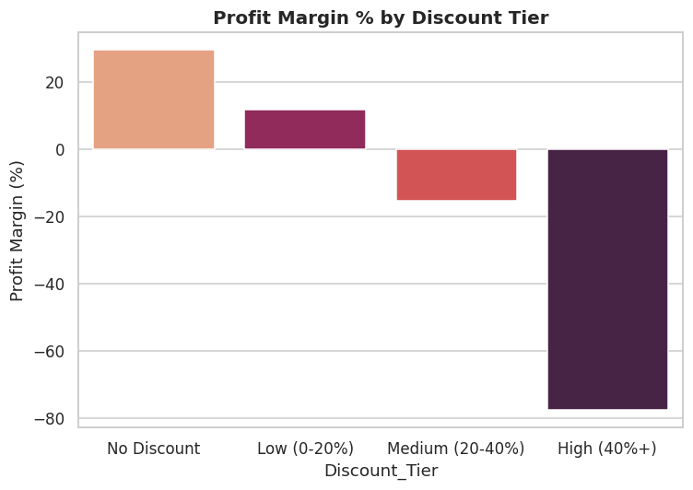
Exploratory Data Analysis — Python Notebook
02_eda.py · 20 charts, each with a printed Business Insight + Recommendation
Coverage
20 visualizations: distributions, category/region/state breakdowns, discount analysis, shipping analysis
RFM segmentation, ABC (Pareto) analysis, and Customer Lifetime Value
Every chart is followed by a printed Insight + Recommendation pair — not just a plot
All figures referenced in the business report trace back to this notebook's output
Sales Performance Dashboard — End-to-End BI Project
Page 4 of 14

Slide 6
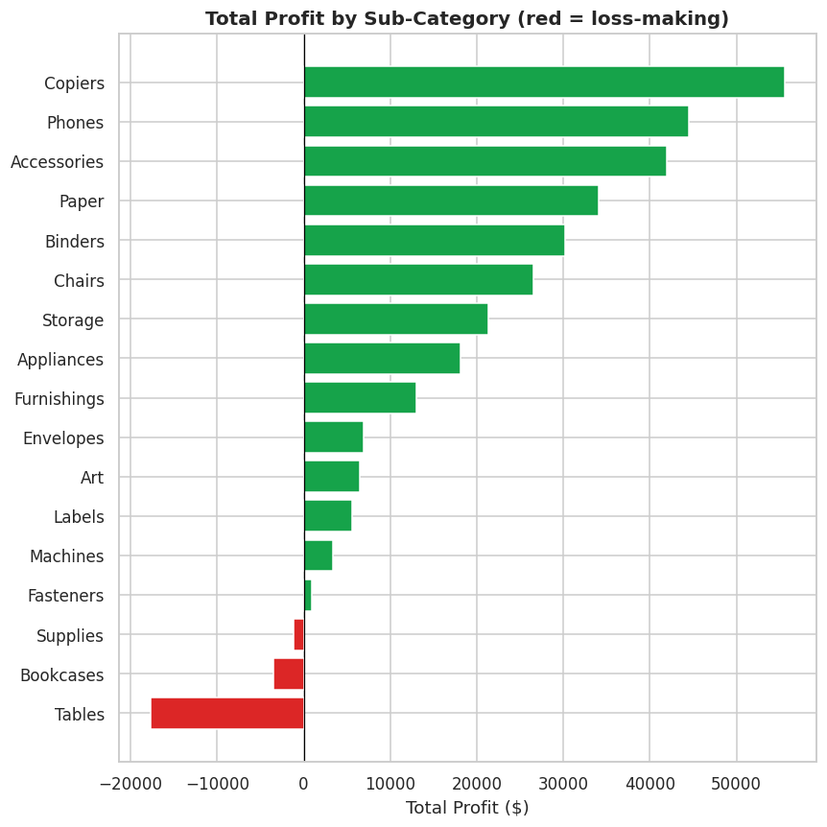
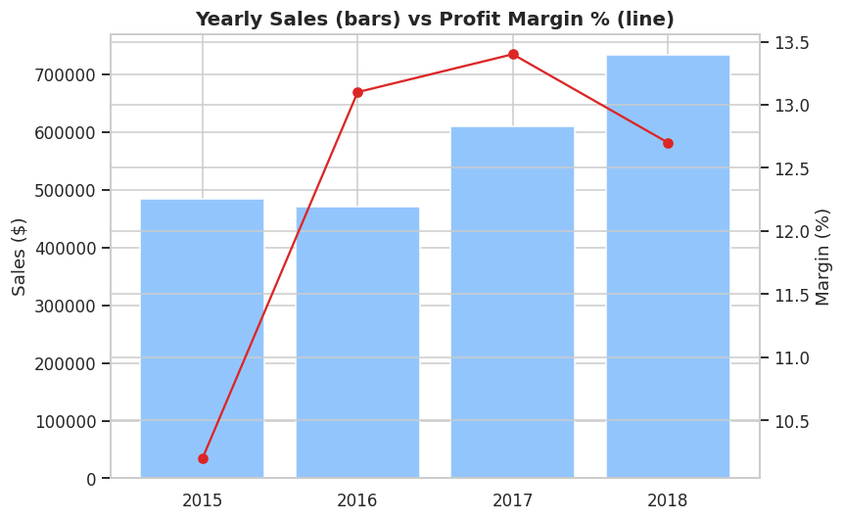
Key Findings from EDA
Where profit is concentrated — and where it's leaking
Tables is the single highest-priority fix: -8.6% margin on $206,966 of sales, a -$17,726 total loss. Company-wide margin actually improved slightly (2015→2018) — profit erosion is localized, not company-wide.
Sales Performance Dashboard — End-to-End BI Project
Page 5 of 14

Slide 7
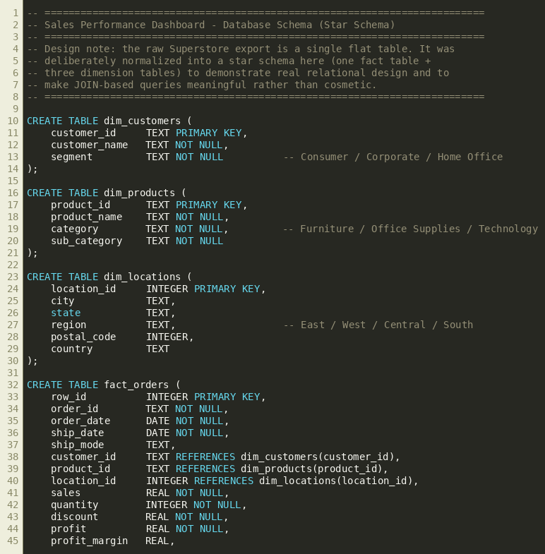
SQL — Star Schema Design
00_schema.sql · normalized star schema built from the flat CSV export
Design rationale
1 fact table (fact_orders) + 3 dimension tables (customers, products, locations)
Deliberately normalized to demonstrate real relational design — not a cosmetic exercise
Indexes on customer_id, product_id, location_id, order_date for query performance
Powers all 40 SQL business queries and the Power BI DAX model
Sales Performance Dashboard — End-to-End BI Project
Page 6 of 14

Slide 8
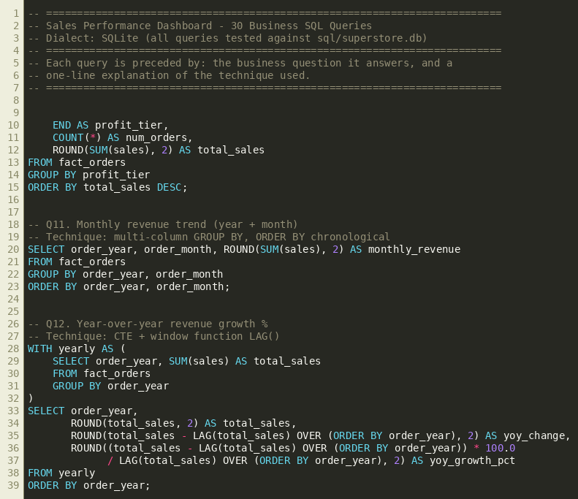
SQL — Business Queries
40 queries: 30 core + 10 advanced window-function/segmentation queries
Techniques demonstrated
SELECT / WHERE / GROUP BY / HAVING / CASE / JOINs / CTEs / Subqueries
Window functions: RANK, DENSE_RANK, ROW_NUMBER, LAG, LEAD, NTILE
Running totals, 3-month moving averages, rolling revenue
Pareto (Top-20%-of-customers) analysis — verified: top 20% drive 48.15% of revenue
Reusable Views for state- and month-level reporting
Every query verified by executing it against the live database
Sales Performance Dashboard — End-to-End BI Project
Page 7 of 14

Slide 9
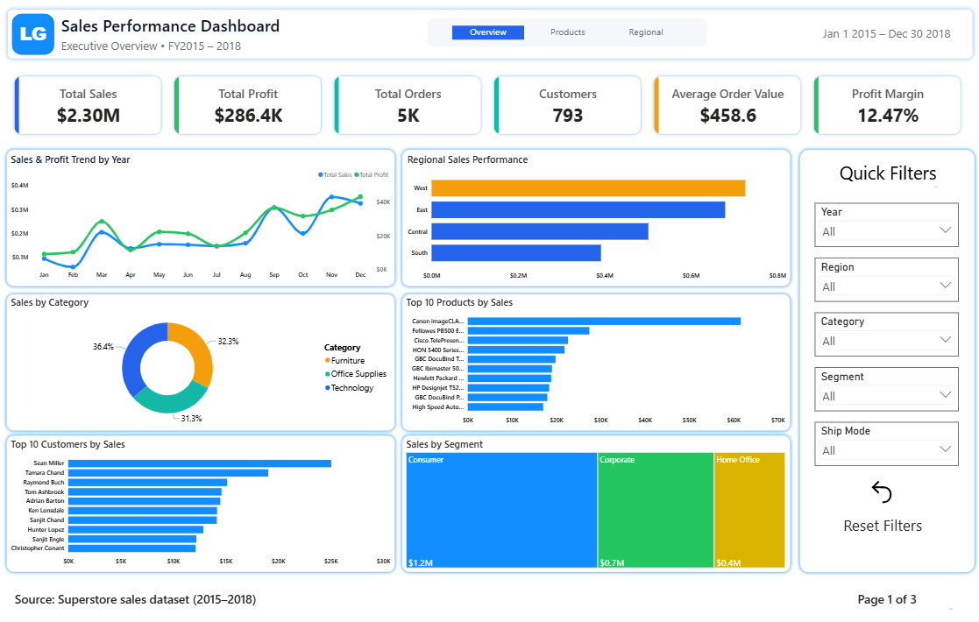
Power BI Dashboard — Page 1
Executive Overview · KPIs, trend, category & regional mix, top products/customers
Sales Performance Dashboard — End-to-End BI Project
Page 8 of 14

Slide 10
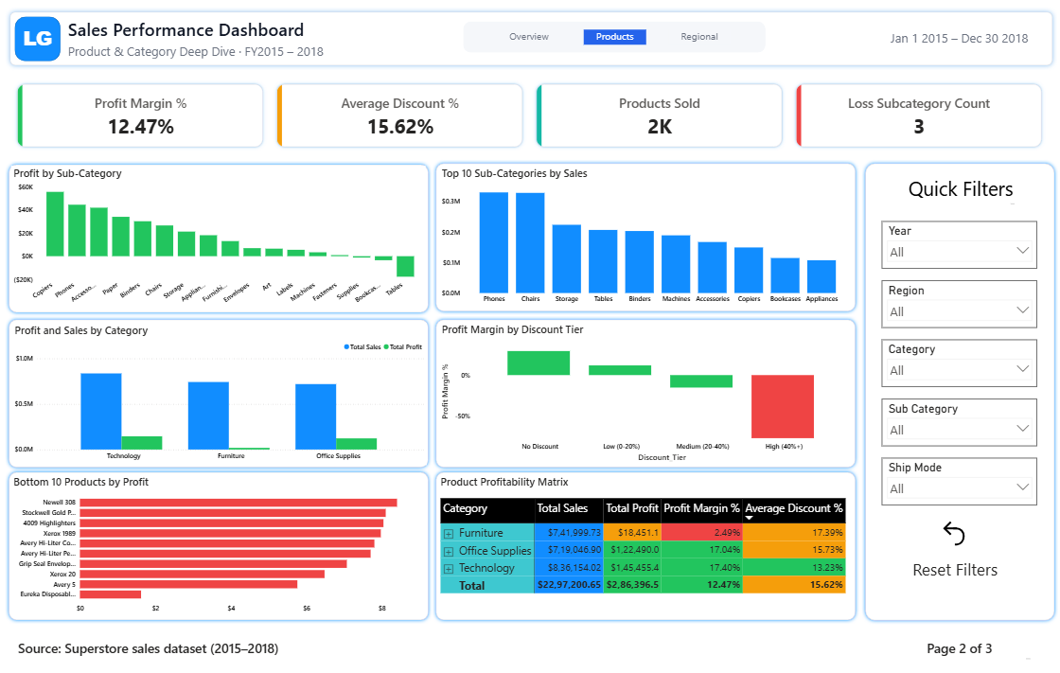
Power BI Dashboard — Page 2
Product & Category Deep Dive · sub-category profit, discount-tier margin analysis
Sales Performance Dashboard — End-to-End BI Project
Page 9 of 14

Slide 11
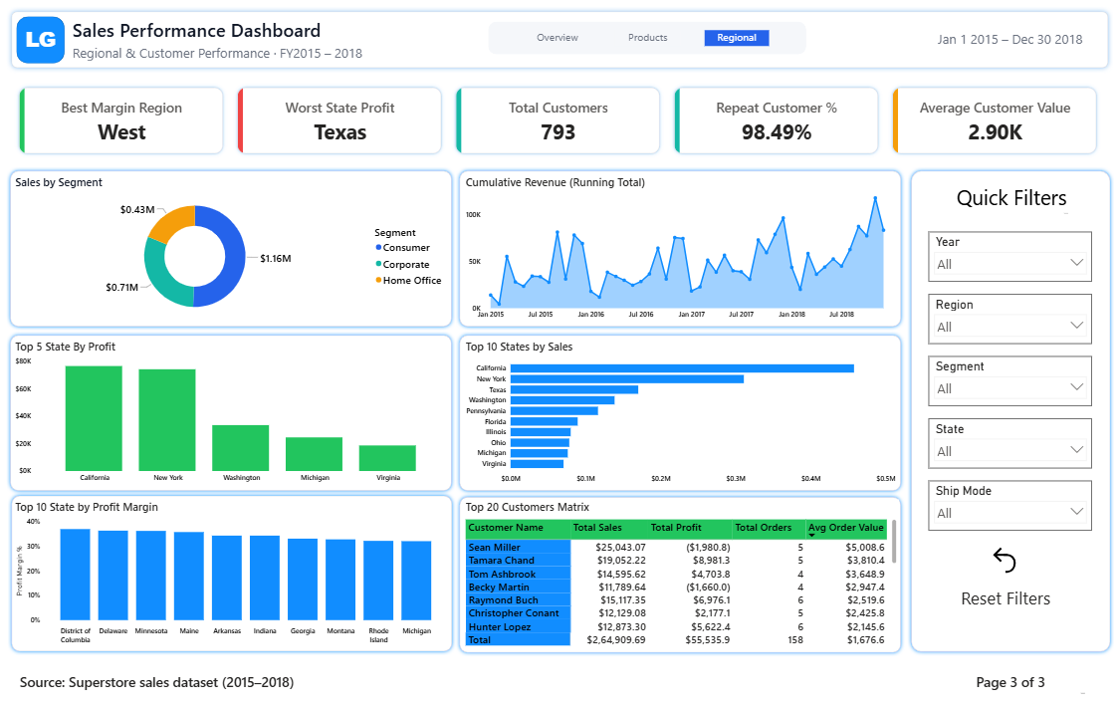
Power BI Dashboard — Page 3
Regional & Customer Performance · state margin, RFM, top-20 customer matrix
Sales Performance Dashboard — End-to-End BI Project
Page 10 of 14

Slide 12
Key Business Insights
21 data-driven insights — 5 highlighted here
Furniture
32.3% of revenue, only 6.4% of profit (2.5% margin) — driven by excessive discounting on Tables
Texas
-$25,729 total profit despite $170K in sales — the single largest geographic loss
Discount threshold
Margin collapses past ~20% discount: 29.5% → -77.4% at 40%+ discount tier
West Region & Technology
Best margin performers (14.9% and 17.4%) — highest-ROI targets for reinvestment
Repeat Customers
98.5% of customers are repeat buyers, driving 99.8% of revenue
Sales Performance Dashboard — End-to-End BI Project
Page 11 of 14

Slide 13
Recommendations
Five targeted, low-risk actions to recover profit without sacrificing revenue growth
1
Cap Furniture discounts — especially Tables — at 20%
2
Open a targeted profitability review in Texas, Ohio, and Pennsylvania (~-$58K combined)
3
Prioritize marketing & inventory investment in Technology and the West region
4
Launch a retention program for the RFM "Champions" segment (24% of customers, ~40% of revenue)
5
Route confirmed high-volume, negative-profit products through repricing/supplier renegotiation
Sales Performance Dashboard — End-to-End BI Project
Page 12 of 14

Slide 14
Thank You
Full project — code, SQL, dashboard guide, and reports — available on request
[Your Name] · your.email@example.com · linkedin.com/in/yourprofile · github.com/yourusername
Sales Performance Dashboard — End-to-End BI Project
Page 14 of 14

