Slide 1
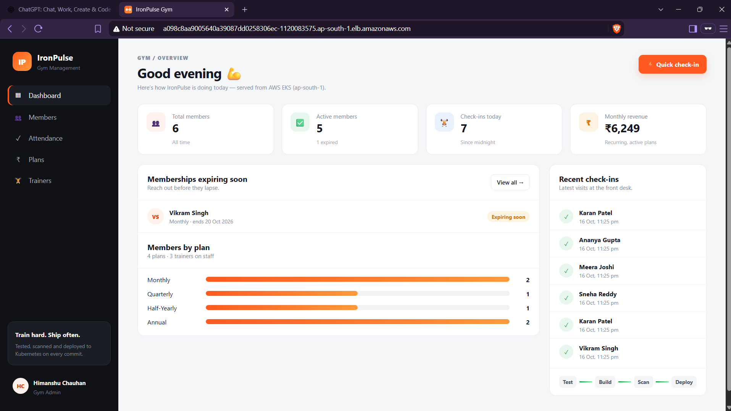
IP
IronPulse
A gym management platform, shipped through a complete DevOps pipeline to AWS EKS
DevOps Final Capstone
Himanshu Chauhan · October 2026
github.com/Himanshu10071/devops-project
Live on AWS EKS through the Traefik Ingress load balancer
Notes:
Introduce IronPulse: a gym management app used as the vehicle for a full DevOps pipeline, from laptop to a monitored EKS cluster.

Slide 2
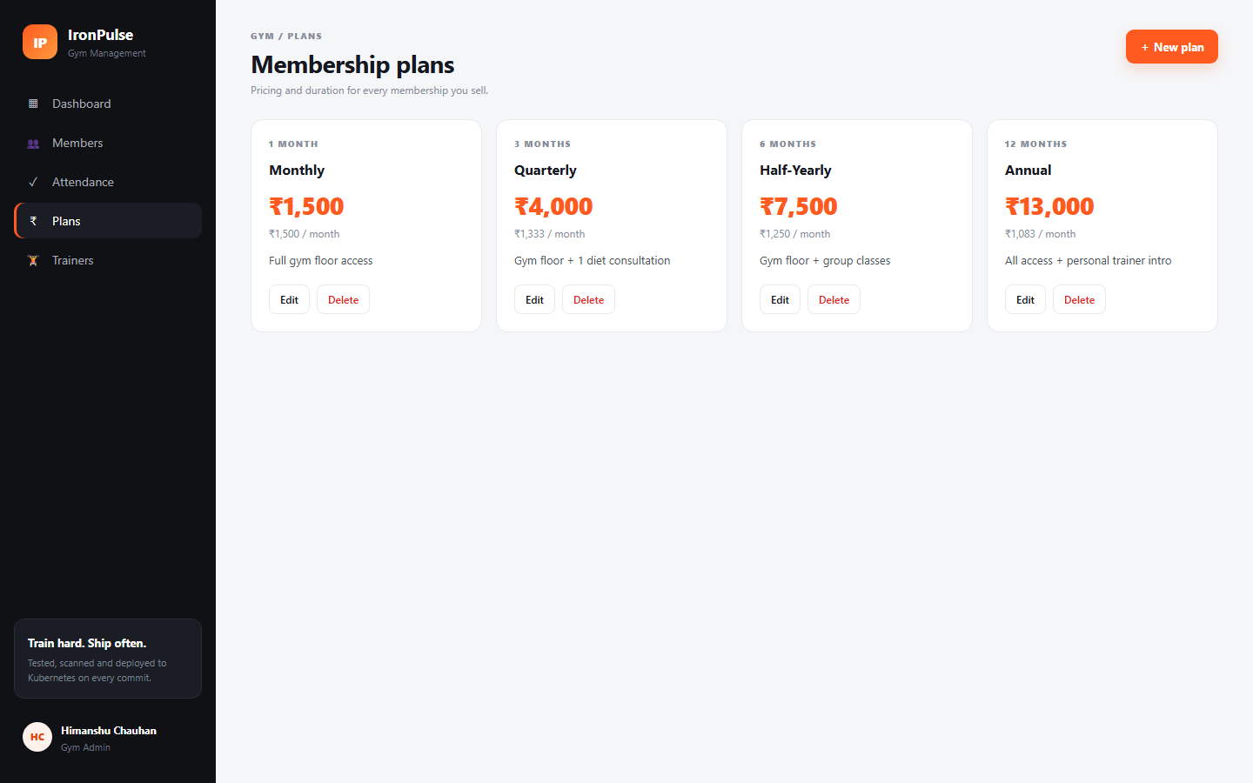
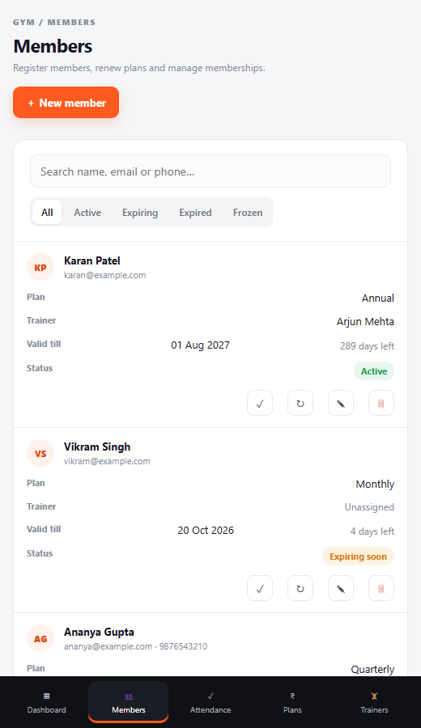
What IronPulse does
M1 · App
1
Members
Register, search, renew, freeze; expiry is computed from the plan
2
Plans
Monthly to annual pricing; a plan in use can't be deleted
3
Trainers
Coaching staff with live member counts
4
Attendance
One-click check-in; expired or frozen members are refused
React 19 frontend · FastAPI backend · PostgreSQL 16 · 20+ REST endpoints · responsive down to phone width
5
Dashboard
KPIs, expiring memberships, revenue, plan mix
Notes:
The app domain: members, plans, trainers, attendance and a dashboard. Business rules live in the backend, e.g. check-in is refused for expired members.

Slide 3
From laptop to a monitored EKS cluster
Architecture
Developer
GitHub
GitHub Actions
pytest
frontend build
docker build
Trivy scan
push GHCR
helm deploy
AWS ap-south-1 · VPC 10.30.0.0/16 · EKS 1.35 · 2 × m7i-flex.large
Terraform
AWS Load Balancer
Traefik Ingress
/ → React + Nginx ×2
VPC · subnets · NAT · EKS · node group · IAM
/api → FastAPI ×2–8
HPA
scrapes
Prometheus ← ServiceMonitor /metrics
PostgreSQL + EBS gp3
Grafana dashboard (auto-provisioned)
Notes:
One push travels: tests, image build, Trivy scan, push to GHCR, then Helm deploys to EKS. Terraform builds the VPC and EKS. Traefik routes / to React and /api to FastAPI; Prometheus and Grafana watch the backend.

Slide 4
Tech stack
Overview
Frontend
Backend
Database
Testing
Containers
React 19, Vite 8, responsive CSS
FastAPI, SQLAlchemy 2, Pydantic 2
PostgreSQL 16, Alembic migrations
Pytest, 27 tests, isolated SQLite
Multi-stage Docker, non-root, Compose
CI/CD
Security
IaC
Kubernetes
Observability
GitHub Actions → GHCR → Helm
Trivy (SHA-pinned), restricted PSA
Terraform: VPC, EKS, IAM, EBS CSI
Helm, Traefik Ingress, HPA
Prometheus Operator, Grafana

Slide 5
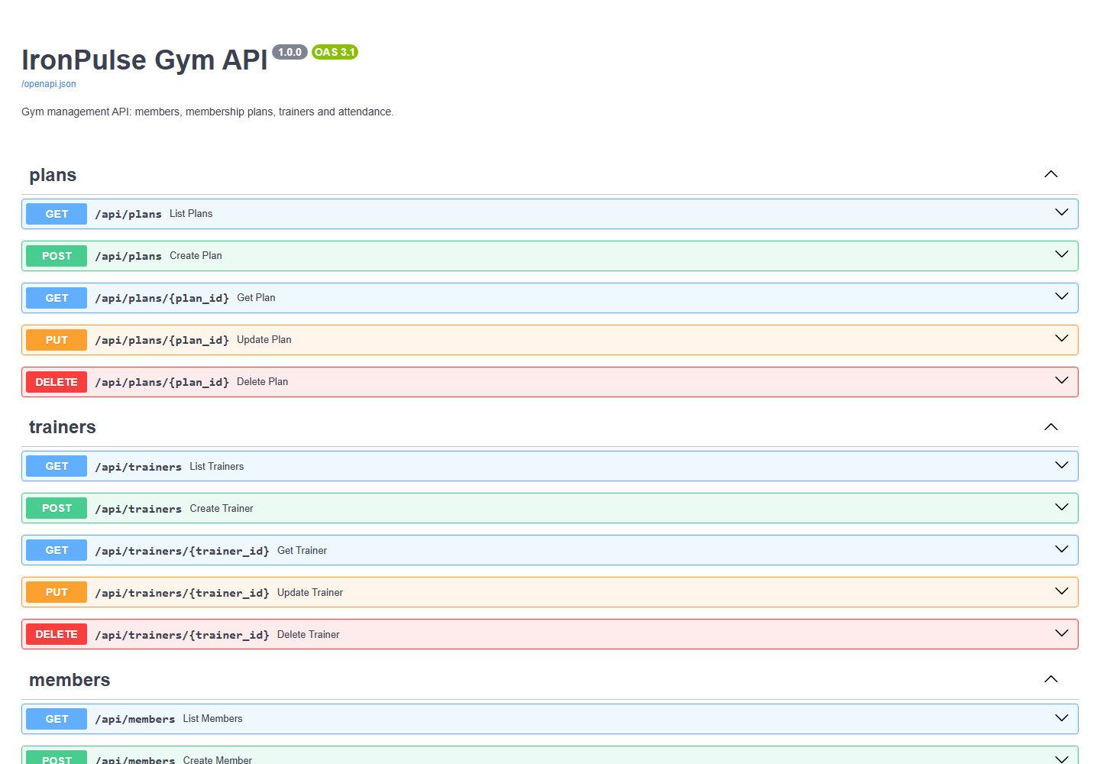
Live on AWS through the Ingress
M1 · M8
FastAPI Swagger at /docs
/ → React frontend
/api, /docs → FastAPI backend
/health liveness, /ready readiness
Dashboard served from the AWS load balancer hostname

Slide 6
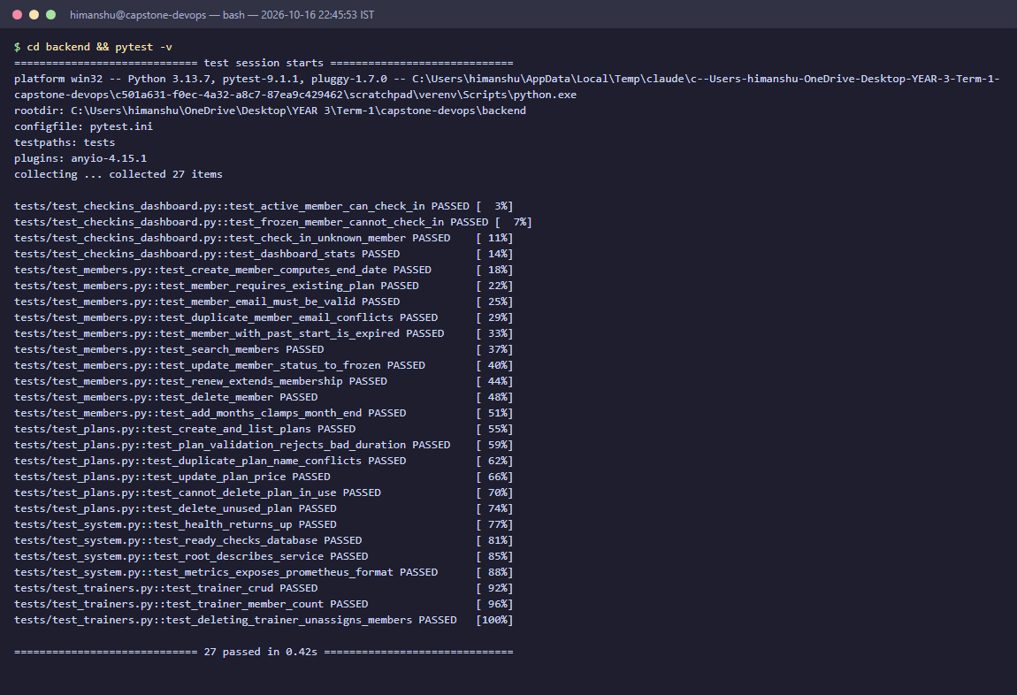
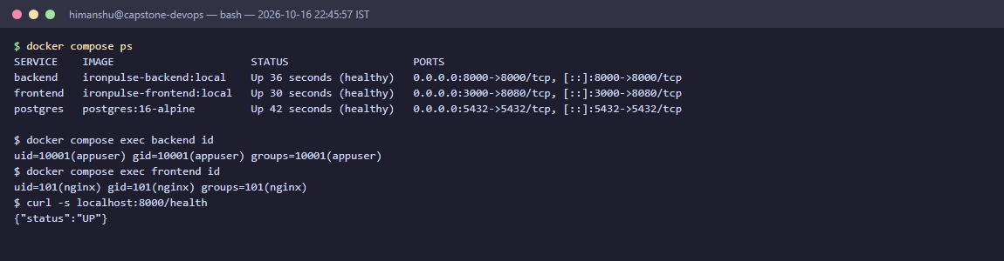
Quality gates before any image exists
M2 · M4
27 / 27
pytest tests passing, on an isolated in-memory DB
3
services from one docker compose up --build
non-root
backend uid 10001 · Nginx uid 101

Slide 7
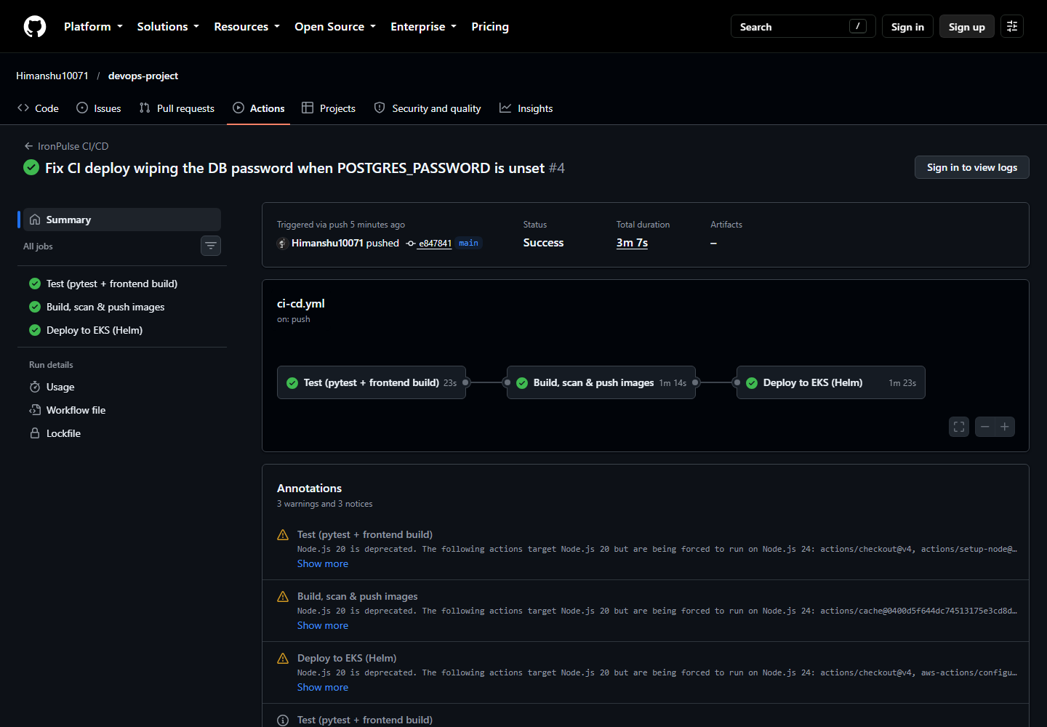
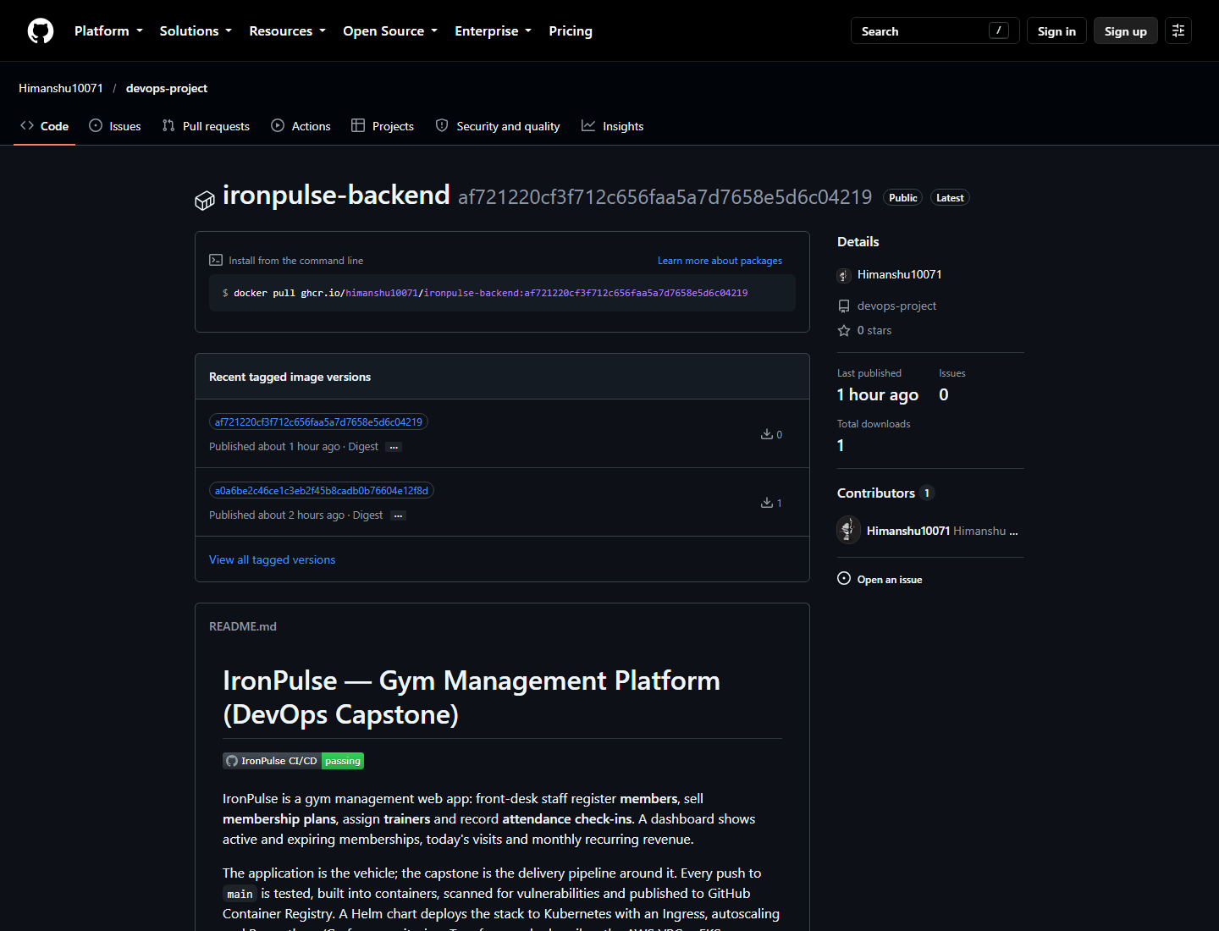
One push: test, build, scan, ship, deploy
M5 · CI/CD
Public GHCR package, tags = commit SHA
Tests gate the build: a failure means nothing is pushed
Every image is tagged with the Git SHA, never latest
Helm deploys that exact SHA and waits for readiness
Run #4: all three jobs green, including the Helm deploy to EKS

Slide 8
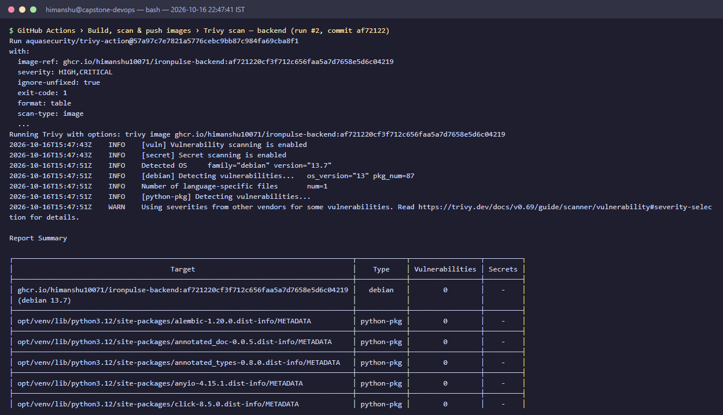
Trivy: 4 HIGH CVEs found and fixed
M6 · Trivy
4 → 0
0
HIGH vulnerabilities
in the frontend image
Cause: urllib3, msgpack, setuptools vendored inside pip
Fix: drop pip from the runtime image; it's build-only
Supply chain: Trivy action pinned to a commit SHA after the 2026 tag hijack
Runtime: non-root pods, restricted Pod Security, least-privilege deploy user
CI scan of the backend image: 0 fixable HIGH/CRITICAL

Slide 9
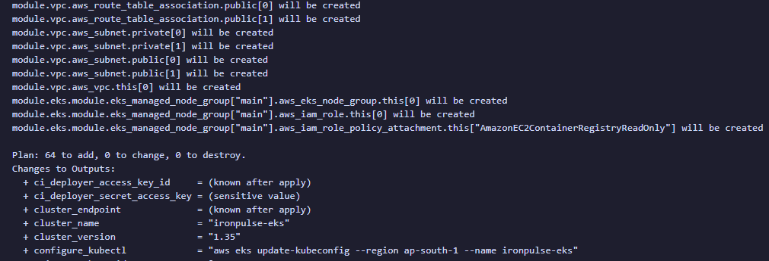
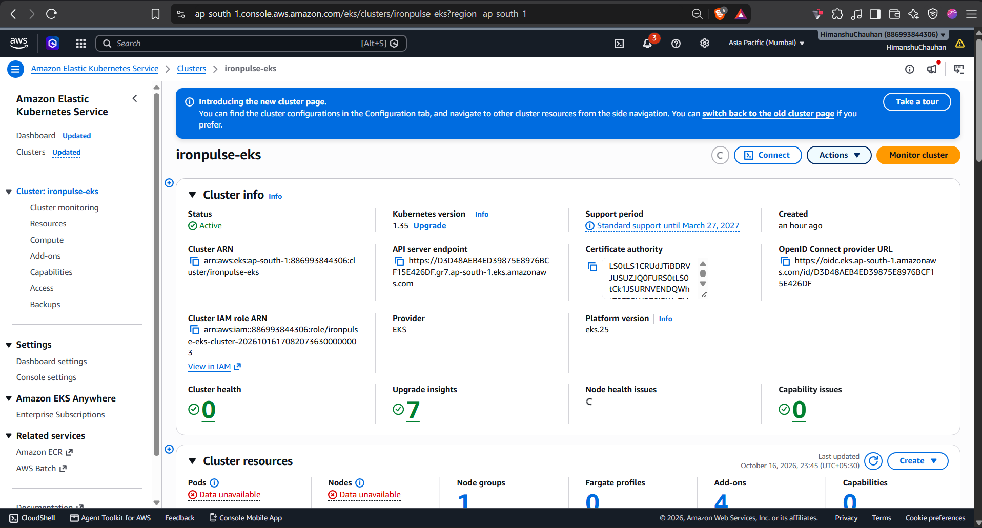
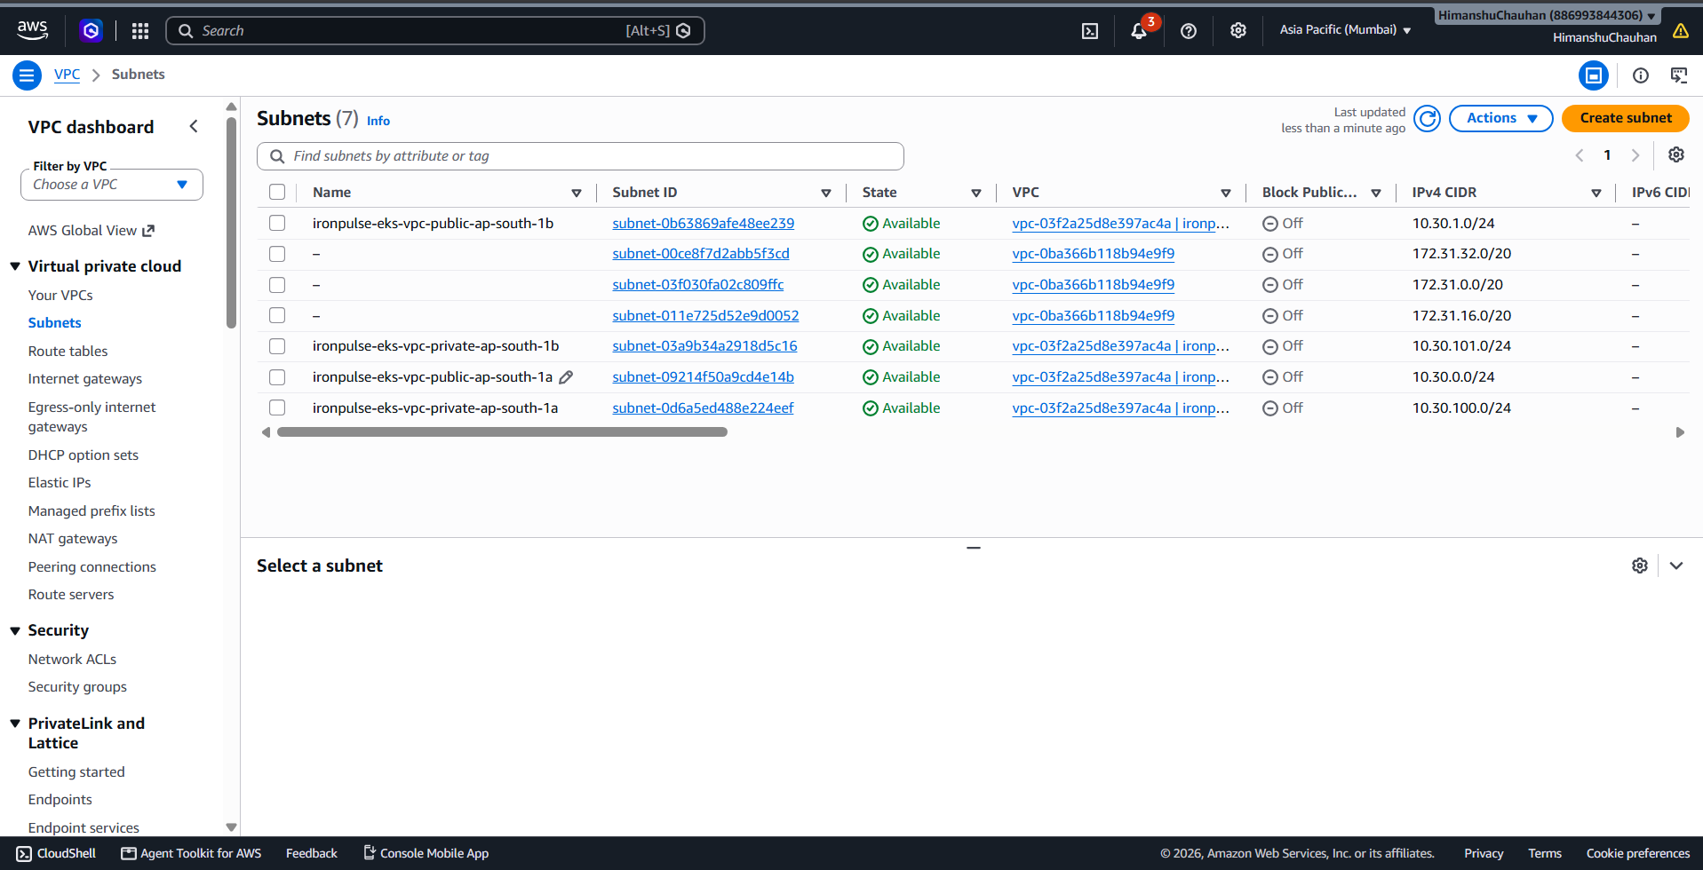
Terraform built the whole AWS stack
M7 · Terraform
terraform plan: 64 resources to add
EKS ironpulse-eks: Active, Kubernetes 1.35
VPC 10.30.0.0/16, NAT gateway, private worker nodes
Managed node group: 2 × m7i-flex.large (AL2023)
EBS CSI driver via IRSA, CI deployer IAM user
2 public + 2 private subnets across two AZs

Slide 10
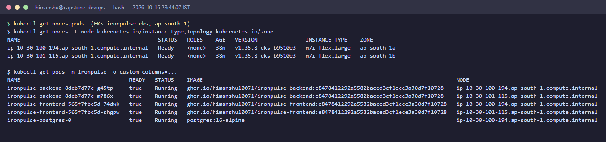
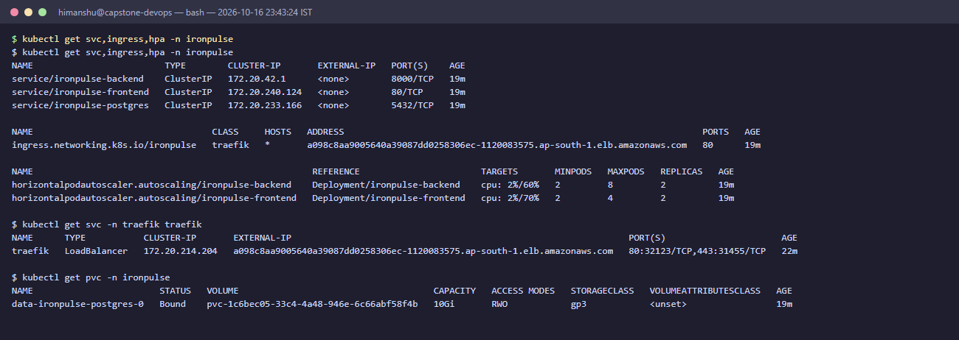
Kubernetes + Helm on EKS
M8 · K8s
2 backend + 2 frontend pods, spread over 2 AZs
ClusterIP Services, Traefik Ingress, Postgres StatefulSet
Restricted Pod Security: non-root, no capabilities
Zero-downtime rolling updates; helm rollback ready

Slide 11
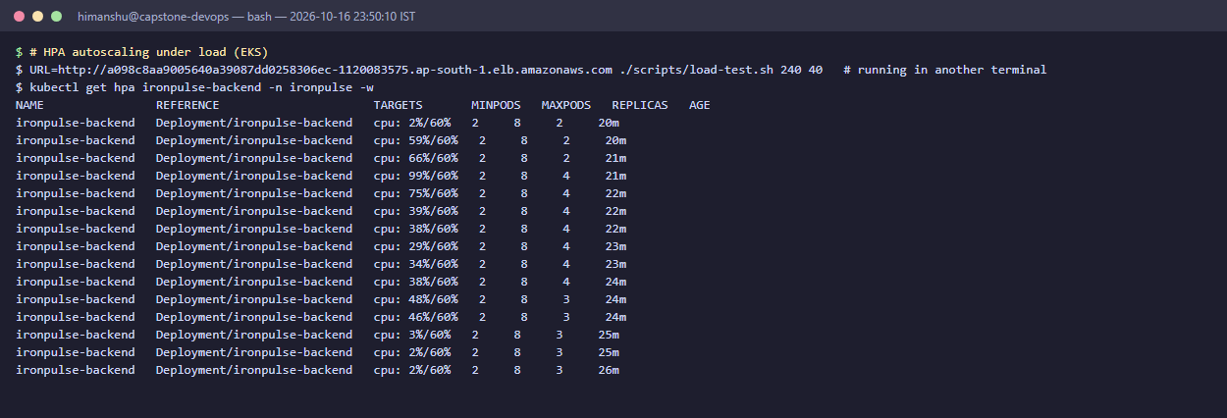
Autoscaling under real load
M8 · HPA
2 → 4
backend pods added by the HPA
99%
CPU vs. the 60% target at peak
kubectl get hpa -w during scripts/load-test.sh
240 s
Load stops → scale-down waits for a 2-minute stabilization window, then steps back to 3 and 2 replicas.
load test: 40 workers through the AWS load balancer

Slide 12
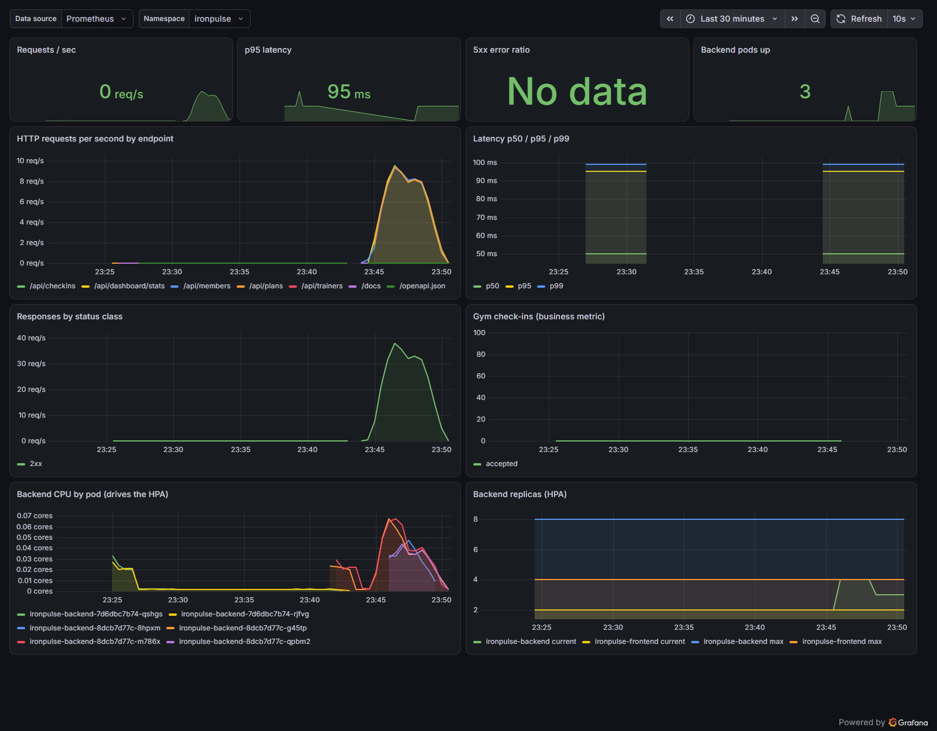
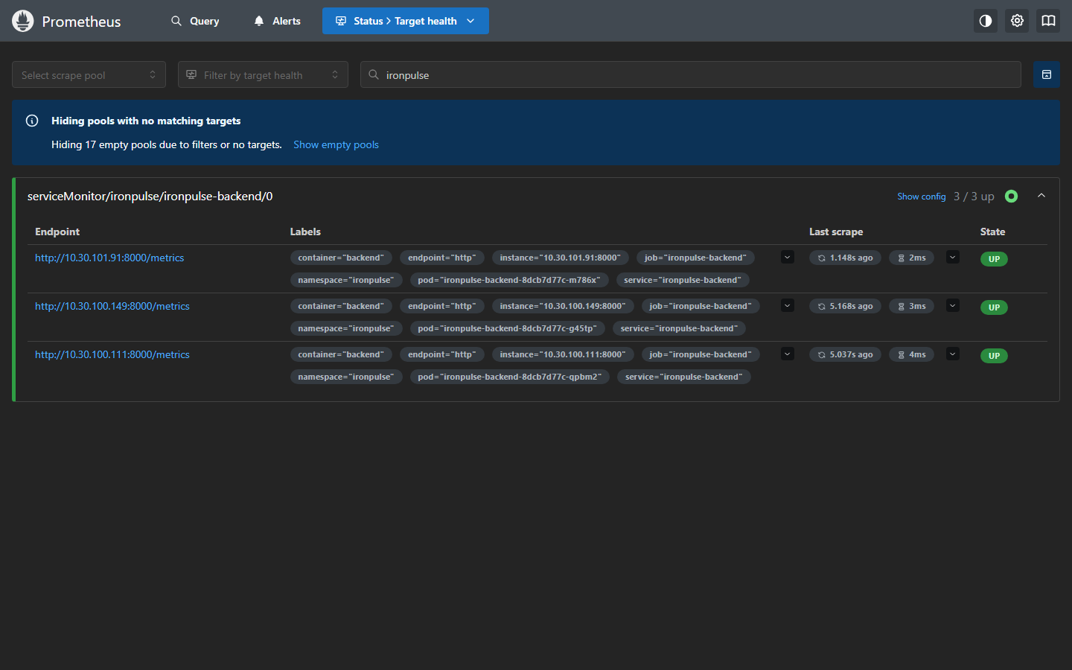
Prometheus + Grafana watching the API
M9 · Monitoring
ServiceMonitor targets: 3/3 UP
/metrics: request rate, latency histograms, status codes
Business metric: gym_checkins_total
Alerts: backend down, >5% errors, p95 > 1 s
Auto-provisioned dashboard during the load test

Slide 13
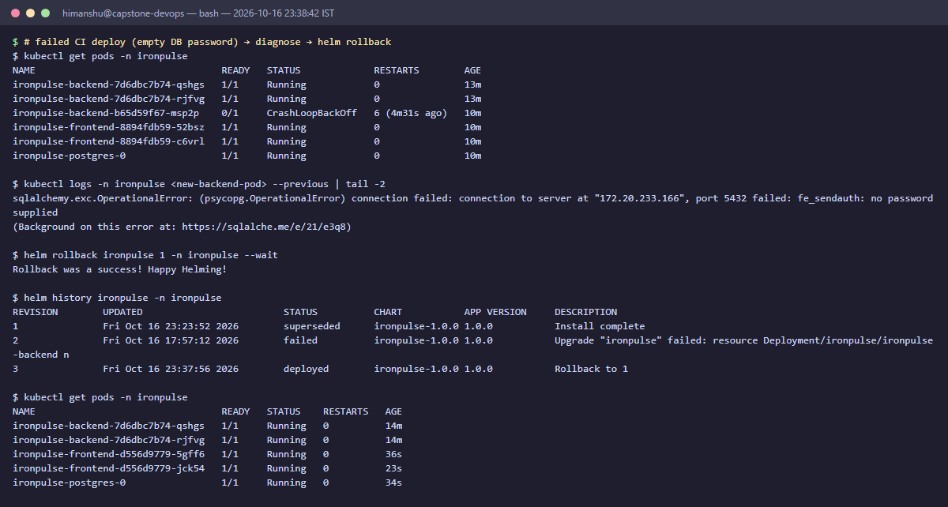
What broke, and how it was fixed
Lessons
No worker nodes
Root can't use kubectl
AWS Free plan rejected t3.medium. Switched to Free Tier eligible m7i-flex.large.
EKS rejects root as a principal. Terraform now creates a scoped deployer IAM user.
Deploy crash-looped
Lab pods never started
Failed revision 2 → rollback → fixed revision 4
CI passed an empty DB password. Old pods kept serving; helm rollback, then fixed the workflow + chart.
Restricted Pod Security blocked them. Lab manifests now set a compliant securityContext.
Every incident is reproducible from the repo and documented in the README.

Slide 14
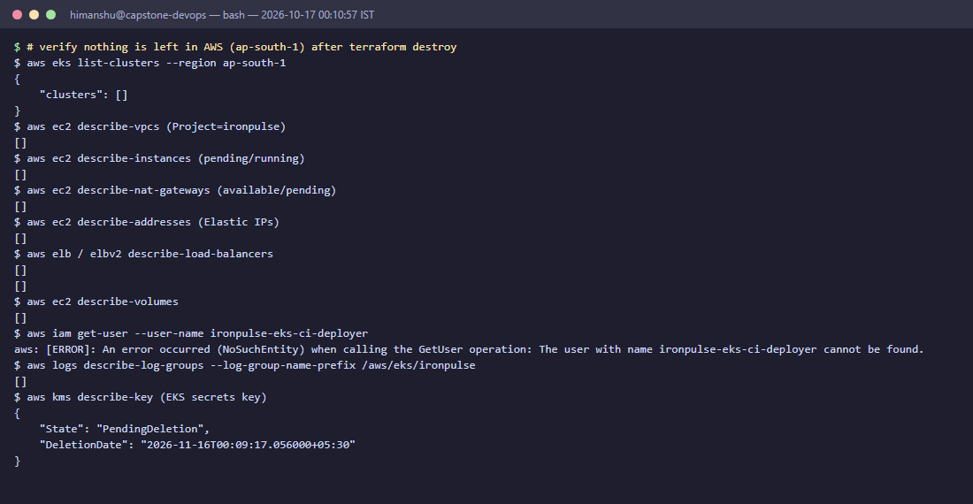
Every rubric module, delivered and verified
✓ M1
App
✓ M2
Tests
✓ M3
Git
✓ M4
Docker
✓ M5
CI/CD
✓ M6
Trivy
✓ M7
Terraform
✓ M8
K8s + Helm
✓ M9
Monitoring
✓ M10
Docs
AWS checked after terraform destroy: all empty
Torn down after verification: no clusters, nodes, NAT gateway, load balancers or volumes left running.
Repository github.com/Himanshu10071/devops-project
Evidence 34 screenshots in docs/screenshots · rubric map in docs/SUBMISSION.md
Thank you

