Slide 1

NCI · MSC DATA ANALYTICS · DOMAIN APPLICATIONS
Before the Docks Run Dry
Forecasting Dublin Bikes availability for proactive rebalancing
with open urban data
Himanshu Devendrasing Rajput
x24230308 · School of Computing · National College of Ireland
Notes:
Good morning. In the next four minutes: a real operational problem, an honest model, and a working tool you will see live.

Slide 2


THE PROBLEM
A bike-share fails in two directions — and the fix is reactive
Empty station
THE PREMISE
No bikes at 08:00 — the commuter walks. 21.5% of June station-hours were empty-risk.
The failure is predictable.
Full station
If hourly availability can be forecast per station, crews can be routed before stations run dry — not after.
No free dock — the return is blocked and the rider is stranded at the wrong end.
Costly rebalancing
Crews truck bikes between stations, usually dispatched after the failure has already happened.
115 stations · Dublin city core
Dublin Bikes · Domain Applications CA
2
Notes:
Two failure modes: empty blocks pick-ups, full blocks returns. Rebalancing is reactive and expensive. Premise: the failure is predictable, so act before it.

Slide 3
THE DATA
Real, open, current — the Smart Dublin station feed
1.86M
249,940
115
raw 5-minute snapshots · Apr–Jun 2026
station-hours after aggregation
docking stations across the city
QUALITY AUDIT — THE FEED IS REMARKABLY CLEAN
0
0
0
1
7.4
missing values
duplicate snapshots
impossible readings
offline row dropped
snapshots / station-hour
The real preprocessing contribution is reshaping, not scrubbing: irregular 5-minute snapshots → one clean hourly row per station.
Dublin Bikes · Domain Applications CA
3
Notes:
Fully open Dublin City Council feed, no synthetic data. 1.86 million snapshots become 249,940 station-hours. Audit: essentially zero defects — the work is reshaping, not scrubbing.

Slide 4
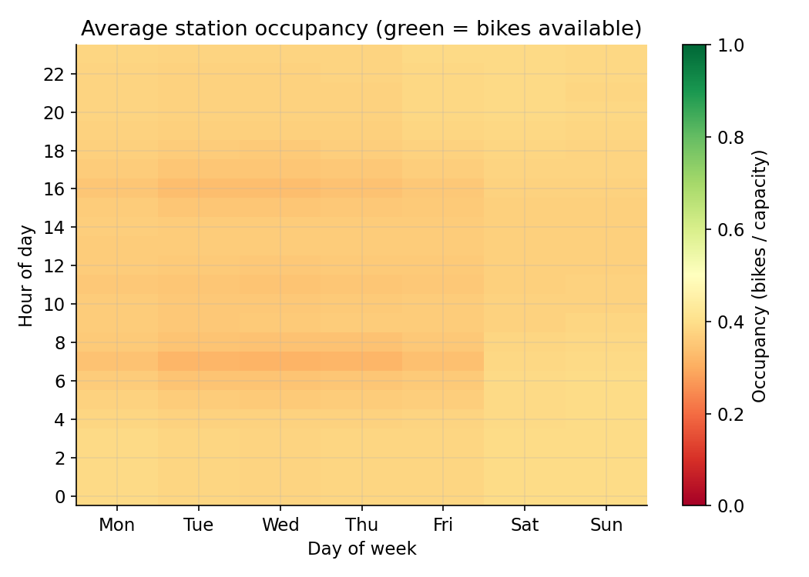



EXPLORATORY ANALYSIS
The commuter tide is the signal
Weekday mornings drain the docks; evenings refill them — a sharp, repeating pulse.
Weekends are flat: the pattern is commuting, not leisure.
This weekly rhythm is exactly what the models must capture — and what the naive baseline memorises.
Dublin Bikes · Domain Applications CA
4
Notes:
Mean occupancy by hour and weekday. Green = bikes available. The tide: morning drain, evening refill, absent at weekends. This is the predictable structure.

Slide 5




METHOD
Four models, one honest test: predict a month never seen
TRAIN — April + May 2026 · 168,352 rows
TEST — unseen June · 81,588 rows
Naive baseline
Linear regression
Random forest
XGBoost
station × weekday × hour mean — the lookup table to beat
one-hot calendar + station identity, OLS
200 trees · min leaf 3
500 trees · depth 7 · lr 0.05
Identical scikit-learn pipelines · no leakage · MAE / RMSE / R² in bikes
Dublin Bikes · Domain Applications CA
5
Notes:
Strict temporal split: fit on April-May, evaluate once on unseen June — the honest deployment scenario. Ladder of four models so the final choice is justified.

Slide 6
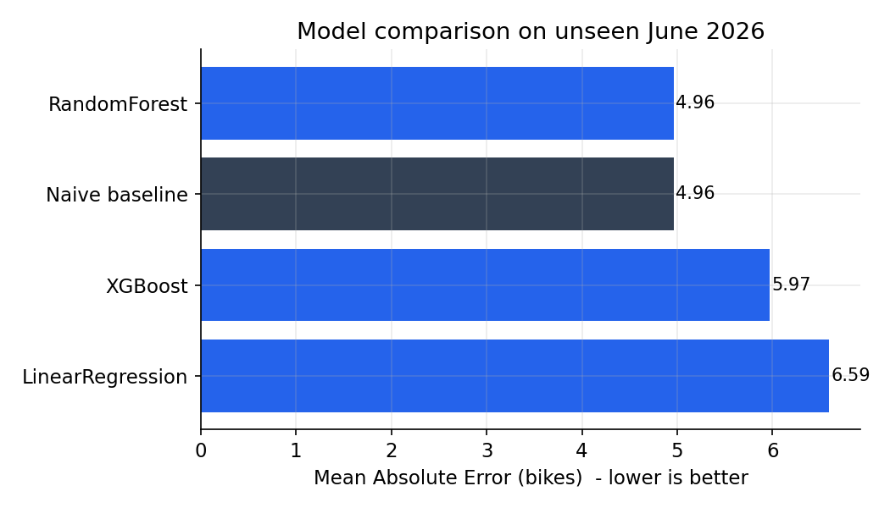
RESULTS — UNSEEN JUNE 2026
Random forest wins — but the honest story is the near-tie
4.96
0.556
MAE (bikes) — best model
R² on unseen June
THE FINDING
The forest only matches the weekly-rhythm lookup table — calendar structure carries almost all predictable signal. Reported as a ceiling, not hidden.
Linear regression −33% worse · XGBoost underfits the 147-column one-hot space
Dublin Bikes · Domain Applications CA
6
Notes:
RF: MAE 4.96 bikes, R-squared 0.556 — marginally ahead of the baseline on RMSE. The instructive result is the near-tie: it quantifies how far calendar features alone go, and defines the bar richer models must clear.

Slide 7
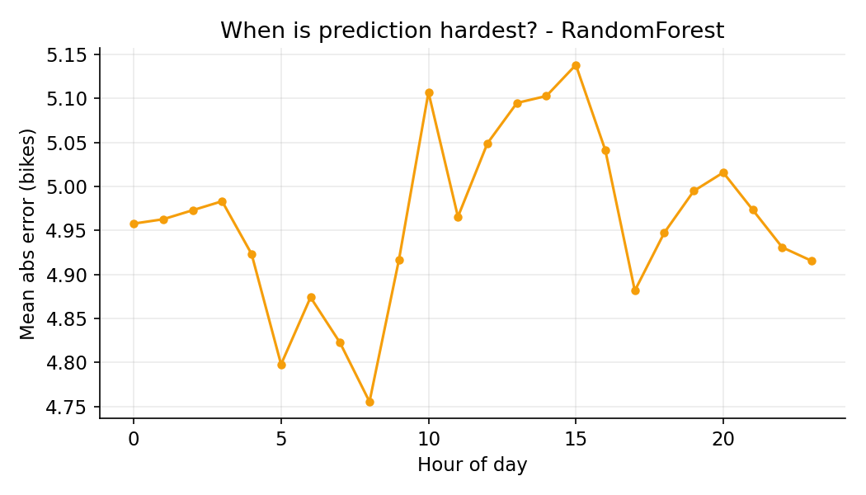
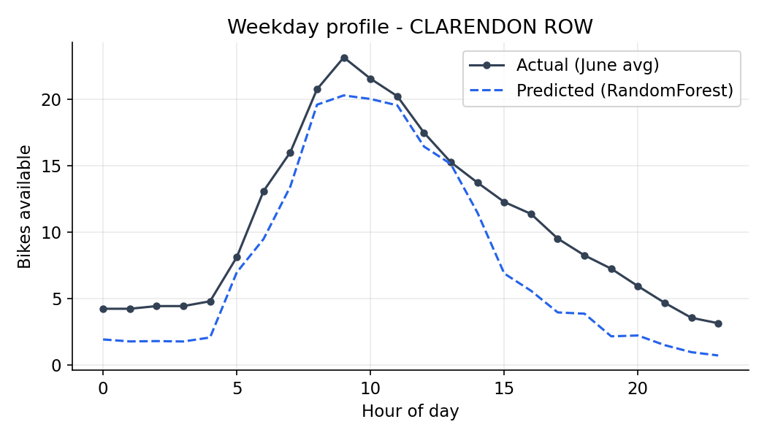
ERROR ANALYSIS
It errs exactly where you'd forgive it — the rush shoulders
Error peaks at 08:00 and 17:00–18:00 — when availability changes fastest. The direction of the tide is still predicted correctly, and rebalancing decisions hinge on direction, not exact counts.
Dublin Bikes · Domain Applications CA
7
Notes:
Left: error by hour peaks at the two commuter shoulders. Right: highest-swing station — the forest tracks the sharp morning drain closely. Least damaging failure profile possible.

Slide 8


FROM FORECAST TO ACTION
A forecast is not a decision — alerts are
Empty-risk alert = predicted ≤ 2 bikes
The threshold is an operations lever
78%
28%
Lower it → fewer, higher-confidence alerts
Raise it → catch more outages, spend more crew time
Exposed as a slider in the dashboard — the trade-off is explicit, not hidden in code
precision — 4 of 5 dispatches justified
recall — the predictable outages
Tuned conservative: crew time is the scarce resource.
Dublin Bikes · Domain Applications CA
8
Notes:
Alerts, not numbers: 78 percent precision means four of five dispatches target a genuine problem. Recall 28 percent — deliberately conservative. The threshold is a visible lever, a management decision.

Slide 9



THE APPLICATION
An operations dashboard, not a notebook
● LIVE DEMO
City map, three views
Rebalancing planner
Predicted bikes · alert status · commuter roles, for any day-hour
Wed 08:00 → move 26 bikes over 27.1 km to relieve 49 low stations — downloadable CSV
Station roles
Honest model page
50 commuter origins · 34 destinations · 31 balanced — a capacity-planning map
Metrics, confusion matrix and the threshold lever — the tool never oversells itself
Streamlit · reads tiny precomputed CSVs · starts instantly · never loads the 545 MB model
Dublin Bikes · Domain Applications CA
9
Notes:
Switch to the live app here: scenario presets, the map, then the planner — 26 bikes, 27 kilometres, one click to download the move list. Then back for ethics and close.

Slide 10



ETHICAL CONCERNS
No personal data — the ethics live in how service is steered
Privacy by design
Aggregate counts at public infrastructure — no trips, no accounts, no individuals.
Spatial equity
Optimising for predicted demand can compound under-service at the periphery — the role and reliability views make chronic neglect visible.
The lever is ethical
A precision-tuned system quietly accepts 72% of outages — and the affected riders are not randomly distributed.
Open + efficient
All data, code and metrics are reproducible; better routing means fewer diesel truck kilometres.
Dublin Bikes · Domain Applications CA
10
Notes:
The feed holds no personal data by design. The real ethics: where the trucks go. Spatial equity, the precision-recall lever as an ethical choice, and full transparency.

Slide 11



CONCLUSION
Open data + honest ML = decisions a crew can act on
Forecasts within ~5 bikes on a month the model never saw
NEXT
Weather + lagged features for the rush shoulders
78%-precision alerts and a concrete, downloadable rebalancing plan
Probabilistic alerts with calibrated confidence
The near-tie with the baseline is the finding: the weekly rhythm is the signal
Couple the planner to a vehicle-routing optimiser
Thank you
Data: Smart Dublin open data portal · dublinbikes station status, Apr–Jun 2026
Dublin Bikes · Domain Applications CA
11
Notes:
Close: within five bikes on an unseen month, alerts a crew can trust, and an honest ceiling reported as a finding. Thank you.

