Slide 1
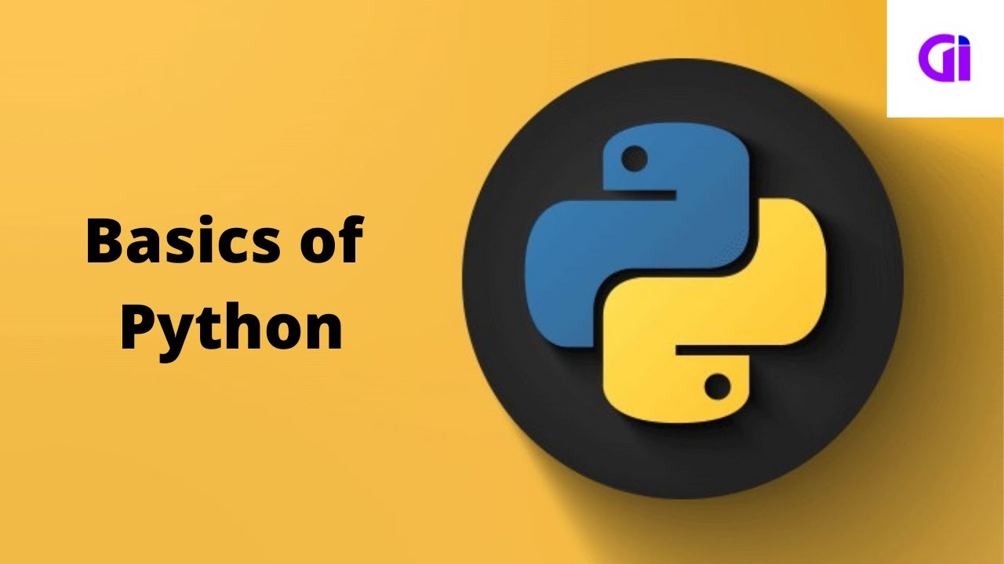
Basic_Python_Project

Slide 2
Python
A comprehensive introduction to Python programming language covering fundamental concepts including variables, data types, control structures, functions, and basic file handling. Designed for beginners, this repository provides clear explanations and practical examples to kickstart your journey into Python programming.

Slide 3
String Indexing
String indexing provides a powerful way to manipulate and access individual characters or substrings within a string in Python. string indexing is a fundamental concept in Python that allows you to work with individual characters or substrings within strings, enabling various string manipulation operations.

Slide 4
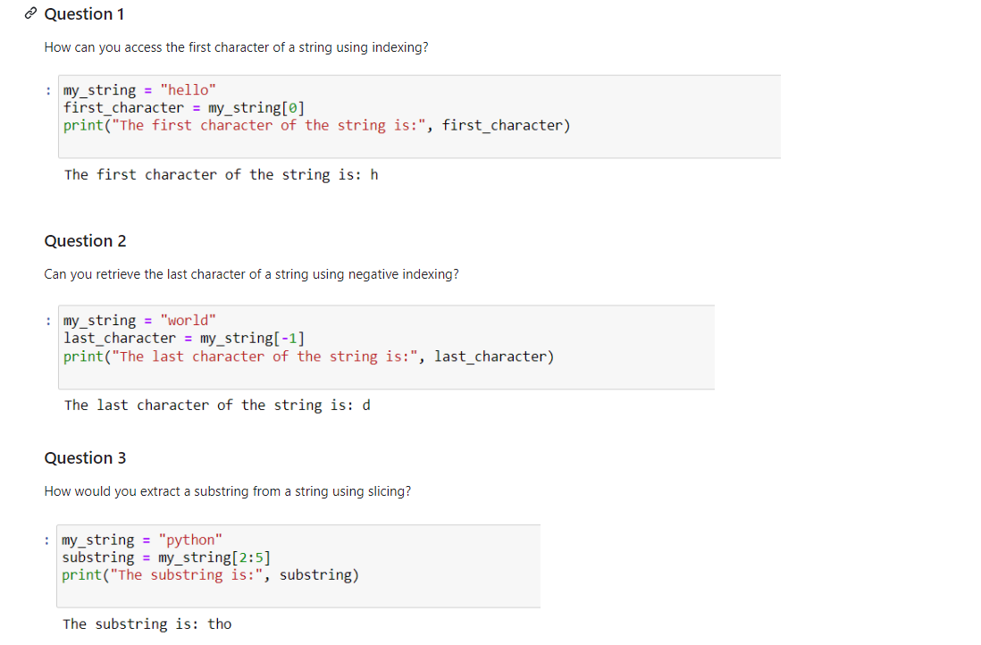
Questions

Slide 5
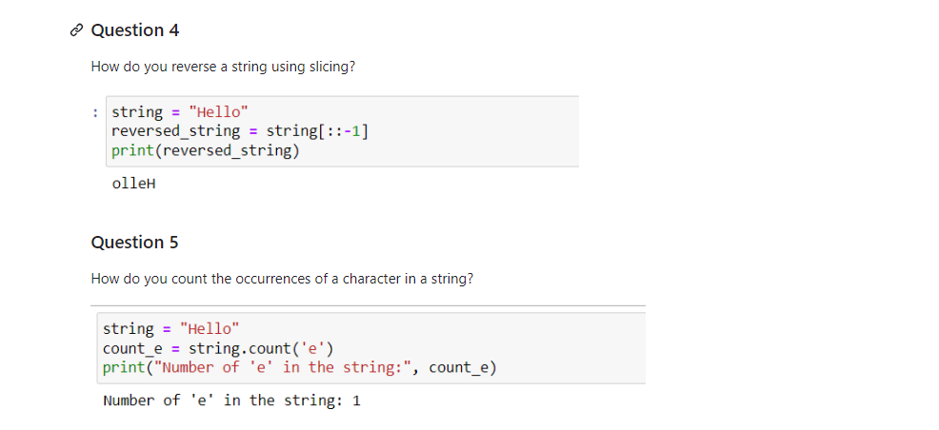
Question

Slide 6
List Operations
list operations provide various ways to manipulate and access elements within lists, making lists versatile and powerful data structures in Python.

Slide 7
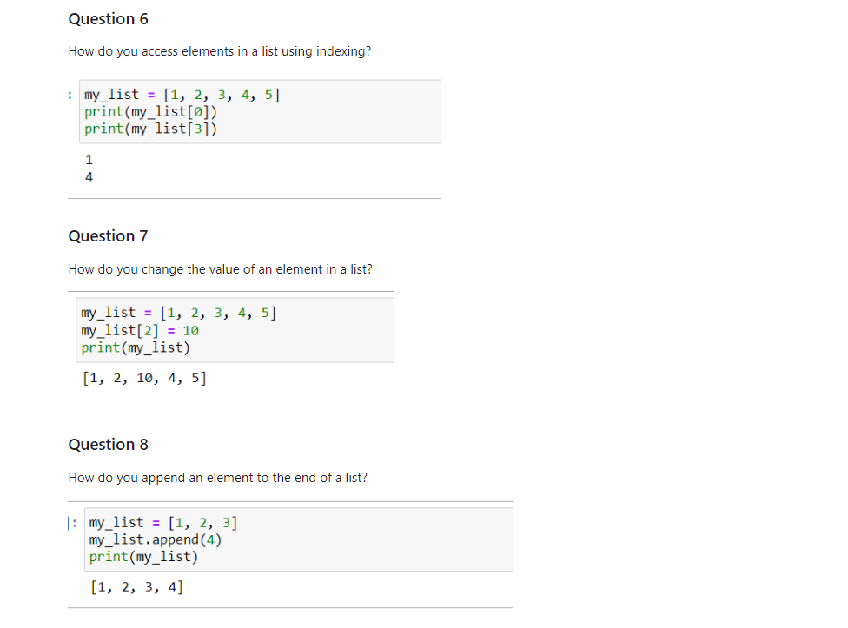
Questions

Slide 8
Dictionary Operations
Dictionaries are collections of key-value pairs, where each key is associated with a value. Dictionary operations allow you to manipulate, access, and perform actions on these key-value pairs.Dictionary operations in Python involve various actions you can perform on dictionaries, which are unordered collections of key-value pairs

Slide 9
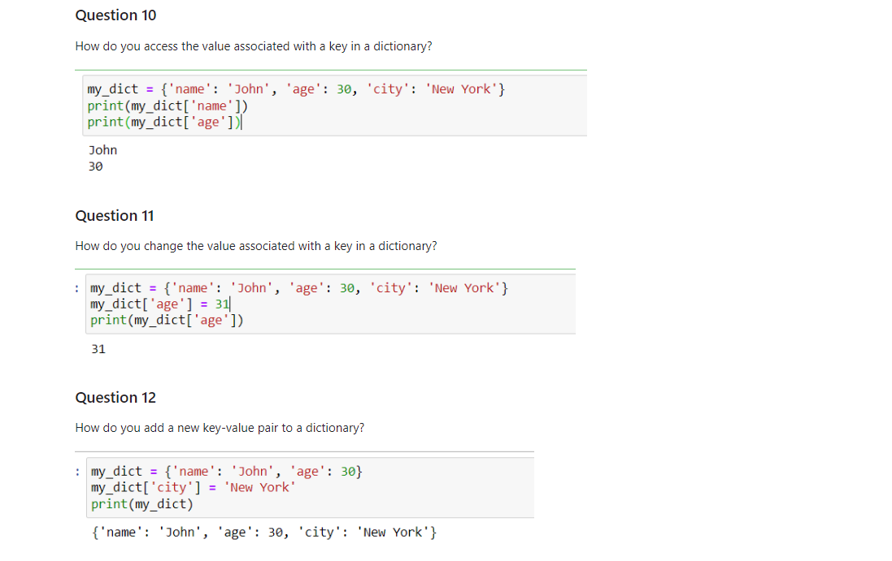
Questions

Slide 10
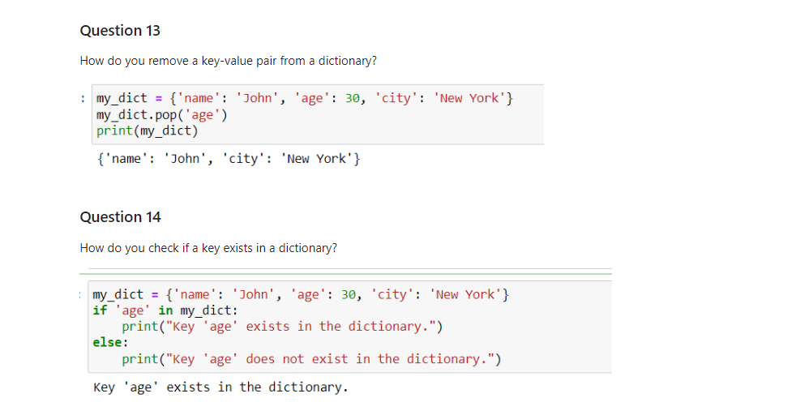
Question

Slide 11
Functions ( Len, Max, Sum )
These built-in functions provide convenient ways to perform common operations in Python programming, such as calculating totals, finding lengths, and identifying maximum or minimum values

Slide 12
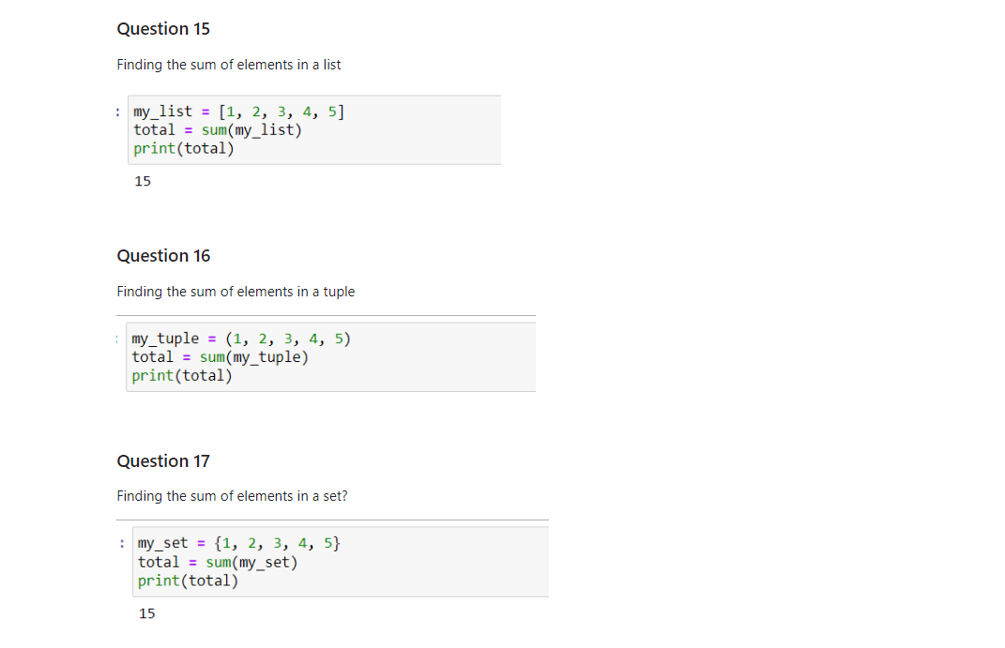
Questions

Slide 13
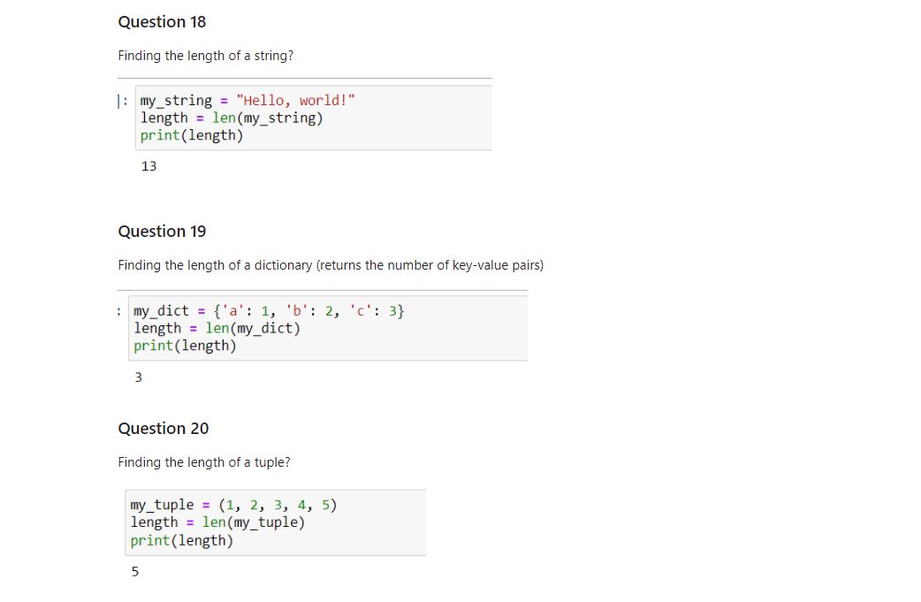
Questions

Slide 14
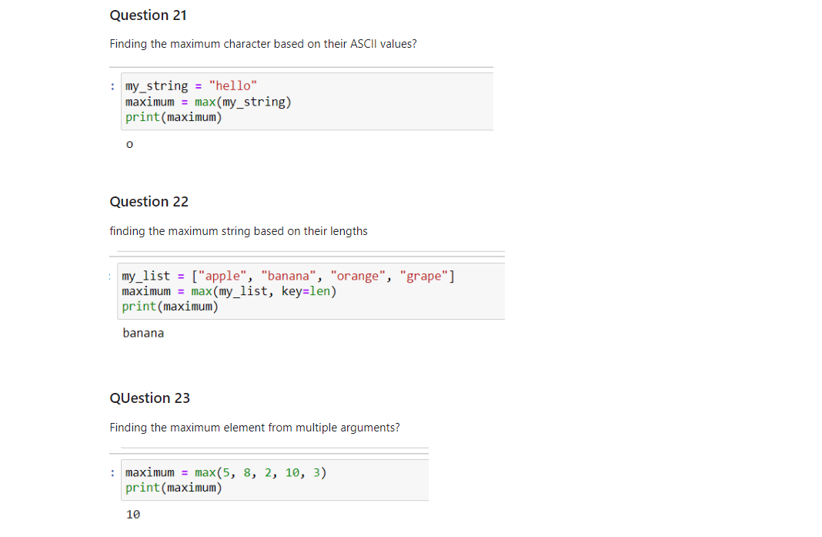
Questions

Slide 15
Looping statements ( While and for looping)
The for loop is used for iterating over a sequence of items, while the while loop is used for executing code based on a condition that can change during execution. Both types of loops are essential constructs in Python programming and provide different ways to control the flow of execution in your code.

Slide 16
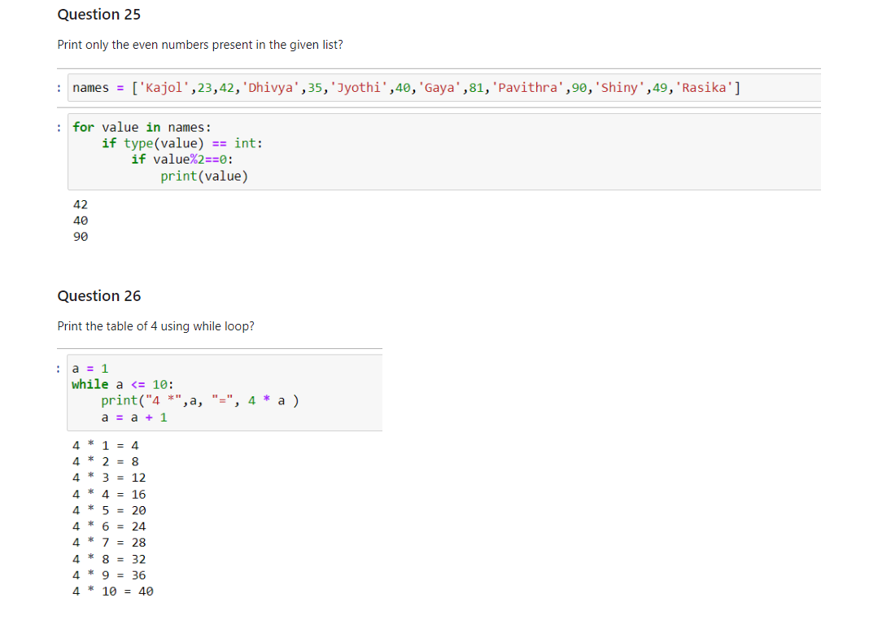
Questions

Slide 17
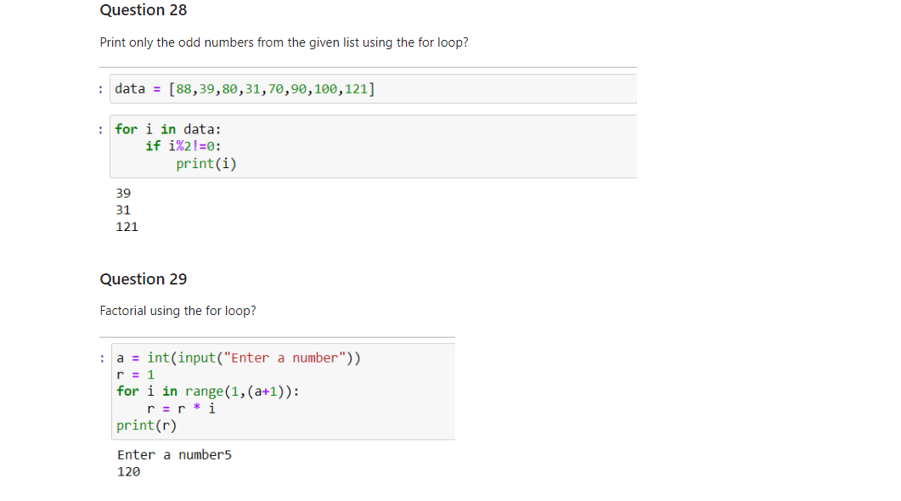
Questions

Slide 18
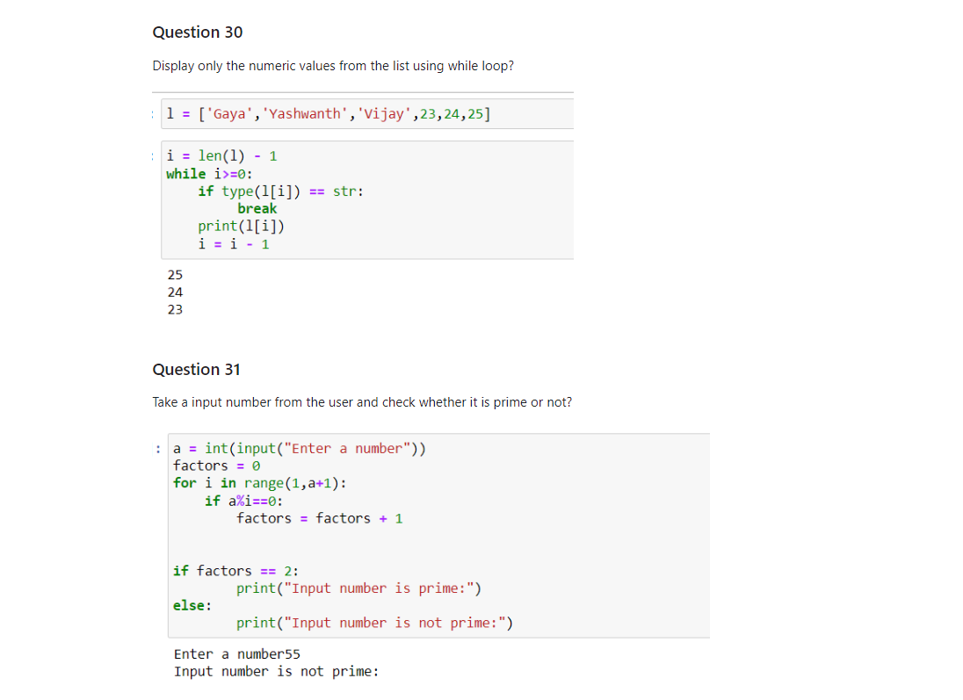
Questions

Slide 19
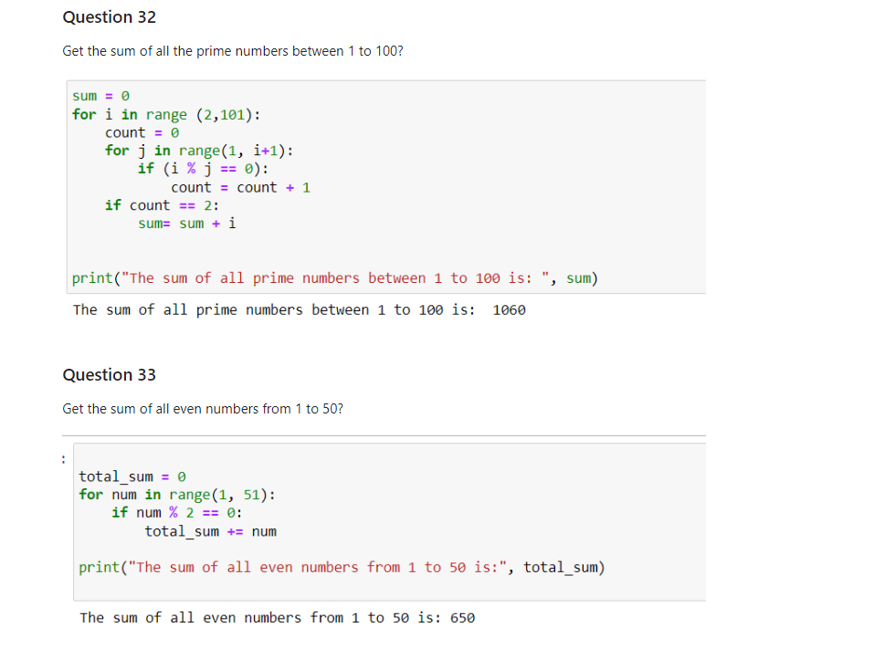
Questions

Slide 20
UDF: Arguments and Parameters
UDF stands for User-Defined Function. It refers to a function that is defined by the user (programmer) rather than provided as part of the programming language's built-in functionality. In Python, as well as in many other programming languages, users can create their own functions to encapsulate specific tasks or pieces of code that they want to reuse multiple times within their programs.

Slide 21
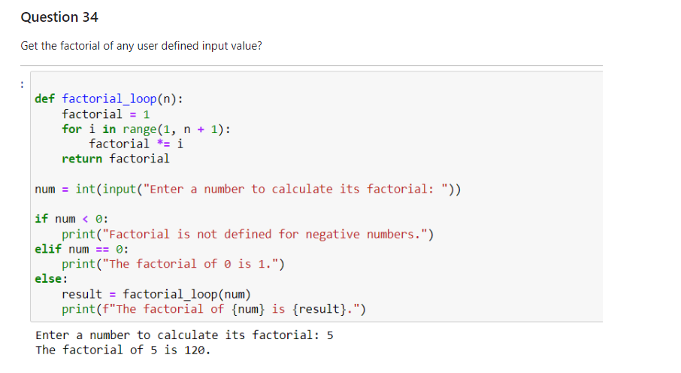
Questions

Slide 22
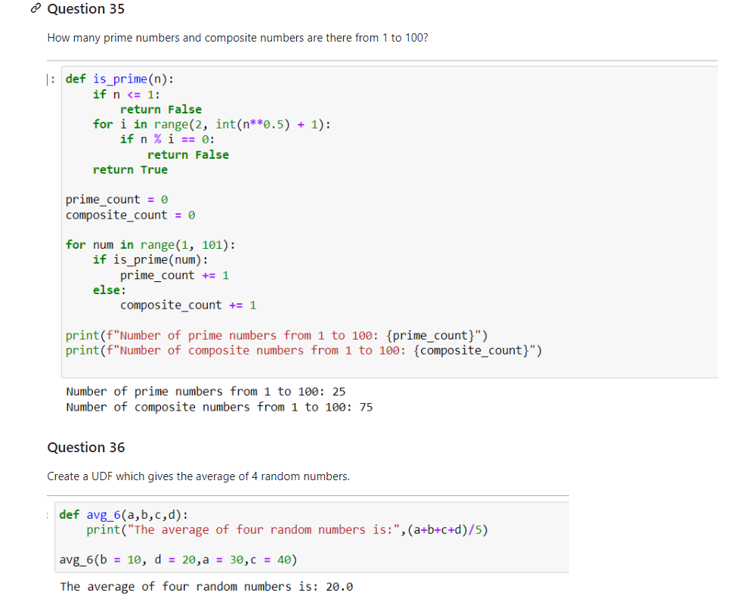
Questions

Slide 23
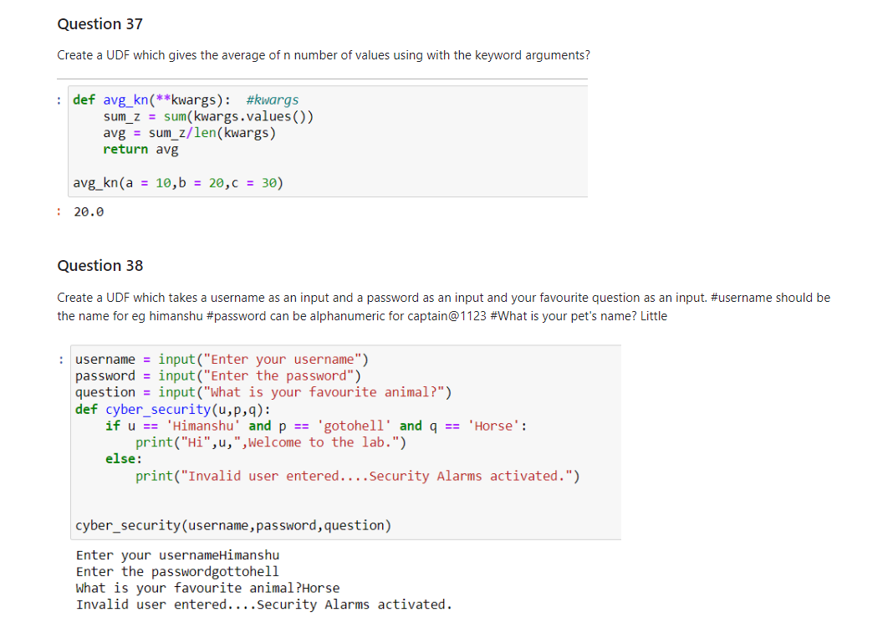
Questions

Slide 24
Lambda Function
A lambda function, also known as an anonymous function or lambda expression, is a small, inline function defined using the lambda keyword in Python.They are typically used when you need a simple function for a short period of time and don't want to define a separate function using the def keyword.

Slide 25
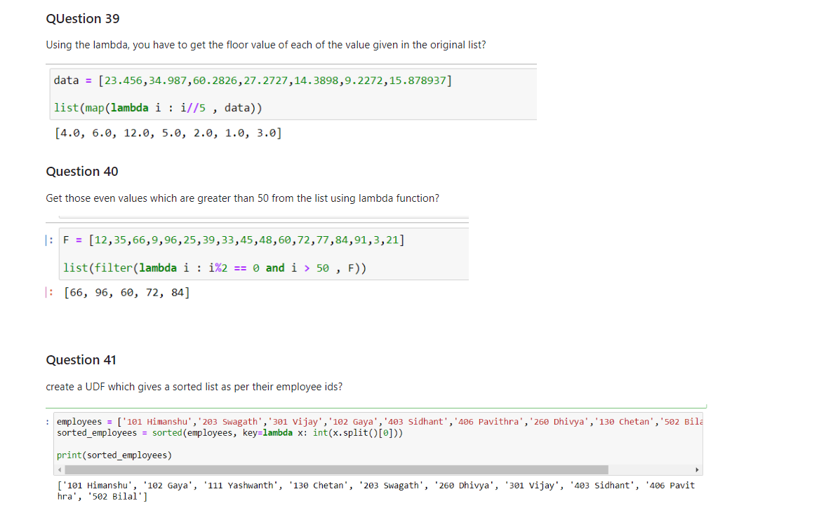
Questions

Slide 26
List comprehension
List comprehension is a concise way to create lists in Python by applying an expression to each item in an iterable. It allows you to generate a new list based on an existing iterable (such as a list, tuple, or range) with minimal code

Slide 27
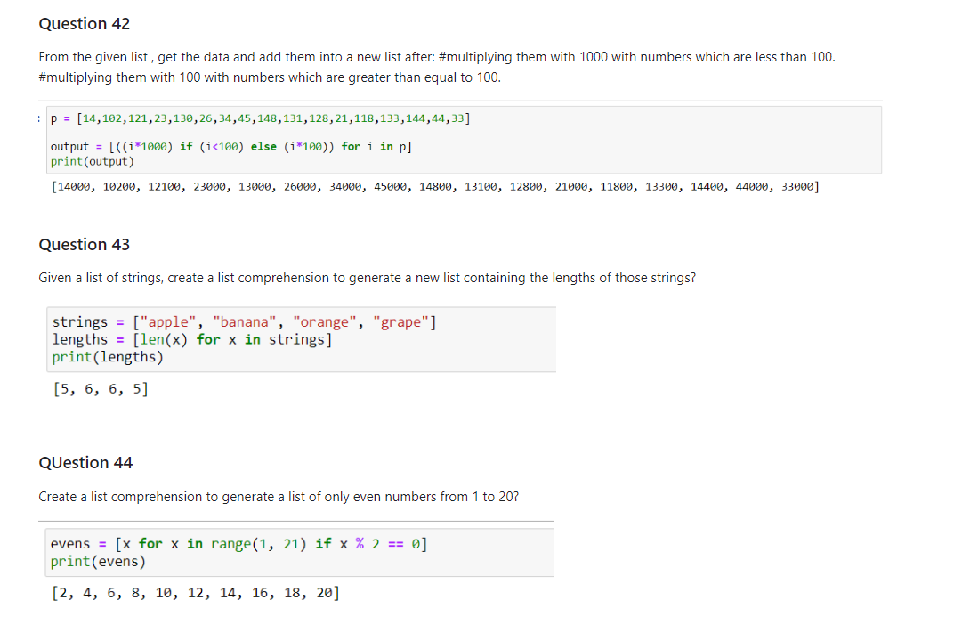
Questions

Slide 28
Class Creation
Class functions/methods are called using dot notation (object.method()), where object is an instance of the class. They operate on the data stored in the object's attributes and provide behavior specific to the class.

Slide 29
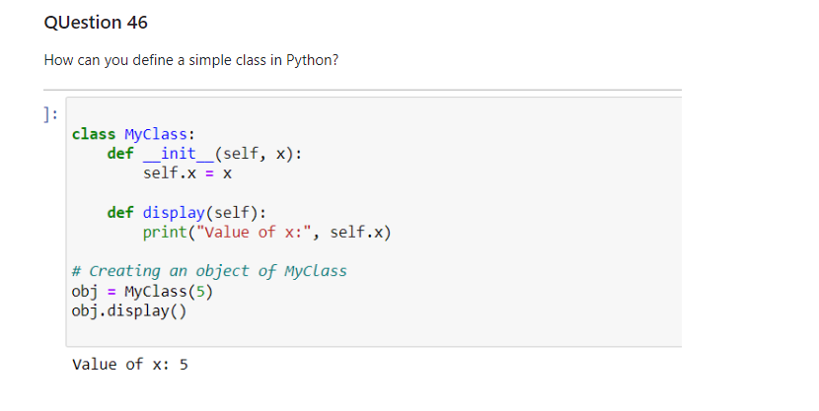
Questions

Slide 30
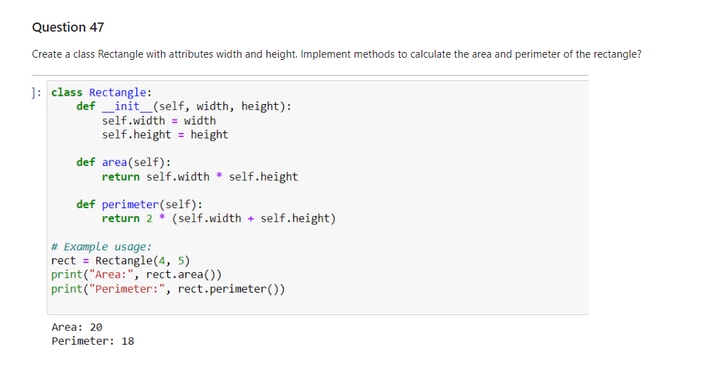
Questions

Slide 31
Class Inheritance
Class inheritance in Python refers to the mechanism by which one class (the subclass or child class) can inherit attributes and methods from another class (the superclass or parent class). This inheritance allows the subclass to reuse code from the superclass, promoting code reusability, organization, and extensibility

Slide 32
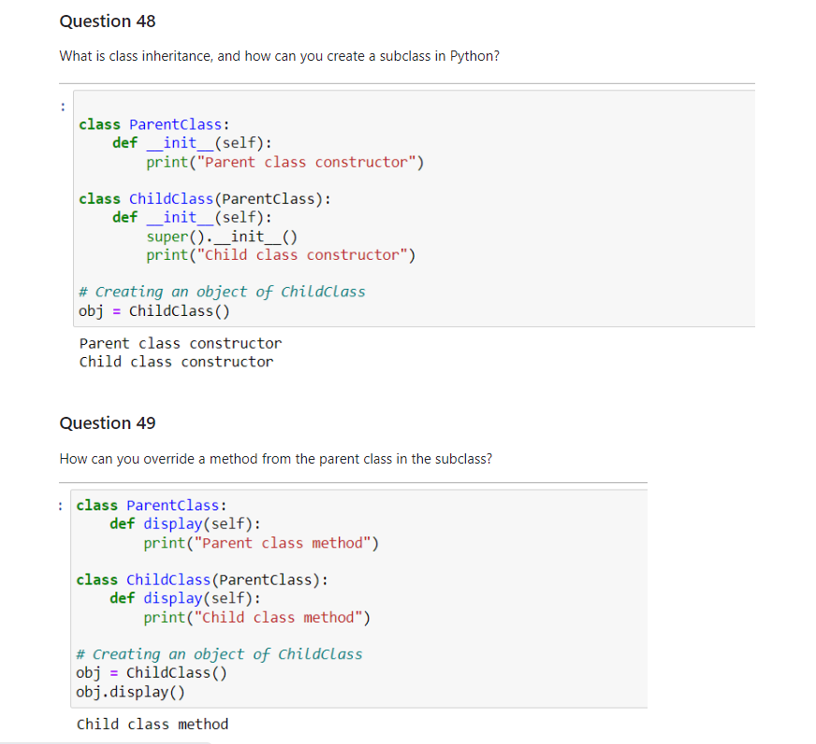
Questions

Slide 33
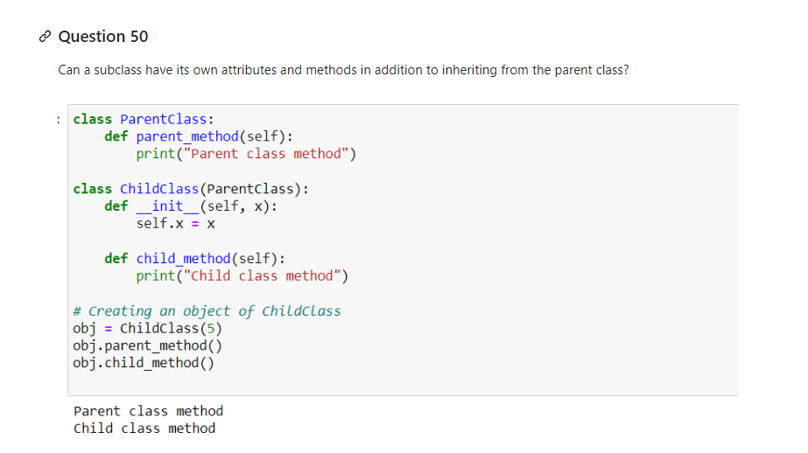
Questions

Slide 34
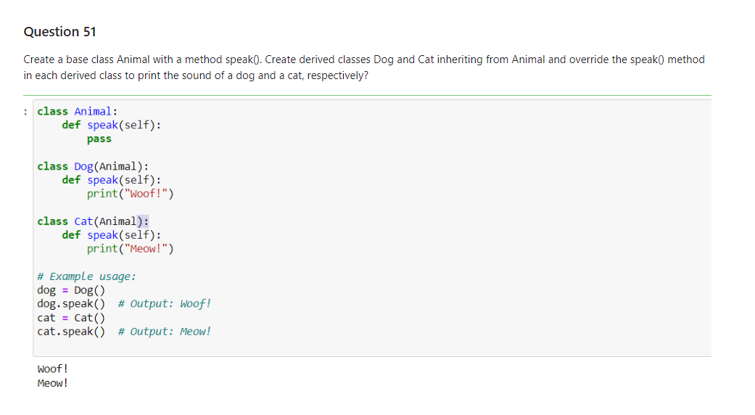
Questions

Slide 35
Thank you
Project by : Himanshu

