Slide 1

HAPPIEST HEALTH · DIGITAL TWIN CHALLENGE · BENGALURU 2026
GlucoTwin
A digital twin that predicts a dangerous blood-sugar spike about an hour before it happens — so a doctor can act in time.
ROC-AUC 0.95
84% caught early
~50 min ahead
95.8% clinically safe
Team Healthcure · IIT Kanpur

Slide 2
MEET THE PATIENT
M
Meera, and millions like her
Her watch and glucose sensor stream all day; her hospital holds nine years of records. Yet the two never talk to each other — so a dangerous spike is found weeks later, after the damage.
Meera R.
101M
people live with diabetes in India — the largest burden of any country on earth.
58 · Coimbatore, Tamil Nadu
Type 2 diabetes 9 years
HbA1c 8.4 %
≈ 1 : 8,000 — endocrinologists per patient — expert time is the scarcest resource
Wears smartwatch + CGM
Reactive by default — excursions are found after the fact, accelerating complications
Illustrative persona — not a real patient

Slide 3
OUR SOLUTION
From reactive to proactive
GlucoTwin builds a living virtual twin of the patient and predicts a hyperglycemic excursion 60–120 minutes in advance.
01
Predict
Forecasts the next hyperglycemic event before it happens — a real window to act.
02
Explain
Shows the doctor the wearable and record signals behind every single alert.
03
Simulate
What-if levers — walk, meds, sleep, meal — turn each prediction into an action.
GlucoTwin — Digital Twin for Type 2 Diabetes
03 / 12

Slide 4
THE FUSION
Two data streams — and why we need both
THE HEALTH RECORD
HbA1c · labs · medications · comorbidities (CKD) · family history
fused
the twin
THE WEARABLE + CGM
one signal
continuous glucose · heart rate & HRV · steps · sleep · meals, every 15 min
Why the fusion is real: whether a meal spikes past 180 is set by a hidden state — anchored by the record and swinging with what only the wearable sees. Neither alone is enough — our ablation proves it.
GlucoTwin — Digital Twin for Type 2 Diabetes
04 / 12

Slide 5
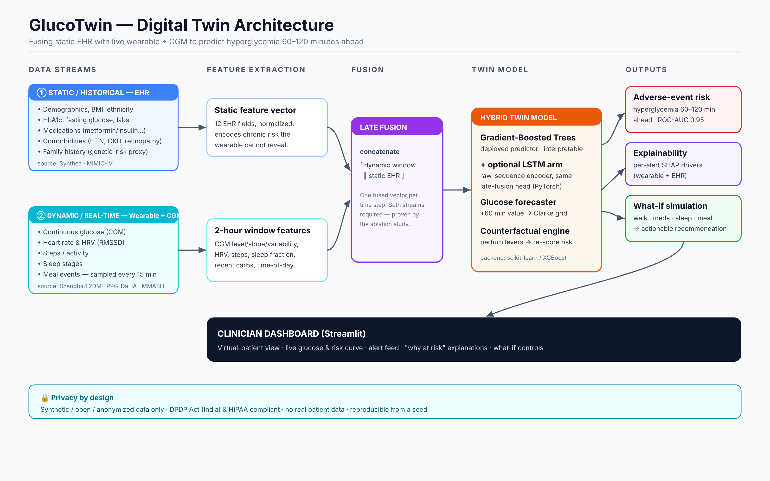
ARCHITECTURE
From two streams to a clinician's screen

Slide 6
THE MODEL
A hybrid twin — interpretable, deep-learning ready
01
Gradient-Boosted Trees
02
Optional LSTM arm
The deployed predictor on the fused vector: interpretable, fast, SHAP-native — chosen over a Transformer on purpose.
Encodes the raw window with the record joined at the dense head — the same late-fusion idea, as a sequence model.
03
Glucose forecaster
04
Counterfactual engine
Predicts glucose +60 min, which powers the Clarke Error Grid clinical-safety check.
Perturbs levers and re-scores risk — this is what makes it a twin, not a classifier.
Target: probability of glucose exceeding 180 mg/dL in the next 60–120 minutes, from the last 2 hours of fused data.
GlucoTwin — Digital Twin for Type 2 Diabetes
06 / 12

Slide 7
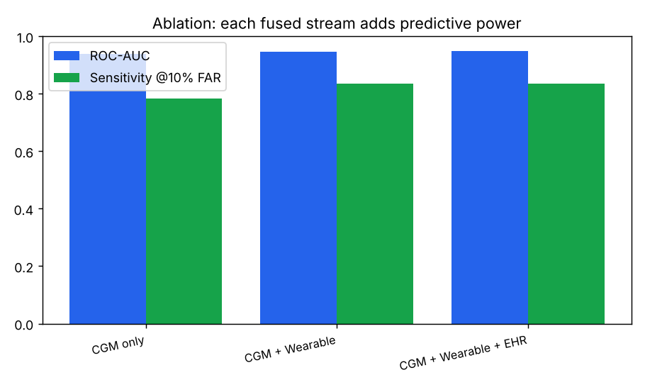
RESULTS
The proof — and the clinical numbers
0.77 → 0.81 → 0.82
PR-AUC as we add CGM → wearable → record. Both streams carry signal the other can't.
0.95
0.82
ROC-AUC
PR-AUC
84%
~50m
Each added stream lifts performance — on held-out patients, no leakage.
caught @10% FAR
lead time
95.8% of forecasts fall in Clarke Zones A + B — clinically safe.
GlucoTwin — Digital Twin for Type 2 Diabetes
07 / 12

Slide 8
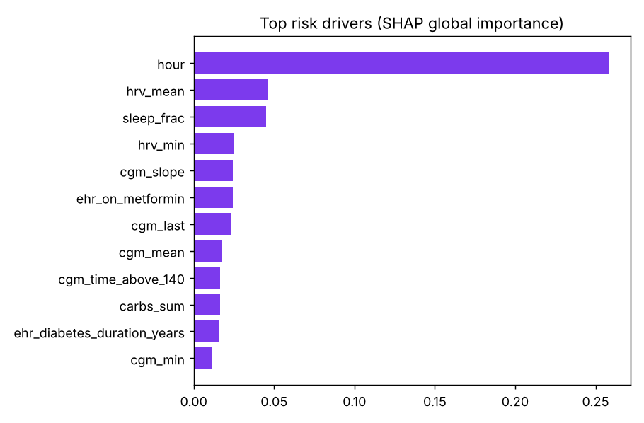
TRUST
Explainable by design — the doctor sees why
“Why is this patient at risk right now?”
SHAP attributes every risk score to its drivers — globally here, per patient in the dashboard. The top drivers blend both streams —
wearable — HRV, sleep, activity
CGM — glucose level & slope, time of day
record — HbA1c, CKD, medications
GlucoTwin — Digital Twin for Type 2 Diabetes
08 / 12

Slide 9
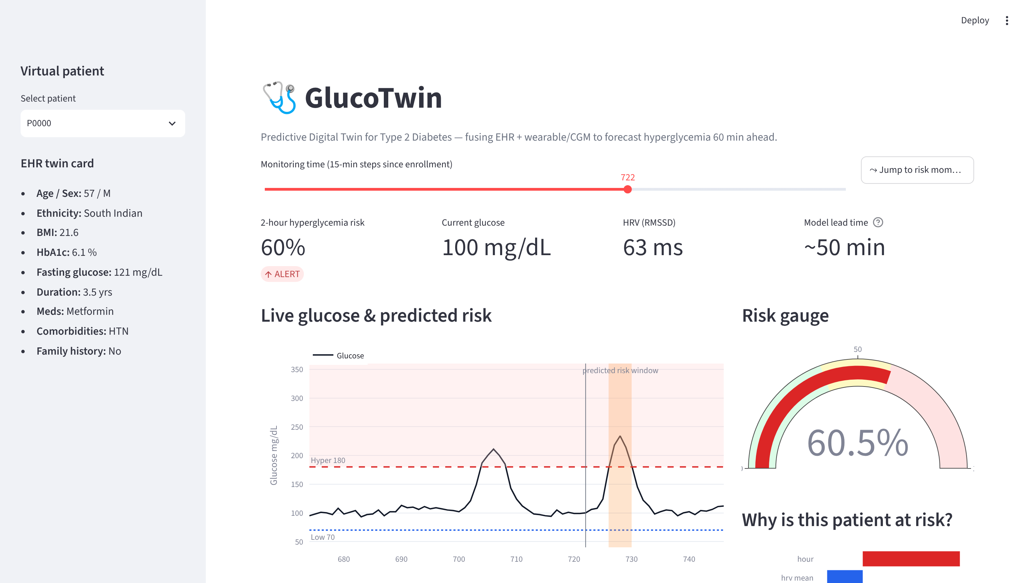
THE PRODUCT
How a doctor meets the virtual patient
Risk climbs before the spike —
that gap is the early warning.
Live gauge & alert state
Every alert is explained
by its SHAP drivers.
GlucoTwin — Digital Twin for Type 2 Diabetes
09 / 12

Slide 10




THE TWIN IN ACTION
Turning a prediction into a recommendation
At 68% predicted risk , the doctor tries interventions on Meera's twin — and watches the risk fall:
A 20-minute walk now
Better sleep, less stress
68% → 37%
68% → 31%
Take metformin
A lighter, low-GI meal
68% → 43%
68% → 55%
Context-aware: the engine edits the twin's state and re-scores — the same model, counterfactually.
GlucoTwin — Digital Twin for Type 2 Diabetes
10 / 12

Slide 11



IMPACT & ROADMAP
Why it matters — and where it goes next
WHAT IT CHANGES FOR INDIA
THE ROAD AHEAD
Remote monitoring & triage
NOW
Proof of concept
one clinician oversees hundreds, ranked by risk
Fused model, dashboard & simulation on synthetic + open data.
Personalized coaching
NEXT
Real data
a concrete, evidence-based next action per patient
Train & validate on ShanghaiT2DM, MIMIC-IV and wearable cohorts.
Prevent complications
THEN
Prospective pilot
catch excursions early — slow kidney, eye & heart disease
A silent-mode hospital pilot measuring real lead time & utility.
Runs on data India already has
LATER
Regulation & scale
wearables + CGM + records, with no new hardware
Bias audits, a CDSCO pathway, clinician-in-the-loop trials.
GlucoTwin — Digital Twin for Type 2 Diabetes
11 / 12

Slide 12

A gentle nudge before the spike —
not a diagnosis
after the damage.
Thank you.
Fuses record + wearable/CGM — both streams proven to add value
Predicts ~50 min ahead · ROC-AUC 0.95 · 84% caught early
Explains every alert & simulates the fix on a virtual twin
Runs in 45 s, zero downloads — synthetic + real-data ready
Team Healthcure · IIT Kanpur

