Slide 1
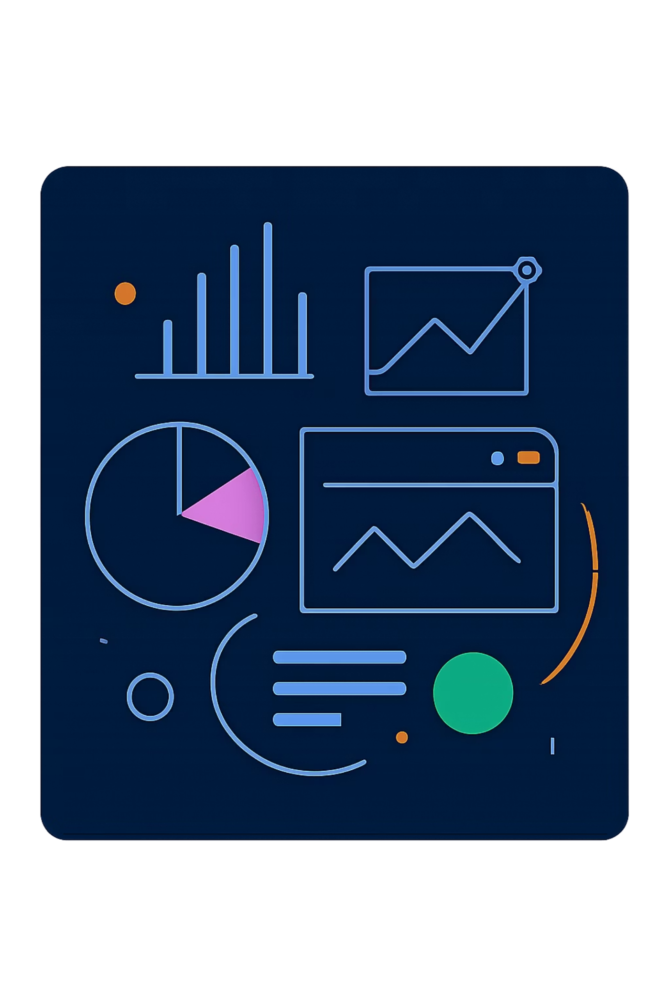
Customer Purchase Pattern Analysis
Uncovering spending patterns, customer segments, and product preferences across 3,900 transactions

Slide 2

Dataset at a Glance
3,900
Transactions
18
Columns
37
Missing Values
Review Rating only
4
Categories
Clothing, Footwear, Accessories, Outerwear

Slide 3
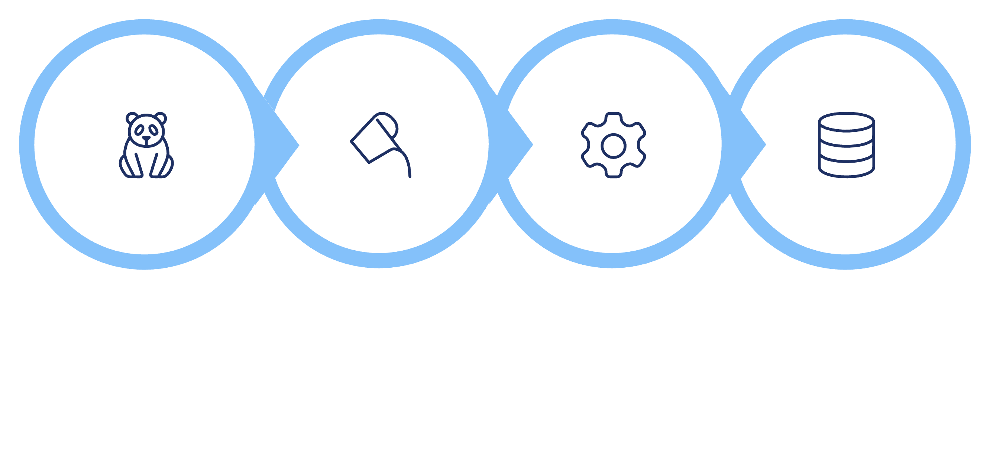
Data Preparation in Python
Load & Explore
Handle Missing
Standardize & Engineer
Load to DB
promo_code_used dropped as redundant with discount_applied

Slide 4
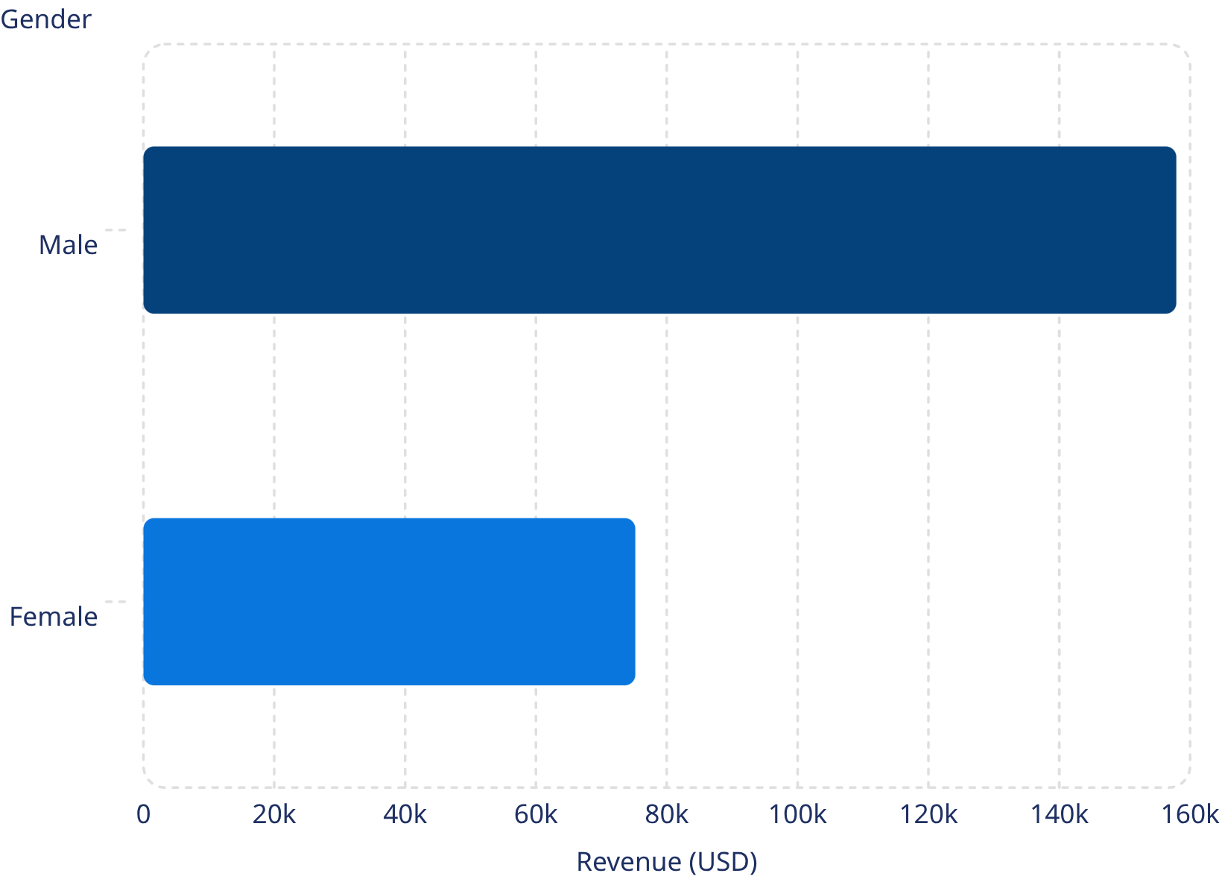
Revenue by Gender
Key Insight
Male customers generated 2.1× more revenue than female customers — a significant gap worth investigating.

Slide 5
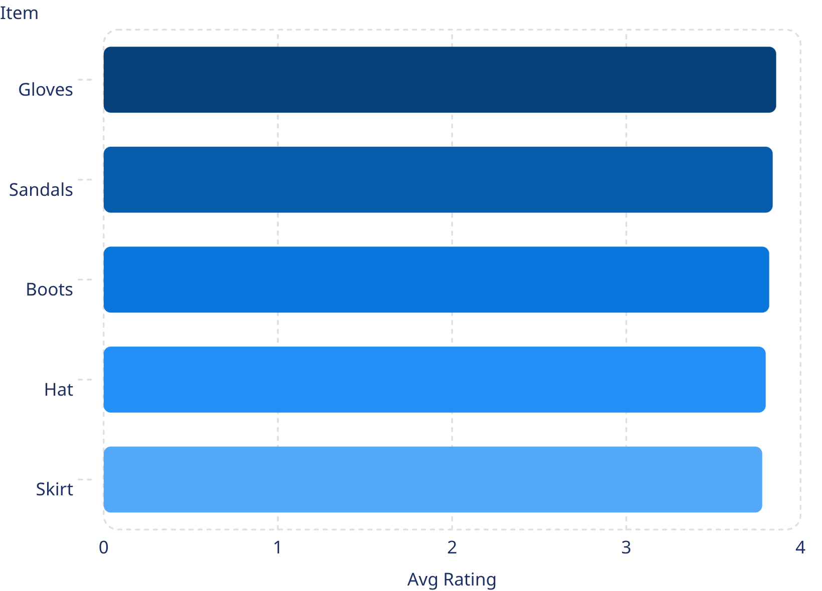
Product & Shipping Insights
Top 5 Products by Rating
Shipping Comparison
Standard
Express
Avg spend: $58.46
Avg spend: $60.48

Slide 6
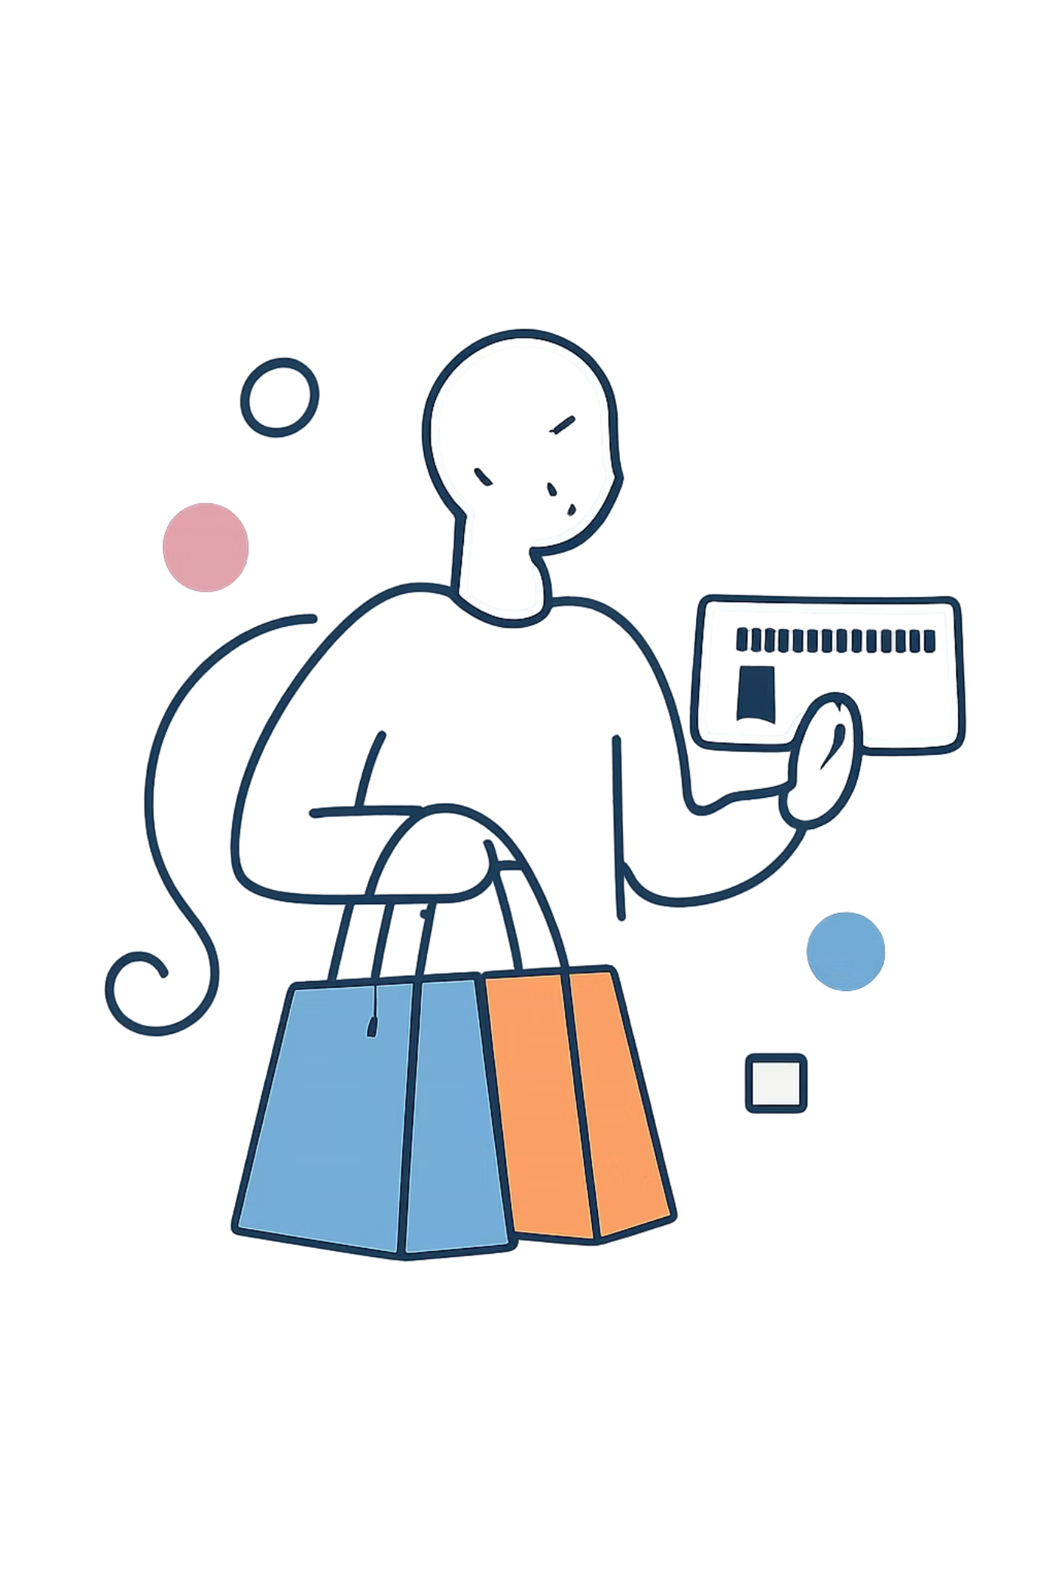
Subscribers vs. Non-Subscribers
Subscribers — 27%
1,053 customers · $59.49 avg · $62,645 total
Non-Subscribers — 73%
2,847 customers · $59.87 avg · $170,436 total
Non-subscribers drive more revenue — opportunity to convert via exclusive benefits.

Slide 7
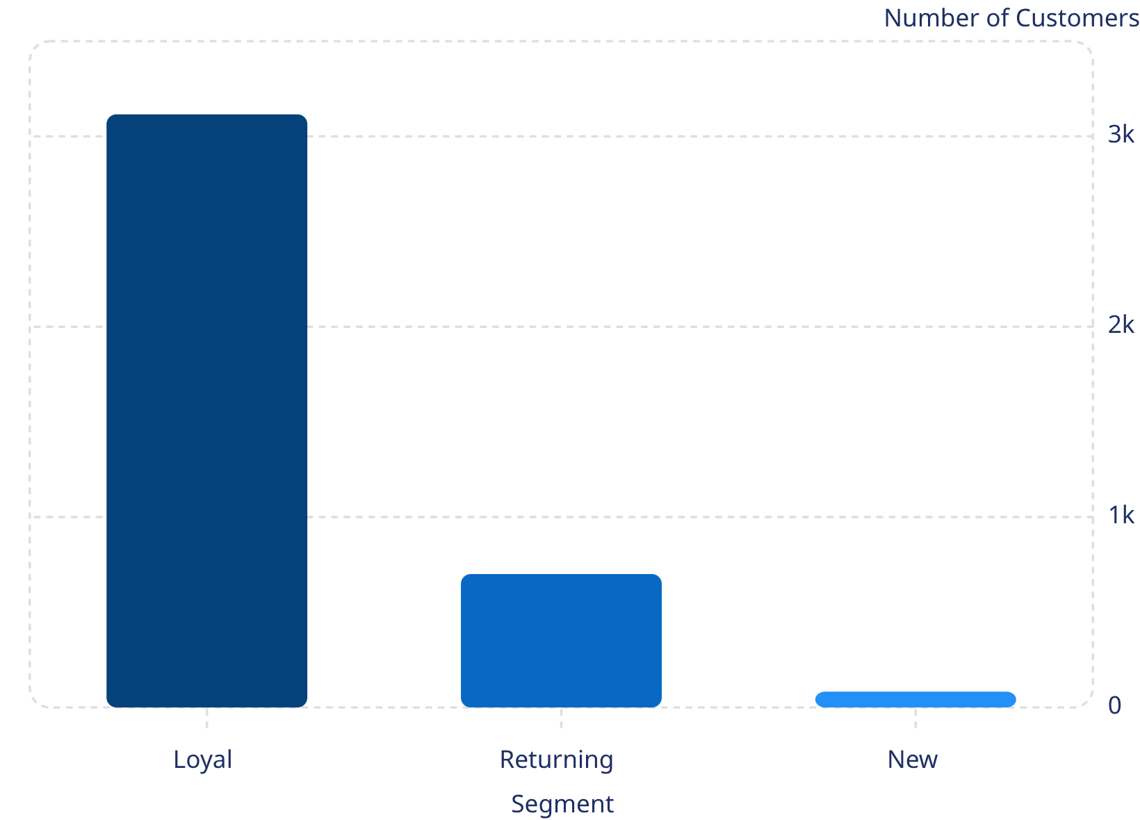

Customer Segmentation
Segment Breakdown
80% of customers are Loyal, yet only 958 repeat buyers (>5 purchases) have subscriptions.
958 repeat buyers subscribe vs. 2,518 who don't — conversion opportunity.

Slide 8
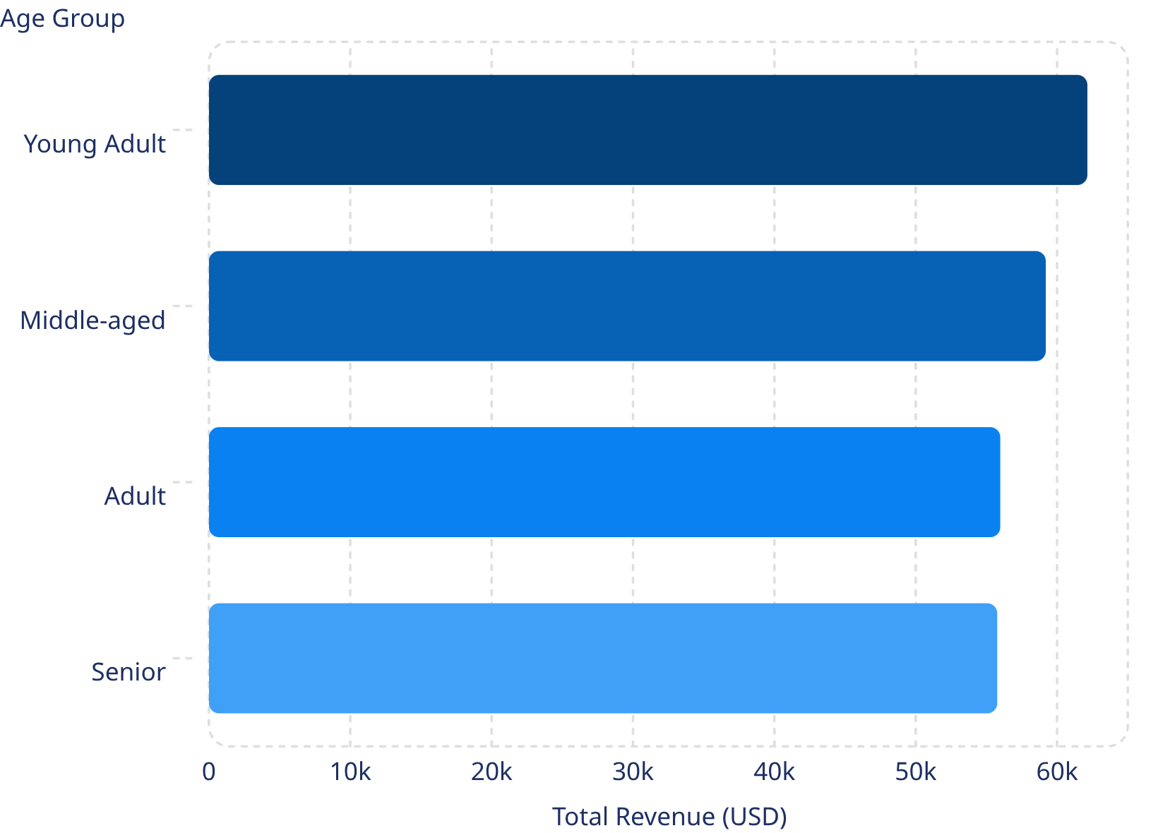
Revenue by Age Group
Age Group Insights
Revenue is fairly balanced across age groups, with Young Adults leading at $62,143.

Slide 9




Power BI Dashboard
Interactive Filters
Subscription, Gender, Category, Shipping Type
Revenue & Sales Charts
By Category and Age Group
Key Metrics
3.9K customers · $59.76 avg · 3.75 rating

Slide 10

Business Recommendations
Boost Subscriptions
Loyalty Programs
Review Discount Policy
Promote exclusive subscriber benefits
Reward repeat buyers to grow Loyal segment
Balance sales boosts with margin control
Product Positioning
Targeted Marketing
Highlight top-rated, best-selling items
Focus on high-revenue age groups & express shippers

