Slide 1

Why People Quit:
Studying Employee Attrition
Team 5:
Swathi Chirukuri
Himanshu Dubey
Emily Maher
Renaldo Persaud
Shubhangi Shubhangi

Slide 2
Problems of Employee Attrition
Problem Statement: IBM is facing an attrition problem and would like to understand which features are impacting attrition the most. What data driven recommendations should IBM implement to help fix this issue.
Business Impact
Impact on company’s revenue
Employee engagement and morale
Constant On-boarding/Off-boarding/Retraining
Team dynamics
Project Delay/Loss of Customer

Slide 3
Literature Review
Preprocessing:
1. We worked on missing data, null values, removed the features whose values were the same in all the rows
2. Transformed the binary format into [0,1]
3. Converted monthly salary into their log value for removing the outliers
4. We have also used “get dummies” for few features and considered it in a predictive model
Modeling:
1. We have implemented various models, i.e, Logistic regression, Multiple Linear Regression, Random Forest, Support Vector Machine, Decision Tree, Neural Network, and KMean Clustering.
2. We are using pycaret(python library) and ROC/RMSE for model comparison.
3. We are comparing all the models and coming up with the best predictive model.

Slide 4
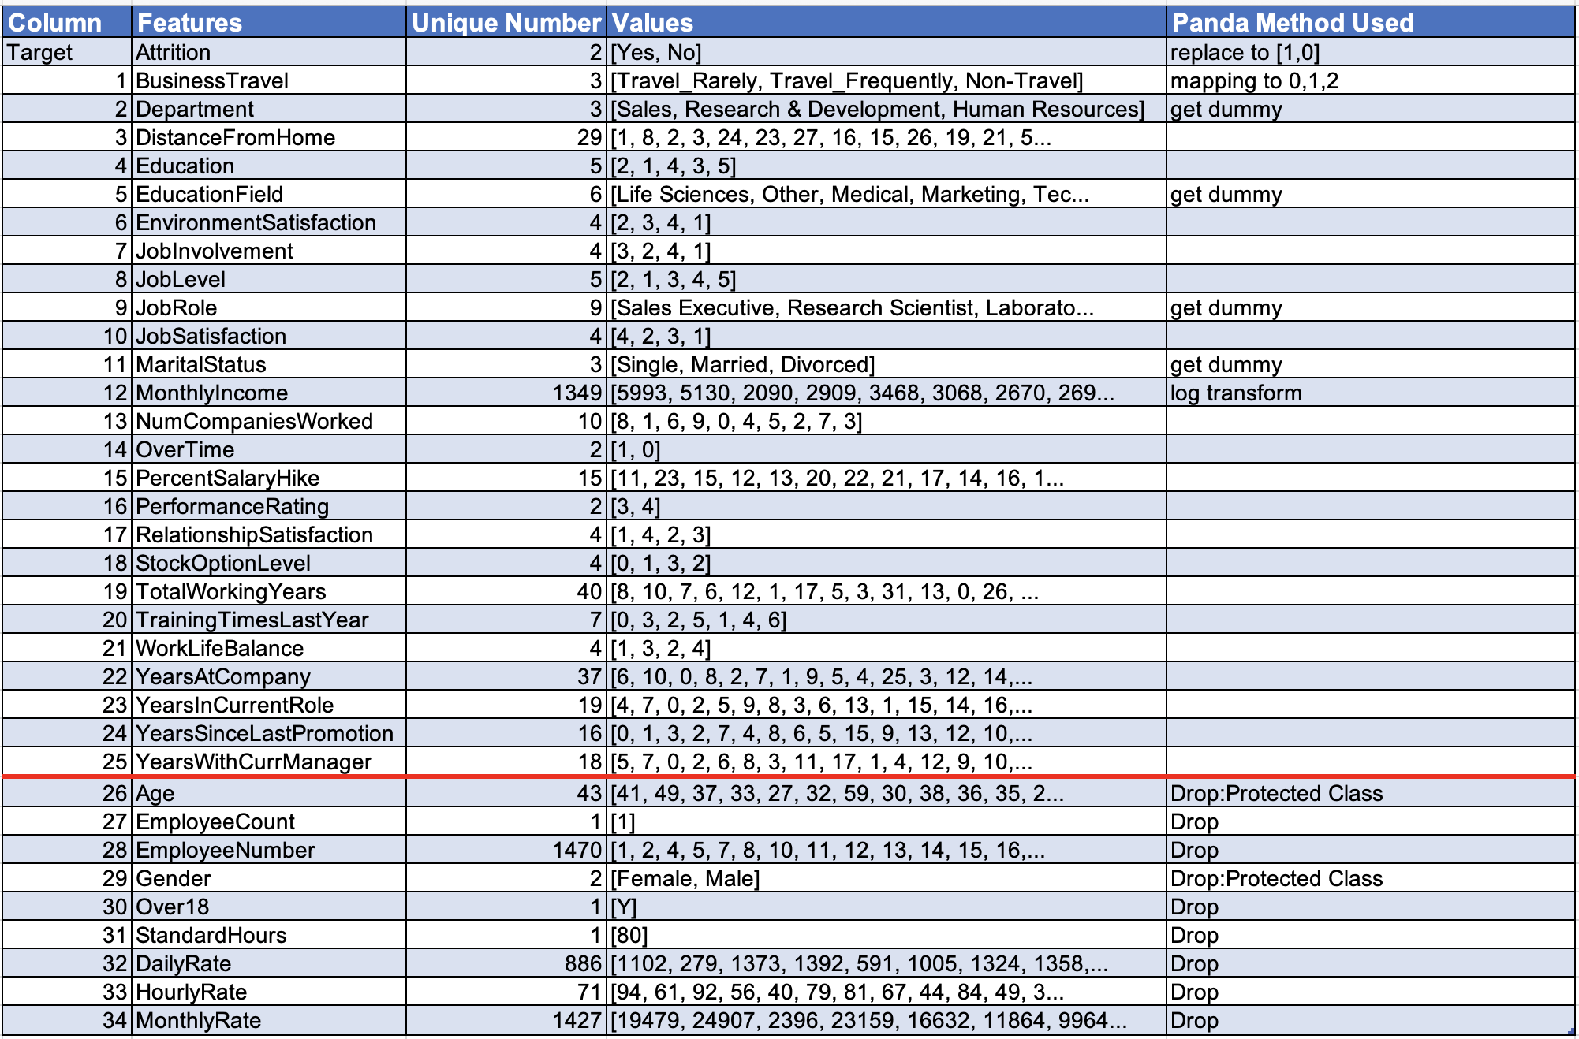
Data Transformation
Features Used
Features Dropped

Slide 5
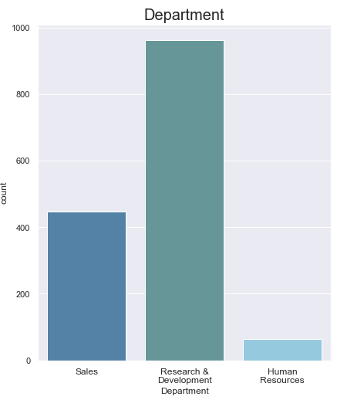
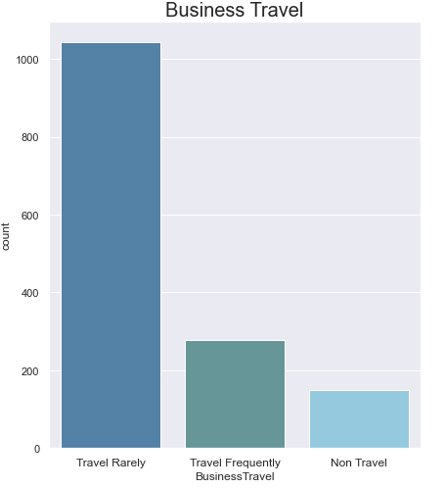
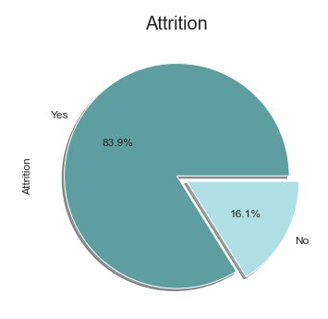
Exploratory Data Analysis
There are three departments in the company. Most of the employees work in Research & Development department while very few work in the HR department.
The dataset contains 16% of
employees who are terminated.
Majority of the employees travel rarely while 10.2% of employees are non travelers.

Slide 6
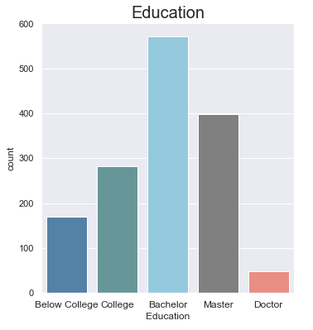
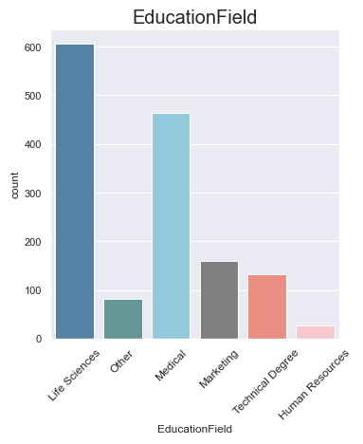
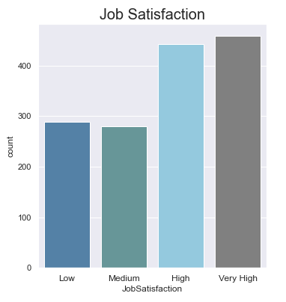
Exploratory Data Analysis
There are 5 categories of Education. Only 3.3% employee hold the highest education qualification, Doctor. Most of the employees have the education category of Bachelor.
Majority of the employees have Life sciences and medical as their field. Whereas the dataset has less employees from marketing, technical degree and HR
More than half of the employees have high and very high job satisfaction.

Slide 7
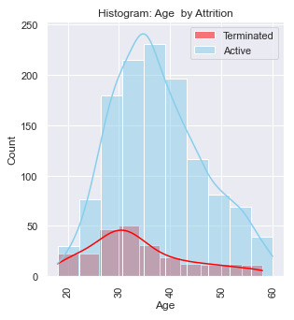
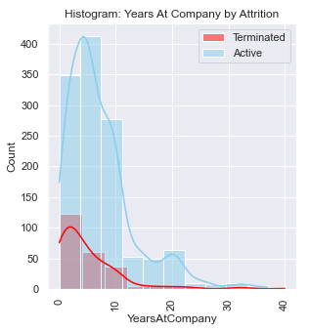
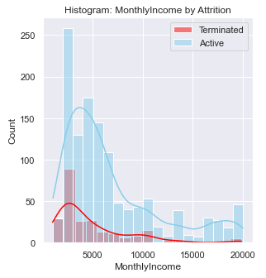
Exploratory Data Analysis
There is low skewness, data is almost normally distributed. Majority of the employees working have their age in the range 28 to 45.
Employees with less working years at company has higher attrition rate compared to employees with more number of years.
Employees get income from 1009 to 19999. Rate of attrition is higher with less income. Data is right skewed with mean greater than the median.

Slide 8
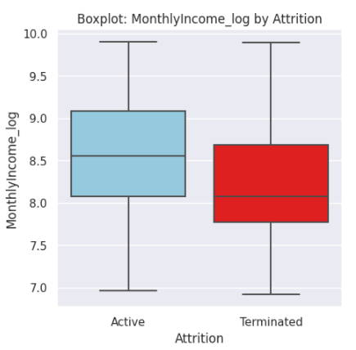
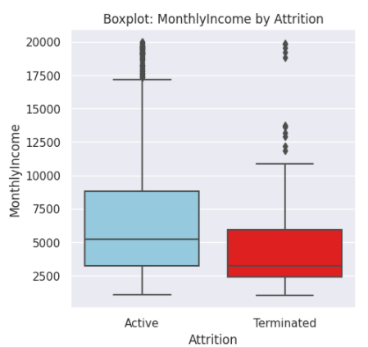
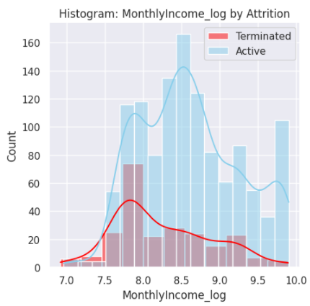
Log Transformation
Outliers are problematic for many statistical analyses because they can cause tests to either miss significant findings or distort real results.
When it comes to skewed distributions, the most common response is to transform the data
Generally, the most common type of skewness is right-skewness
Consequently, the most common type of transformation is the log transform

Slide 9
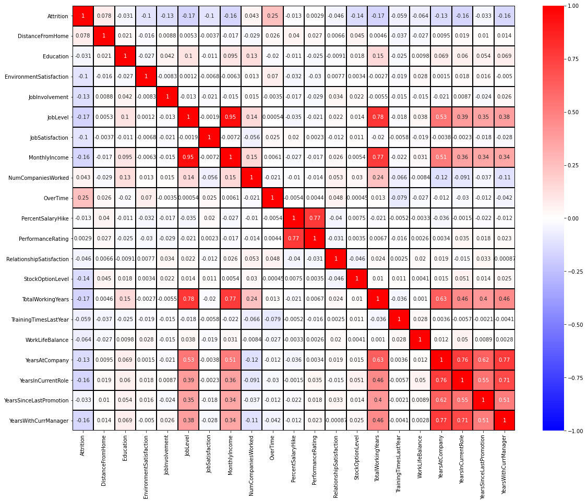
Correlation Matrix
High Correlation to Attrition:
Business Travel
Overtime
Monthly Income
Job Level
Years in Current Role
Total working years
Years at company
Years in the current role
Years with current manager

Slide 10
Models
Linear Regression
Random Forest
Support Vector Machine(SVM)
Logistic Regression
Decision Tree
Neural Network
KMean Clustering
Gradient Boosting Classifier

Slide 11
Input Variables
X = Business Travel, Distance from home, Education, Environment Satisfaction, Job involvement, Job level, Job Satisfaction, Number of Companies worked, Over Time, Percent Salary Hike, Performance Rating ,Relationship Satisfaction, Stock Option Level, Total Working Years, Training Times Last Year, Work Life Balance, Years At Company, Years In Current Role, Years Since Last Promotion, Years With Current Manager, Monthly Income, Marital Status
y = Attrition

Slide 12
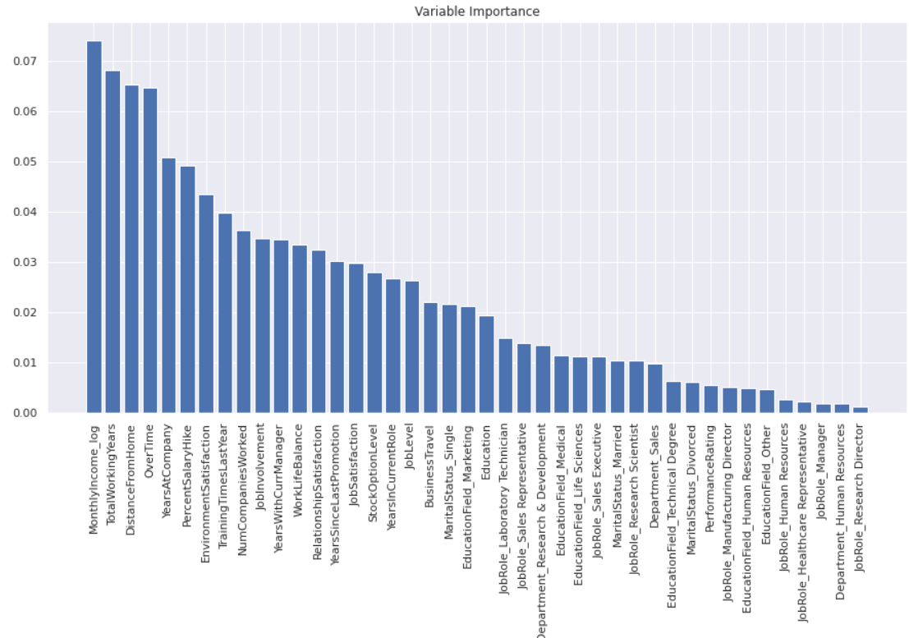
Random Forest
Gradient Boosting Classifier
Accuracy = 0.87
Mean Squared Error (MSE) = 0.13
Root Mean Squared Error (RMSE) = 0.36
Accuracy = 0.87
Mean Squared Error (MSE) = 0.13
Root Mean Squared Error (RMSE) = 0.37

Slide 13
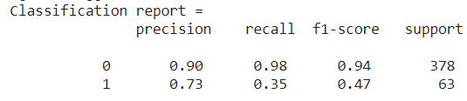
Support Vector Machine(SVM)
Accuracy = 0.89
Mean Squared Error (MSE) = 0.11
Root Mean Squared Error (RMSE) = 0.33
Linear Regression
Neural Network
R-square : 0.258
R-square : 0.25

Slide 14
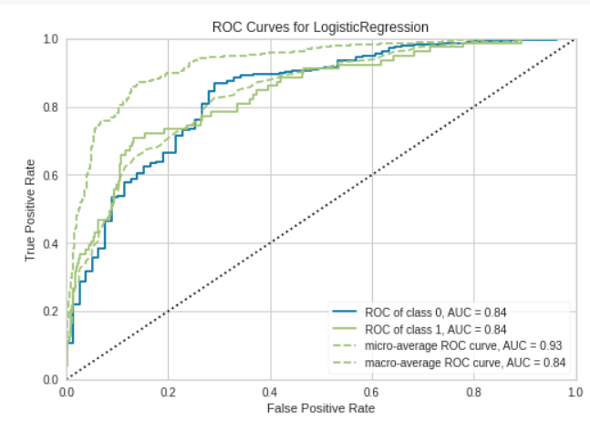
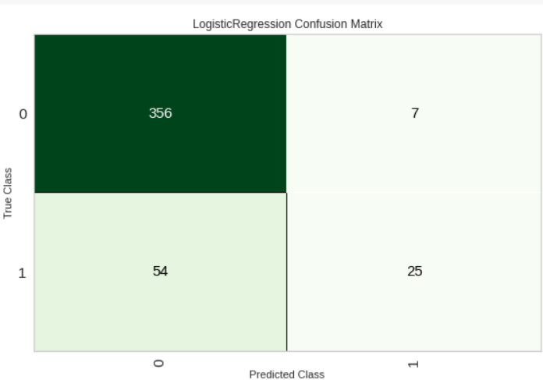
Logistic Regression
Accuracy = 0.89
Mean Squared Error (MSE) = 0.11
Root Mean Squared Error (RMSE) = 0.33

Slide 15
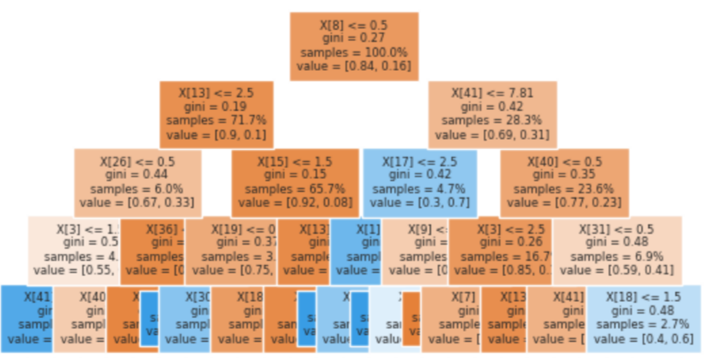
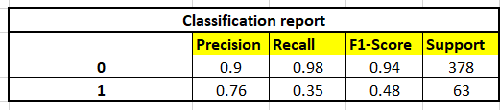
Decision Tree
Accuracy = 0.79
Mean Squared Error (MSE) = 0.21
Root Mean Squared Error (RMSE) = 0.46

Slide 16
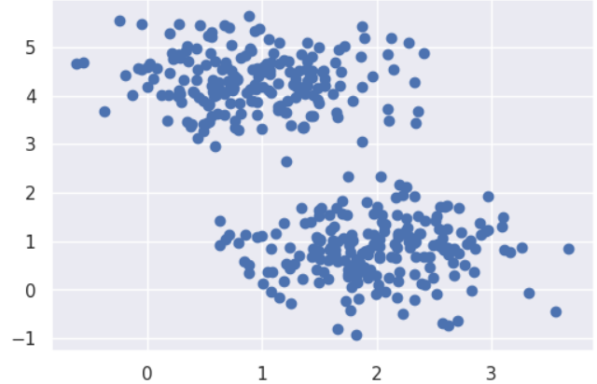
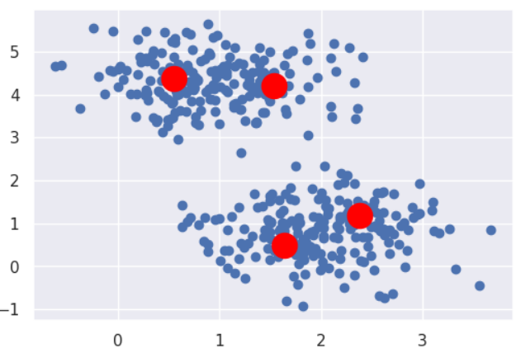
K Means Clustering
No of Clusters = 4

Slide 17
Model Comparison
Model | Accuracy | RMSE | MSE | R-Square
Logistic Regression** | 0.89 | 0.11 | 0.33
Random Forest | 0.87 | 0.13 | 0.36
Support Machine Vector | 0.89 | .11 | .033
Gradient Boosting Classifier | 0.87 | .13 | .37
Decision Tree | .79 | .21 | .46
Linear Regression |  |  |  | .0258
K Nearest Neighbor
Neural Network |  |  |  | 0.25

Slide 18
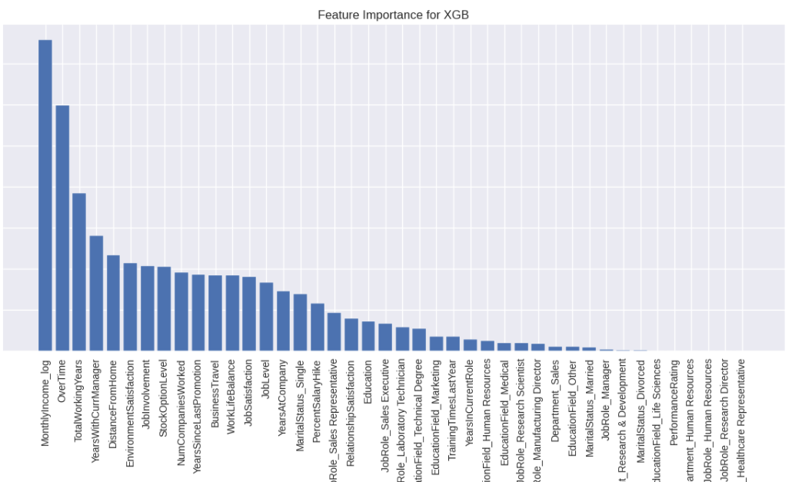
Variable Importance
2 methods utilized to identify key variables:
Feature Importance
(Random Forest, Decision Tree, Gradient Boosting)
Recursive Feature Elimination
(Logistic Regression)
Top Variables:
monthly income_log
total working years
work life balance
job satisfaction
overtime
environment satisfaction

Slide 19
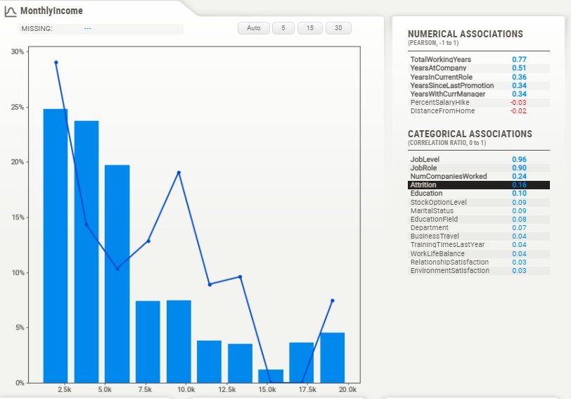
Recommendations
Ensure employee salaries are in line with market standards, particularly lower-level jobs.

Slide 20
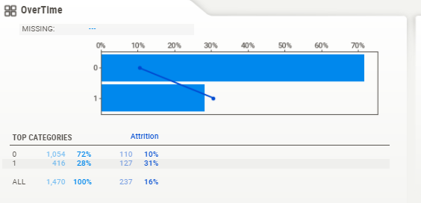
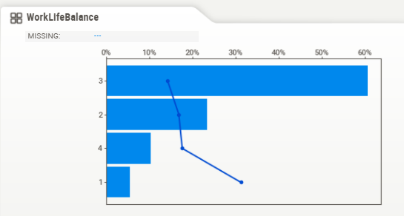
Recommendations
Reduce Overtime when possible
Promote Work/Life Balance

Slide 21
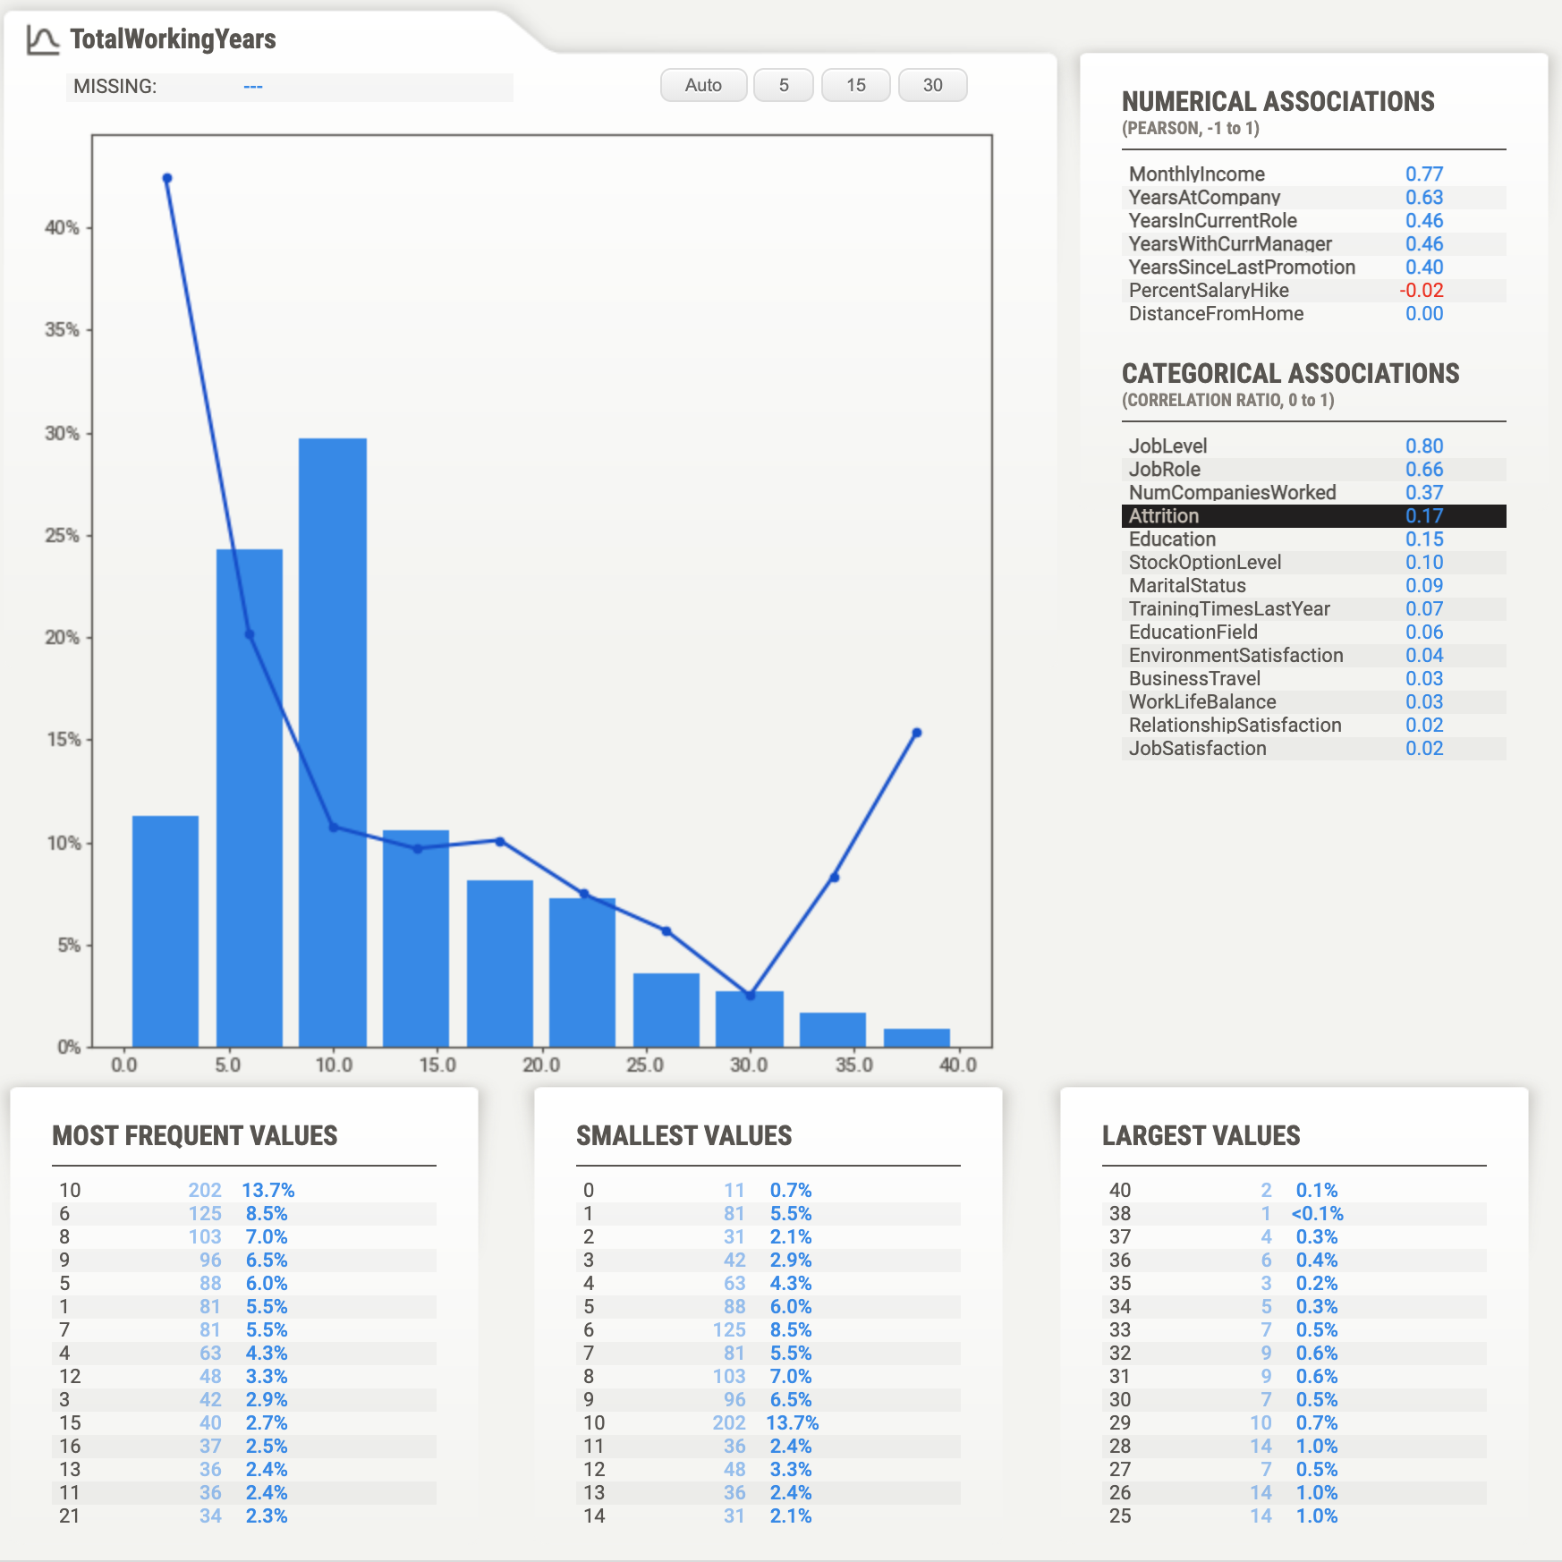
Recommendations
Highest level of attrition in 5-10 year range. Implement early career/junior development programs.

Slide 22
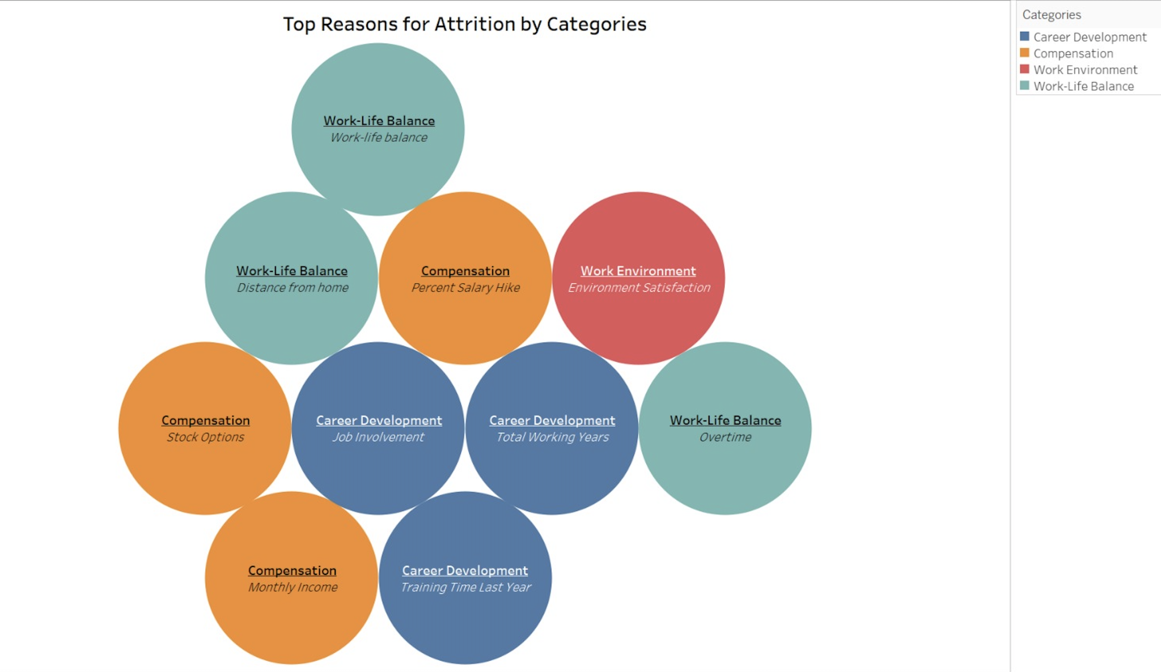
Findings

Slide 23
Thank you for your time! Questions?

