Slide 1
Bank Marketing Campaign Analysis
11.3%
said yes
Who subscribes to a term deposit, and how to call them first
Portuguese bank phone campaigns, 41,176 customer contacts | Himanshu Prakash | 2026
Notes:
Open with the problem: only about 1 in 9 calls ends in a subscription. The goal is to find who says yes and rank customers before dialling.

Slide 2
Calling smarter, not more: a ranked list reaches two-thirds of buyers with a fifth of the calls
65%
4.7x
67%
of customers who said yes to an earlier campaign said yes again (vs 9% for new contacts)
lift in the top 10% of model scores (53% conversion vs 11% average)
of subscribers captured by calling only the top-scored 20% of customers
Best audiences: past responders, retirees (65+), students and cellular contacts
Weak levers: marital status, education and loans barely change the odds
Honest caveat: accuracy drops on a time-forward test, so validate live before scaling
Notes:
Three numbers carry the story: prior success, lift, and gains. The caveat on the right-hand side is covered on the final slide.

Slide 3
From 41,188 raw call records to a ranked call list in five steps
1
2
3
4
5
Understand
Clean
Explore
Segment
Predict
21 columns, 11% positive, hidden 'unknown' values
12 duplicates removed, 999 sentinel flagged, 8 features built
Conversion rate and lift for every driver
Rule-based and K-Means groups of customers
Gradient boosting ranks customers before the call
One rule throughout: only information known before the call is used to predict. Call duration is excluded because it is only known afterwards.
Notes:
The project lives in five notebooks, one per step. Leakage from call duration is the most important modelling decision.

Slide 4
Retirees, students and under-25s convert at 2-4x the average
Conversion rate by age band (%)
Conversion rate by job (%)
Notes:
Age is U-shaped: the oldest and youngest customers are the most receptive, but 65+ is only about 660 customers. Baseline is 11.3%.

Slide 5
Low interest rates and a first call do the heavy lifting; repeat calls fade fast
By 3-month Euribor quintile (%)
By number of calls to the same customer (%)
Channel: cellular contacts convert at 14.7% vs 5.2% on fixed telephone. These timing effects are associations, not proof of cause.
Notes:
May took a third of all calls at 6.4%. Months such as March, September, October and December convert near 50% but on very few calls, likely warm lists.

Slide 6
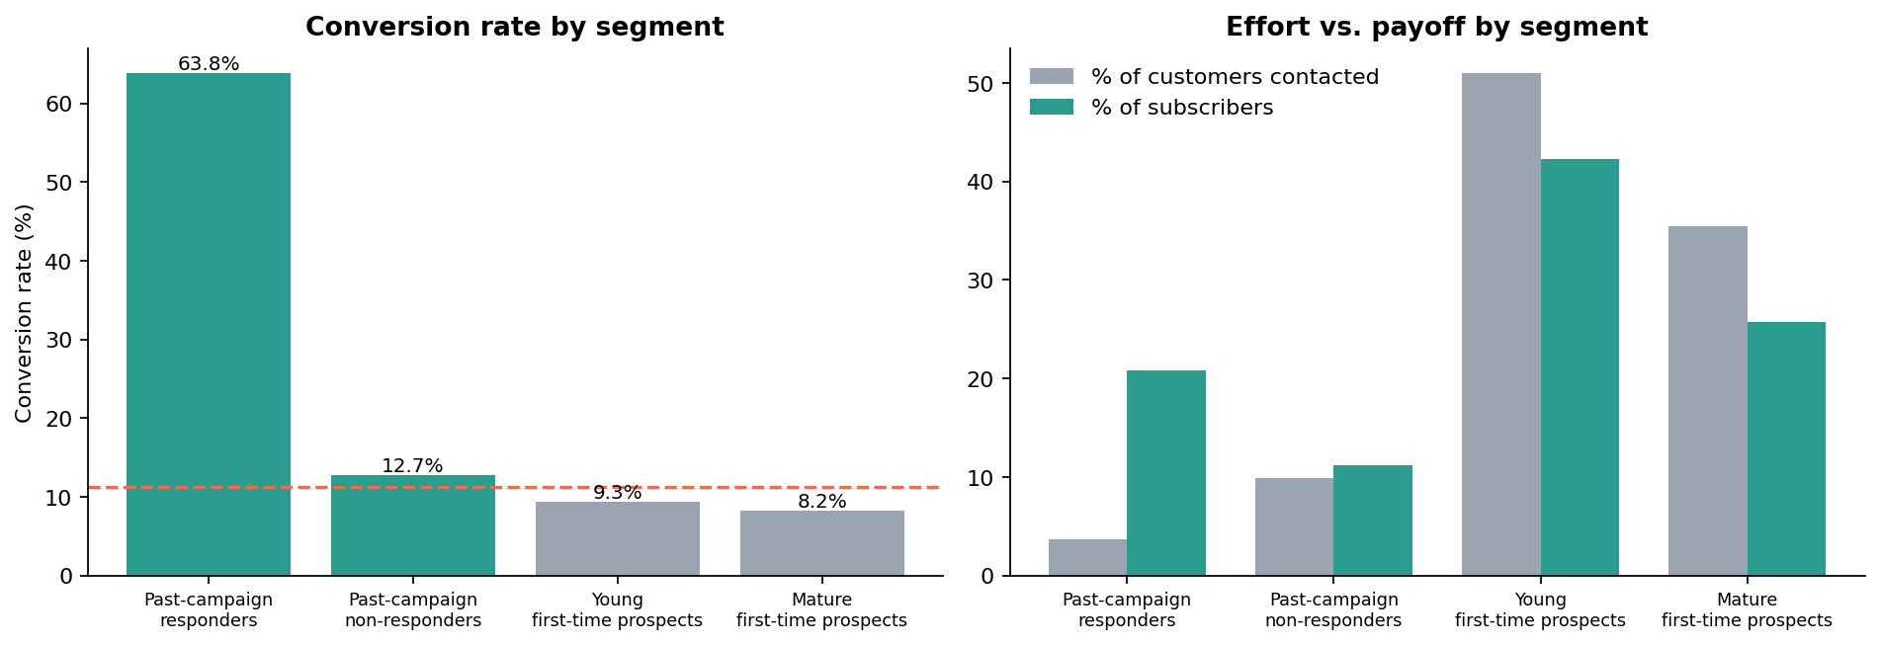
Past responders are 4% of the base but 21% of all subscribers
Segment | Customers | Conversion | Action
Past-campaign responders | 1,515 | 63.8% | Protect and prioritise
Past-campaign non-responders | 4,079 | 12.7% | Maintain, new offer
First-time prospects (young and mature) | 35,582 | 8.2-9.3% | Re-target, use score
Notes:
K-Means with k=4 (best silhouette, 0.18). Prior-campaign history is the main separator; the silhouette is modest, so treat segments as profiles, not hard boundaries.

Slide 7
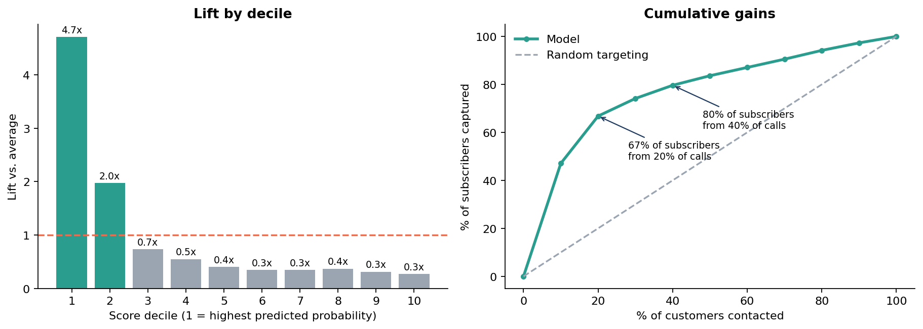
A pre-call score concentrates buyers: the top 20% holds two-thirds of them
0.81
53%
0.95
test ROC-AUC (random split), gradient boosting
conversion in the top score decile
AUC if call duration leaked in: why it is excluded
Notes:
Three models were compared; differences are small (0.800, 0.811, 0.812). Gradient boosting was selected. Features exclude duration.

Slide 8
Illustration: calling the top ~19% could lift profit per call from about EUR 1 to EUR 29
Call everyone
Call top-scored only
41,176 calls
100% of subscribers
EUR 52K profit
EUR 1.3 per call
7,944 calls (19%)
66% of subscribers
EUR 229K profit
EUR 28.8 per call
Assumptions are illustrative: EUR 10 cost per call, EUR 100 net value per deposit (break-even conversion 10%). The cut-off was chosen on the test set, so real gains will be lower. Replace with the bank's actual figures.
Notes:
This is a what-if, not a forecast. The ordering of strategies is robust; the euro values depend entirely on the stated assumptions.

Slide 9
Four moves to improve targeting and revenue
1
Rank before you dial
2
Re-activate past responders
Score every customer and work the list top-down; stop where expected conversion falls below break-even.
A 64% hit rate on 3.7% of the base: call first, with senior agents.
3
Shift channel and cap repeats
4
Test niche audiences
Prefer cellular numbers and limit attempts per customer; success drops to under 5% after 8 calls.
Retirees, students and under-25s respond well; pilot tailored offers, then measure.
Notes:
Each recommendation maps to a notebook finding. Pilots should run with a holdout group so uplift can be measured causally.

Slide 10
Before scaling: the 0.81 is optimistic, so validate on live calls
Out-of-time check: trained on earlier calls, tested on the latest 20%, AUC falls to 0.64-0.67.
Period effect: economic indicators lead the model, and the data covers one unusual stretch (2008-2010).
Association, not cause: month and rate effects mix with who the bank chose to call.
Next steps: retrain regularly, run a live holdout test, and replace illustrative costs with real ones.
0.64
AUC on a time-forward test
Notes:
Being upfront about this makes the rest of the analysis more credible. The ranking still beats random, but expect smaller lifts than the random-split figures.

