Slide 1
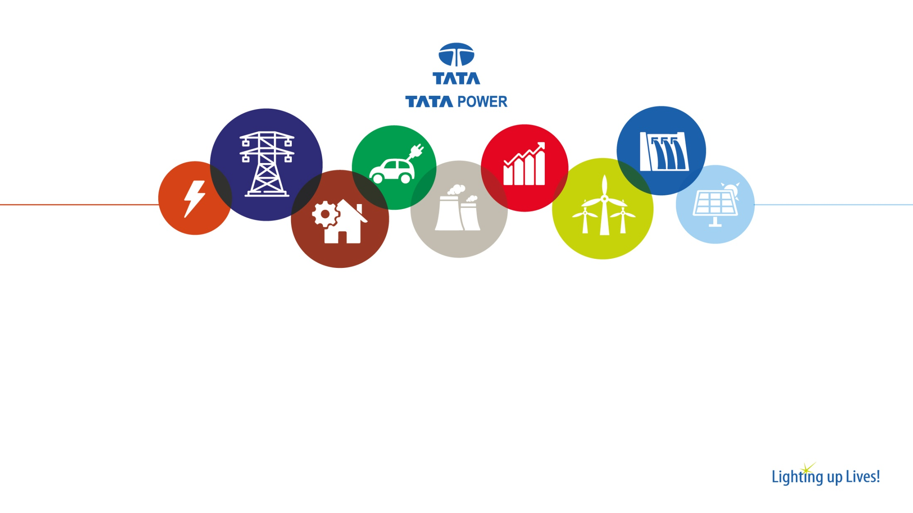
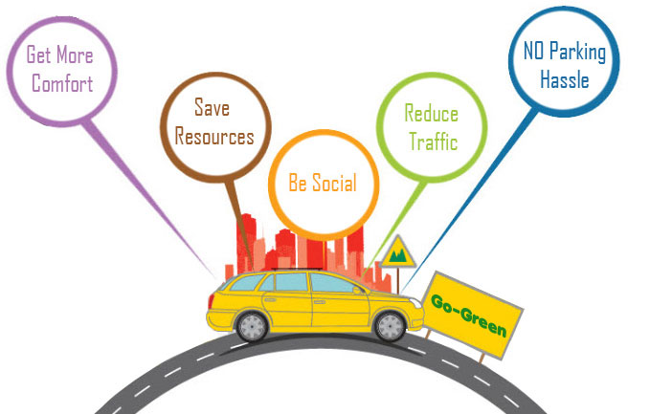
RideHub Car Pooling

Slide 2

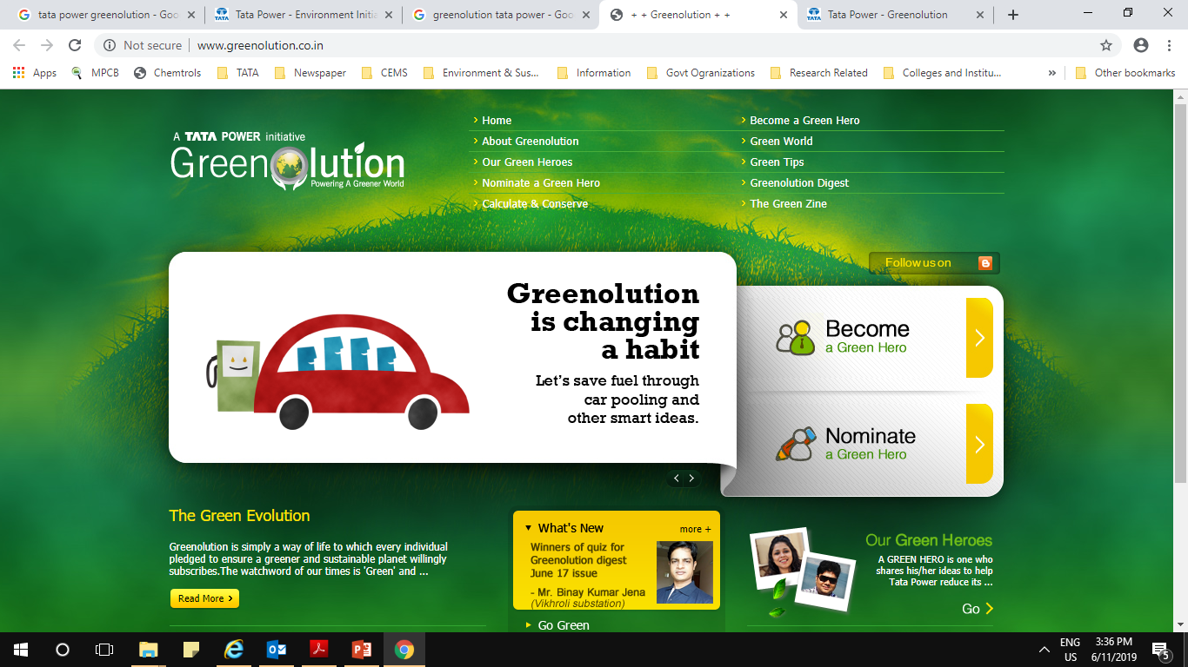
Purpose of Car Pooling
The main idea of Car Pooling is that a group of people can ride in one vehicle instead of having individuals driving their own car or riding in hired cars. They can take turns using their cars so that there is savings in terms of money as well as emissions or else ask for one car to pick and ride so as to reduce number of cars deployed.
Car pooling is also extended to company officials travelling to outside locations.
Travelling by company busses is the first option. Cars to be used on need basis only.
Ride Hub | 01

Slide 3
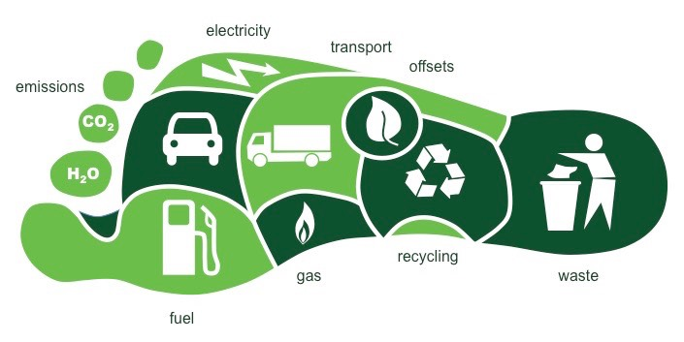

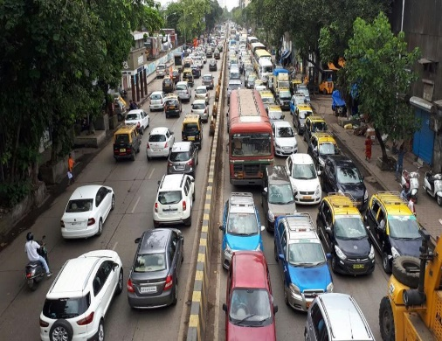
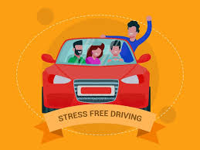
Car Pooling Benefits
Reduces the carbon footprint per employee and for the organization
Cuts fuel costs drastically and saves money
Reduces potential risks on roads and helps in decongestion of traffic
Lessens the stress of driving Improves the cultural integration of the organization
Ride Hub | 02

Slide 4

Modes of Carpooling
OLA Corporate Ride
Office Buses
Carpooling by colony residence
Public transport
RideHub.com
Shuttle services inside plant
Modes of Carpooling
by Tata Power
Ride Hub | 03

Slide 5
Hardware Configuration & Software used
Personal computer
At least 4GB of RAM
At least Hard disk (300GB, 500GB .etc.)
At least Processor 2.7GHZ
Platform: Windows 10
Platform is any hardware used to host an application or service.
Language: android studio, firebase
A programming language is a formal computer language designed to communicate instructions to a machine, particularly a computer. Programming languages can be used to create programs to control the behavior of a machine or to express algorithms.
Ride Hub | 04

Slide 6

Short Term
Cost Effectiveness
Long Term
Remarkable savings in expenses and fossil fuel consumption
Individual
Potential saving for the car poolers in terms of rupee value
Organization
Green image, cash outflow
Tangible
Savings
Intangible
Employee bonding
Cost Benefit Analysis
Ride Hub | 05

Slide 7
Challenges & Opportunities
Challenges
Distributed locations
Status prevents participation
Restricted availability of share rides / carpooling to isolated locations
Traffic congestion hampers easy pick up for sharing in peak hours
Opportunities
Promoting more numbers of Carpooling / share rides for individual
Reducing personal vehicles during peak hours
Preference to share rides while Cab booking
Higher promotional Discounts & offers on carpooling / share rides
Ride Hub | 06

Slide 8
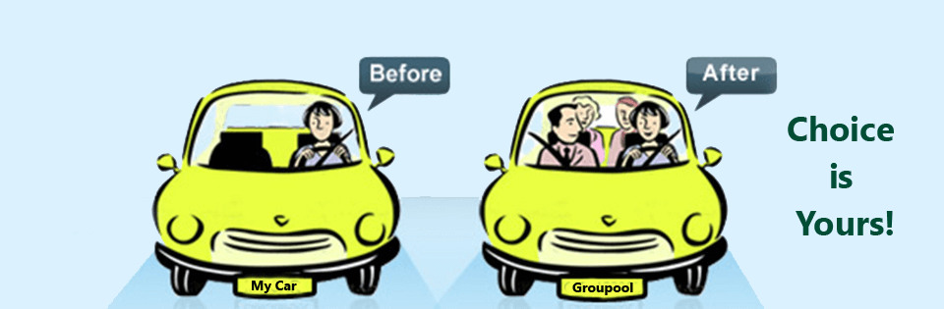
Choice is yours
Ride Hub | 07

Slide 9
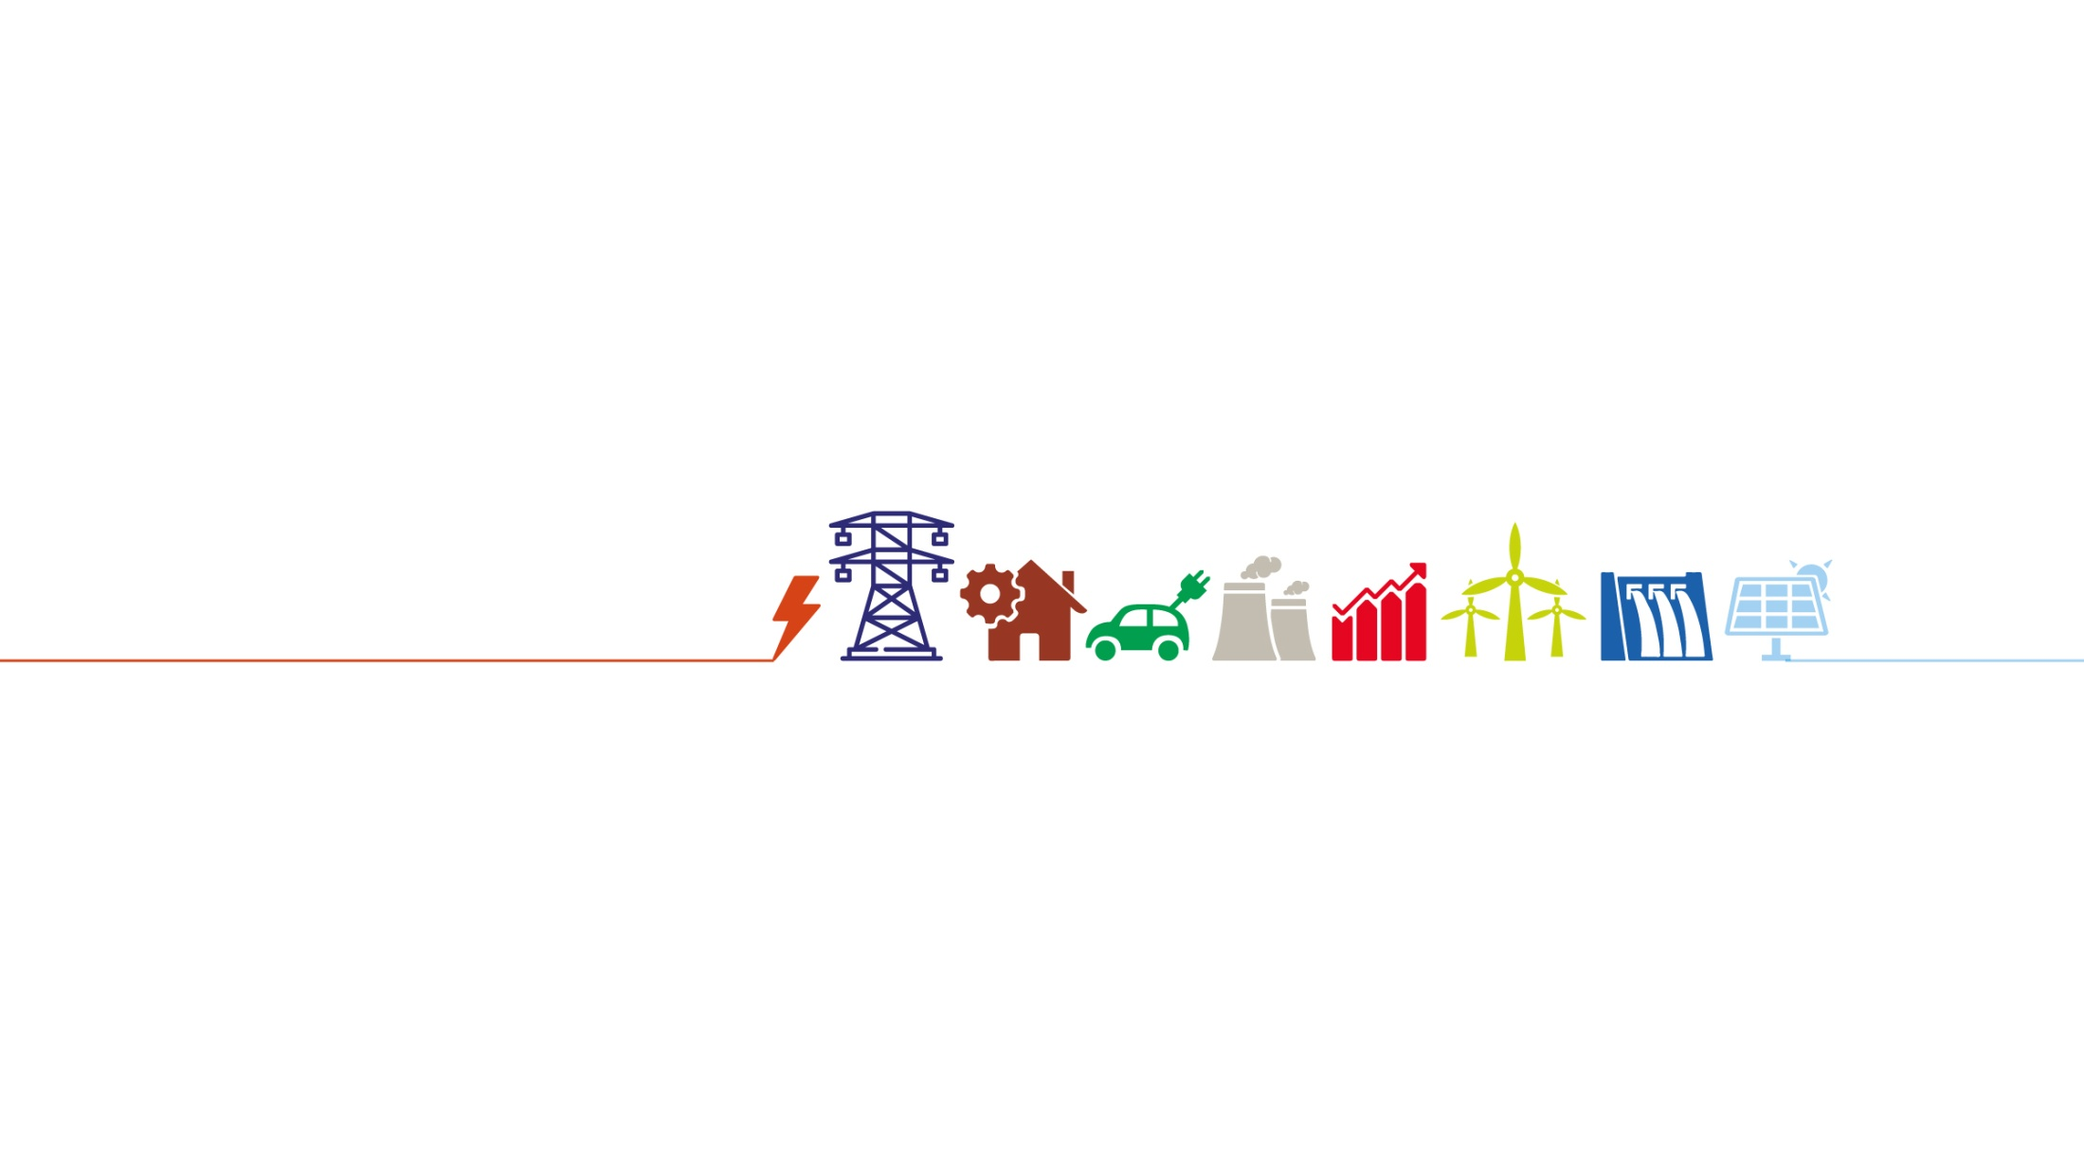
Thank You!
Website: www.RideHub.com
Email Id: panchalhimanshu038@ridehub.com
Private and Confidential |

