Slide 1
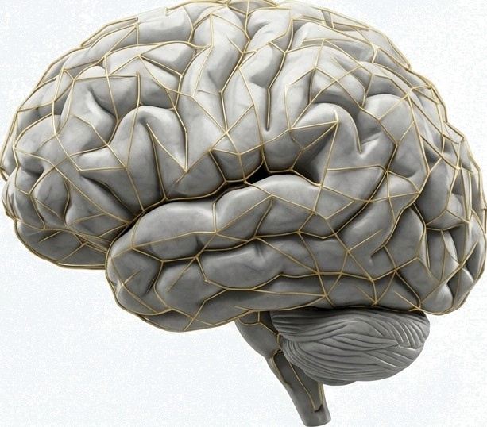
NeuroInsight
Accelerating Accelerating Alzheimer's Diagnosis with AI
A Deep Learning Classifier Achieving 98% Accuracy on MRI Brain Scans

Slide 2
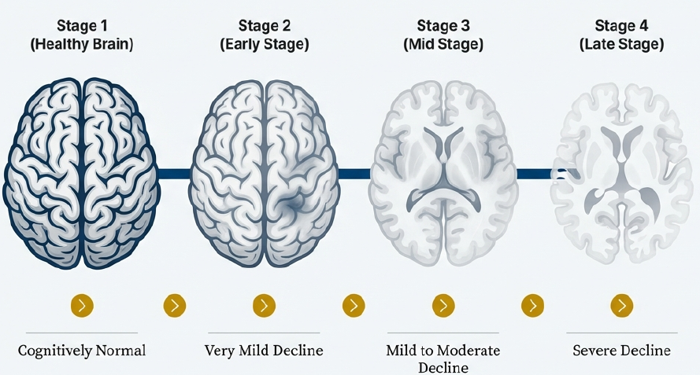
Alzheimer's Disease is a Progressive Neurological Crisis
Alzheimer‘s Disease (AD) is a progressive neurodivergent disorder and a leading cause of dementia globally. It gradually impairs memory, cognitive thinking, and behavioral abilities. Early diagnosis is crucial in slowing the progression of cognitive deterioration deterioration and supporting timely patient treatment planning.
G NotebookLM

Slide 3
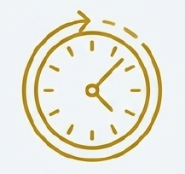
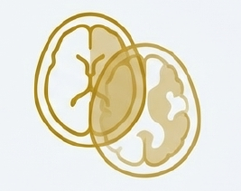
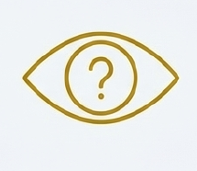
Manual MRI Analysis Presents a Diagnostic Bottleneck
The traditional radiology-based diagnosis relies heavily on expert radiologists manually analyzing MRI scans. This process struggles with consistency and scalability, especially with an increasing number of dementia patients.
Subjective
Interpretation can vary between radiologists, leading to inconsistencies.
Error-Prone
Human fatigue and subtle visual cues can lead to misinterpretation.
Time-Consuming
Analysis requires significant expert hours per scan.

Slide 4
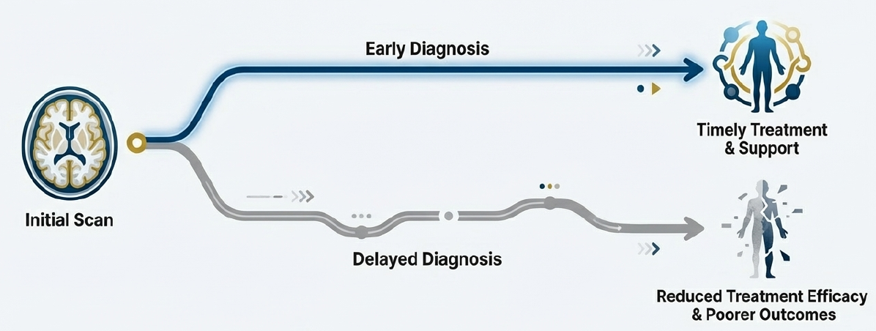
Diagnostic Delays and Inaccuracies Have a Real Human Cost
Misinterpretation or delayed diagnosis leads directly to late treatment initiation, which reduces patient quality of life and the effectiveness of care plans. Furthermore, medical centers face radiologist shortages, placing the entire system under immense strain and creating a critical need for automated support systems.

Slide 5

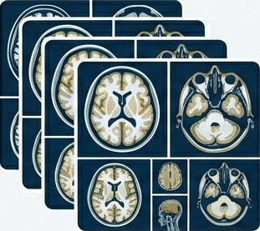
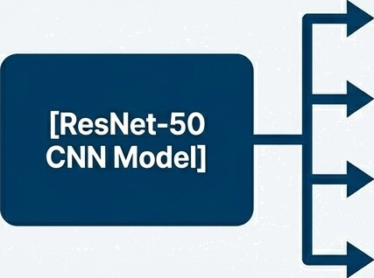




Neurolnsight-Classifier: An Automated, Reliable, and Scalable Solution
We present an AI-powered deep learning approach using MRI brain scan classification to automate Alzheimer's diagnosis. The system is designed to provide faster and more accurate support for medical professionals.
[MRI Scan Input]
The model learns to identify structural brain abnormalities from MRI scans and predicts one of four distinct classes.

Slide 6
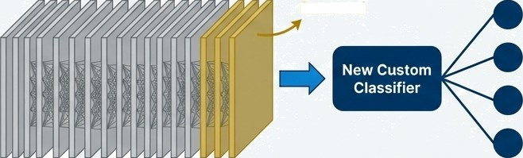
Engineered for Diagnostic Accuracy and Clinical Impact
Project Objectives
Build a high-performance Alzheimer's classification model.
Classify MRI images into multiple dementia severity categories.
Automate and improve diagnostic reliability over manual assessment.
Deliver a reproducible, research ready workflow for academic use.
Core Architecture
Method: A Convolutional Neural Network (CNN) using ResNet-50 Transfer Learning.
Rationale: Leverages the powerful feature extraction capabilities of a model pre-trained on the vast ImageNet dataset, fine-tuned specifically for this medical imaging task.
Last Layers Removed
Pre-trained ResNet-SO
on ImageHet
4 Alzheimer's
Classes

Slide 7
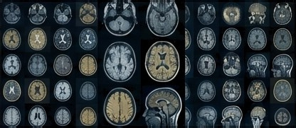
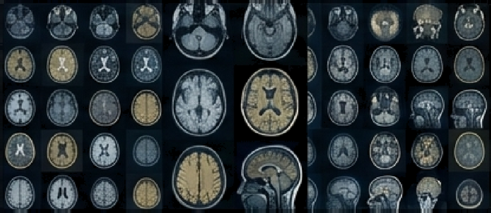
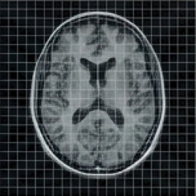
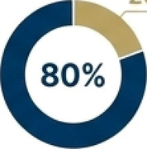
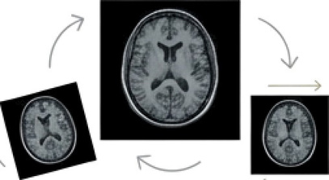

The Workflow, Part 1: Fueling the Model
with a Prepared Dataset
224x224
Training
Validation
1. Dataset Acquisition
Sourced from the public OASIS / Kaggle Brain MRI dataset, containing labeled scans categorized by dementia severity for supervised training.
2. Data Preprocessing
Images were resized to 224x224 pixels for CNN compatibility. Pixel normaliza-tion was applied to improve training stability. The dataset was split into 80% for training and 20% for validation.
3. Data Augmentation
To address class imbalance and improve model generalization, techniques like random rotation, flipping, and shifting were applied to the training set.

Slide 8
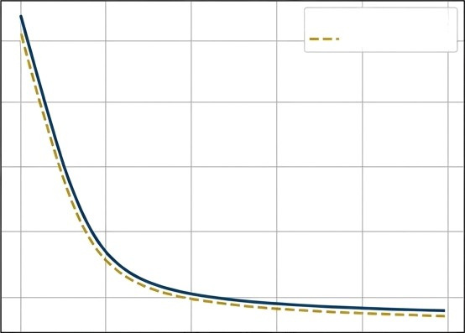
The Workflow, Part 2: Forging Intelligence in the Training Pipeline
The model was trained for multiple epochs using a PyTorch DataLoader pipeline for efficient mini-batch processing. Real-time monitoring of training and validation curves guided the process.
Model Loss Over Epochs
Key Training Components
Training Loss
Validation Loss
Loss Function: Cross-Entropy
Optimizer: Adam
Regularization: Batch Normalization & Dropout to reduce over-fitting.
Acceleration: CUDA GPU acceleration for improved performance and efficiency.
Epochs

Slide 9



The Model Achieved a Diagnostic Accuracy of Over 97%
Performance was measured against the 20% validation set, demonstrating strong generalization to unseen data.
98%
Final Training Accuracy
97-98%
Final Validation Accuracy
4 Classes
Successfully identified
Non-Demented, Very Mild, Mild, and Moderate stages.

Slide 10
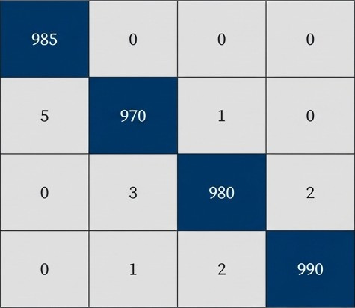
Understanding the Model's Decisions Beyond Overall Accuracy
Non
Very Mild
High precision and recall across all four classes, indicating very low misclassification rates between adjacent stages of dementia.
Actual Class
Mild
Moderate
Non
Very Mild Mild
Moderate
Predicted Class
G
NotebookLM

Slide 11
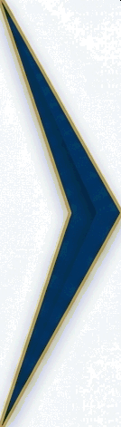
From Research Project to Real-World Clinical Value
FEATURE IMPACT
Reduces the manual workload for radiologists and enables faster patient screening.
Automated Classification of MRI Scans Reduces the manual workload for radiologists and enables faster patient screening.
Provides an objective, repeatable method for tracking disease progression over time.
Multi-Class Severity Support (4 Classes) Provides an objective, repeatable method for tracking disease progression over time.
Delivers a scalable and reproducible system for medical imaging evaluation in clinical or academic settings.
Complete End-to-End Pipeline Delivers a scalable and reproducible system for medical imaging evaluation in clinical or academic settings.

Slide 12
A New Paradigm for AI-Empowered Neurological Diagnosis
The NeuroInsight-Classifier successfully identifies Alzheimer's disease severity from MRI scans with high predictive performance. The automation of this process can significanUy reduce radiologist worHoad and improve clinical decision accuracy.
This project demonstrates strong potential for integration into real-world healthcare systems, including telemedicine platforms and hospital Picture Archiving and Communication Systems (PACS), with proper deployment pipelines.

Slide 13
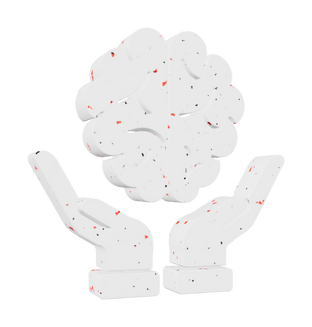
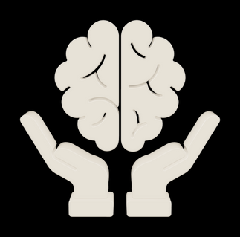
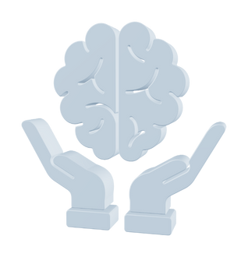
-------------Meet The Team-------------
NeuroInsight
Himanshu Gaur
23BCY10127
VIT Bhopal University
Paarth Vakharia
23BCY10075
VIT Bhopal University
Abhinav Mehra
23BCY10015
VIT Bhopal University

