Slide 1

Online Notes Sharing
By. Fakhruddin Chaudhary(12), Aijaz Chaudhary(11)
Prof. Shweta Waghmare & Prof. Anamika Dhawan

Slide 2
INTRODUCTION
In this project "Notes Sharing Site Project" student and faculty can upload/download particular subject notes. Through the notes sharing process, users can upload, download and also view the study notes uploaded by others.
User can also edit the notes uploaded by him. In this project two major modules that have been provided are administrator module and user module. It’s an easy for user and Admin to retrieve the data if the vehicle has been visited through number, he can get that data and can get all the past and present record from here.
The several features that are provided by this project are that the users can upload and download the study notes.
However the users do not have authority to delete the records of the website. This authority vests only with the administrator. It is also a secure and easy to use process. Also, in recent days, there has been a lot of demand for multimedia notes.

Slide 3
SCOPE & PURPOSE
PURPOSE:
All users can upload and share study notes with other users.
Users can select the stream (branch) at the time of upload.
User can upload notes in the pdf, doc, ppt, zip, txt etc. file format.
User can search notes via branch, subject and title.
Administrator or management can manage the users and notes.
Admin can accept or reject the notes uploaded request. Notes can published only after accepted by admin.

Slide 4
Existing System: Proposed System:
In present situation in any user share files via social networking site like drive, whatsapp or via gmail. To avoid using social networking sites our software help user to easily share files with our friends and also search notes by its title, subject and branch.
The main aim of the project is to user can share notes easily in the web.
In this System, notes uploading , searching and downloading is possible.
User can login from any location and upload notes and download multimedia notes uploaded by other users.

Slide 5
Project Analysis:
This Application has been divided into two modules.
User Module
Admin Module

Slide 6
User Module
Here are the list of activities of MEMBER.
The users have to create an account into the system by registering themselves and then may login into the system and utilize the services.
Without login they only can see details about application and they contact admin for notes which they want by filling form.
All user can upload their notes in any format (zip, pdf, doc, etc.) and can view, delete and download his uploaded notes.
User can view and download others uploaded notes also by searching via branch, subject and title.
All the user can update their profile and change account password

Slide 7
Admin Module
Here are the list of activities of ADMIN.
Admin can administer the system and can manage the users and notes.
Admin can accept or reject the notes uploading request. Notes can published only after accepted by admin.
Admin can view all the notes uploaded by user and He/She can delete unwanted notes and spam user.
Admin can change password and can view un-signup user query regarding which notes they want.

Slide 8
SCOPE
The project has a wide scope, as it is not intended to a particular organization. This project is going to develop generic software, which can be applied by any businesses organization. More over it provides facility to its users. Also the software is going to provide a huge amount of summary data.

Slide 9



SOFTWARE & HARDWARE REQUIREMENT
TECHNOLOGY USED IN PROJECT BOOK MY PARKING
HTML
CSS
Bootstrap 5
JAVASCRIPT
Python
Django
SQLite3

Slide 10
SOFTWARE REQUIREMENT:
Operating System: Windows/Linux
Programming Language: Python 3 or greater
IDE: VS Code, Pycharm, Python IDLE
Database: Default Django Server for Sqlite3
HARDWARE REQUIREMENT:
Processor: Intel i3 or higher
CPU Speed: 1.8 GHz or higher
Hard disk: 20GB
RAM: 1GB
Internet Connectivity: Minimum 10 Mbps

Slide 11
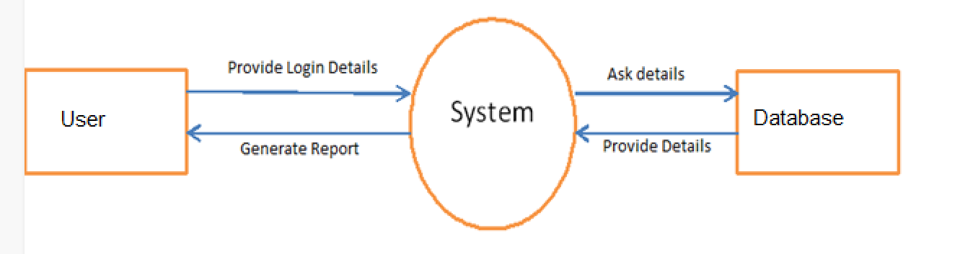
DATA FLOW DIAGRAM Level 0

Slide 12
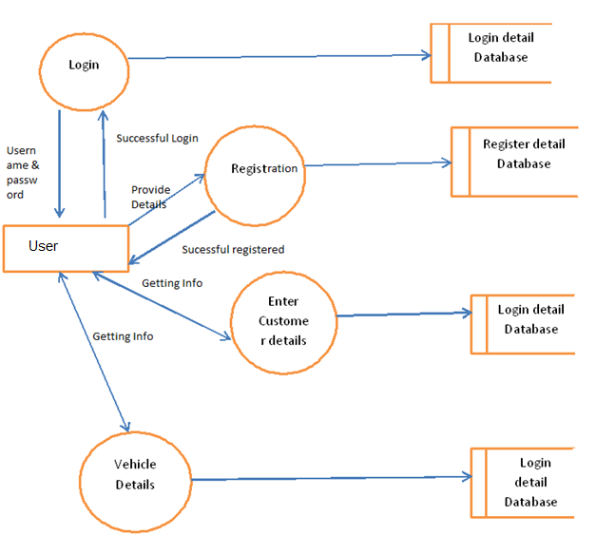
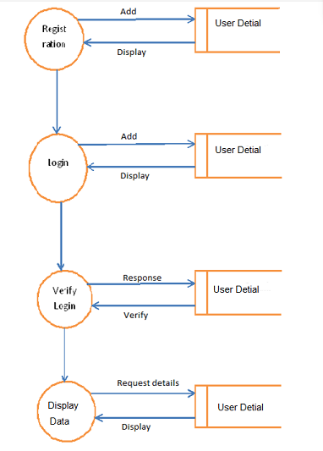
Level 1 Level 2

Slide 13
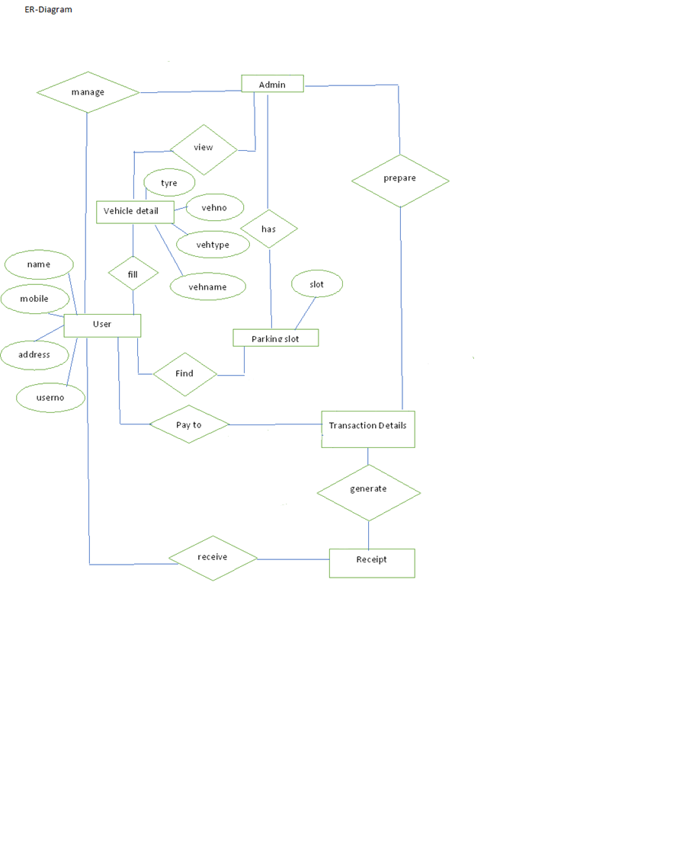
ER DIAGRAM

Slide 14
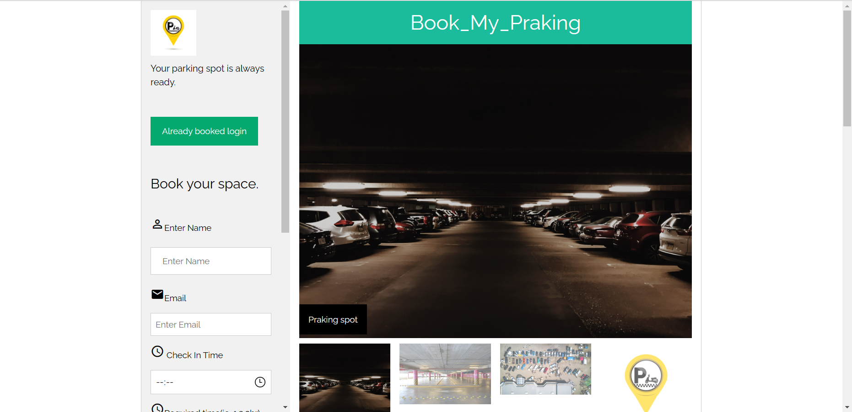
USER INTERFACE

Slide 15
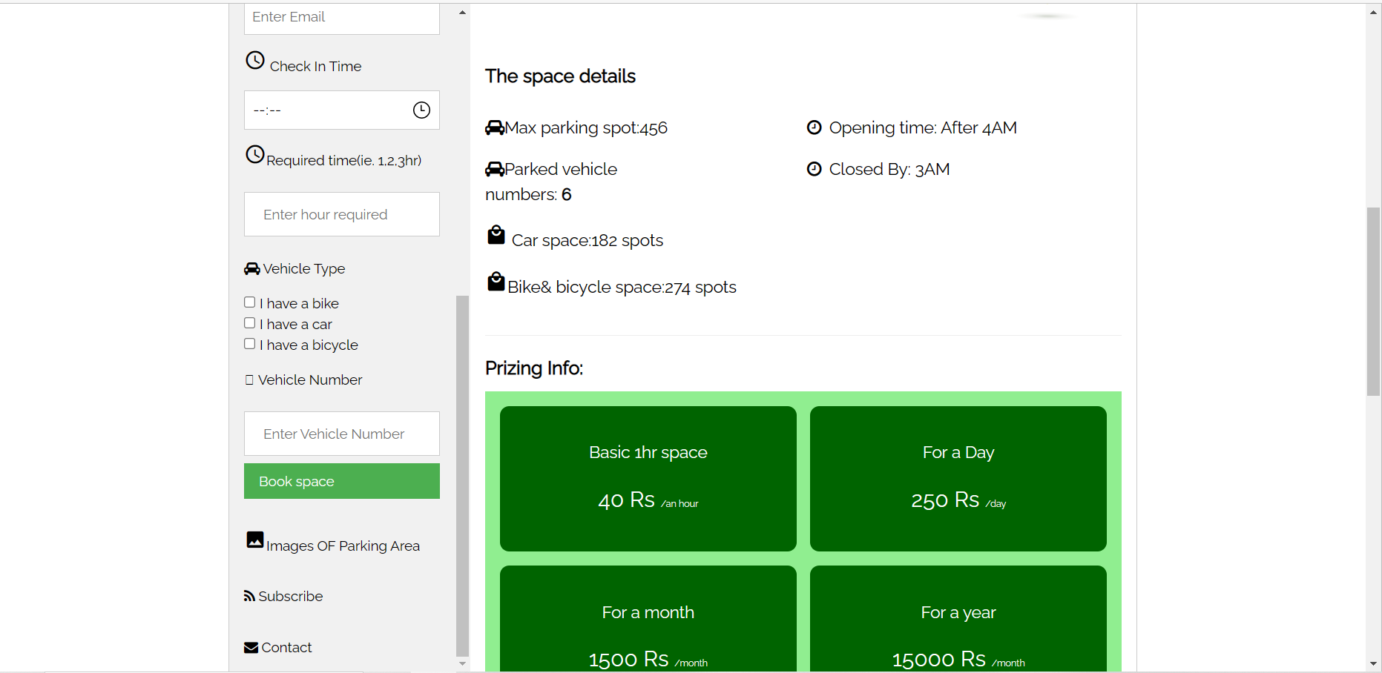
Homepage

Slide 16
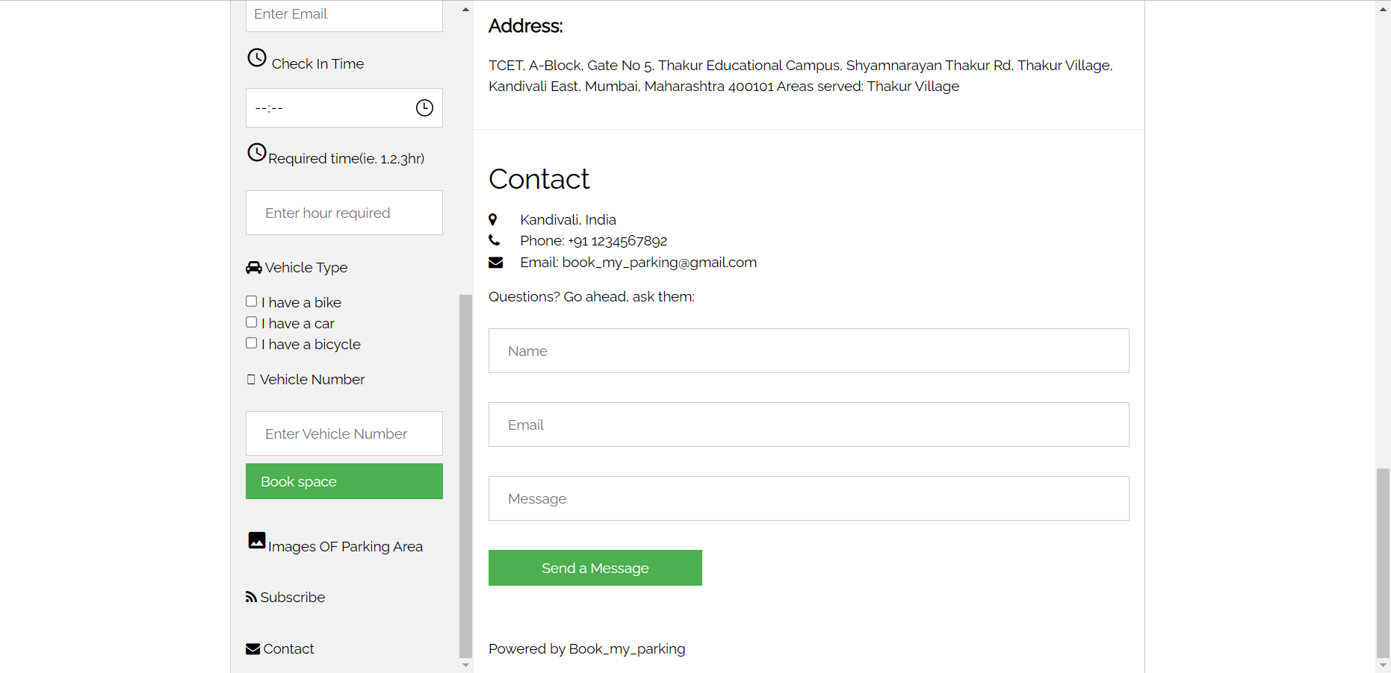
Homepage

Slide 17
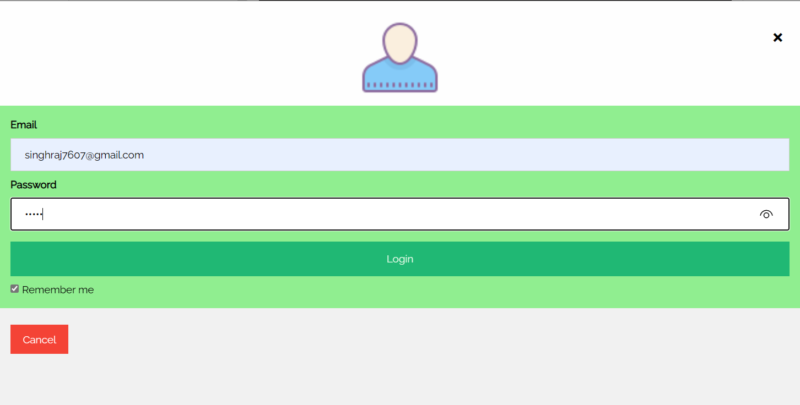
Login Page

Slide 18
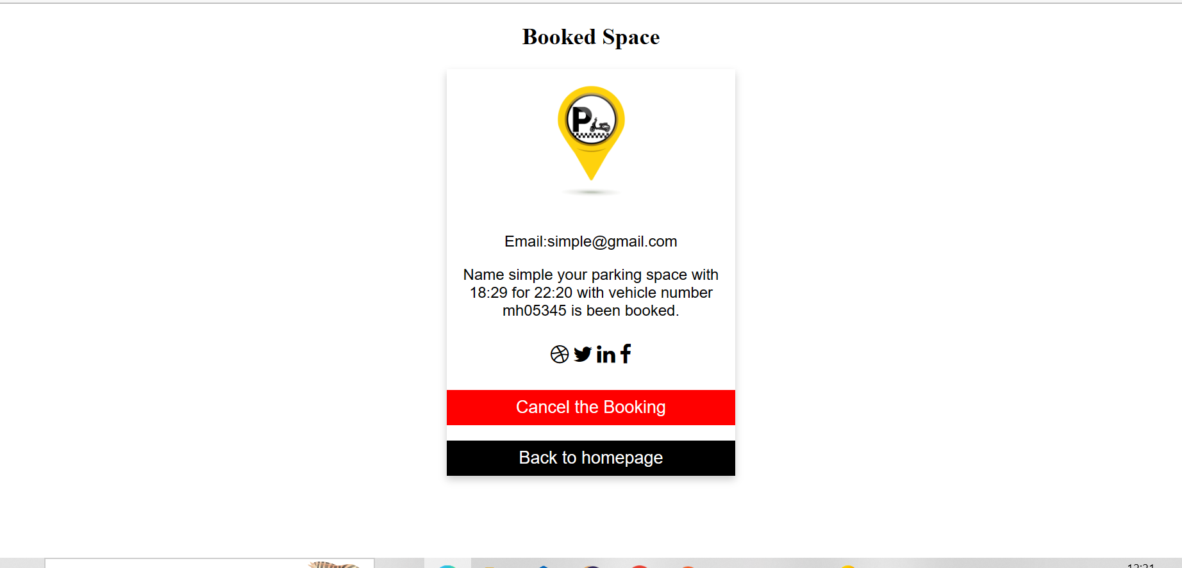
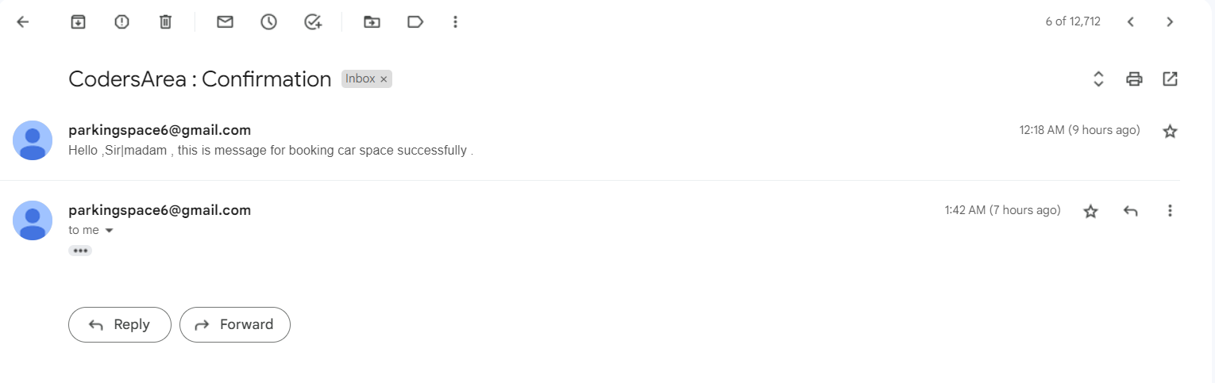
EMAIL CONFORMATION

Slide 19
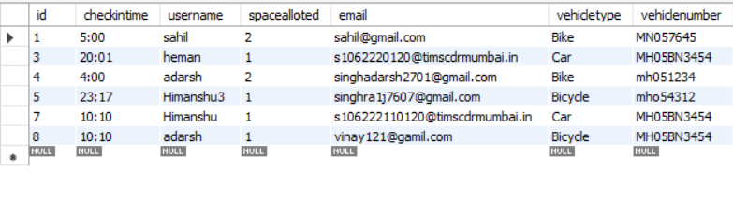
Database

Slide 20
PROJECT CONCLUSION
This Project is minimizing the task of parking a vehicle by paying and saying some details about customer and vehicle to save data. In this the vehicle is parked as a safe and secure. This project is done as Efficient as possible
Hereby I, the Student of MCA 1st semester concludes that the project was completely and slowly developed by me. I also conclude that this project has helped us gain more knowledge about the topic that we are indulged ourselves into “Visual Studio”. I would be glad to enhance and promote this project if given chance and help ourselves and society in the near future
The developed application is tested with sample inputs and outputs obtained in according to the requirement. Even though I have tried our level best to make it a dream project. Due to time constraints. I could not add more facilities to it.
The efficiency of the developed system can be enhanced with some minor modifications. Future development can be made in proposed system by integration more services like:
It can be implemented through web pages.
New effectives modules can be added time to time

Slide 21
FUTURE ENHANCEMENT
Enhancement to create a Bigger and Better System
These enhancements deal with what would be required in a new improved, bigger and better system
In future if when a vehicle enters into the parking area there should be one sensor in which the user can easy identify from outside only Is there parking is full or empty or space is allocated.
In future the vehicle can be parked by machines

Slide 22
THANK YOU

