Slide 1

Online Notes Sharing
By. Fakhruddin Chaudhary(12), Aijaz Chaudhary(11)
Prof. Rashmi Vipat

Slide 2
INTRODUCTION
In this project "Notes Sharing Site Project" student and faculty can upload/download particular subject notes. Through the notes sharing process, users can upload, download and also view the study notes uploaded by others.
User can also edit the notes uploaded by him. In this project two major modules that have been provided are administrator module and user module. It’s an easy for user and Admin to retrieve the data if the vehicle has been visited through number, he can get that data and can get all the past and present record from here.
The several features that are provided by this project are that the users can upload and download the study notes.
However the users do not have authority to delete the records of the website. This authority vests only with the administrator. It is also a secure and easy to use process. Also, in recent days, there has been a lot of demand for multimedia notes.

Slide 3
SCOPE & PURPOSE
PURPOSE:
All users can upload and share study notes with other users.
Users can select the stream (branch) at the time of upload.
User can upload notes in the pdf, doc, ppt, zip, txt etc. file format.
User can search notes via branch, subject and title.
Administrator or management can manage the users and notes.
Admin can accept or reject the notes uploaded request. Notes can published only after accepted by admin.

Slide 4
Existing System: Proposed System:
In present situation in any user share files via social networking site like drive, whatsapp or via gmail. To avoid using social networking sites our software help user to easily share files with our friends and also search notes by its title, subject and branch.
The main aim of the project is to user can share notes easily in the web.
In this System, notes uploading , searching and downloading is possible.
User can login from any location and upload notes and download multimedia notes uploaded by other users.

Slide 5
Project Analysis:
This Application has been divided into two modules.
User Module
Admin Module

Slide 6
User Module
Here are the list of activities of MEMBER.
The users have to create an account into the system by registering themselves and then may login into the system and utilize the services.
Without login they only can see details about application and they contact admin for notes which they want by filling form.
All user can upload their notes in any format (zip, pdf, doc, etc.) and can view, delete and download his uploaded notes.
User can view and download others uploaded notes also by searching via branch, subject and title.
All the user can update their profile and change account password

Slide 7
Admin Module
Here are the list of activities of ADMIN.
Admin can administer the system and can manage the users and notes.
Admin can accept or reject the notes uploading request. Notes can published only after accepted by admin.
Admin can view all the notes uploaded by user and He/She can delete unwanted notes and spam user.
Admin can change password and can view un-signup user query regarding which notes they want.

Slide 8
SCOPE
The project has a wide scope, as it is not intended to a particular organization. This project is going to develop generic software, which can be applied by any businesses organization. More over it provides facility to its users. Also the software is going to provide a huge amount of summary data.

Slide 9

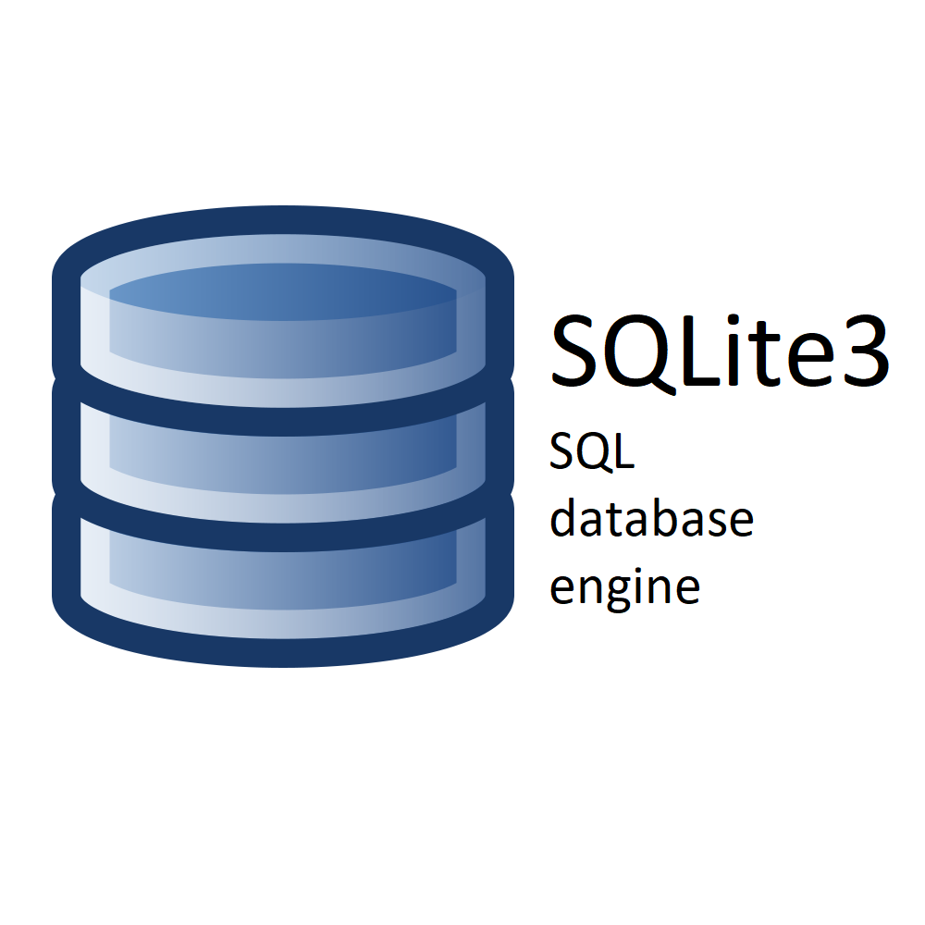

SOFTWARE & HARDWARE REQUIREMENT
TECHNOLOGY USED IN PROJECT BOOK MY PARKING
HTML
CSS
Bootstrap 5
JAVASCRIPT
Python
Django
SQLite3

Slide 10
SOFTWARE REQUIREMENT:
Operating System: Windows/Linux
Programming Language: Python 3 or greater
IDE: VS Code, Pycharm, Python IDLE
Database: Default Django Server for Sqlite3
HARDWARE REQUIREMENT:
Processor: Intel i3 or higher
CPU Speed: 1.8 GHz or higher
Hard disk: 20GB
RAM: 1GB
Internet Connectivity: Minimum 10 Mbps

Slide 11
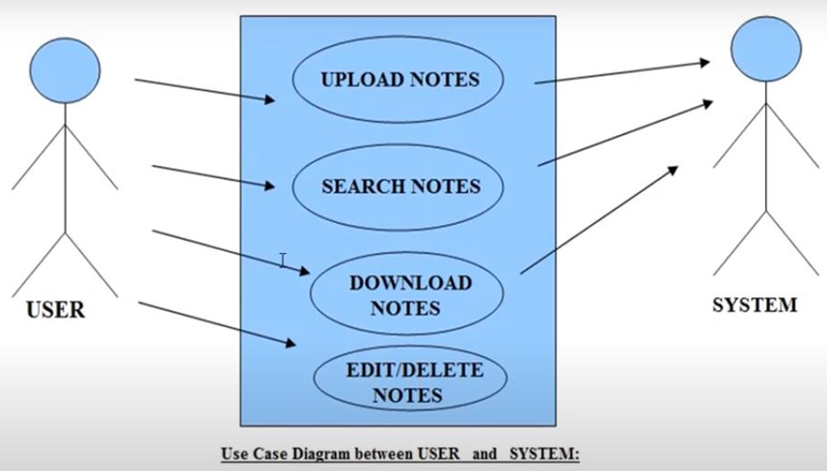
Use Case Diagram
User Module

Slide 12
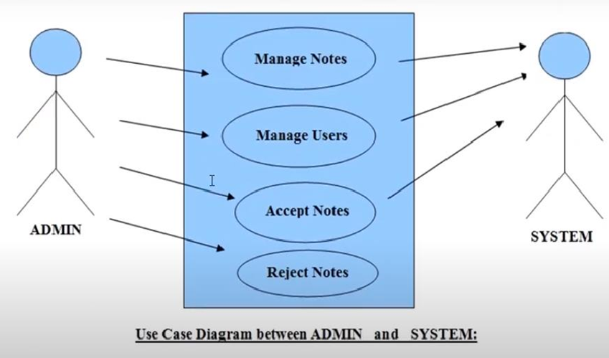
Use Case Diagram

Slide 13
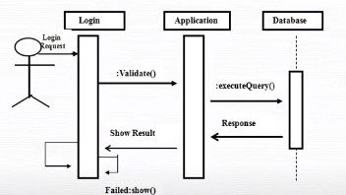
Sequence Diagram For Administrator:

Slide 14
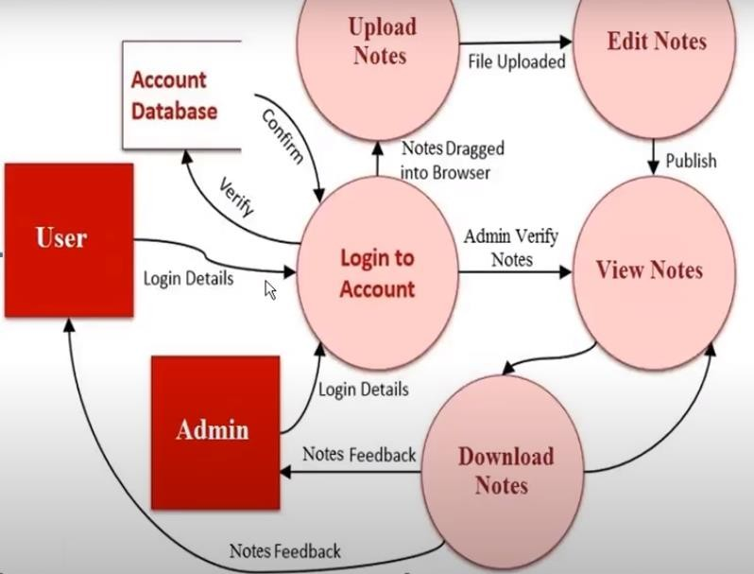
ER DIAGRAM

Slide 15
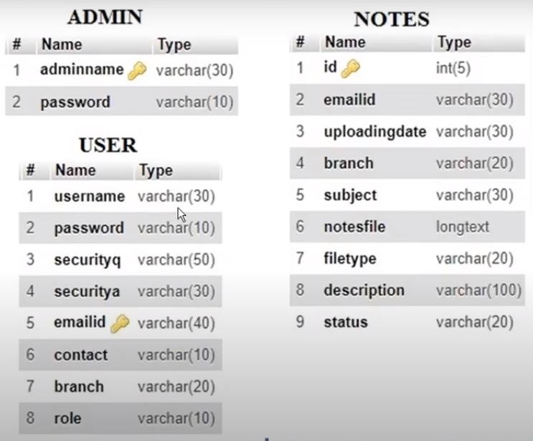
Database Design

Slide 16
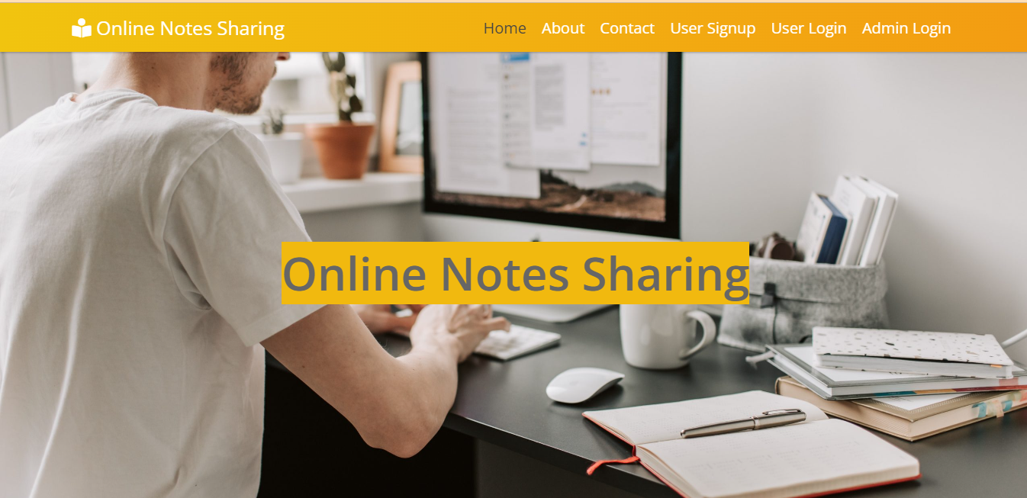
USER INTERFACE

Slide 17
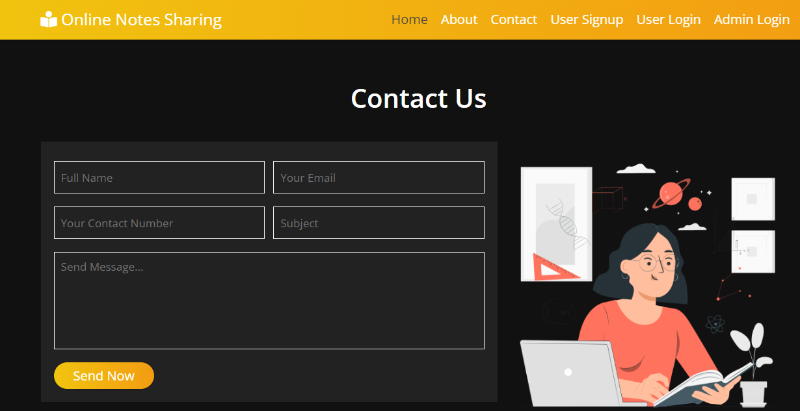
Contact Page

Slide 18
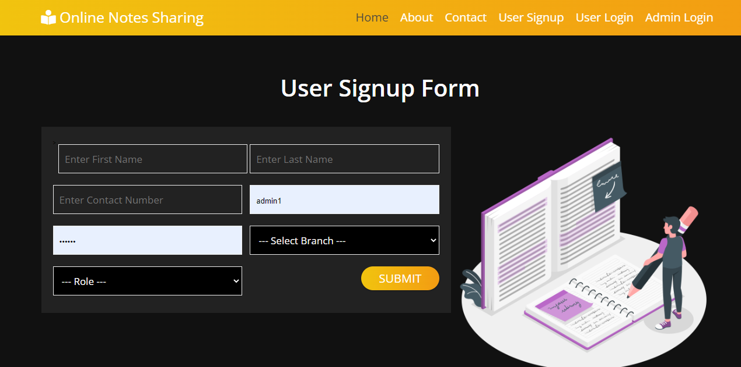
Signup Page

Slide 19
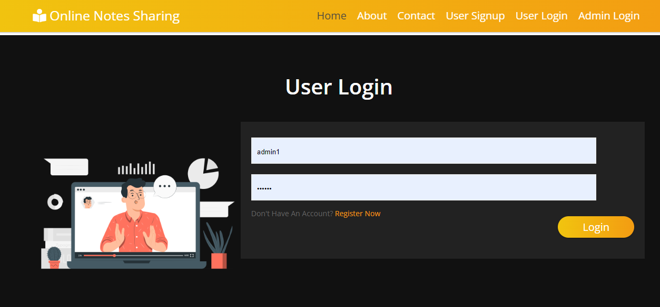
Login Page

Slide 20
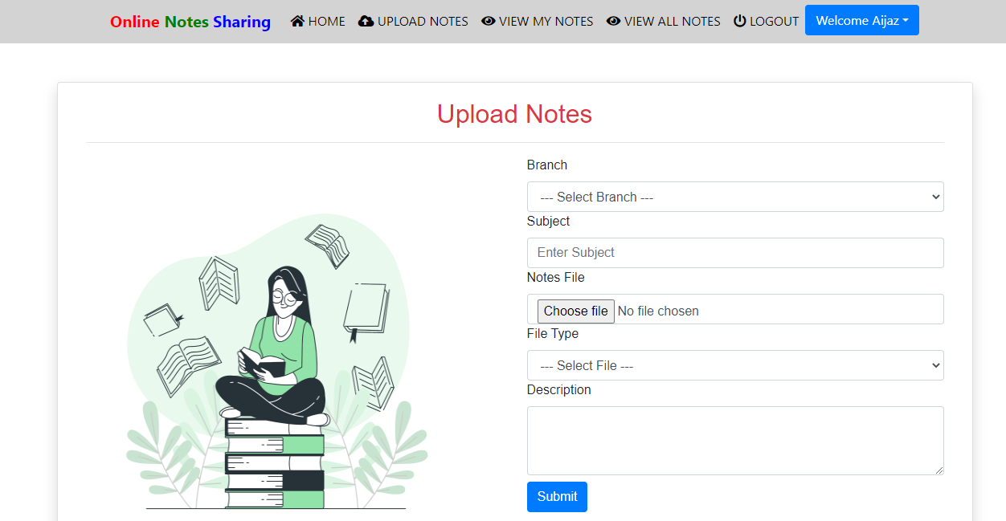
Upload Notes

Slide 21
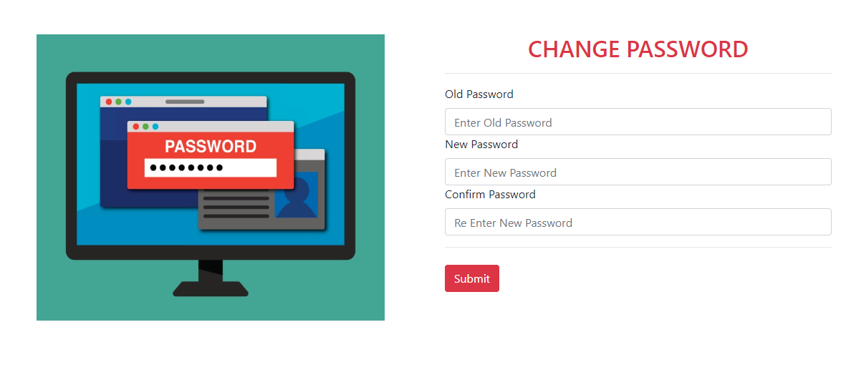
Change Password Page

Slide 22
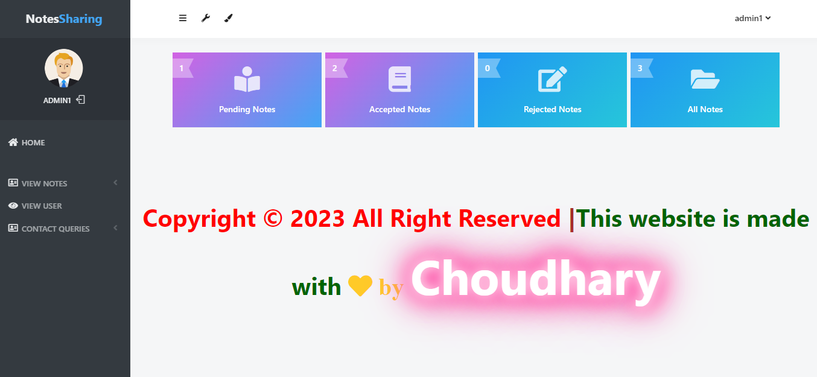
Admin Dashboard

Slide 23
FUTURE ENHANCEMENT
The project made here is just to ensure that this product could be valid in functioning the basic requirements and result the expected outcomes. Here all the facilities are made and tested.
Currently the system is not suggested to be commercial as it does not fulfill complex beta level clients. The system does give accurate and expected result at the alpha level
It is not possible to develop a system that makes all the requirements of the user. User requirements keep changing as the system is being used. Some of the future enhancements that can be done to the system are:
As Technology emerges, it is possible to upgrade the system and can be adaptable to desired environment.
Based on the future security issues, security can be improved using emerging technologies.
When the requirements occur the hardcopy of the report generation as well as softcopy make be provided.
More functionalities can be allotted to the student side of the system.
GUI can be made more presentable adding many more updated components.
Designing can be improved.
Any possible and sensible updates suggested by the clients.

Slide 24
REFERENCE AND BIBLIOGRAPHY
Websites:
https://www.youtube/telusko.com/
https://stackoverflow.com/
https://www.geeksforgeeks.org/
https://www.w3schools.com/

Slide 25
THANK YOU

