Slide 1

presented by:-
Name of student: Himanshu kumar
Registration number: 12215185

Slide 2
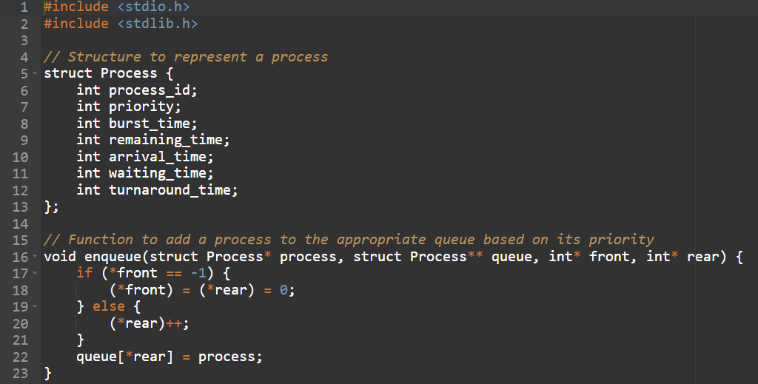
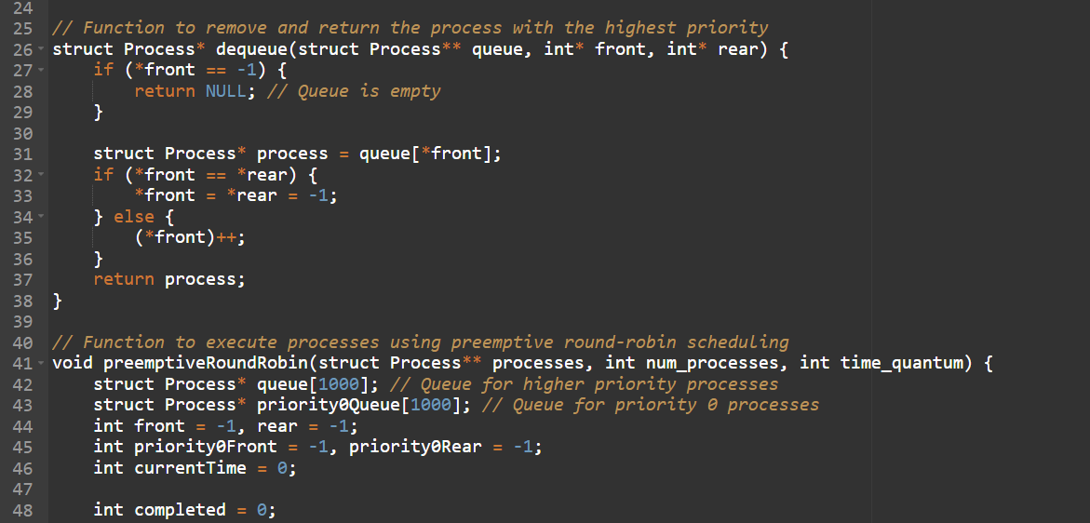
Ques. CPU schedules N processes which arrive at different time intervals and each process is allocated the CPU for a specific user input time unit, processes are scheduled using a preemptive round robin scheduling algorithm. Each process must be assigned a numerical priority, with a higher number indicating a higher relative priority. In addition to the processes one task has priority 0. The length of a time quantum is T units, where T is the custom time considered as time quantum for processing. If a process is preempted by a higher-priority process, the preempted process is placed at the end of the queue. Design a scheduler so that the task with priority 0 does not starve for resources and gets the CPU at some time unit to execute. Also compute waiting time, turn around.
Ans To implement a preemptive round-robin scheduler in C that ensures the task with priority 0 does not starve for resources, you can maintain a separate queue for processes with priority 0 and another queue for higher-priority processes. The lower the priority number, the higher the priority. Here's a sample implementation:

Slide 3
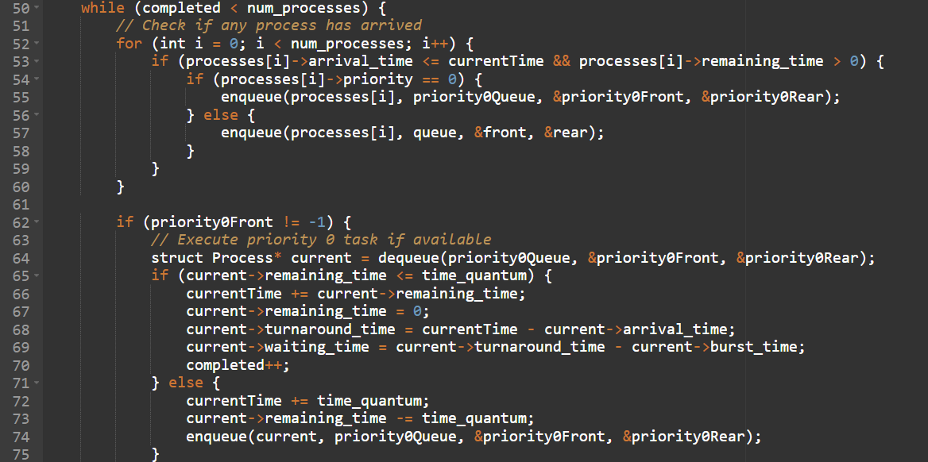
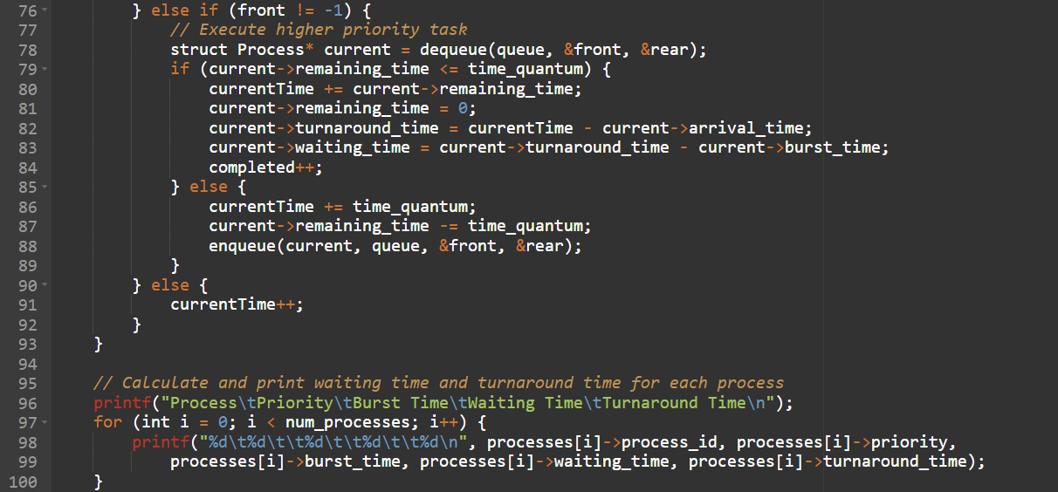

Slide 4
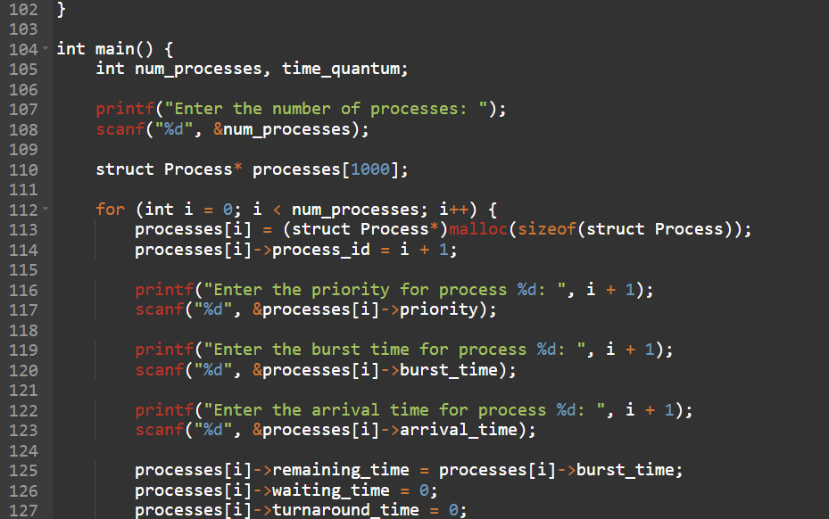
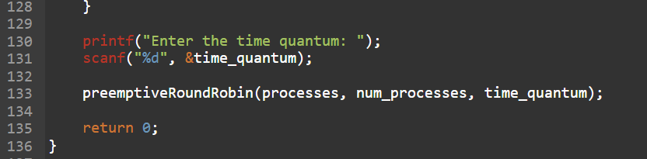

Slide 5
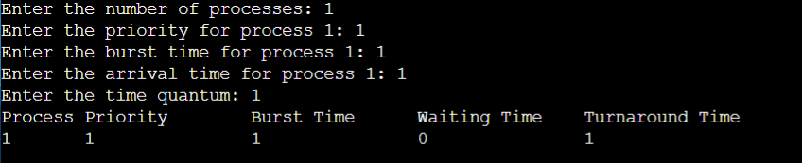
The output of the provided C program. Here's the expected output:

