Slide 1

A Comprehensive strategy to launch a self-service portal for SCHERP
By: TEAM AZTECHS
Business Case
The present study provides the comprehensive strategy plan to launch a self-service portal for a European media giant, SCHERP.
With a growing subscriber base, Scherp has noticed an increase in calls to customer representatives, leading to a pile up of pending tickets and a drop in customer experience. With the long term vision, Scherp decided to open a self service portal such that it would be made available across four platforms – Desktop browser, Mobile browser, Mobile App and Set-top box
Scherp hired EXL to determine the target platform and provide a comprehensive strategy to launch the self service portal.
Plan of Action
1. Prediction of self-service platform based on customer data using machine learning
2. Cost estimation for development of self-service portal
3. Targeting customers using proper marketing strategy and its cost estimation
4. Cost Effectiveness
Statistical tools and Technologies Used
1. SPYDER (Anaconda Package)
2. Python Libraries for data visualization and data pre-processing (pandas,matplotlib,numpy,sklearn etc.)
3. Microsoft Excel tools for calculation part (pivot tables, pie-chart)

Slide 2
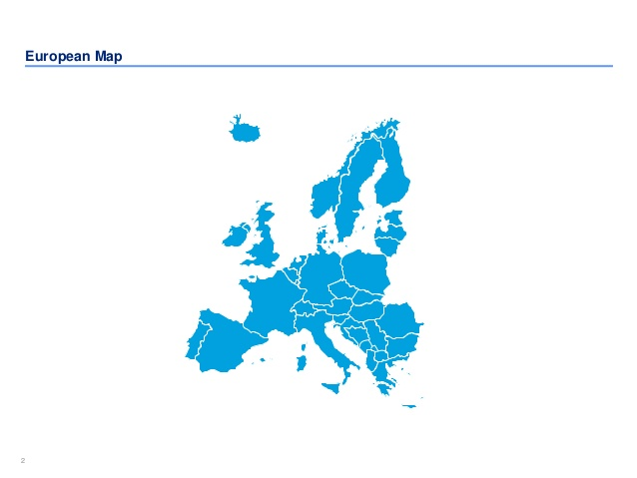
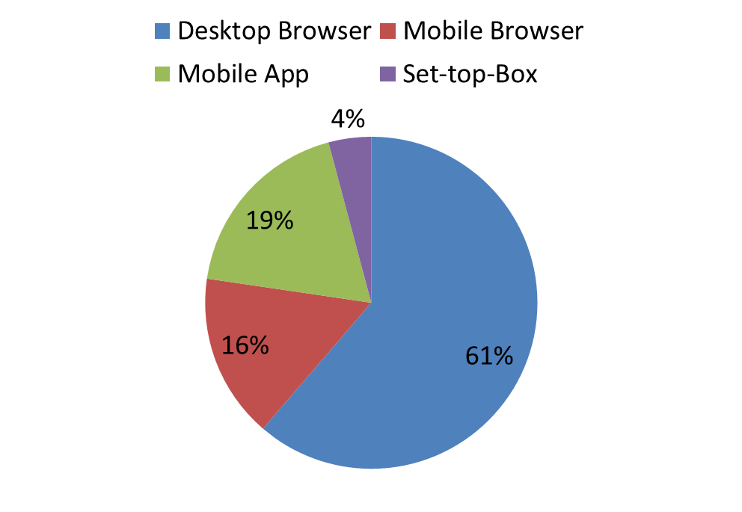
Prediction of self-service platform
Demographics
Population of Europe: 750 Million*
In the problem statement, we are provided with the train data set having 300000 examples with level mentioned (type of self-service portal) and the test data of another 300000 examples, for which we have predicted the levels based on various parameters given.
We trained various machine learning models (XG Boost Classifier, Random Forest, Gradient Boosting, Logistic regression) and tuned it for obtaining better accuracy by dividing the train data set in to train data and test data.
Bagging (combines output from weak learner and creates strong learner) and boosting (higher focus on examples which are misclassified) are applied.
Number of Customers in Europe = 2/5 x Population of Europe
= 300 Million
Based on the prediction model, Distribution of self service portal for the dataset (300 Thousand)
Projection of the data set as a sample over the population – Number of customers using respective self service portal
a. Desktop Browser – 183 million
b. Mobile Browser – 48 million
c. Mobile App – 57 million
d. Set-top box – 12 million
Predicted self service platform as per given dataset
*-
https://www.worldometers.info/world-population/europe-population/

Slide 3



Development cost
Marketing Strategy
On the basis of service platform predicted
Set-top box
Mobile App
Desktop Browser
Mobile Browser
As the company has decided to make a self-service portal, so let’s us assume that the company outsources the development of self service portal.
For this development the outsourcing company charges 2 dollar / login*.
Total number of login (in a year) = [Total no. of tickets raised in last one year(var26) + No. of sales calls made by customer to buy a product (in last 30 days)(var31) x 12 months.] x 1000 (Projecting over population)
Total number of login (in a year) = 6500 million
Total development cost = 6500 x 2 = 13000 million dollars/year
Since Set-top box predicted customers subscribe and use Television facilities more, therefore marketing strategy for these customers:
Television Advertisement
Direct Mails
As there are only 5 main TV channel that are viewed maximum so we can telecast the advertisement on these channels
63% people in Europe use social media apps and for 19% customers, mobile app is the predicted service platform. Assuming all these people use social media, the marketing strategy is as follows :
Social media marketing
SMS marketing
Since customers for whom desktop browser is the predicted service platform are more likely to use email services. Hence, we will target these customers through email marketing.
Mobile browser are the predicted platform for 16% of total population. Taking cost consideration, these customers are to be introduced about the portal through –
Calling
SMS Marketing
*-
https://www.salesforce.com/products/community-cloud/pricing/self-service/

Slide 4
Marketing Cost/Year
Set-Top Box
No. of Customers: 12 Million
T.V Ad:
Development cost: Set-up cost + Media ad = 5.3 million $ (30 sec ad)*
Telecast cost = Cost to telecast a 30 sec ad** x No. of times x No of channels x No. of days
= 3212.35 x 5 x 5 x 365
= 29.3 million $
2. Direct mail:
Cost of 1 DM = 0.38 $***
Total cost = 12 * 0.38 = 4.56 million $
Total: 39.16 million $
Mobile App
No. of Customers: 57 Million
Social Media:
Cost = No. of Customers x Cost per Click**** = 57 * 0.5
= 28.5 million $
2. SMS Marketing:
Cost = No. of Customers x No. of times x Cost/SMS***** = 57 x 4 x 0.04
= 9.12 million $
Total: 37.62 million $
Desktop Browser
No. of Customers: 183 Million
Email Marketing:
Cost: No. of Customers x No of times x Cost per email******
= 183 x 4 x 0.05
= 36.6 million $
Direct mail:
Cost of 1 DM = 0.38$***
Total Cost = 183*0.38 = 69.54 million $
Total: 106.14 million $
Mobile Browser
No. of Customers: 48 Million
Calling:
Cost = No. of Customers x avg time x no. of times x avg call charges/min*******
= 48 x 3 x 2 x 0.222
= 63.93 million $
2. SMS Marketing:
Cost = No. of Customers x No. of times x Cost/SMS***** = 48 x 4 x 0.04
= 7.68 million $
Total: 71.61 million $
Total Marketing Cost: 255 Million $
*-
**-
***-
****-
*****-
******-
*******-
https://www.webfx.com/blog/business-advice/the-cost-of-advertising-nationally-broken-down-by-medium/
https://www.thedrum.com/news/2017/02/22/how-much-does-it-cost-advertise-uk-tv-heres-what-channel-4-itv-and-more-charge-slots
https://www.firstmove.co.uk/2018/08/10/what-is-the-cost-of-direct-mail/
https://www.lyfemarketing.com/blog/cost-advertise-instagram/
https://www.textmarketer.co.uk/pricing-eu/
https://www.webfx.com/blog/business-advice/the-cost-of-advertising-nationally-broken-down-by-medium/
https://www.euractiv.com/section/digital/news/calling-within-europe-will-be-cheaper-from-may-2019/

Slide 5
Techniques to get people to use self-service portal
1. Creating Proper and phase wise context:
First phase – Coming soon
Second phase – Portal is live
Third phase – Feedback link
2. Creating an online community where customers can post issues as well as share solutions with each other.
3. Providing customers with search capabilities on the self-service portal
4. Offering the means for customers to rate the content and their experience with the portal – then make the appropriate adjustments based on that feedback
5. Developing a knowledge article or guide to the self-service portal
Variable cost to the company (When self service portal is not launched)/Year
Cost Effectiveness
Total Cost required for Launching the Self-Service Portal/year:
Total Development Cost
+
Total Marketing cost
= 13255 million $
Total cost required to run call center/year:
Call charges/year
+
Total salary of Customer Representatives
= 17200 million $
Hence Cost Effectiveness:
17200 – 13185
= 3945 million $
Call charges/year
Total Salary of CRs/year
Assuming customer calls for 2 reasons;
a. Raising an issue (Ticket)
b. Enquiry about new product
As per dataset total number of tickets: Total no. of tickets raised in last one year(var26) = 5477674
As per dataset total calls for enquiry = No. of sales calls made by customer to buy a product (in last 30 days)(var31) x 12 months
= 88061 x 12 = 1056732
Total Call charges: Total calls made per year x Call charges/min x1000 (Projecting over population) x avg time of talk
= 6534406 x 0.222 x 1000 x 5
= 7250 million $
Assuming total number of working days per year = 240
Total Calls/day: Total calls made per year x1000 (Projecting over population) / 240
= (6534406 x 1000)/240
= 27,226,692 calls/day
Let us assume out of 8 hrs of work, CR spends 5 hrs on phone, So total no of CRs required per day
= (Total calls made per day x avg time of talk) / (5 hrs x 60)
= (27226692 x 5) / (5 x 60)
= 453778 CRs
Assuming per hour salary of CR as 11.44 $*, Total salary of all the CRs per year = No. of CRs per day x Salary/hr x No. of work hrs x No. of days of work in a year
= 453778 x 11.44 x 8 x 240
= 9967.2 million $
Total Cost: 17200 million $
*-
https://www.payscale.com/research/DE/Job=Call_Center_Agent/Hourly_Rate

Slide 6
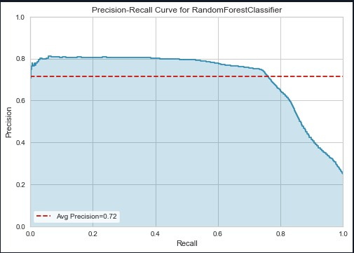
Summary and Recommendations
Hypothesis testing
We will be performing hypothesis testing based on the number of visits and cost considerations.
300,000 customers will be considered as sample for the test.
We will count the increase in the number of visits per day for 30 days and will decide accordingly the hypothesis as the null hypothesis and the alternate hypothesis.
If this increase is satisfactory then we will opt this alternative otherwise we can work in two different ways
Here is the graph of precision vs recall for the current model we have used.
Above mentioned model has the average precision of 0.72.
We can plot and check for various other average precision and precision vs recall plot by defining different learning rate values.
The larger learning rate will be for the one which is the more important class
Increasing precision of prediction of communication mode for marketing of self-service portal based on customer type.
Different variable from the data set can be used as indicator for deciding the efficient way for marketing for the target customer.
Examples of such parameters are –
Mail Open Rate of the target customer. (Var 7)
Indictor if customer prefers direct mail or not. (Var 37)
By increasing the precision of prediction model what was used to predict the type of self-service portal for a target customer
Regulation of precision versus recall for multi-label classification.
Methods like combining the output from weak learner and creating a strong learner which will improve the prediction power of the model (BAGGING) and focusing higher on examples which are more misclassified (BOOSTING)
can be used.
Recommendations for marketing strategy
According to the above mentioned study, the introduction of self-service portal instead of hiring more customer reps will improve customer experience and reduce the cost by 3945 million $ over a span of one year.
For more efficient marketing, we can also introduce discount offer on first transaction through these self-service portal.
We can also introduce these self-service platform to the customers whenever they make a call to the customer representatives through the recorded message and also through our company’s website.
We can also use Chatbot on company’s website for introducing the self-service platform.
We can also send the customer the link to the relevant knowledge article of the self-service portal after resolving the customer’s issue.

