Slide 1
GIT – SCM
Février 2016

Slide 2
Agenda
  Version control
  GIT Introduction
  Repository creation & clone
  Saving changes & resetting
  Reverting changes
  Saving temporarily
  Syncing
  Branch management & conflict resolution
  Pull request
  Guidelines NFC/Digifact

Slide 3
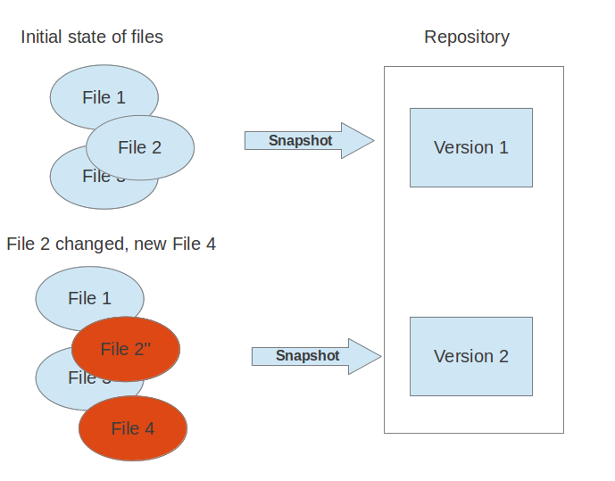
Version control
  A version control system (VCS) allows you to track the history of a collection of files.
  Captures a snapshot of the files at a certain point
  Allows you to switch between these versions
  These versions are stored in a specific place, typically called a repository

Slide 4
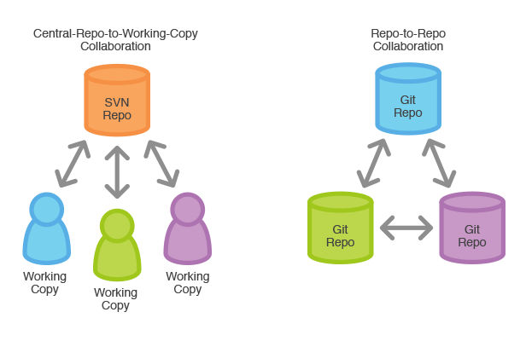
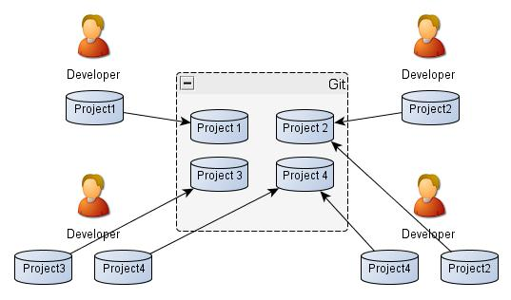
GIT - Introduction

Slide 5
Repository creation & clone
  git init <directory>
  Transform the current directory into a Git repository. This adds a .git folder to the current directory and makes it possible to start recording revisions of the project.
  git clone <repo> <directory>
  Clone the repository located at <repo> into the folder called <directory> on the local machine.
  Ex: git clone https://himanshuarora@bitbucket.org/zengularity/nfc.git
  Clone Mode: HTTPS/SSH (SSH needs transfer of public key to GIT server but once properly configured no need to enter username/password for push/pull )

Slide 6
GIT Config
  git config --global user.name <name>
  git config --global user.email <email>
  Define the author username/email to be used for all commits by the current user.
  To be done only the first time after git installation.

Slide 7
Saving changes & resetting
  git add <file>
  git add <directory>
  Adds a change in the working directory to the staging area. It tells Git that you want to include updates to a particular file in the next commit.
  git commit -m "<message>"
  The staged snapshot is committed to the project history
  Ex: git add .
  git commit –m “Commit all local changes”
  git status
  List which files are staged, unstaged, and untracked.

Slide 8

  git reset --files
  git reset --hard
  Opposite of git add
  Remove the specified file from the staging area, but leave the working directory unchanged.
  --hard Resets the index and working tree. Any changes to tracked files in the working tree since <commit> are discarded. Resets the staging area and the working directory to match the most recent commit

Slide 9
Reverting changes
  git checkout filename
This will replace filename with the latest version from the current branch.
WARNING: your changes will be discarded — no backup is kept.
  git checkout <commit> <file>
  Check out a previous version of a file. This turns the <file> that resides in the working directory into an exact copy of the one from <commit> and adds it to the staging area.
  git checkout <commit>
  Update all files in the working directory to match the specified commit.
  Ex: git checkout a1e8fb5
  git checkout HEAD hello.scala (Checkout most recent version of file in local project history)

Slide 10

  git revert <commit>
  The git revert command undoes a committed snapshot. But, instead of removing the commit from the project history, it figures out how to undo the changes introduced by the commit and appends a new commit with the resulting content. This prevents Git from losing history
  EX:
  # Edit some tracked files
  # Commit a snapshot
  git commit -m "Make some changes that will be undone"
  # Revert the commit we just created
  git revert HEAD

Slide 11
  git clean
  The git clean command removes untracked files from your working directory. This is really more of a convenience command, since it’s trivial to see which files are untracked with git status and remove them manually.
  The git clean command is often executed in conjunction with git reset --hard. Remember that resetting only affects tracked files, so a separate command is required for cleaning up untracked ones.

Slide 12
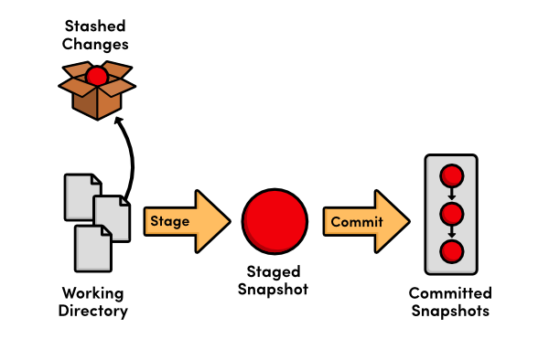
Saving temporarily
  git stash
  When you want to record the current state of the working directory and the index(staged files), but want to go back to a clean working directory. The command saves your local modifications away and reverts the working directory to match the HEAD commit.
  git stash pop
  Remove a single stashed state from the stash list and apply it on top of the current working tree state, i.e., do the inverse operation of git stash

Slide 13
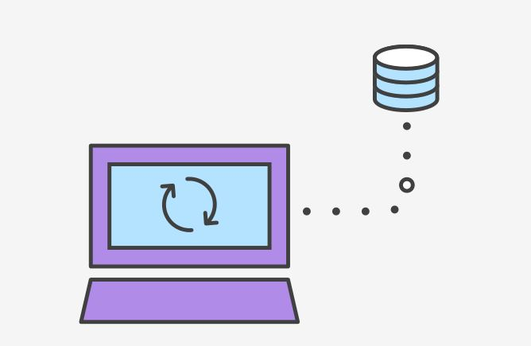
Syncing
“SVN uses a single central repository to serve as the communication hub for developers, and collaboration takes place by passing changesets between the developers’ working copies and the central repository. This is different from Git’s collaboration model, which gives every developer their own copy of the repository, complete with its own local history and branch structure. Users typically need to share a series of commits rather than a single changeset. Instead of committing a changeset from a working copy to the central repository, Git lets you share entire branches between repositories.”

Slide 14
  git fetch
  Imports commits from a remote repository into your local repo. The resulting commits are stored as remote branches instead of the normal local branches that we’ve been working with.
  Ex: This example walks through the typical workflow for synchronizing your local repository with the central repository's master branch.
  git fetch origin master
  (to fetch master branch from remote repo origin)
  git merge FETCH_HEAD
  (to merge the master branch fetched from remote repository into the master branch of your local repository)

Slide 15
  git pull
  Merging upstream changes into your local repository is a common task in Git-based collaboration workflows. We already know how to do this with git fetch followed by git merge, but git pull rolls this into a single command.
  Ex: To pull dev branch from remote origin and merge it to dev branch in local repository
  git pull origin dev
  GIT PULL = SVN UPDATE

Slide 16
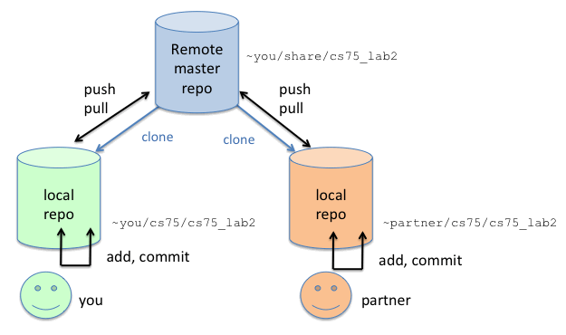
  git push
  Pushing is how you transfer commits from your local repository to a remote repo. It's the counterpart to git fetch,
  Ex: To push your local dev branch to remote repository
  git push origin dev
  GIT PUSH = SVN COMMIT

Slide 17
Branch management
  Default git branch name = master
  Naming conventions
  releases/2.1.x
  features/name_feature (ex. features/profils/IHM)
  issue/num_mantis
  fix/xyz
  test/xyz
  Do not use bare numbers (or hex numbers) as part of your branch naming scheme. Git may decide that a number is part of a sha-1 instead of a branch name.
  git checkout 7714 (7714 NOK as branch name but fix/7714 or fix7714 works fine)

Slide 18
  git branch
  List all of the branches in your repository.
  git branch <branch>
  Create a new branch called <branch>. This does not check out the new branch.
  git branch -d <branch>
  Delete the specified branch. This is a “safe” operation in that Git prevents you from deleting the branch if it has unmerged changes.
  git branch -D <branch>
  Force delete the specified branch, even if it has unmerged changes.
  git branch -m <branch>
  Rename the current branch to <branch>.

Slide 19
  git checkout <existing-branch>
  Check out the specified branch, which should have already been created with git branch.
  git checkout -b <new-branch>
  Create and check out <new-branch>.
  git merge <branch>
  Merge the specified branch into the current branch. Git will determine the merge algorithm automatically.
  git merge --no-ff <branch>
  Merge the specified branch into the current branch, but always generate a merge commit (even if it was a fast-forward merge). This is useful for documenting all merges that occur in your repository.
  git fetch && git checkout <remote-branch>
  To bring a remote branch created by someone else to your local repository and start working on that branch.

Slide 20
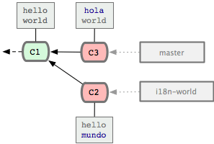
  CONFLICTS
  If the two branches you‘re trying to merge both changed the same part of the same file, Git won’t be able to figure out which version to use. When such a situation occurs, it stops right before the merge commit so that you can resolve the conflicts manually.

Slide 21
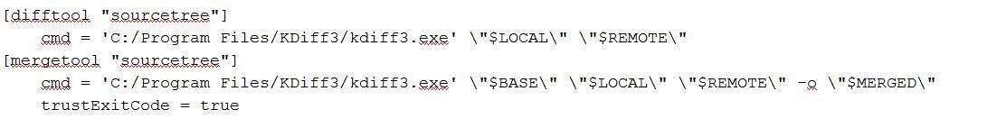
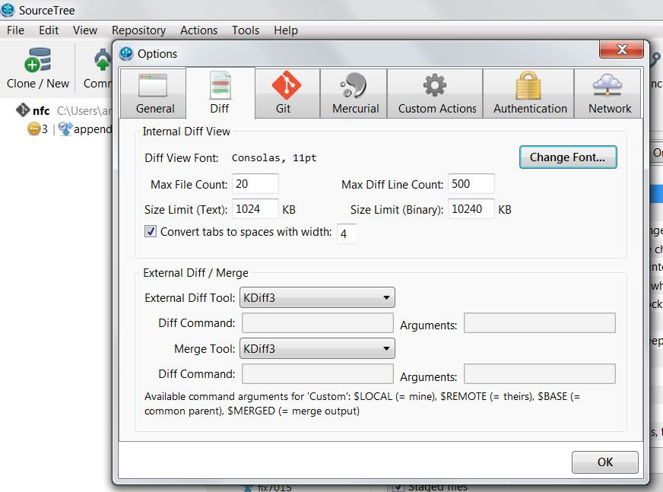
  CONFLICT – RESOLUTION BY SOURCE TREE & KDIFF3
  Configuration needed in .gitconfig
  Goto c:/user/xyz/.gitconfig and add
  Configuration needed in SourceTree
  Goto Tools/Options and choose kdiff3 as external diff/merge tool

Slide 22
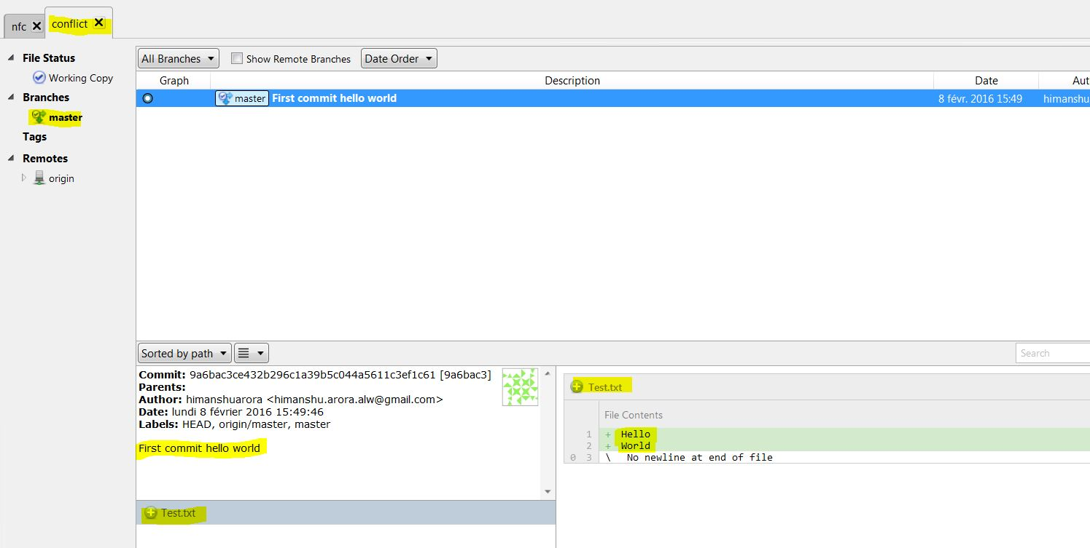
  LIVE EXEMPLE
  Created a GitHub repo & cloned to local machine
  https://github.com/HimanshuArora1234/conflict
  Created a file and committed and pushed to origin/master branch

Slide 23
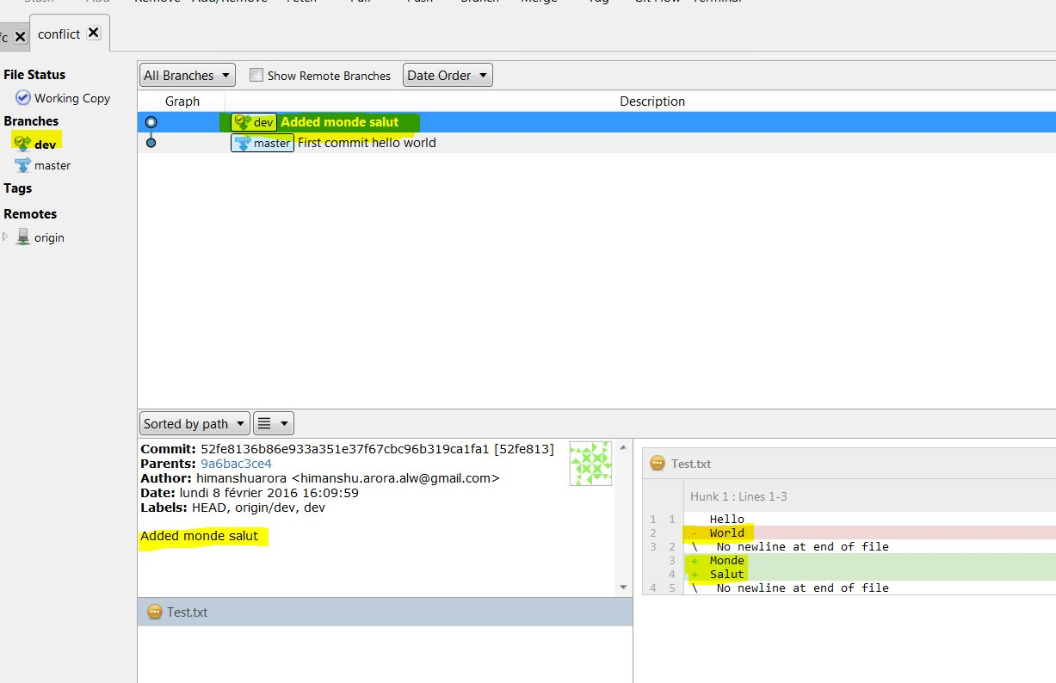
  Created a branch dev from master and checkout this branch and also modified the file, committed and pushed the branch to remote repo.

Slide 24
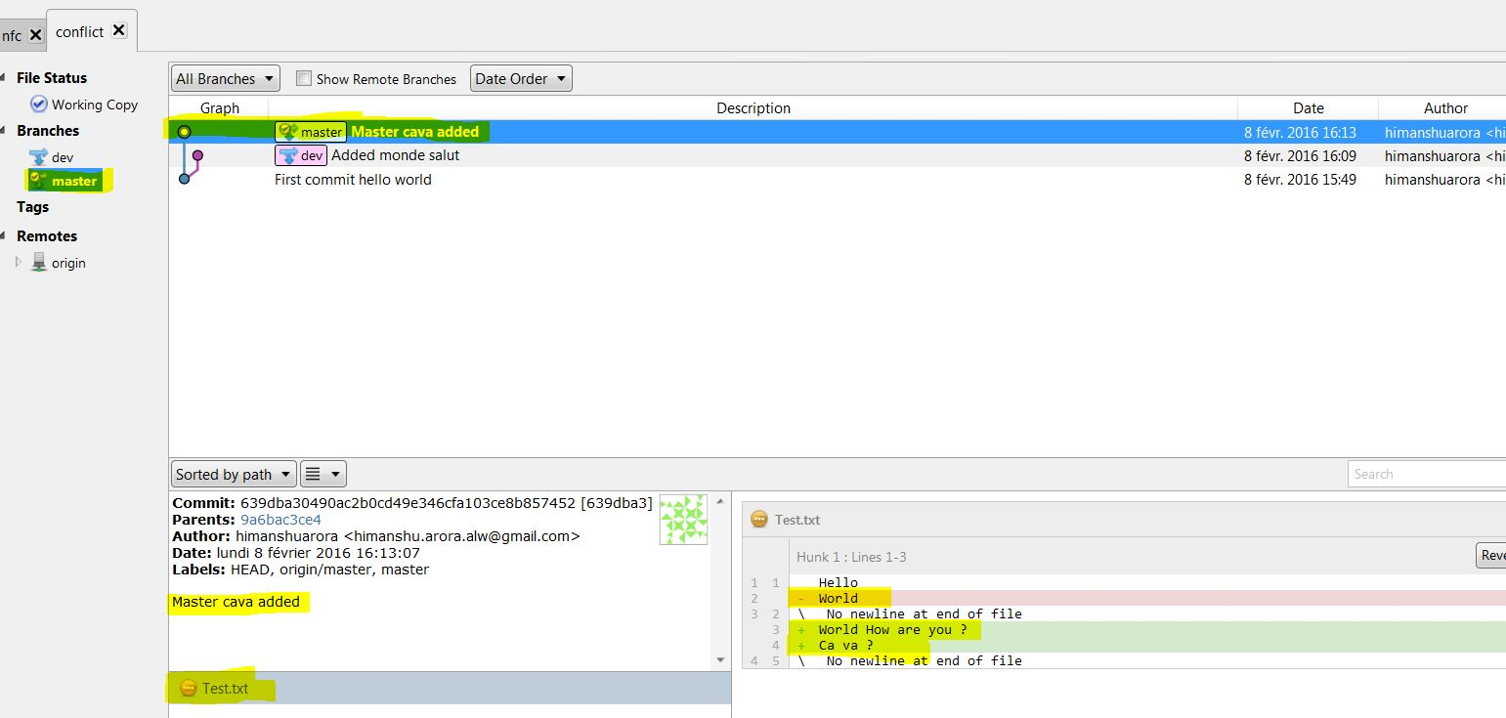
  Switch back to master and change the file, commit and push master.

Slide 25
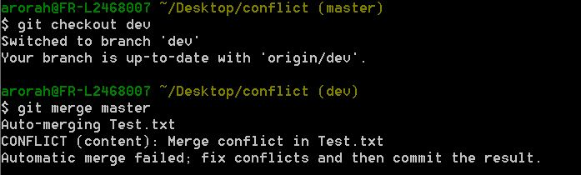
  NEED TO MERGE DEV INTO MASTER
  Attention ! Merge master into dev first so that all the conflicts will be resolved in dev itself then only merge dev into master.
  Steps: (currently on branch master)
  git pull origin master
  git checkout dev
  git merge master
  Resolve conflicts if any
  git commit if resolved any conflicts
  git push origin dev
  git checkout master
  git merge dev

Slide 26
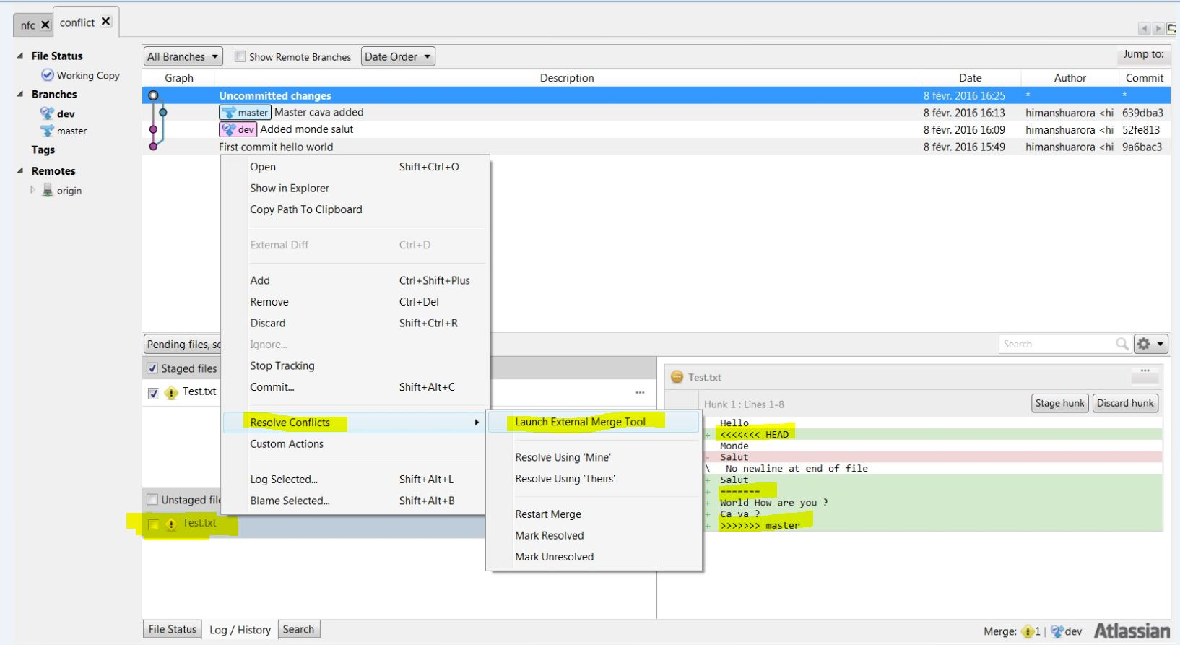

Slide 28
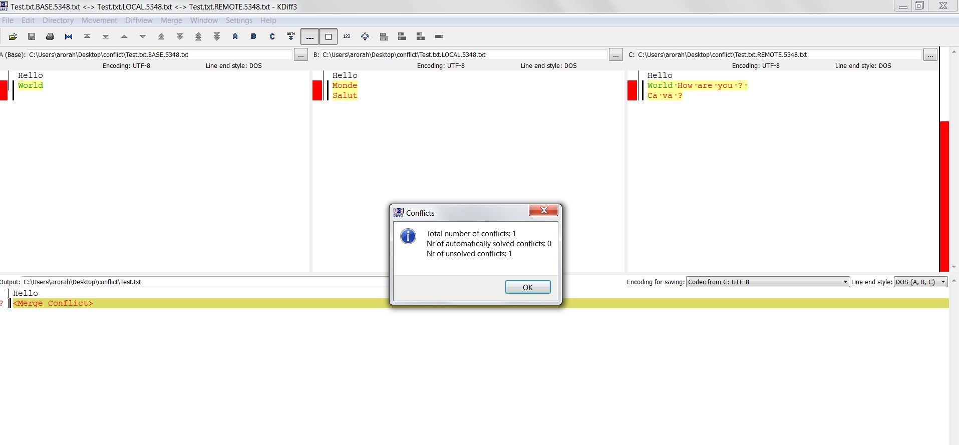
  Do nothing until the following Kdiff window appears
A : Base version (last stable version)
B: Version of file in your local repository
C: Version of file in remote repository
Output: Result file after conflict resolution

Slide 29
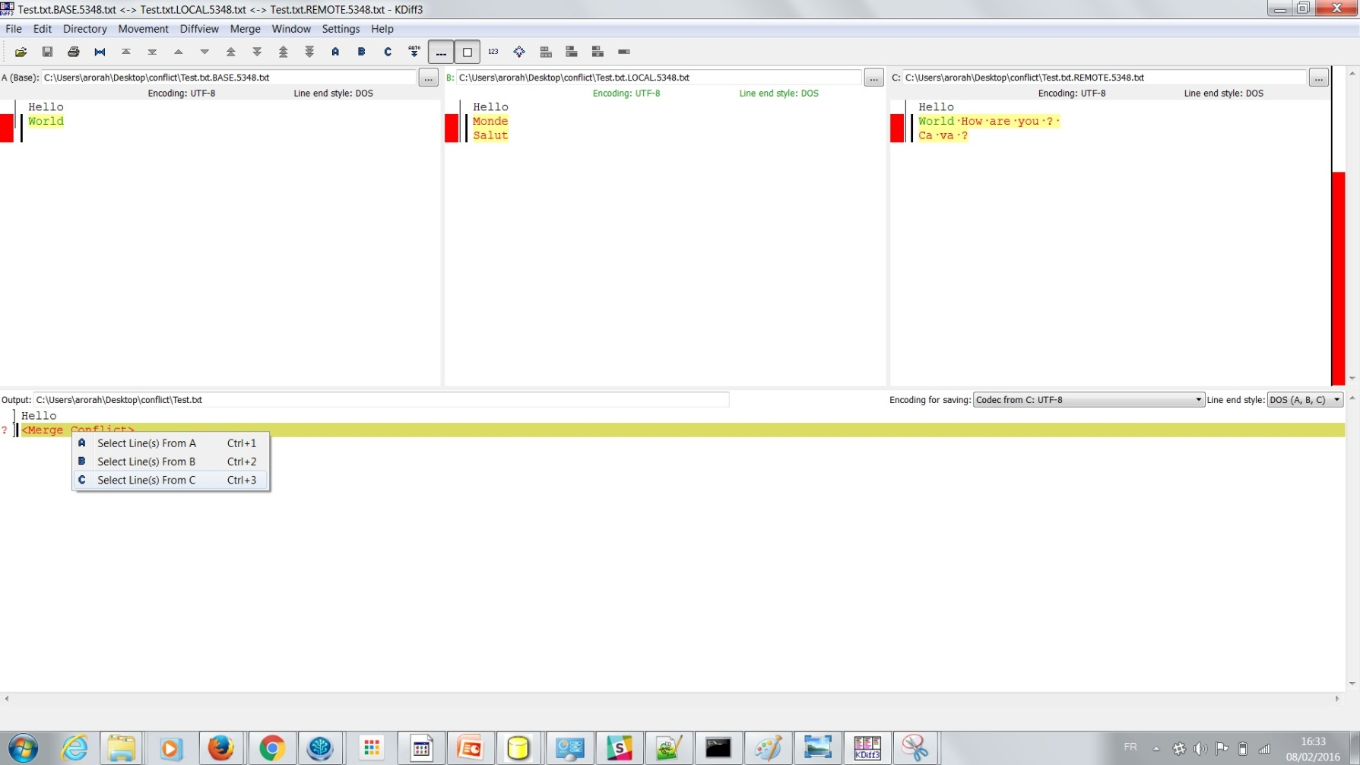
  Choose the version (A/B/C) of your convenience at every conflict point and once all conflicts are resolved hit Ctrl+S and close Kdiff window.

Slide 30
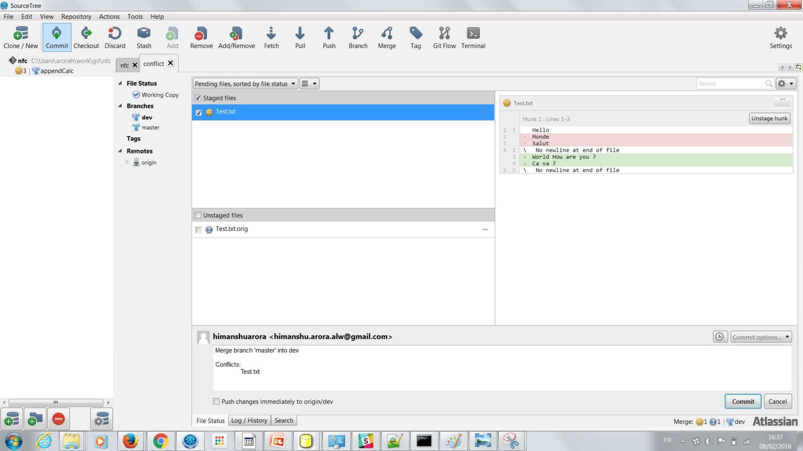
  Commit the changed made as the result of merge keeping the default message intact and then push your branch.

Slide 31
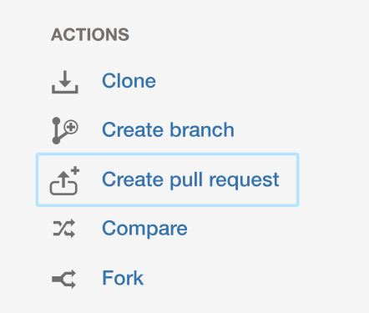
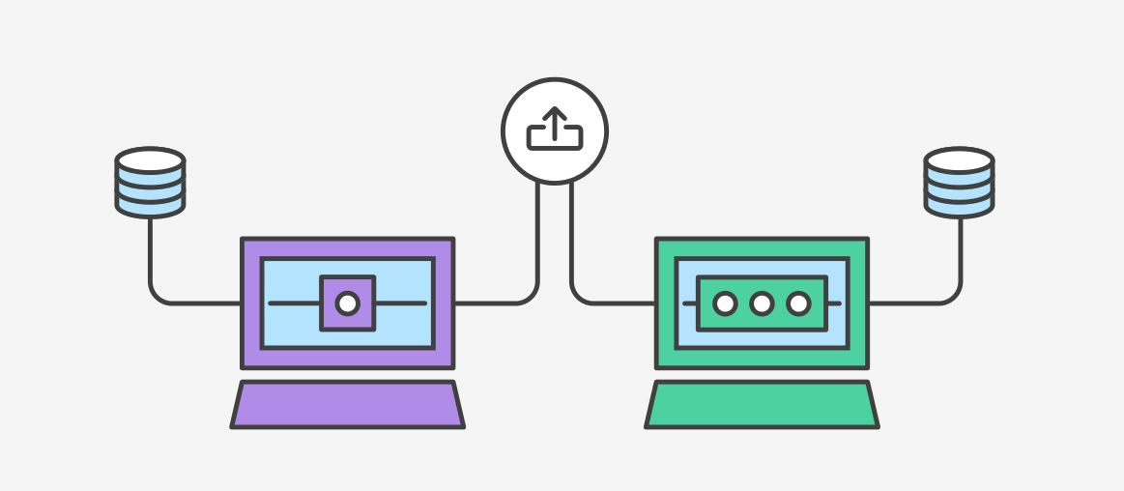
Pull request
“Pull requests are a feature that makes it easier for developers to collaborate using BitBucket. They provide a user-friendly web interface for discussing proposed changes before integrating them into the official project.”

Slide 32
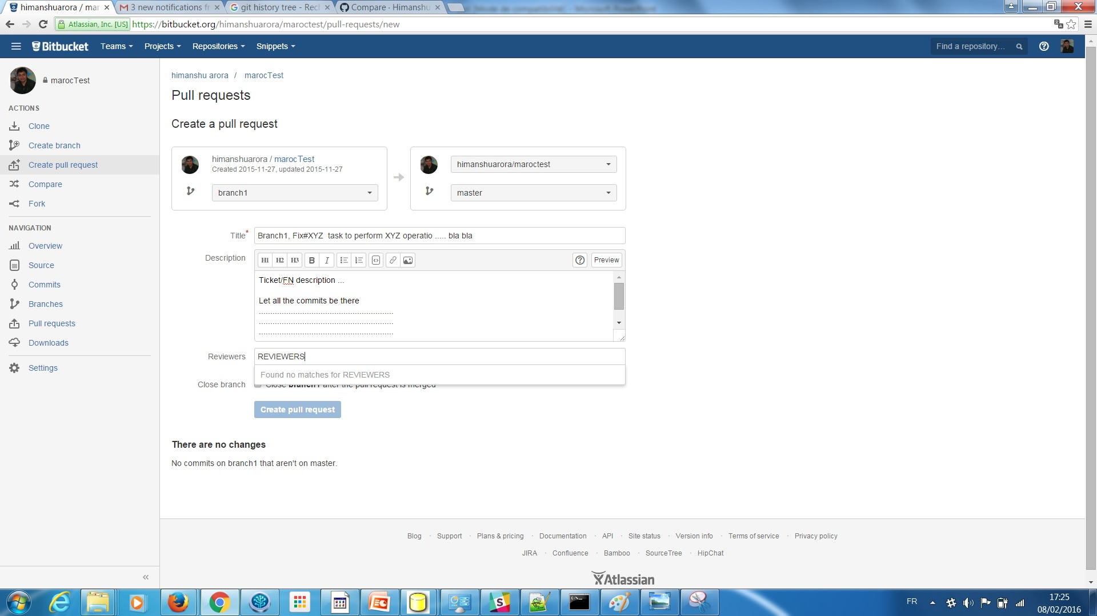

Slide 33
  Steps to create a Pull request
  Ex: (currently on branch dev and need to merge branch1 into dev)
  git pull origin dev
  git checkout branch1
  git merge dev
  Resolve conflicts if any
  git commit if resolved any conflicts
  git push origin branch1
  Create pull request to merge branch1 into dev
  Reviewer made some comments and need to do some changes
  Make changes (on branch1)
  git commit –m “msg”
  git push origin branch1 (this will automatically update the pull req so no need to recreate a new pull req)
  Reviewer has approved your Pull request
  Reviewer has merged your branch to dev and deleted branch1 from remote repo
  git branch –d branch1 (to delete branch1 from local repo)

Slide 34
Guidelines NFC/Digifact
  Before merging .. Attention!
  The following is in the context of NFC/Digifact.
  Close your ATOM
  Stop all the NPM watchers
  This is necessary because sometimes Atom or watchers may lock some JavaScript files which may cause the failure of merge. And this will leave you in a dirty state. The solution to get rid of this problem will be to stop your watchers, close Atom, Run git reset --hard and then restart the merge.
  Always create your branch originating from the branch dev which should later be merged back to dev only unless it’s really necessary. (Strictly for NFC)
  Commit message : Must to write small and useful description on each commit (needed to track history and obligatory for the reviewers to understand the pull request)
  Ex : WIP – Description of work in progress
  Always good to merge dev in your branch at least once or twice (recommended) a day to avoid the conflicts later.

