Slide 1
Sales Analysis
By Himanshu Bansal

Slide 2
Project Team
Members:
Himanshu Bansal
17BCS3985
B.E. CSE IBM Big Data Analytics

Slide 3

Contents
About the presentation​
Use of certain graphs for visualization​
Describing the case in brief​
General Insights​
Company’s performance​
Highlighting the important trends visible in the data set.​
How can we measure our performance in terms of customer acquisition and building customer loyalty?​
What kind of customers do typically buy from us?​
The drivers of sales and related insights​
How can we increase the sales? Measure to be taken to avoid out of stock situations. ​
Exploring more
Complimentary close​

Slide 4
About Presentation
This presentation is to give an overview of the use case of an E-commerce company who has its operation in various countries. The aim of this presentation is to scrape out insights from the same.

Slide 5

Use of certain graphs
In this presentation the following graphs are used for the purposes mentioned below
Bar graph: For comparing different values of the same attribute where values of these values are the main interest.
Pie chart: For comparing different values of the same attribute where values are seen as in form of a percentage of the total.
Line chart: For finding out the trend.

Slide 6



Describing the case in brief
The dataset consists of two tables. One is the sales table and the other one is the date table.
The sales table consists of all the details of the transactions made which include the product detail, quantity sold, unit price etc
The date table consists of the details of the time and date at which the transaction was made.

Slide 7
General Insights
In this section of the presentation we will be taking a look at different questions and see how the data is able to answer them.

Slide 8
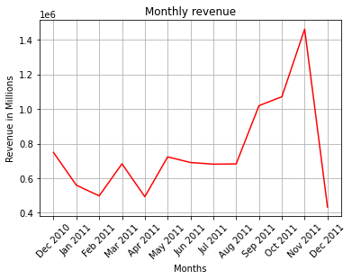
Company’s Performance

Slide 9
Yearly: There’s an annual increase of 95.17% in the total revenue generated from Dec 2010 to Nov 2011.
Quarterly:
Q1(Dec 2010-Mar 2011 exclusive):
There’s a dip of 33.49%
Q2(Mar 2011-Jun 2011 exclusive):
There’s an increase of 5.86%
Q3(Jun 2011-Sept 2011 exclusive)
There’s a fall of 1.22%
Q4(Sept 2011- Dec 2011 exclusive)
There’s a rise of 43.35%

Slide 10

Inference and other insights of this case
The dip we see after Nov 2011 is because we don’t have data for the month of December. As of Dec 2011, the records are of only 9 days and not of the whole month.
Dec 2011 is still kept in the analysis so as not to tamper the dataset.
Similarly for Dec 2010, the data of that month is of only 20 days. In that case we can take the mean for 10 days and add it to the month for filling the revenue detail of the missing 10 days.

Slide 11
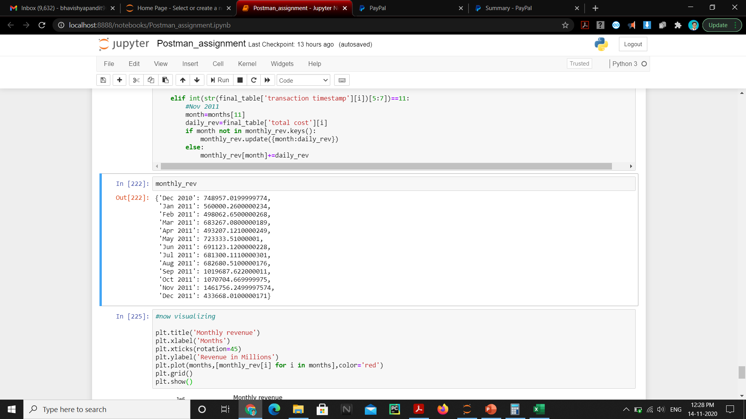
Monthly revenue generated

Slide 12

Important insights and trends in the dataset
We observe an increase in the revenue over the month, although there are a few valleys because in real time the graph is never linearly inclined.
The incline of Oct 2011 to Nov 2011 is 36.52% whereas the incline of Aug 2011 to Sep 2011 is 49.36%
The sales of the company has improved in one year.
It would be safe to say that there is a random trend that can be observed in the limited data that is provided.

Slide 13

Measuring performance in terms of customer acquisition and building customer loyalty
We can measure it by analysing how much revenue is being generated, how many transactions are happening, how much quantity of product is being sold and how many times the same customer is coming back to buy from us.
We have had seen the analysis of revenue that is being generated so we will see the rest of the metrics.

Slide 14
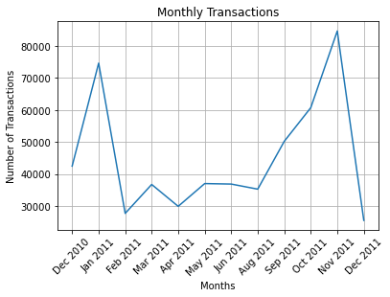
Monthly Transactions

Slide 15
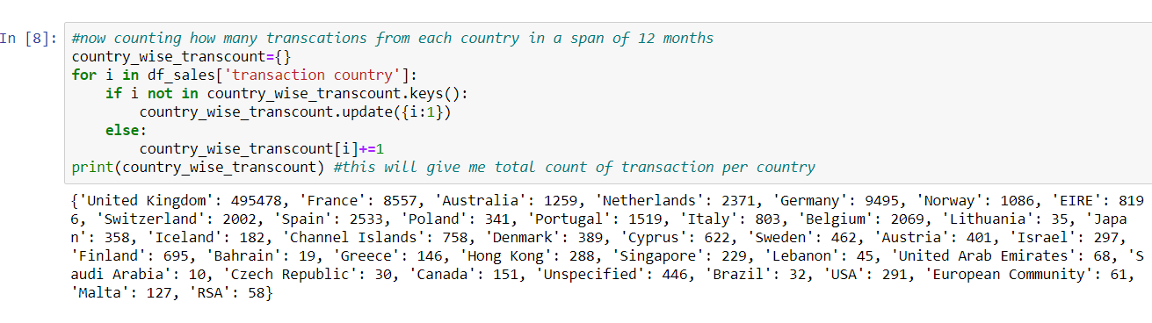
Who are our customers?
This shows a list of 38 countries along with the number of transactions each country had from Dec 2010 to Dec 2011.
Maximum number of transactions are from United kingdom.
Minimum number of transactions are from Saudi Arabia.

Slide 16
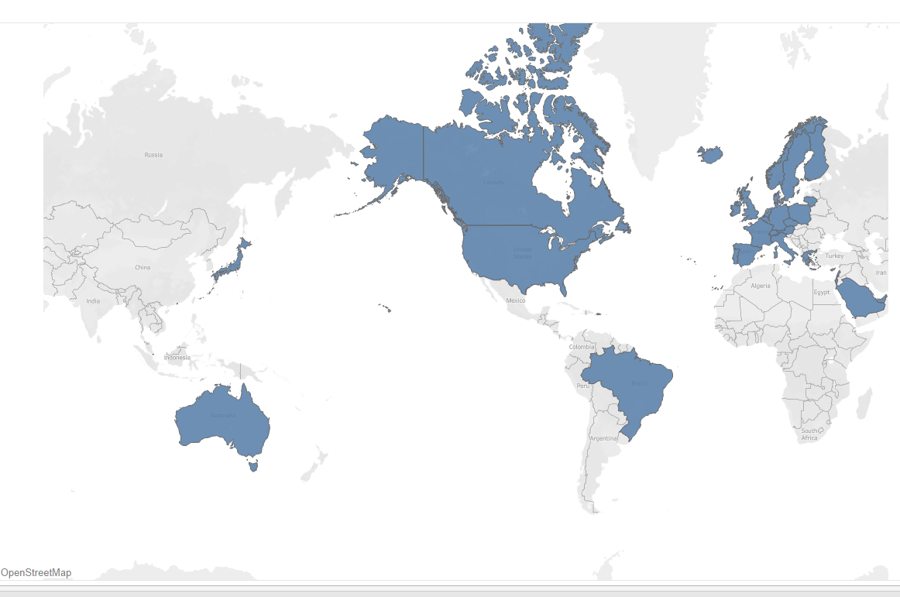
List of countries

Slide 17
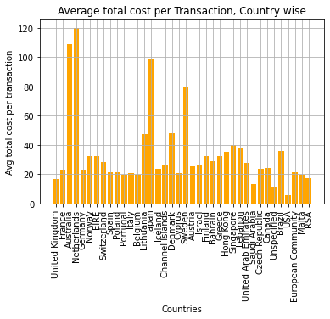
What kind of customers buy from us?
United Kingdom had the most number of transactions but its average total cost per transaction is at 35th position out of 38 countries.
Where as Netherlands stands the first in the same criteria with an average total cost of 120.05(currency) per transaction.
Netherlands had 2371 transaction and stood up strong where as UK was at the top in transactions but here in this criteria Netherlands is at first place.
This shows that most of the transaction that are made from countries like UK, Germany, France and other countries with high number of transactions are made from middle class people because the average of these countries is less than 40.

Slide 18
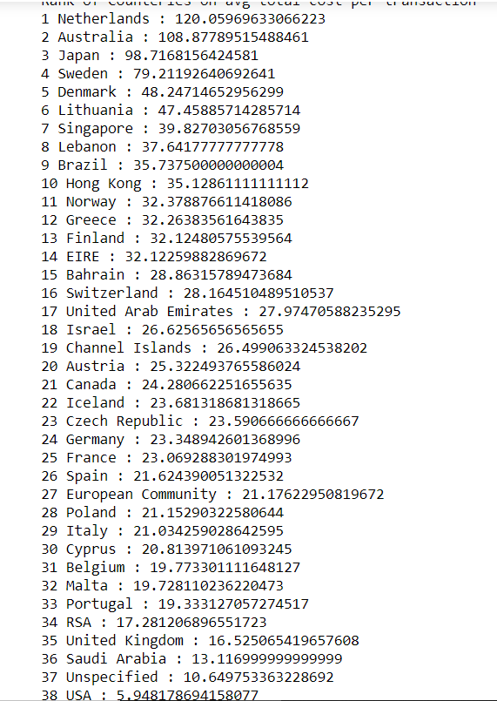
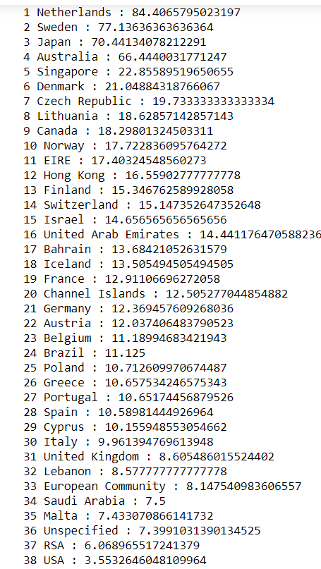
Rank of countries with Average total cost per Transaction
Average total cost per transaction
Average quantity sold per transaction

Slide 19

What factors drive the company’s sales?
There are 3 key factors that drive the sales of the company, as observed from the data given and they are:
Number of transaction: More number of transactions, more the sales
Quantity sold: More quantity sold, more would be the revenue generated.
Total cost: It is quantity sold*unit price. The sales of company are impacted the most by this factor as for it to go up both the quantity and the unit price has to be considerably high.
A transaction with say 4 qty of stock with a unit price of 1 would give a total cost of 4 where as on the other hand a case with unit price of 2 and qty of stock 3 would generate a total cost of 6 units of currency.

Slide 20
What initiatives can be taken to improve the sales?
There are a lot of countries where the number of transactions are less than 1000 a year. The company had expanded vastly in some areas without even pillaring the areas that are already doing good like Australia, Netherlands etc.
UK has the most number of transactions, after that we have countries like Germany, France, Spain, Netherlands where growth is a dire need. The number of transactions in these countries would grow faster than the ones were number is almost dead like Saudi Arabia, Brazil, RSA etc.
Countries like Lebanon don’t fall in the upper most transaction countries like Germany and also not in the lower ones like Saudi Arabia but the average total cost per transaction is relatively high here. So a good focus on such countries can surely scrape a considerable amount of sales for the company.

Slide 21
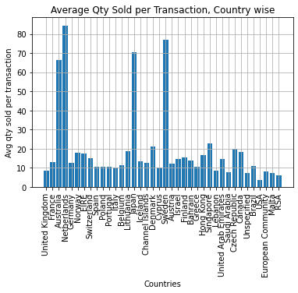
Exploring more
“Torture the data, and it will confess to anything.”
– Ronald Coase

Slide 22
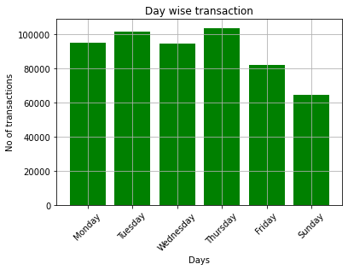
Day wise transactions to the company

Slide 23
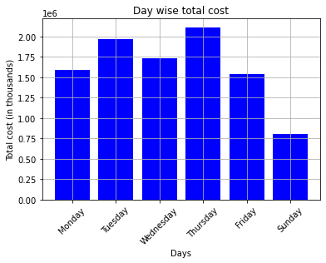
Day wise revenue to the company

Slide 24
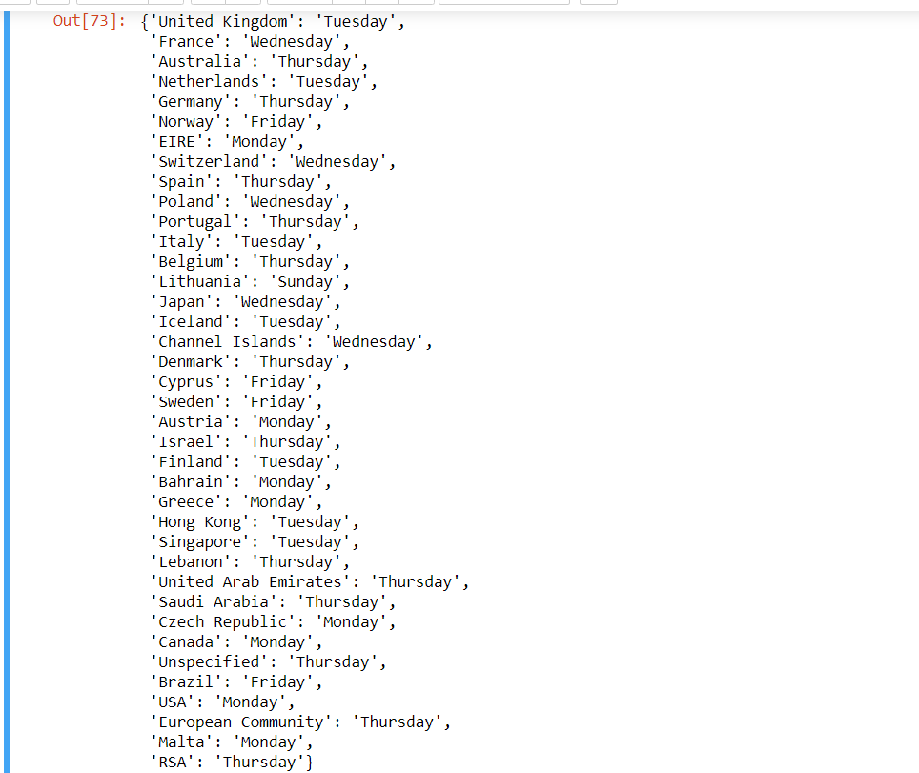
Finding the day with max number of transactions for each country

Slide 25

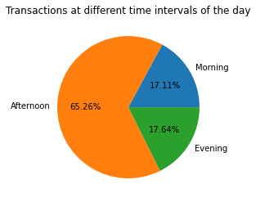
Revenue insights at different time intervals of the day

Slide 26
Thank you for your valuable time
Himanshu Bansal
17BCS3985

