Slide 1
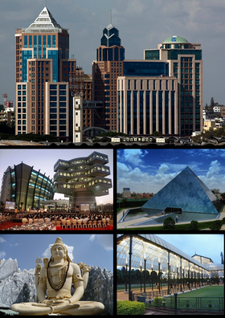
Coursera Capstone IBM Applied Data Science Capstone
Clustering Bus Stations in Bengaluru, India
By: Himanshu Baswal
June 2021

Slide 2
Business Problem
Location of Bus station is important decisions because that will determine whether it was effective to create it in the location.
Objective : To analyze and select the best location in the city of Bengaluru, India to open multiple bus station.
This project is important as the city has expanded its area to 741 km2. This has resulted in need for connecting the area at the border of the city.
Business Question : In Bengaluru, after the expansion of the city to 741km2, the newer area of the city needs to connect to the mainland, where would you recommend that they set up bus stations?

Slide 3
Data Description
Data required:
List of neighborhoods in Bengaluru
Latitude and Longitude of the neighborhoods
Venue data, particularly data related to bus stations
Sources of data:
Wikipedia page for neighbourhoods (https://commons.wikimedia.org/wiki/Category:Suburbs_of_Bangalore)
Geocoder package for latitude and longitude coordinates
Foursquare API for venue data

Slide 4
Methodology
Web scraping Wikipedia page for neighborhoods list.
Get latitude and longitude coordinates using Geocoder
Use Foursquare API to get venue data
Group data by neighborhood and taking the mean of the frequency of occurrence of each venue category
Filter venue category by Bus Station
Perform clustering on the data by using k-means clustering
Visualize the clusters in a map using Folium

Slide 5
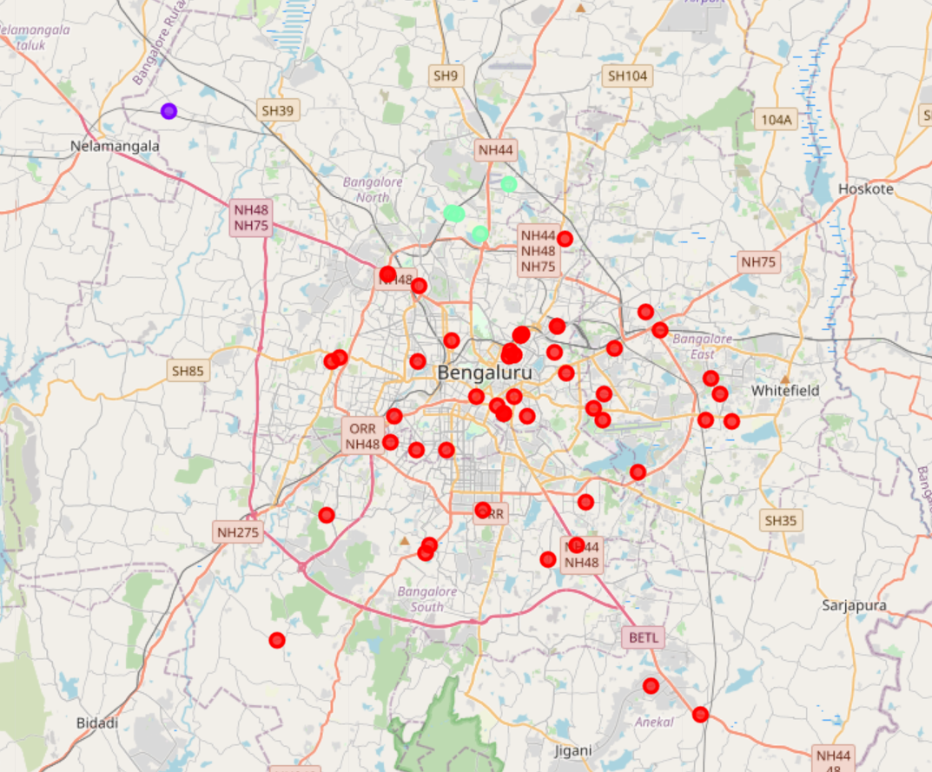
Results
Categorized the neighborhoods into 3 clusters:
Cluster 0 : Neighborhoods with highest
concentration of Bus Stations
Cluster 1 : Neighborhoods with lowest
concentration of Bus Stations
Cluster 2 : Neighborhoods with moderate
concentration of Bus Stations
Figure 1: Visuals of the Clustered neighborhoods in Bengaluru

Slide 6
Discussion
Most of the bus stations are concentrated in the central area of the city.
Highest number in cluster 0 and moderate number in cluster 2.
Cluster 1 has very low number to no bus stations in the neighborhood.
This project considered only the frequency of occurrence of bus stations, there are other factors such as population density in the cluster 1 and cluster 2, land availability, economic indulgence of the people living in the outer parts of the city and whether the people living in cluster 1 and 2 do really require a bus station for commute.

Slide 7
Conclusion
In this project, we have gone through the process of identifying the business problem, specifying the data required, extracting and preparing the data, performing machine learning by clustering the data into 3 clusters based on their similarities, and lastly providing recommendations to the relevant stakeholders i.e., council of development in the city (BBMP) to open bus stations.
Answer to the business question : The neighborhoods in cluster 1 and 2 are the most preferred locations to open a new bus station.

