Slide 1
Text <-> Speech Converter
HTML & JavaScript Application for Text and Speech Conversion
Author: (Himanshu Bisht)

Slide 2
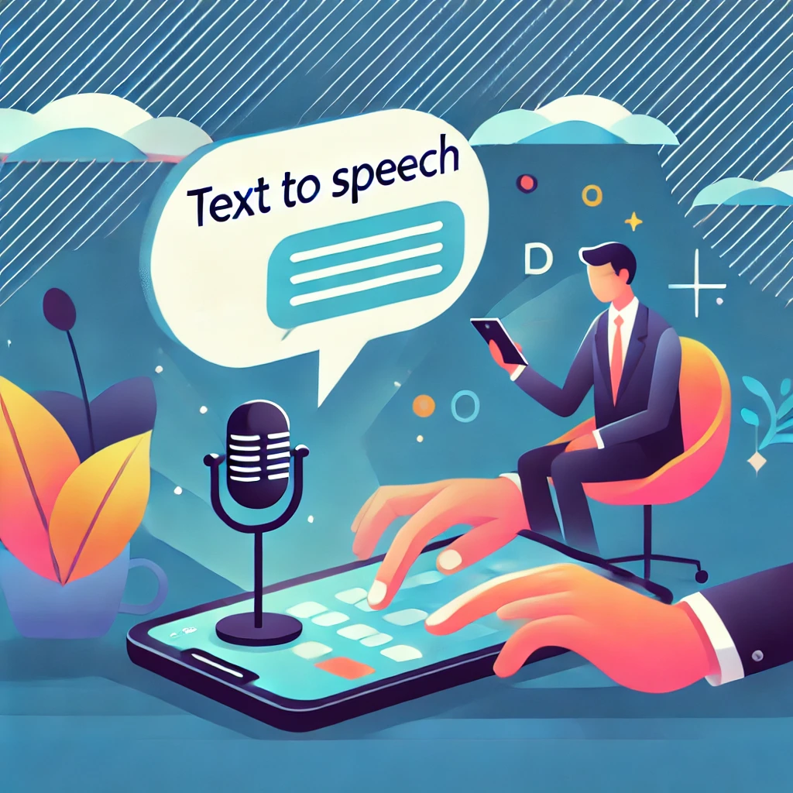
Introduction
This is a simple web-based application that allows users to convert text to speech and vice versa.
Built using HTML, CSS, and JavaScript.
Two main functionalities:
1. Text to Speech: Convert typed text to speech.
2. Speech to Text: Convert recorded speech to text.

Slide 3
Overview of the HTML Structure
The HTML structure is divided into two main sections:
1. Text to Speech Section
2. Speech to Text Section
Each section is represented in HTML with corresponding IDs and classes for easy styling and JavaScript functionality.

Slide 4
Text to Speech Section
Elements:
- A <textarea> for typing text.
- A <select> dropdown for language selection.
- A 'Listen' button to trigger the speech output.
JavaScript is used to handle text-to-speech functionality.

Slide 5
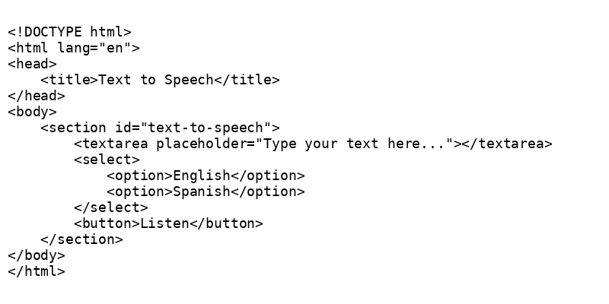

Slide 6

Speech to Text Section
Elements:
- A <textarea> for displaying the converted text from recorded speech.
- A 'Record' button to start recording the speech.
JavaScript handles the speech-to-text conversion.

Slide 7
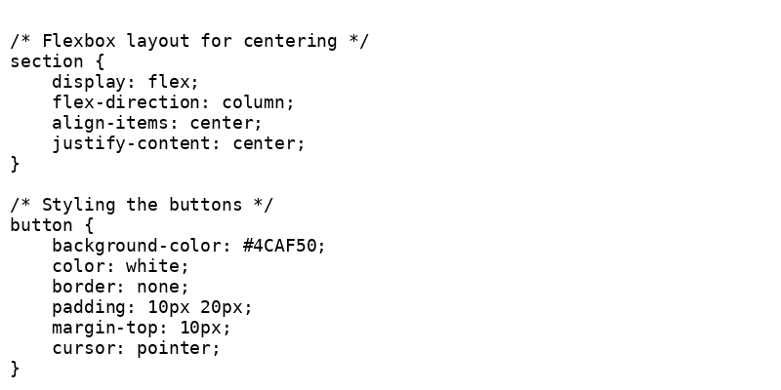
CSS Styling
- Flexbox Layout for centering the content.
- Hover Effects for interactive buttons.
- Custom styles for buttons, textareas, and selection boxes to improve user experience.

Slide 8
JavaScript Functionality
- showSection() function: Switches between Text-to-Speech and Speech-to-Text sections.
- Speech synthesis for Text-to-Speech.
- Speech recognition for Speech-to-Text.

Slide 9
Demo
- Show a live demo or screenshots of the application.
- Display how the user interacts with the 'Text to Speech' and 'Speech to Text' sections.

Slide 10
Conclusion
- This web app is a simple and useful tool for converting between text and speech.
- Potential applications: accessibility tools, voice assistants, and language learning.
- Open for future improvements, such as adding more languages and speech synthesis options.

Slide 11
Thank You

