Slide 1
Face Recognition Based attendance System
A 5th semester Project By HIMANSHU CHAND
B.Tech(CSE)/GEHU-DDN/1918375

Slide 2
About the Project
The main purpose of this project is to build A face recognition-based attendance monitoring system for educational institution to enhance and upgrade the current attendance system into more efficient and effective as compared to before.
In this project, face databases will be created to pump data into the recognizer algorithm. Then, during the attendance taking session, faces will be compared against the database to seek for identity.
When an individual is identified, its attendance will be taken down automatically saving necessary information into a excel sheet.
At the end of the day, the excel sheet containing attendance information regarding all individuals are given to the respective faculty.

Slide 3
Working of the project
The project works on 5 different steps in order to provide final output
1. Importing Images
When we have multiple images, importing them individually can become messy. Therefore we will write a script to import all images in a given folder at once. For this we will need the os library so we will import that first. We will store all the images in one list and their names in another.
2. Compute Encodings
Now that we have a list of images we can iterate through those and create corresponding encoded list for known faces. To do this we will create a function in which first we run a loop for images and convert them to RGB and find their encodings using face_encoding function. Then we will append each encoding to our list.
3. Webcam images and their encodings
First we will read the image from the webcam with cv2.VideoCapture function and then resize it to quarter the size. This is done to increase the speed of the system. Once we have the webcam frame we will find all the faces in our image. The face_locations function is used for this purpose. Later we will find the face_encodings as well.

Slide 4
Working of the project
4. Finding Matches in the database images
Now we can match the current face encodings to our known faces encoding list to find the matches. We will also compute the distance. This is done to find the best match in case more than one face is detected at a time.
Once we have the list of face distances we can find the minimum one, as this would be the best match. Now based on the index value we can determine the name of the person and display it on the original Image.
5. Marking the attendance in csv file
Lastly we are going to add the automated attendance code. We will start by writing a function that requires only one input which is the name of the user. First we open our Attendance file which is in .csv format. Then we read all the lines and iterate through each line using a for loop. Next we can split using comma ‘,’. This will allow us to get the first element which is the name of the user. If the user in the camera already has an entry in the file then nothing will happen. On the other hand if the user is new then the name of the user along with the current time stamp will be stored. We can use the datetime class in the date time package to get the current time.

Slide 5
Aim and objectives
The objective of this project is to develop face recognition based automated attendance system. Expected achievements in order to fulfill the objectives are:
To detect the face segment from the video frame.
To extract the useful features from the face detected.
To classify the features in order to recognize the face detected.
To record the attendance of the identified person.
Image
Obtained
Face
Feature
Face
Attendance
from video
detection
extraction
recognition
frame

Slide 6
Achievements and learnings
Through this project I have successfully completed my first project using Python Face-Recognition library.
Working in this project has given me a well idea about implementation and working of different library modules like cv2, NumPy etc.
While working in this project I got to know about how a csv file can be manipulated with the help of different requirements in python.
Just because of this project I got to know about how we can merge our webcam to a project and use it in real time image processing.
Apart from all challenges and problem, I learned how working with programming language is fun and enhancing my skills .

Slide 7
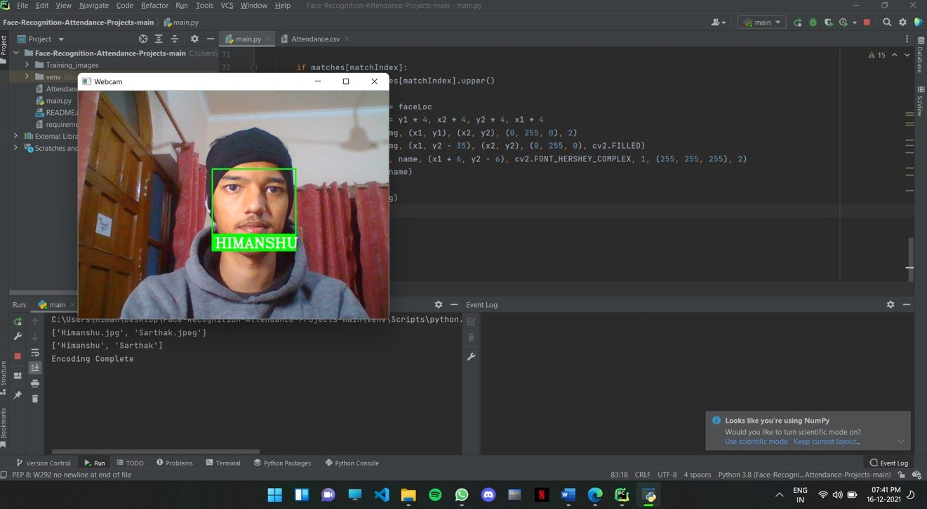
Screenshots of project

Slide 8
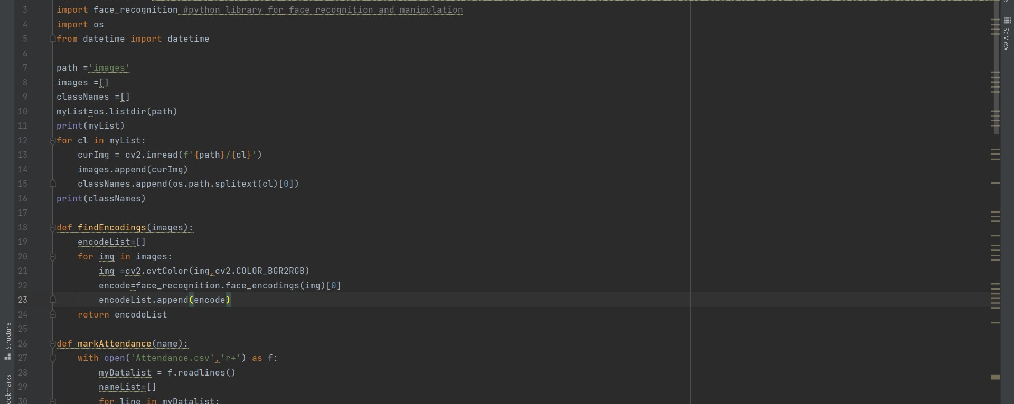
Screenshots of project
TAKUMA HAYASHI
MIRJAM NILSSON​
FLORA BERGGREN​
RAJESH SANTOSHI
President
Chief Executive Officer
Chief Operations Officer
VP Marketing
GRAHAM BARNES
ROWAN MURPHY
ELIZABETH MOORE
ROBIN KLINE
VP Product
SEO Strategist
Product Designer
Content Developer

Slide 9
Problems and challenges faced
One of the problems in real-time face recognition is the difficulty to obtain sufficient and suitable images for training and testing purpose. It is hard to obtain in real-time databases with a variety of variables, and it is hard to obtain publicly available databases.
Besides, it is very difficult to obtain an open source or the free face recognition software in order to make comparisons. In this proposed approach, PyCharm demo version software is downloaded and implemented in the laptop.
The images used in database shouldn’t be of much bigger size, as it will occupy more disk space and comparison of image with real time webcam image using cv2 will be more time taking and resource consuming too.

Slide 10
conclusion
In this approach, a face recognition based automated attendance system is thoroughly described. The proposed approach provides a method to identify the individuals by comparing their input image obtained from recording video frame with respect to train image. This proposed approach able to detect and localize face from an input facial image, which is obtained from the recording video frame.
The accuracy of this proposed approach is 100 % for high-quality images,
95%(approx.) for low-quality images.
As a conclusion for analysis, the extraction of facial feature could be
challenging especially in different lighting conditions.

Slide 11
THANK YOU
HIMANSHU CHAND
Section-A / section Roll:40
Uni Roll no:1918375
B.Tech(C.S.E)/ GEHU-DDN
+91-8126443582
himanshuchand38@gmail.com

