Slide 1



Mitron_Bank_Analysis
View in Power BI
Last data refresh:
1/7/2024 6:29:57 AM UTC
Downloaded at:
1/7/2024 6:38:44 AM UTC

Slide 2
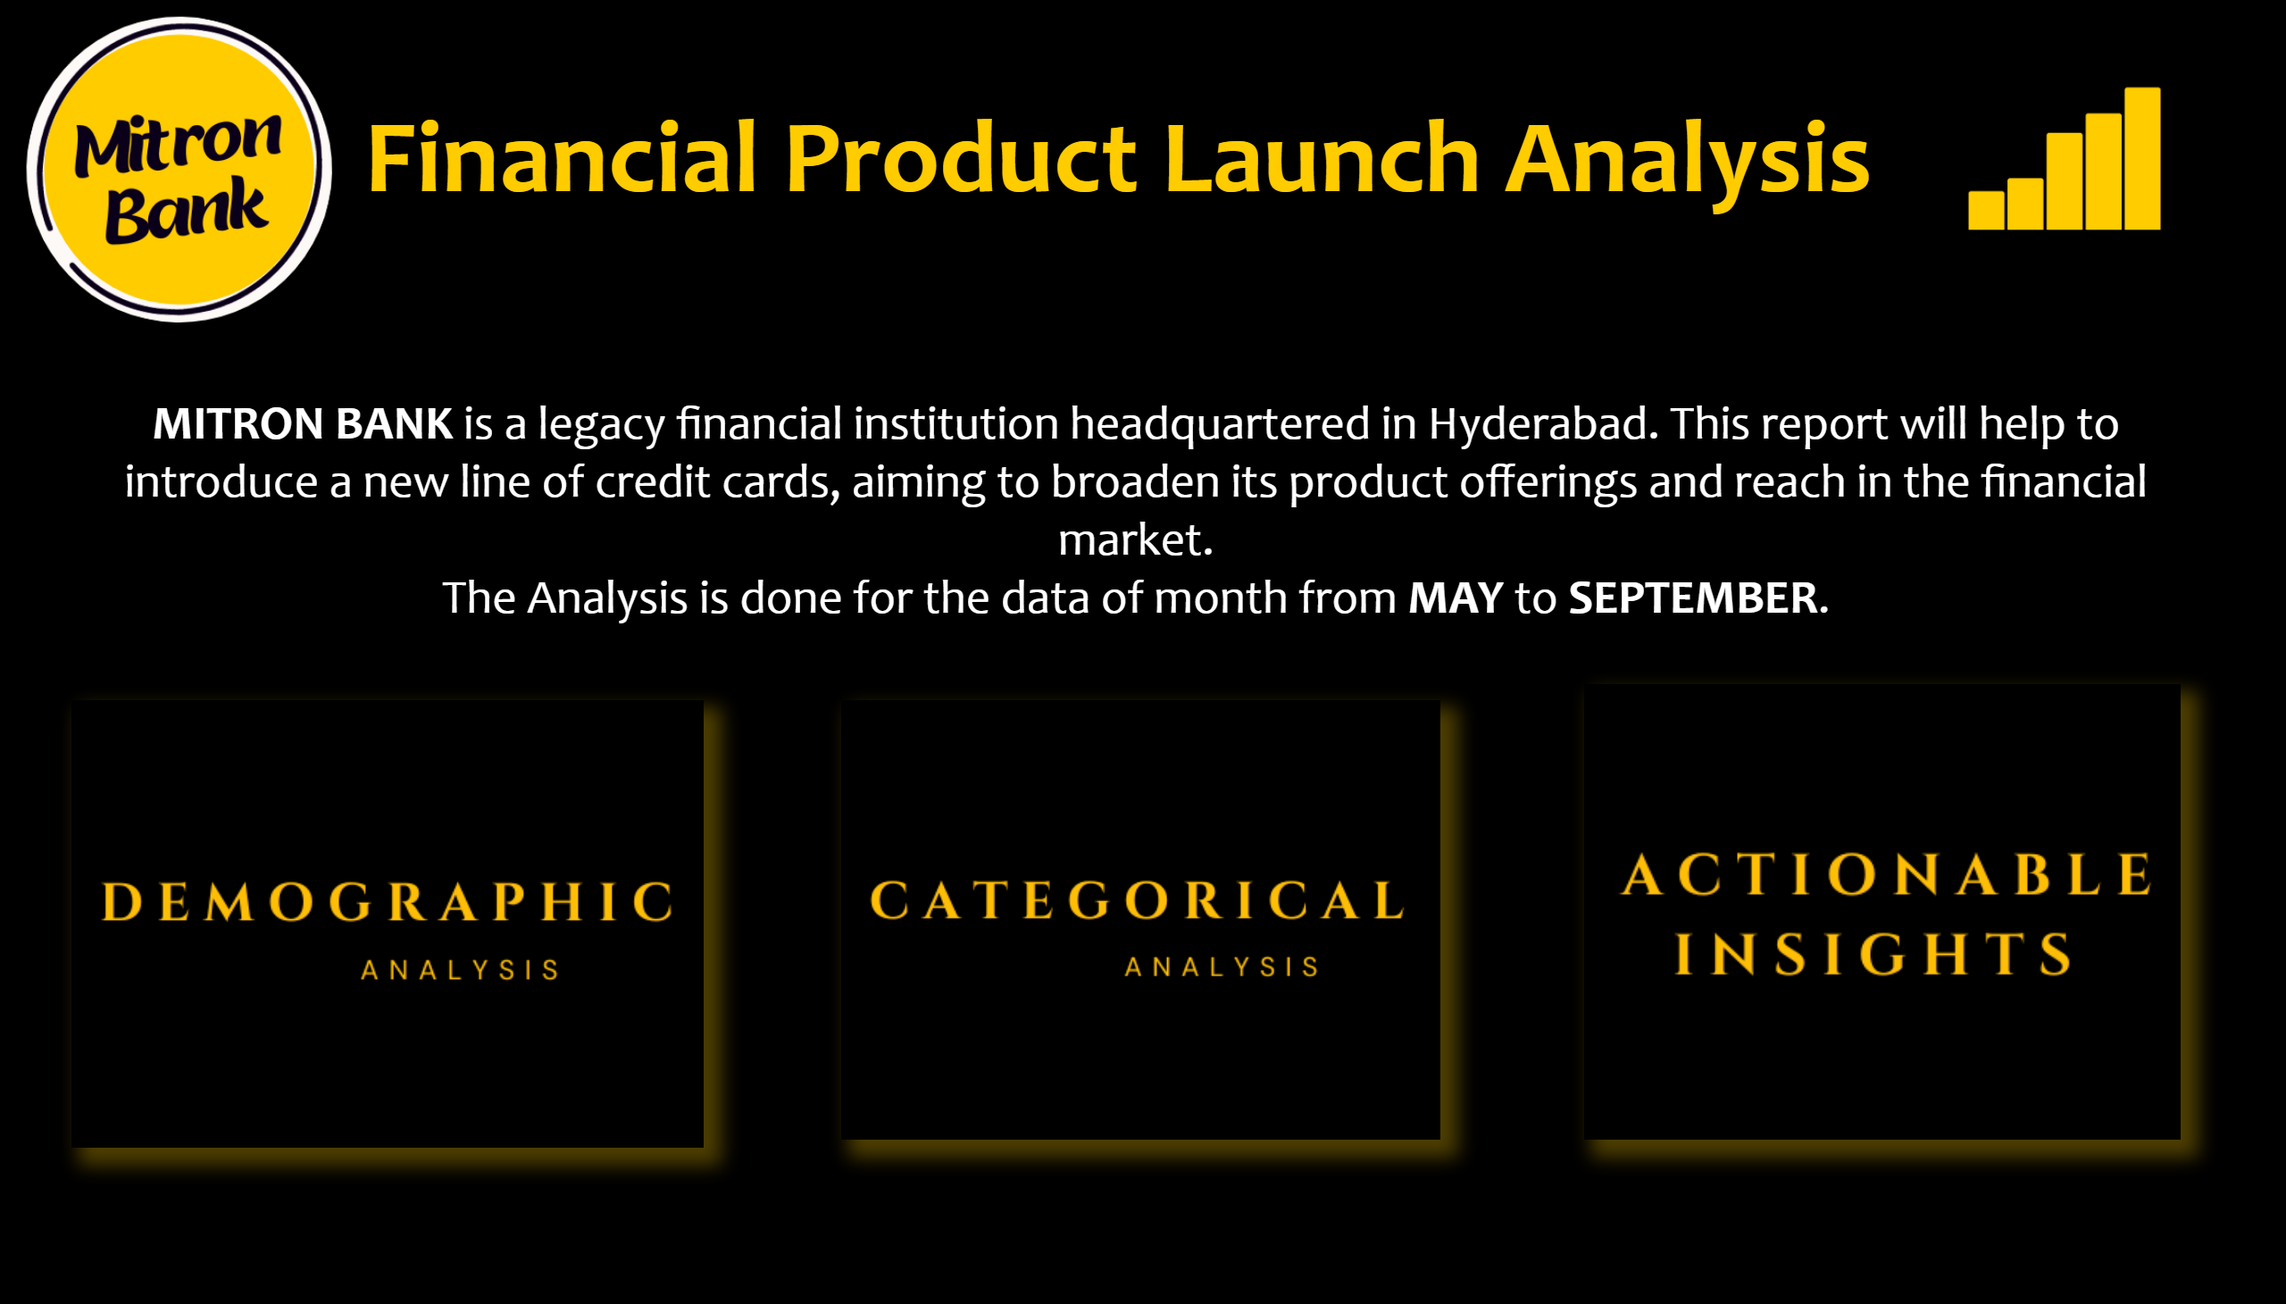
Home
Notes:
image
No alt text provided
textbox
No alt text provided
image
No alt text provided
image
No alt text provided
image
No alt text provided
image
No alt text provided
textbox
No alt text provided

Slide 3
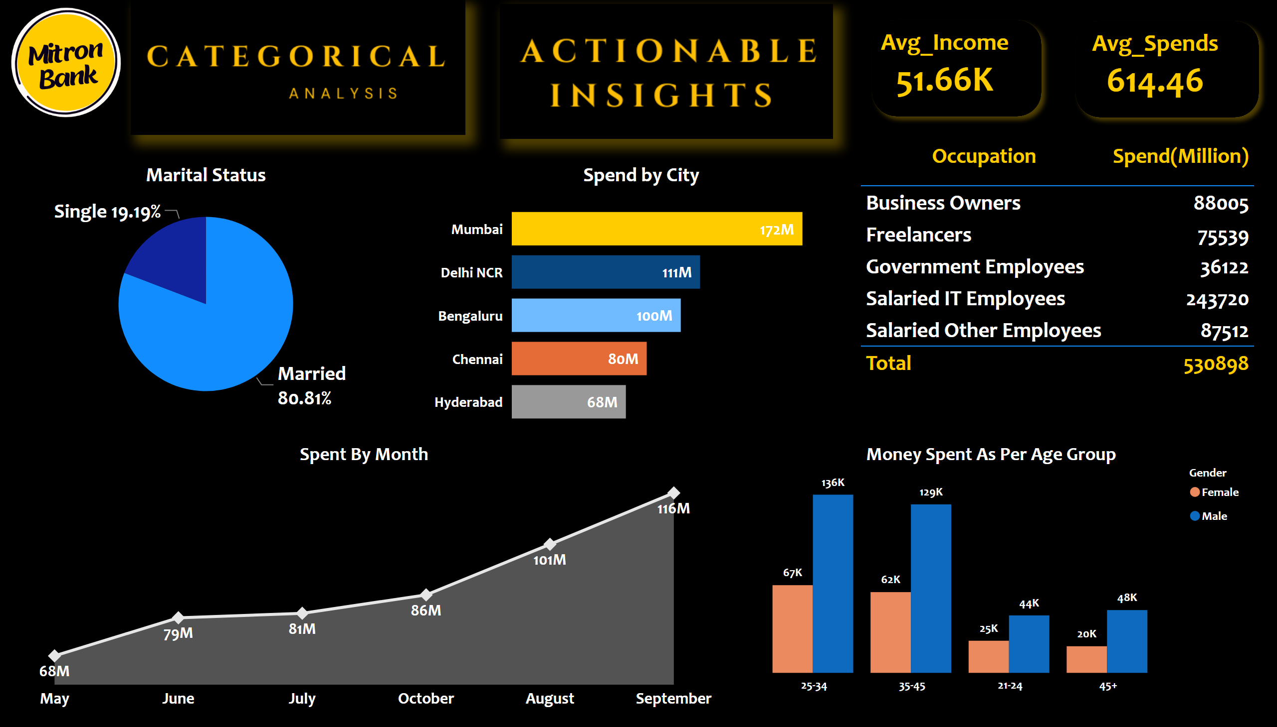
Demographic Analysis
Notes:
image
No alt text provided
cardVisual
No alt text provided
cardVisual
No alt text provided
Money Spent As Per Age Group
No alt text provided
Spent By Month
No alt text provided
Spend by City
No alt text provided
Marital Status
No alt text provided
tableEx
No alt text provided
image
No alt text provided
image
No alt text provided

Slide 4
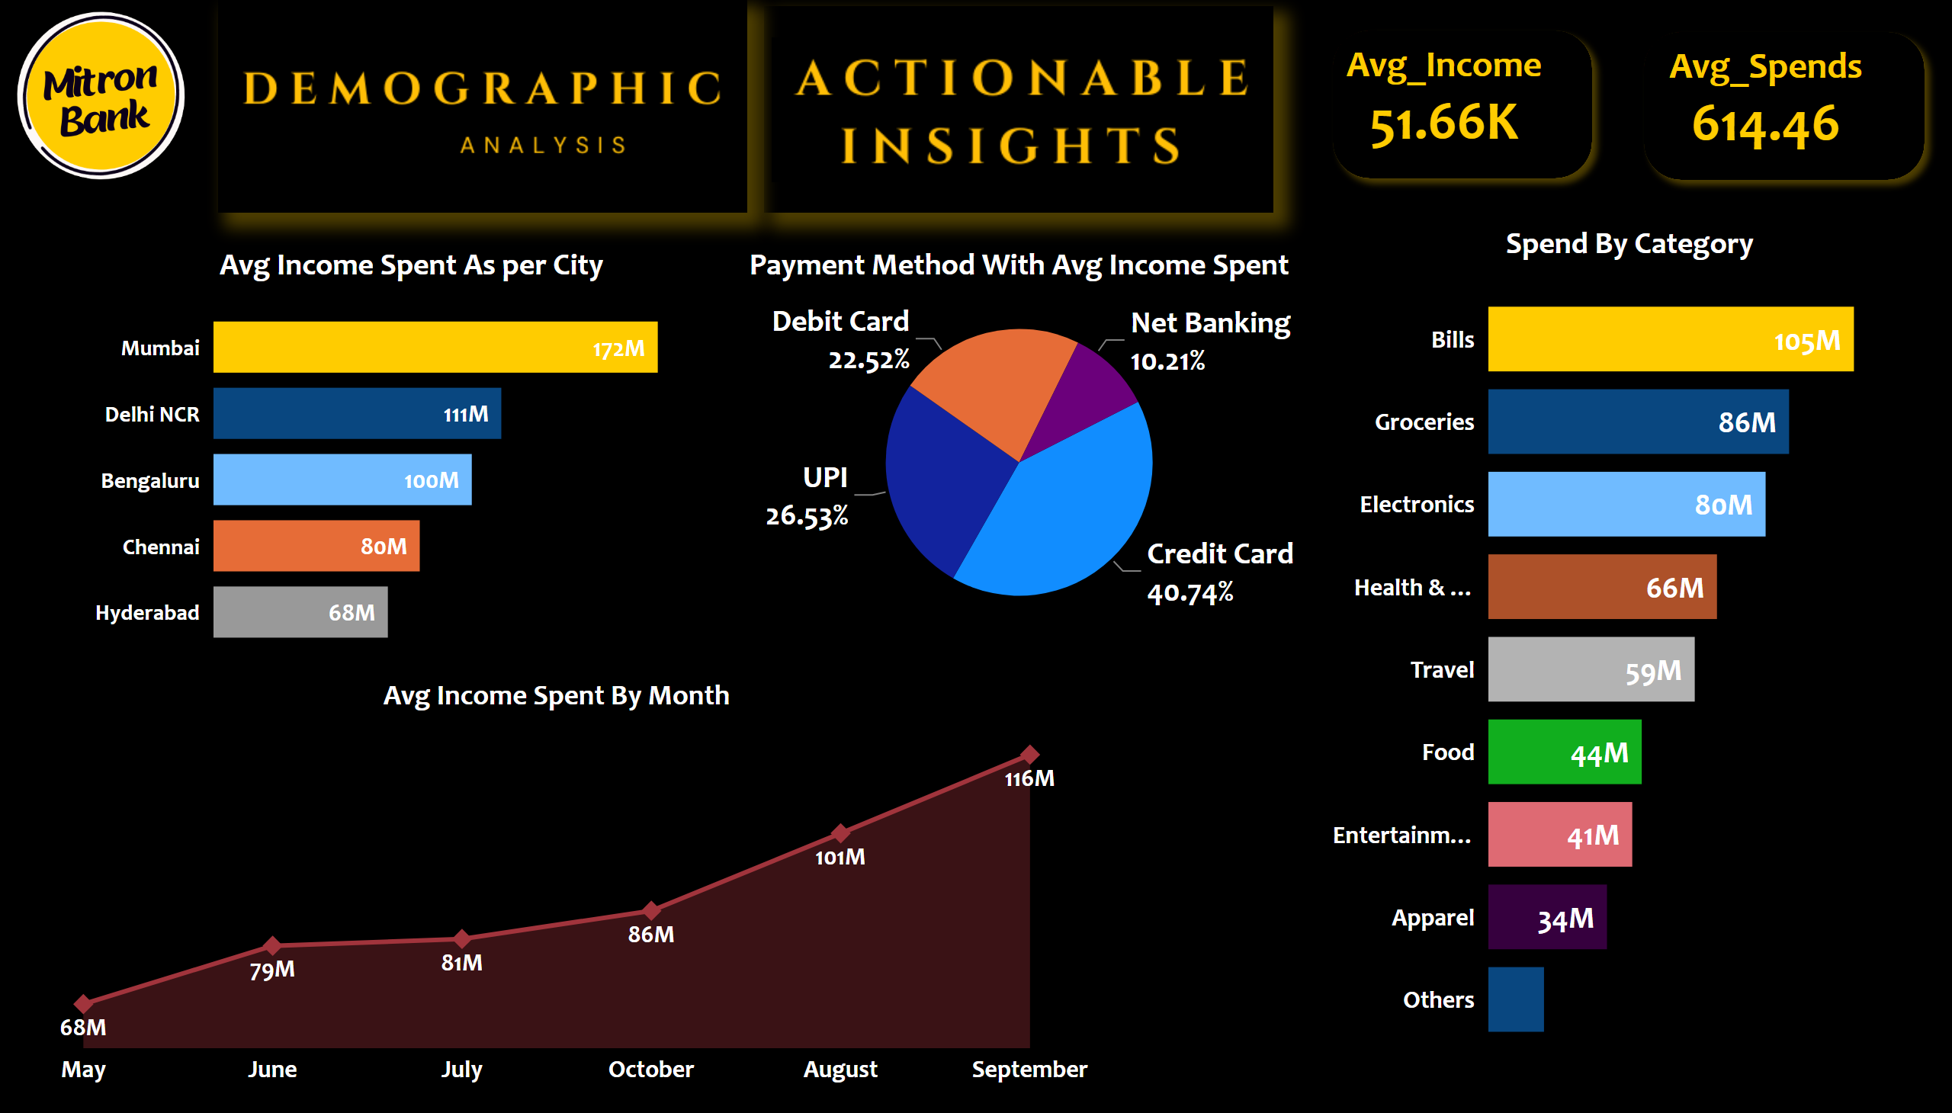
Categorical Analysis
Notes:
image
No alt text provided
cardVisual
No alt text provided
cardVisual
No alt text provided
Avg Income Spent By Month
No alt text provided
Avg Income Spent As per City
No alt text provided
Payment Method With Avg Income Spent
No alt text provided
Spend By Category
No alt text provided
image
No alt text provided
image
No alt text provided

Slide 5
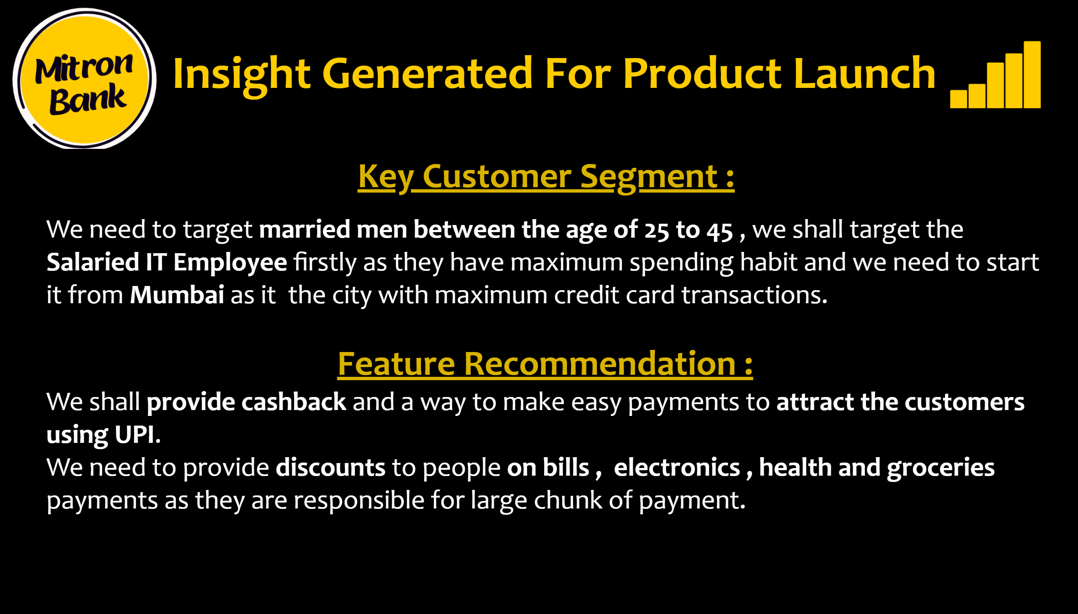
Insights
Notes:
image
No alt text provided
textbox
No alt text provided
image
No alt text provided
textbox
No alt text provided

