Slide 1
Business Objectives
This company is the largest online loan marketplace, facilitating personal loans, business loans, and financing of medical procedures. Borrowers can easily access lower interest rate loans through a fast online interface.
Like most other lending companies, lending loans to ‘risky’ applicants is the largest source of financial loss (called credit loss). Credit loss is the amount of money lost by the lender when the borrower refuses to pay or runs away with the money owed. In other words, borrowers who default cause the largest amount of loss to the lenders. In this case, the customers labelled as 'charged-off' are the 'defaulters'.
If one is able to identify these risky loan applicants, then such loans can be reduced thereby cutting down the amount of credit loss. Identification of such applicants using EDA is the aim of this case study.
In other words, the company wants to understand the driving factors (or driver variables) behind loan default, i.e. the variables which are strong indicators of default. The company can utilize this knowledge for its portfolio and risk assessment.

Slide 2
Variable Understanding
Variables are defined in Four border category
ID
Internal
Bureau
Demographic
ID Variable
ID :- Loan ID
Member ID :- Customer ID
Loan Status :- Status on the loan
Internal
last_credit_pull_d :- Bureau pull on which date.
loan_amnt :- Customer asked amount.
Funded_Amnt :- Total amount approved by lending club.
funded_amnt_inv :- Actual loan amount given to customer by lender.
grade :- grade or type of the loan.
sub_grade :- sub_grade of the loan.
term :- duration of the loan.
title :- loan title provide by the customer.(Unstructured format)
verification status :- income is verified or not.
installment :- emi of the loan.
int_rate :- interest rate on the loan.
issue_D :- issue date of the loan.

Slide 3
Bureau
Delinq_2yrs :- number of times dpd 30 plus in last 2 years.
earliest_cr_line :- date of first loan taken.
inq_last_6_months :- inquiry in last 6 months.
mths_since_last_delinq :- how many month the customer is clean with out any delinquency.
mths_since_last_record :- what is last time customer is recorded in bureau.
open_Acc :- number of active loans of the customer.
pub_rec :- Number of derogatory public records
pub_rec_bankruptcies :- Number of public record bankruptcies
revol_bal :- Credit revolving amount. Loan taken of 50K when is reducing to match the same taken another loan to make amount back to 50K.
total_acc :- total number of trade lines a customer have.
dti :- A ratio calculated using the borrower’s total monthly debt payments on the total debt obligations, excluding mortgage and the requested LC loan, divided by the borrower’s self-reported monthly income.
Demographic
addr_state :- state of the customer.
decs :- purpose of the loan describe by the customer. (Unstructured format)
home_ownership :- If customer have home or not. Not verified field.
Purpose :- drop down field of purpose of customer.
zip_code :- hashed zip code of the customer.
verfication_status :- Income is verified or not.

Slide 4
Approach
Understanding each and every Variable.
Identifying dependent and independent variable.
Checking for the event rates.
Checking for the data types of all the variables and correcting all the data types and format.
Univariate Analysis :- Data types, Missing Rate, Histogram, Box Plot, Describe of python.
Bivariate Analysis :- One way Anova and chi square test with dependent variable.
Summarizing results of univariate and bivariate analysis.
Creating business logic variables.
Using Information value and woe for identifying most important variable.
Plotting line chart of important variable and drawing conclusions.
Event Distribution
Event Distribution
Event | Count Of Customers | Event Percentage
Fully Paid | 32950 | 83.0%
Charged Off | 5627 | 14.2%
Current | 1140 | 2.9%
Event Distribution after cleaning
Event | Count Of Customers | Event Percentage
Fully Paid | 32915 | 85.4%
Charged Off | 5627 | 14.6%

Slide 5
Results of simple Univariate and Bivariate analysis
Univariate Analysis
According to IQR almost all the Continuous column have less than 10% of outliers.
Most of the customer belongs to CA State(18%).
Last credit pull is 2016 for 37% of the total base.
For customer coming to lending club almost 47% of the customer purpose of taking loan is debt consolidation.
Disbursement is increasing year on year from 2007 to 2011. In 2011 53% of total disbursement happens.
We have verified income for almost 57% of the total customers.
According to our customer almost 89% customer owns a property or have a mortgage loan on them.
Almost 22% of the total customer have a employment length of 10 or 10+ years.
A4, B3, A5 are the most sold subgrade of loan category.
B,A,C are the most sold grade of the loan.
75% of the total customer takes short term loan of 36 months.
Median loan_amount ask by the customer is 9600.
Median funded_amount suggested by lending club is 9550.
Median amount funded by investor is 8733.
Average intereset rate charge by the company is 11-12%.
Average installment is 255 per month.
Median anual income of the customer base is 58000.
dti is normally distributed accross customer.
for most of the customer delinq_2yrs is 0.
almost 50% of the population does 0 inquiry in last 6 months.

Slide 6
Bivariate Analysis
mths_since_last_delinq, open_acc, revol_bal are not related to event variable and they have very less p value.
term has the highest impact on loan status. but it has only two value and we cannot recommend bank to give only 36 or 60 months loan. (either one).
Higher the ask of loan_amnt higher chances of default same with funded amount and invested amount.
Higher term customers tends to default more.
Customer having higher int rate tends to default more. Higher int rate given to those customer who have high chance of default. This is moving in the correct direction.
G grade have the highest default rate.
People having missing emp length have more default rate.
Home ownership having value as other tends to default more.
Higher the income tends to default less.
Verified income salary people tends to default more. Reason can be non verified income employee come from small business background.
People taking loan for education tends to default more.
higher dti higher chances to default more.
Higher the 2 year delinquency higher chances of default.
High inquiry higher chances of default.
Higher number of open account lower the chance of default. Knows how to handle money. same with total number of loans.
Higher Number of public record bankruptcies higher chances of default.

Slide 7
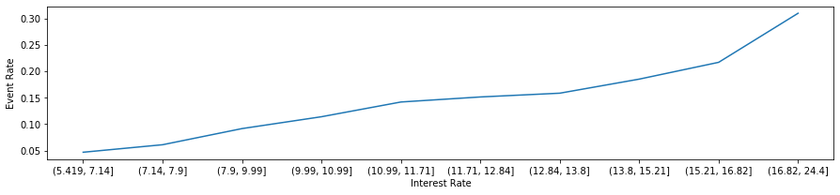
Suggestions (At the Time of Collection)
Interest Rate
Cutoff | N | Events | % of Events | Non-Events | % of Non-Events | WoE | IV | Event_Percentage | Cutoff_Min
(5.419, 7.14] | 4186 | 196 | 0.034832 | 3990 | 0.121221 | 1.24708 | 0.107734 | 0.046823 | 7.14
(7.14, 7.9] | 3818 | 233 | 0.041407 | 3585 | 0.108917 | 0.967123 | 0.06529 | 0.061027 | 7.9
(7.9, 9.99] | 4042 | 370 | 0.065754 | 3672 | 0.11156 | 0.528637 | 0.024215 | 0.091539 | 9.99
(9.99, 10.99] | 4256 | 485 | 0.086192 | 3771 | 0.114568 | 0.284595 | 0.008076 | 0.113957 | 10.99
(10.99, 11.71] | 2990 | 424 | 0.075351 | 2566 | 0.077958 | 0.034018 | 0.000089 | 0.141806 | 11.71
(11.71, 12.84] | 3938 | 596 | 0.105918 | 3342 | 0.101534 | -0.042268 | 0.000185 | 0.151346 | 12.84
(12.84, 13.8] | 3862 | 612 | 0.108761 | 3250 | 0.098739 | -0.096674 | 0.000969 | 0.158467 | 13.8
(13.8, 15.21] | 3777 | 699 | 0.124222 | 3078 | 0.093514 | -0.283967 | 0.00872 | 0.185068 | 15.21
(15.21, 16.82] | 3920 | 850 | 0.151057 | 3070 | 0.093271 | -0.482156 | 0.027862 | 0.216837 | 16.82
(16.82, 24.4] | 3753 | 1162 | 0.206504 | 2591 | 0.078718 | -0.964451 | 0.123244 | 0.309619 | 24.4
# Most important variable is coming as Int_Rate.
# But at the time of acquisition we give higher interest in two scenarios.
# 1. When customer is asking for more loan and we want to give the same amount but as per current process he/she is eligible for small ticket size.
# 2. When customer chances of default is little high as compare to other population.
# Now as we have already given the loan to customer, risk assessment which we have taken into consideration at the time of acquisition is holding true.

Slide 8
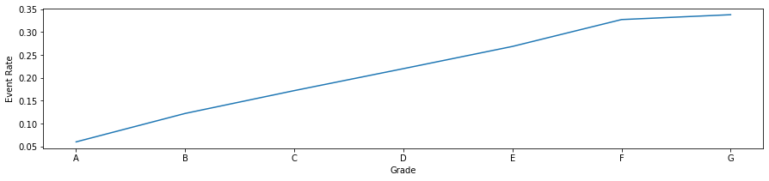
Grade
Cutoff | N | Events | % of Events | Non-Events | % of Non-Events | WoE | IV | Event_Percentage | Cutoff_Min
A | 10027 | 602 | 0.106984 | 9425 | 0.286344 | 0.984512 | 0.176581 | 0.060038 | A
B | 11664 | 1425 | 0.253243 | 10239 | 0.311074 | 0.20568 | 0.011895 | 0.122171 | B
C | 7831 | 1347 | 0.239382 | 6484 | 0.196992 | -0.194894 | 0.008261 | 0.172009 | C
D | 5083 | 1118 | 0.198685 | 3965 | 0.120462 | -0.500388 | 0.039142 | 0.219949 | D
E | 2663 | 715 | 0.127066 | 1948 | 0.059183 | -0.764076 | 0.051868 | 0.268494 | E
F | 975 | 319 | 0.056691 | 656 | 0.01993 | -1.045382 | 0.038429 | 0.327179 | F
G | 299 | 101 | 0.017949 | 198 | 0.006015 | -1.093206 | 0.013046 | 0.337793 | G
# Second Most important variable is coming as Grade.
# We can not take any call on grade specifically as its just a type of a loan.
# But at the time of collection we need to put more effort on grade 'G' customer as they have high chance of default as
# compare to 'A' grade.

Slide 9
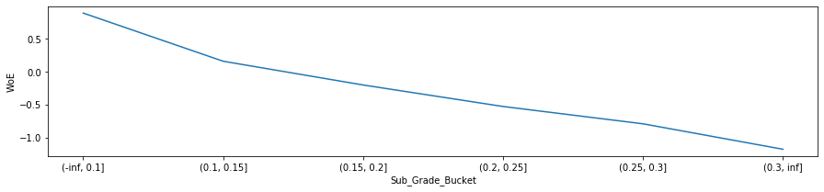
Sub Grade Bucket
Cutoff | N | Events | % of Events | Non-Events | % of Non-Events | WoE | IV | Event_Percentage | Cutoff_Min
(-inf, 0.1] | 11823 | 773 | 0.137373 | 11050 | 0.335713 | 0.893555 | 0.177227 | 0.065381 | 0.1
(0.1, 0.15] | 9868 | 1254 | 0.222854 | 8614 | 0.261704 | 0.160698 | 0.006243 | 0.127077 | 0.15
(0.15, 0.2] | 8761 | 1514 | 0.26906 | 7247 | 0.220173 | -0.20052 | 0.009803 | 0.172811 | 0.2
(0.2, 0.25] | 3890 | 874 | 0.155323 | 3016 | 0.09163 | -0.527746 | 0.033613 | 0.224679 | 0.25
(0.25, 0.3] | 3458 | 947 | 0.168296 | 2511 | 0.076287 | -0.791215 | 0.072798 | 0.273858 | 0.3
(0.3, inf] | 742 | 265 | 0.047094 | 477 | 0.014492 | -1.178565 | 0.038424 | 0.357143 | inf
# Third Most important variable is coming as Sub Grade.
# We can not take any call on sub grade specifically as its just a sub type of a Loan.
# But at the time of collection we need to put more effort based on sub grade.
# Sub Grade :- F2,G1,G5,F4,G2,G3,F5 need to focus on these category while collection. As chances of default is high.

Slide 10
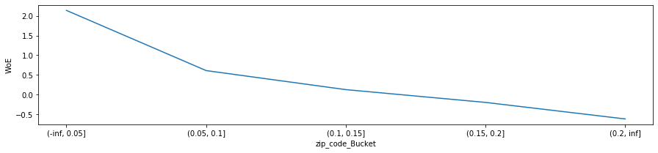
Zip code
Cutoff | N | Events | % of Events | Non-Events | % of Non-Events | WoE | IV | Event_Percentage | Cutoff_Min
(-inf, 0.05] | 1314 | 26 | 0.004621 | 1288 | 0.039131 | 2.136397 | 0.073728 | 0.019787 | 0.05
(0.05, 0.1] | 6545 | 556 | 0.098809 | 5989 | 0.181954 | 0.610559 | 0.050764 | 0.08495 | 0.1
(0.1, 0.15] | 15578 | 2037 | 0.362005 | 13541 | 0.411393 | 0.127892 | 0.006316 | 0.130761 | 0.15
(0.15, 0.2] | 9135 | 1573 | 0.279545 | 7562 | 0.229743 | -0.196201 | 0.009771 | 0.172195 | 0.2
(0.2, inf] | 5970 | 1435 | 0.25502 | 4535 | 0.137779 | -0.615692 | 0.072185 | 0.240369 | inf
# Forth Most important variable is coming as Zip-Code.
# We can not take any call on zip code specifically as its just a zip code. We can't say if you are coming from this zip code we will no give loan to you.
# But at the time of collection we need to put more effort based on zip code.
Zip code :- Need to focus on below list of zip code as they have high chance of default. '871xx', '346xx', '925xx', '751xx', '630xx', '339xx', '488xx','330xx', '245xx', '207xx', '905xx', '914xx', '333xx', '331xx','234xx', '917xx', '305xx', '571xx', '628xx', '171xx', '128xx','657xx', '341xx', '148xx', '960xx', '347xx', '065xx', '446xx','633xx', '360xx', '400xx', '754xx', '816xx', '119xx', '014xx','434xx', '344xx', '279xx', '285xx', '983xx', '547xx', '616xx','172xx', '161xx', '037xx', '974xx', '984xx', '907xx', '363xx','081xx', '971xx', '856xx', '844xx', '489xx', '013xx', '312xx','271xx', '302xx', '927xx', '444xx', '265xx', '238xx', '108xx','361xx', '321xx', '349xx', '641xx', '906xx', '890xx', '623xx','259xx', '779xx', '106xx', '675xx', '325xx', '497xx', '795xx','725xx', '154xx', '135xx', '593xx', '671xx', '487xx', '635xx','484xx', '546xx', '745xx', '449xx', '392xx', '056xx', '407xx', '367xx', '976xx', '937xx', '278xx', '354xx', '445xx', '439xx','072xx', '559xx', '283xx', '308xx', '153xx', '891xx', '082xx','147xx', '206xx', '224xx', '986xx', '614xx', '711xx', '626xx','447xx', '863xx', '826xx', '158xx', '615xx', '422xx', '244xx','619xx', '997xx', '026xx', '187xx', '177xx', '570xx', '534xx','075xx', '935xx', '766xx', '807xx', '758xx', '883xx', '035xx','859xx', '638xx', '425xx', '724xx', '264xx', '713xx', '316xx','376xx', '599xx', '668xx', '406xx', '409xx', '639xx', '912xx','924xx', '253xx', '611xx', '499xx', '573xx', '755xx', '438xx','215xx', '808xx', '744xx', '719xx', '203xx', '608xx', '607xx','897xx', '413xx', '798xx', '673xx', '496xx', '416xx','685xx','746xx', '561xx', '833xx', '663xx', '385xx', '669xx', '373xx','689xx', '094xx', '999xx'

Slide 11
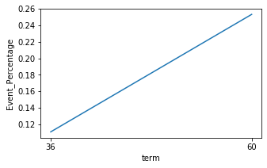
Term
Cutoff | N | Events | % of Events | Non-Events | % of Non-Events | WoE | IV | Event_Percentage | Cutoff_Min
36 | 29063 | 3227 | 0.573485 | 25836 | 0.784931 | 0.313864 | 0.066365 | 0.111035 | 36
60 | 9479 | 2400 | 0.426515 | 7079 | 0.215069 | -0.684688 | 0.144774 | 0.253191 | 60
# Fifth Most important variable is coming as Term.
# We can not take any call on term as higher the tenure higher the profit but in return higher the chances of default.
# But at the time of collection we need to put more effort based on term.
# Term :- Customer taking loan for 60 Months have high chance of default. Need to focus at the time of collection.

Slide 12
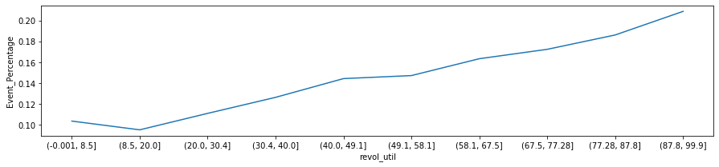
Suggestions (At the Time of Acquisition)
Revol_Util
Cutoff | N | Events | % of Events | Non-Events | % of Non-Events | WoE | IV | Event_Percentage | Cutoff_Min
(-0.001, 8.5] | 3875 | 402 | 0.071441 | 3473 | 0.105514 | 0.38997 | 0.013287 | 0.103742 | 8.5
(8.5, 20.0] | 3860 | 368 | 0.065399 | 3492 | 0.106091 | 0.483795 | 0.019687 | 0.095337 | 20
(20.0, 30.4] | 3851 | 428 | 0.076062 | 3423 | 0.103995 | 0.312797 | 0.008737 | 0.11114 | 30.4
(30.4, 40.0] | 3849 | 487 | 0.086547 | 3362 | 0.102142 | 0.165675 | 0.002584 | 0.126526 | 40
(40.0, 49.1] | 3875 | 560 | 0.09952 | 3315 | 0.100714 | 0.011924 | 0.000014 | 0.144516 | 49.1
(49.1, 58.1] | 3819 | 563 | 0.100053 | 3256 | 0.098921 | -0.011377 | 0.000013 | 0.147421 | 58.1
(58.1, 67.5] | 3875 | 634 | 0.112671 | 3241 | 0.098466 | -0.134764 | 0.001914 | 0.163613 | 67.5
(67.5, 77.28] | 3829 | 661 | 0.117469 | 3168 | 0.096248 | -0.19925 | 0.004228 | 0.17263 | 77.28
(77.28, 87.8] | 3868 | 721 | 0.128132 | 3147 | 0.09561 | -0.292786 | 0.009522 | 0.186401 | 87.8
(87.8, 99.9] | 3841 | 803 | 0.142705 | 3038 | 0.092298 | -0.435752 | 0.021965 | 0.20906 | 99.9
# sixth Most important variable is coming as revol_util.
# We can take a call on this. We can use this variable at the time of acquisition.
# customer with higher revol_util tends to do more default so we can give higher interest rate or not give the loan at all.
# revol_util :- Customer with higher revol_util tends to do more default.

Slide 13
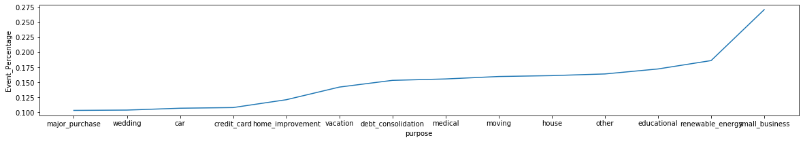
Purpose
Cutoff | N | Events | % of Events | Non-Events | % of Non-Events | WoE | IV | Event_Percentage | Cutoff_Min
major_purchase | 2150 | 222 | 0.039453 | 1928 | 0.058575 | 0.395209 | 0.007557 | 0.103256 | major_purchase
wedding | 925 | 96 | 0.017061 | 829 | 0.025186 | 0.38952 | 0.003165 | 0.103784 | wedding
car | 1497 | 160 | 0.028434 | 1337 | 0.04062 | 0.356658 | 0.004346 | 0.10688 | car
credit_card | 5020 | 542 | 0.096321 | 4478 | 0.136047 | 0.345314 | 0.013718 | 0.107968 | credit_card
home_improvement | 2867 | 347 | 0.061667 | 2520 | 0.076561 | 0.216337 | 0.003222 | 0.121032 | home_improvement
vacation | 373 | 53 | 0.009419 | 320 | 0.009722 | 0.031677 | 0.00001 | 0.142091 | vacation
debt_consolidation | 18048 | 2767 | 0.491736 | 15281 | 0.464256 | -0.057506 | 0.00158 | 0.153313 | debt_consolidation
medical | 681 | 106 | 0.018838 | 575 | 0.017469 | -0.075421 | 0.000103 | 0.155653 | medical
moving | 576 | 92 | 0.01635 | 484 | 0.014705 | -0.106056 | 0.000174 | 0.159722 | moving
house | 366 | 59 | 0.010485 | 307 | 0.009327 | -0.117042 | 0.000136 | 0.161202 | house
other | 3860 | 633 | 0.112493 | 3227 | 0.09804 | -0.137514 | 0.001987 | 0.16399 | other
educational | 325 | 56 | 0.009952 | 269 | 0.008173 | -0.196992 | 0.000351 | 0.172308 | educational
renewable_energy | 102 | 19 | 0.003377 | 83 | 0.002522 | -0.29195 | 0.00025 | 0.186275 | renewable_energy
small_business | 1752 | 475 | 0.084414 | 1277 | 0.038797 | -0.777398 | 0.035463 | 0.271119 | small_business
# Seventh Most important variable is coming as purpose.
# We can take a call on this. We can use this variable at the time of acquisition.
# Customer giving purpose as small business tends to do more default.
# purpose :- Purpose as small business customer tends to default more.

Slide 14
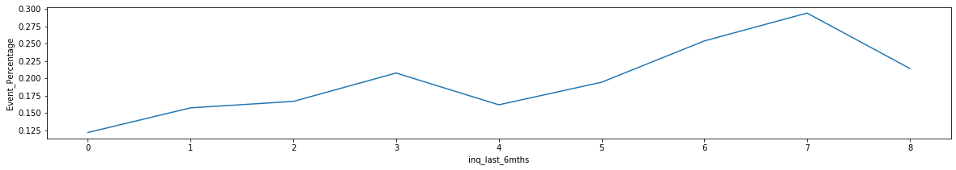
Inquiry Last 6 Months
Cutoff | N | Events | % of Events | Non-Events | % of Non-Events | WoE | IV | Event_Percentage | Cutoff_Min
0 | 18694 | 2280 | 0.405189 | 16414 | 0.498678 | 0.207607 | 0.019409 | 0.121964 | 0
1 | 10645 | 1677 | 0.298027 | 8968 | 0.272459 | -0.089696 | 0.002293 | 0.157539 | 1
2 | 5653 | 943 | 0.167585 | 4710 | 0.143096 | -0.157975 | 0.003869 | 0.166814 | 2
3 | 2980 | 619 | 0.110005 | 2361 | 0.07173 | -0.427617 | 0.016367 | 0.207718 | 3
4 | 315 | 51 | 0.009063 | 264 | 0.008021 | -0.122229 | 0.000127 | 0.161905 | 4
5 | 144 | 28 | 0.004976 | 116 | 0.003524 | -0.344966 | 0.000501 | 0.194444 | 5
6 | 63 | 16 | 0.002843 | 47 | 0.001428 | -0.688793 | 0.000975 | 0.253968 | 6
7 | 34 | 10 | 0.001777 | 24 | 0.000729 | -0.890883 | 0.000934 | 0.294118 | 7
8 | 14 | 3 | 0.000533 | 11 | 0.000334 | -0.467069 | 0.000093 | 0.214286 | 8
# Eighth Most important variable is coming as inq_last_6mths.
# We can take a call on this. We can use this variable at the time of acquisition.
# Higher the number of inquire higher the chance of default.
# This is logical as customer is not getting loan in the market that's why number of inquiry is high.
# inq_last_6mths :- Higher the number of inquire higher the chance of default.

Slide 15
Annual Income With Verification Status
Cutoff | N | Events | % of Events | Non-Events | % of Non-Events | WoE | IV | Event_Percentage | Cutoff_Min
10_0 | 958 | 101 | 0.017949 | 857 | 0.026037 | 0.371965 | 0.003008 | 0.105428 | 0
1_0 | 2417 | 421 | 0.074818 | 1996 | 0.060641 | -0.210084 | 0.002978 | 0.174183 | 0
8_0 | 1542 | 146 | 0.025946 | 1396 | 0.042412 | 0.491408 | 0.008091 | 0.094682 | 0
2_0 | 1610 | 258 | 0.04585 | 1352 | 0.041075 | -0.109971 | 0.000525 | 0.160248 | 0
3_0 | 2018 | 265 | 0.047094 | 1753 | 0.053258 | 0.123002 | 0.000758 | 0.131318 | 0
7_0 | 1571 | 171 | 0.030389 | 1400 | 0.042534 | 0.336212 | 0.004083 | 0.108848 | 0
4_0 | 1909 | 250 | 0.044429 | 1659 | 0.050403 | 0.126157 | 0.000754 | 0.130959 | 0
9_0 | 1219 | 105 | 0.01866 | 1114 | 0.033845 | 0.5954 | 0.009041 | 0.086136 | 0
5_0 | 1700 | 205 | 0.036431 | 1495 | 0.04542 | 0.220519 | 0.001982 | 0.120588 | 0
6_0 | 1721 | 220 | 0.039097 | 1501 | 0.045602 | 0.153907 | 0.001001 | 0.127833 | 0
8_1 | 2491 | 364 | 0.064688 | 2127 | 0.064621 | -0.001038 | 6.97E-08 | 0.146126 | 1
7_1 | 2321 | 347 | 0.061667 | 1974 | 0.059973 | -0.02786 | 4.72E-05 | 0.149505 | 1
6_1 | 2151 | 368 | 0.065399 | 1783 | 0.05417 | -0.188382 | 0.002115 | 0.171083 | 1
4_1 | 1999 | 342 | 0.060778 | 1657 | 0.050342 | -0.188399 | 0.001966 | 0.171086 | 1
3_1 | 1846 | 362 | 0.064333 | 1484 | 0.045086 | -0.3555 | 0.006842 | 0.1961 | 1
2_1 | 1549 | 316 | 0.056158 | 1233 | 0.03746 | -0.404889 | 0.00757 | 0.204003 | 1
1_1 | 2133 | 418 | 0.074285 | 1715 | 0.052104 | -0.354665 | 0.007867 | 0.195968 | 1
10_1 | 2879 | 328 | 0.05829 | 2551 | 0.077503 | 0.284875 | 0.005473 | 0.113928 | 1
5_1 | 2101 | 356 | 0.063266 | 1745 | 0.053015 | -0.176773 | 0.001812 | 0.169443 | 1
9_1 | 2407 | 284 | 0.050471 | 2123 | 0.064499 | 0.245259 | 0.003441 | 0.117989 | 1

Slide 16
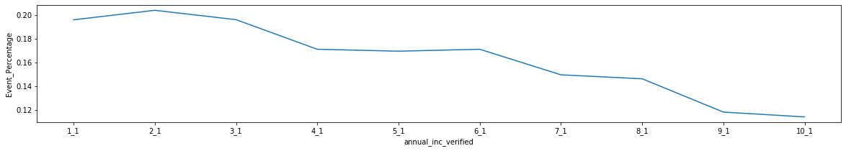
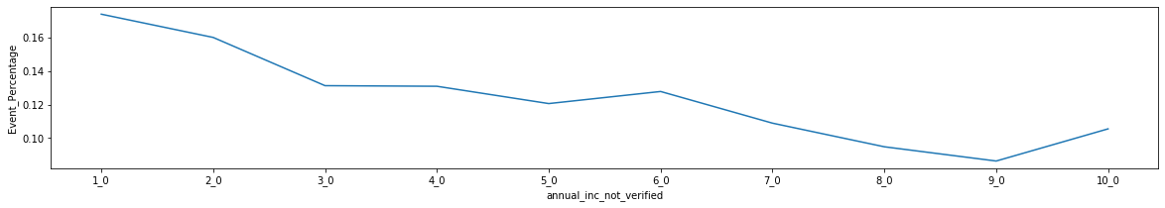
Annual Income With Verification Status (Continue)
# Ninth Most important variable is coming as annual_inc with Verification Status.
# Higher the annual_inc lower the chance of default.
# IV of annual_income with verification status is higher than normal annual income
# annual income with reference to verification status :- Higher the income in both cases higher the chance of default.

Slide 17
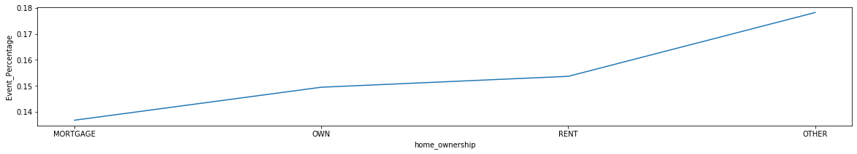
Home Ownership
Cutoff | N | Events | % of Events | Non-Events | % of Non-Events | WoE | IV | Event_Percentage | Cutoff_Min
MORTGAGE | 17006 | 2327 | 0.413542 | 14679 | 0.445967 | 0.075486 | 0.002448 | 0.136834 | MORTGAGE
OWN | 2963 | 443 | 0.078728 | 2520 | 0.076561 | -0.027908 | 0.00006 | 0.149511 | OWN
RENT | 18472 | 2839 | 0.504532 | 15633 | 0.474951 | -0.06042 | 0.001787 | 0.153692 | RENT
OTHER | 101 | 18 | 0.003199 | 83 | 0.002522 | -0.237883 | 0.000161 | 0.178218 | OTHER
# Tenth Most important variable is coming as home_ownership.
# We can take a call on this. We can use this variable at the time of acquisition.
# Customer not owning property tends to do more default.
# home_ownership :- Home ownership as Other tends to do more default.

Slide 18
Two ways we can reduce the risk.
By focusing on customer at time of collection.
Int_Rate :- Need to focus on collection and put more effort on customer having higher interest rate.
Grade :- Grade G have higher chances of default need to focus on these type of customer more.
Sub Grade :- F2,G1,G5,F4,G2,G3,F5 need to focus on these category while collection. As chances of default is high.
Term :- Customer taking loan for 60 Months have high chance of default. Need to focus at the time of collection.
Zip code :- Need to focus on below list of zip code as they have high chance of default.
'871xx', '346xx', '925xx', '751xx', '630xx', '339xx', '488xx','330xx', '245xx', '207xx', '905xx', '914xx', '333xx', '331xx','234xx', '917xx', '305xx', '571xx', '628xx', '171xx', '128xx','657xx', '341xx', '148xx', '960xx', '347xx', '065xx', '446xx','633xx', '360xx', '400xx', '754xx', '816xx', '119xx', '014xx','434xx', '344xx', '279xx', '285xx', '983xx', '547xx', '616xx','172xx', '161xx', '037xx', '974xx', '984xx', '907xx', '363xx','081xx', '971xx', '856xx', '844xx', '489xx', '013xx', '312xx','271xx', '302xx', '927xx', '444xx', '265xx', '238xx', '108xx','361xx', '321xx', '349xx', '641xx', '906xx', '890xx', '623xx','259xx', '779xx', '106xx', '675xx', '325xx', '497xx', '795xx','725xx', '154xx', '135xx', '593xx', '671xx', '487xx', '635xx','484xx', '546xx', '745xx', '449xx', '392xx', '056xx', '407xx', '367xx', '976xx', '937xx', '278xx', '354xx', '445xx', '439xx','072xx', '559xx', '283xx', '308xx', '153xx', '891xx', '082xx','147xx', '206xx', '224xx', '986xx', '614xx', '711xx', '626xx','447xx', '863xx', '826xx', '158xx', '615xx', '422xx', '244xx','619xx', '997xx', '026xx', '187xx', '177xx', '570xx', '534xx','075xx', '935xx', '766xx', '807xx', '758xx', '883xx', '035xx','859xx', '638xx', '425xx', '724xx', '264xx', '713xx', '316xx','376xx', '599xx', '668xx', '406xx', '409xx', '639xx', '912xx','924xx', '253xx', '611xx', '499xx', '573xx', '755xx', '438xx','215xx', '808xx', '744xx', '719xx', '203xx', '608xx', '607xx','897xx', '413xx', '798xx', '673xx', '496xx', '416xx','685xx','746xx', '561xx', '833xx', '663xx', '385xx', '669xx', '373xx','689xx', '094xx', '999xx‘
By Changing Acquisition Score model and including below variables.
revol_util :- Customer with higher revol_util tends to do more default.
purpose :- Purpose as small business customer tends to default more.
inq_last_6mths :- Higher the number of inquire higher the chance of default.
annual income with reference to verification status :- Higher the income in both cases higher the chance of default.
homeownership :- Home ownership as Other tends to do more default.
*** Variable used in rejecting a customer are not used like amount requested, application date, loan title, risk score, DTI, zip code, State, Emp Length, Policy Code

