Slide 1
SyneHack.DS – Mobile Device Procurement
Name: Himanshu Goel
Date: 19 Aug 2017

Slide 2
Outline & Content
Understanding Data
Imbalanced Classification Problem
Applying Naïve Bayes Algorithm
Applying Random Forest Algorithm
Applying Logistic Regression Algorithm
Choosing Best Algorithm
Conclusion

Slide 3
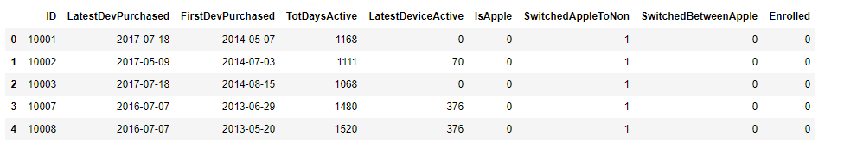
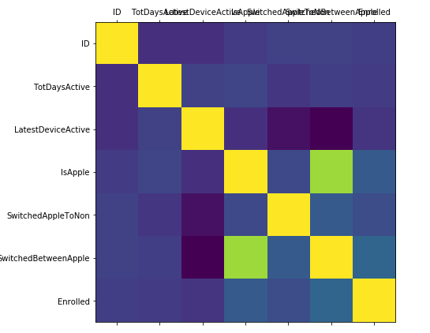
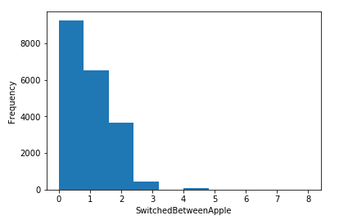
Understanding Data
Sample Data
Viewing Correlation Matrix and Histograms

Slide 4
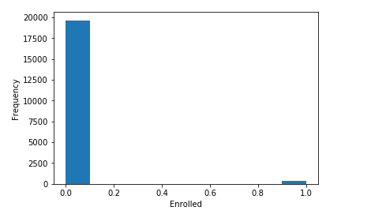

Imbalanced Classification Problem
Value of True cases is very Low
Solutions to Handler Imbalanced Classification Problem:
Collect More Data?
Resampling Your Dataset
Penalized Models
SMOTE

Slide 5
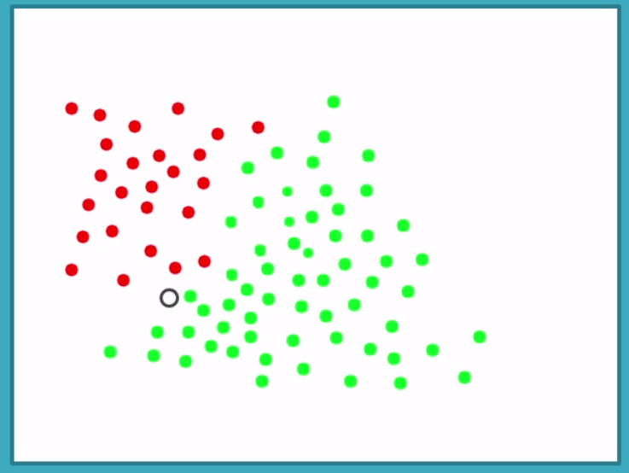
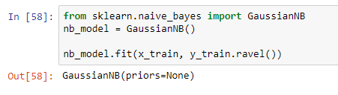
Applying Naïve Bayes Algorithm
Naïve Bayes:
Based on likelihood and probability
Every feature has same weight
Outcome
Accuracy is 97.48%
Recall value is very less 3%

Slide 6
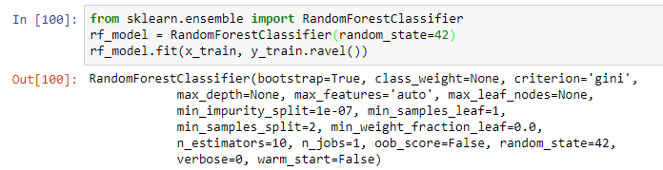
Applying Random Forest Algorithm
Random Forest Algorithm
Ensemble Algorithm
Fits multiple trees with subsets of data, control overfitting
Outcome
Accuracy is 97.97%
Recall value is very less 2%
Even with class_weight=“balanced” recall value is just 3%

Slide 7
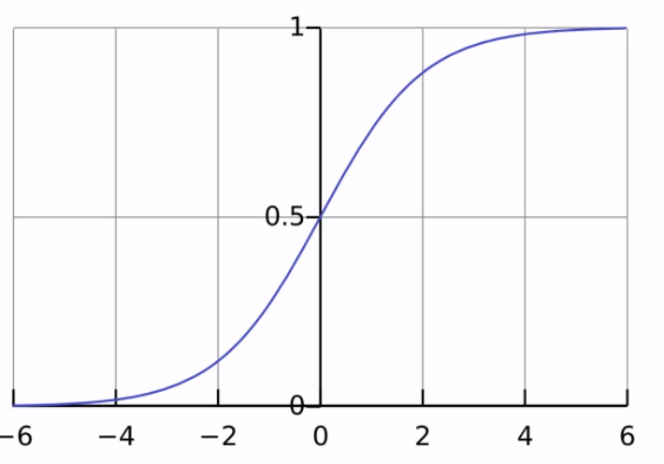

Applying Logistic Regression
Logistic Regression
Confusing name, Binary Result
Relationship between features are weighted
Penalized Models
Outcome
Accuracy dropped to 77.39%
Recall value has been improved to 95%

Slide 8
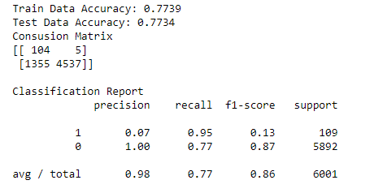
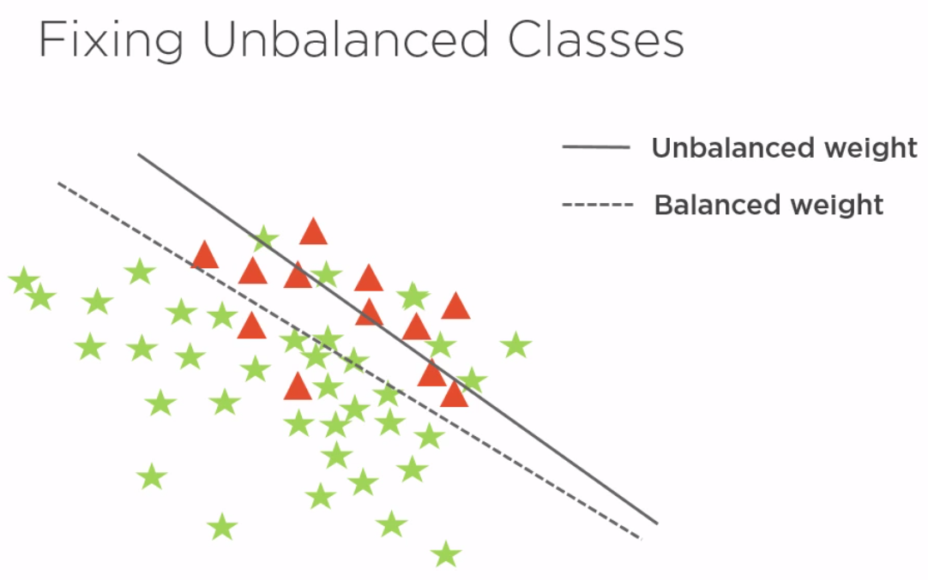
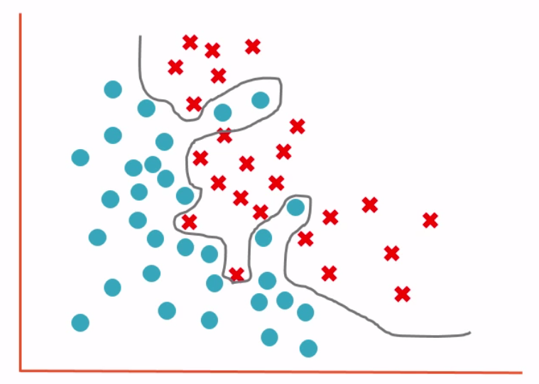
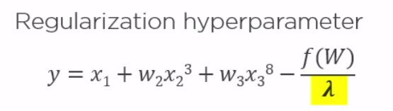
Choosing Best Algorithm
Logistic Regression
Recall value is high
Handled imbalanced classification problem
Handled overfitting problem
Better performance on real world data

Slide 9

Conclusion
Alternate Solutions
Using other Algorithms
Synthetic Data Generation
Cost Sensitive Learning (CSL)
Evaluating Performance Matric
Anomaly Detection

