Slide 1

Quizzy
Submitted by:
Jeevesh Chawla(23/CS/191)
Himanshu Gupta(23/CS/175)
(Batch-CSE3, 1st Semester)

Slide 2
introduction
Quizzes can be used for assessment, testing students' knowledge, and reinforcing learning.
Online quizzes help assess employees' understanding of training materials. In marketing, quizzes engage users and provide personalized content or product recommendations.
Online quizzes can gather data and opinions from a broad audience. Quizzes for entertainment are popular, often found in social media and on websites.
Whether it's for learning, marketing, data collection, or entertainment, online quizzes offer an interactive way to engage users and achieve specific goals.
We create our project with help of HTML and CSS. This extension is very useful in today’s world and also have applications in different fields. The chrome extension fulfill almost all need of user but there are also some future scope which we would like to add in it in future.

Slide 3
UTILITIES AND TECHNOLOGIES USED
In the project we have used Visual Studio Code for writing code and saving it for future requirements. All directories and files are saved there and we will provide a derive link for the same.
For creating this chrome extension I have used HTML and CSS and JS. HTML is used for creating a skeleton of our extension. HTML helps in adding images, documents with headings, text, tables, lists, photos, etc. Retrieve online information via hypertext links, at the click of a button. All features button our added using HTML.
CSS is cascading style sheet which is used here for adding design and making it more stylish. So that it looks more attractive and whoever is watching the site take more intersect.

Slide 4
About the project
HTML Structure: Create an HTML file for your quiz.Define the structure of your quiz, including questions and answer choices. Use HTML elements like <div>, <h1>, <p>, <ul>, and <li>.
CSS Styling:Style your quiz using CSS to make it visually appealing.Use CSS to format questions, answer choices, and buttons.
JavaScript for Quiz Logic:Use JavaScript to handle the quiz logic.

Slide 5
Little about languages used
HTML (Hypertext Markup Language): HTML is the backbone of web content. It's used to structure and organize the content on a web page. HTML uses tags to define elements like headings, paragraphs, images, links, and more. It provides the structure and semantics of a web page.
CSS (Cascading Style Sheets): CSS is responsible for the presentation and styling of web content. It allows you to control the layout, colors, fonts, and design of HTML elements. CSS rules define how elements should look on a page, separating design from content.
JavaScript: JavaScript is a versatile scripting language used for adding interactivity and functionality to web pages. It enables dynamic features like form validation, animations, and responsive behavior. JavaScript can interact with the HTML and CSS of a page, making it interactive and responsive to user actions.

Slide 6
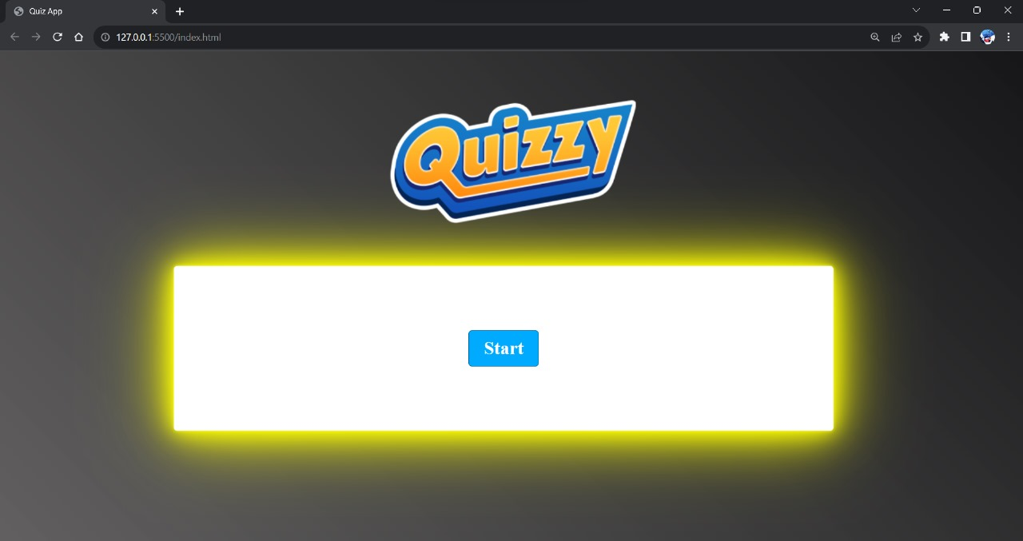
Working and functionalities: Screenshots
Welcome to Quizzy:
Screenshot of the start of the quiz

Slide 7
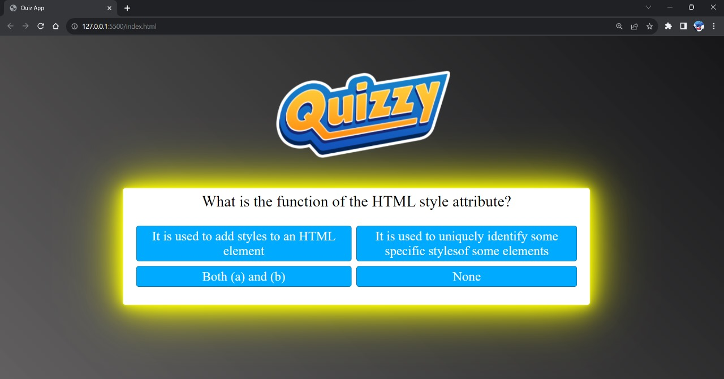
Working and functionalities: Screenshots
Display of the first question of the Quiz

Slide 8
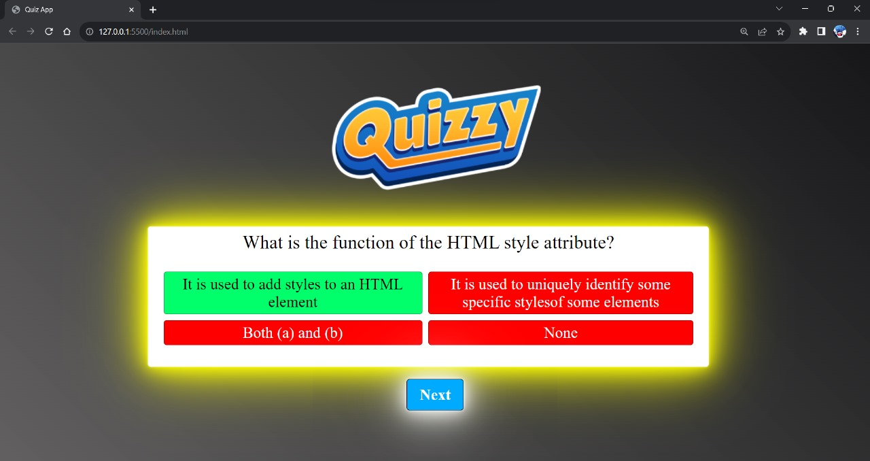
Working and functionalities: Screenshots
Display of the Correct and Incorrect Answer

Slide 9
Future Scope and Conclusions
Quizzes will get smarter with the help of computers and fancy tech. They'll know you better and give you more accurate questions.
Quizzes will become like games. You can win prizes, compete with others, and have a blast while learning.
Schools and online learning will use quizzes more to help you learn new stuff and practice what you know.
You'll find quizzes for all kinds of interests and jobs, from cooking to space exploration.
The info collected from quizzes will help quiz makers make them better and more personal for you.
In simple words, quizzes are getting cooler, more fun, and super useful for learning and having a good time.

Slide 10


Jeevesh Chawla
Himanshu Gupta

