Slide 1


PRODUCT : ZIP Tales

Slide 2
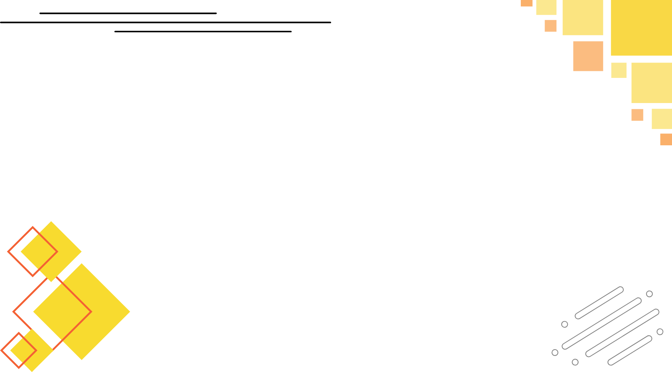
PROBLEM STATEMENT
The proliferation of fake news and misinformation poses a significant threat to informed decision-making and community trust. Many individuals struggle to discern credible news sources from unreliable ones, leading to confusion and skepticism about the information they receive.
ISSUES ADDRESSED
Lack of Reliable Sources: Difficulty in identifying trustworthy news outlets and content.
Misinformation Spread: Rapid dissemination of false information across social media and online platforms.
Low Media Literacy: Insufficient understanding of how to critically evaluate news and distinguish fact from fiction.
Community Disengagement: A growing sense of disconnection and distrust among community members regarding news content.

Slide 3


PROPOSED SOLUTION
ZIP TALES: Local News, Smartly Delivered
To combat the challenges of fake news and misinformation, ZIP TALES will launch an AI-powered news
verification platform designed to enhance credibility assessment and engage the community effectively. By leveraging advanced technology and user participation, the platform aims to restore trust in local news and promote informed decision-making.
Key Features:
Real-Time Credibility Scoring: Utilize AI to analyze news articles and assign credibility scores based on author reputation and factual accuracy.
Community Voting: Allow users to upvote or downvote news stories, fostering a collaborative approach to verification.
Transparency: Offer clear reports on how credibility scores are determined, enhancing user understanding of the evaluation process.

Slide 4

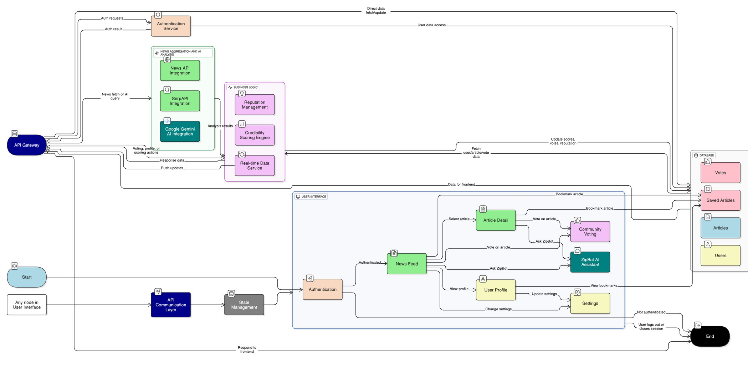
FLOWCHART

Slide 5
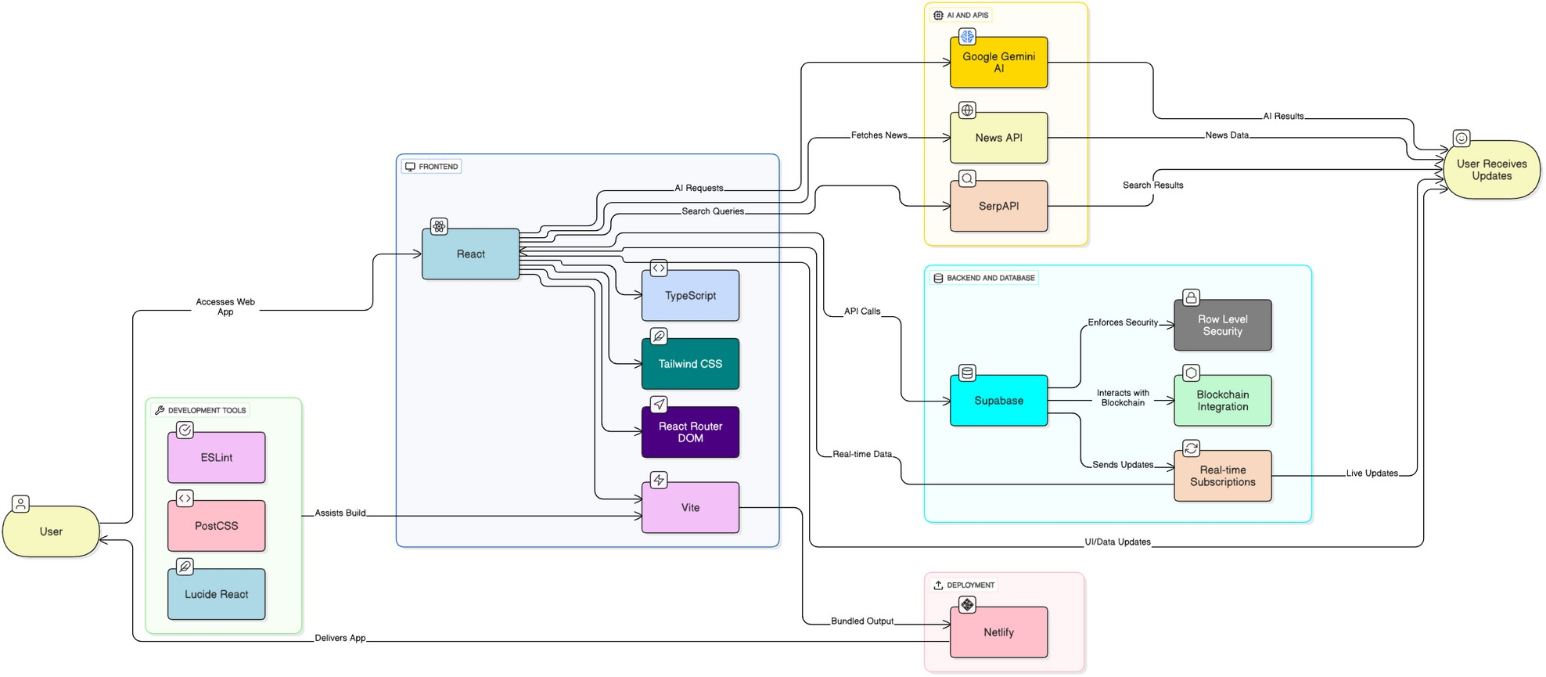
TECH STACK

Slide 6



PROTOTYPE
DEPLOYEMENT LINK
GITHUB LINK

Slide 7
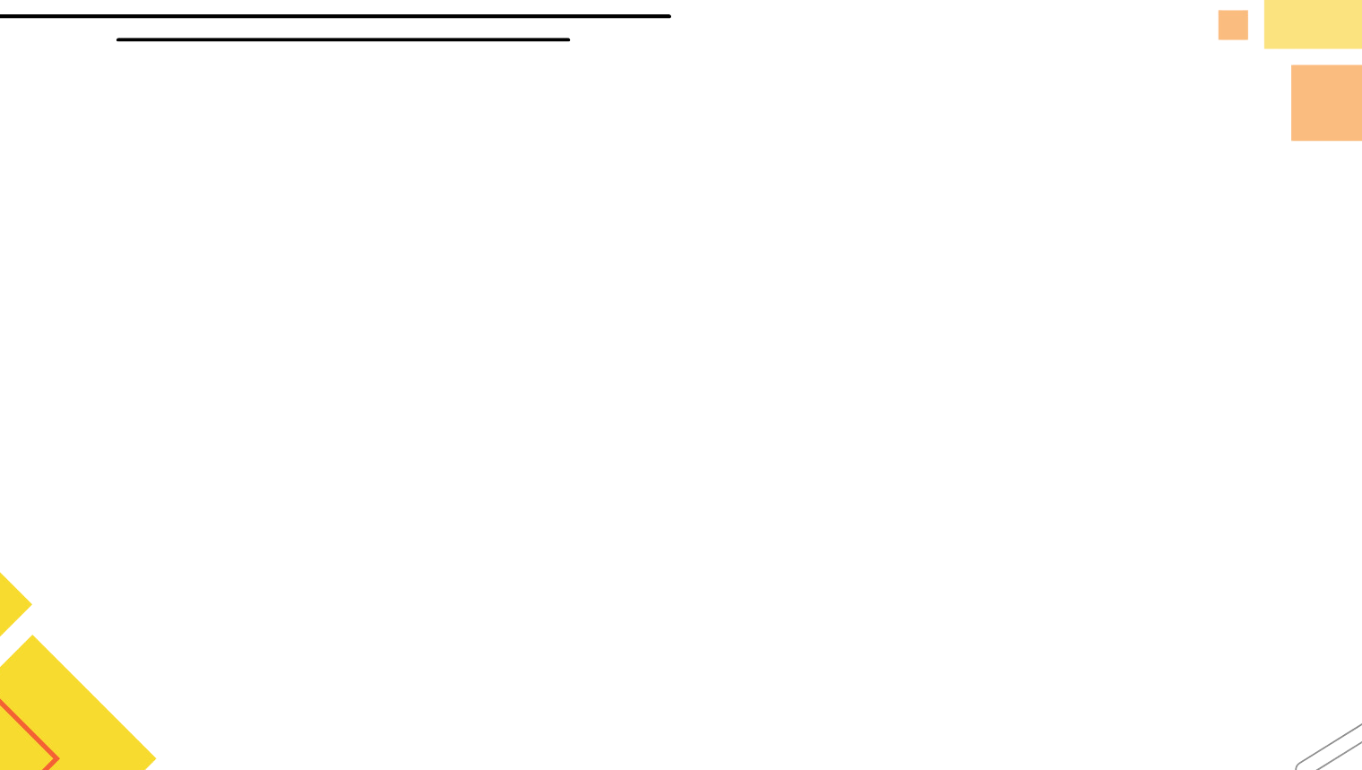
FEATURES
Community-Driven Voting Mechanism
NOVELTY
Personalized News Delivery
Custom 404 Error Page
Gamification of Engagement
Dynamic Scoring Categories
Automated Personalized Feeds

Slide 8
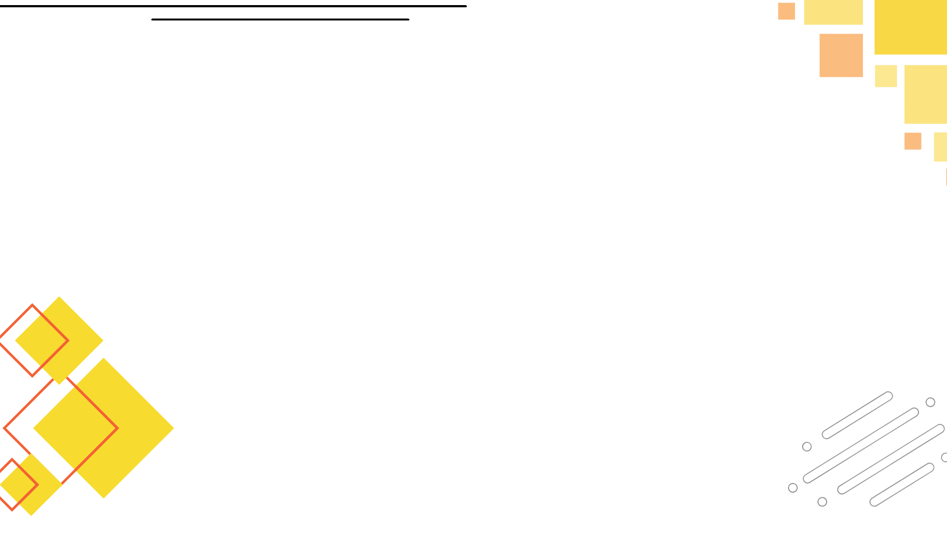
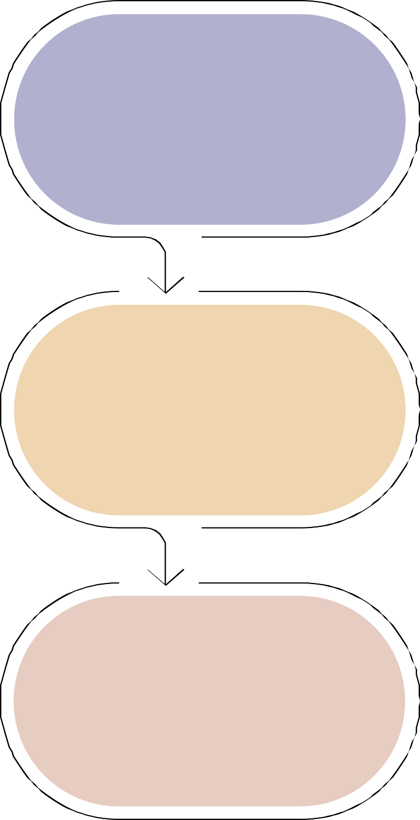




DRAWBACKS
Dependence on User Engagement
SHOWSTOPPERS
Content Moderation
Scalability Concerns
Potential for Manipulation
Competition
Legal and Ethical Issues
Technical Complexity

Slide 9

THANK YOU !

