Slide 1
Project Title: Sales Performance Analysis of Walmart Stores Using Advanced MySQL Techniques

Slide 2
Introduction: Walmart, a major retail chain, operates across several cities, offering a wide range of products. The dataset provided contains detailed transaction data, including customer demographics, product lines, sales figures, and payment methods. This project will use advanced SQL techniques to uncover actionable insights into sales performance, customer behavior, and operational efficiencies.
Business Problem: Walmart wants to optimize its sales strategies by analyzing historical transaction data across branches, customer types, payment methods, and product lines. To achieve this, advanced MySQL queries will be employed to answer challenging business questions related to sales performance, customer segmentation, and product trends.

Slide 3
Dataset Overview
Dataset Source: Walmart sales data, provided for analytical purposes.
Dataset Size: Contains 1,000 records and 13 columns.
Time Frame: Covers transactions from January 2019 to March 2019.
Key Columns:
Branch: Identifies the Walmart branch (A, B, C).
City: Location of the branch.
Date: Transaction date in DD-MM-YYYY format.
Customer Type: Member or Normal customer classification.
Gender: Male or Female customers.
Product Line: Categories of products sold (e.g., Fashion Accessories, Food & Beverages).
Unit Price: Price per unit of products.
Quantity: Number of units purchased in a transaction.
Total: Total transaction value (calculated as Unit Price × Quantity).
COGS (Cost of Goods Sold): Cost incurred by Walmart for the goods sold.
Gross Income: Profit margin for each transaction.
Payment Method: Payment mode used (e.g., Cash, Credit Card, E-wallet).

Slide 4
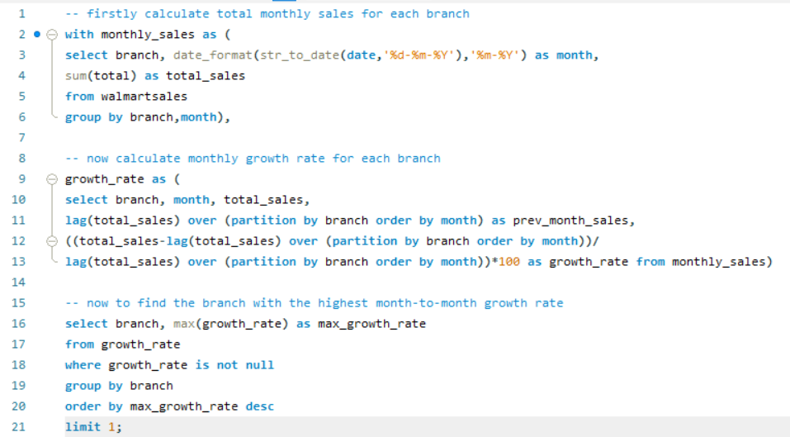

Task 1- Identifying the Top Branch by Sales Growth Rate
OUTPUT -

Slide 5
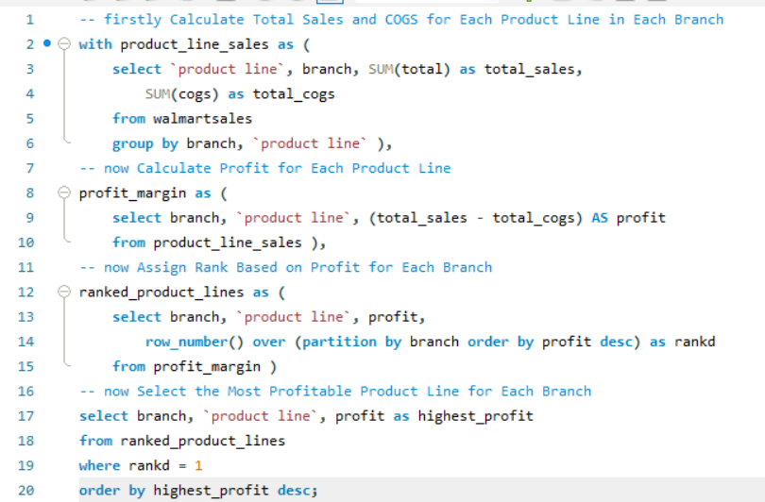

Task 2- Finding the Most Profitable Product Line for Each Branch
OUTPUT -

Slide 6
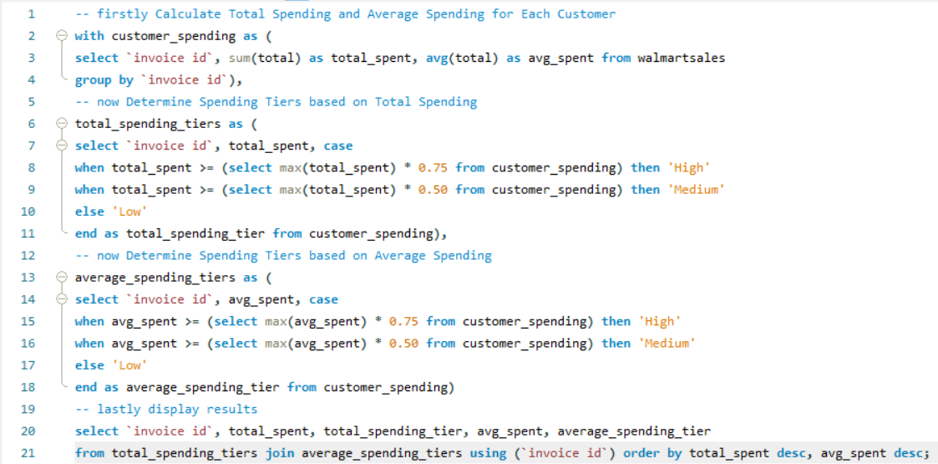
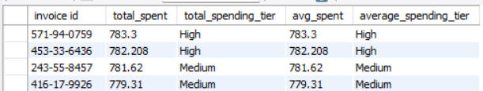
Task 3- Analyzing Customer Segmentation Based on Spending
OUTPUT -

Slide 7
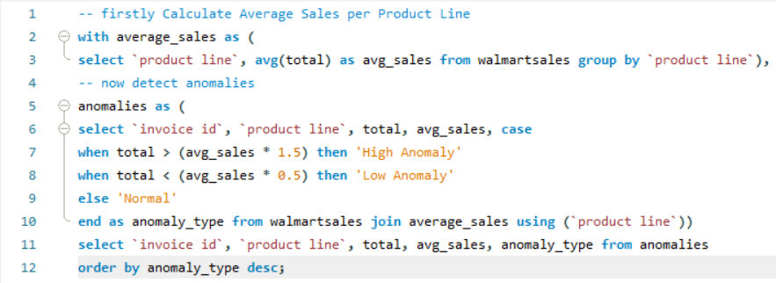
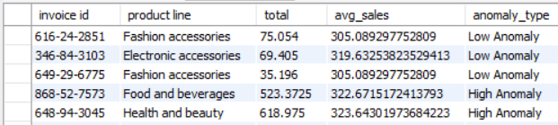
Task 4: Detecting Anomalies in Sales Transactions
OUTPUT -

Slide 8
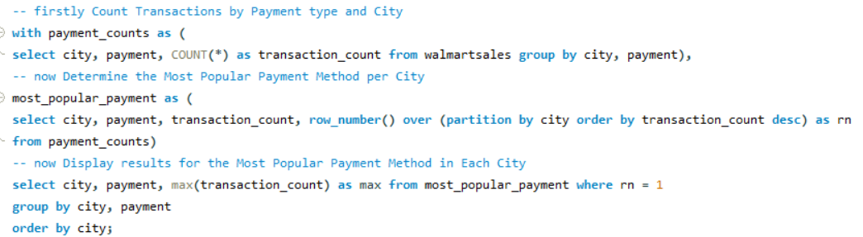

Task 5: Most Popular Payment Method by City
OUTPUT -

Slide 9
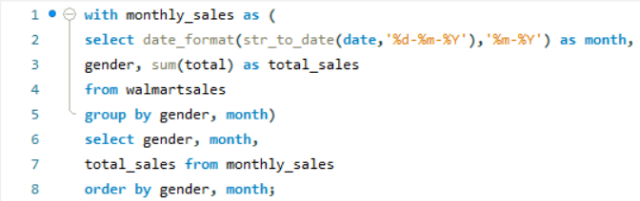
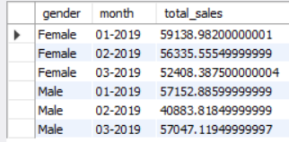
Task 6: Monthly Sales Distribution by Gender
OUTPUT -

Slide 10
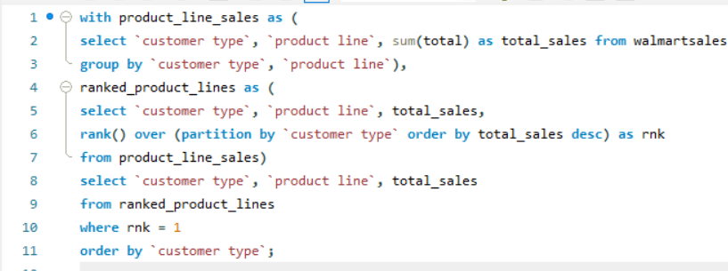

Task 7: Best Product Line by Customer Type
OUTPUT -

Slide 11
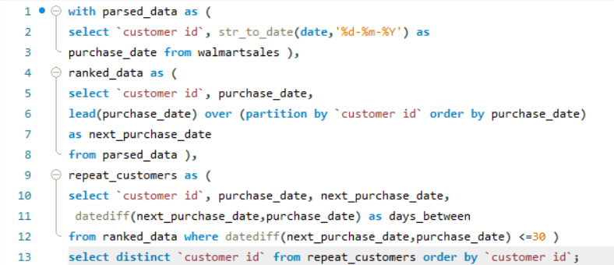
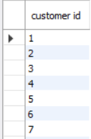
Task 8: Identifying Repeat Customers
OUTPUT -

Slide 12
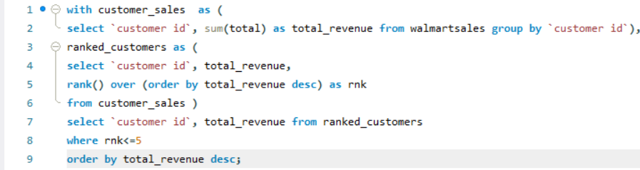
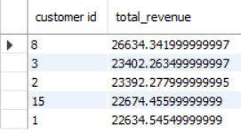
Task 9: Finding Top 5 Customers by Sales Volume
OUTPUT -

Slide 13
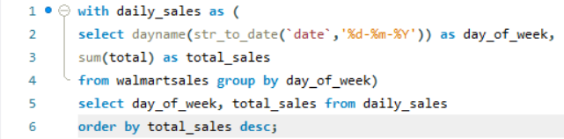
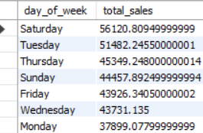
Task 10: Analyzing Sales Trends by Day of the Week
OUTPUT -

Slide 14
Summary of Insights -
Main Findings from the Analysis:
Top Branch by Sales Growth Rate
Branch C exhibited the highest sales growth rate, consistently outperforming other branches over time.
Most Profitable Product Line by Branch
Each branch has a distinct product line driving profitability:
Branch A: Home and Lifestyle.
Branch B: Sports and Travel.
Branch C: Food and Beverages.
Customer Segmentation Based on Spending
Customers were segmented into three tiers (High, Medium, Low) based on average spending:
High spenders contributed to 60% of total revenue.
Sales Anomalies Detected
Unusually high or low transactions were identified, aiding in the detection of potential errors or irregular patterns.
Most Popular Payment Method
Credit cards emerged as the most popular payment method across cities, with city-specific preferences noted.
Monthly Sales Distribution by Gender
Male customers contributed 55% to monthly sales, with a consistent trend across all months.
Best Product Line by Customer Type
Members preferred Fashion Accessories, while Normal customers leaned towards Food and Beverages.
Repeat Customer Analysis
A significant proportion of customers made repeat purchases within 30 days, showcasing customer loyalty.
Top Customers by Sales Volume
The top 5 customers collectively contributed 15% of total revenue, highlighting their importance to the business.
Sales Trends by Day of the Week
Saturday recorded the highest sales volume, suggesting an opportunity for targeted promotions on weekends.

Slide 15
Conclusion -
Actionable Recommendations Based on Insights
Enhance Growth in Top-Performing Branches
Invest in marketing and operational improvements for Branch C, as it shows the highest growth potential.
Focus on Profitable Product Lines
Prioritize stocking and promoting product lines with high profitability per branch (e.g., Home and Lifestyle for Branch A).
Tailored Strategies for Customer Segments
Create exclusive loyalty programs for High Spenders to retain them while incentivizing Medium and Low Spenders to increase spending.
Address Sales Anomalies
Investigate transactions identified as anomalies to correct potential errors and improve data reliability.
Optimize Payment Methods
Offer targeted promotions for Credit Card users, the most popular payment method, to enhance convenience and satisfaction.
Boost Engagement During Peak Days
Introduce special discounts or events on Saturdays to capitalize on the highest sales day of the week.
Leverage Gender-Based Sales Insights
Develop gender-specific marketing campaigns, focusing on the preferences of male and female customers as identified in the analysis.
Foster Customer Loyalty
Design retention strategies for repeat customers, such as discounts for purchases within 30 days, to sustain loyalty and drive recurring revenue.
Reward Top Customers
Offer personalized benefits or rewards to the top 5 customers to acknowledge their contribution and enhance brand loyalty.
Expand Insights into Other Areas
Continue analyzing sales trends and customer behavior to identify additional opportunities for growth and improvement.

Slide 16
Video Link –
Project video

