Slide 1
Google Maps
VeLa AI Day Planner
India Edition · v2
From a vague idea to a perfect day — in 30 seconds.
✨ Now with Anchor Planning · Live Adaptive Replanning
Enhancing navigation with conversational AI · Anchor-Based Planning · Real-Time Adaptive Replanning · Constraint-Aware Routing

Slide 2
T H E P R O B L E M
Planning a day out in India is unnecessarily painful.
Users lose 20–40 minutes before the fun even starts.
Fragmented Search
No Time Intelligence
Users manually search each venue — chai spot, museum, park, restaurant — one by one, with no connective logic.
Opening hours, crowd levels, and heat windows must be cross-checked on separate screens before committing.
Broken Routing
Plans Go Stale Fast
A list of favourites doesn't equal a sensible route. Users often realise mid-day they've built a backwards, traffic-heavy path.
Even a good static itinerary becomes obsolete the moment breakfast runs long or traffic spikes — forcing manual replanning.
20–40 minutes of planning friction for what should take 30 seconds.

Slide 3
U S E R S T O R Y
Meet Rohit, 31 — Primary Persona
Urban Weekend Explorer · Noida, Delhi NCR · Android · Spontaneous planner
"It's Sunday. I want breakfast, a park, something indoors for the afternoon heat, and dinner under ₹800 per person. But traffic changes everything — and every time I open Maps I have to start from scratch."
A
K
P
Arjun, 38
Kavya, 24
Priya, 27
Bengaluru · Family · Child-friendly
Hyderabad · Solo · Authentic local
Mumbai · Date nights · Budget-conscious
1
2
3
4
Searches 'breakfast Noida'
Checks hours one by one
Tries to build a route
Gives up & WhatsApps friends
200+ results. No context.
Three tabs open. Still unsure.
Pins scattered. No sequence.
Loses Maps entirely.

Slide 4
W H Y N O W ?
The technology finally caught up.
Three converging shifts make this possible today — not 3 years ago.
1
2
3
Large Language Models
Real-Time Places API
India's Urban Surge
Gemini / LLMs on-device
Live crowd & hours data
430M smartphone users
Natural language trip requests can now be parsed with intent, budget, and mood understood — no structured filters needed. Computationally infeasible at scale before 2023.
Google's Popular Times, live Business Hours, and traffic APIs now expose enough signal to make constraint-aware scheduling reliable at scale.
India has 430M+ smartphone users with Google Maps installed. Weekend day-trip culture in Tier 1/2 cities is growing 34% YoY.

Slide 5
T H E S O L U T I O N
VeLa AI Day Planner
A conversational AI layer that turns natural language into a smart, timed, routable itinerary — built for India.
01
02
03
Natural Language Input
Anchor-Based Planning
AI Constraint Solver
Type your mood — 'lazy Sunday, chai + park + museum, dinner under ₹800'. No forms or filters needed.
AI proposes one anchor stop first. User confirms, then AI builds the rest. Reduces cold-start hesitation.
Understands opening hours, crowd levels, heat index, travel time and budget to build the ideal sequence.
04
05
06
Live Conflict Detection
One-Tap Swapping
Adaptive Replanning
Warns you if a stop closes before you'd arrive and auto-adjusts the schedule to keep the day smooth.
Don't like a suggestion? Tap swap to see two AI-curated alternatives with ratings and reasons.
Mid-day AI engine detects delays & traffic spikes. Recomputes and suggests the optimal stop reorder automatically.

Slide 6
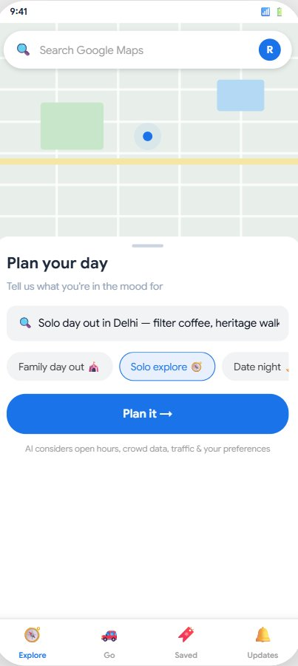
P R O T O T Y P E · S C R E E N 1 · C O N V E R S A T I O N A L I N P U T
Familiar Maps Chrome
The planner lives inside existing Maps UI — feels native, not bolted on.
Natural Language Input
AI parses mood, budget, activity type and timing from plain text.
Quick-Tap Mood Chips
Accelerate input for users who want to start fast without typing.
"Plan It" CTA
Single tap triggers: NLP intent → Places match → constraint-aware route.

Slide 7
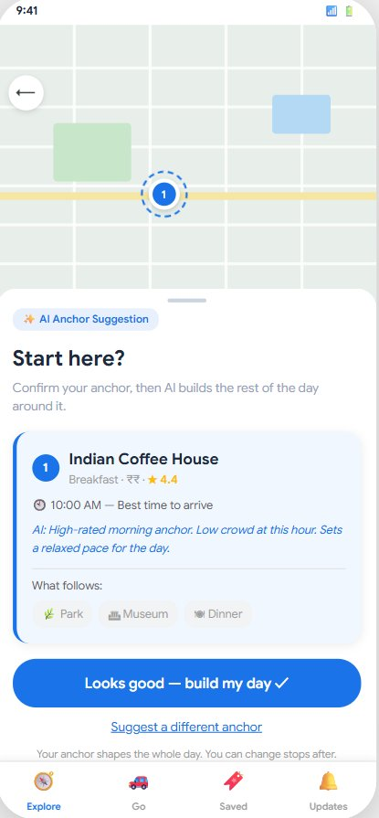
NEW
P R O T O T Y P E · S C R E E N 1 b · A N C H O R - B A S E D P L A N N I N G ( N E W )
Why Anchor Planning?
Most users hesitate to commit to a full AI-generated day on the first try.
BEFORE (Cold Start)
AFTER (Anchor First)
AI dumps a full 4-stop plan
AI suggests ONE anchor stop
User feels overwhelmed
User confirms (low commitment)
User hesitates — what if it's bad?
AI then builds the rest
Low activation & trust
Higher trust & plan completion
+28%
+35%
High
Activation Rate
Plan Completion
Trust Score
Less intimidating entry
Higher commitment via anchors
Step-by-step validation

Slide 8
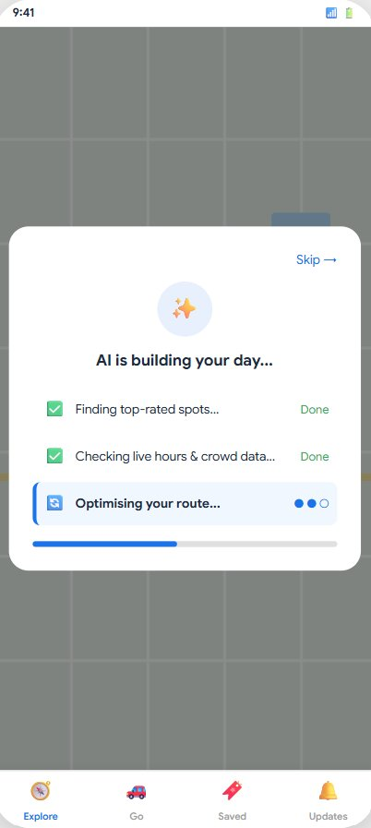
P R O T O T Y P E · S C R E E N 2 · A I B U I L D I N G Y O U R D A Y
Building Trust Through Transparency
The loading screen isn't UX filler — it shows users the AI is doing real, intelligent work.
Step 1: Top-Rated Spots
AI queries Google Places for highly-rated venues matching mood, category and budget.
Step 2: Live Hours & Crowds
Real-time Popular Times + Business Hours API ensures no stop is closed or overwhelmingly crowded.
Step 3: Route Optimisation
TSP-style routing ensures stops flow geographically — no doubling back across Delhi's traffic.

Slide 9
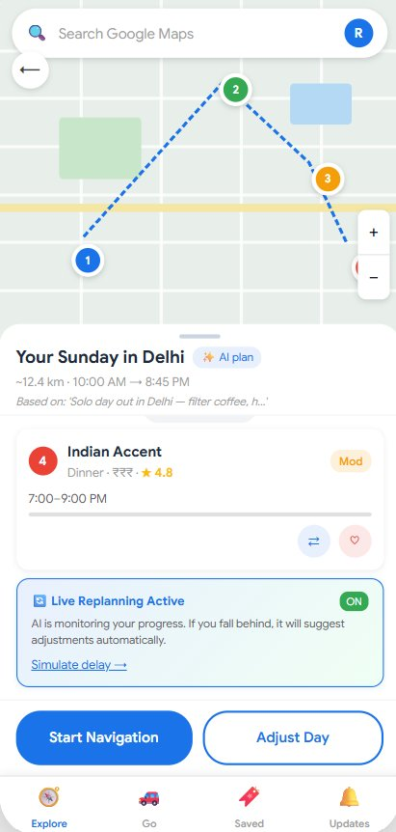
P R O T O T Y P E · S C R E E N 3 · Y O U R D A Y I T I N E R A R Y
Live Map With Numbered Pins + Route
4 stops as numbered pins on a real route line — instant spatial orientation before scrolling.
Live Replanning Status
Persistent AI monitoring banner at page bottom. Blue = active replanning. Tapping 'Simulate delay →' launches the full replan flow (Screen 6).
Stop Cards With AI Reasoning
Each card shows time slot, crowd indicator (green/amber/red), rating. ⚠ warning if conflict detected.
Live Replanning Banner (NEW)
Persistent strip confirms adaptive AI is active. 'Simulate delay →' link triggers the replan flow.

Slide 10
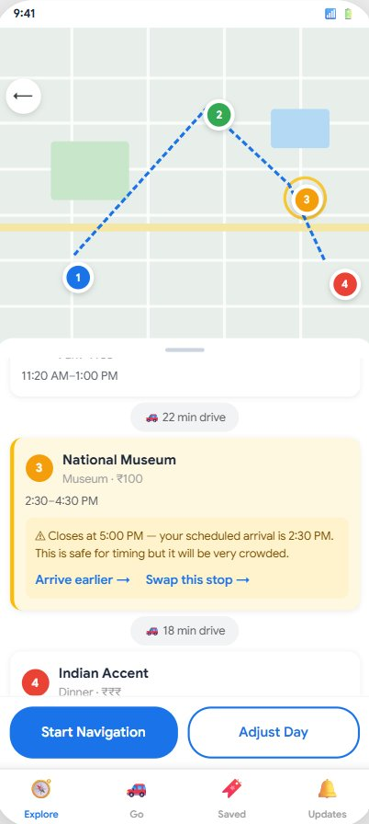
P R O T O T Y P E · S C R E E N 4 · A I C O N F L I C T D E T E C T I O N
Amber Alert Strip
Replaces the blue 'on track' strip. Signals urgency. 'Tap to reorder' guides user to action.
Pulsing Pin Animation
Pin 3 gets a pulsing amber ring — instantly draws attention to the conflicted stop on the map.
Conflict Detail Card
Stop 3 turns amber with a warning box showing exact closing time, your ETA and the risk level.
"Arrive Earlier" or "Swap" Actions
Two escape options. 'Arrive earlier' adjusts schedule in-place. 'Swap' opens AI-curated alternatives.

Slide 11
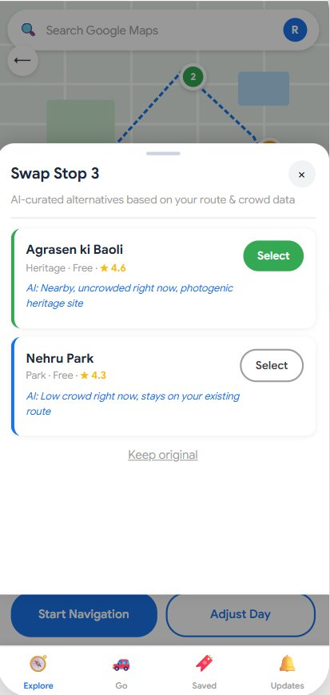
P R O T O T Y P E · S C R E E N 5 · O N E - T A P S W A P D R A W E R
Drawer Slides Up From Bottom
Background (itinerary) stays visible but dimmed. Tapping the overlay closes the drawer.
2 AI-Curated Alternatives
Each option filtered by proximity, crowd level, route efficiency, and budget — not just popularity.
AI Reasoning Shown Per Option
One-line natural language justification ('Nearby, uncrowded, great photos') builds trust in AI choice.
Keep Original Always Available
Escape hatch prevents frustration — users feel in control even when the AI is suggesting changes.

Slide 12
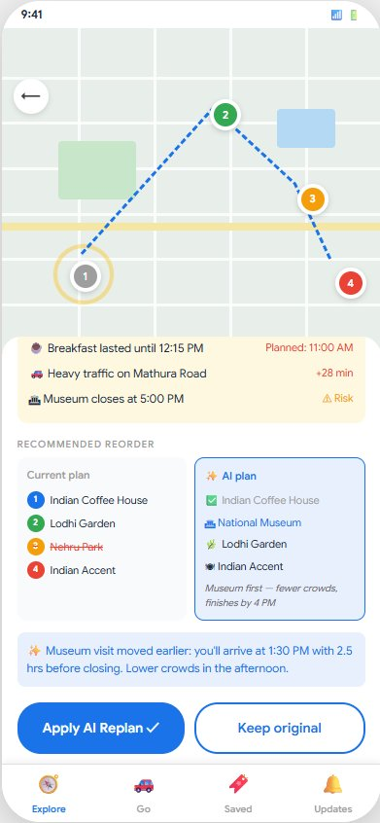
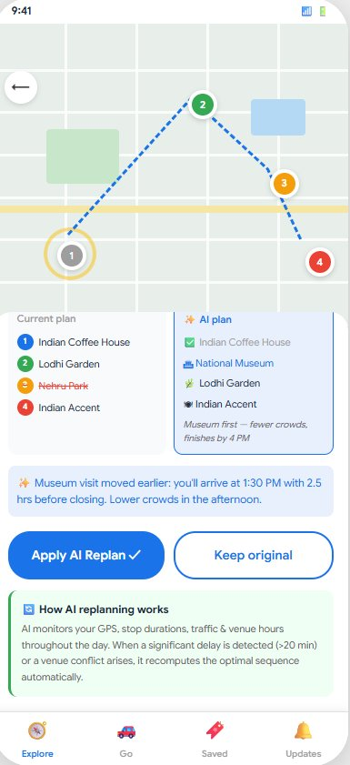
NEW
P R O T O T Y P E · S C R E E N 6 · A D A P T I V E R E P L A N N I N G E N G I N E ( N E W )
Adaptive Replanning Engine
Mid-day AI detects delays, traffic spikes and venue conflicts — recomputes the optimal stop sequence.
1 Monitor Signals
2 Trigger Recompute
GPS, stop duration, traffic, venue hours, crowd levels — all tracked continuously
Delay >20 min, ETA change >15%, or venue closing within 60 min triggers the engine
3 Generate New Plan
4 User Notification
Remaining stops + current time + live traffic + venue hours → new optimal sequence
Small banner: 'Your schedule shifted. Visit Museum first?' — one tap to apply or keep.
+15–20%
High
Longer
More
CRD+ Completion
User Trust Score
Session Duration
Booking Conversions
📱 Prototype Flow: Screen 3 (initial) → Screen 4 (conflict on Museum) → Screen 5 (user swaps Museum for Nehru Park) → Screen 6 (delay simulation triggers AI replan — suggests restoring National Museum at 1:30 PM for better timing & lower crowds).

Slide 13
W H Y A I · N O T J U S T A B U Z Z W O R D
AI does the hard work that humans can't.
Planning Task
Manual Today
VeLa AI
Find venues matching mood & budget
30+ min manual search
Instant NLP + Places API match
Check opening hours for all stops
Manual for each place
Auto-checked in real time
Avoid crowds & peak wait times
Guess or skip
Live Popular Times data
Build an efficient route across Delhi
Mental mapping / trial & error
Optimised TSP routing
Detect closing-time conflicts
Usually missed entirely
Automatic warning banner
Swap a stop mid-day
Start over from scratch
One-tap AI-curated swap
Adapt to delays & traffic spikes
Re-plan manually every time
Adaptive Replanning Engine ✨

Slide 14
P R O D U C T D E P T H · E D G E C A S E S & E R R O R S T A T E S
Graceful failure is part of the experience.
A robust product anticipates what can go wrong — and handles it without breaking trust.
Impossible Constraints
All Venues Closed
Poor Network / Offline
Scenario: Budget ₹200 per person — no viable dinner options found.
Scenario: User plans on a national holiday — most museums are closed.
Scenario: User loses data mid-trip between stops.
AI Response: AI explains: 'We found options up to ₹350. Want to adjust your budget?'
AI Response: AI surfaces upfront: 'Most indoor venues are closed today. Showing parks + outdoor options.'
AI Response: Cached itinerary available offline. Navigation continues with last-known directions.
Overly Vague Input
Replanning Refused
All Alternatives Bad
Scenario: User types: 'I want to have fun today'.
Scenario: User taps 'Keep original' after AI suggests reorder.
Scenario: User taps swap — but all nearby alternatives are crowded or closed.
AI Response: AI asks one clarifying question: 'Active outdoor, cultural, or food-focused?'
AI Response: AI respects choice. Continues monitoring silently. Re-prompts only if conflict worsens.
AI Response: AI shows message: 'No better alternatives right now. Try after 3 PM or expand the area.'

Slide 15
C O M P E T I T I V E L A N D S C A P E · W H Y G O O G L E W I N S
Only Google can execute — not just suggest.
Capability
VeLa AI
Zomato
ChatGPT
Instagram
Yelp
Live traffic telemetry
✓
✗
✗
✗
✗
Verified business hours
✓
~
✗
✗
~
Popular Times crowd data
✓
✗
✗
✗
✗
Multi-stop route optimisation
✓
✗
✗
✗
✗
Budget filter (INR)
✓
~
~
✗
✗
Android default distribution
✓
✗
✗
✗
✗
Booking integration
✓
✓
✗
✗
~
Mid-day adaptive replanning ✨
✓
✗
✗
✗
✗
Google's moat is structural — no competitor combines live traffic + verified hours + crowd data + adaptive replanning + booking + Android distribution in a single product.

Slide 16
I M P A C T · M E T R I C S & B U S I N E S S C A S E
North Star: Completed Real-World Days (CRD+)
CRD+ = user navigated to ≥60% of planned stops + no unresolved conflicts + post-day rating ≥4/5. Target: 25% within 90 days of GA.
+23%
3×
₹1,394 Cr
Session depth vs. baseline
Place saves vs. manual search
Commission revenue Year 1
Guardrail Metrics — must not regress
Monetisation Phases
Next Steps
Organic search volume
Restaurant & activity booking commissions (₹120 / ₹80 avg)
Q1
User research, NLU eval, anchor UX testing
Ph 1
< 3% decline vs. control
Q2
Backend + 5% A/B test Delhi (all 6 screens)
ETA accuracy
Sponsored swap placements (CPC/CPB) + Google One Premium
Ph 2
< 5% deviation from baseline
Q3
Closed beta: 3 cities + adaptive replan live
Ad revenue/session
UPI-integrated bookings + B2B data intelligence
Ph 3
GA + monetisation + anchor mode rollout
No regression (feature adds sessions)
Q4

Slide 17
The opportunity is clear.
The technology is ready.
India is waiting.
430M+ Google Maps users in India deserve a day planning experience that thinks with them — not just for them.
Conversational Input
Anchor Planning ✨
Live Conflict Detection
One-Tap Swap
Adaptive Replanning ✨
VeLa AI Day Planner · India Edition · v2
Built on: NLP Intent Parsing · Google Places API · Popular Times · TSP Route Optimisation · Live Traffic Telemetry · Anchor-Based UX · Adaptive Replanning

