Slide 1
Shree Uttar Gujarat BCA College Semester : 5 Project Submission for Sem 5 Water Filter Website Student Name: Parmar Himanshu Bipinbhai Student Roll No: 172
Shree Uttar Gujarat BCA College

Slide 2
INDEX
Chapter | Page No.
Introduction Project description Project Profile Environment Description Hardware and Software Requirements Technologies Used System Analysis Existing System and its Drawbacks Expected Advantages Proposed System Scope Project modules Objectives / Functionalities Detail Planning Data Flow Diagram / UML Process Specification / Activity Flow Diagram Data Dictionary Entity-Relationship Diagram / Class Diagram System Design Input Design Output Design Limitations and Future Scope of Enhancements References | 1 2 4 6 8 14 24 25
Shree Uttar Gujarat BCA College

Slide 3
Introduction
Water Filter Website provides the user with the facility of Water filter, Gas gehser and Gharghanti anywhere and anytime. Here user can see photos of all types of Water filter, Gas gehser and Gharghanti. If the user likes, he can fill the Contact us form or Call the mobile number of krishna Sales & Service. The purpose of developing Water filter website is that the user can get the facility of Water filter, Gas gehser and Gharghanti.
Shree Uttar Gujarat BCA College

Slide 4
Hardware And Software
HARDWARE-REQUIREMENT :
HARDWARE-REQUIREMENT :
Processor | Intel(R) Core(TM) i5-6300U CPU @ 2.40GHz 2.50 GHz
Memory | 256 MB
Hard Disk | 250 GB
SOFTWARE-REQUIREMENT :
Operating System | Microsoft Windows 10
Front End | VScode
Back End | Phpmyadmin
Scripting Language | Javascript
Database | Mysql
Shree Uttar Gujarat BCA College

Slide 5
System Analysis
Existing System and its Drawbacks :
Existing System
When the admin goes into the system, the admin can only check the contact list and change the contact status of the users, where the admin can't change the category and add new products but the admin can't change the access.
Once the user is logged in, the user can fill out the contact us form. User cannot fill contact us form if user is not logged in. Feedback not available.
Drawbacks
In the admin panel, whenever the admin login there, the admin can only show the contact list of the users. The only thing an admin can do is that he/she can only change the status of a contact.
When user logs in, he/she can not change/modify his/her profile or cannot change/update the login details.
Shree Uttar Gujarat BCA College

Slide 6
System Analysis
Feasibility Study :
The feasibility study is an important phase during the development of anyproject, its goal is to determine whether the project is doable or not.
Technical Feasibility
Creating a specialized website focusing on water filter technology is technically feasible.
You'd need to design the site, implement features like product listings, educational content, user interfaces, and possibly e-commerce capabilities for purchasing filters.
It would also involve server setup, database management, and ensuring security measures for.
Tailoring the content and design to the water filter niche will be essential for user engagement and success.
Shree Uttar Gujarat BCA College

Slide 7
Proposed System
Aim of The System
A water filter specialization website aims to provide detailed information, resources, and products related to water filtration.
It may focus on educating users about various types of water filters, their features, benefits, installation guides, maintenance tips, and help users choose the right filter for their specific needs.
Scope of System
The scope of the water filter specialization system involves providing a comprehensive platform that caters to various aspects related to water filtration and purification.
The different types of modules present in this project are
Visitor
Admin
Shree Uttar Gujarat BCA College

Slide 8
Visitor Module
Shows their products after login.
Visitor can view category and its products.
Shree Uttar Gujarat BCA College

Slide 9
Admin Module
Only admin can view in admin portal.
Only admin can view and control product categories (coming soon)
Shree Uttar Gujarat BCA College

Slide 10
Technology Used
Hardware Configuration:
Client Side
RAM | 8 GB
Hard Disk | 240 GB
Processor | Intel(R) Core(TM) i5-6300U CPU @ 2.40GHz 2.50 GHz
Shree Uttar Gujarat BCA College

Slide 11
Continue.....
Software Requirement:
Client Side
Server Side
Web Browser | Google Chrome or any compatible browser
Operating System | Windows 11
Web Server | APACHE
Server side Language | PHP
Database Server | Mysql
Web Browser | Google Chrome or any compatible browser
Operating System | Windows 10
Shree Uttar Gujarat BCA College

Slide 12
Database Design
 |  | Sign up
No | Field Name | Data type | Constraints
1 | id | Int | Primary key
2 | name | Varchar | Not null
3 | username | Varchar | Not null
4 | email | Varchar | Not null
5 | Password | Varchar | Not null
6 | mobileno | Varchar | Not null
 |  | Contact
No | Field Name | Data type | Constraints
1 | id | Int | Primary key
2 | email | Varchar | Not null
3 | mobileno | Varchar | Not null
4 | checkboxdata | Varchar | Not null
5 | complaint | Varchar | Not null
Shree Uttar Gujarat BCA College

Slide 13
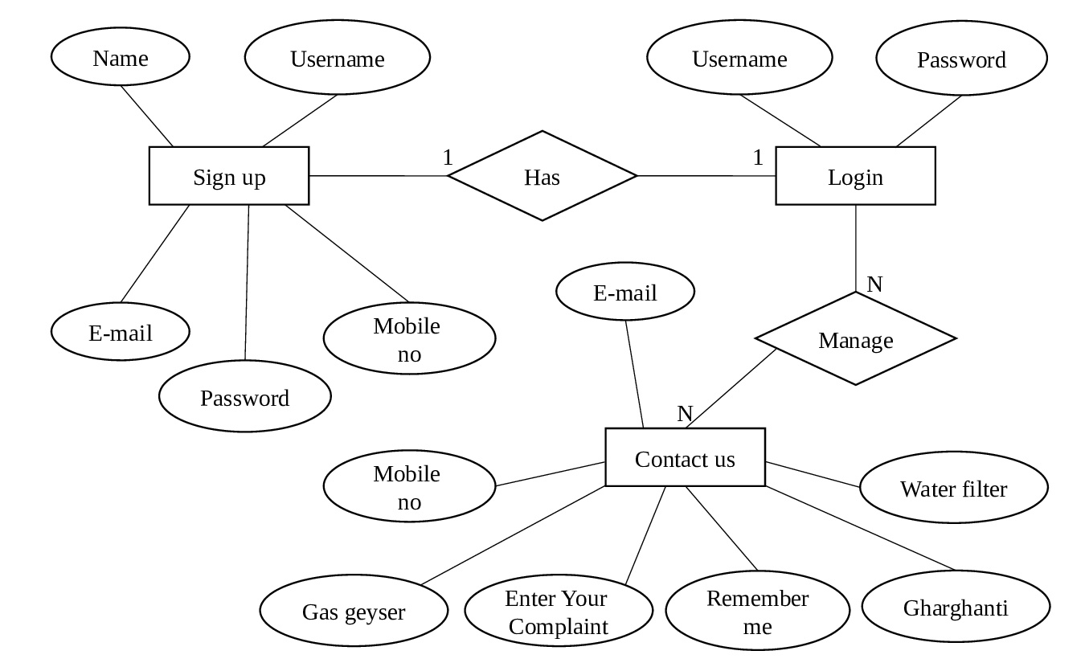
ER Diagram
Shree Uttar Gujarat BCA College

Slide 14
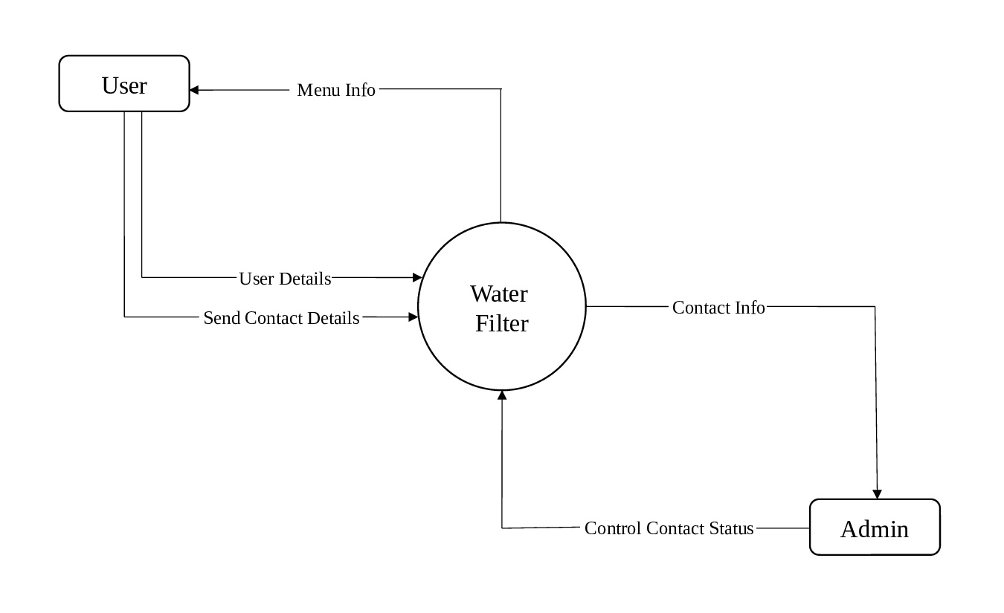
Data Flow Diagrams DFD
Zero Level:
Shree Uttar Gujarat BCA College

Slide 15
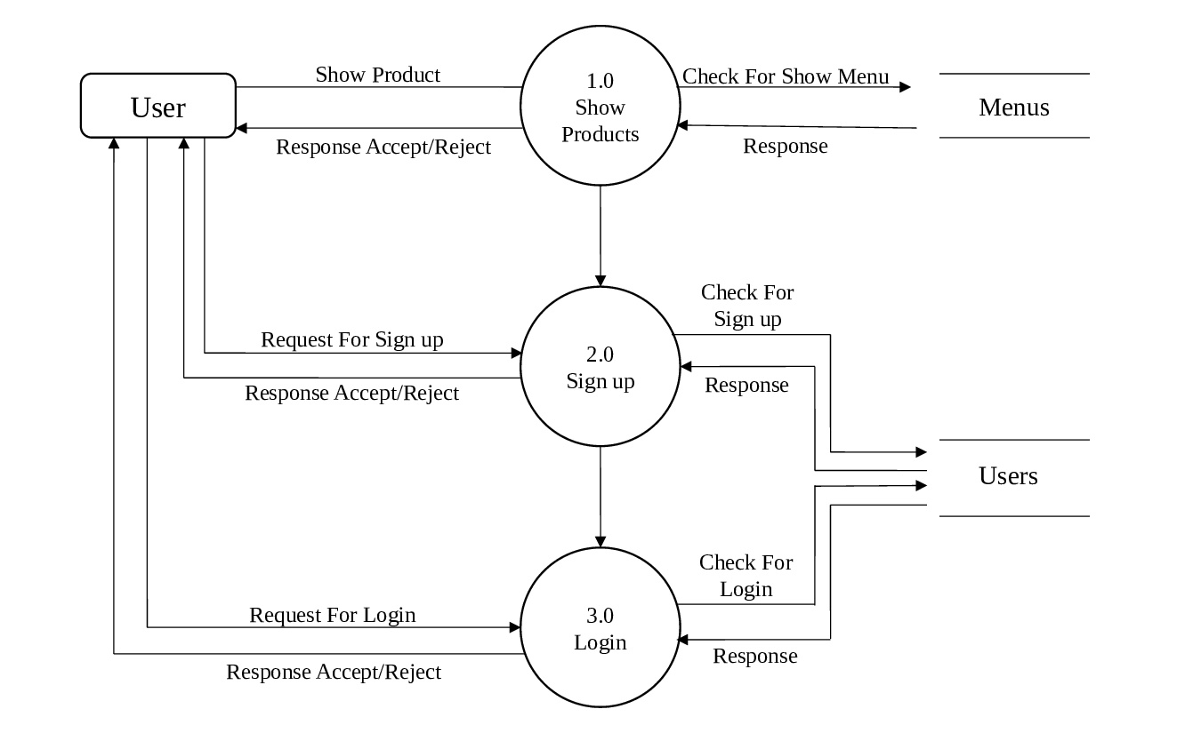
Continue….
First Level:
Shree Uttar Gujarat BCA College

Slide 16
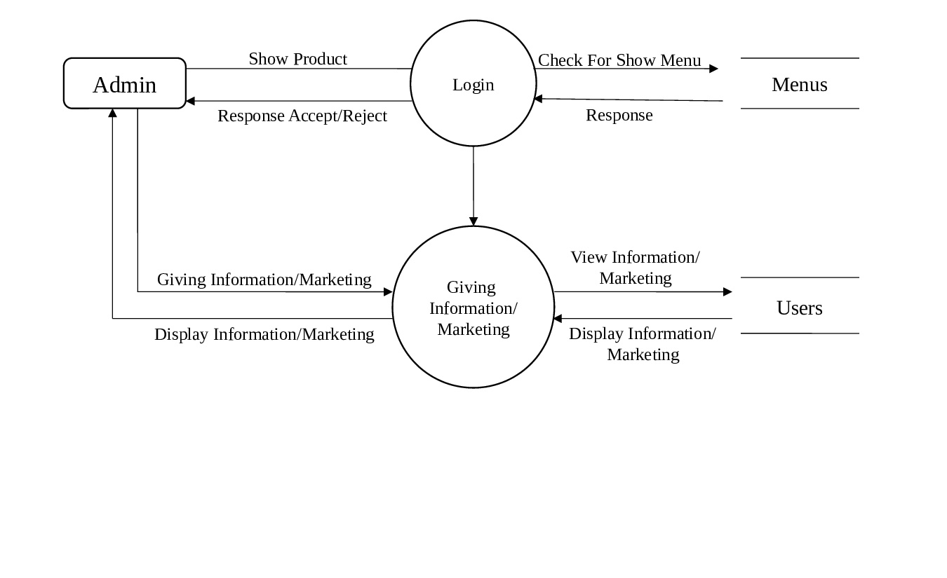
Continue….
Second Level:
Shree Uttar Gujarat BCA College

Slide 17
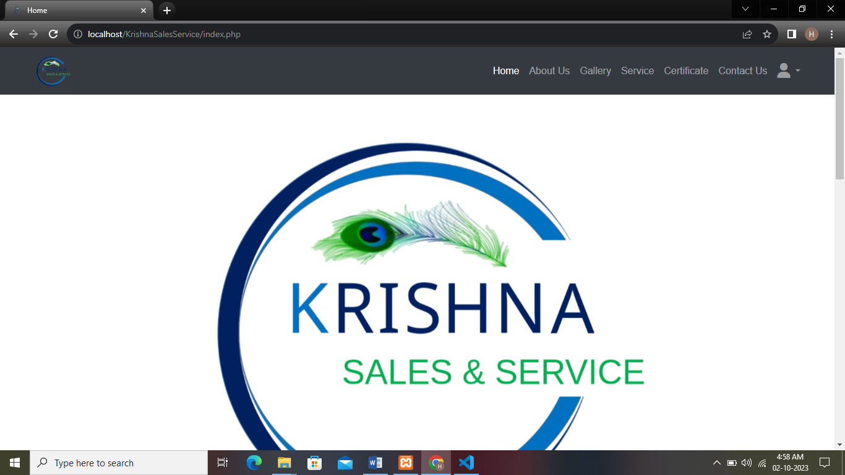
Project Screens
Shree Uttar Gujarat BCA College

Slide 18
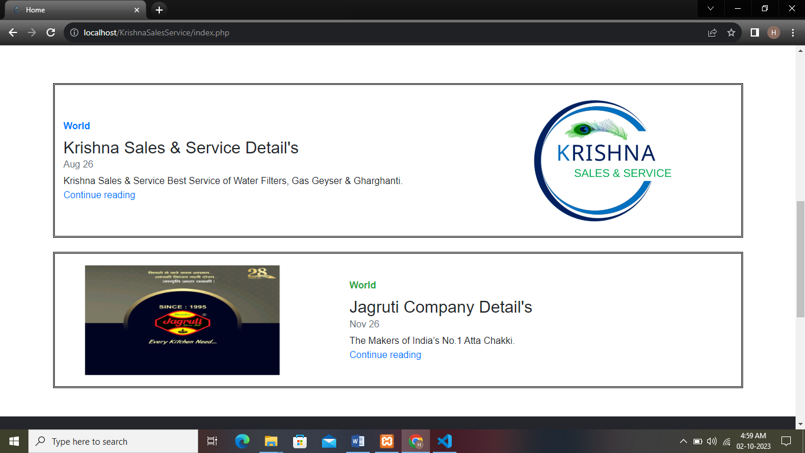
Shree Uttar Gujarat BCA College

Slide 19
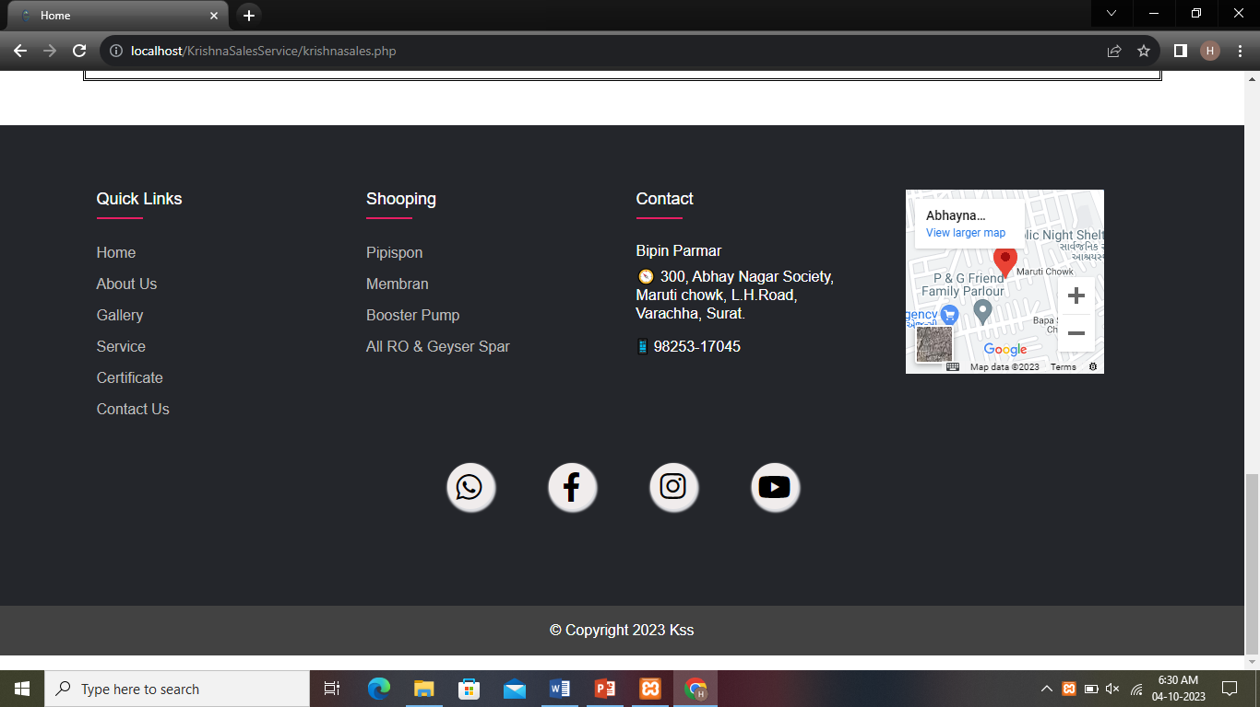
Shree Uttar Gujarat BCA College

Slide 20
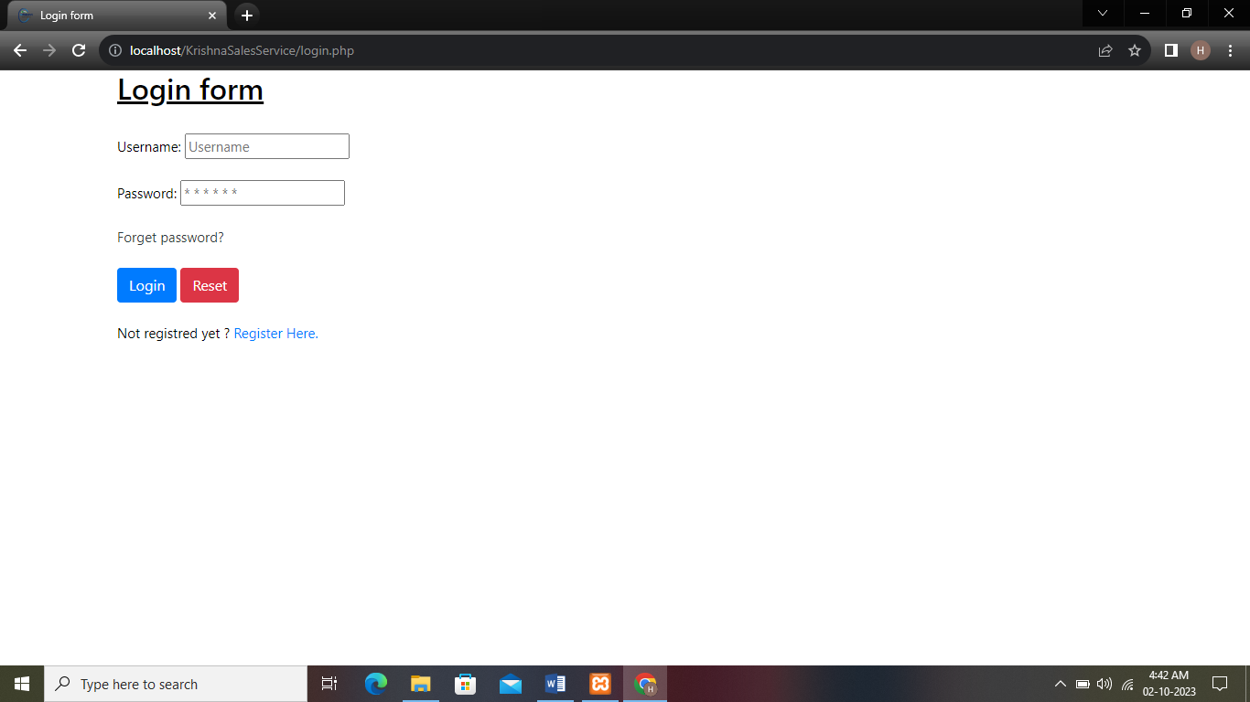
Shree Uttar Gujarat BCA College

Slide 21
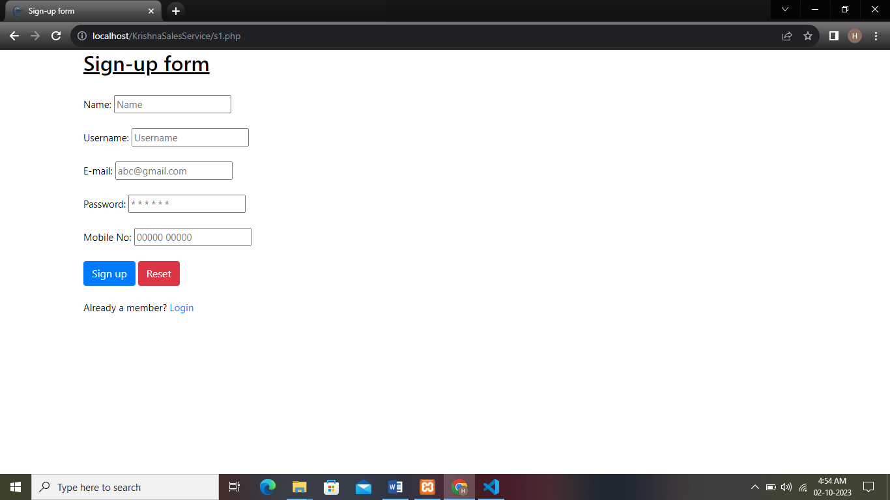
Shree Uttar Gujarat BCA College

Slide 22
Disadvantages
Disadvantages:
Using a non-user-friendly dashboard:
One of the main reasons your software can bring your business down is using non-user-friendly water filter software. If the water filter software you are using for your business is difficult to use, incomprehensible, and many of your customers may not be able to fully utilize it, it may not be desirable for your business.
Accuracy:
There are many software available that do not give accuracy to your business. They created non-accurate reports which can cause you a lot of trouble. Because the owner knows how his business is going and how much profit he will get. But at the end of the month if the software gives wrong report then the pump will be damaged.
Shree Uttar Gujarat BCA College

Slide 23
Conclusion
A project named Water Filter website was studied in depth and analyzed for code design and implementation. It was done under the guidance of an experienced project guide. All current needs and possibilities have been taken care of during the project time.
Shree Uttar Gujarat BCA College

Slide 24
References
For PHP
https://www.php.net
https://www.w3schools.com/php/

Slide 25
Thank You Very Much!!!!

