Slide 1
BTP Presentation
Himanshu
18ME10024

Slide 2
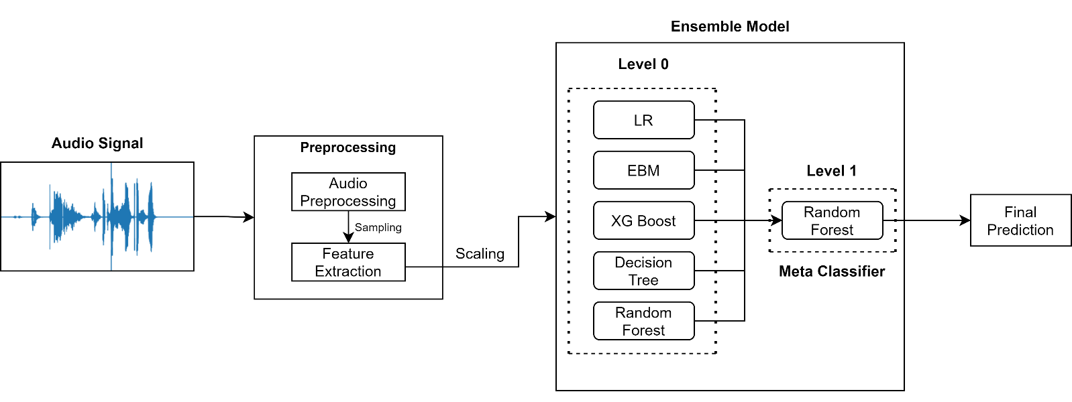
Introduction
Creating a Model for Detection of Cough in Audio Recordings
COVID-19 Cough Pattern Analysis
Notes:
COVID-19 was first identified on January 2020 in Wuhan, China; since then, much technological advancement is already in place to identify COVID-19 patients.
Here, I present a COVID-19 cough classifier that would help in contactless detection of COVID-19 patients by analysing their audio cough samples.
The report demonstrates five machine learning classification models and combines those models into an ensemble model with 25 features.
- The results are promising, scoring accuracy of 99.3%, a sensitivity of 99% on validation data with an Area under the ROC curve of 0.97.

Slide 3
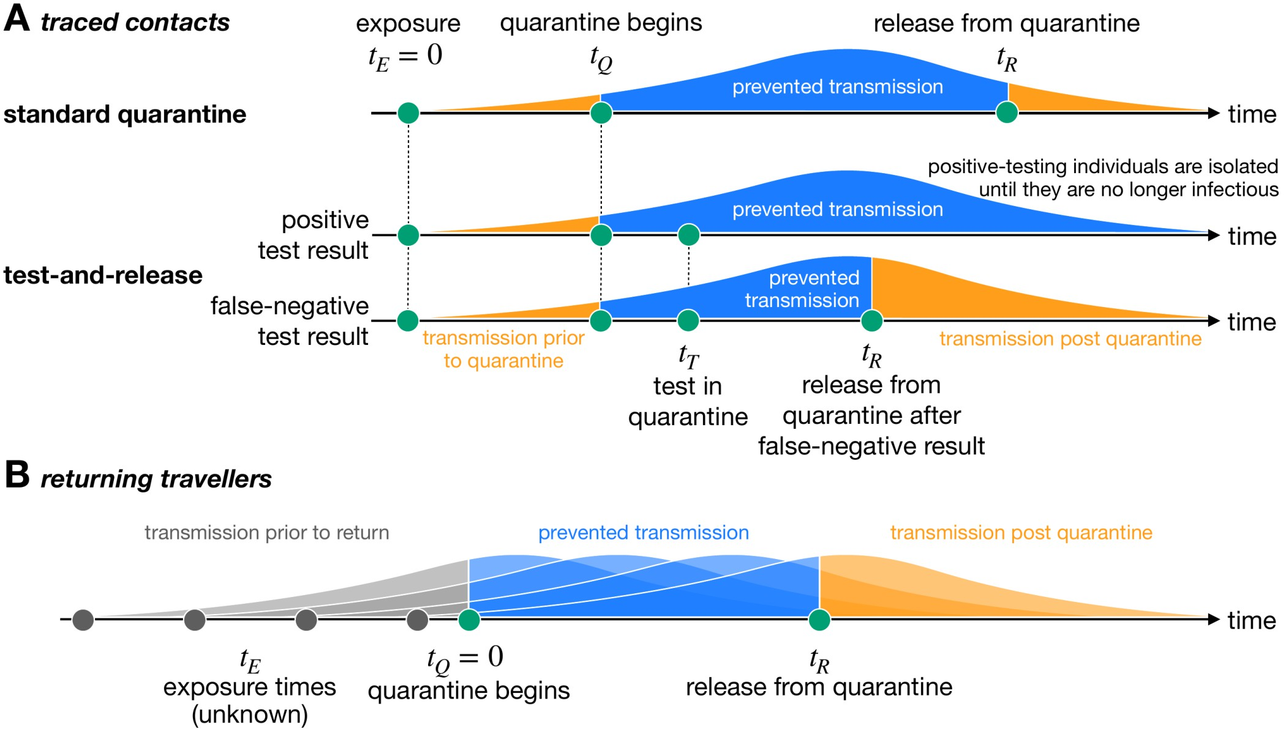
Motivation and Existing Solution
Increased rate of Testing has led to significant prevention in transmission of COVID 19
Frequent Testing can be really affective at catching COVID – 19 infections and potentially blocking transmission
Existing Solution: RTPCR Kits
Takes at least 24 hours to get results
Limited frequency of tests
Doesn’t account for new strains
Can be performed only by medical professionals
Notes:
Motivation and Existing solution: Studies have pointed out that Frequent COVID-19 testing is the key to efficient and early detection of COVID - 19(Pt 1 and 2). A study has even pointed out that Testing half the population weekly would drive the virus toward elimination within weeks – even if those tests are significantly less sensitive than clinical tests.
The image shown here shows the present scenario of how testing along with quarantine can potentially block transmission (even with false negative results):
1. Standard Quarantine + No Testing → here if the person is carrying the disease and is Asymptomatic, he will continue to transmit disease post quarantine
Now, with test results:
2. If a person has a positive test result, he will be isolated and hence the transmission is prevented.
3. If the test results is inaccurate and the person is wrongly detected as covid negative, keeping him in isolation till the test results will also lead to prevention in transmission.
The current testing method RTPCR has certain disadvantages as listed here:
1.
2.
3.
4.
Researchers say that when it comes to public health, it's better to have a less sensitive test with results today than a more sensitive one with results tomorrow(https://www.business-standard.com/article/current-affairs/frequent-rapid-testing-can-cripple-coronavirus-within-weeks-study-120112300270_1.html), Frequent Testing: https://www.journalofhospitalinfection.com/article/S0195-6701(21)00287-5/fulltext

Slide 4
Motivation
Increased rate of Testing has led to significant prevention in transmission of COVID 19
Frequent Testing can be really affective at catching COVID – 19 infections and potentially blocking transmission
Existing Solution: RTPCR Kits
Takes at least 24 hours to get results
Limited frequency of tests
Doesn’t account for new strains
Can be performed only by medical professionals
Notes:
In the previous sem BTP, I found that there was a correlation between the type of cough and certain metrics which I extracted from those coughs.
But these metrics were difficult to understand and comprehend
I wanted to now analyse the coughs using metrics which were easily understandable

Slide 5
Problem Statement
Can we make a COVID-19 detection method which:
Can give accurate test results in relatively less time?
Can be performed more frequently (hourly/daily)?
Can detect New Strains?
Can be performed without Medical Assistance?
Can be cheaper than RTPCR?
Notes:
The Existing solution which is the RTPCR has certain disadvantages as discussed in the previous slide, I try to address these questions in my COVID Detection model.
(The first Q is) 1. can we get accurate test results with reduced waiting time
2. Currently, experts have suggested that RTPCR tests be taken after a gap of at least 14 days. Here the question is Can we propose a method using which we can conduct tests more frequently? This can significantly bring down transmission as the potentially infected person can immediately isolate or get treated after he is diagnosed as covid positively.
3. New Strains of COVID 19 are not detected by RTPCR, can it be detected in any way?
4. Is there a way to perform the tests without having to visit testing centres or without any medical supervision?
5. RTPCRs are very costly with their price ranging from Rs 500 to 1500. Can we have tests which are more cost effective?
Source: https://health-desk.org/articles/how-many-days-after-exposure-should-one-be-tested-to-yield-the-most-accurate-results-and-with-which-test

Slide 6
Literature Review
In recent years, studies have suggested the use of acoustic features for identifying respiratory diseases in cough signals
Several studies have used Machine Learning techniques to process respiratory data and cough sounds
Researchers have also found some alteration in frequency characteristics of sound due to presence of COVID-19 in the lungs
Certain metrics like MFCCs(Mel Frequency Cepstral Coefficients), Zero Crossing Rate, Spectral Centroid have become state-of-the-art features to extract information out of sounds
Techniques like Deep Learning, Hidden Markov Models, Support Vector Machines have been used to detect cough sounds in voice recordings and to detect presence of COVID – 19 in cough sounds
Notes:
Pt 1.: This review attempts to summarize the vital studies in cough detection and identify diseases based on cough audio samples' features like frequency, duration, and intensity
Pt 2.:
Pt 3.:
Pt 4.: Which works on the sample principle of detecting the presence of certain frequency

Slide 7
Novelty
Usage of Interpretable Models to understand the output of Individual Models
Usage of Ensemble learning to combine the output of these Models
Creation of Web Application for increasing the usability of the Model
Tested the Application in Real time on COVID-19 positive patients admitted in Visakhapatnam Steel General Hospital
Notes:
One More Point -- DONE

Slide 8
Methodology
Data Sources Used in the Project:
1279 Cough Recordings were obtained from The Indian Institute of Science, Bangalore and is available on GitHub
164 Cough Recordings were obtained from The University of Manchester and is available on Mendeley
Notes:
Dataset used to train my Machine Learning models have been obtained from two sources: IISc Bangalore and The University of Manchester
Here you can see the distribution of COVID Positive and COVID Negative cough Recording.
Researchers say that COVID-19 has a different response with respect to the country's geographical location; hence, I have given more emphasis to collecting data from Indian resources to make the model more relevant for this climatic condition.
CEBM: https://www.cebm.net/covid-19/effect-of-latitude-on-covid-19/

Slide 9
Methodology
Data Sources Used in the Project:
1279 Cough Recordings were obtained from The Indian Institute of Science, Bangalore and is available on GitHub
164 Cough Recordings were obtained from The University of Manchester and is available on Mendeley
Notes:
Dataset used to train my Machine Learning models have been obtained from two sources: IISc Bangalore and The University of Manchester
Here you can see the distribution of COVID Positive and COVID Negative cough Recording.
Researchers say that COVID-19 has a different response with respect to the country's geographical location; hence, I have given more emphasis to collecting data from Indian resources to make the model more relevant for this climatic condition.
CEBM: https://www.cebm.net/covid-19/effect-of-latitude-on-covid-19/

Slide 10
Methodology
Cough sound carries underutilized respiratory health information
COVID-19 influences the lower respiratory system in a distinctive way
Comparing COVID-19 and Non-COVID-19 patients’ cough recordings will help us differentiate and detect COVID-19 patients
Machine Learning techniques can be used to discover hidden patterns in COVID-19 cough sounds
Notes:
Now that we have the data, we need to understand why we are taking this approach to detect COVID-19. Hence we need to Before understanding how the features were extracted, we need to understand 1. Why we are taking this approach? and 2. Why we are extracting these features?
Pt 1.: Studies have reported that Cough sound contains vital underutilised respiratory health info, which can be used for analysis
Pt 2.: Methods like X-rays and Chest CT scans have been used to identify COVID-19 patients, these methods have suggested that the COVID-19 influences the LRS in a distinctive way
Pt 3.: Capturing and comparing the time-varying characteristics would help us reveal important patterns/differences in COVID-19 and Non-COVID-19 cough sounds
Pt 4.: Comparing such huge numerical database is not possible manually, hence machine learning techniques are used for the finding the hidden patterns in cough sounds
COVERED -- Extra Pt: These minor differences can not be manually processed hence we can use Machine Learning for the comparison
- Before applying the machine learning techniques we need to convert the cough sound waves from analog signal to a digital signal
-* Cough Sound recordings are analog signals and need to be converted to digital signals for further processing

Slide 11
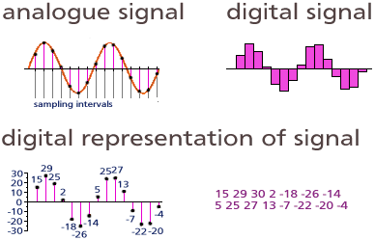
Analog Digital Converter (ADC):
Analogue Signal → Digital Signal → Digital Representation of the obtained points → Array of numbers
Here the Sampling Rate is fixed to 22050 Hz for all cough samples
This process is performed using Python’s Librosa Library
Notes:
-** Analog Digital Conversion (ADC) consists of 3 steps → Sampling ,Quantization and Encoding
Sampling: Here we try to freeze the signal, this is done by taking samples of the wave after a specified time interval (The inverse of this interval is called sampling rate), this is shown under Analogue signal
Quantization: - After sampling we have a discrete time continuous valued signal, this signal is then converted to discrete time discrete valued signal using quantization.
- Here the reference signal is partitioned into several discrete quanta and then the input signal is matched with the correct quantum. This is shown under digital signal.
Encoding: Here; for each quantum, a unique digital code will be assigned and after that the input signal is allocated with this digital code. These digital codes are stored in form of an array as shown on the right under digital representation of signal

Slide 12
Feature Extraction :
COVID-19 is said to cause inflammation of the upper airway and larynx
This inflammation affects the flexibility of the vocal cords hence cause minor alterations in frequency
25 time-frequency features are extracted from each cough audio sample to observe these alterations
Here 5 of the features are mean of instantaneous frequency peaks of each audio wave
Rest 20 features are Mel Frequency Cepstral Coefficients (MFCCs)
Notes:
WHY FEATURES --Now that we have the cough audio signals in digital format we need to identify which features to extract in order to obtain maximum spectral information in the cough.
Studies have found that COVID causes inflammation in upper airway and larynx which alters the flexibility of Vocal cords hence affecting the frequency of cough sounds
These time-frequency features are extracted to understand the frequency alterations due to presence of COVID-19 and use this principle to build our Machine Learning Model

Slide 13
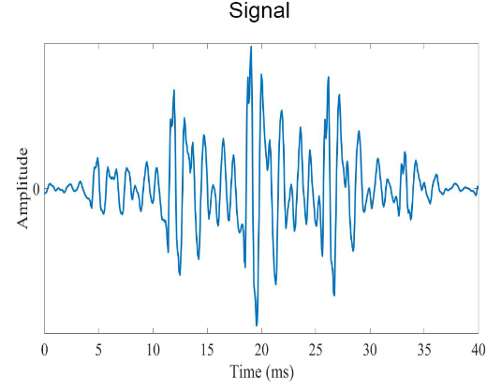
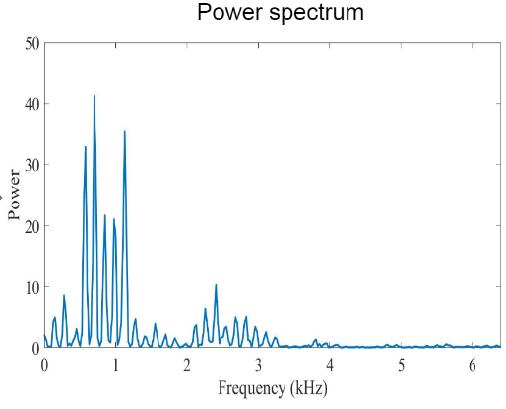
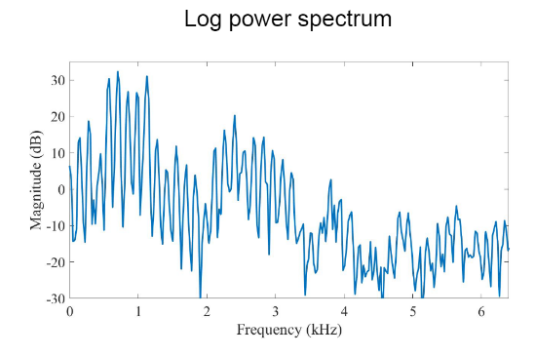
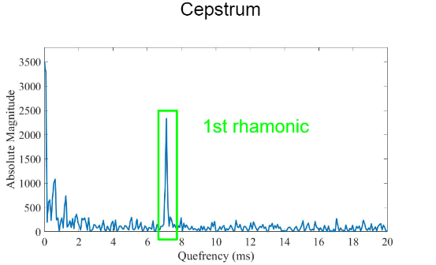



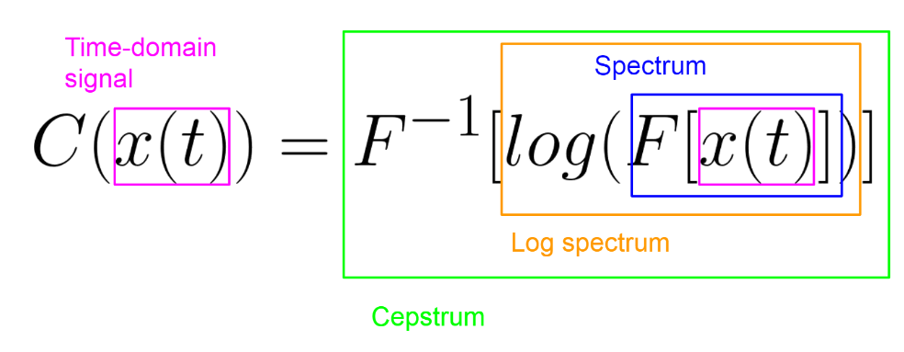

Mel Frequency Cepstral Coefficients (MFCCs) :
MFCC of a signal are a set of features which reveals the variation of the signal’s frequency content as time evolves
Extraction Process:
DFT → Discrete Fourier Transform
IDFT → Inverse DFT
$$Magnitude(dB)=10log⁡\left(\frac{Power}{{Power}_{0}}\right)$$
Notes:
HOW FEATURES – MFCC
I will now explain how MFCC are extracted from the cough sound
Firstly, STFT is applied on the digital signal of cough sound,
STFT uses a sliding window function $g(t)$ centred at time $τ$ to consecutively perform ‘time localised Fourier transform of the signal $x(t)$. The result reveals that the variation of the signal’s frequency content as time evolves.

Slide 14
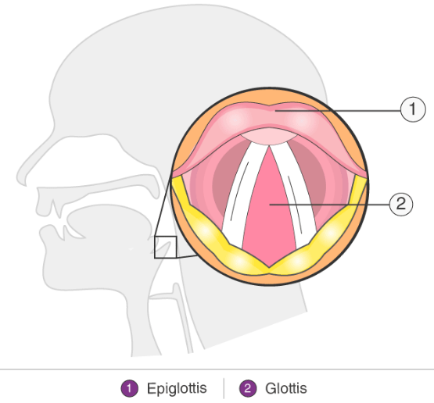
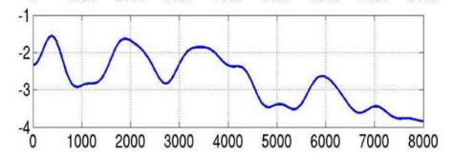
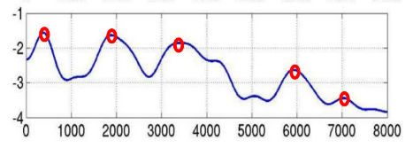
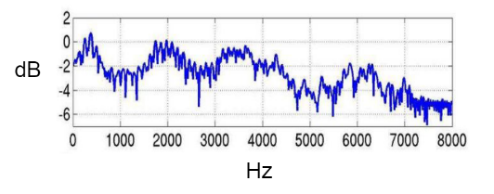
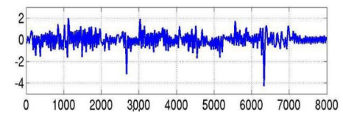
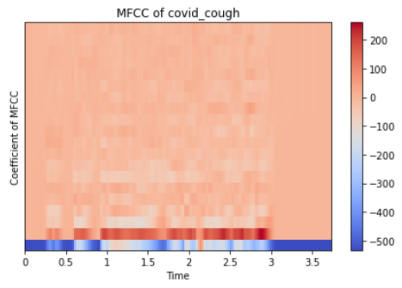
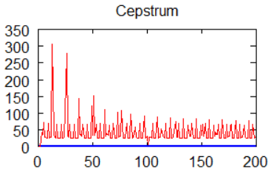
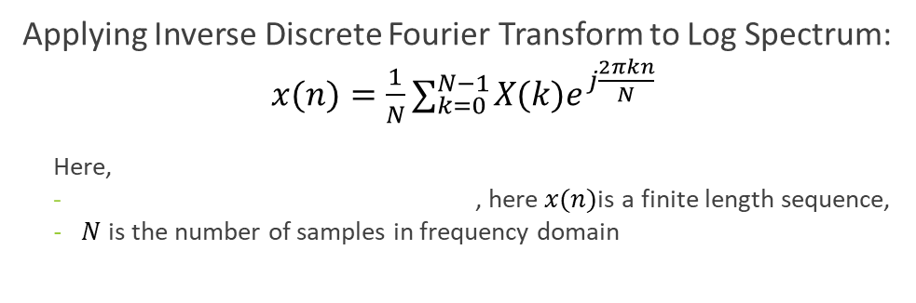
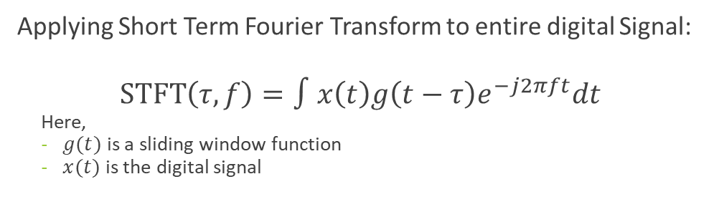

Mel Frequency Cepstral Coefficients (MFCCs) :
Log Spectrum due to Vocal Tract
Log Spectrum of portion of signal
IDFT
Vocal Tract
Glottis
Log Spectrum due to Glottal Pulse
First 20 Features are the required MFCCs
Applying Short Term Fourier Transform to entire digital Signal:
$$\operatorname{STFT}\left(τ,f\right)=∫x\left(t\right)g\left(t−τ\right)e^{−j2πft}dt$$
Here,
$g(t)$ is a sliding window function
$x(t)$ is the digital signal
Applying Inverse Discrete Fourier Transform to Log Spectrum:
$x(n)=\frac{1}{N}∑_{k=0}^{N−1} X(k)e^{j\frac{2πkn}{N}}$
Here,
, here$x(n)$is a finite length sequence,
$N$is the number of samples in frequency domain
$$DFT →X(k)=∑_{n=0}^{N−1} x(n)e^{−j\frac{2πkn}{N}}$$
Notes:
HOW FEATURES – MFCC
The Log spectrum graph obtained in the previous slide can be divided into 2 parts, one is due to.
COVID-19 alters the flexibility of vocal cords
The frequency of these peaks carries the identity of the cough hence is able to distinguish between COVID and Non- COVID cough
Now, After applying the IDFT, we obtain the occurrences (get the frequency) of different peaks present in the log spectrum graph
Y-value corresponding to the first 20 coordinates on X-axis are the first 20 MFCCs of that portion of cough signal
The mean of these 20 MFCCs of all the portions of the cough signal represents the first 20 MFCCs of the entire cough
The method of applying the DFT to small portion of cough signal is performed by applying STFT to the entire signal

Slide 15
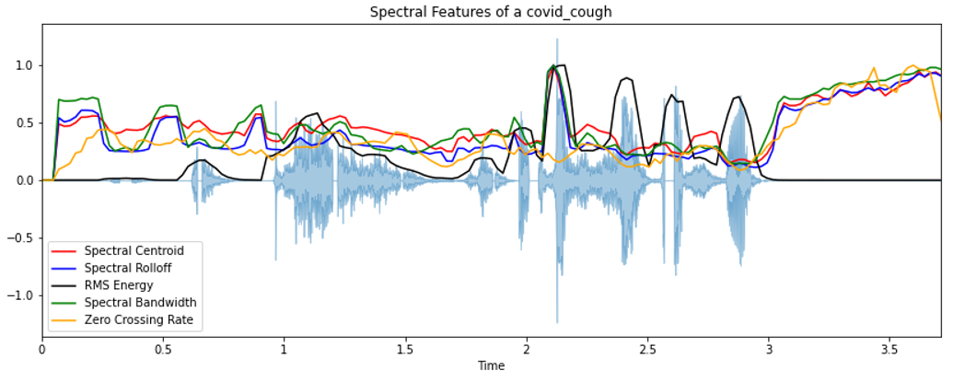
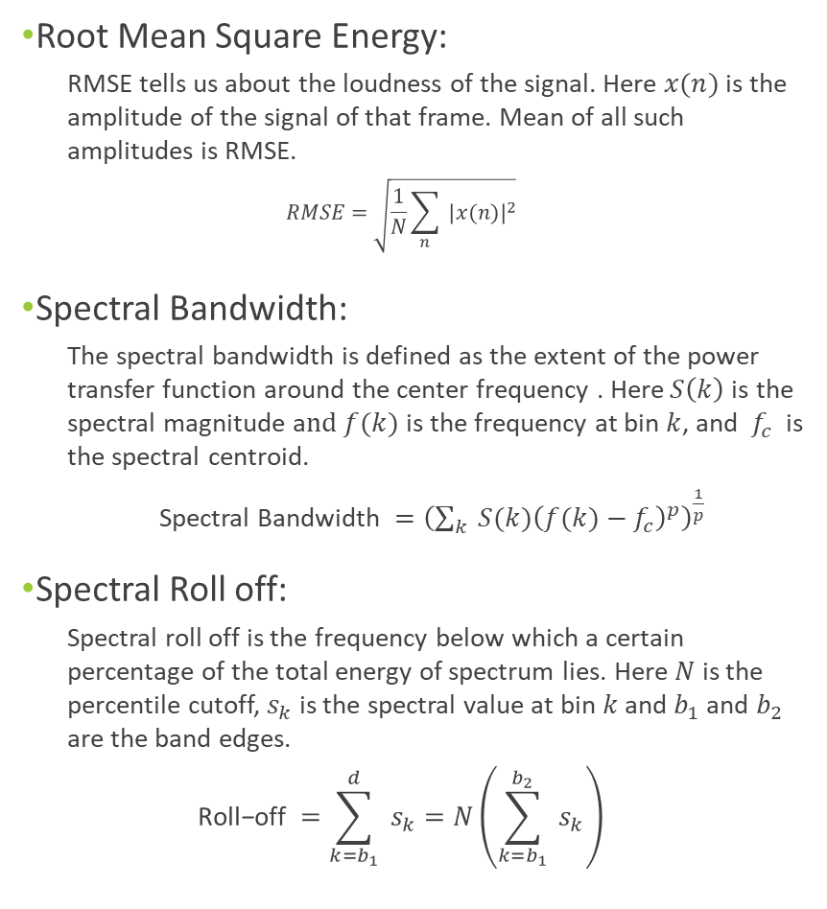
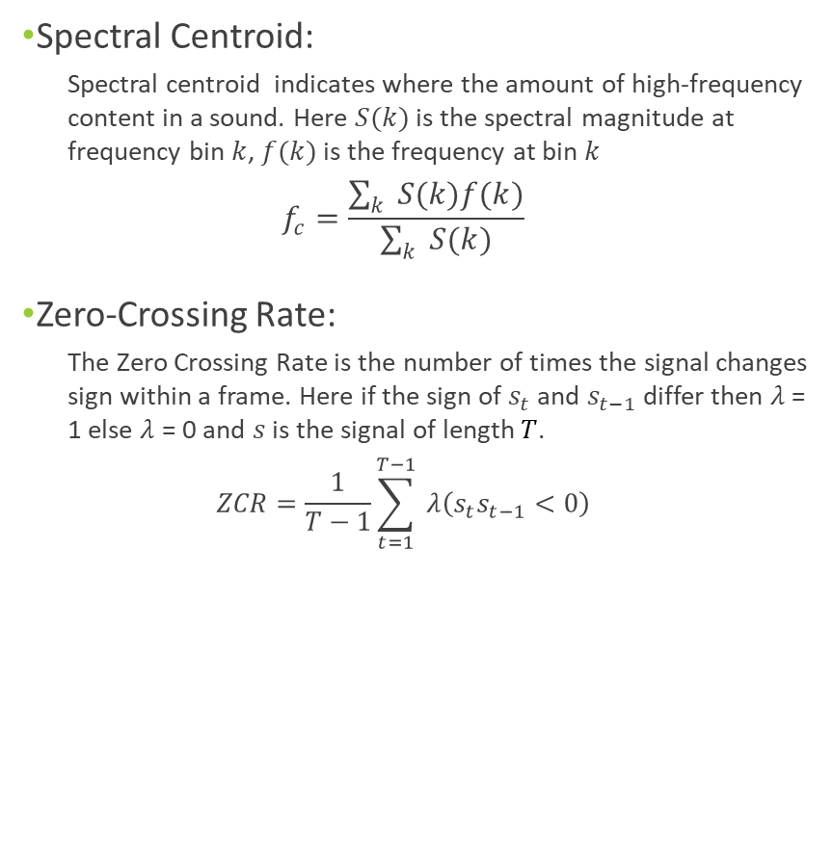
Root Mean Square Energy:
RMSE tells us about the loudness of the signal. Here $x(n)$ is the amplitude of the signal of that frame. Mean of all such amplitudes is RMSE.
$$RMSE=\sqrt{\frac{1}{N}\sum_{n}{ }|x(n)|^{2}}$$
Spectral Bandwidth:
The spectral bandwidth is defined as the extent of the power transfer function around the center frequency . Here$S\left(k\right)$is the spectral magnitude a$nd f(k)$ is the frequency at bin $k$, and $f_{c}$ is the spectral centroid.
Spectral Bandwidth$={\left(\sum_{k}{ }S(k){\left(f(k)−f_{c}\right)}^{p}\right)}^{\frac{1}{p}}$
Spectral Roll off:
Spectral roll off is the frequency below which a certain percentage of the total energy of spectrum lies. Here $N$ is the percentile cutoff, $s_{k}$ is the spectral value at bin $k$ and $b_{1}$and $b_{2}$ are the band edges.
$$\text{Roll}\text{−}\text{off} =\sum_{k=b_{1}}^{d}{ }s_{k}=N\left(\sum_{k=b_{1}}^{b_{2}}{ }s_{k}\right)$$
Spectral Centroid:
Spectral centroid indicates where the amount of high-frequency content in a sound. Here $S(k)$ is the spectral magnitude at frequency bin $k$, $f(k)$ is the frequency at bin $k$
$$f_{c}=\frac{\sum_{k}{ }S(k)f(k)}{\sum_{k}{ }S(k)}$$
Zero-Crossing Rate:
The Zero Crossing Rate is the number of times the signal changes sign within a frame. Here if the sign of $s_{t}$ and $s_{t−1}$ differ then $λ$ = 1 else $λ$ = 0 and $s$ is the signal of length $T$.
$$ZCR=\frac{1}{T−1}\sum_{t=1}^{T−1}{ }λ\left(s_{t}s_{t−1}<0\right)$$
Notes:
HOW FEATURES
The rest of the features are as follows:
RMSE: Root Mean Square Energy’s magnitude is the energy of the signal. It tells us about the loudness of the audio signal. RMSE is the square root of the mean square (the average of the squares of the magnitude of the audio frames). We take the mean of all such amplitudes.
S RF: Spectral roll off is the frequency below which a certain percentage of the total energy of spectrum lies. In our case, I have taken that percentage as 85% percentage.
S.B: The spectral bandwidth is defined as the extent of the power transfer function around the center frequency which is the spectral roll off.
S.Centroid: Spectral centroid is a measure to compute the “center of mass” of a given spectrum. It tells us about where the energy of the high frequency content is concentrated
ZCR: The Zero Crossing Rate is the number of times the signal changes sign within a frame

Slide 16
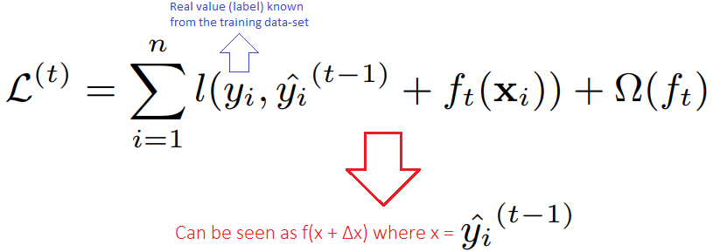
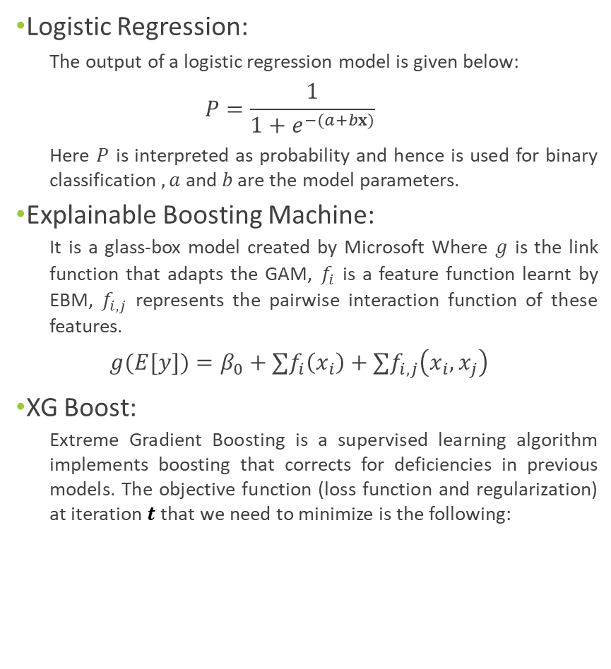
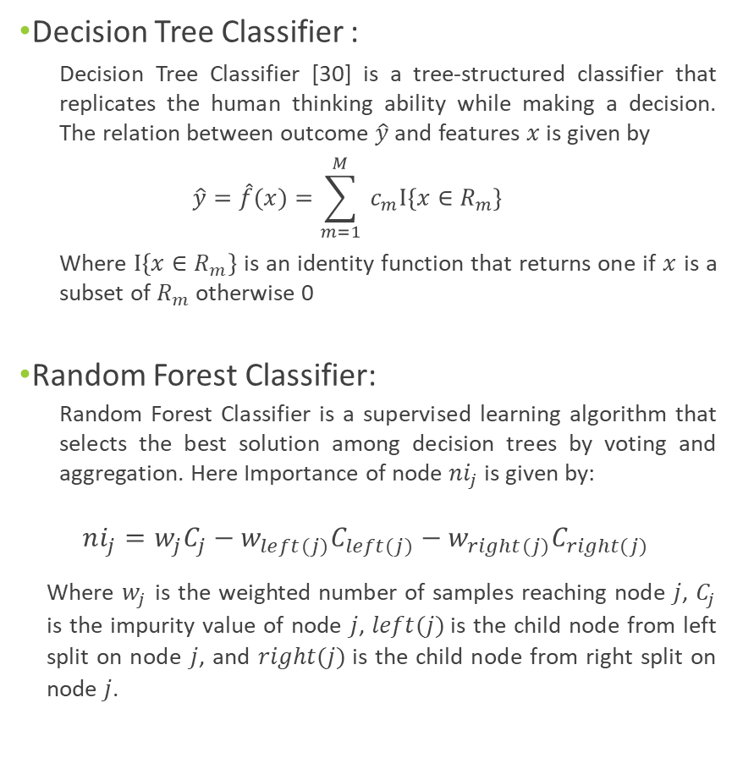
Logistic Regression:
The output of a logistic regression model is given below:
$$P=\frac{1}{1+e^{−(a+bx)}}$$
Here $P$ is interpreted as probability and hence is used for binary classification $,a$ and $b$ are the model parameters.
Explainable Boosting Machine:
It is a glass-box model created by Microsoft Where $g$ is the link function that adapts the GAM, $f_{i}$ is a feature function learnt by EBM, $f_{i,j}$ represents the pairwise interaction function of these features.
$$g(E[y])=β_{0}+∑f_{i}\left(x_{i}\right)+∑f_{i,j}\left(x_{i},x_{j}\right)$$
XG Boost:
Extreme Gradient Boosting is a supervised learning algorithm implements boosting that corrects for deficiencies in previous models. The objective function (loss function and regularization) at iteration $t$that we need to minimize is the following:
Decision Tree Classifier :
Decision Tree Classifier [30] is a tree-structured classifier that replicates the human thinking ability while making a decision. The relation between outcome $\hat{y}$ and features $x$ is given by
$$\hat{y}=\hat{f}(x)=\sum_{m=1}^{M}{ }c_{m}I\left\{x∈R_{m}\right\}$$
Where $I\left\{x∈R_{m}\right\}$ is an identity function that returns one if $x$ is a subset of $R_{m}$ otherwise 0
Random Forest Classifier:
Random Forest Classifier is a supervised learning algorithm that selects the best solution among decision trees by voting and aggregation. Here Importance of node $ni_{j}$ is given by:
$ni_{j}=w_{j}C_{j}−w_{left(j)}C_{left(j)}−w_{right(j)}C_{right(j)}$
Where $w_{j}$ is the weighted number of samples reaching node $j$, $C_{j}$ is the impurity value of node $j$, $left(j)$is the child node from left split on node $j$, and $right(j)$is the child node from right split on node $j$.
Notes:
INDIVIDUAL MODELS
LR:
EBM: . It is a modification of a generalized additive model. Where $g$ is the link function that adapts the GAM, $f_{i}$ is a feature function that is learned by EBM Explainable Boosting Classifier using machine learning techniques like Gradient Boosting and Bagging, $f_{i,j}$ represents the pairwise interaction function [29] of these features. Being an additive model, contributions of each feature to the prediction can be observed and hence these contributions can be understood, making the model completely interpretable.
XGBOOST: It is a supervised learning algo which uses Boosting technique to correct for deficiencies created in previous models. This is the object function which comprises of loss function and regularization.
Dtree: The relation between outcome $\hat{y}$ and features $x$ is given by the formula. Where $I\left\{x∈R_{m}\right\}$ is an identity function that returns one if $x$ is a subset of $R_{m}$ otherwise 0. Here Rm is a subset or leaf node.
RFC: Random Forest Classifier is a supervised learning algorithm that fits decision trees on randomly selected subsamples, and selects the best solution among these trees by voting and aggregation

Slide 17
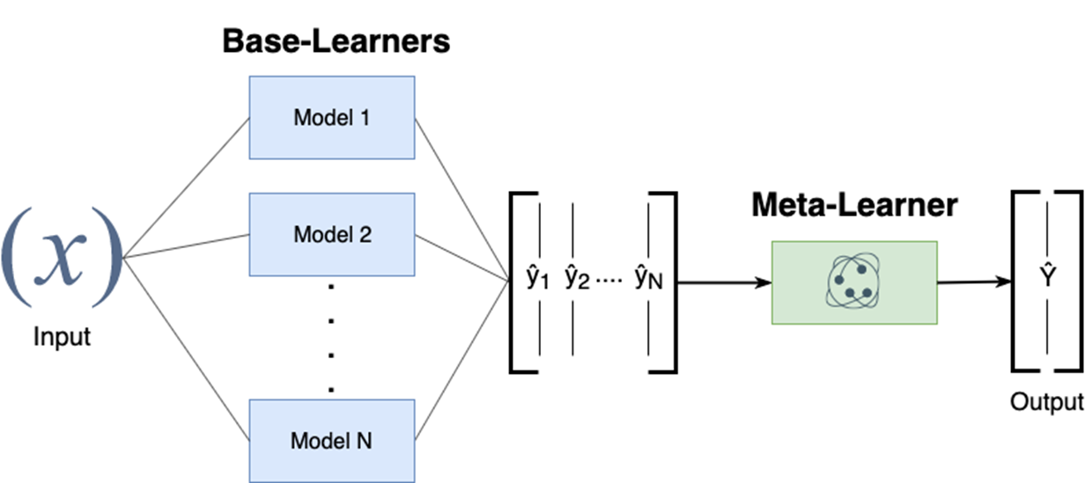
Ensemble Model:
Stacking Ensemble used to combine predictions of different models
Ensemble Techniques are known to increase classification accuracy and avoid overfitting
Notes:
ENSEMBLE MODELS *The idea here is to combine models with more explainability and more precision*
Combined the models and trained the ensemble model on train dataset
Base Model or Base Learners are those models which fit the training data and the predictions are made
Meta model or Meta Learners is the model which learns how to combine the predictions of the Base models best
Here, Logistic Regression, Explainable Boosting Machine, XG Boost, Decision Tree and Random Forest Classifier has been used as “Level 0” models. Random Forest Classifier has been used as the “Level 1” model.
Further Explanation:

Slide 18
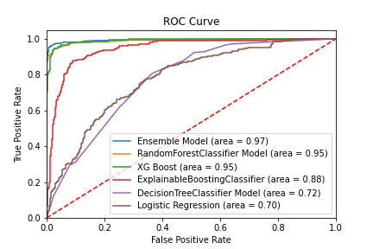
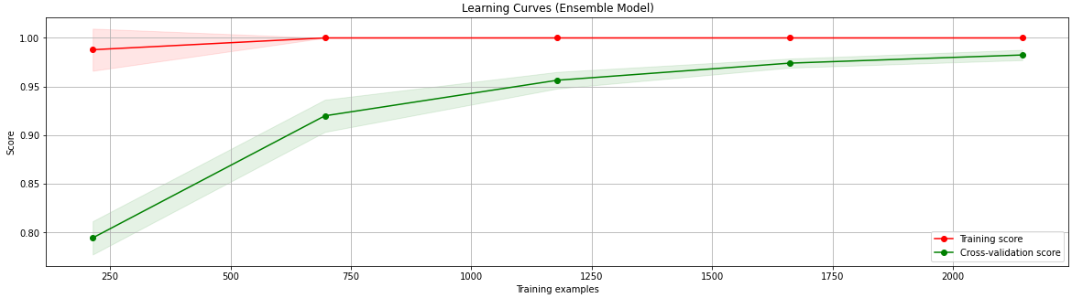
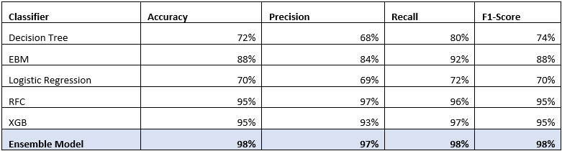
Results
Two Important Metrics:
Correct Detection of COVID-19 Positive Patients (Recall)
Precise detection of such Patients (Precision)
Here Recall and ROC curve was used to evaluated the model as wrongly identifying an infected patient can lead to further transmission of the Virus
Notes:
RESULTS
For evaluating our model, there are 2 important metrics.
Correctly identifying all the COVID-19 Positive Patients including the asymptotic ones → Recall: Recall is the measure of the Total True positives (in this case COVID positive patients’ cough) detected by the Model
This metric is more important as we can not let a COVID-19 Positive patient get tested as Negative as that would lead to increased transmission, hence Recall is the correct metric for evaluating the models used for detecting COVID positive patients, and a Recall of 1 would be ideal for such a model.
Correct differentiation between COVID-19 and Non-COVID-19 patients’ cough
Learning Curve of the Model → Used to check if the model was overfitting the dataset which was not the case
Table → As we can see the table, our Model has shown highest Recall and Precision

Slide 19
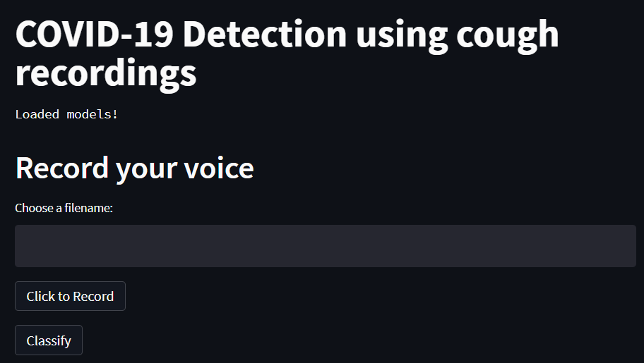
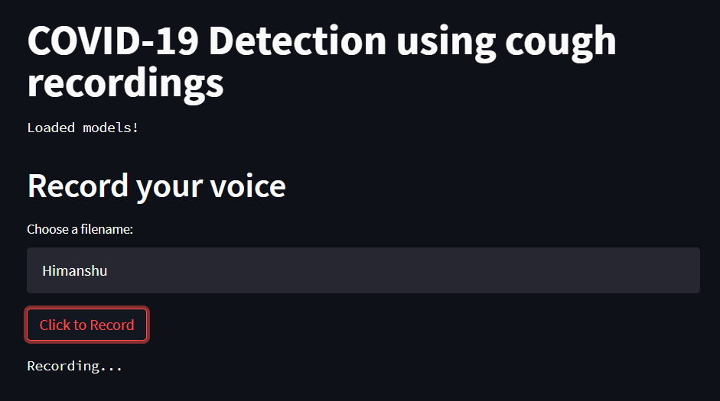
Web Application
Application created using Python and Streamlit Library
Ensemble Model Preloaded to reduce Waiting times
User prompted to input their name and record their cough for 5 seconds
Notes:
APP
Figure 1.: In the application, the user is the prompted to input their name and record their cough. Here I have taken a sample of my cough recording hence I have inserted my name. As we can see, the app starts recording the cough sounds. This recording is of a 5 second duration.

Slide 20
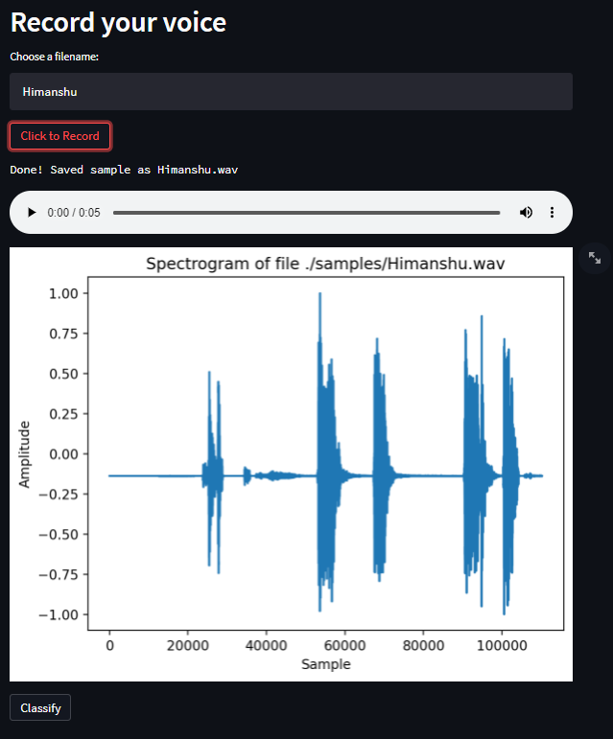
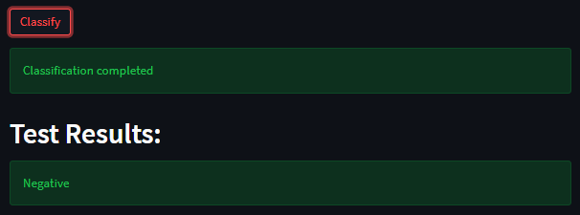
Web Application
After the recording is completed, the recording and the corresponding waveform (Amplitude vs Time) is displayed to the user
The recording is classified using the Ensemble Model.
After the classification, the user is displayed with the test result
Notes:
APP
Figure 1.: The user can listen to his/her recording to ensure that the cough has been accurately recorded.

Slide 21
App Results
The app was tested in real time on COVID-19 Positive Patients admitted in Visakhapatnam Steel General Hospital(VSGH)
Notes:
APP RESULTS:
The app was tested on 15 COVID-19 positive Patients. These patients belonged to Visakhapatnam Steel General Hospital. The app detected 13 of these patients correctly.

Slide 22
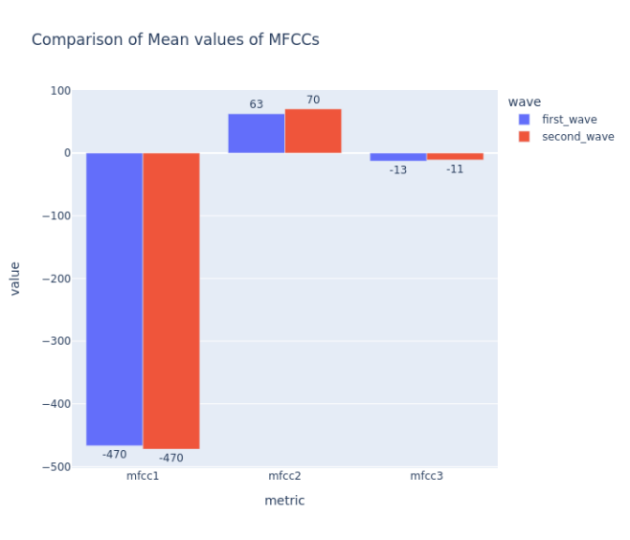
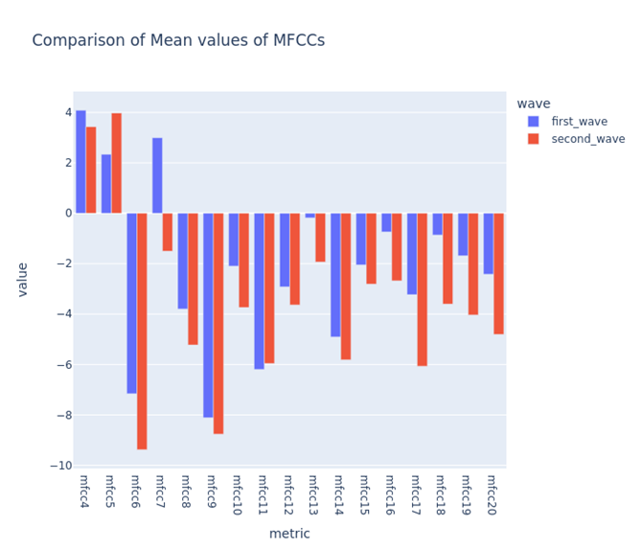
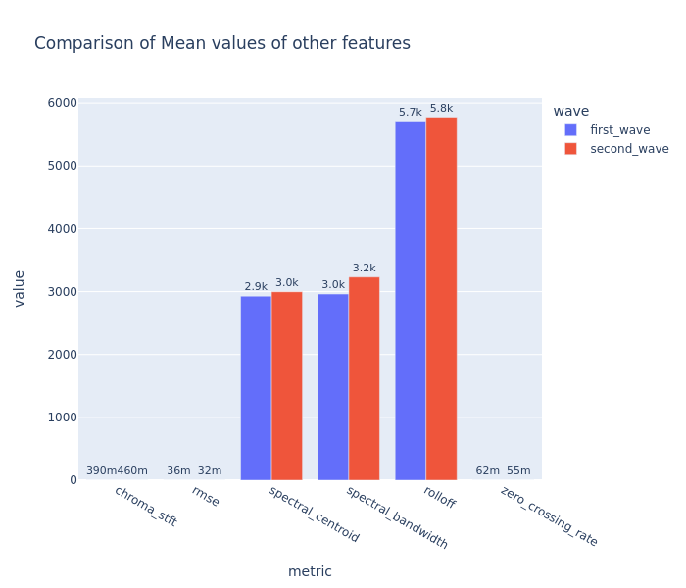
COVID 1ST AND 2ND WAVE COMPARISON
The available dataset was divided into two parts – First Wave Data and Second Wave Data
Mean value of Higher Order MFCCs showed Significant relative differences for the two waves
This meant that both waves showed differences in vocal tract movements at higher frequencies
Notes:
COVID 1ST AND 2ND WAVE COMPARISON
Method:
The cough recordings have been divided into two parts according to the wave they belonged to. The dataset dating from April 2020 to December 2020 was labelled as the First Wave. The dataset dating from March 2021 to August 2021 was labelled as the Second Wave.
The features were extracted as discussed above, and these features were grouped by their wave and analysed to find significant relative differences among both the waves. The Exploratory Data Analysis using visual methods, using python libraries like Dtale, Plotly, Seaborn

