Slide 1

“Travel is the only thing you buy that makes you richer.”

Slide 2
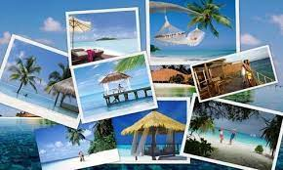
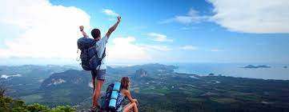
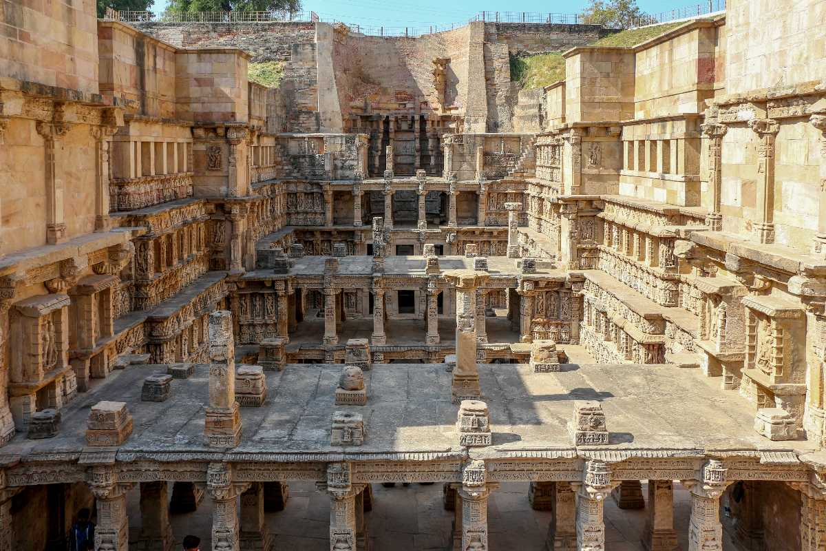
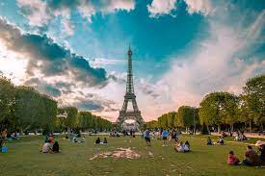

Slide 3
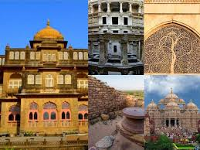
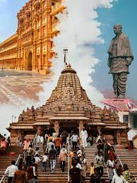
GUJARAT
Within Gujarat there are a wide variety of historic forts, palaces, mosques, temples, and places of historical importance in India's struggle for independence

Slide 4
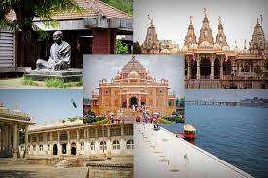
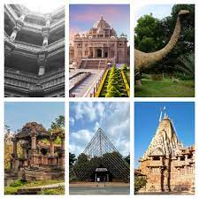
AHMEDABAD
Ahmedabad is a cultured city with a rich heritage of craft and theatre.

Slide 5
Comparing to Other websites:
My Tour:
Here , The videos and the information are uploaded together.
By uploading in this way , the visitors get help and they didn’t need to change the page.
Other Websites:
In other websites , the videos and information are uploaded separately.
Due to this the visitors have to go on another page and the video can be stop also.

Slide 6
Thank You
Hope You Enjoyed The Presentation.

