Slide 1
Sql for Datascience

Slide 2
Mysql Handler precedence
Text
In case you have multiple handlers that handle the same error, MySQL will call the most specific handler to handle the error first based on the following rules:
An error always maps to a MySQL error code because in MySQL it is the most specific.
An SQLSTATE may map to many MySQL error codes, therefore, it is less specific.
In short, the exceptions are handled in the following order:
MySQL error code handler,
SQLSTATE handler
SQLEXCEPTION handler

Slide 3
Using a named error condition
Text
MySQL provides a way to have named error conditions
The DECLARE CONDITION statement allows you to associate a name with an error condition.
DECLARE condition_name CONDITION FOR condition_value;
After the declaration, you can use condition_name in the place of condition_value .
BEGIN
DECLARE TableNotFound CONDITION for 1146 ;
DECLARE EXIT HANDLER FOR TableNotFound
SELECT 'Please create table abc first' Message;
SELECT * FROM abc;
END

Slide 4
Cursor
Mysql
A cursor is used to iterate through a result set returned by a SELECT statement in stored procedures. It allows you to iterate through a set of rows returned by a query and process each row individually.
Step 1 : Declare a cursor by using the DECLARE statement:
DECLARE cursor_name CURSOR FOR SELECT_statement;
Step 2 : Open the cursor by using the OPEN statement.
OPEN cursor_name;
Step 3 : Use the FETCH statement to retrieve the next row pointed by the cursor and move the cursor to the next row in the result set.
FETCH cursor_name INTO variables list;
Step 4 : Deactivate the cursor and release the memory associated with it using the CLOSE statement:
CLOSE cursor_name;

Slide 5
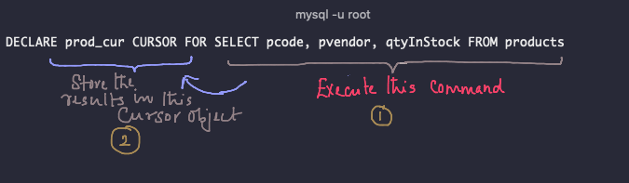

Step 1 Declare the cursor

Slide 6

Step 2 Open cursor
Text

Slide 7
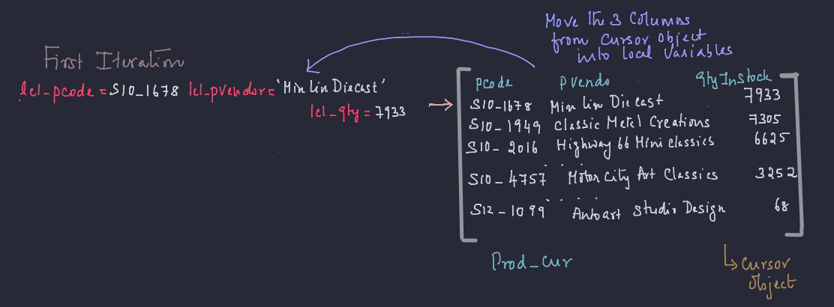
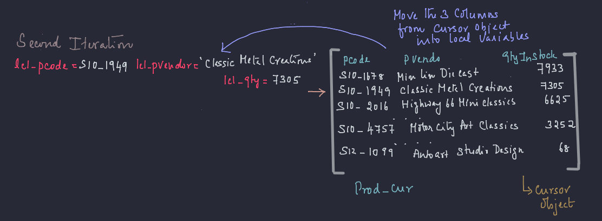
Step 3 fetch the cursor

Slide 8
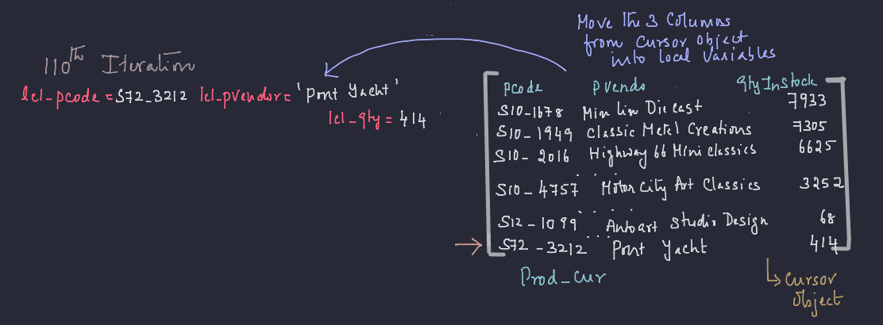

Not found exception

Slide 9
Steps for handling cursors
Recap
DECLARE cursor-name CURSOR FOR SELECT ...;
DECLARE CONTINUE HANDLER FOR NOT FOUND
OPEN cursor-name;
FETCH cursor-name INTO variable [, variable];
CLOSE cursor-name;

Slide 10
properties of cursors
Text
Cursor has three important properties that we need to be familiar with in order to avoid unexpected results:
Asensitive : Once open, the cursor will not reflect changes in its source tables. In fact, MySQL does not guarantee the cursor will be updated, so you can't rely on it.
Read Only : Cursors are not updatable.
Not Scrollable : Cursors can be traversed only in one direction, forward, and you can't skip records from fetching.

Slide 11
Removing stored procedures
Text
The DROP PROCEDURE statement deletes a stored procedure from the database.
DROP PROCEDURE [IF EXISTS] stored_procedure_name;
When you drop a procedure that does not exist without using the IF EXISTS option, MySQL issues an error.
Instead if you use the IF EXISTS option, MySQL issues a warning.

