Slide 1
Sql for Data ANALYSTS

Slide 2
MySql server
Connecting to

Slide 3
Mysql
Text
mysql is an interactive program
It enables you to connect to a MySQL server, run queries, and view the results
It is sometimes referred to as the “terminal monitor” or just “monitor”
To see a list of options provided by mysql, invoke it with the --help option:
shell> mysql --help

Slide 4
Using command line interface
Mysql
shell> mysql -h host -u user -p
Enter password: ********
Welcome to the MySQL monitor. Commands end with ; or \g. Your MySQL connection id is 25338 to server version: 8.0.20-standard
Type 'help;' or '\h' for help. Type '\c' to clear the buffer.
mysql>_
The mysql> prompt tells you that mysql is ready for you to enter SQL statements.
NOTE
If you are logging in on the same machine that MySQL is running on, you can omit the host
shell> mysql -u user -p
You can disconnect any time by typing QUIT (or \q) at the mysql> prompt
mysql> QUIT
Bye

Slide 5
Executing queries
Mysql
A query normally consists of an SQL statement followed by a semicolon.
When you issue a query, mysql sends it to the server for execution and displays the results.
It displays query output in tabular form (rows and columns). The first row contains labels for the columns.
It also shows how many rows were returned and how long the query took to execute, which gives you a rough idea of server performance.
Note: Keywords are case insensitive.

Slide 6
Creating a Database
Text
Use the SHOW statement to find out what databases currently exist on the server:
mysql> SHOW DATABASES ;
Use the CREATE statement to create a new database
mysql> CREATE DATABASE test ;

Slide 7
Selecting a Database
Text
Creating a database does not select it for use; you must do that explicitly.
Use the USE statement to select an existing database from mysql prompt
mysql> USE test ;
Database changed
Alternatively, you can select the database on the command line when you invoke mysql.
mysql> mysql -u user -p test
Enter password: ********

Slide 8
Creating a table
Text
Use SHOW command to check the tables available on your database.
Just after creating the database , the database is empty
mysql> SHOW TABLES;
Empty set (0.00 sec)
Use the CREATE TABLE statement to specify the layout of your table:
mysql> CREATE TABLE pet (
name VARCHAR(20),
owner VARCHAR(20),
species VARCHAR(20),
sex CHAR(1),
birth DATE, death DATE);
The DESCRIBE command can be used to check the structure of a table database.
mysql> DESCRIBE City;

Slide 9
Database schema
Text
Represents the logical view of the entire database.
Defines how the data is organized and the relations among them.
Contains a descriptive detail of the database, which can be depicted by means of schema diagrams.

Slide 10
Database schema diagram
Text

Slide 11
SQL Commands
Types of SQL Statements
SQL statements are categorized into four different types of statements

Slide 12
Data Definition Language
DDL or Data Definition Language consists of the SQL commands that can be used to define the database schema. It is used to create and modify the structure of objects in the database.
CREATE – is used to create the database or its objects (like table, index, function, views, stored procedures and triggers).
DROP – is used to delete objects from the database.
ALTER-is used to alter the structure of the database.
TRUNCATE–is used to remove all records from a table. All spaces allocated for the records are removed.
RENAME –is used to rename an object existing in the database.

Slide 13
Data Query Language (DQL)
DQL statements are used for executing queries on the data within schema objects.
The purpose of DQL Command is to retrieve the information stored in the database based on the query passed to it.
SELECT – is used to retrieve data from the a database.
Data Manipulation Language (DML)
The SQL commands that deal with the manipulation of data in the database are known as DML or Data Manipulation Language.
Majority of the database operations belong to this category.
INSERT – is used to insert data into a table.
UPDATE – is used to update existing data within a table.
DELETE – is used to delete records from a database table.

Slide 14
Data Control Language
DCL includes commands which mainly deals with the rights, permissions and other controls associated with the database system.
GRANT - gives user’s access privileges to database.
REVOKE - withdraw user’s access privileges given by using the GRANT command.

Slide 15
Transaction Control Language
TCL commands deal with the transactions within the database.
COMMIT – commits a Transaction.
ROLLBACK – rollbacks a transaction in case of any error occurs.
SAVEPOINT – sets a savepoint within a transaction.
SET TRANSACTION – specify characteristics for the transaction.

Slide 16
SQL Data Types

Slide 17
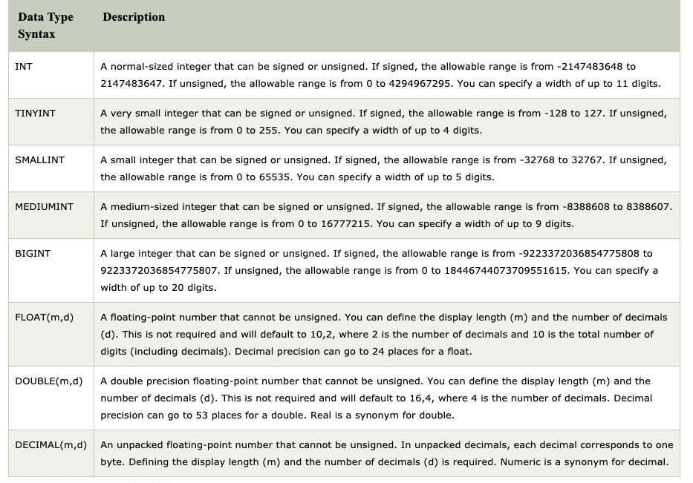
Numeric Data Types

Slide 18
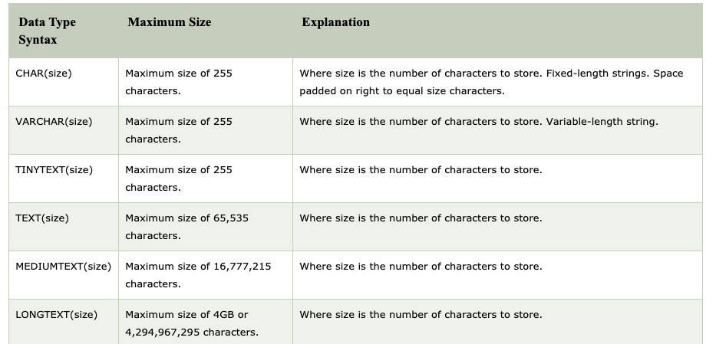
String Data Types

Slide 19
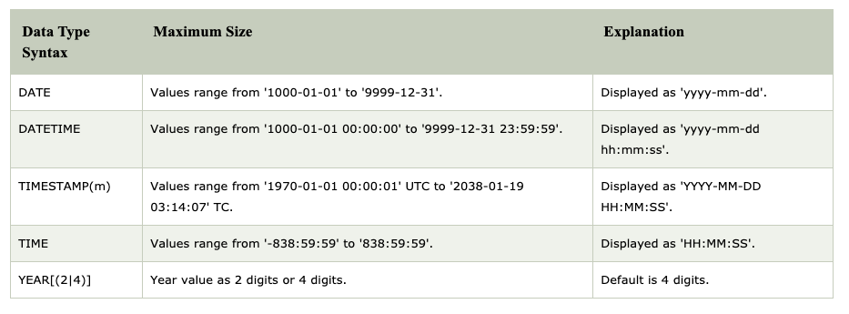
Date and Time x

Slide 20
DATE
It is used for values with a date part but no time part. MySQL retrieves and displays DATE values as YYYY-MM-DD The supported range is 1000-01-01 to 9999-12-31.
DATETIME
It is used for values that contain both date and time parts. MySQL retrieves and displays DATETIME values as YYYY-MM-DD HH:MM:SS The supported range is 1000-01-01 00:00:00 to 9999-12-31 23:59:59.
Date & Time
TIMESTAMP
It is used for values that contain both date and time parts. TIMESTAMP has a range of 1970-01-01 00:00:01 UTC to 2038-01-19 03:14:07 UTC.
TIME
Time values are in HH:MM:SS format (or HHH:MM:SS format for large hours values). TIME values may range from -838:59:59 to 838:59:59.

Slide 21
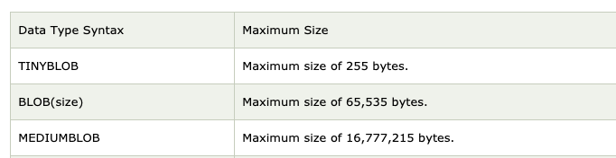
Large Object Data (LOB) Types

Slide 22
Working with NULL Values
NULL means “a missing unknown value”
It is treated differently from other values.
You cannot use arithmetic comparison operators such as =, <, or <> to test for NULL.
The IS NULL and IS NOT NULL operators are used to instead.

