Slide 1
FAKE -NEWS DETECTION PROJECT
-Presented By-
Himanshu Sharma

Slide 2
INTRODUCTION
This project is related to the authenticity of Information has become a longstanding issue affecting businesses and society, both for printed and digital media. On social networks, the reach and effects of information spread occur at such a fast pace and so amplified that distorted, inaccurate, or false information acquires a tremendous potential to cause real-world impacts, within minutes, for millions of users. Recently, several public concerns about this problem and some approaches to mitigate the problem were expressed.

Slide 3
INTRODUCTION
In given dataset, there are 6 columns in the dataset provided to you. The description of each of the column is given below:
“id”: Unique id of each news article.
“headline”: It is the title of the news.
“news”: It contains the full text of the news article.
“Unnamed:0”: It is a serial number.
“written_by”: It represents the author of the news article.
“label”: It tells whether the news is fake (1) or not fake (0).

Slide 4
Business Problem
Business problem in this project, build a model with the help of NLPT & ML to predict whether a news is fake or not fake.

Slide 5
Motivation
Motivation for the problem undertaken Because this project will help us to know fake news and real news. Which will be helpful in detecting real and fake news to any organization and society.

Slide 6
Review of Dataset
Review of Dataset is basically related to comprehensive summary of dataset as well as descriptions of input variables and output variable.

Slide 7
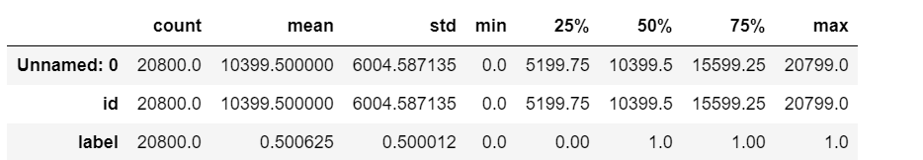
Statistical Descriptions
The statistical descriptions of dataset using Dataframe.describe() command in python, which tells the following statistical descriptions:

Slide 8
Data Preprocessing
Data pre-processing in Machine Learning is a crucial step that helps enhance the quality of data to promote the extraction of meaningful insights from the data. In simple words, data pre-processing in Machine Learning is a data mining technique that transforms raw data into an understandable and readable format.

Slide 9
Data Preprocessing Conti..
Steps in Data Pre-processing in Machine Learning:
Read dataset and make it in proper format.
Encode labels
Convert all cases to lower
Remove punctuations
Remove Stopwords
Check stats of messages
Convert all texts into vectors
Import classifier
Train and test
Check the accuracy/confusion matrix.

Slide 10
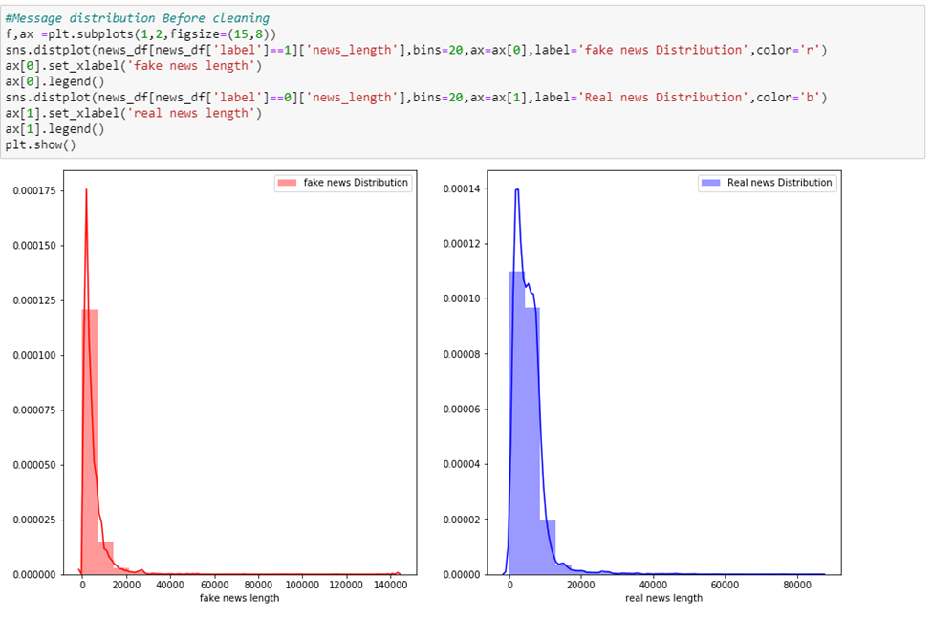
Data Visualizations
1.News Distribution Before cleaning

Slide 11
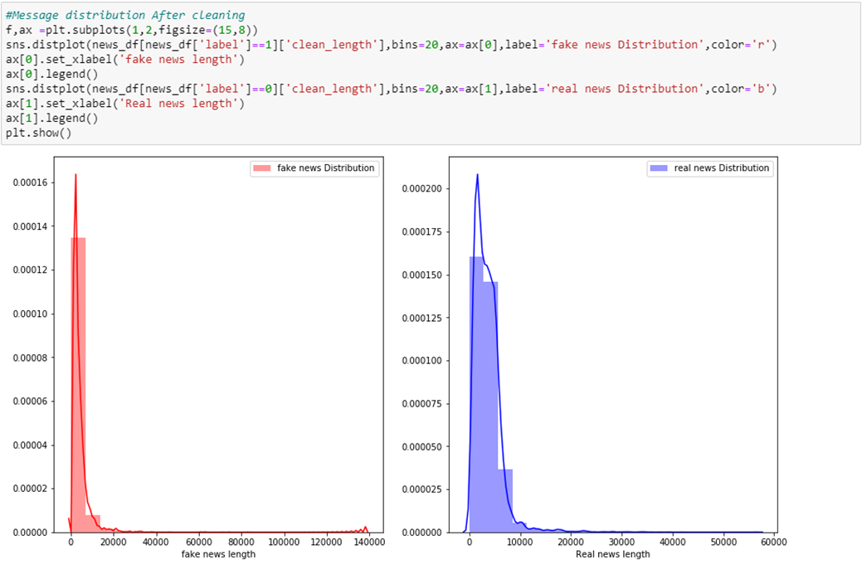
Data Visualizations Conti..
2. News Distribution After Cleaning

Slide 12
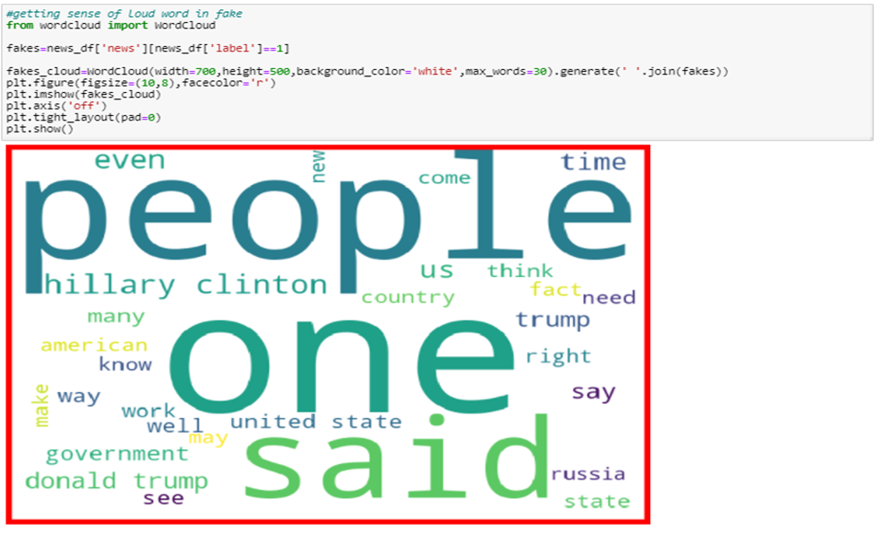
Data Visualizations Conti..
3.Getting sense of Loud word in fack news

Slide 13
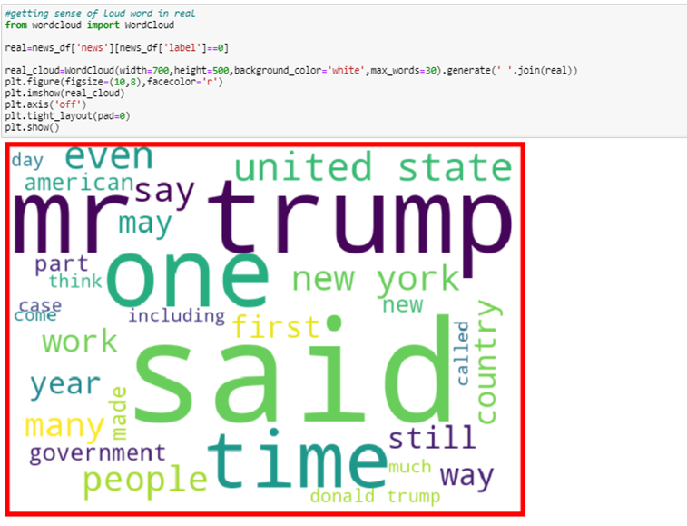
Data Visualizations Conti..
4.Getting sense of loud word in real news

Slide 14
Model Development and Evaluation
In this dataset we build a model to predict whether a news is fake i.e., “1” or not fake i.e.,”0”.
Testing of Identified Approaches (Algorithms)
• Convert all texts into vectors
• Import classifier
• Train and test

Slide 15
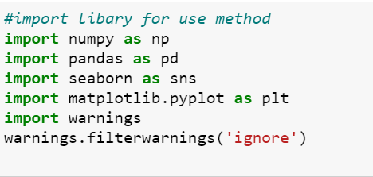
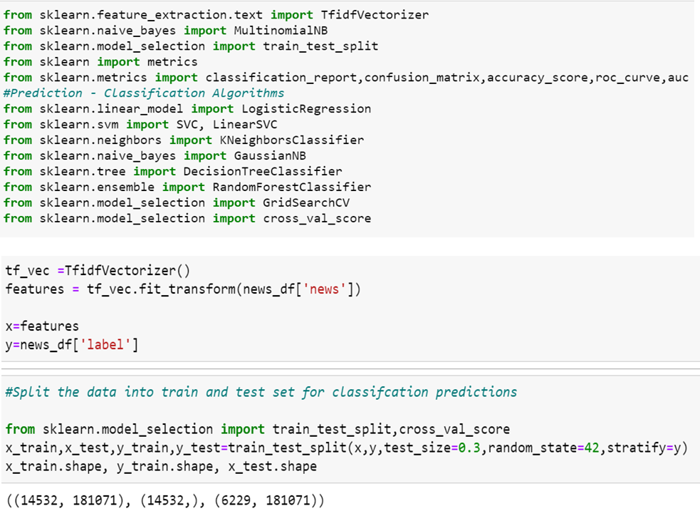
Used Library :-

Slide 16
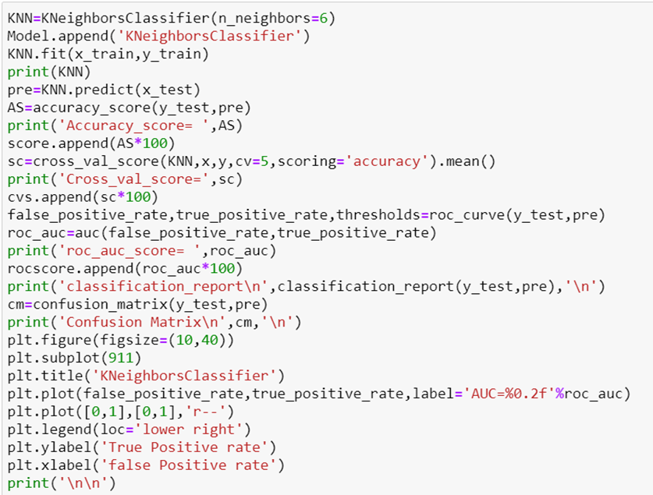
Model Development and Evaluation Conti..
1.kneighborsclassifier algorithm

Slide 17
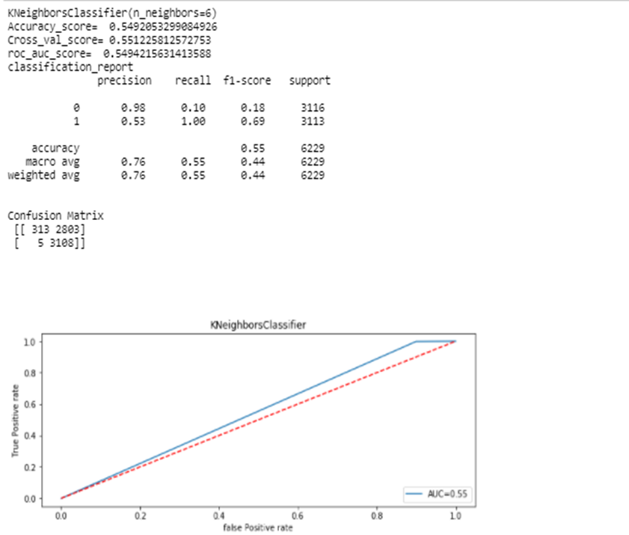
Model Development and Evaluation Conti..

Slide 18
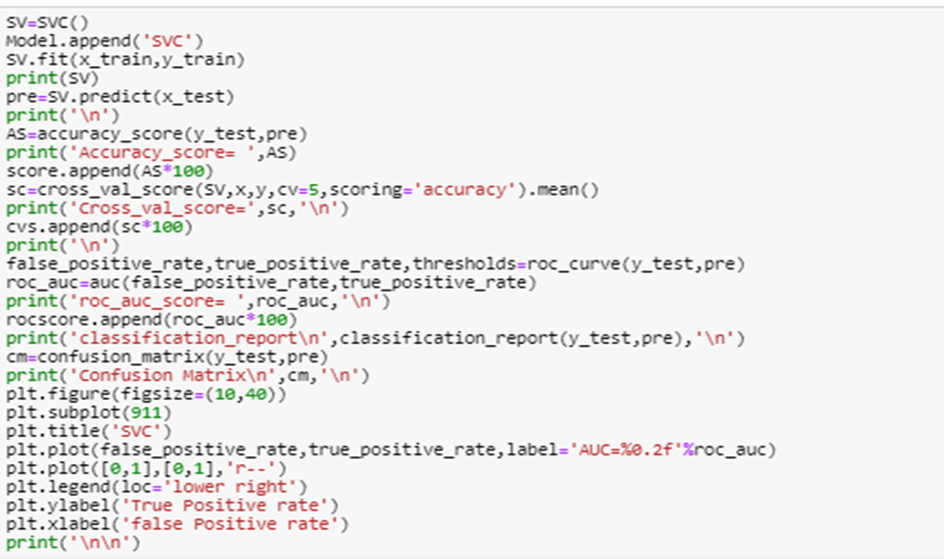
Model Development and Evaluation Conti..
2. svc algorithm

Slide 19
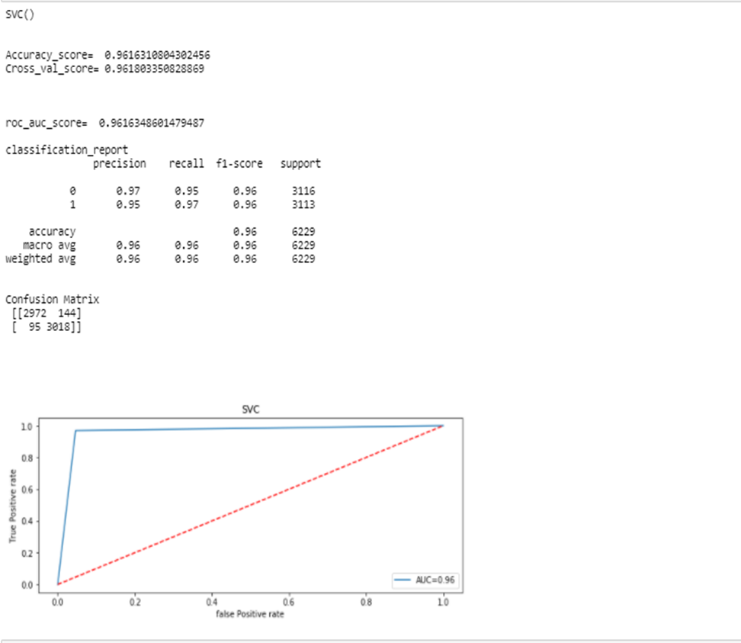
Model Development and Evaluation Conti..

Slide 20
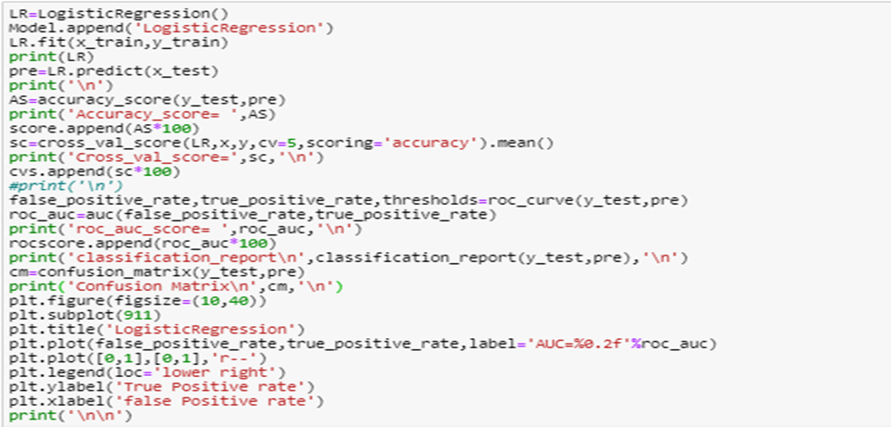
Model Development and Evaluation Conti..
3. Logistic regression

Slide 21
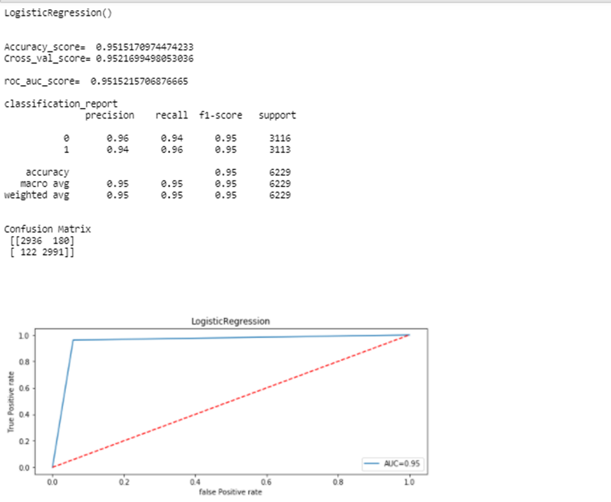
Model Development and Evaluation Conti..

Slide 22
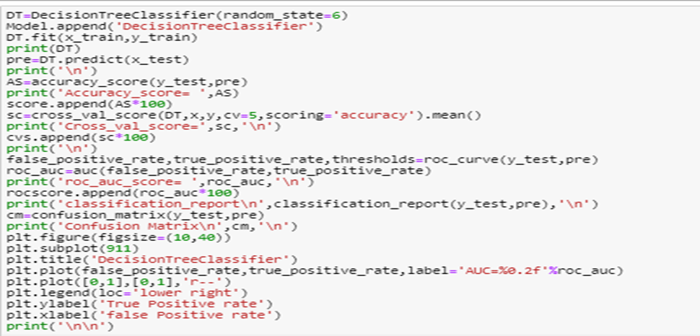
Model Development and Evaluation Conti..
4. Decision tree classifier

Slide 23
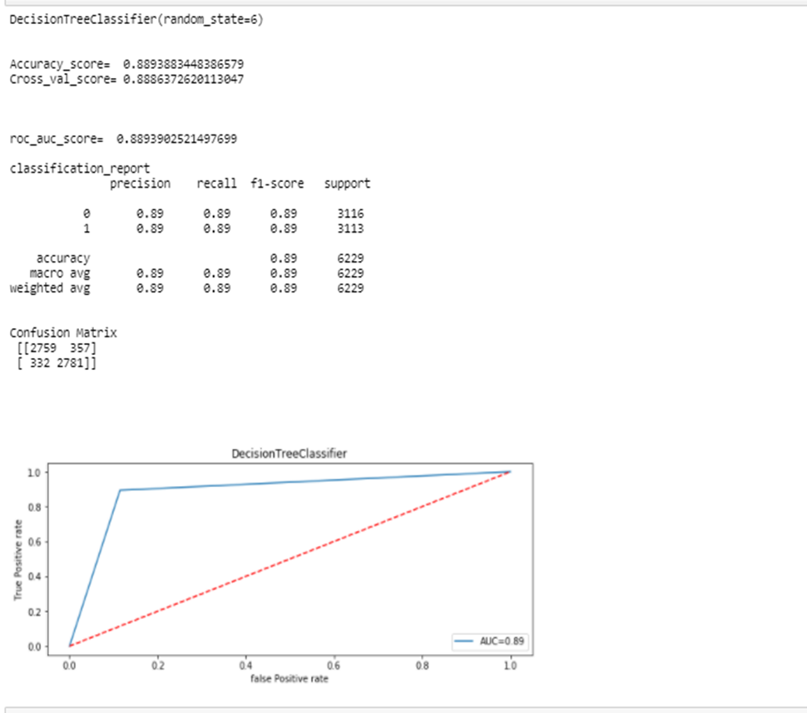
Model Development and Evaluation Conti..

Slide 24
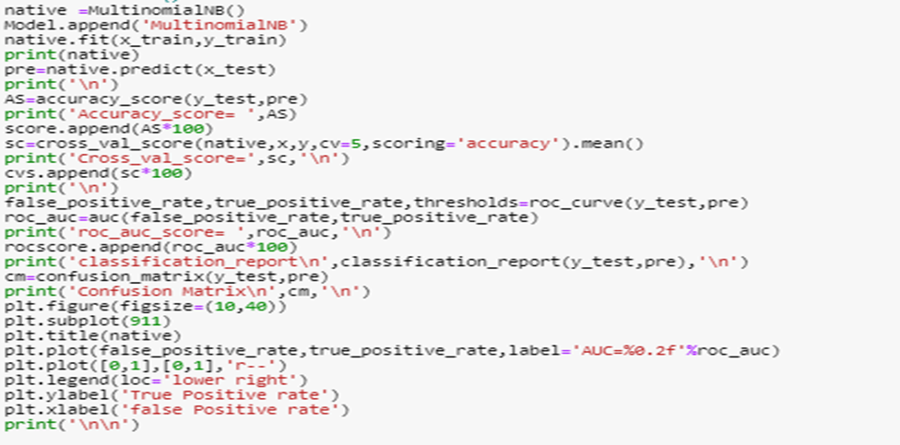
Model Development and Evaluation Conti..
5.MultinomialNB

Slide 25
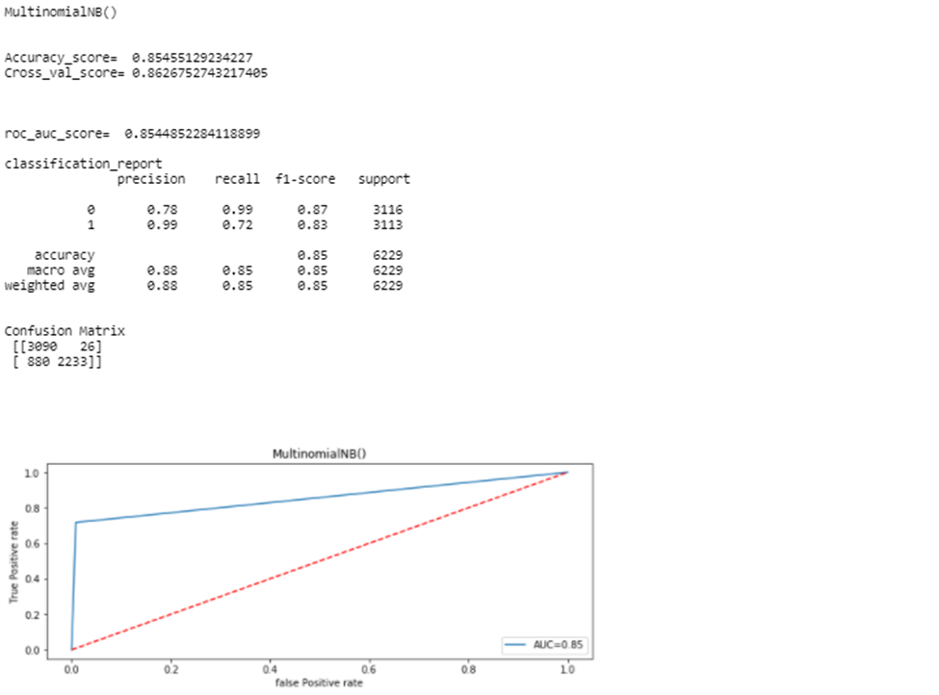
Model Development and Evaluation Conti..

Slide 26
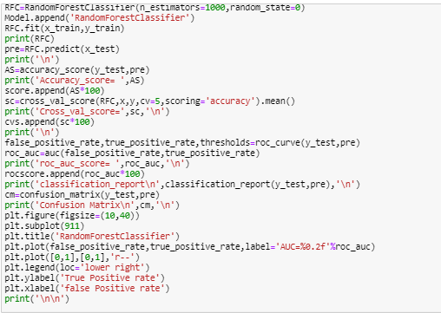
Model Development and Evaluation Conti..
6. RandomForestClassifier

Slide 27
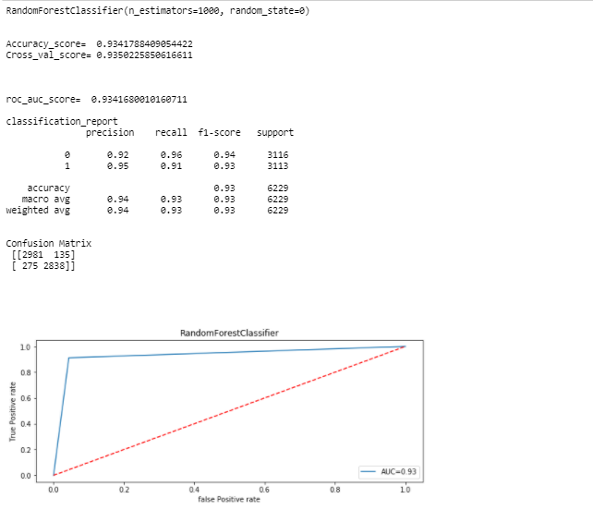
Model Development and Evaluation Conti..

Slide 28
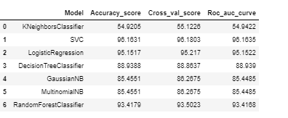
Results

Slide 29
CONCLUSION
After analysing data, visualization and modelling, we come to the conclusion that using the Support Vector Classification algorithm is suitable for modelling of label's prediction.

Slide 30
Thank You..

