Slide 1
MICRO-CREDIT DEFAULTER MODEL
-Presented By-
Himanshu Sharma

Slide 2
INTRODUCTION
A Microfinance Institution (MFI) is an organization that offers financial services to low income populations. Microfinance services (MFS) becomes very useful when targeting especially the unbanked poor families living in remote areas with not much sources of income. The MFS provided by MFI are Group Loans, Agricultural Loans, Individual Business Loans and so on.
In given dataset, about Telecom Industry from Indonesia. They are a fixed wireless telecommunications network provider. They have launched various products and have developed its business and organization based on the budget operator model, offering better products at Lower Prices to all value conscious customers through a strategy of disruptive innovation that focuses on the subscriber.

Slide 3
Business Problem
Business problem in this project, build a model which can be used to predict in terms of a probability for each loan transaction, whether the customer will be paying back the loaned amount within 5 days of issuance of loan. In this case, Label ‘1’ indicates that the loan has been payed i.e. Non- defaulter, while, Label ‘0’ indicates that the loan has not been payed i.e. defaulter.

Slide 4
Motivation
Motivation for the problem undertaken because project scenario basically related to predict label in team of defaulter and non-defaulters in telecom company. Through this project we can easily find the defaulter, which is cause of loss of telecom company.

Slide 5
Review of Dataset
Review of Dataset is basically related to comprehensive summary of dataset as well as descriptions of input variables and output variable.

Slide 6
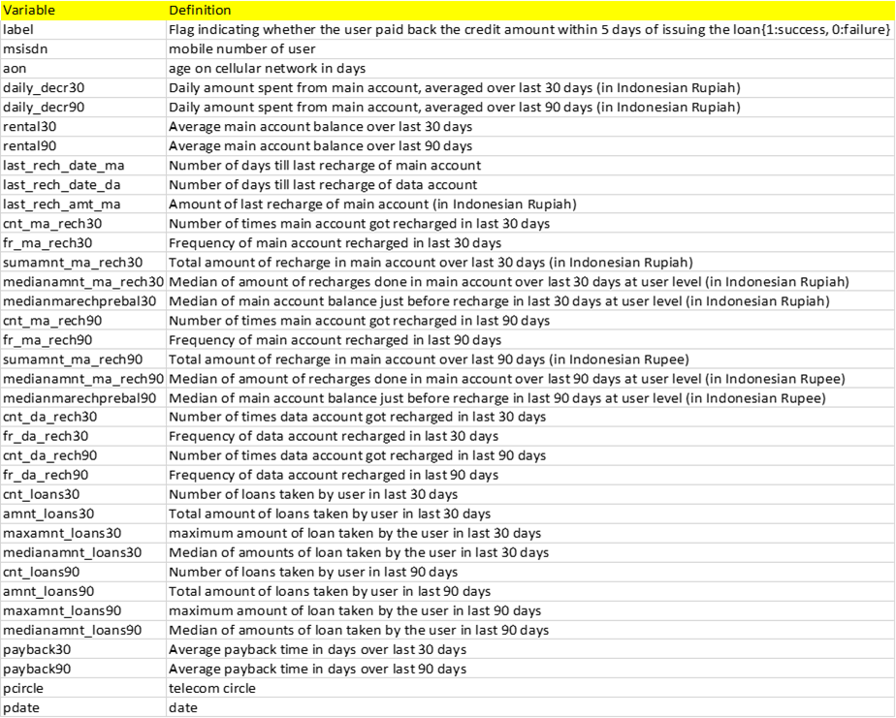

Slide 7
Statistical Descriptions
The statistical descriptions of dataset using Dataframe.describe() command in python, which tells the following statistical descriptions:

Slide 8
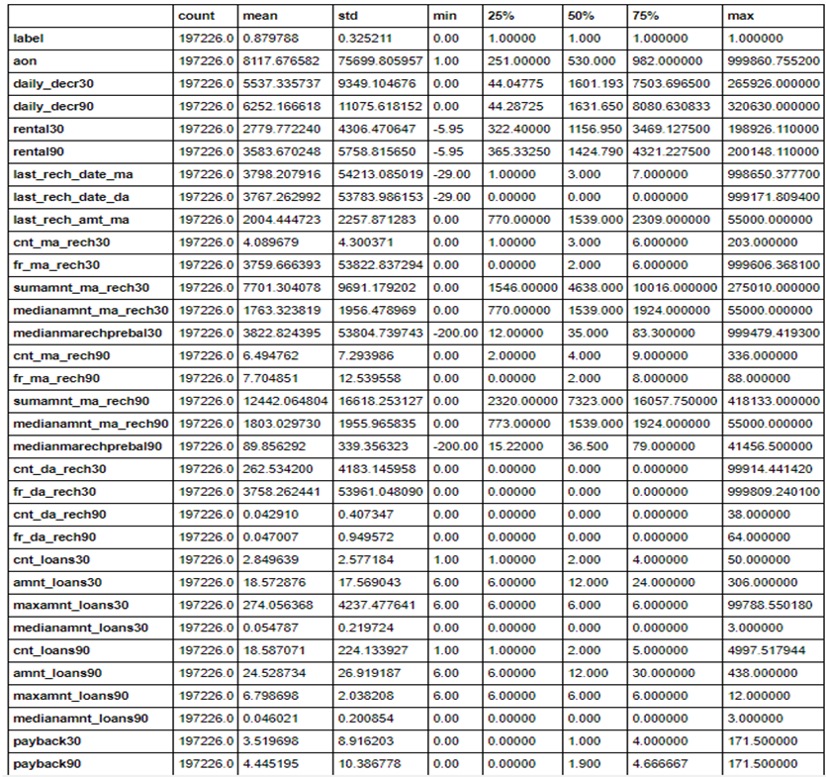

Slide 9
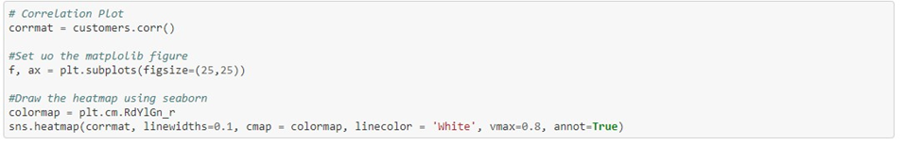
Data Inputs-Output Relationships
Python is a great language for doing data analysis, primarily because of the fantastic ecosystem of data-centric python packages. Pandas is one of those packages and makes importing and analyzing data much easier.
Pandas dataframe.corr() is used to find the pairwise correlation of all columns in the dataframe.

Slide 10
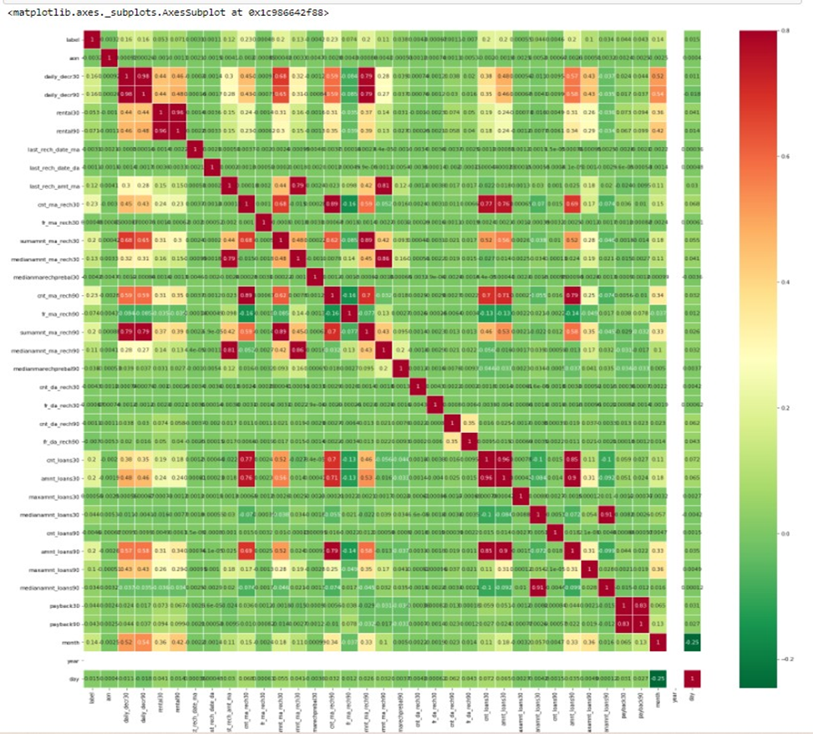

Slide 11
Data Preprocessing
Data pre-processing in Machine Learning is a crucial step that helps enhance the quality of data to promote the extraction of meaningful insights from the data. In simple words, data pre-processing in Machine Learning is a data mining technique that transforms raw data into an understandable and readable format.

Slide 12
Data Preprocessing Conti..
Steps in Data Pre-processing in Machine Learning:
Acquire the dataset
Import all the crucial libraries
Import the dataset
Identifying and handling the missing values
Encoding the categorical data
Splitting the dataset
Feature scaling

Slide 13
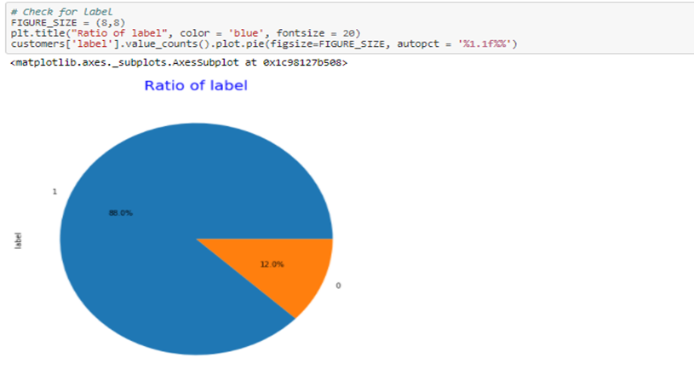
Data Visualizations
Visualize the Label variable percentage

Slide 14
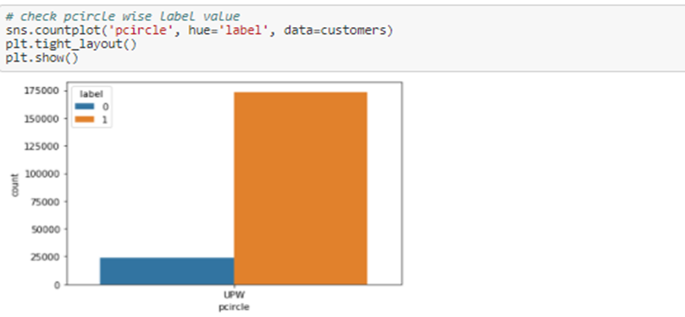
Data Visualizations Conti..
Visualize the Label variable over pcircle

Slide 15
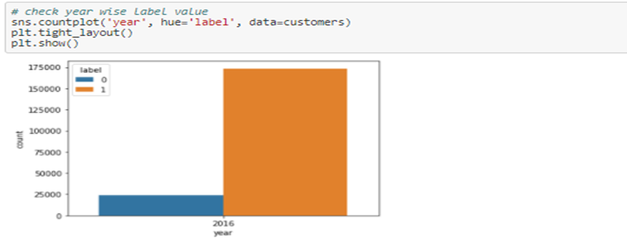
Data Visualizations Conti..
c) Visualize the Label variable over Year

Slide 16
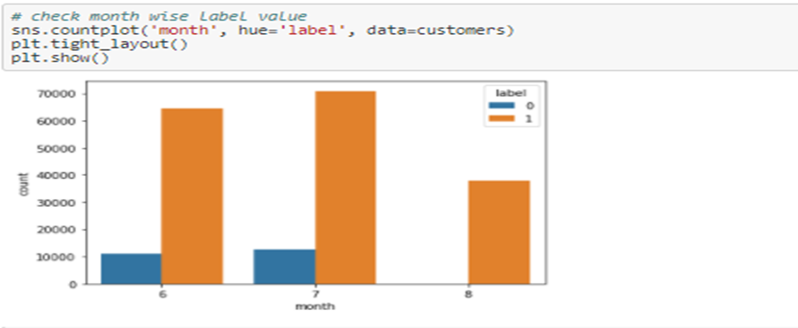
Data Visualizations Conti..
d) Visualize the Label variable over Month

Slide 17
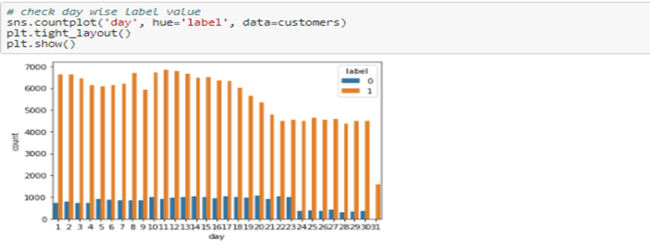
Data Visualizations Conti..
e) Visualize the Label variable over days

Slide 18
Model Development and Evaluation
In this case Label has two outcomes ‘1’ and ‘0’, that’s why we use classification model algorithms, because A classification model attempts to draw some conclusion from observed values. Given one or more inputs a classification model will try to predict the value of one or more outcomes. For example, when filtering emails “spam” or “not spam”.

Slide 19
Model Development and Evaluation Conti..
1.kneighborsclassifier algorithm

